Slide 1

What’s the buzz about...
Contributors:
Максим Аверин
Антон Каразеев
Елизавета Шевцова
Mentors:
Оксана Галзитская Никита Довидченко

Slide 2
ToDos
1. What were the research trends in past years and how did they change?
2. Which substances were in main focus? What is happening now?

Slide 3




Tools

Slide 4
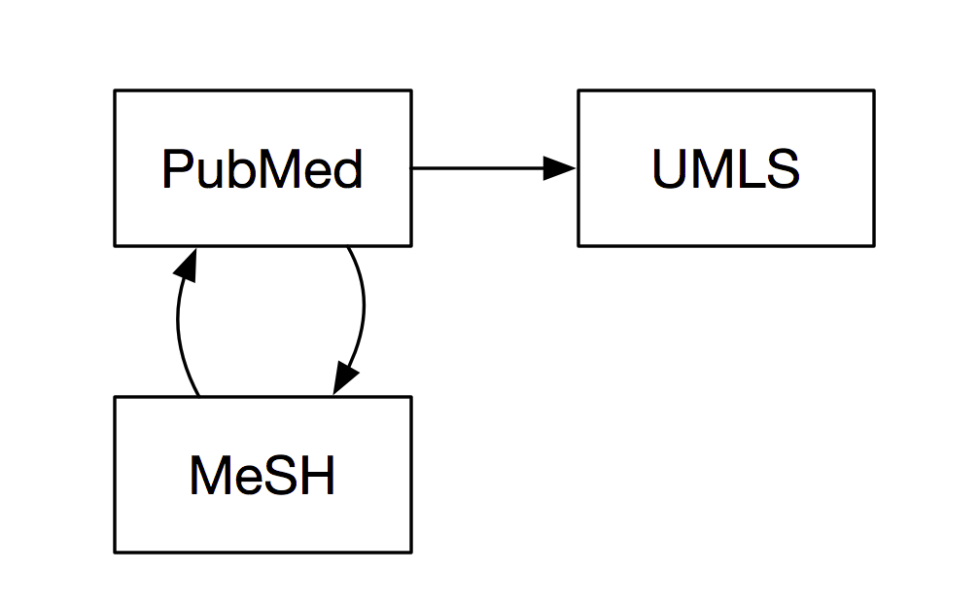
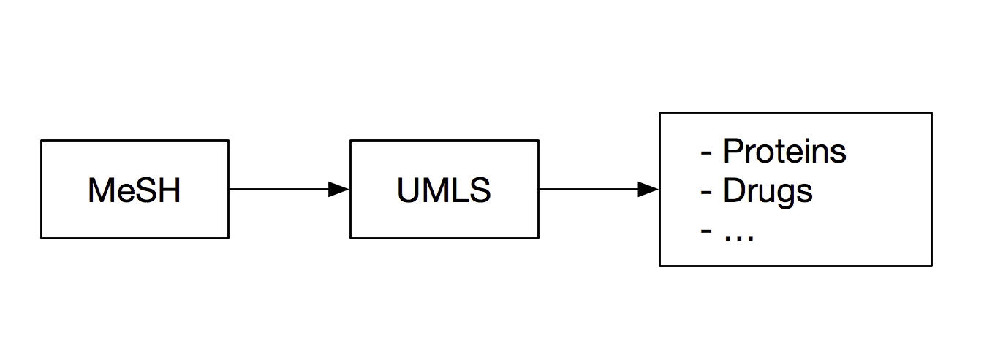

Slide 5
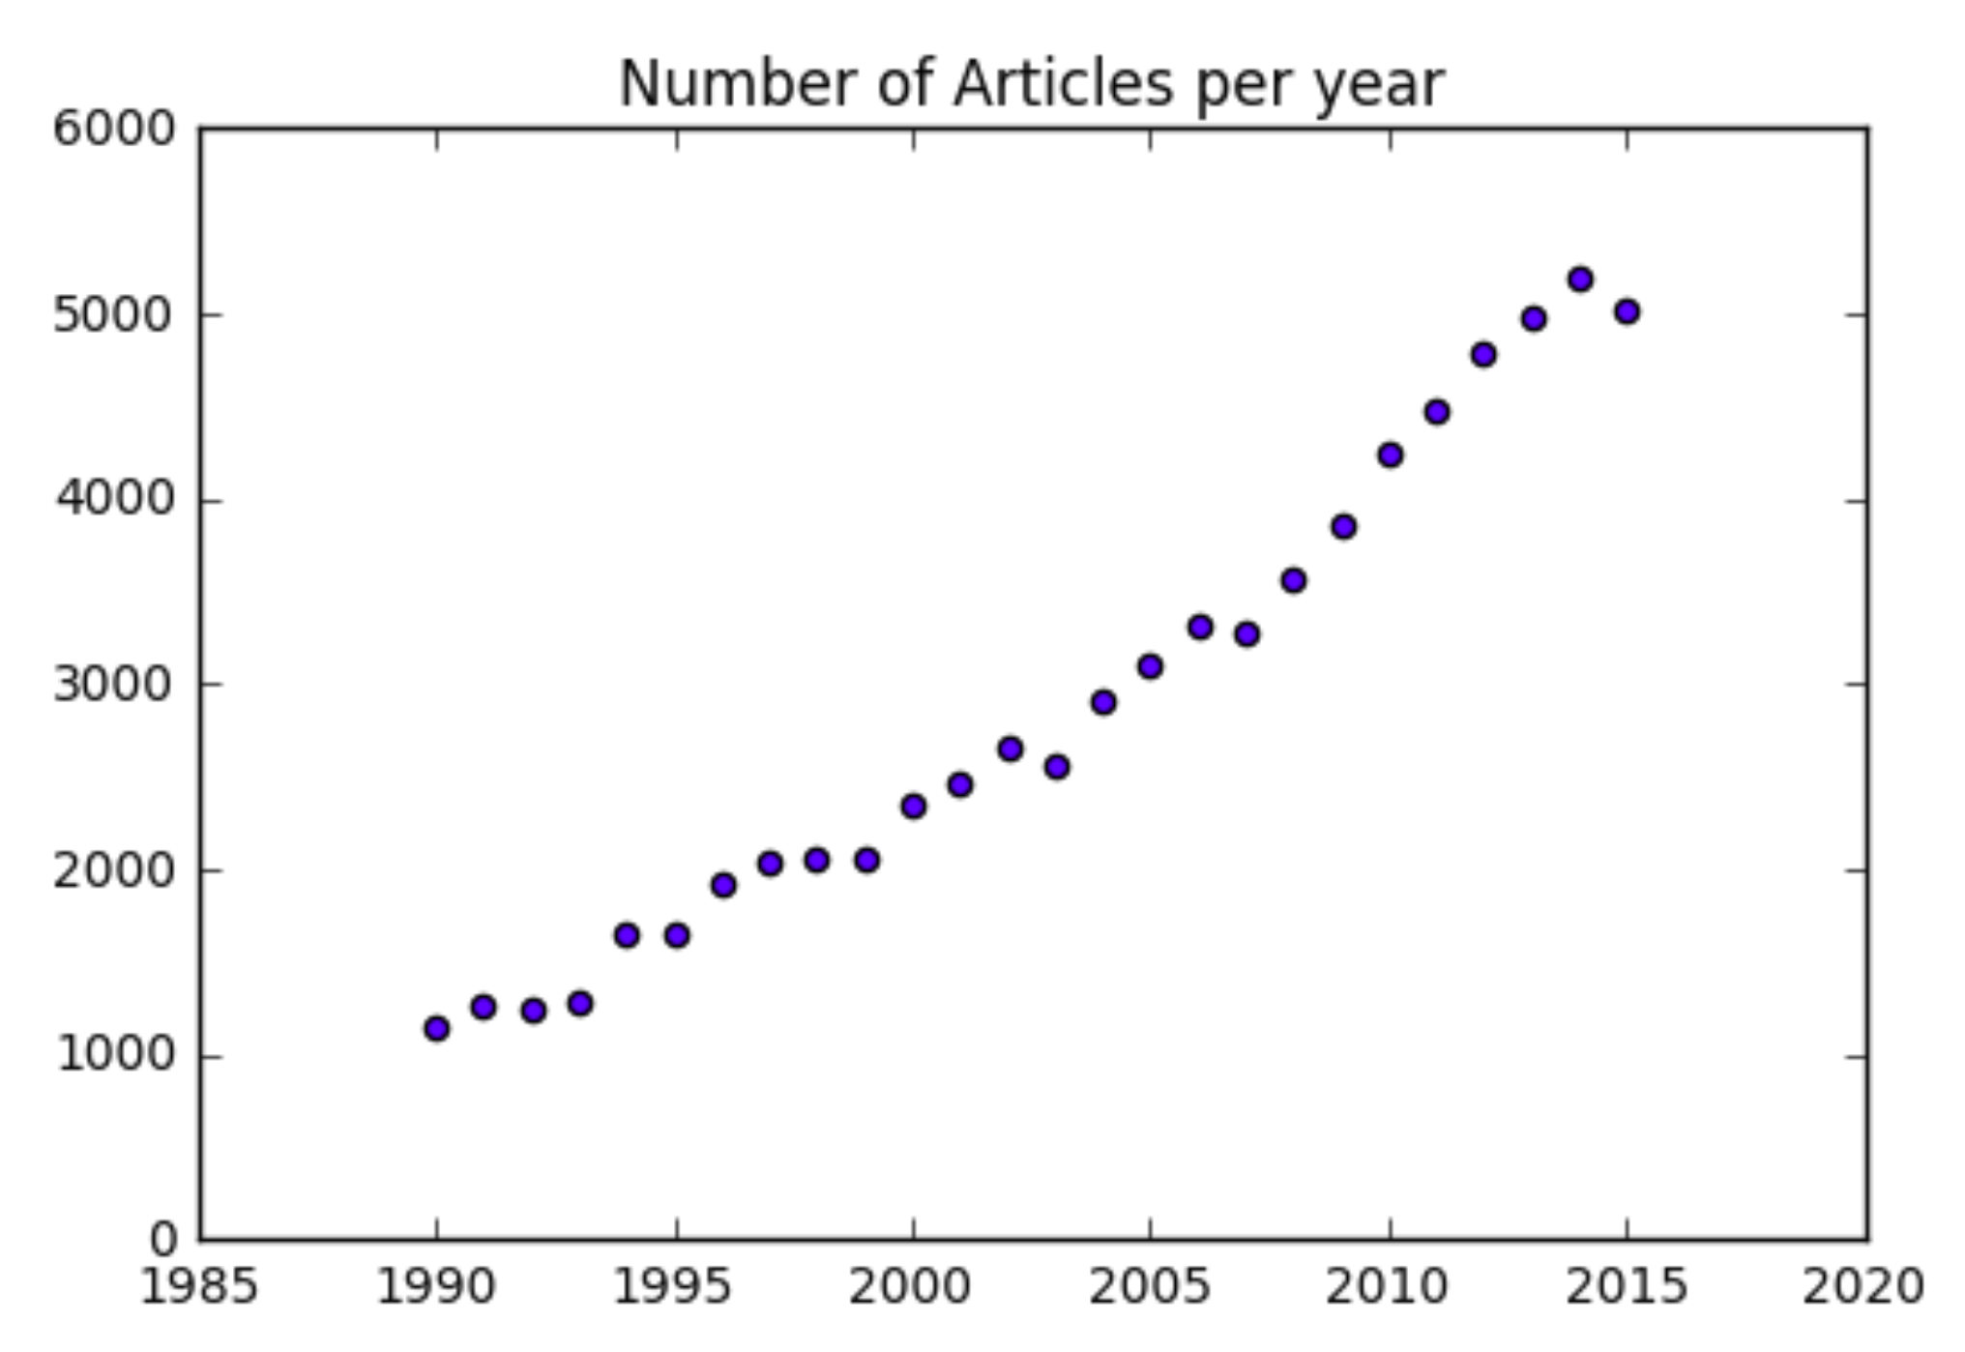
Number of articles
27 years of research & 70000 articles analyzed

Slide 6
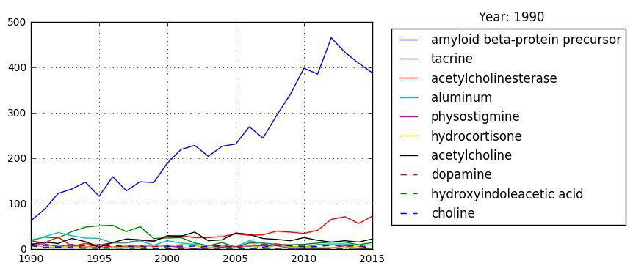
Results
Number of articles

Slide 7
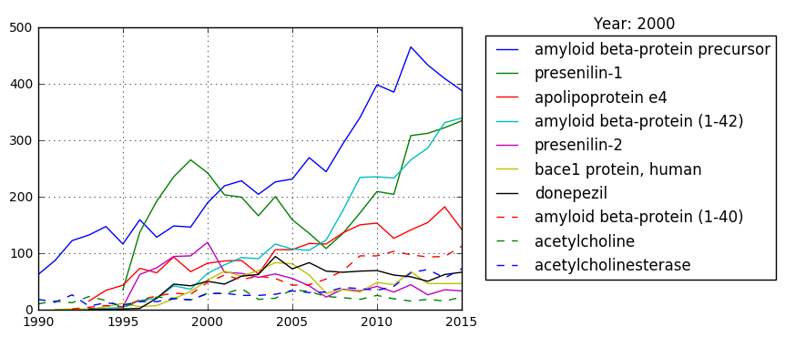
Number of articles

Slide 8
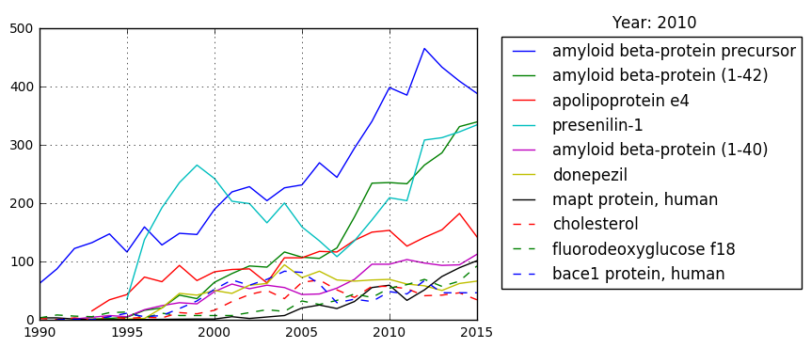
Number of articles

Slide 9
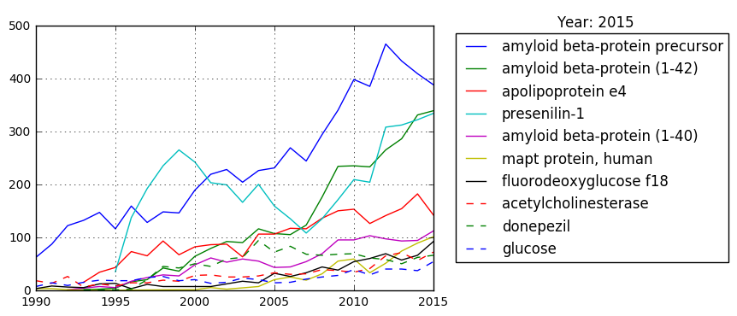
Number of articles

Slide 10
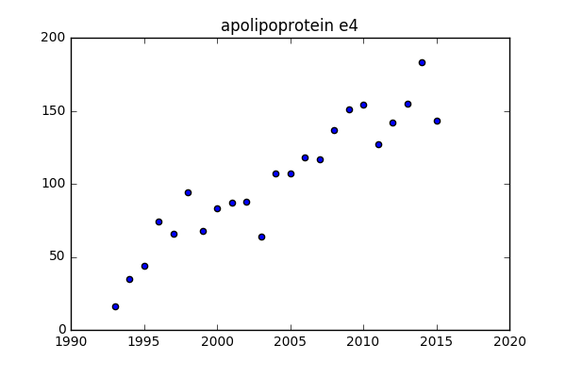
Stable rise: disease biomarkers
Number of articles

Slide 11
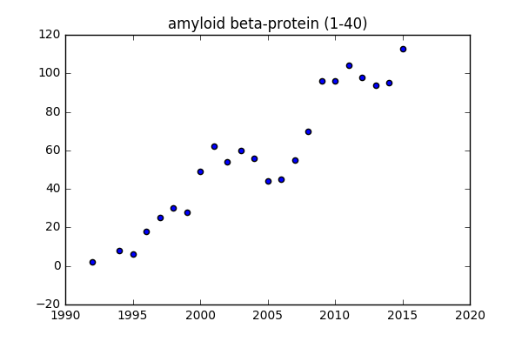
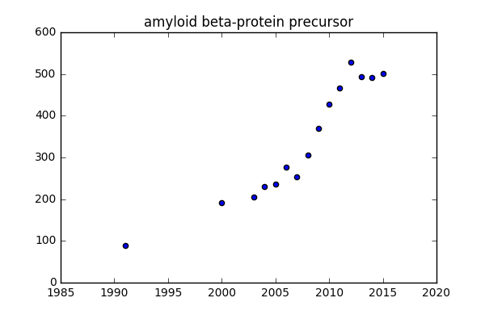
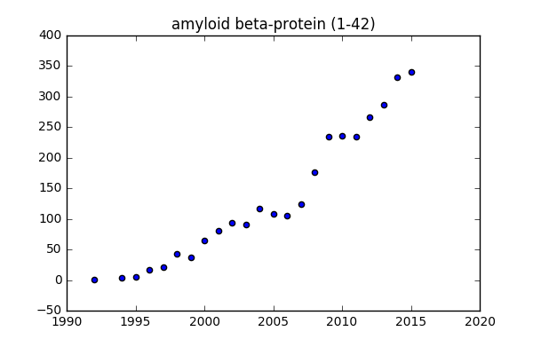

Slide 12
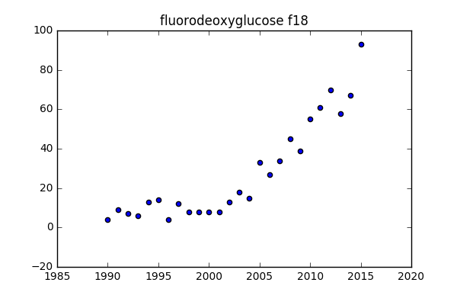
New research tool for tomography

Slide 13
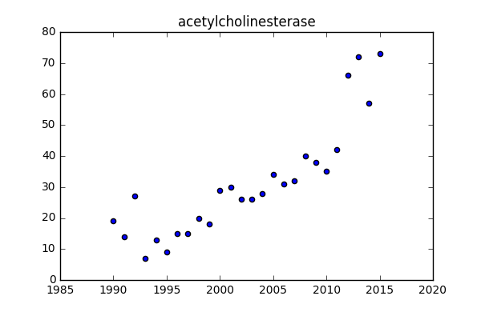
2000’s hypothesis
Number of articles

Slide 14
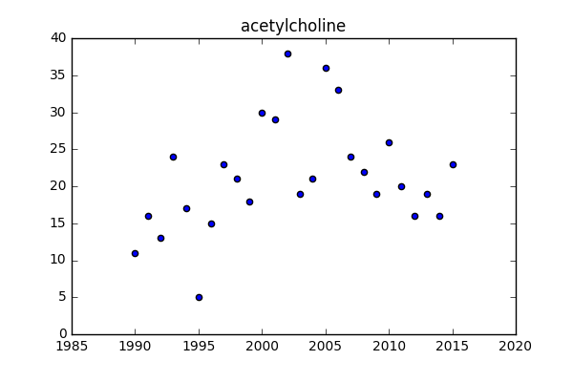
Number of articles

Slide 15
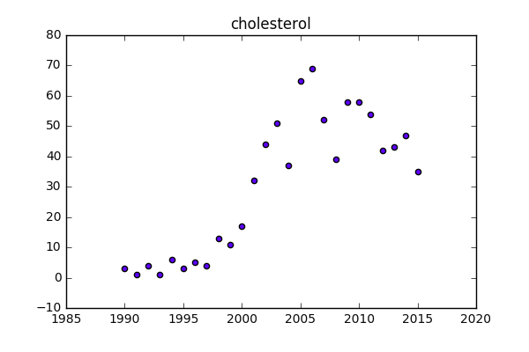
Number of articles

Slide 16
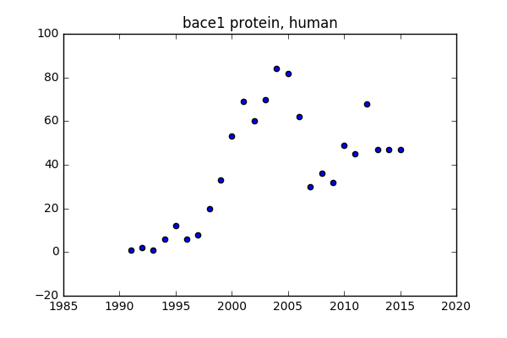
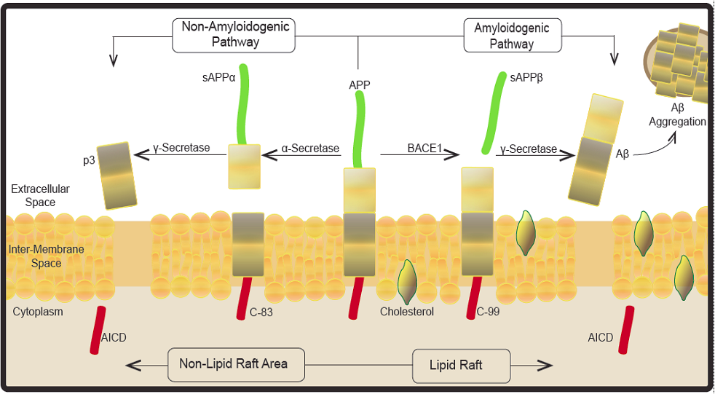
Becoming unpopular
Number of articles

Slide 17
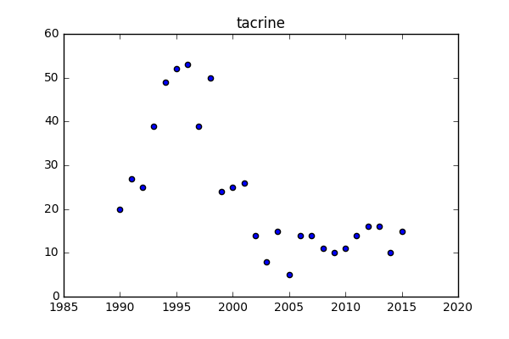
Number of articles

Slide 18
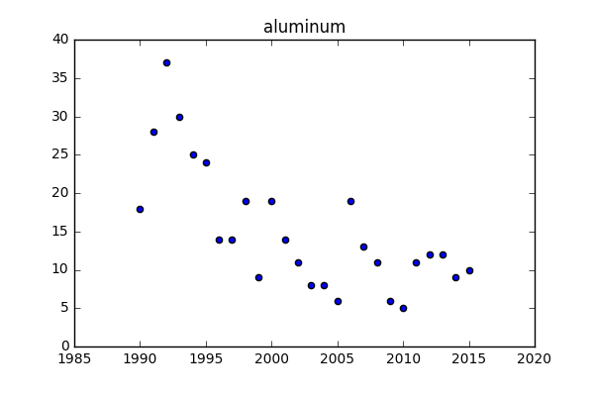
Number of articles

Slide 19
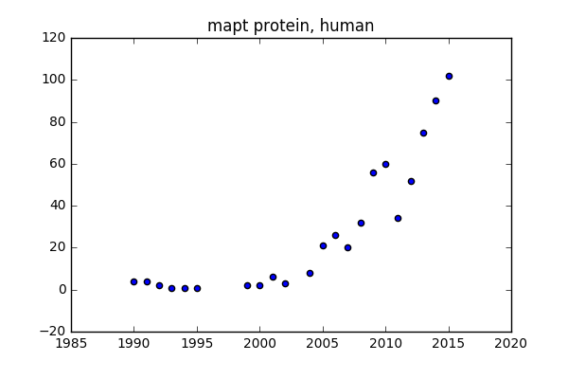
New findings
Number of articles

Slide 20
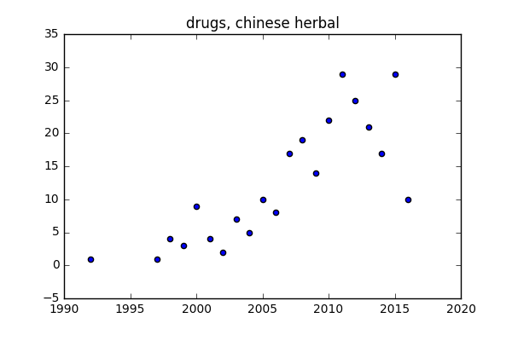

Unexpected trends
Number of articles

Slide 21
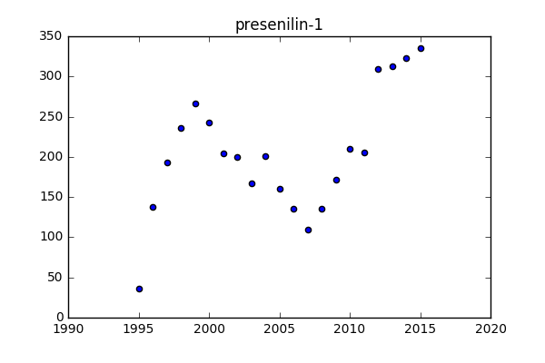
NGS rise
Early disease contributor
Number of articles

Slide 22
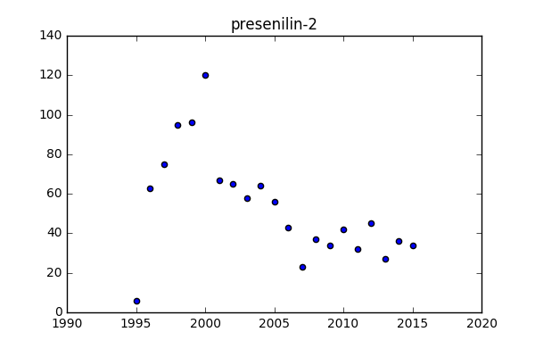
Number of articles

Slide 23
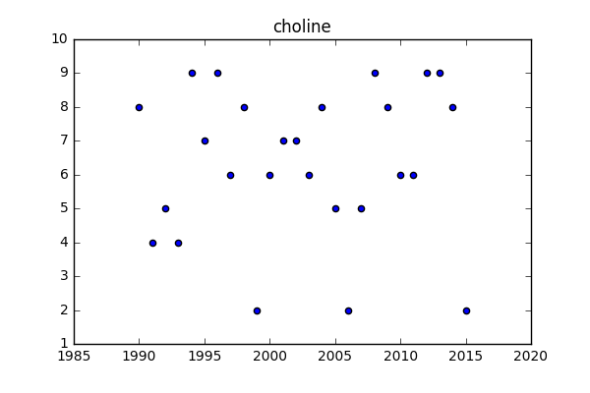
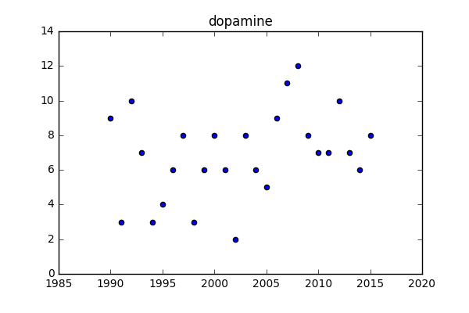
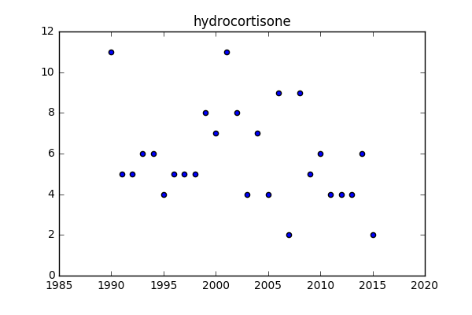
Wasted Petri dishes

Slide 24

Yield
Also:
Trends in disease research analyzed by years
Most promising fields identified
New pipeline for biologists for data search
New data can be extracted: possible interactions that not yet known

Slide 25
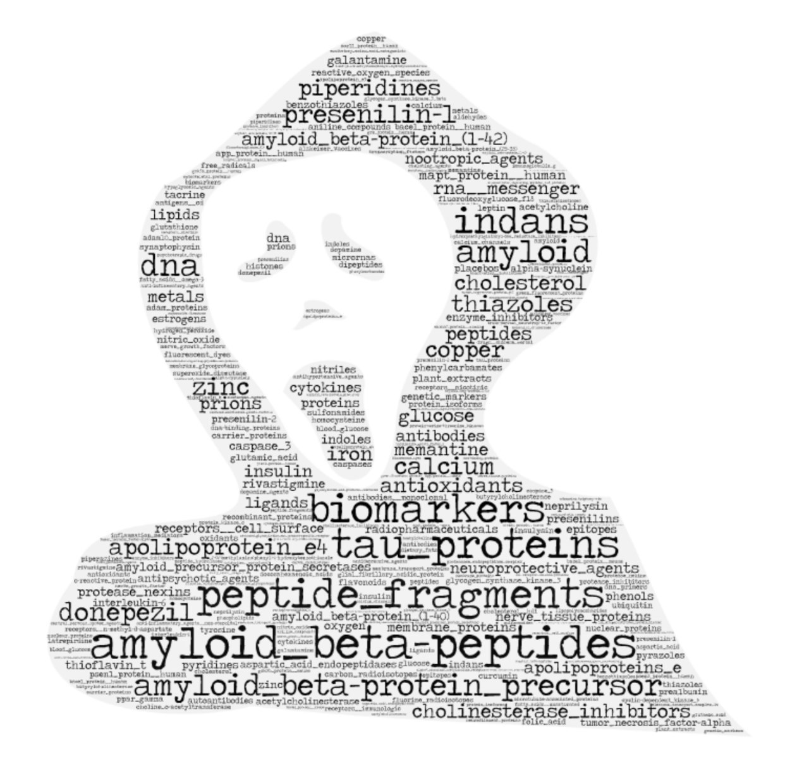
Спасибо за внимание!

