Slide 1
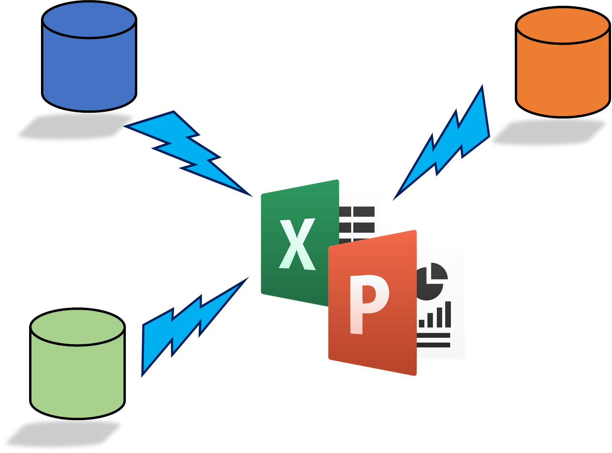
Rocker Reporting V3
PowerPoint User Guide

Slide 2
Prereqs
Install python-pptx
C:\Program Files (x86)\Odoo 13.0\python\Scripts>
"C:\Program Files (x86)\Odoo 13.0\python\python" "C:\Program Files (x86)\Odoo 13.0\python\Scripts\pip.exe" install python-pptx
Or UBUNTU
pip3 install python-pptx

Slide 3
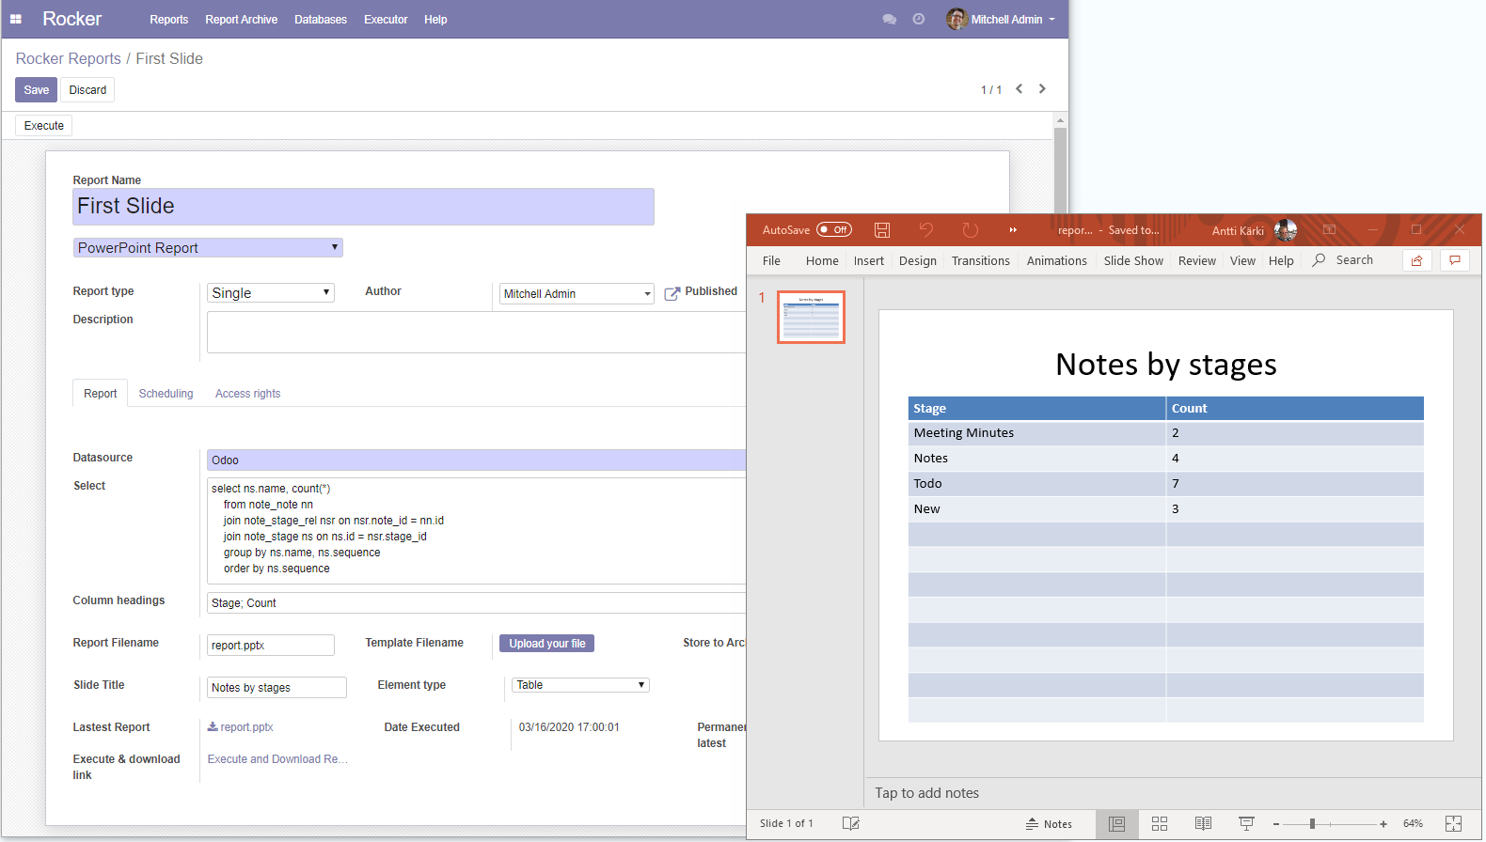
Table list element
Save & Execute
Give name
Select Powerpoint
Select Single
Datasource & Select-clause
Table headings
Slide Title
Element type : Table

Slide 4
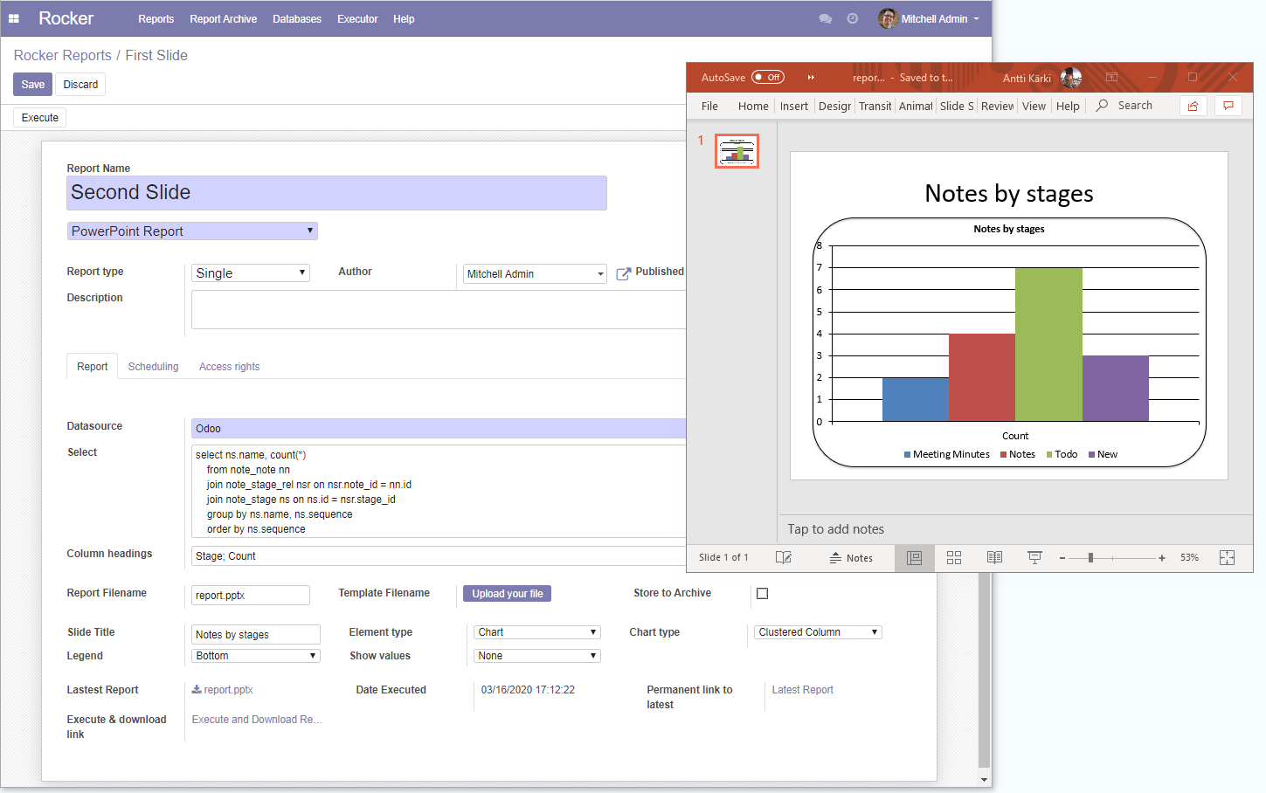
Chart element: Clustered Column
Save & Execute
Give name
Select Powerpoint
Slide Title & Chart Title
Select Single
Datasource & Select-clause
Category name from Headings
Slide Title & Chart Title
Data Series from row data
Display Legend
Element type : Chart
Chart type : Clustered Column

Slide 5
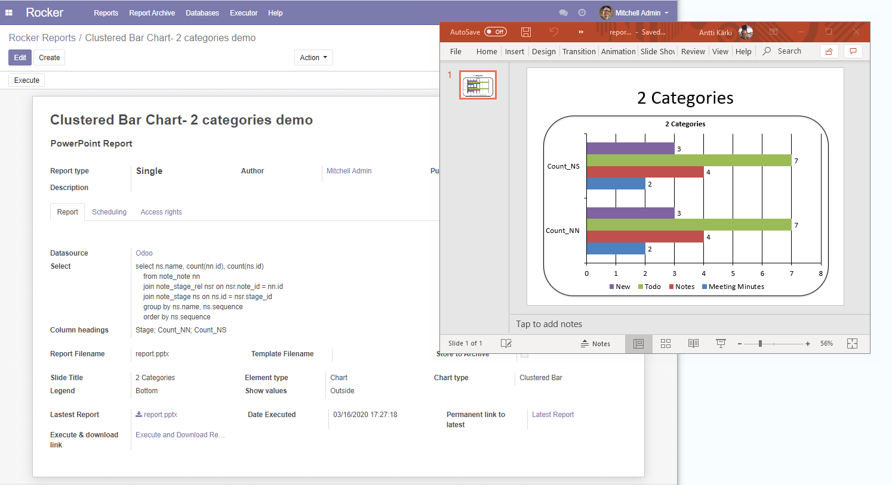
Chart element: Categories
Save & Execute
Give name
Slide Title & Chart Title
Select Powerpoint
Categories 1 & 2 (Data columns) from Headings
Select Single
Datasource & Select-clause
Series name
Slide Title & Chart Title
Data Series from row data
Display Legend
Element type : Chart
Show values
Chart type : Clustered Bar

Slide 6
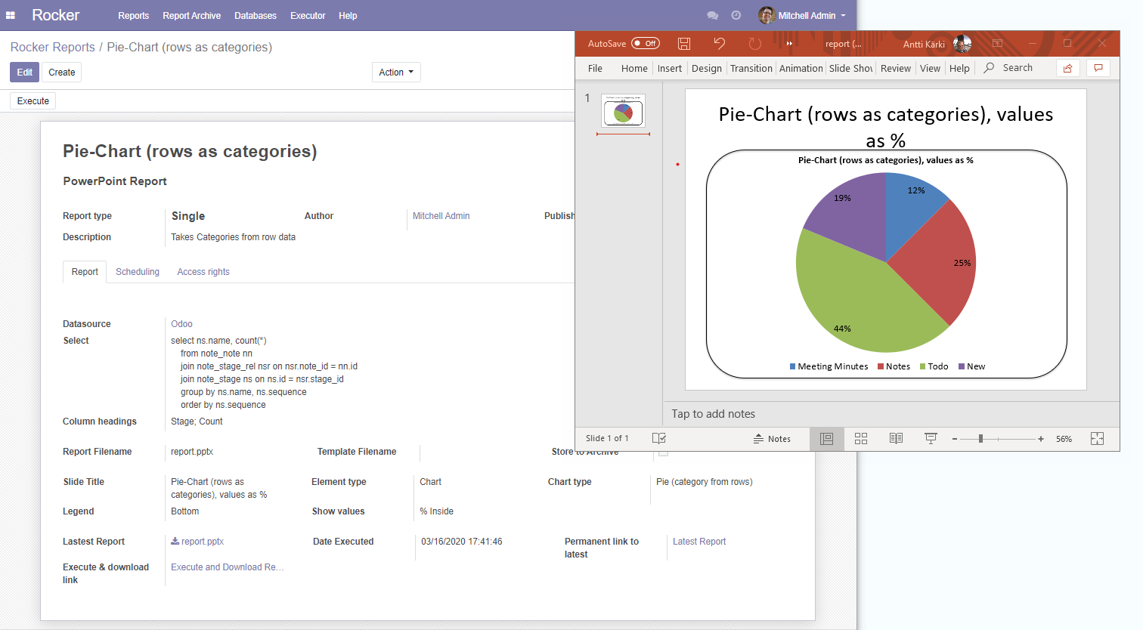
Chart element: Categories
Save & Execute
Give name
Select Powerpoint
Select Single
Datasource & Select-clause
Series name
Slide Title & Chart Title
Data Series from row data
Display Legend
Element type : Chart
Show values as Percentage
Chart type : Pie

Slide 7
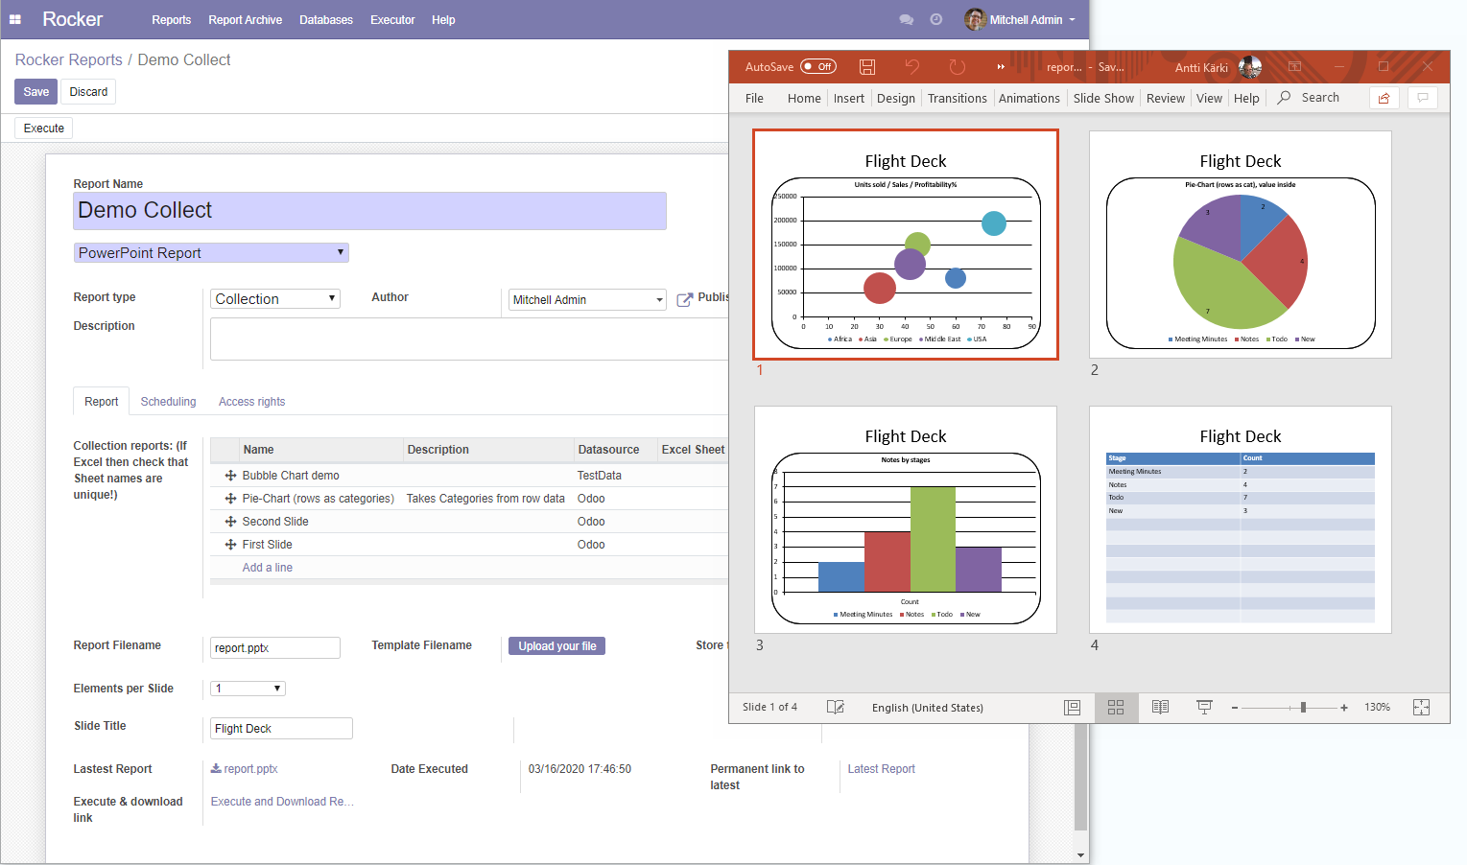
Powerpoint Collection
Save & Execute
Give name
Select Powerpoint
Select Collection
Add some reports
Elements (reports) per Slide
Title for Deck

Slide 8
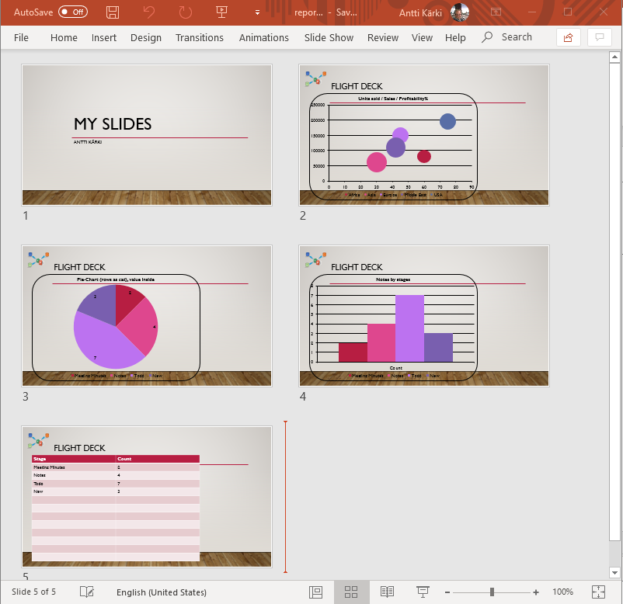
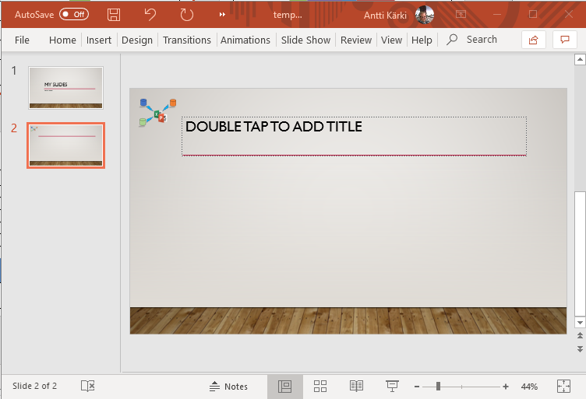
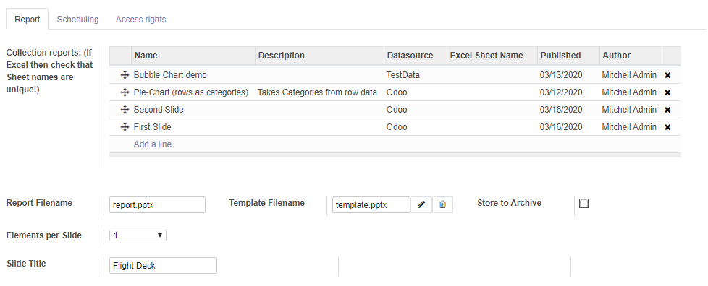
Powerpoint Template
Edit Template, save to disk
Upload Template to Odoo
Execute report

Slide 9
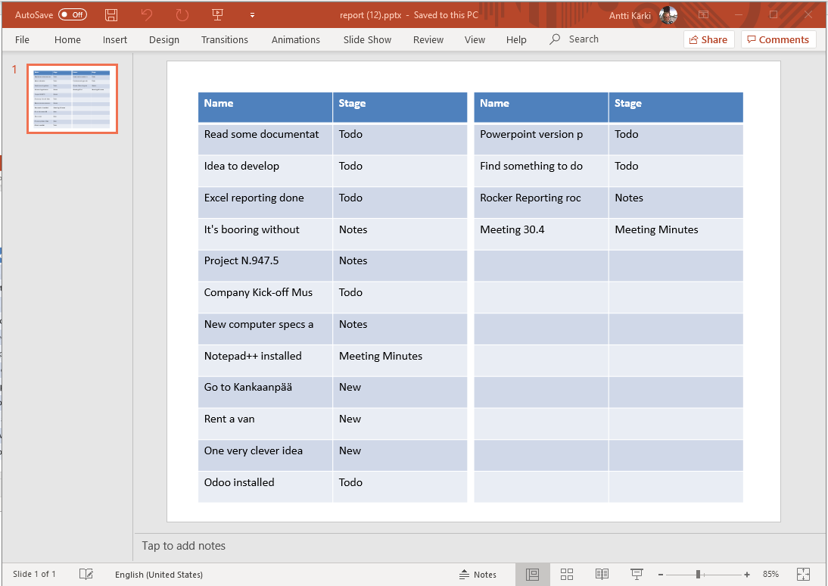
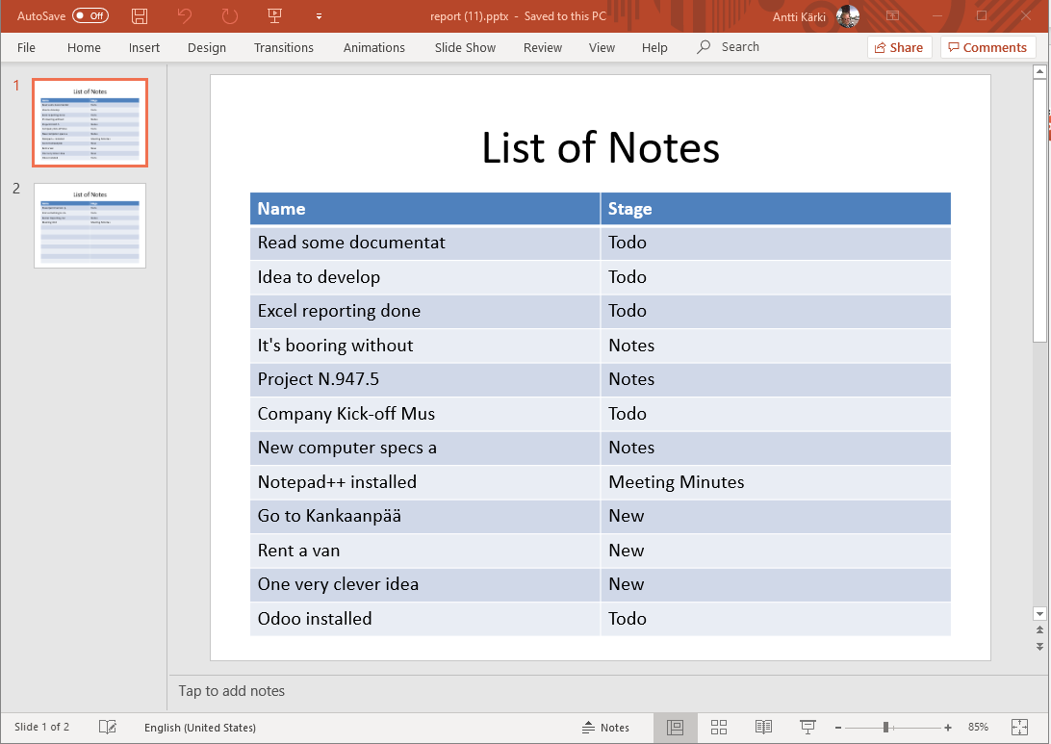
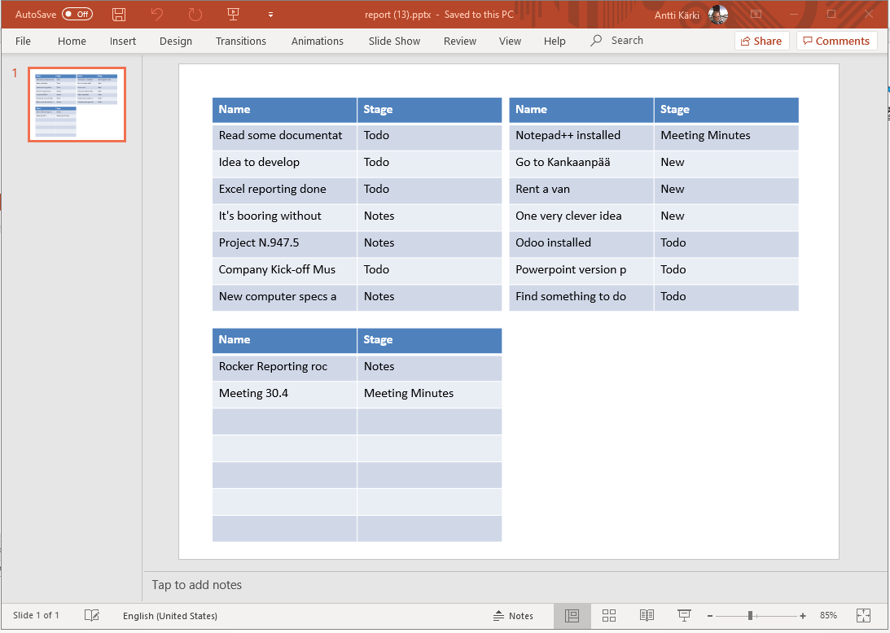
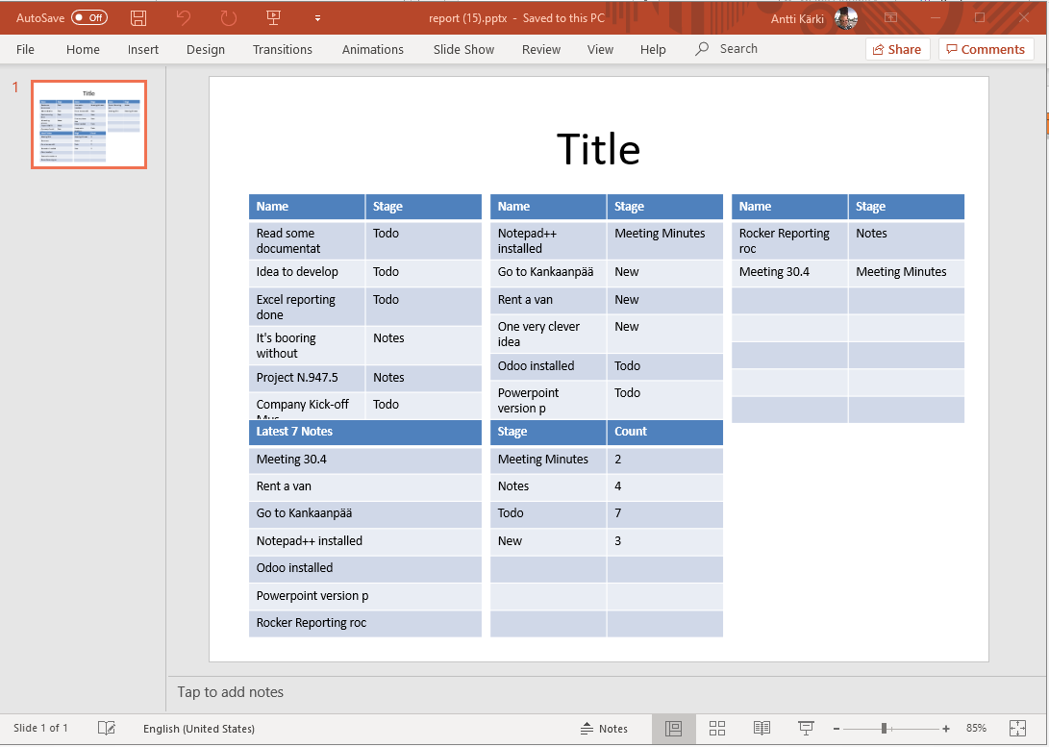
Table list
Collection report / 2 elements per slide 13 rows (heading + 12)
New slide if more rows
Single report 13 rows (heading + 12)
New slide if more rows
Collection report / 4 elements per slide 8 rows (heading + 7)
New slide if more rows
Collection report / 6 elements per slide 8 rows (heading + 7)
New slide if more rows

Slide 10
Chart examples
Made with Collection Report 4 Elements per slide

Slide 11
Flight Deck
Latest 7 Notes
Meeting 30.4
Rent a van
Go to Kankaanpää
Notepad++ installed
Odoo installed
Powerpoint version p
Rocker Reporting roc

Slide 12
Flight Deck

Slide 13
Flight Deck

Slide 14
Flight Deck

Slide 15
Flight Deck

Slide 16
Example data & query

