Slide 1
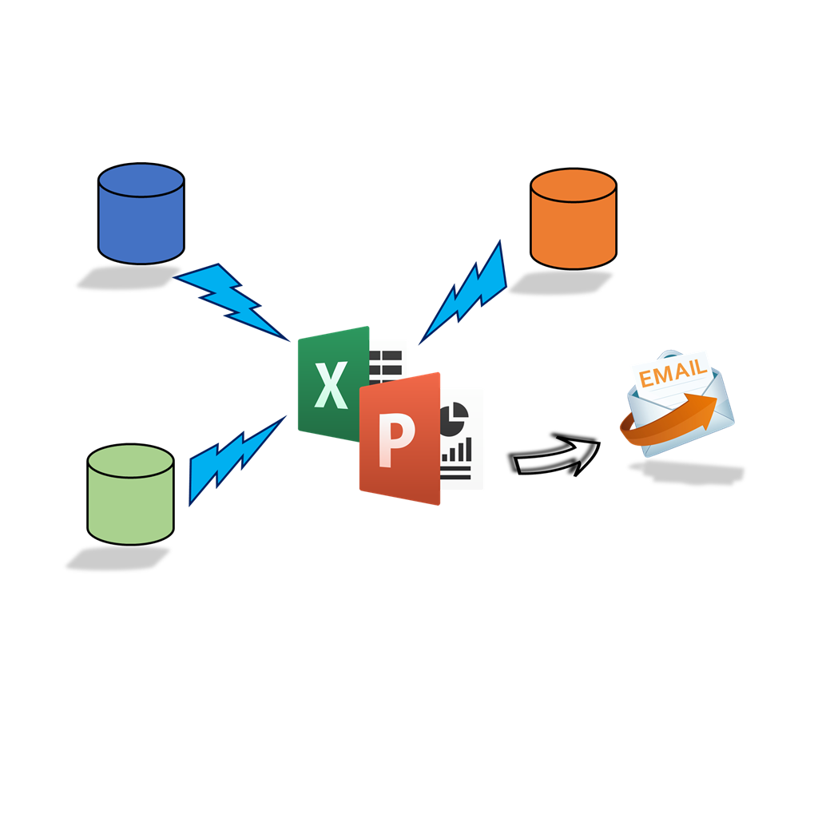
Rocker Reporting V3
Excel Charts & Pivots User Guide

Slide 2
Prereqs
Note:
Normal table based charts don’t work. Openpyxl does not update chart references
Excel charts must be build with Dynamic range names
pip3 install openpyxl
pip3 install pandas
Database drivers installed

Slide 3
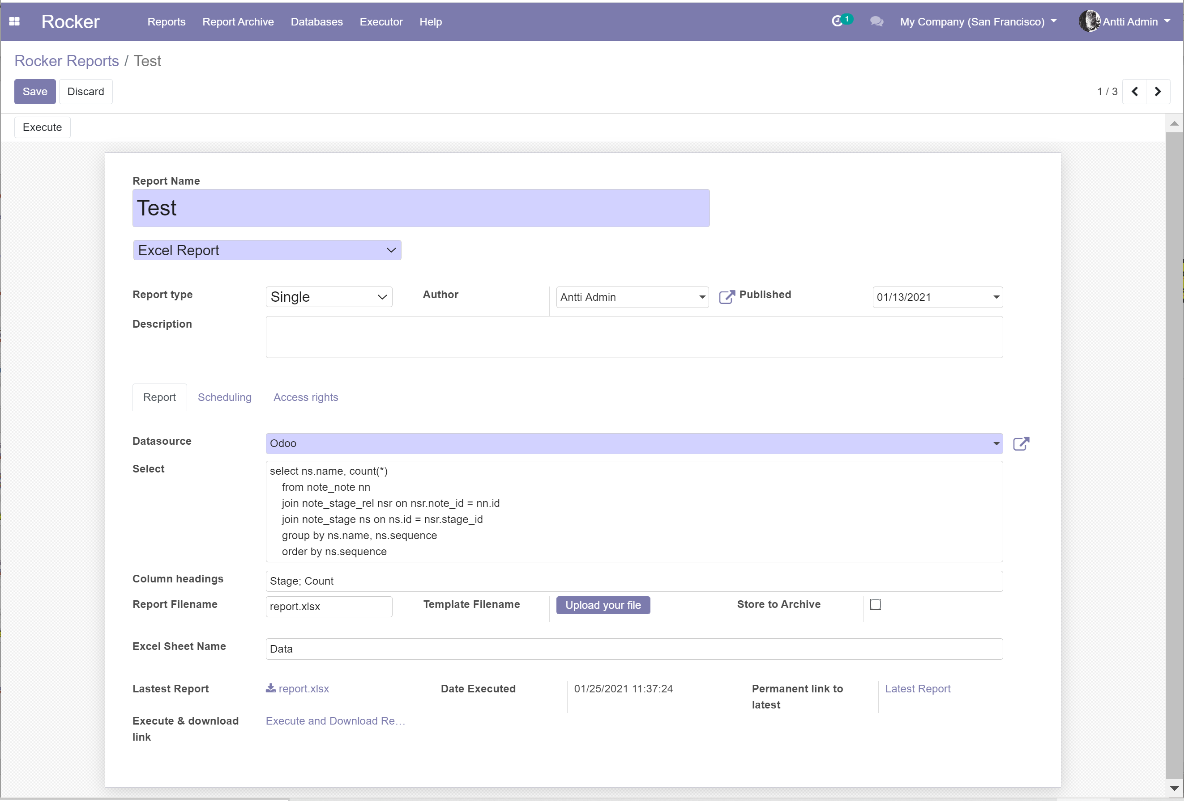
Create Excel report
Save & Execute
Give name
Select Excel
Select Single
Datasource & Select-clause
Column headings
Sheet Name

Slide 4
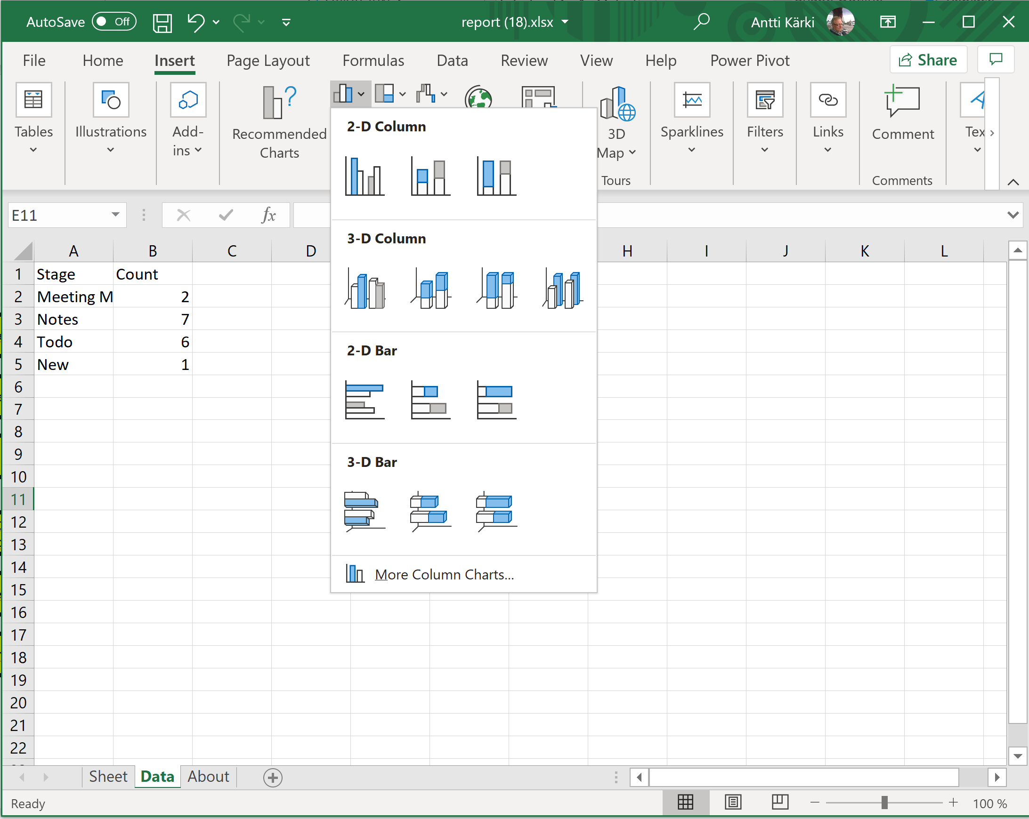
Open report for editing
From Inser menu select add chart
Select Chart

Slide 5
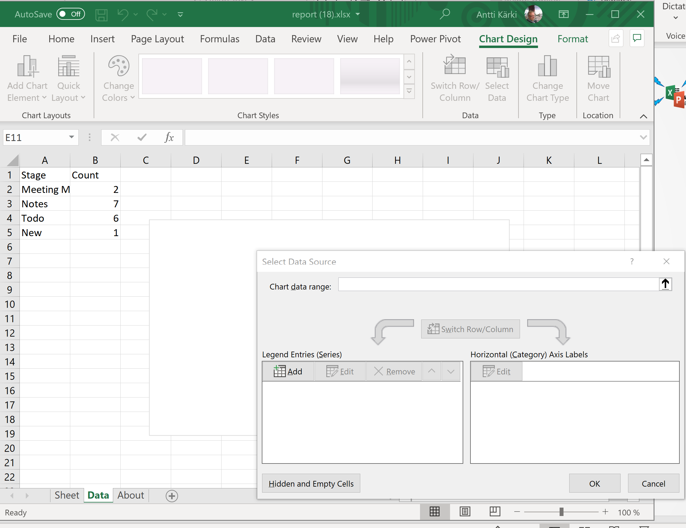
Open report for editing
Right click chart & select SELECT DATA…
Next click Add Legend Entries (Series)
Third click Edit Horizontal category axis Labels

Slide 6
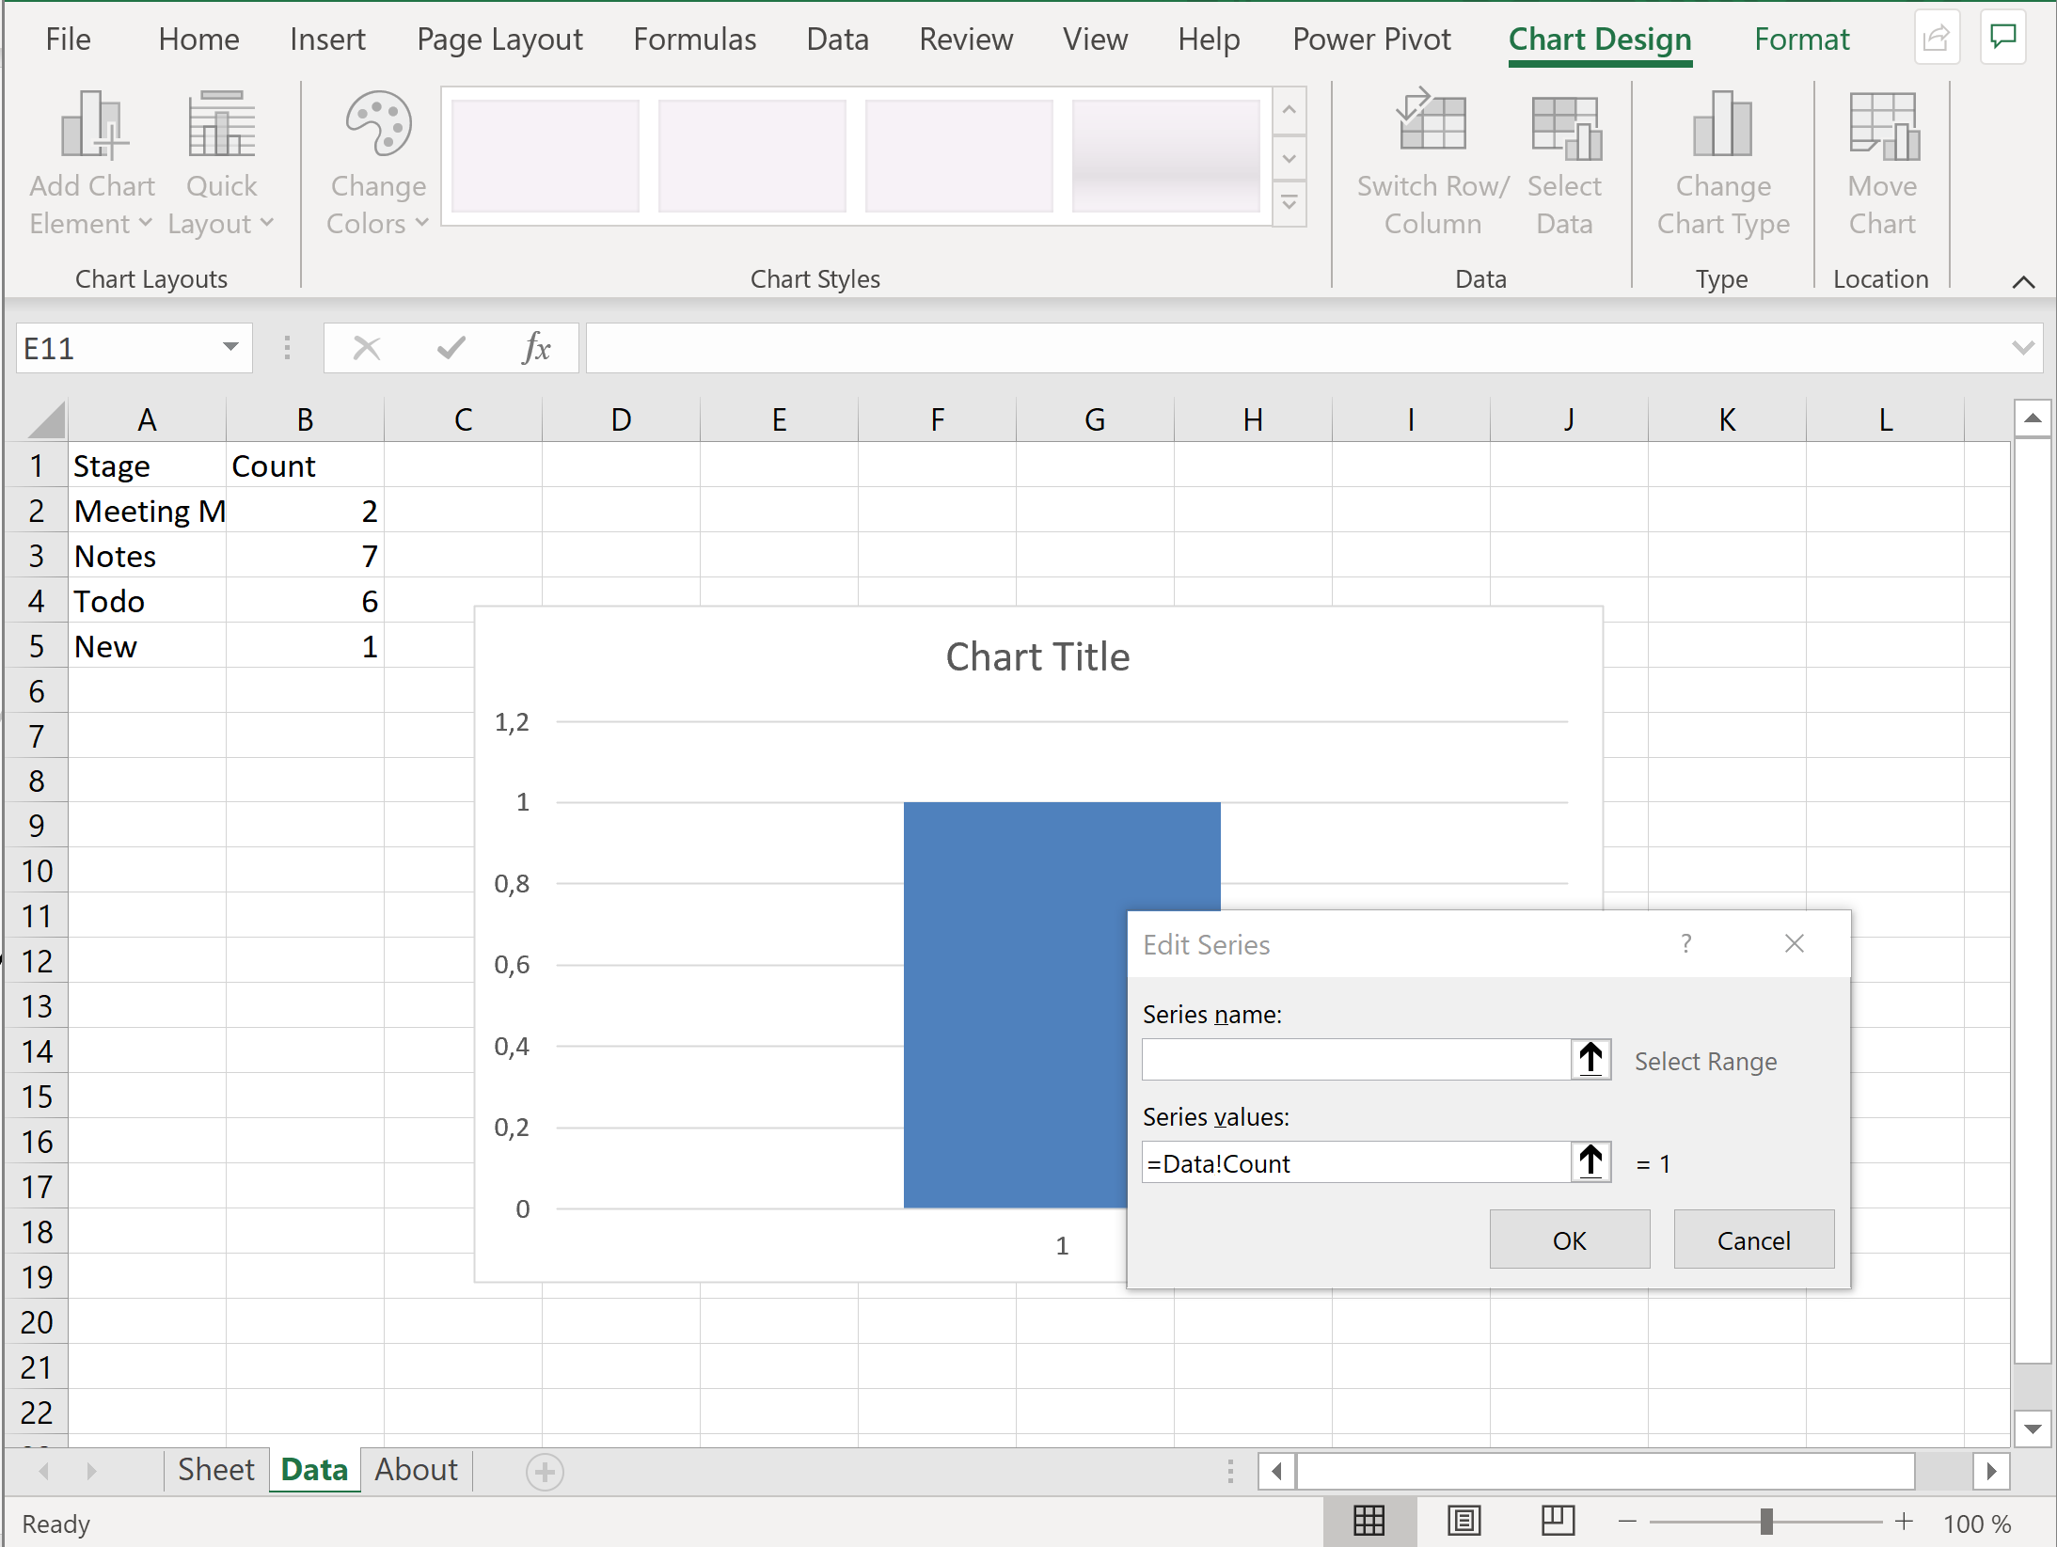
Open report for editing
Rocker has created Dynamic Range Names for every column heading / area
In this case Stage & Count
Use dynamic ranges here
Note:
Series values contains data sheet name
Note:
Series values contains data sheet name
Normal table based charts don’t work. Openpyxl does not update chart references
Edit Series values field

Slide 7
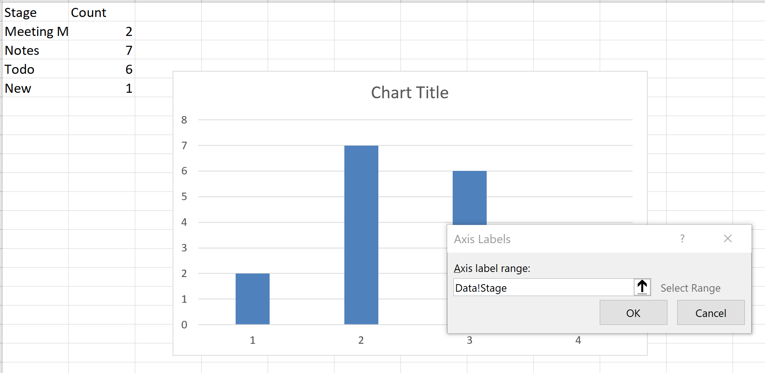
Open report for editing
Normal table based charts don’t work. Openpyxl does not update chart references
Edit Axis Label range, use dynamic range names

Slide 8
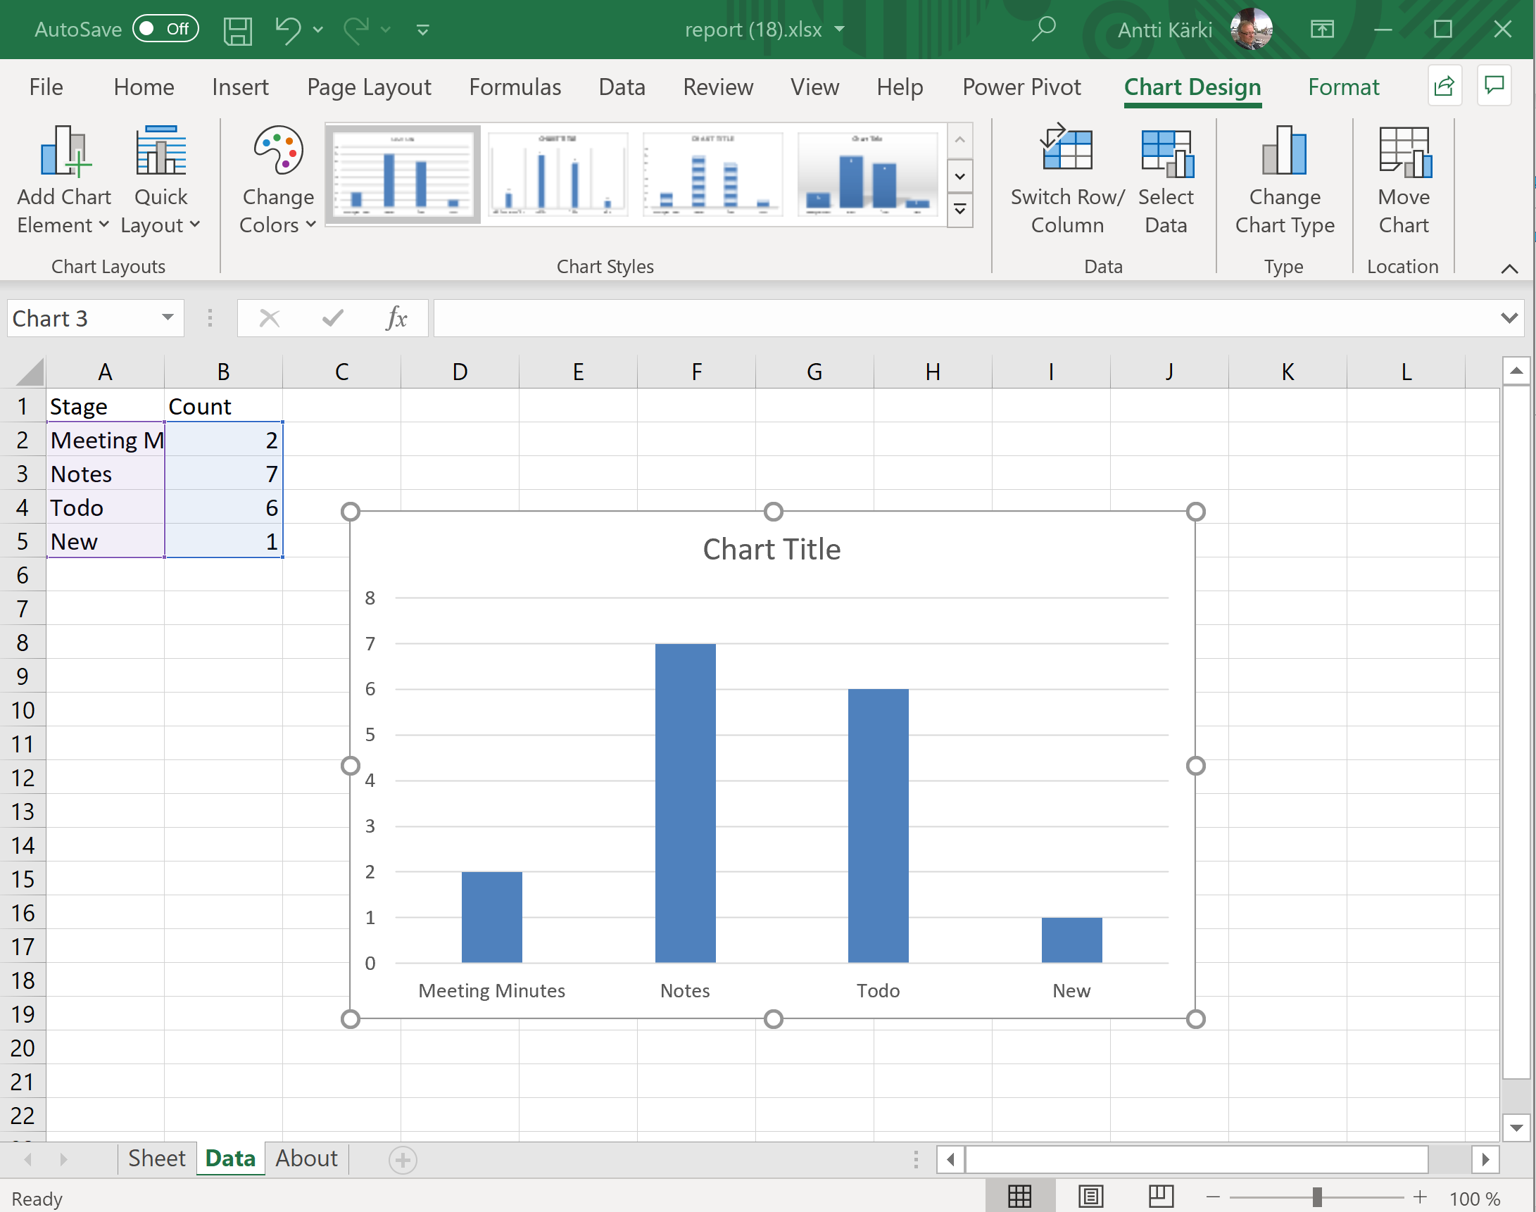
Save template

Slide 9
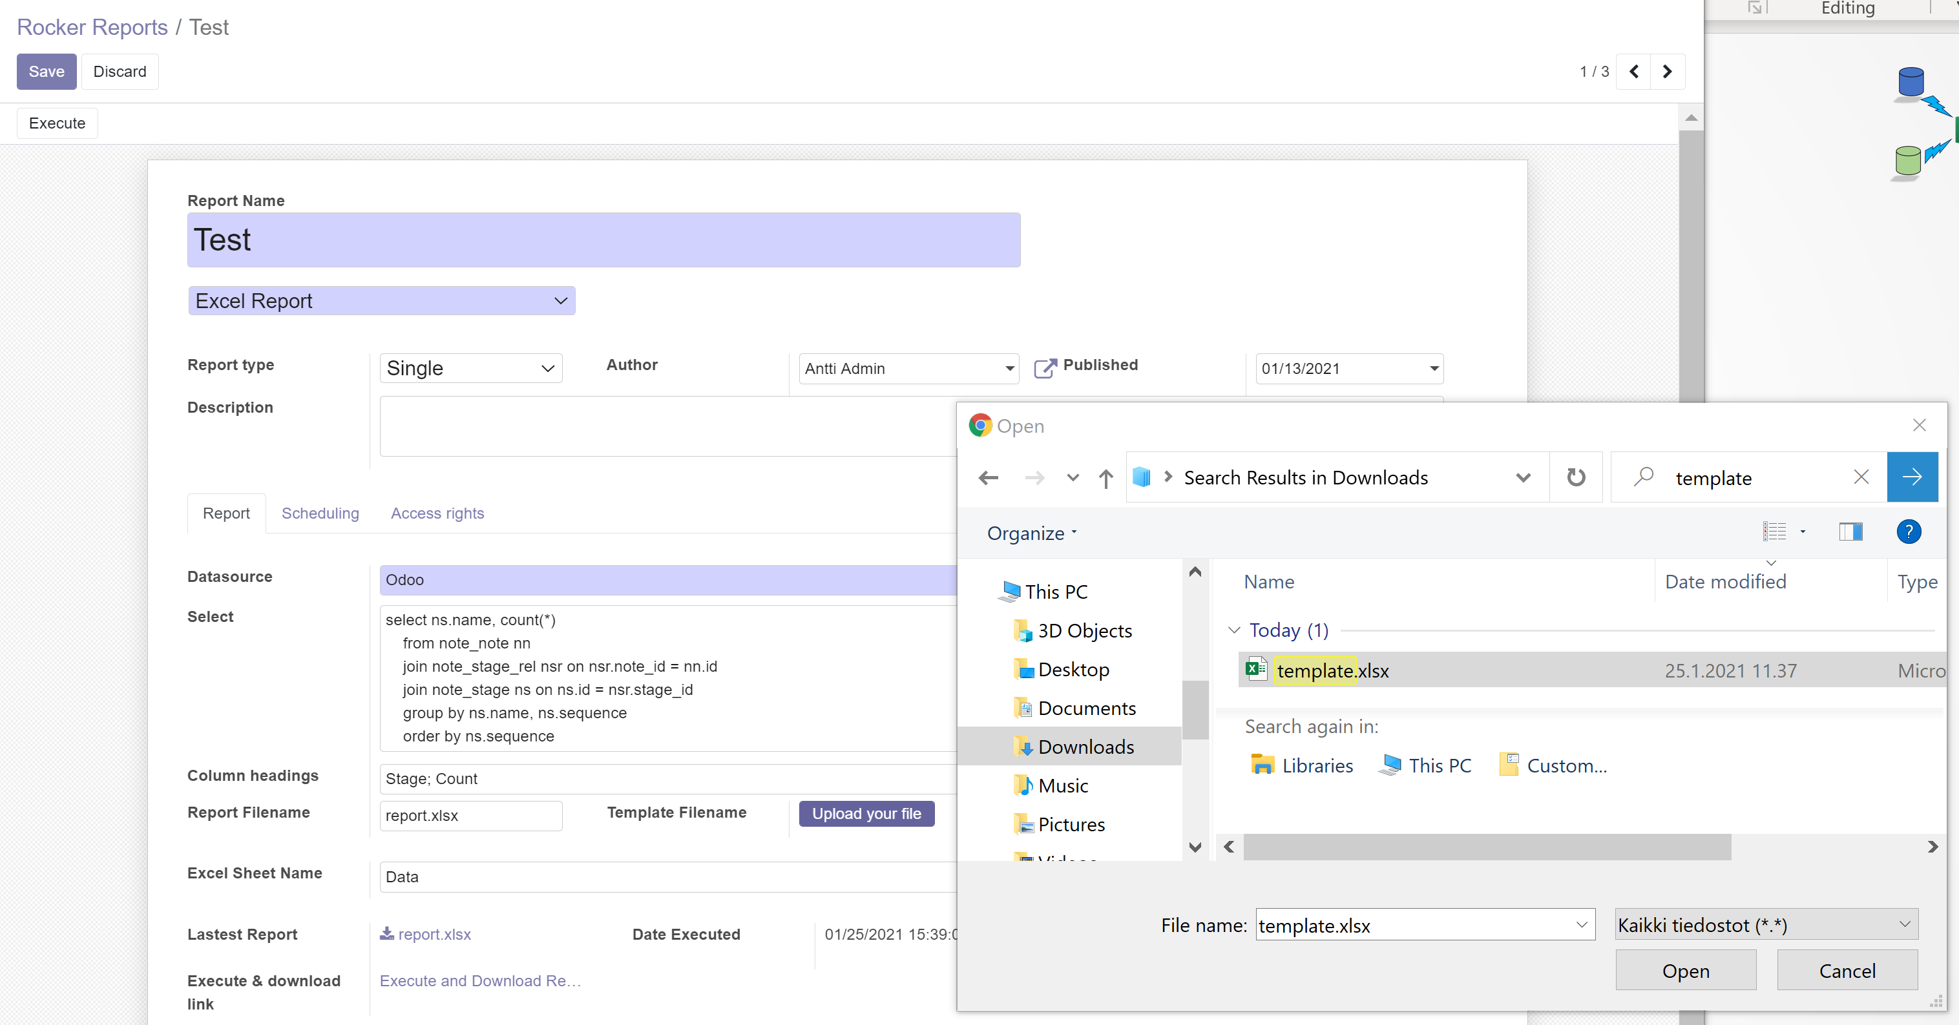
Edit and upload template

Slide 10
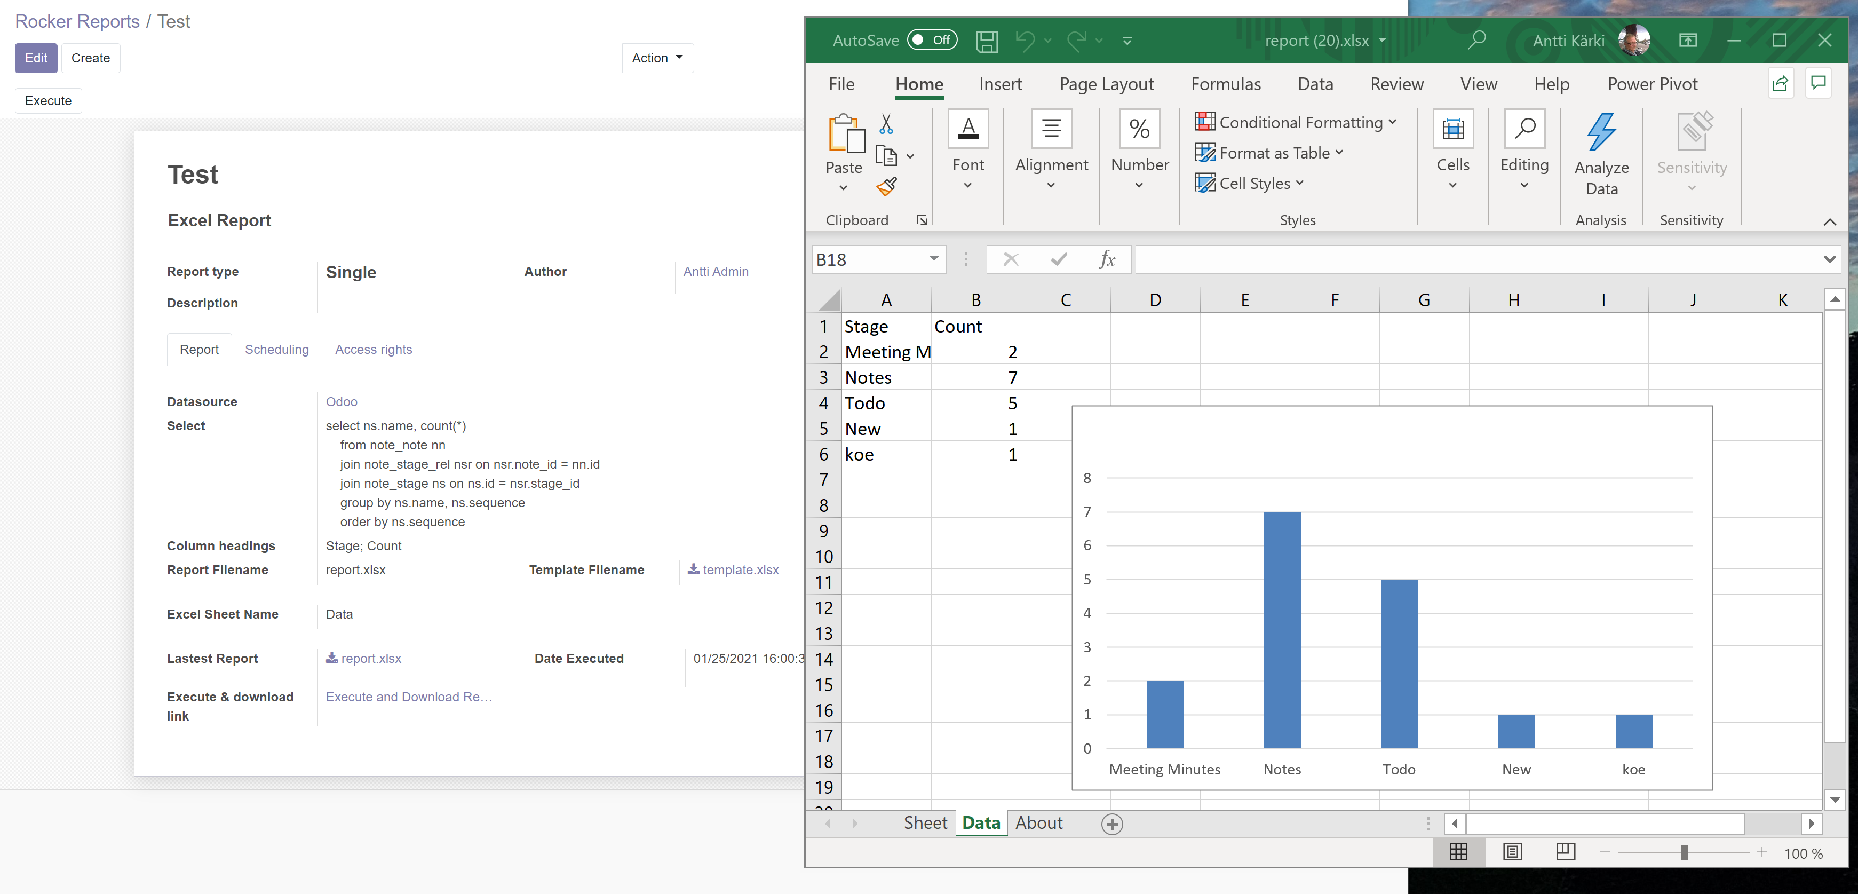
Execute

Slide 11
Excel collection reports

Slide 12
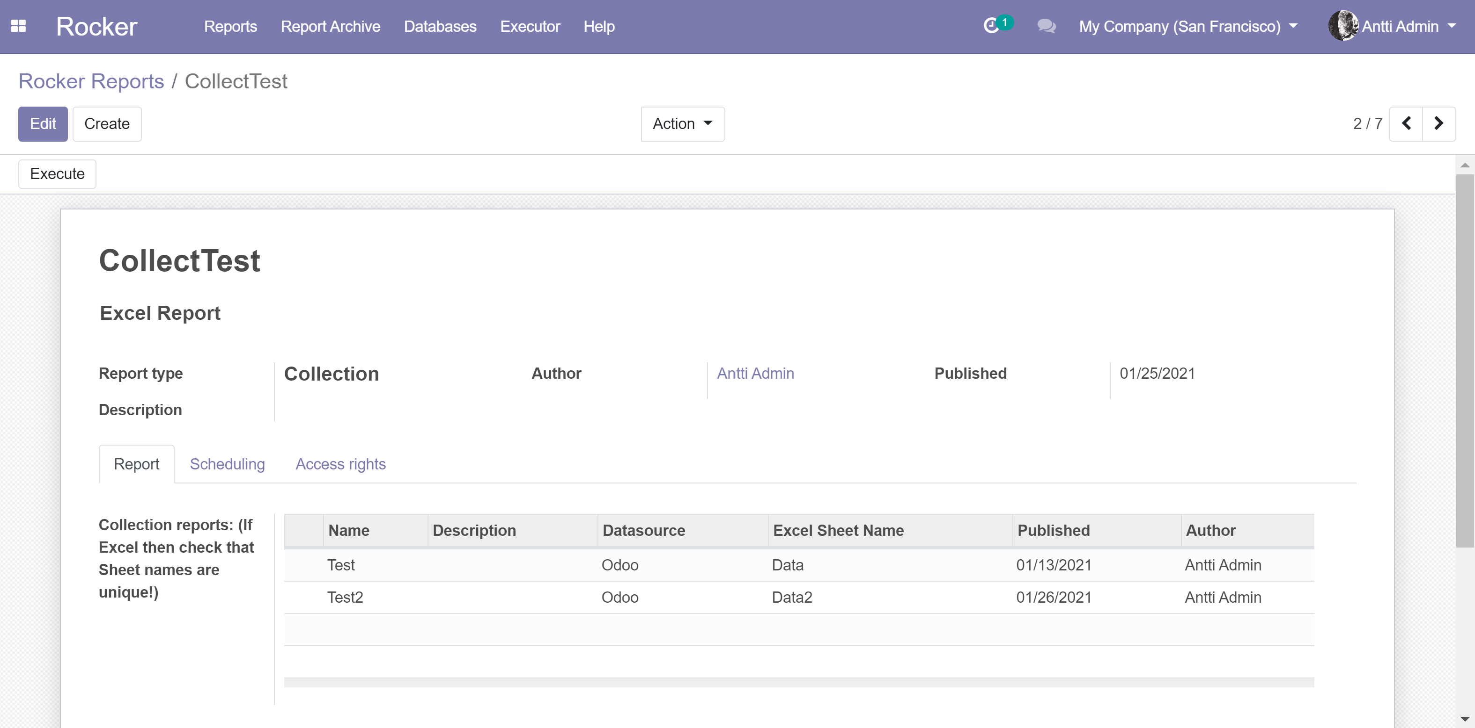
Create collection
Verify that Sheet names are unique

Slide 13
Create collection
Verify that Sheet names are unique. Use also unique column heading (one Named Range per column)

Slide 14
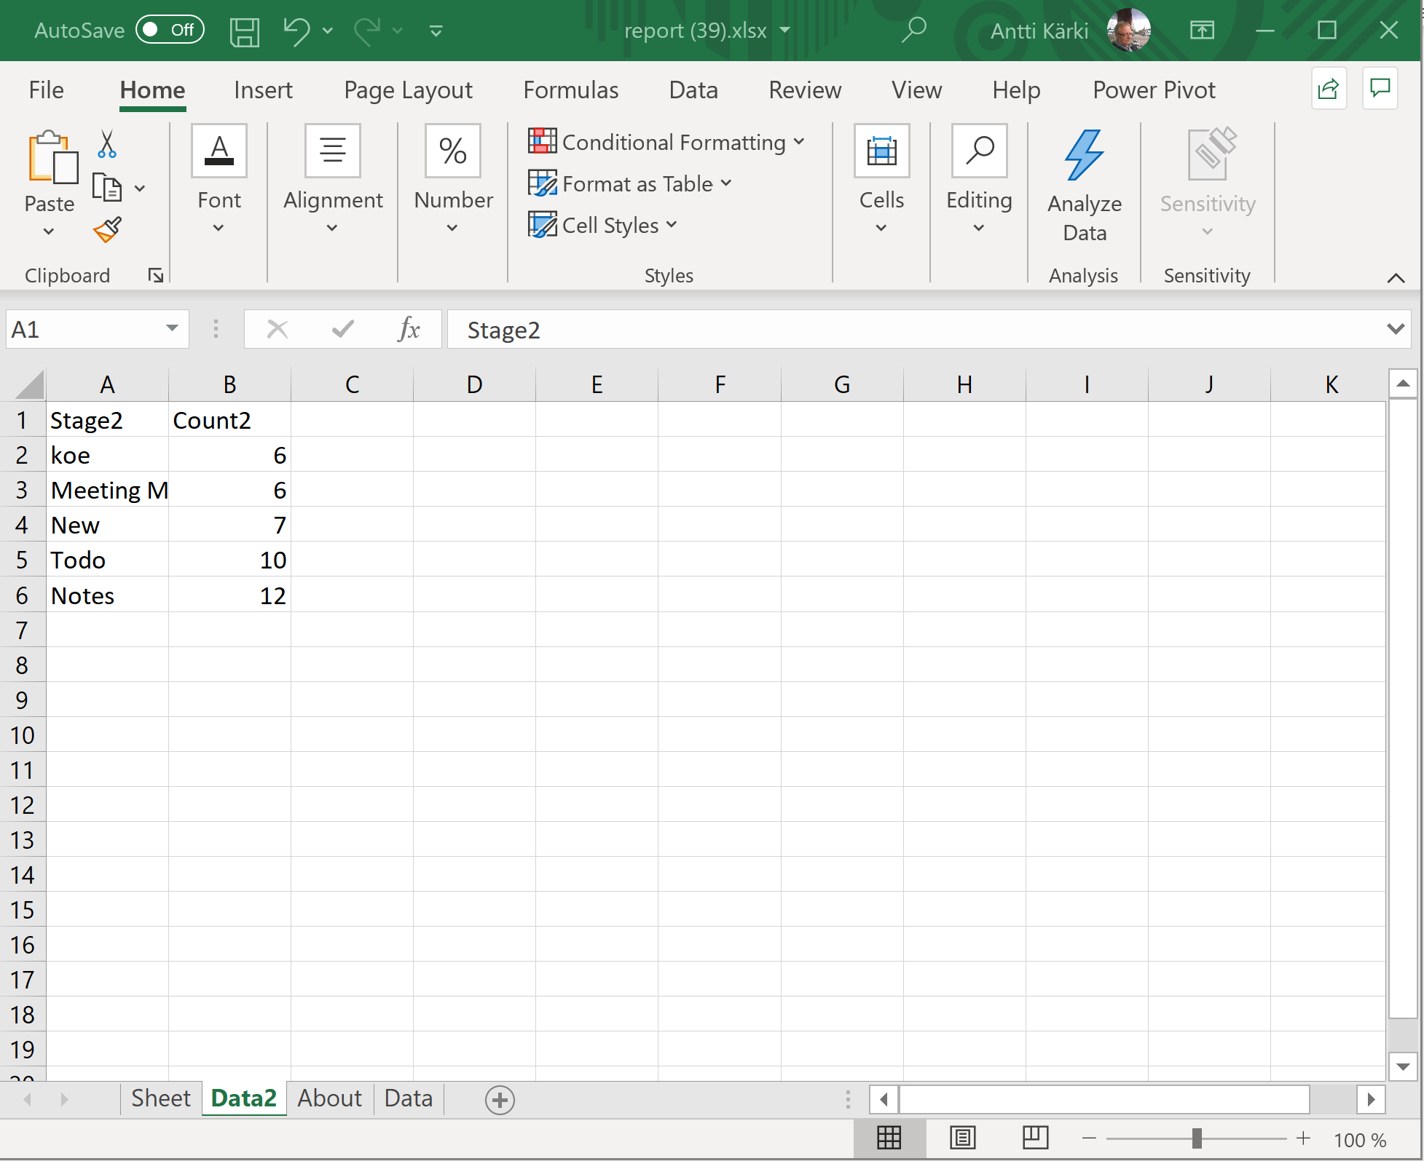
Execute report and open Excel for editing
Unique column headings (one Named Range per column)
Verify that Sheet names are unique

Slide 15
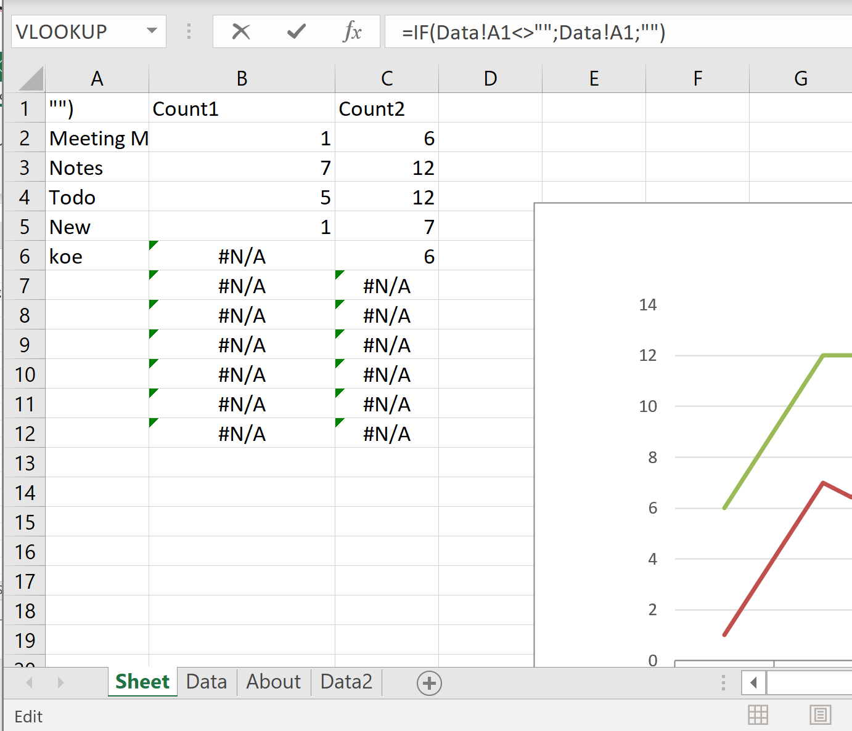
Use empty Sheet and add some formulas
Take series names from e.g. sheet Data with formula
=IF(Data!A1<>"";Data!A1;"")
Copy formula to cells below

Slide 16
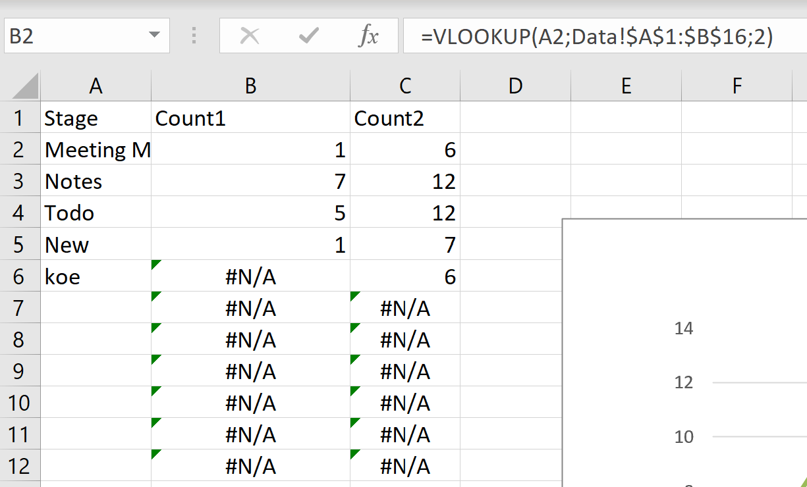
Take data with VLOOKUP
=VLOOKUP(A2;Data!$A$1:$B$16;2)
Copy formula to cells below
Take more data from other sheets
=VLOOKUP(A2;Data2!$A$1:$B$16;2)
Copy formula to cells below

Slide 17
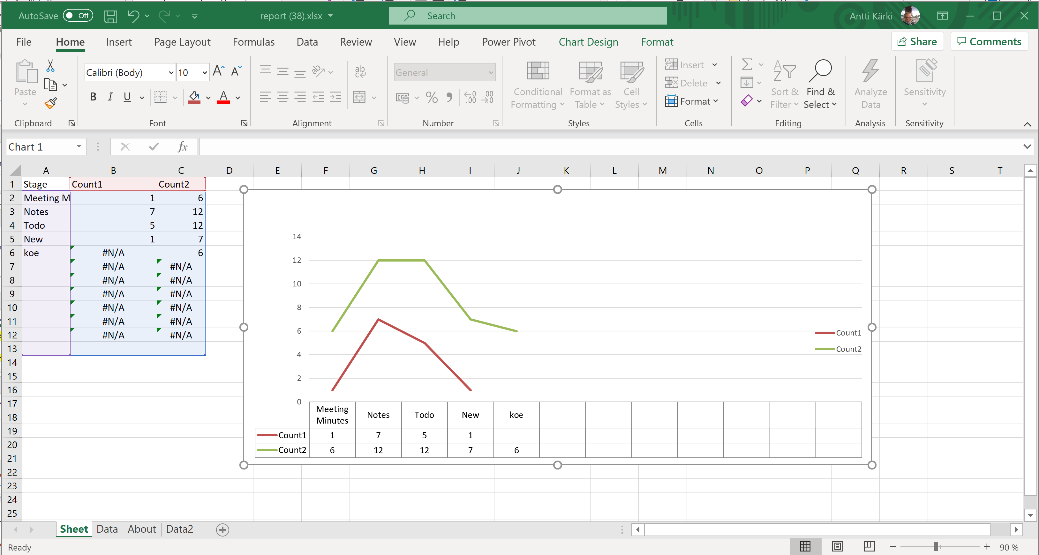
Save as template, upload template and execute
Note:
You must enable editing, otherwise Excel does not update Chart

Slide 18
Pivots

Slide 19
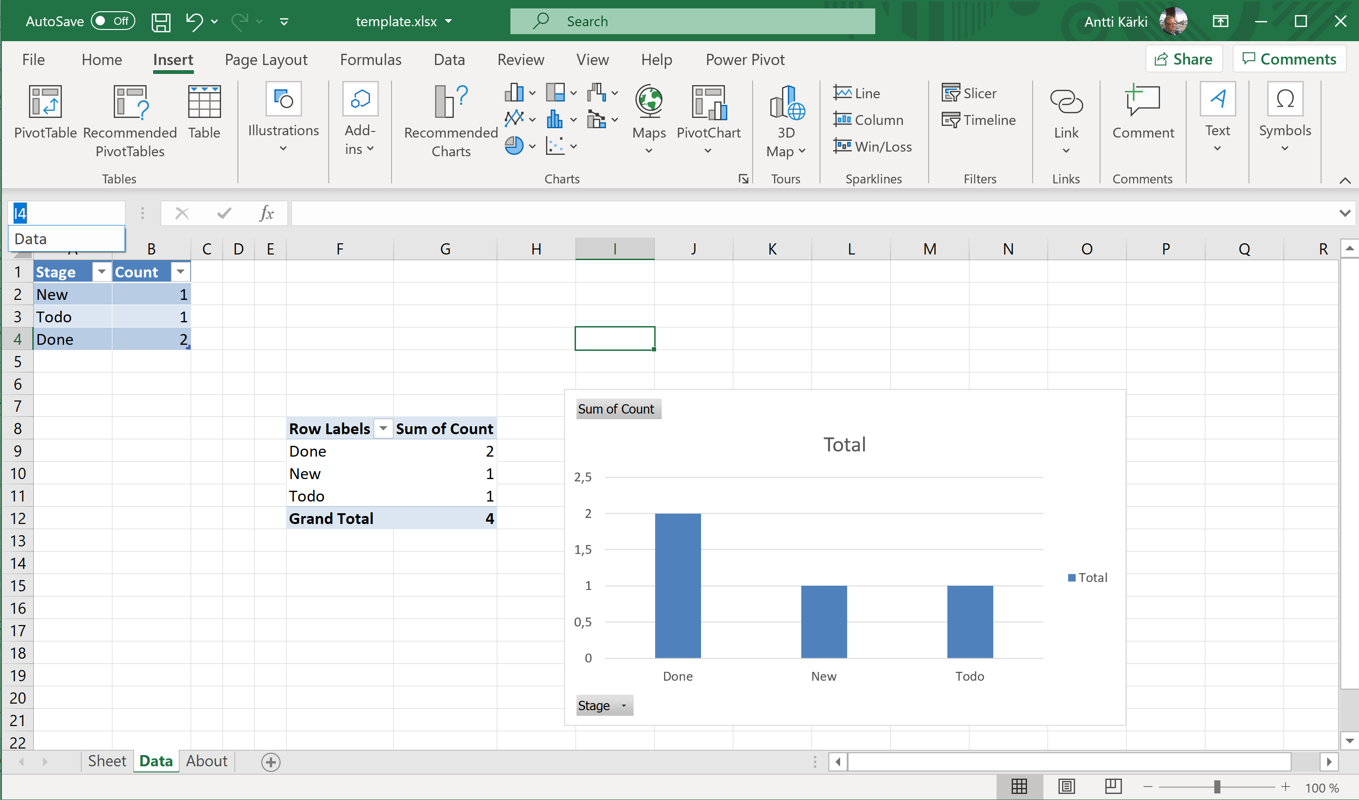
Open tempate for editing
Don’t use PowerPivot. Openpyxl does not support it
Select table
(don’t create overlaping tables on data area)
Insert Pivot Chart
Insert Pivot

Slide 20
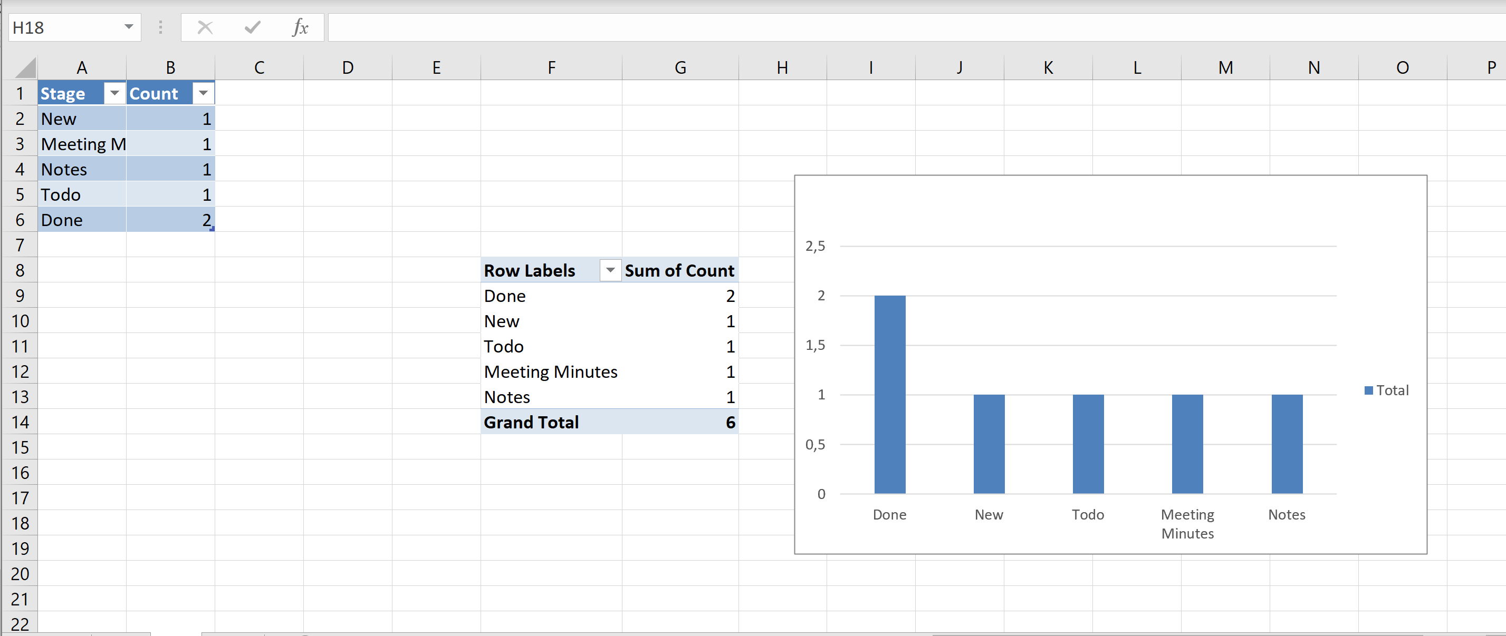
Pivot is updated as soon you enable Editing

