Slide 1
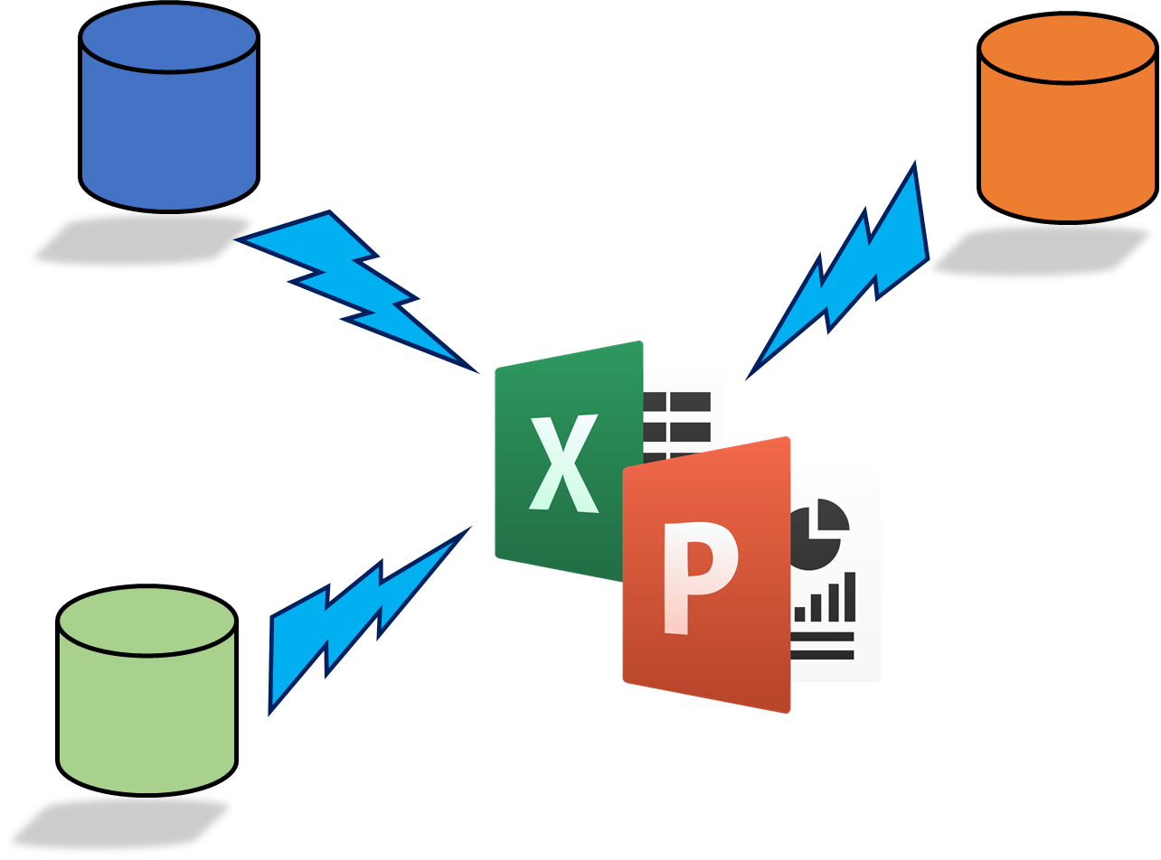
Rocker Reporting v3
Installation Guide

Slide 2

Install Odoo 12 or Odoo 13 or Odoo 14 Linux / Unix & Windows platforms are all OK
Download from
https://www.odoo.com/page/download
https://computingforgeeks.com/how-to-install-odoo-on-ubuntu-linux/
Didn’t install nginx
Had to create:
odoo@odoo:/var/lib$ sudo mkdir odoo
/var/log/odoo/odoo-server.log
/etc/odoo/odoo.conf
/usr/lib/python3/dist-packages/odoo/addons
sudo service odoo restar

Slide 3
Install some Python packages
sudo apt install python3-pip
sudo pip3 install openpyxl
sudo pip3 install pandas
sudo pip3 install python-pptx
Install needed database drivers
By default Odoo’s postgresql database drivers exist
You just need to create reporting user

Slide 4
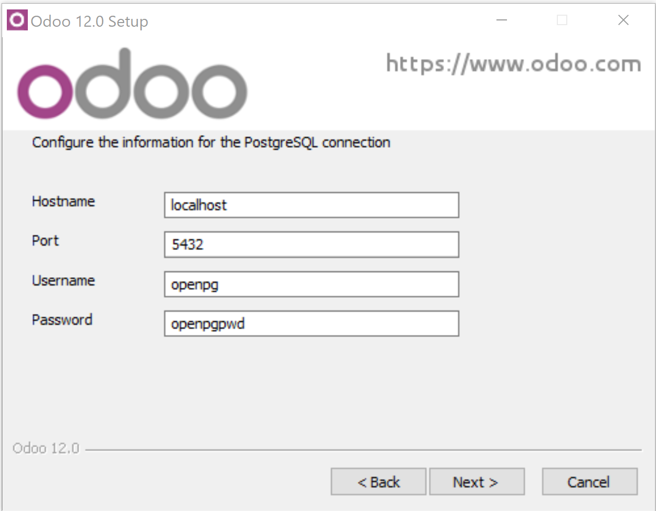
Install Odoo 12 or Odoo 13 for Windows
Windows example
We are using Win32Com so Windows platform is required
Download from
https://www.odoo.com/page/download
I used Windows 10 Pro

Slide 5
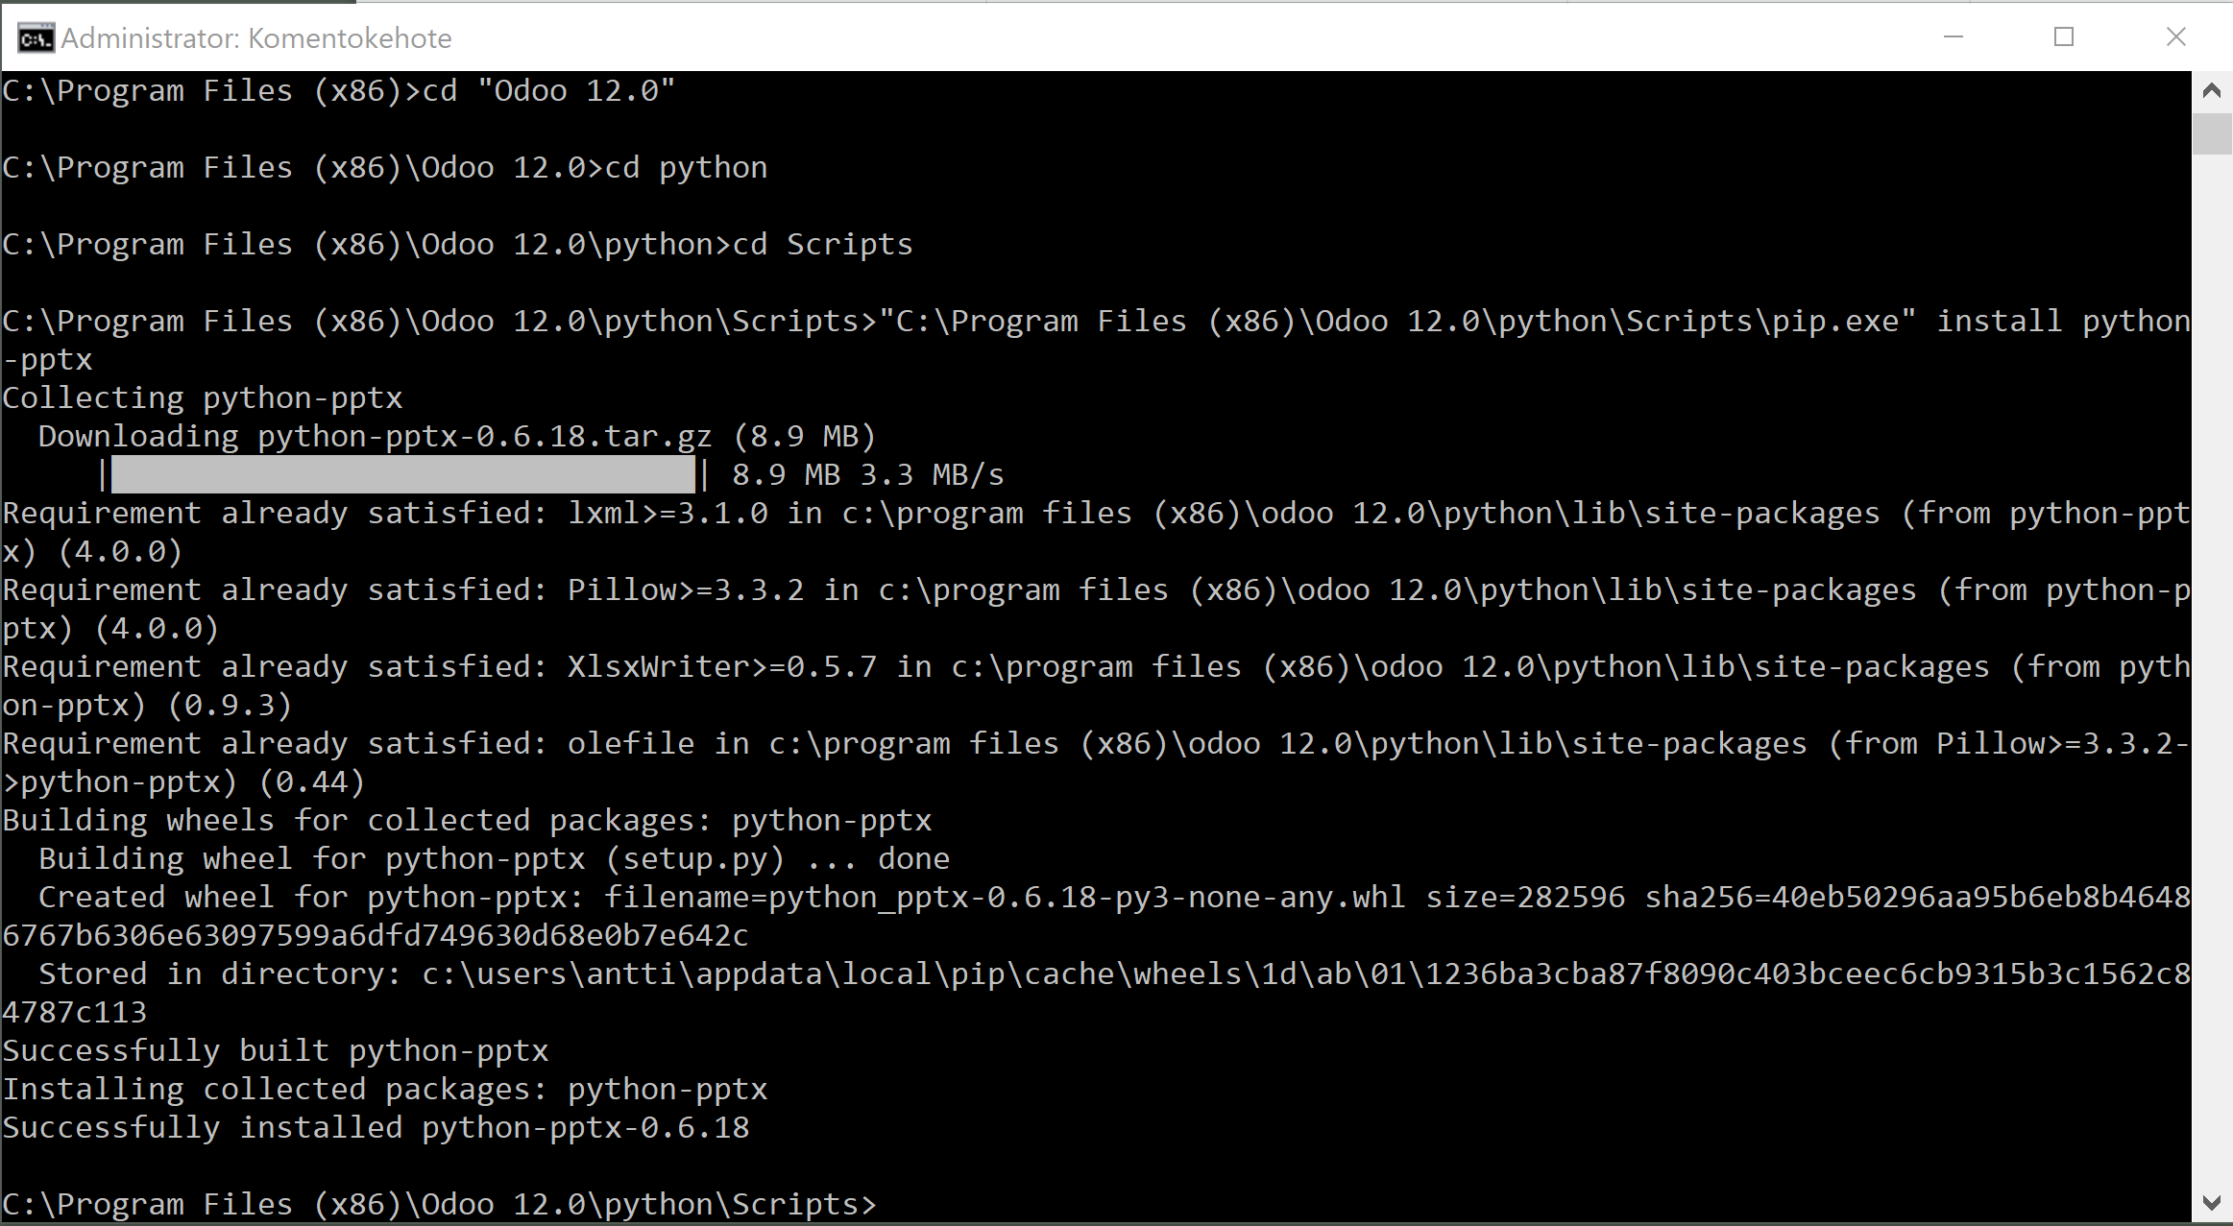
PowerPoints: Install python-pptx
Windows example
Start CMD with Administrator rights
Execute:
"C:\Program Files (x86)\Odoo 13.0\python\python" "C:\Program Files (x86)\Odoo 12.0\python\Scripts\pip.exe" install python-pptx
"C:\Program Files (x86)\Odoo 13.0\python\python" pip3.exe install cx-Oracle --upgrade

Slide 6
Download and install rocker_app
Windows example
Download rocker_app.zip from Odoo Apps
Check addons_path from odoo.conf
[options]
addons_path = C:\Program Files (x86)\Odoo 12.0\server\odoo\addons
Extract rocker_app.zip (to documents folder)
Copy rocker_app folder to C:\Program Files (x86)\Odoo 12.0\server\odoo\addons
Restart Odoo service
Or Odoo 13.0 / 14.0

Slide 7
Download and install rocker_app
Download rocker_app.zip from Odoo Apps
Check addons_path from odoo.conf
[options]
addons_path = C:\Program Files (x86)\Odoo 12.0\server\odoo\addons
Extract rocker_app.zip (to documents folder)
Copy rocker_app folder to C:\Program Files (x86)\Odoo 12.0\server\odoo\addons
Restart Odoo service
Or Odoo 13.0 & 14

Slide 8
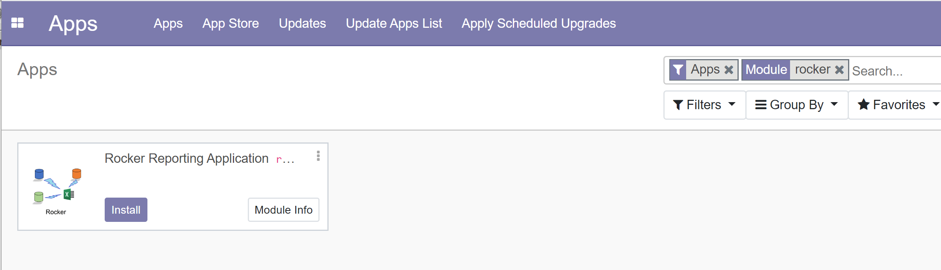
Install Rocker module
Activate developer mode
Update Apps List
Search for Rocker
Install

Slide 9
Before you can create database connection in Rocker_app you have to: Create reporting user for Odoo
sudo -u postgres createuser --login --pwprompt rocker
login with user odoo
Execute psql, then
GRANT CONNECT ON DATABASE database_name TO username;
GRANT SELECT ON ALL TABLES IN SCHEMA name TO username;
GRANT CONNECT ON DATABASE odoo TO rocker;
service odoo restart
Works in Ubuntu ☺

Slide 10
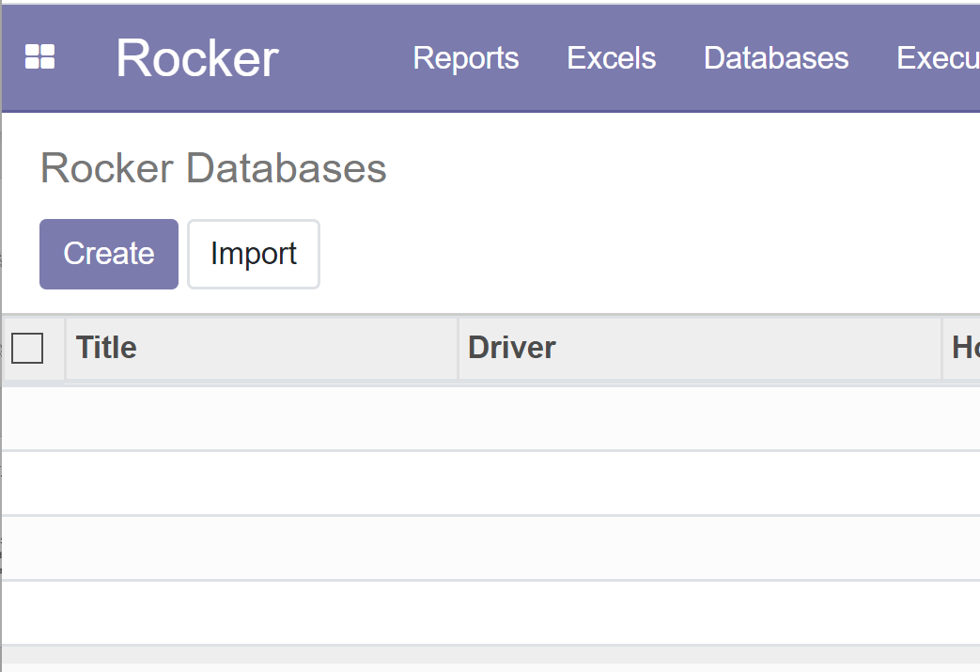
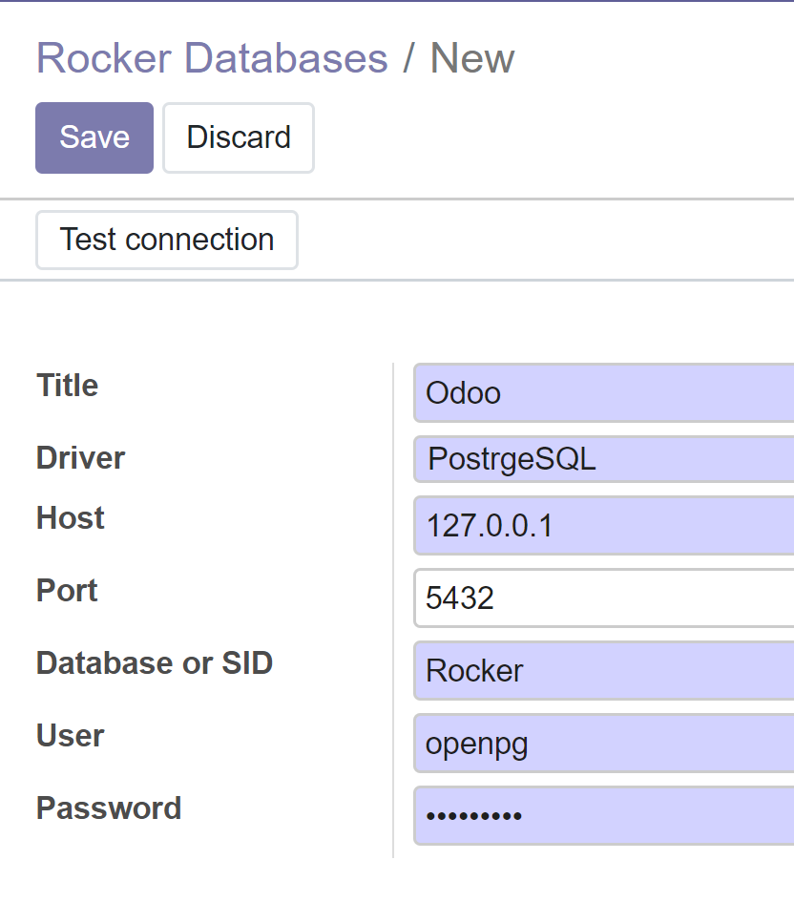
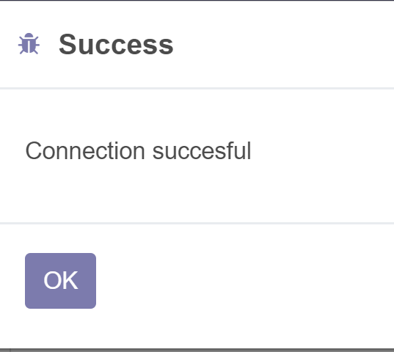
Create database / datasource for PostgreSQL ( Odoo)
Select Databases from menu
Create…
Select PostgreSQL driver, Change database name & other data when necessary
Save
Test connection

Slide 11
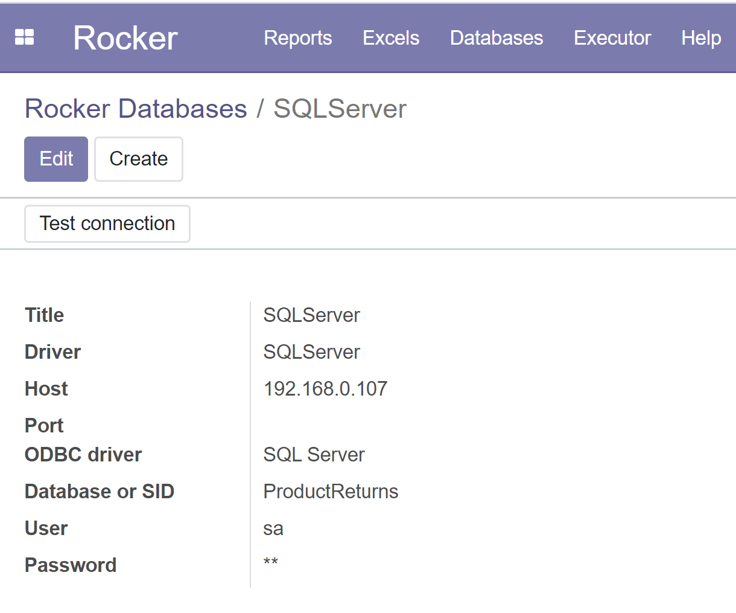
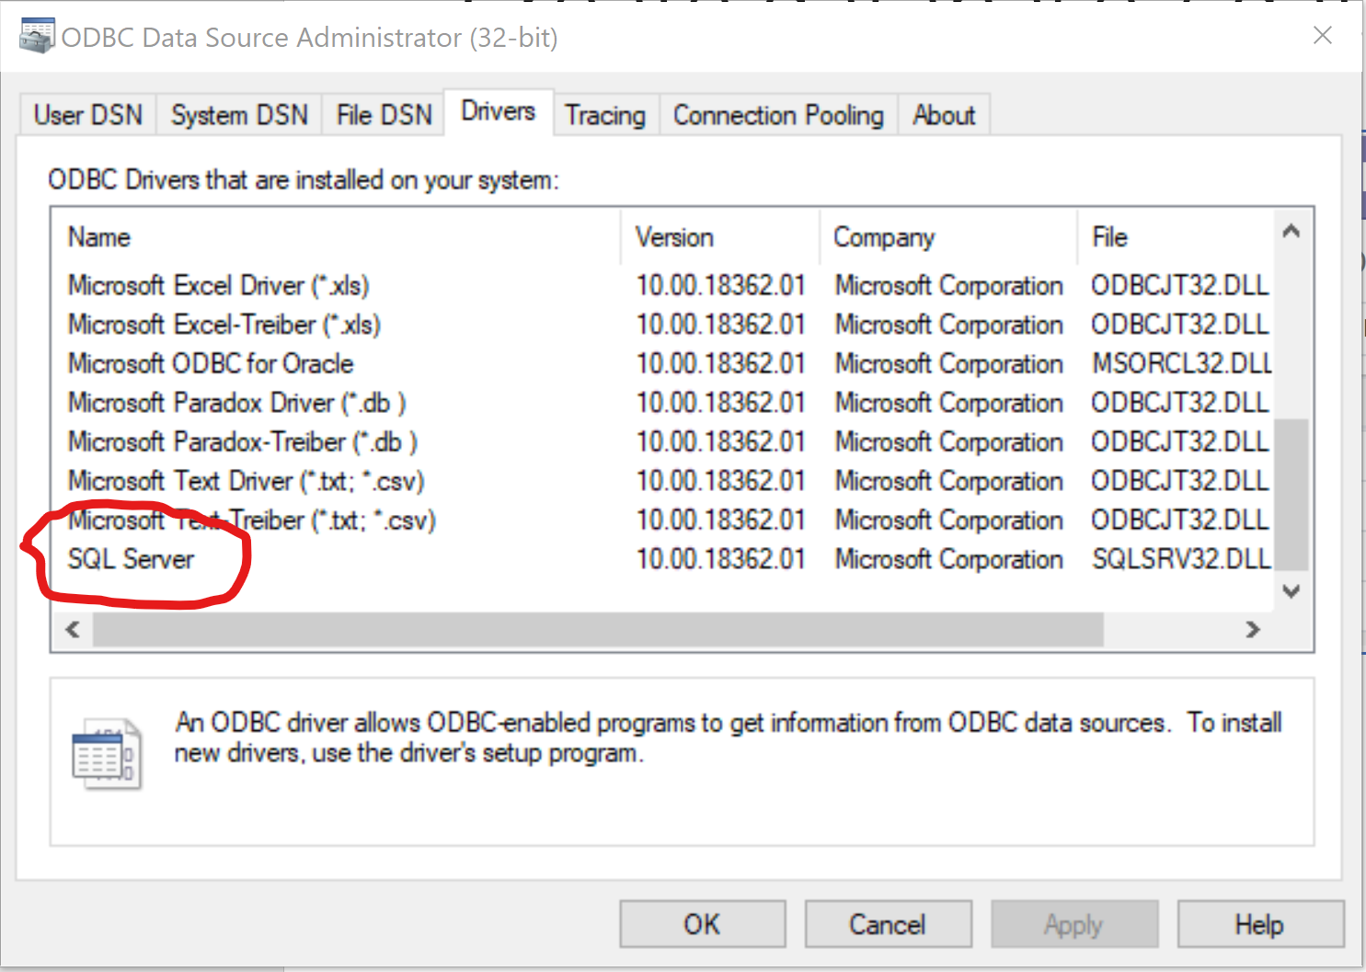
Create database / datasource for SQLServer / ODBC
Windows example
C:\Program Files (x86)\Odoo 12.0\python\Scripts>pip install pyodbc
Select Databases from menu
Create…
Select SQLServer driver, Change database name & other data when necessary
Save
Test connection

Slide 12
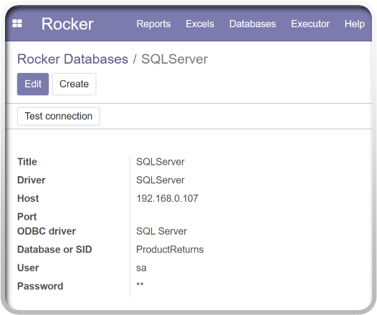
Ubuntu SQLServer / ODBC drivers
curl https://packages.microsoft.com/config/ubuntu/20.04/prod.list | sudo tee /etc/apt/sources.list.d/msprod.list
sudo apt-get update
sudo apt-get install mssql-tools unixodbc-dev
echo 'export PATH="$PATH:/opt/mssql-tools/bin"' >> ~/.bash_profile
echo 'export PATH="$PATH:/opt/mssql-tools/bin"' >> ~/.bashrc source ~/.bashrc'
sqlcmd -S localhost -U SA -P '<YourPassword>’
Test connection
sqlcmd -S 192.168.1.88 -U sa –P sapwd

Slide 13
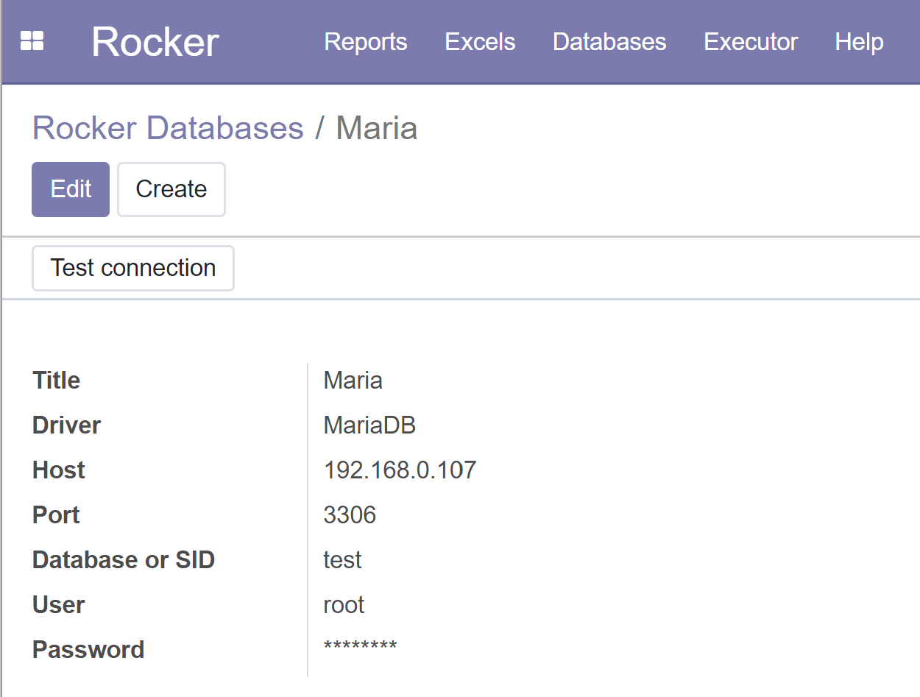
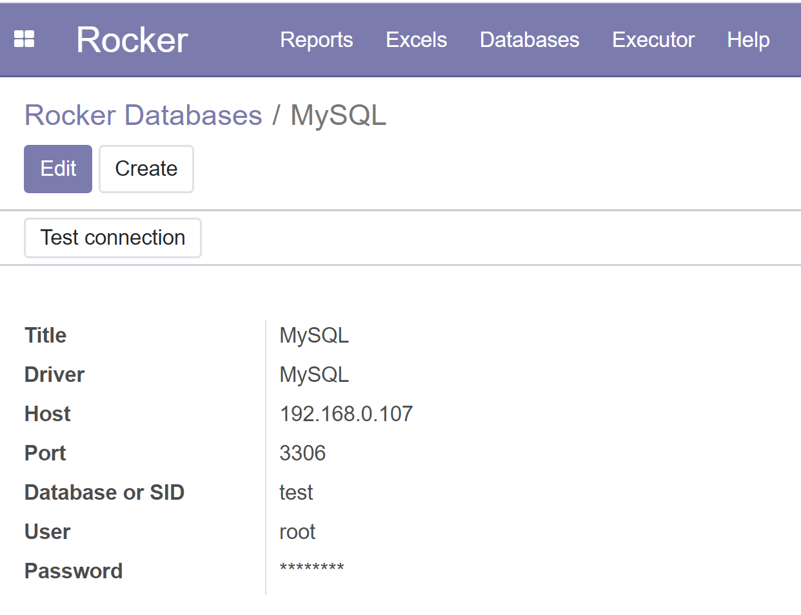
Create database / datasource for MySQL or MariaDB
Windows example
C:\Program Files (x86)\Odoo 12.0\python\Scripts> pip install mysql-connector-python
Select Databases from menu
Create…
Select MySQL or MariaDB driver, Change database name & other data when necessary
Save
Test connection

Slide 14
Ubuntu / datasource for MySQL or MariaDB
sudo apt-get update
sudo apt-get install mysql-client
pip3 install mysql-connector
Test
mysql -u root -p -h 127.0.0.1
mysql -u root -p -h 192.168.1.88
Select Databases from menu
Create…
Select MySQL or MariaDB driver, Change database name & other data when necessary
Save
Test connection

Slide 15
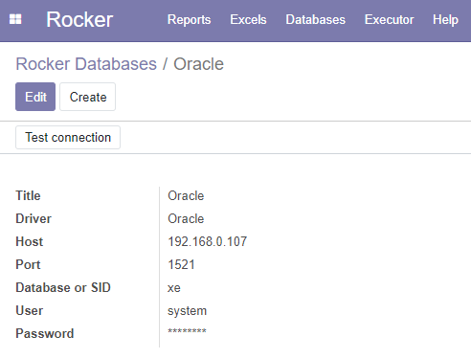
Create database / datasource for Oracle
Windows example
Download and install Oracle instant client from: https://www.oracle.com/database/technologies/instant-client/downloads.html
Extract file to e.g. C:\Oracle\instantclient_19_5
Add C:\Oracle\instantclient_19_5 to PATH (System variables side)
Install Microsoft Visual C++ Redistributable from https://support.microsoft.com/en-us/help/2977003/the-latest-supported-visual-c-downloads
I installed both 32 & 64-bit
Install python drivers
C:\Program Files (x86)\Odoo 12.0\python\Scripts> pip install cx_Oracle –upgrade
Reboot
Select Databases from menu
Create…
Select Oracle driver, Change SID & other data when necessary
Save & Test connection
https://cx-oracle.readthedocs.io/en/latest/user_guide/installation.html

Slide 16
Create database / datasource for Oracle
UBUNTU
https://gist.github.com/kimus/10012910
sudo apt-get install build-essential unzip python-dev libaio-dev
export ORACLE_HOME=/home/odoo/instantclient_21_1
cd $ORACLE_HOME
ln -s libclntsh.so.21.1 libclntsh.so #the version number on your .so file might be different
export ORACLE_HOME=/home/odoo/instantclient_21_1
export LD_LIBRARY_PATH=$LD_LIBRARY_PATH:$ORACLE_HOME
source ~/.bashrc
sudo nano /etc/ld.so.conf.d/oracle.conf
add row:
/home/odoo/instantclient_21_1
sudo ldconfig
sudo pip3 install cx_oracle
https://cx-oracle.readthedocs.io/en/latest/user_guide/installation.html

Slide 17
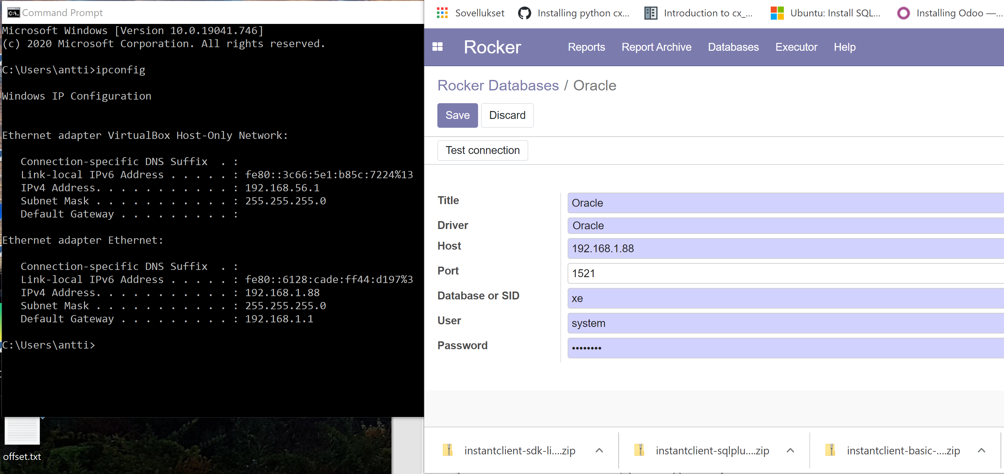
Oracle DB connection

Slide 18
Copy
Windows example
cx_Oracle.cp37-win32.pyd
cx_Oracle-8.1.0.dist-info folder
To
C:\Program Files (x86)\Odoo 13.0\python\Lib\site-packages

Slide 19
If something goes wrong
Start Odoo in Debug mode "C:\Program Files (x86)\Odoo 12.0\python\python.exe" ./odoo-bin -c odoo.conf --log-level=debug in C:\Program Files (x86)\Odoo 12.0\server -folder
Check odoo.log from
"C:\Program Files (x86)\Odoo 12.0\server\odoo.log"

