Slide 1
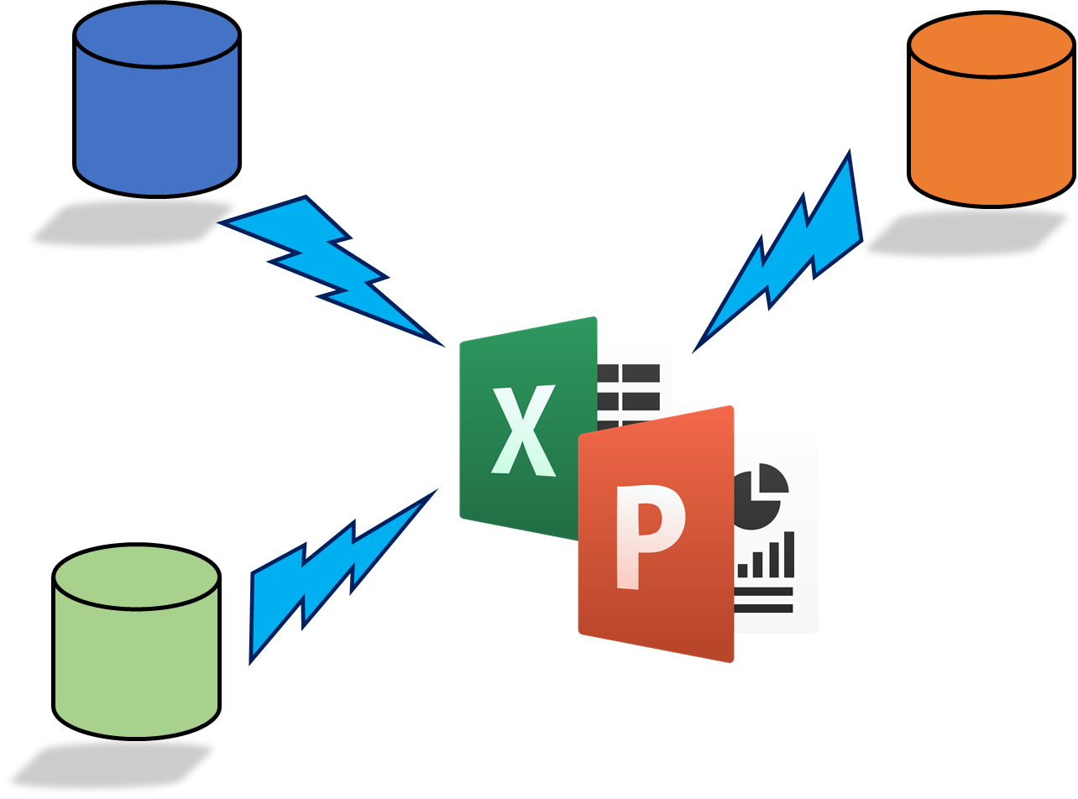
Rocker Reporting V3
Email User Guide

Slide 2
Configure Odoo Outgoing Email server Case: Gmail

Slide 3
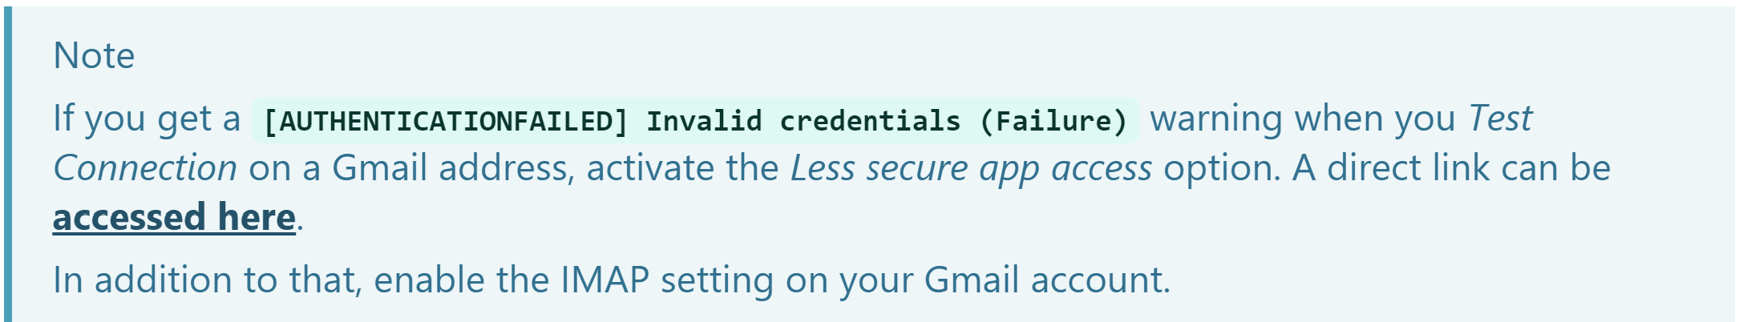
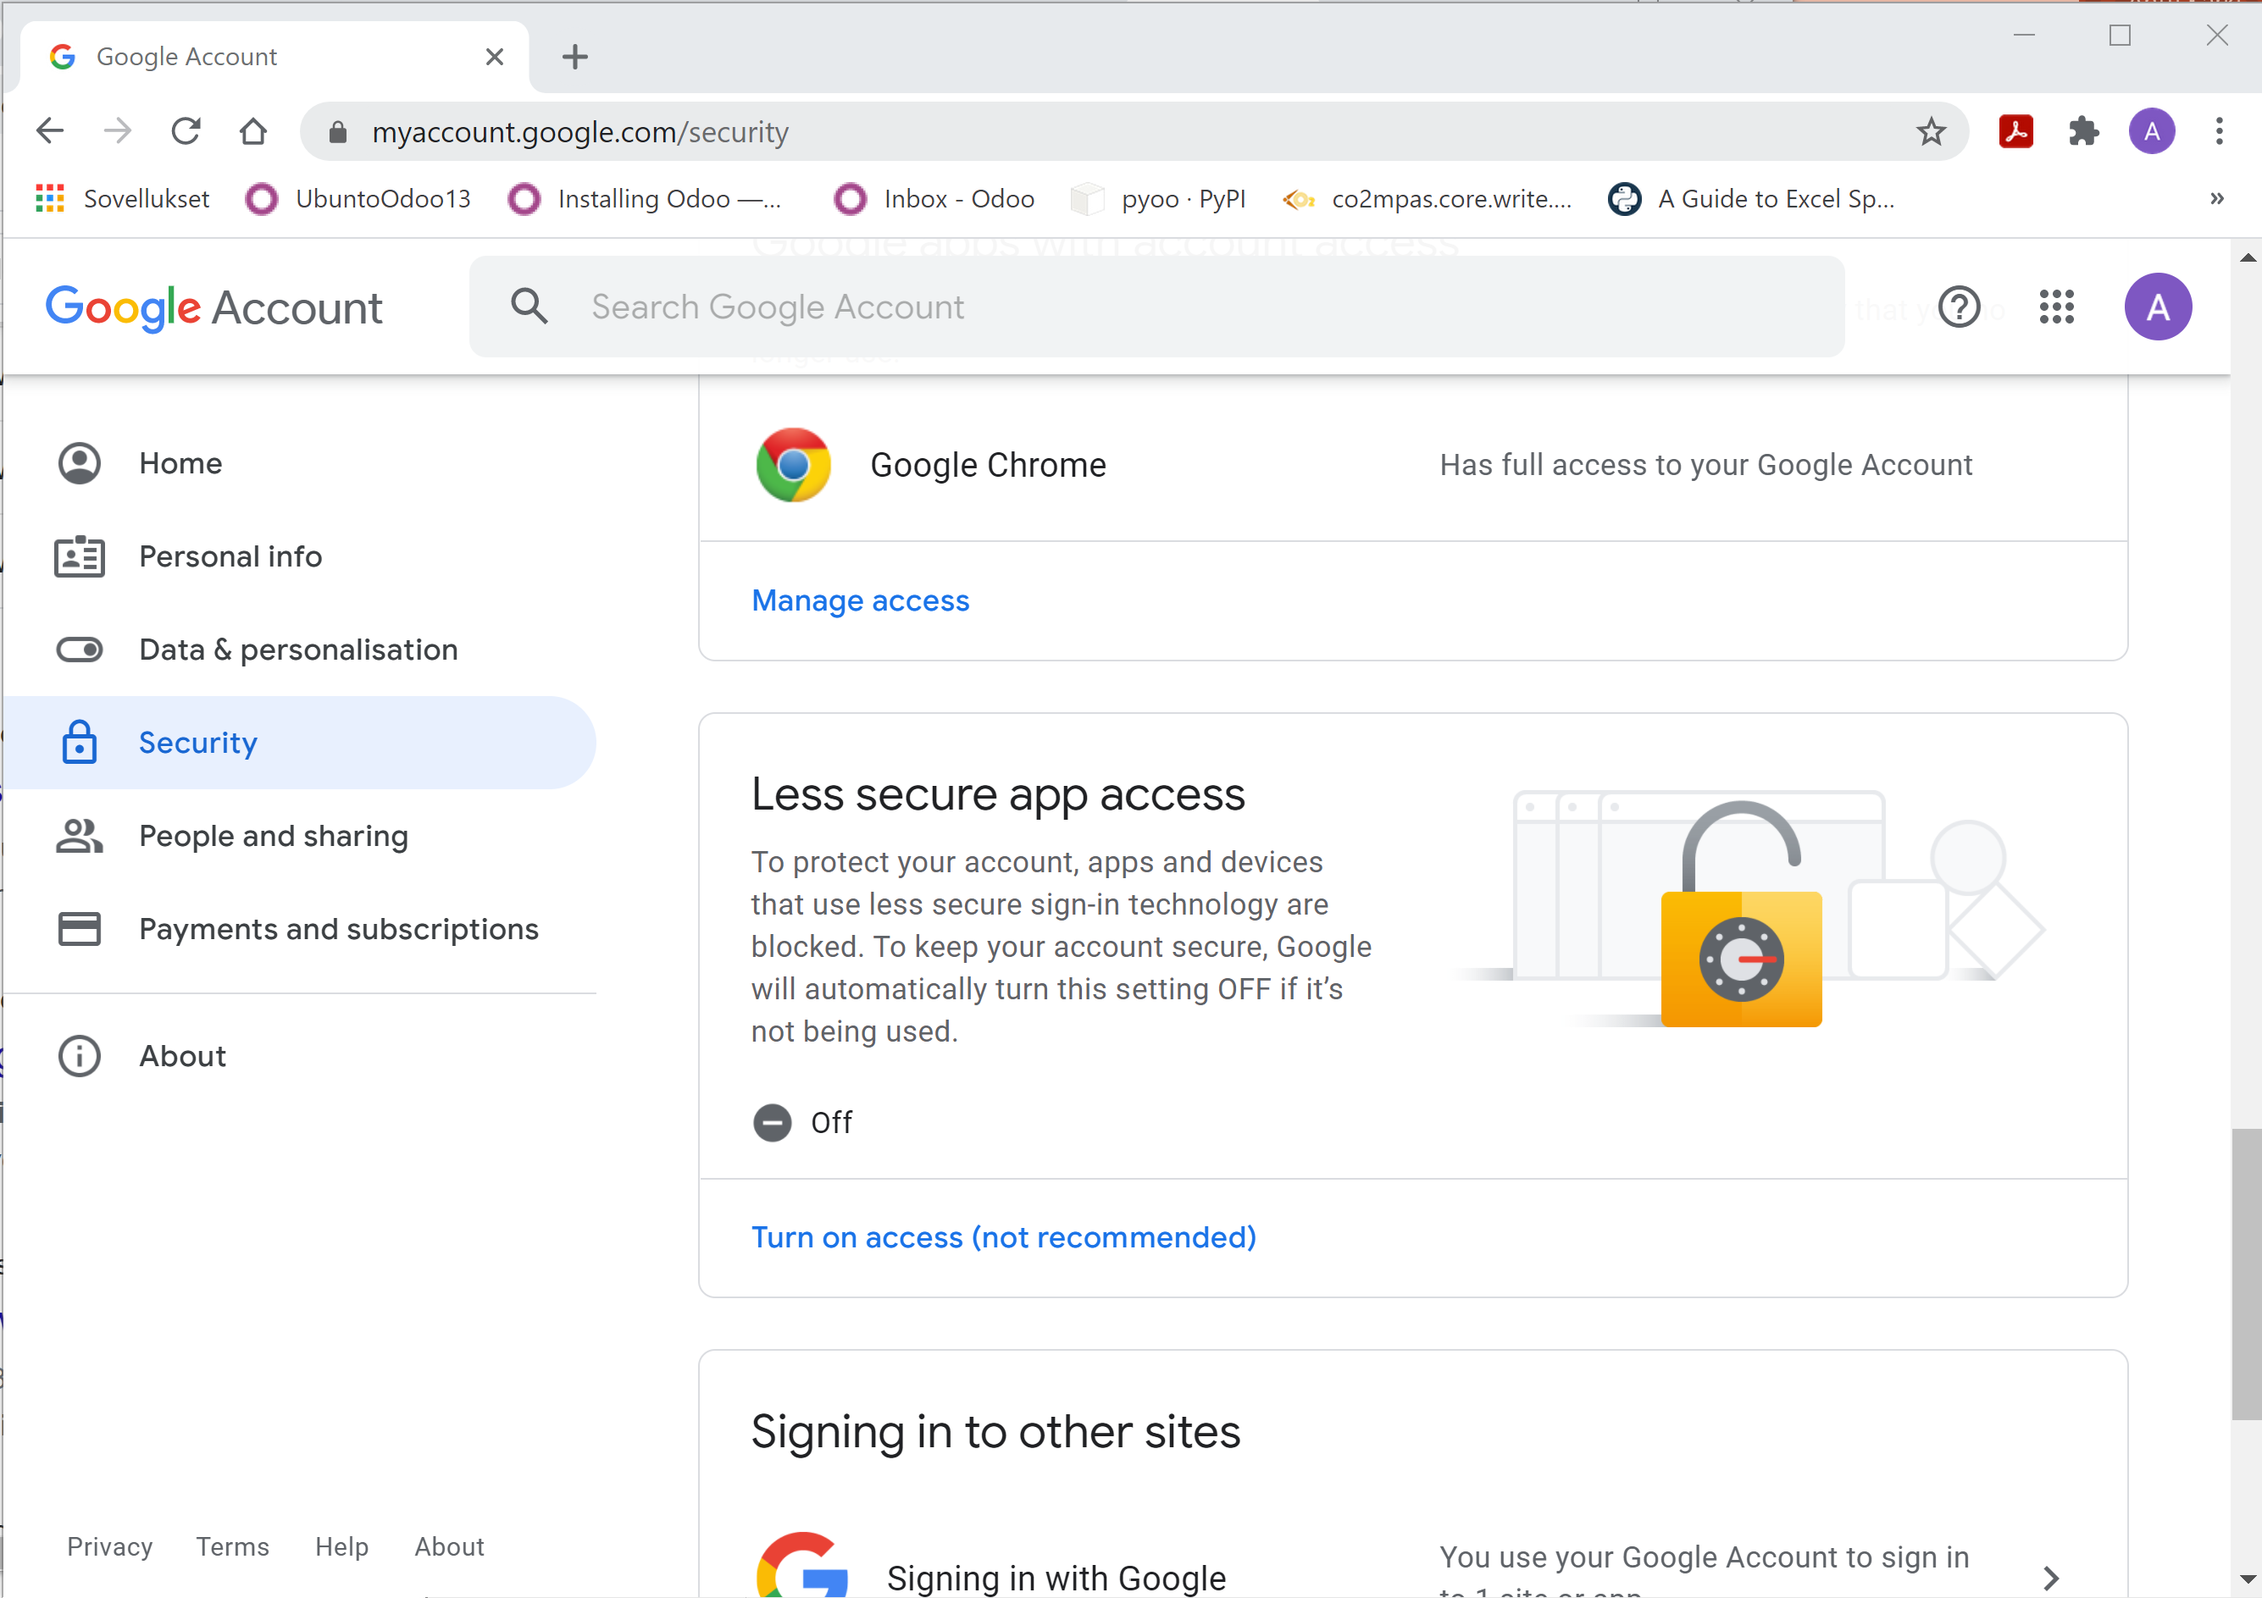
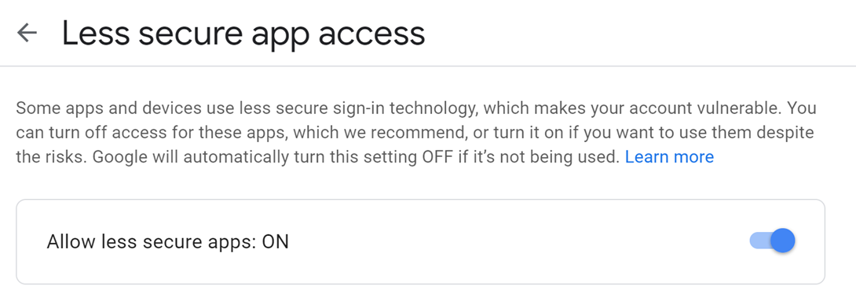
Gmail settings

Slide 4
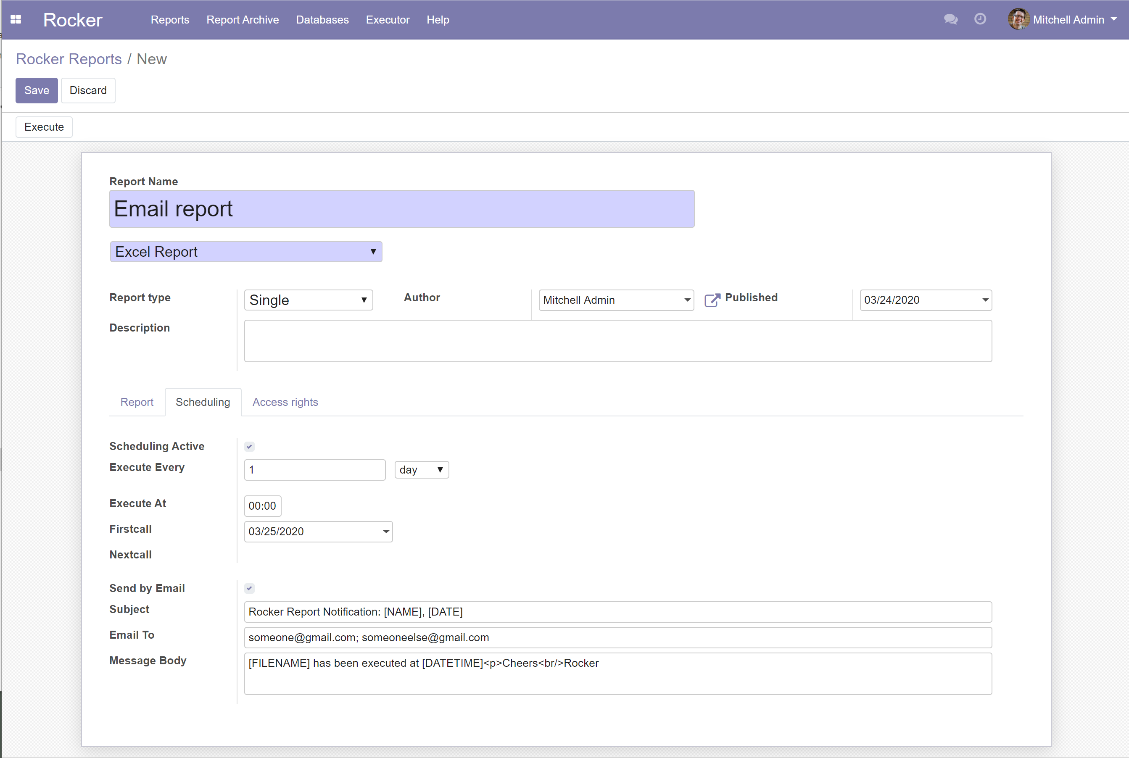
Define email for Report
Activate Scheduling
How often report is generated
Time when it runs
First start
Nextcall: when it runs next time (updated by executor)
Activate Send by Email
Add subject
Add email addresses
Add message
Special tags for Subject & Message body:
[NAME] = Report name
[DATE] = date executed
[FILENAME] = Report filename e.g. reports.xlsx
[DATETIME] = current datetime
Tags must be UPPERCASE

Slide 5
Define Execute At for Report
Note: Execute at
If interval is every minute, then only minutes taken from Execute at for Nextcall
If interval is hour, then only minutes taken from Execute at for Nextcall
If interval is day or month, then hour & minutes taken from Execute at for Nextcall
(this is because we don’t want execution time to flush day by day)

Slide 6
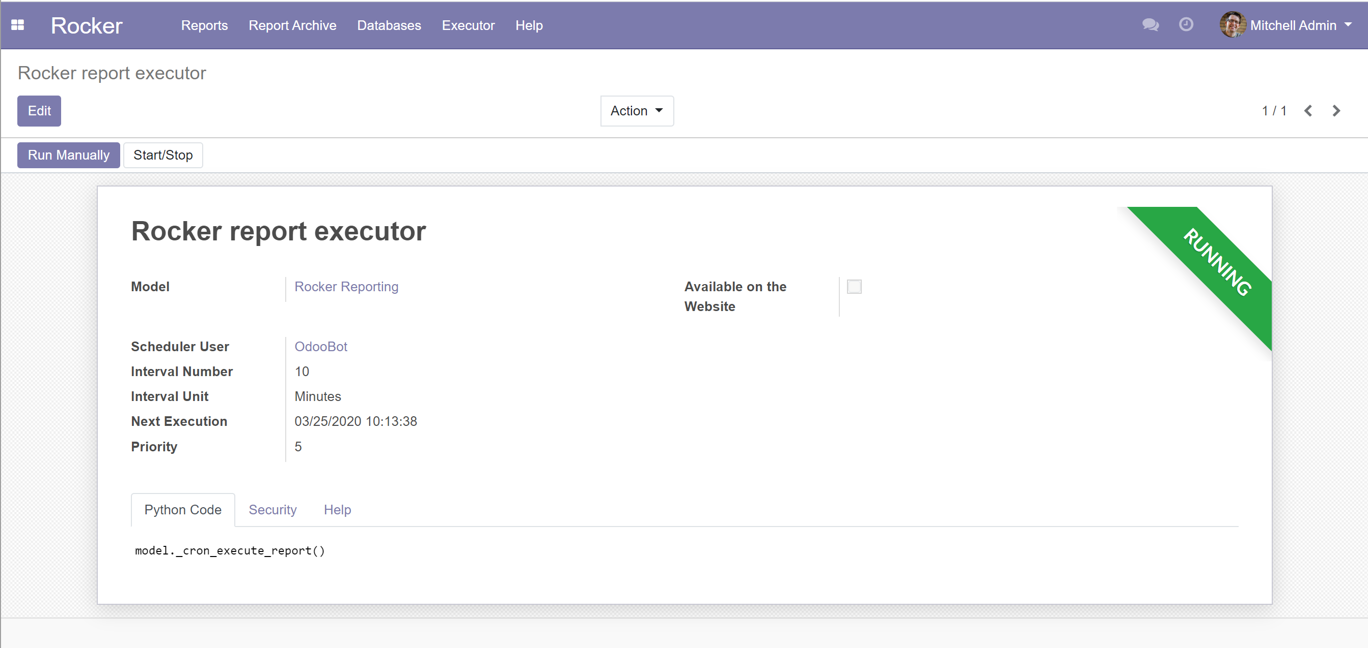
Activate Executor (= Odoo Cron job)
Note: If job runs every 10 mins, then you can’t execute reports every minute
You can test email, execute Run Manually

Slide 7
Email example
Advice users to save excel to their own disk before opening

