Slide 1
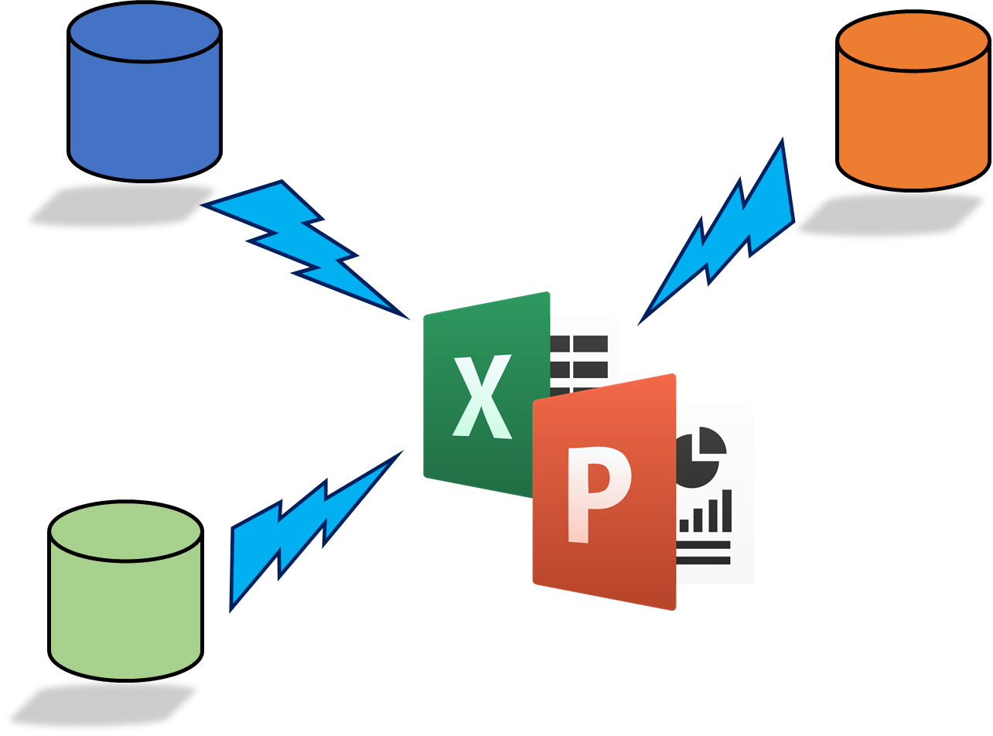
Rocker Reporting v3
Installation Guide

Slide 2

Install Odoo 12 or Odoo 13 or Odoo 14 Linux / Unix & Windows platforms are all OK
Download from
https://www.odoo.com/page/download
https://computingforgeeks.com/how-to-install-odoo-on-ubuntu-linux/
Didn’t install nginx
Had to create:
odoo@odoo:/var/lib$ sudo mkdir odoo
/var/log/odoo/odoo-server.log
/etc/odoo/odoo.conf
/usr/lib/python3/dist-packages/odoo/addons
sudo service odoo restar

Slide 3
Install some Python packages
UBUNTU
sudo apt install python3-pip
sudo pip3 install openpyxl
sudo pip3 install pandas
sudo pip3 install python-pptx
Install needed database drivers
By default Odoo’s postgresql database drivers exist
You just need to create reporting user
openpyxl version 3.0.6 (2021-01-14)

Slide 4
Windows platform
"C:\Odoo15\python\python" "C:\Odoo15\python\Scripts\pip.exe" install openpyxl
>"C:\Odoo15\python\python" "C:\Odoo15\python\Scripts\pip.exe" install pandas
"C:\Odoo15\python\python" "C:\Odoo15\python\Scripts\pip.exe" install python-pptx

Slide 5
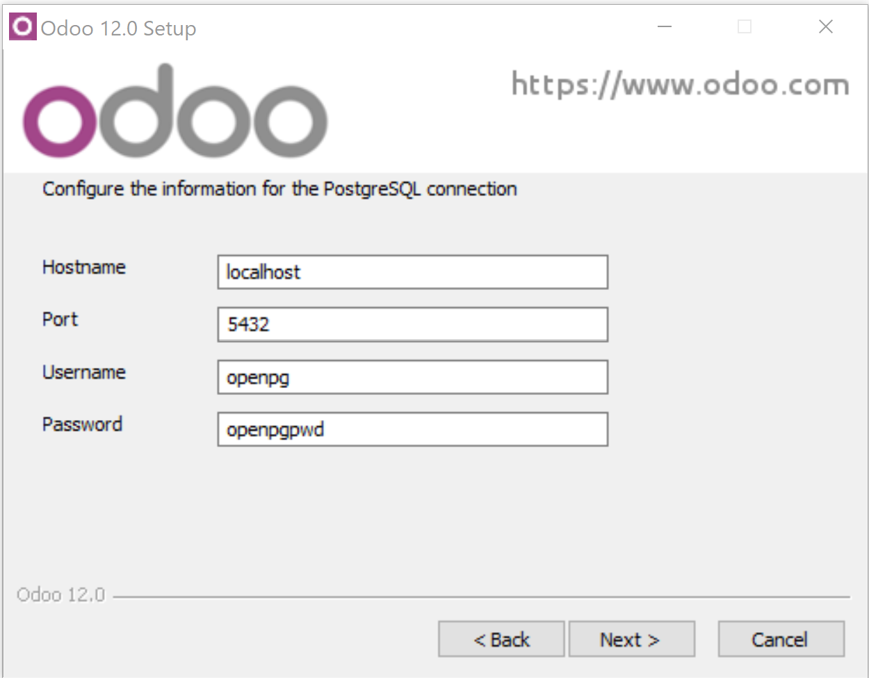
Install Odoo for Windows
Windows example
Download from
https://www.odoo.com/page/download
I used Windows 10 Pro
NOTE:
There is also a special version of Rocker Reporting for Windows. It uses win32api and therefore can not be used on Linux platform. But it runs real Excel and supports all excel functionalities like PowerPivot. Look from Odoo Apps

Slide 6
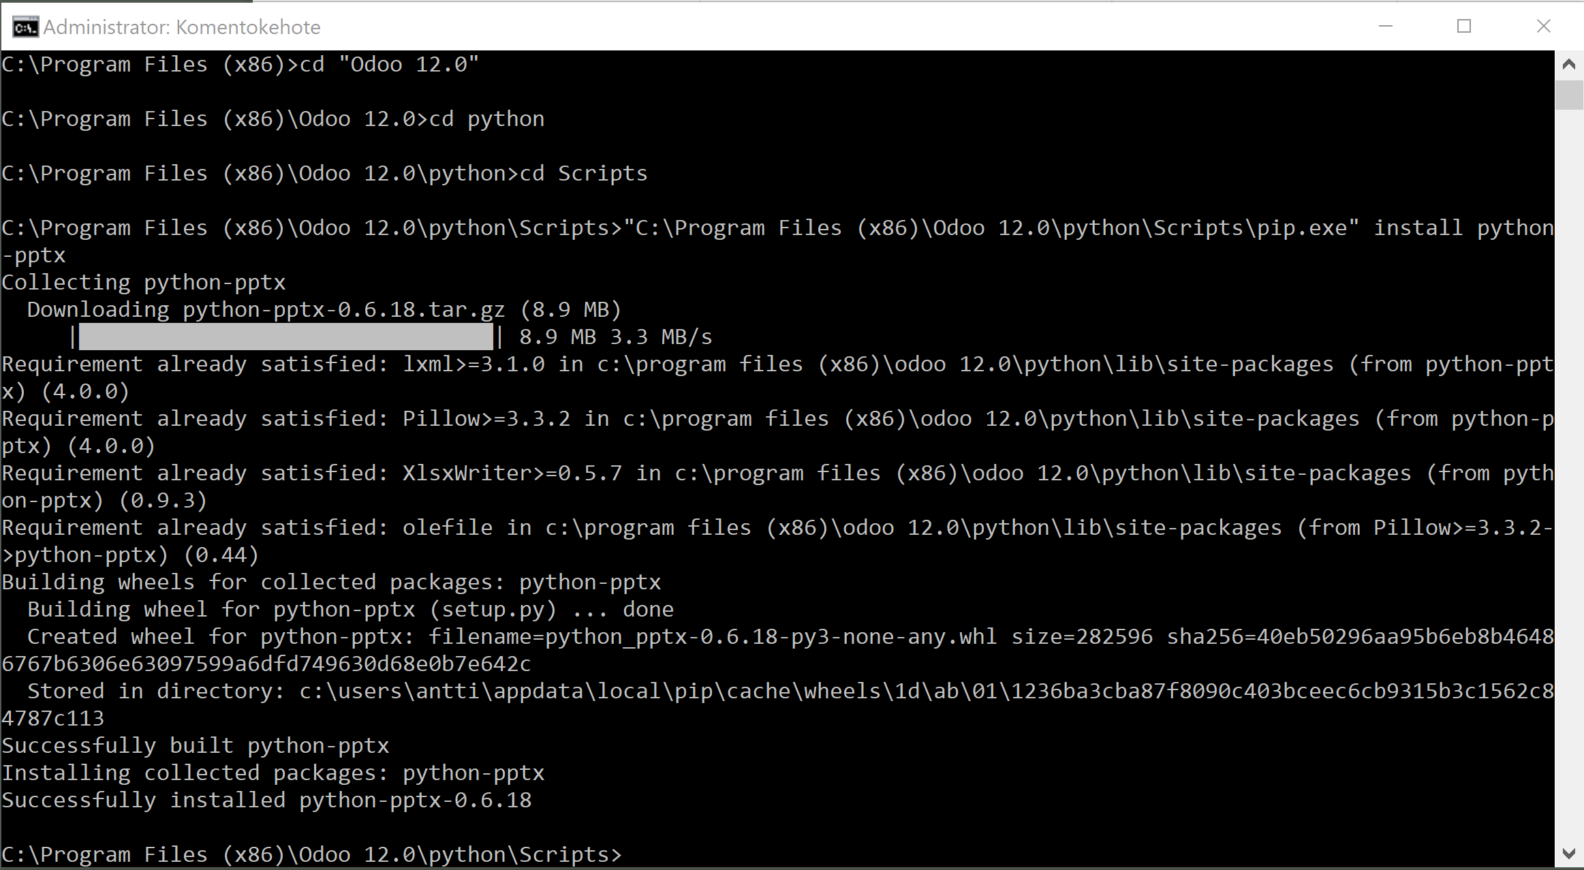
PowerPoints: Install python-pptx
Windows example
Start CMD with Administrator rights
Execute:
"C:\Program Files (x86)\Odoo 13.0\python\python" "C:\Program Files (x86)\Odoo 12.0\python\Scripts\pip.exe" install python-pptx
"C:\Program Files (x86)\Odoo 13.0\python\python" pip3.exe install cx-Oracle --upgrade

Slide 7
Download and install rocker_app
Windows example
Download rocker_app.zip from Odoo Apps
Check addons_path from odoo.conf
[options]
addons_path = C:\Program Files (x86)\Odoo 12.0\server\odoo\addons
Extract rocker_app.zip (to documents folder)
Copy rocker_app folder to C:\Program Files (x86)\Odoo 12.0\server\odoo\addons
Restart Odoo service
Or Odoo 13.0 / 14.0

Slide 8
Download and install rocker_app
Download rocker_app.zip from Odoo Apps
Check addons_path from odoo.conf
[options]
addons_path = C:\Program Files (x86)\Odoo 12.0\server\odoo\addons
Extract rocker_app.zip (to documents folder)
Copy rocker_app folder to C:\Program Files (x86)\Odoo 12.0\server\odoo\addons
Restart Odoo service
Or Odoo 13.0 & 14

Slide 9
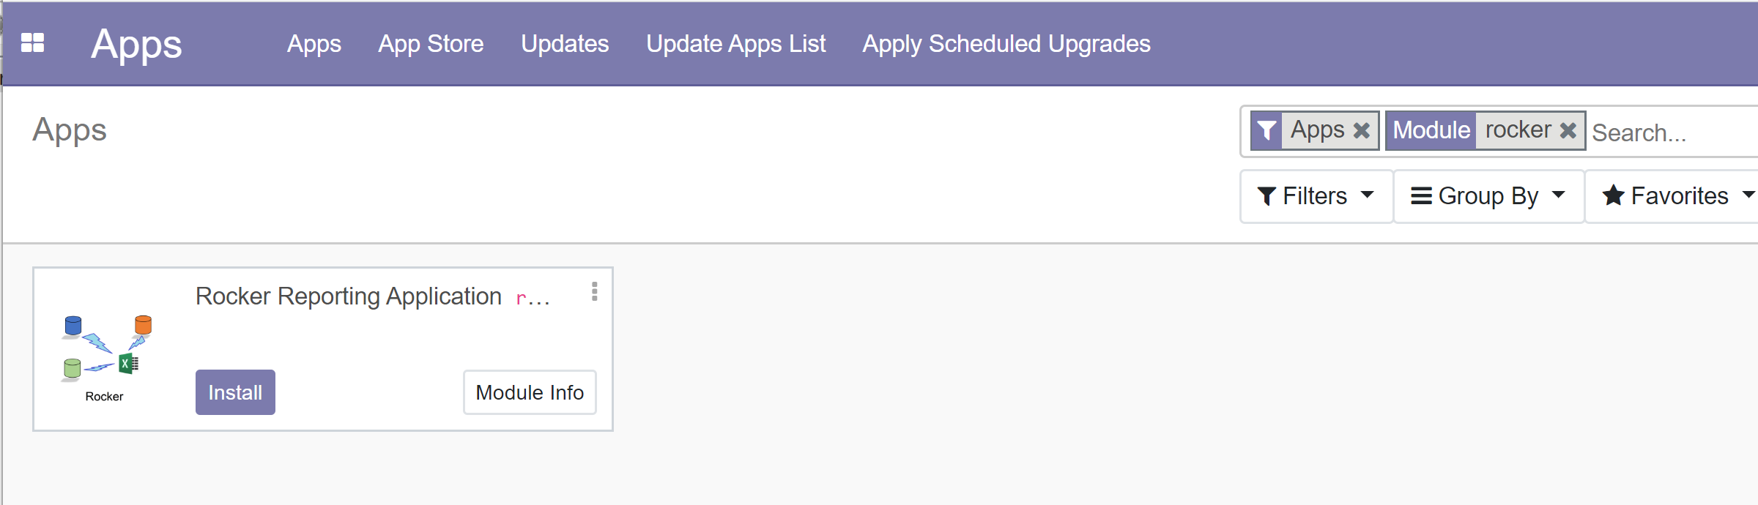
Install Rocker module
Activate developer mode
Update Apps List
Search for Rocker
Install

Slide 10
Before you can create database connection in Rocker_app you have to: Create reporting user for Odoo
sudo -u postgres createuser --login --pwprompt rocker
login with user odoo
Execute psql, then
GRANT CONNECT ON DATABASE database_name TO username;
GRANT SELECT ON ALL TABLES IN SCHEMA name TO username;
GRANT CONNECT ON DATABASE odoo TO rocker;
service odoo restart
Works in Ubuntu ☺

Slide 11
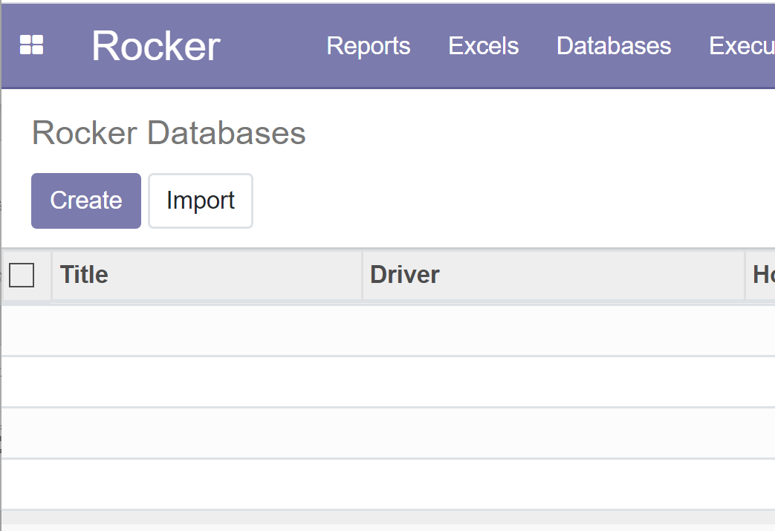
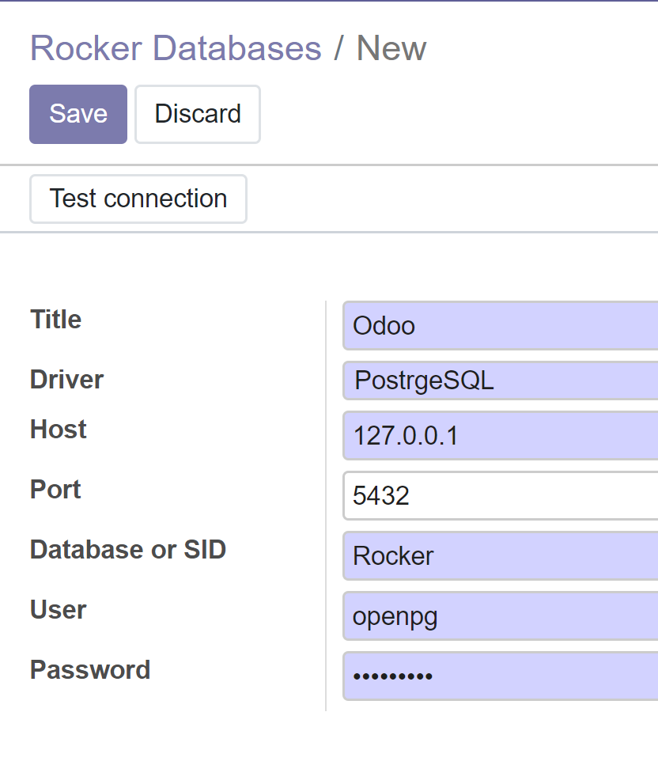
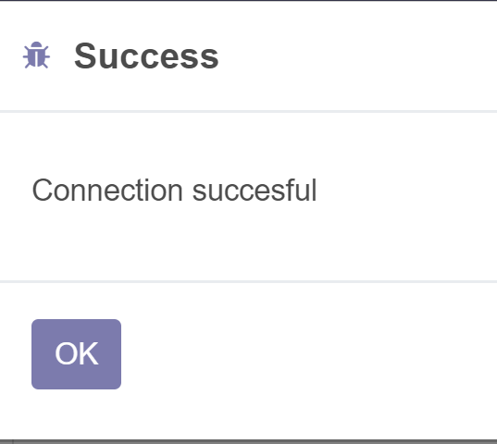
Create database / datasource for PostgreSQL ( Odoo)
Select Databases from menu
Create…
Select PostgreSQL driver, Change database name & other data when necessary
Save
Test connection

Slide 12
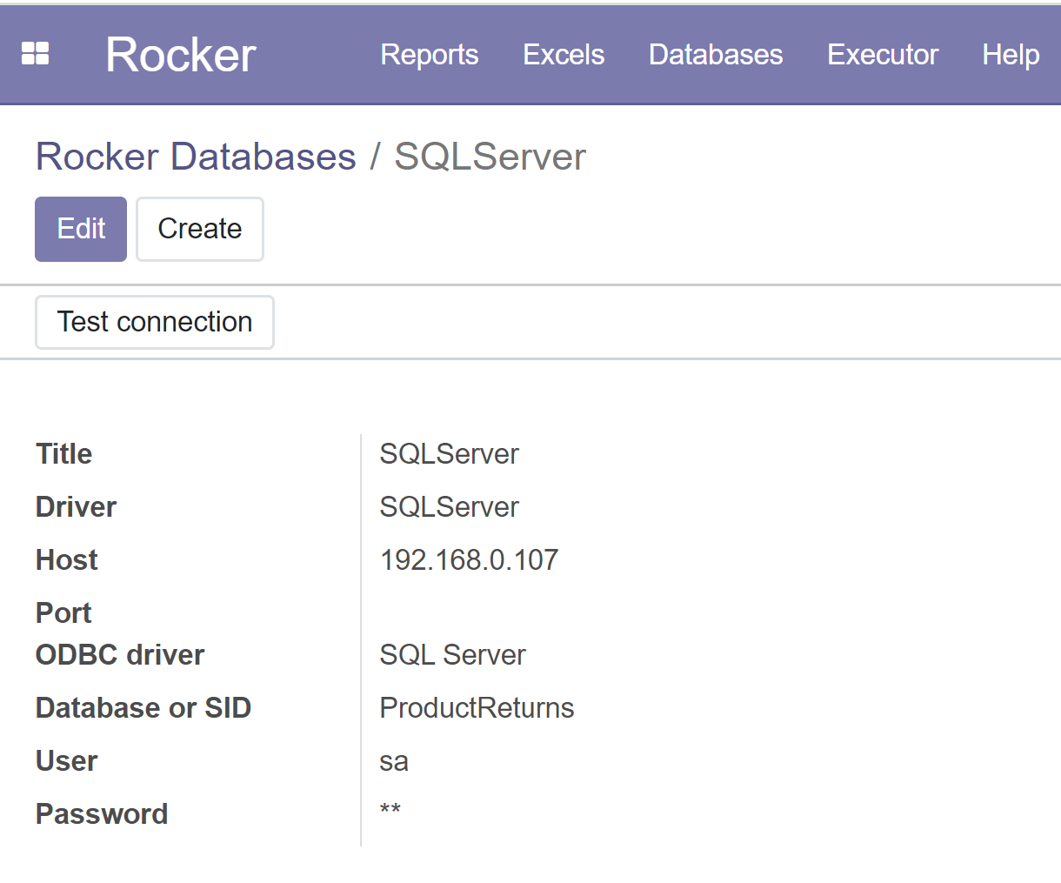
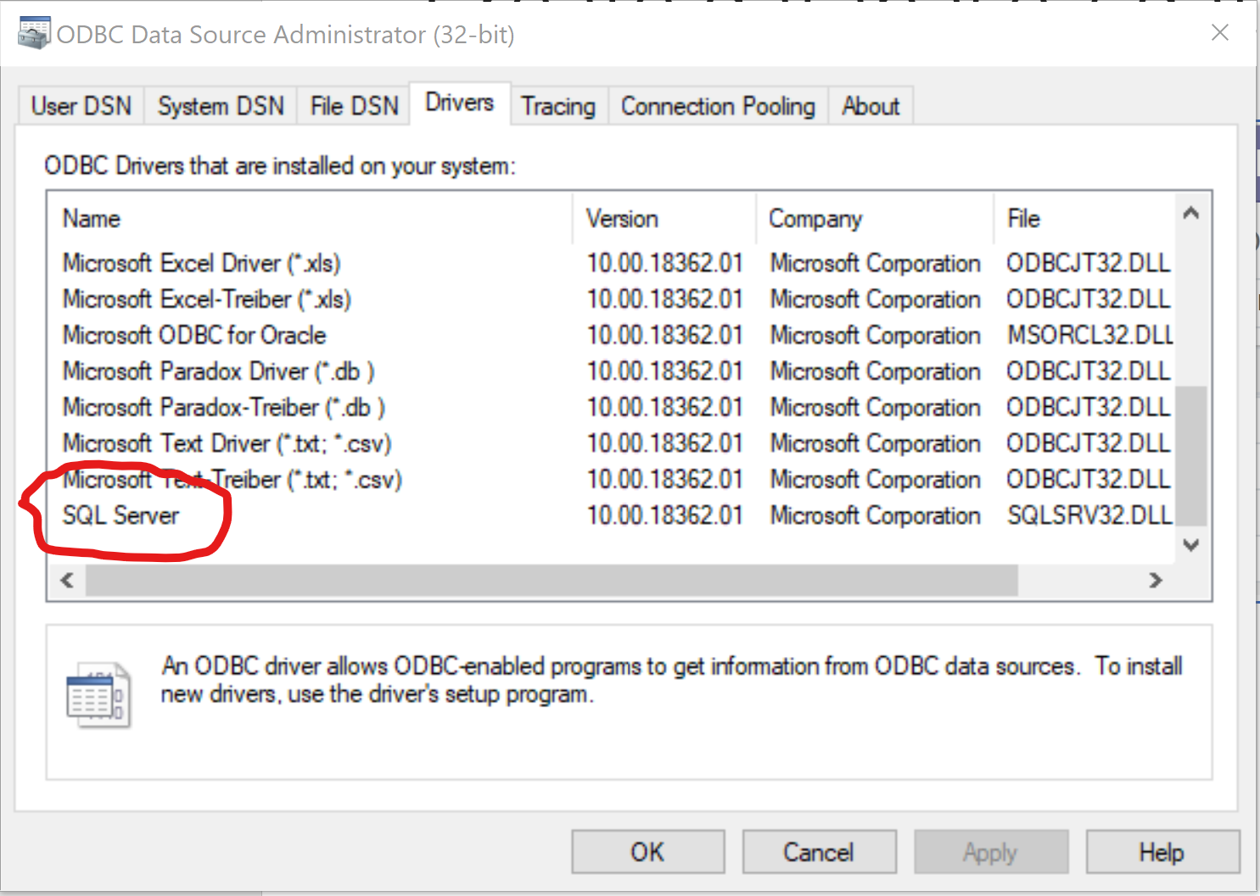
Create database / datasource for SQLServer / ODBC
Windows example
C:\Program Files (x86)\Odoo 12.0\python\Scripts>pip install pyodbc
Select Databases from menu
Create…
Select SQLServer driver, Change database name & other data when necessary
Save
Test connection

Slide 13
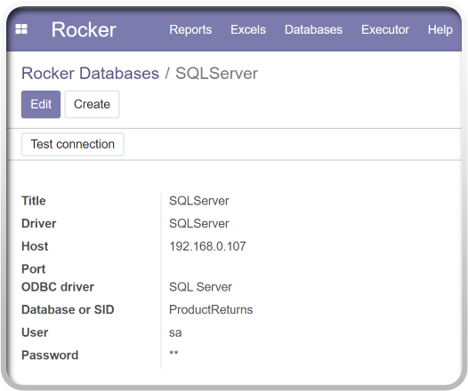
Ubuntu SQLServer / ODBC drivers
curl https://packages.microsoft.com/config/ubuntu/20.04/prod.list | sudo tee /etc/apt/sources.list.d/msprod.list
sudo apt-get update
sudo apt-get install mssql-tools unixodbc-dev
echo 'export PATH="$PATH:/opt/mssql-tools/bin"' >> ~/.bash_profile
echo 'export PATH="$PATH:/opt/mssql-tools/bin"' >> ~/.bashrc source ~/.bashrc'
sqlcmd -S localhost -U SA -P '<YourPassword>’
Test connection
sqlcmd -S 192.168.1.88 -U sa –P sapwd

Slide 14
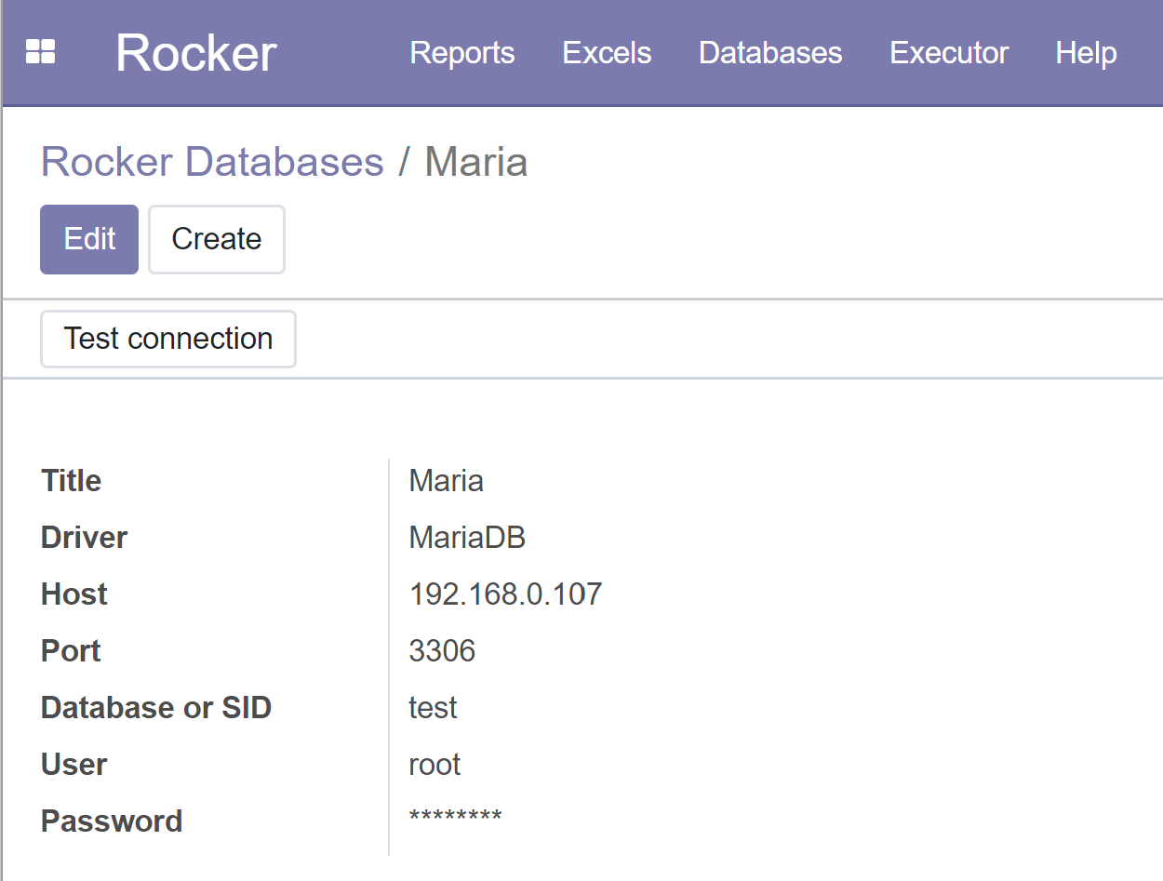
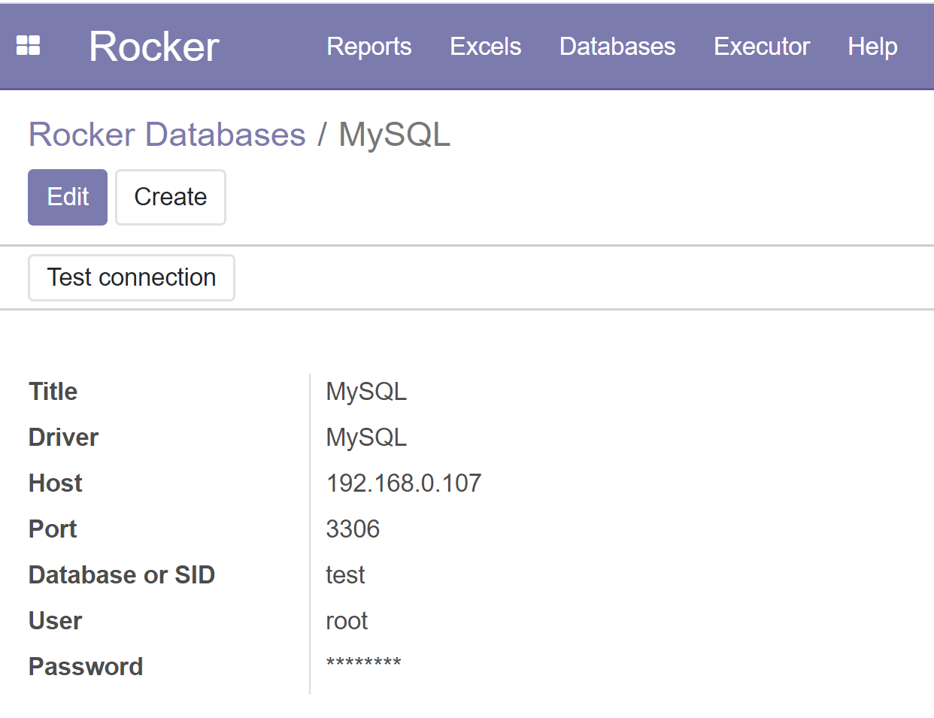
Create database / datasource for MySQL or MariaDB
Windows example
C:\Program Files (x86)\Odoo 12.0\python\Scripts> pip install mysql-connector-python
Select Databases from menu
Create…
Select MySQL or MariaDB driver, Change database name & other data when necessary
Save
Test connection

Slide 15
Ubuntu / datasource for MySQL or MariaDB
sudo apt-get update
sudo apt-get install mysql-client
pip3 install mysql-connector
Test
mysql -u root -p -h 127.0.0.1
mysql -u root -p -h 192.168.1.88
Select Databases from menu
Create…
Select MySQL or MariaDB driver, Change database name & other data when necessary
Save
Test connection

Slide 16
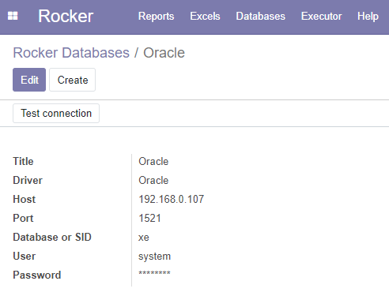
Create database / datasource for Oracle
Windows example
Download and install Oracle instant client from: https://www.oracle.com/database/technologies/instant-client/downloads.html
Extract file to e.g. C:\Oracle\instantclient_19_5
Add C:\Oracle\instantclient_19_5 to PATH (System variables side)
Install Microsoft Visual C++ Redistributable from https://support.microsoft.com/en-us/help/2977003/the-latest-supported-visual-c-downloads
I installed both 32 & 64-bit
Install python drivers
C:\Program Files (x86)\Odoo 12.0\python\Scripts> pip install cx_Oracle –upgrade
Reboot
Select Databases from menu
Create…
Select Oracle driver, Change SID & other data when necessary
Save & Test connection
https://cx-oracle.readthedocs.io/en/latest/user_guide/installation.html

Slide 17
Create database / datasource for Oracle
UBUNTU
https://gist.github.com/kimus/10012910
sudo apt-get install build-essential unzip python-dev libaio-dev
export ORACLE_HOME=/home/odoo/instantclient_21_1
cd $ORACLE_HOME
ln -s libclntsh.so.21.1 libclntsh.so #the version number on your .so file might be different
export ORACLE_HOME=/home/odoo/instantclient_21_1
export LD_LIBRARY_PATH=$LD_LIBRARY_PATH:$ORACLE_HOME
source ~/.bashrc
sudo nano /etc/ld.so.conf.d/oracle.conf
add row:
/home/odoo/instantclient_21_1
sudo ldconfig
sudo pip3 install cx_oracle
https://cx-oracle.readthedocs.io/en/latest/user_guide/installation.html

Slide 18
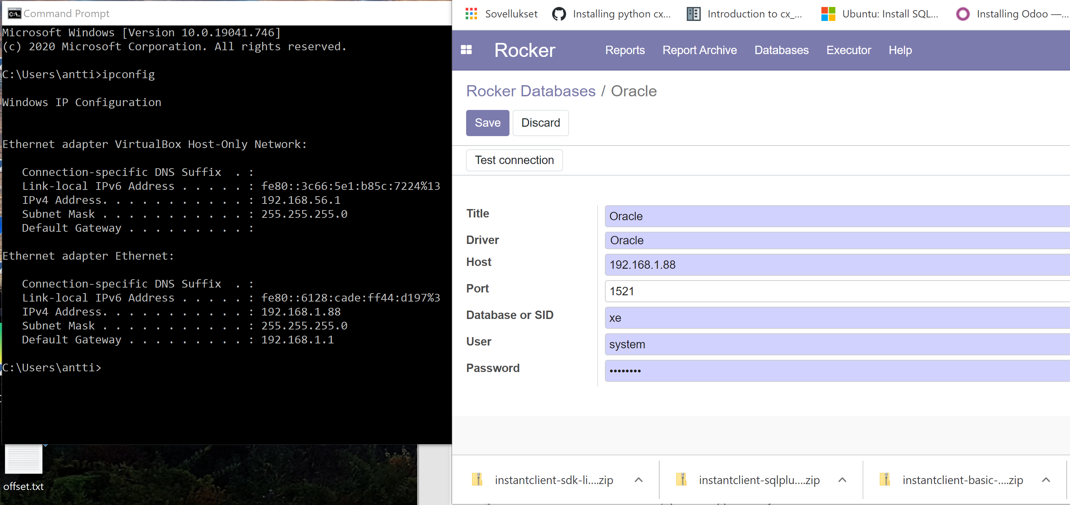
Oracle DB connection

Slide 19
Copy files
Windows example
cx_Oracle.cp37-win32.pyd
cx_Oracle-8.1.0.dist-info folder
To
C:\Program Files (x86)\Odoo 13.0\python\Lib\site-packages

Slide 20
If something goes wrong
Start Odoo in Debug mode "C:\Program Files (x86)\Odoo 12.0\python\python.exe" ./odoo-bin -c odoo.conf --log-level=debug in C:\Program Files (x86)\Odoo 12.0\server -folder
Check odoo.log from
"C:\Program Files (x86)\Odoo 12.0\server\odoo.log"

