Slide 1
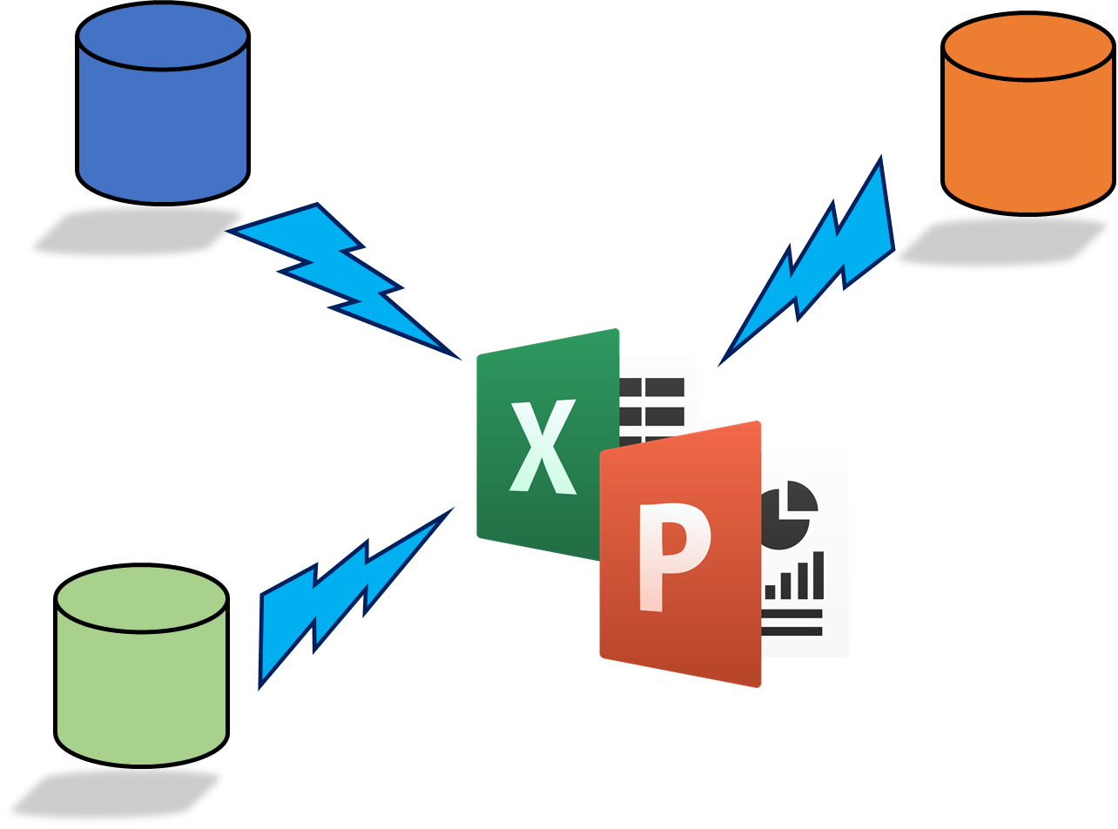
Rocker Reporting
Installation Guide
19.9.2023

Slide 2

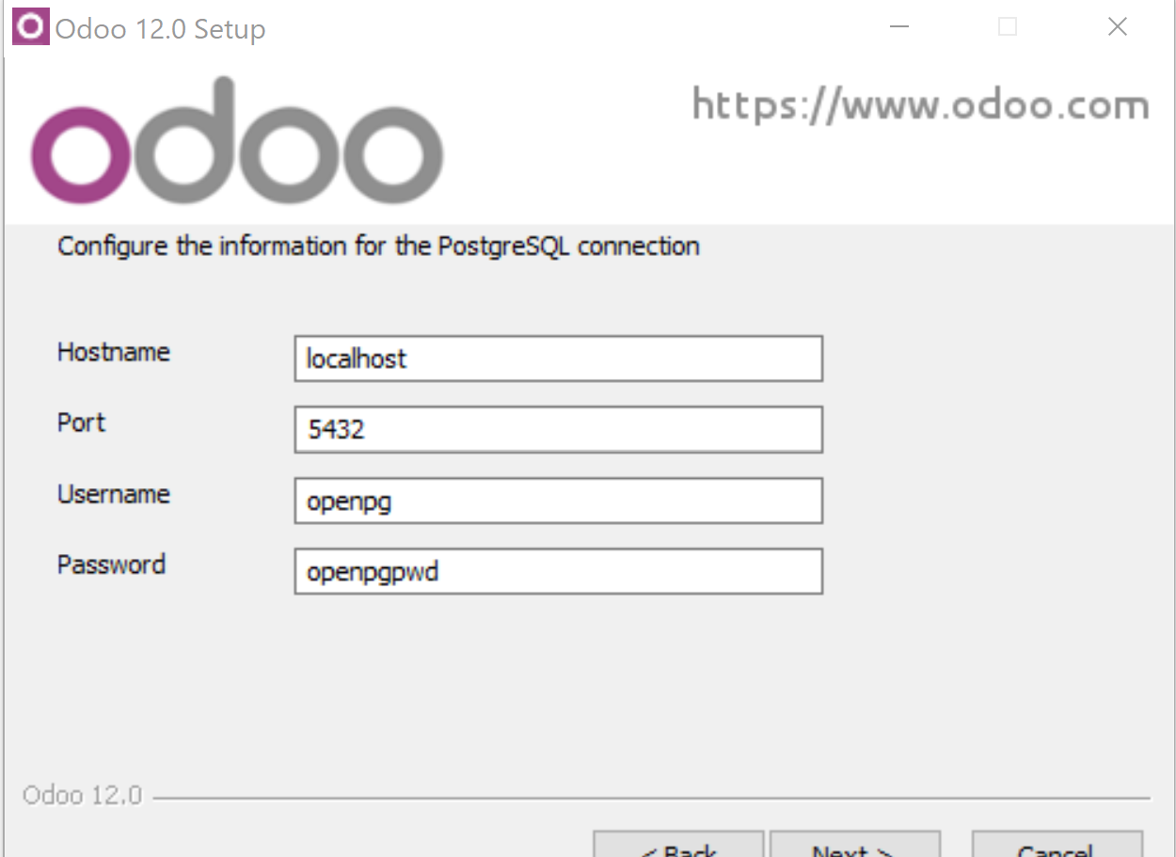
Install Odoo (12,13,14,15 or 16 or 17) for Windows
We are using Win32Com so Windows platform is required
Download from
https://www.odoo.com/page/download
I used Windows 10

Slide 3
Verify pywin32 is installed
By default win32com is installed
(Checked Odoo 12, 13 & 14, 15, 16)
Add path
Add python to path
Change to
Change to Python/Scripts folder
C:\Program Files (x86)\Odoo 12.0\python\Scripts>
Execute pip
Execute pip install pywin32
C:\Program Files (x86)\Odoo 12.0\python\Scripts>pip install pywin32
Requirement already satisfied: pywin32 in c:\program files (x86)\odoo 12.0\python\lib\site-packages (227)
(Note: start cmd in admin mode)

Slide 4
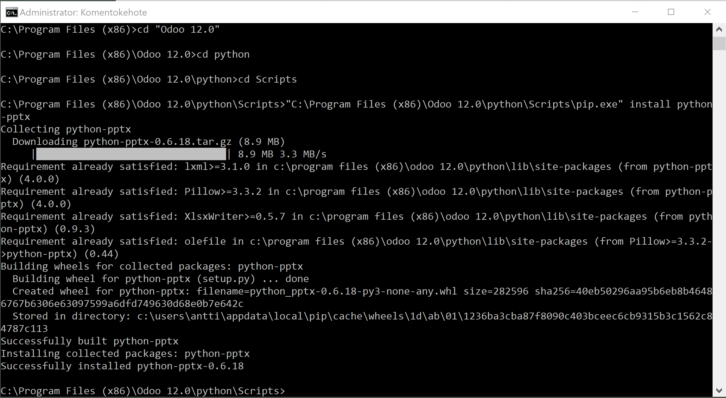
PowerPoints: Install python-pptx
Start CMD with Administrator rights
Execute (Odoo 13 example):
"C:\Program Files (x86)\Odoo 13.0\python\python" "C:\Program Files (x86)\Odoo 13.0\python\Scripts\pip.exe" install python-pptx
Or just “pip install python-pptx” if your python is in path
"C:\Odoo17\python\python" "C:\Odoo17\python\Scripts\pip.exe" install python-pptx

Slide 5
Download and install rocker_app
Download rocker_app.zip from Odoo Apps
Check addons_path from odoo.conf
[options]
addons_path = C:\Program Files (x86)\Odoo 12.0\server\odoo\addons
Extract rocker_app.zip (to documents folder)
Copy rocker_app folder to C:\Program Files (x86)\Odoo 12.0\server\odoo\addons
Restart Odoo service
Or Odoo 13.0

Slide 6
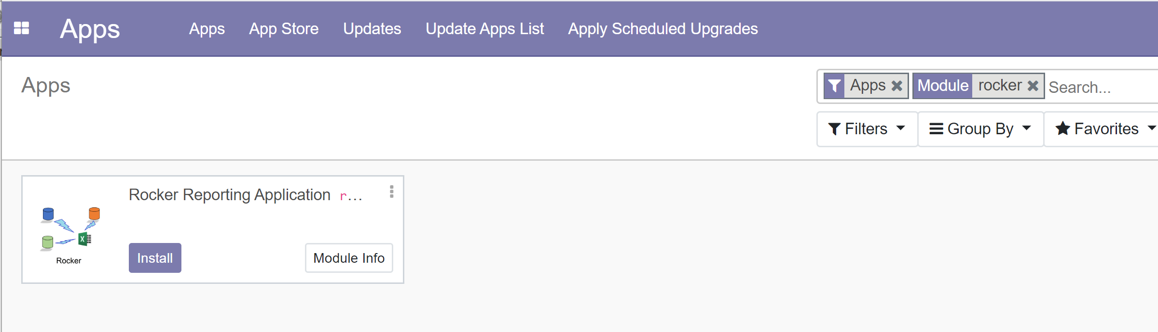
Install Rocker module
Activate developer mode
Update Apps List
Search for Rocker
Install

Slide 7
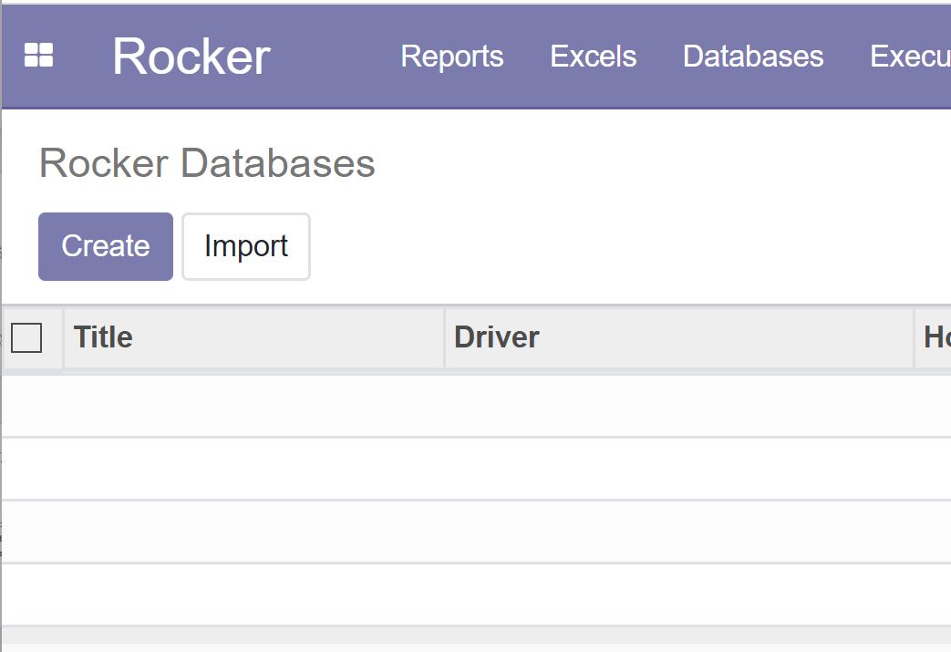
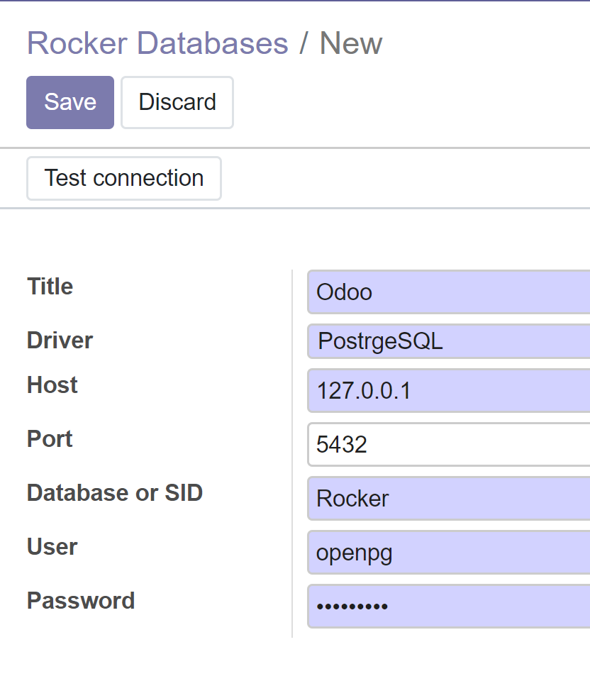
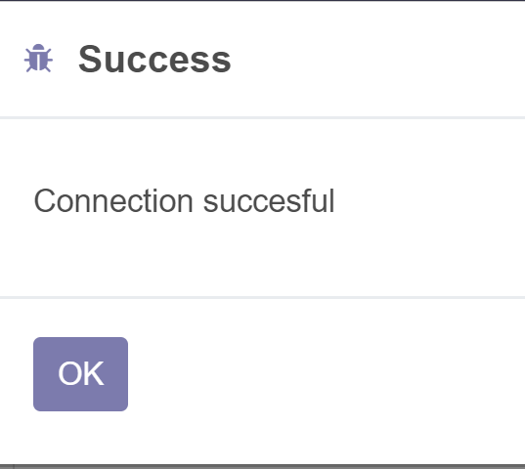
Create database / datasource for PostgreSQL ( Odoo)
Select Databases from menu
Create…
Select PostgreSQL driver, Change database name & other data when necessary
Save
Test connection

Slide 8
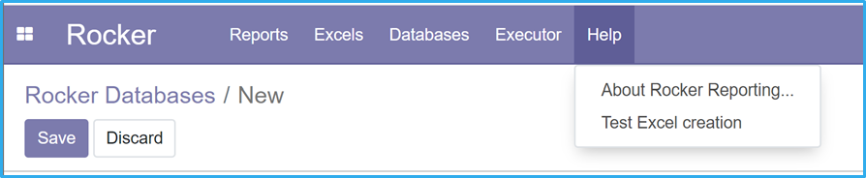
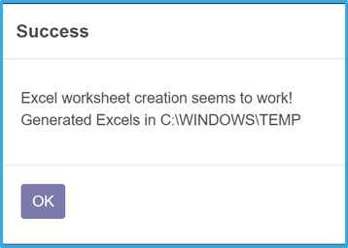
Test Excel functionality
Pre-reqs: Excel 32-bit installed on server
If not working you should:
Create folder C:\Windows\SysWOW64\config\systemprofile\Desktop ( or C:\Windows\System32\config\systemprofile\Desktop if 32-bit windows)
Reboot after folder creation, check access rights
If you don’t do this, you’ll get exception from Workbook.SaveAs or Open command
Execute “Test Excel creation” from Help menu
32 bit Excel needed, otherwise win32api can not call Excel from Odoo service
If you only have 64 bit Excel, then you have to start Odoo from command prompt (does not work if Odoo runs as a service). (Check something goes wrong slide)
At the moment (15.2.2021) we have a problem starting Excel if Odoon runs as a service Start Odoo from command prompt (see next slide)
See next slide how to get rid of errors

Slide 9
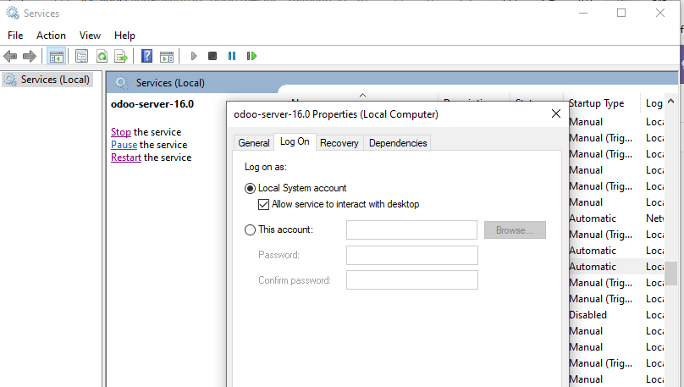
Excel error 1: Change Odoo service properties Also for Odoo 17
Very Important!!!

Slide 10
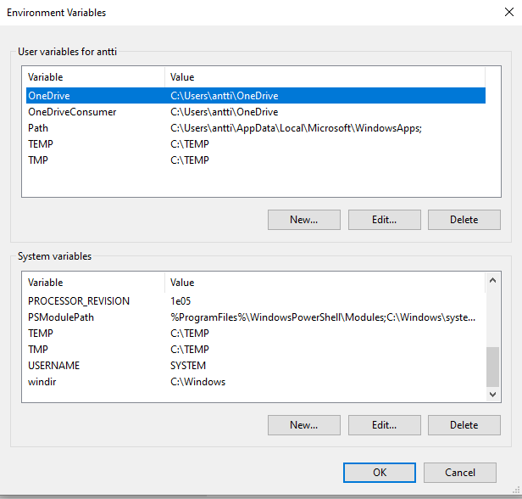
Excel errors 2: Change environment variables. TEMP to C:\TEMP Give full access rights to Everyone to C:/TEMP

Slide 11
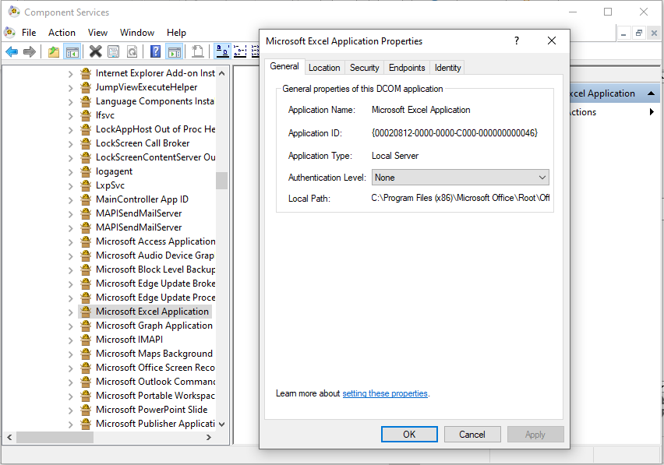
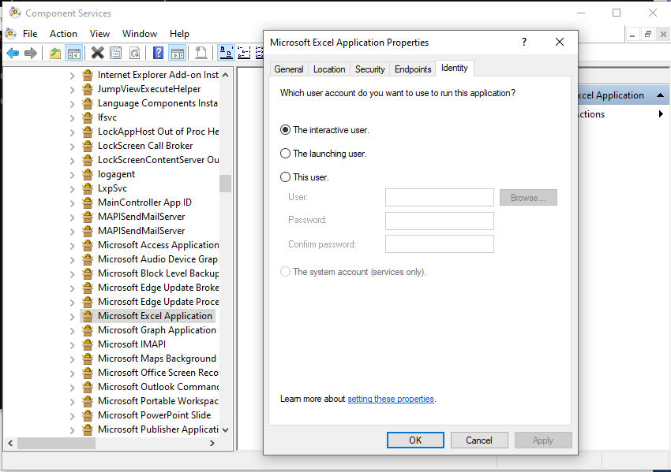
Excel errors 3: mmc.exe comexp.msc /32
Maybe not needed
Run CMD with Admin rights
Execute mmc.exe comexp.msc /32
Find Microsot Excel Application from: Component services, Computers, My Computer, DCOM Config, Microsoft Excel Application
Change properties: General & Identity
Authentication Level: None
Identity set Interactive user

Slide 12
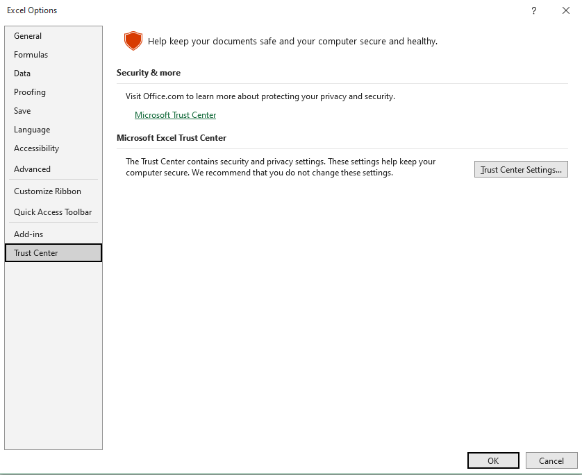
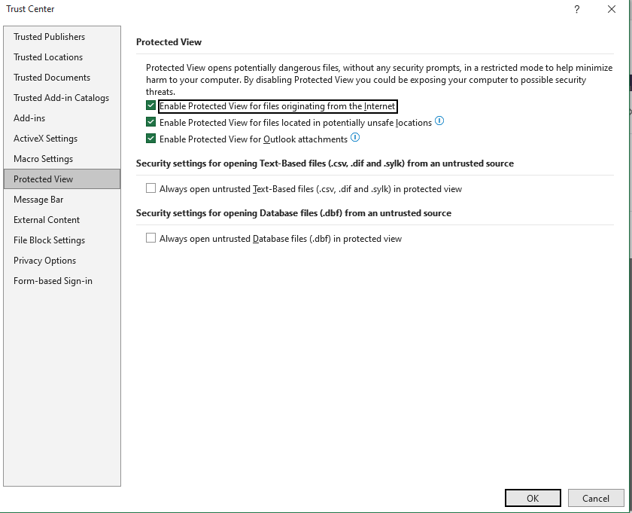
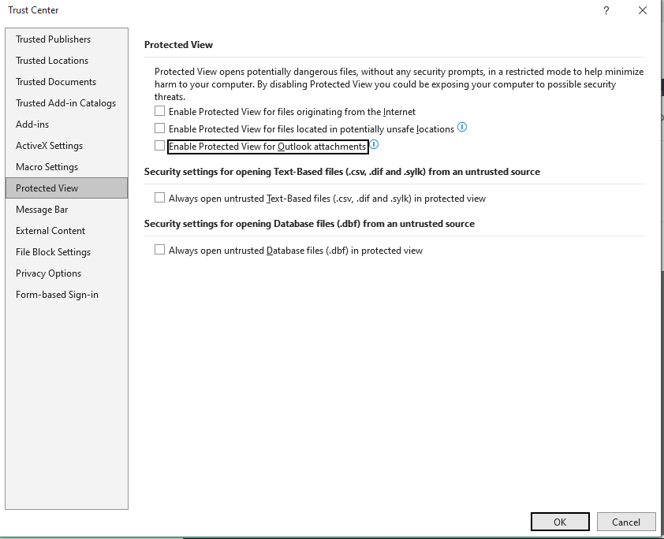
Excel error 4: Change Excel Trust Center settings
Maybe not needed
File, Options, Trust Center, Trust Center Settings,
Protected View: uncheck all

Slide 13
Or Start Odoo from command prompt (cmd)
"C:\Program Files (x86)\Odoo 13.0\python\python.exe" "C:\Program Files (x86)\Odoo 13.0\server\odoo-bin" -c "C:\Program Files (x86)\Odoo 13.0\server\odoo.conf" --log-level=debug
"C:\Program Files (x86)\Odoo 12.0\python\python.exe" "C:\Program Files (x86)\Odoo 12.0\server\odoo-bin" -c "C:\Program Files (x86)\Odoo 12.0\server\odoo.conf" --log-level=debug
"C:\Odoo14\python\python.exe" "C:\Odoo14\server\odoo-bin" -c "C:\Odoo14\server\odoo.conf" --log-level=debug
When everything runs smootly, change logger_level to “info”

Slide 14
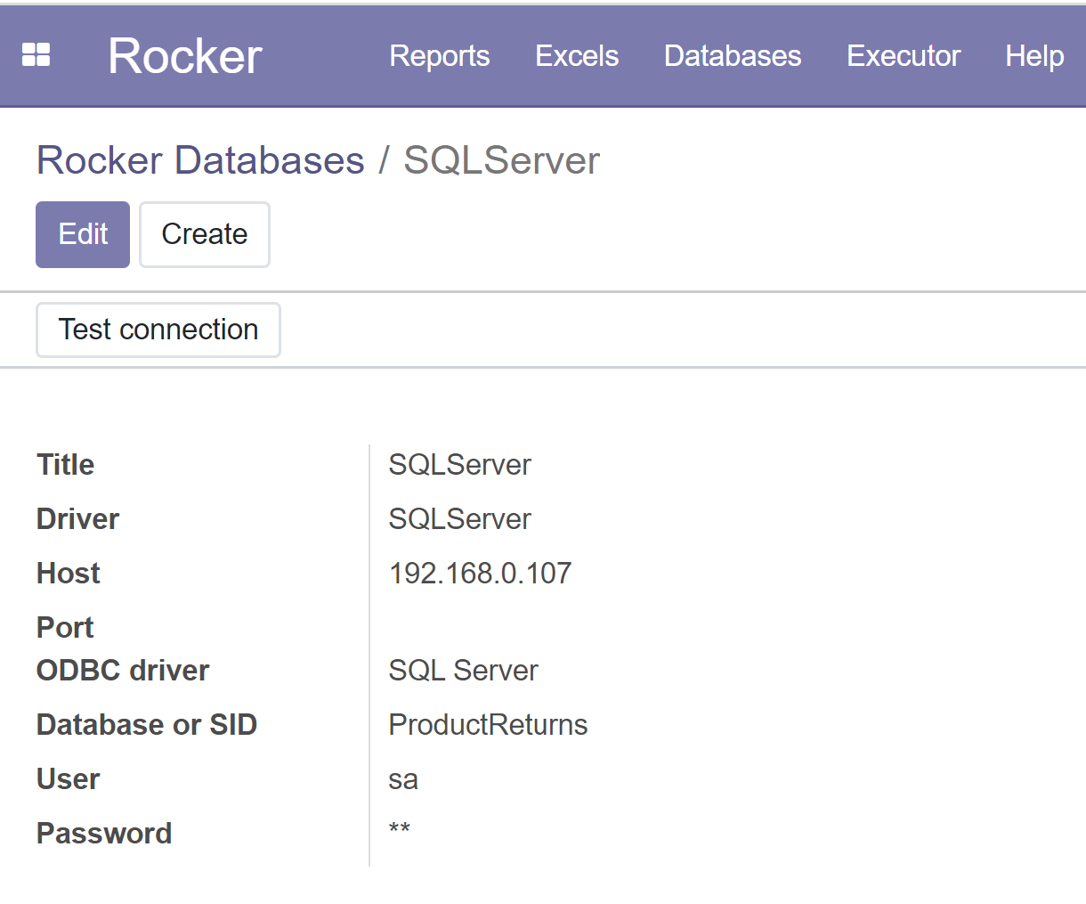
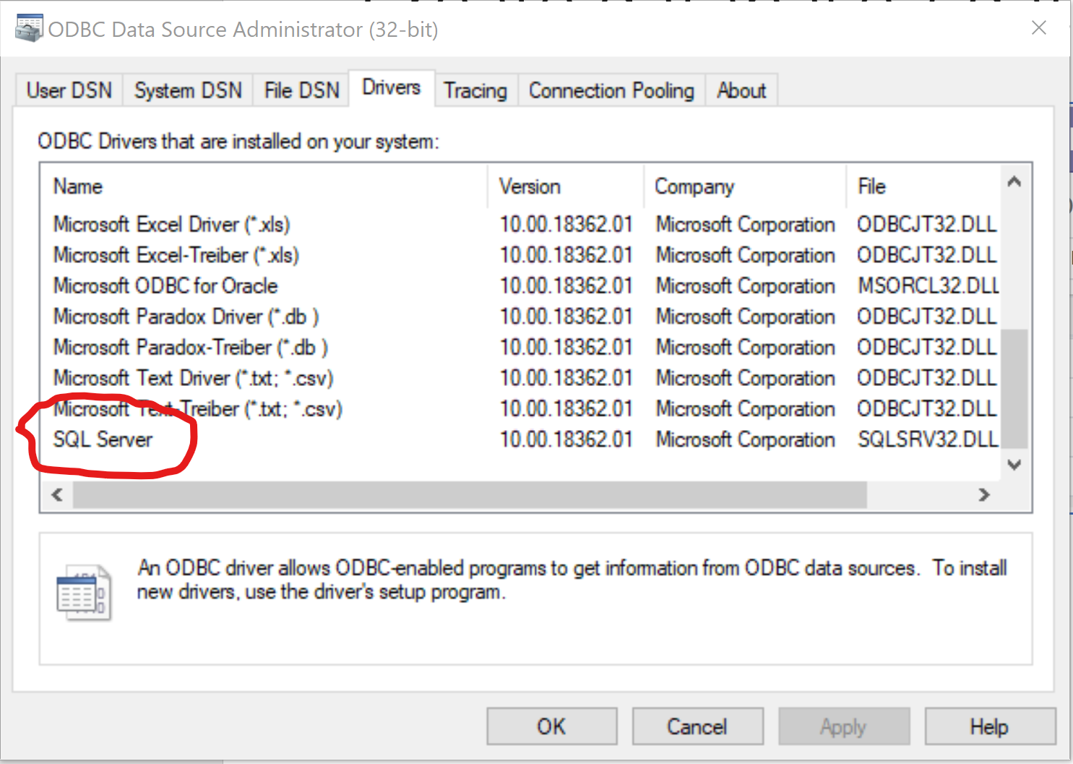
Create database / datasource for SQLServer / ODBC
C:\Program Files (x86)\Odoo 12.0\python\Scripts>pip install pyodbc
Select Databases from menu
Create…
Select SQLServer driver, Change database name & other data when necessary
Save
Test connection

Slide 15
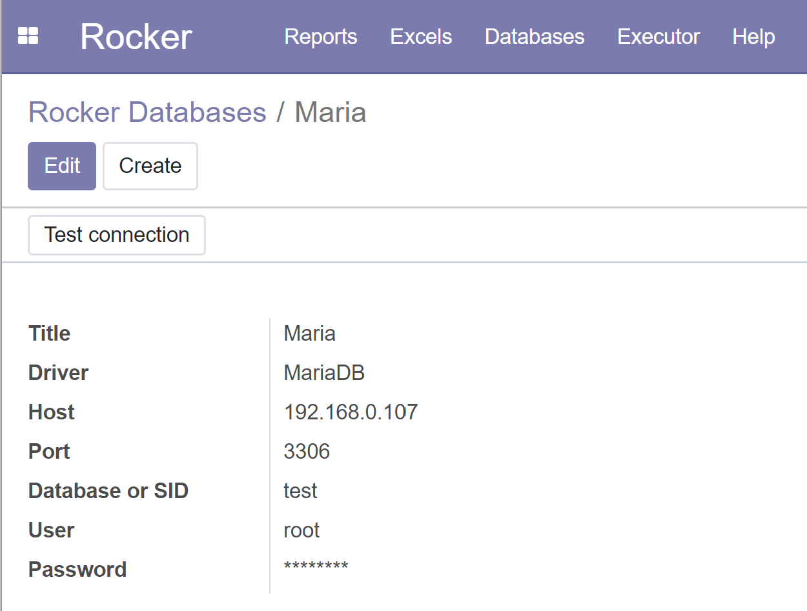
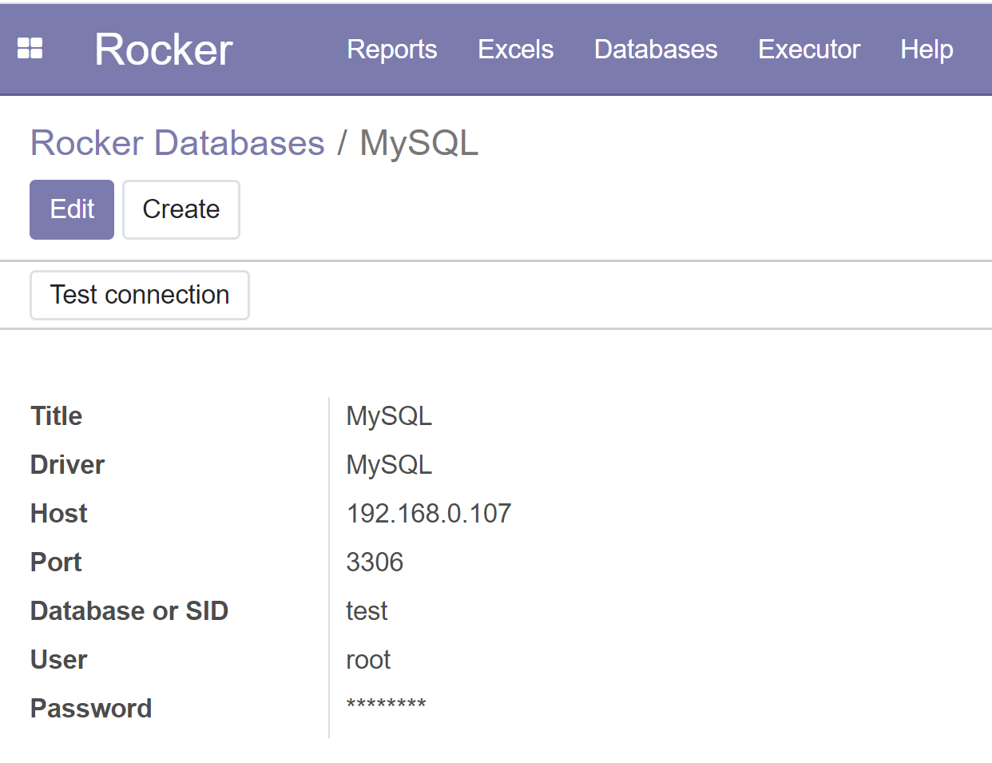
Create database / datasource for MySQL or MariaDB
C:\Program Files (x86)\Odoo 12.0\python\Scripts> pip install mysql-connector-python
Select Databases from menu
Create…
Select MySQL or MariaDB driver, Change database name & other data when necessary
Save
Test connection

Slide 16
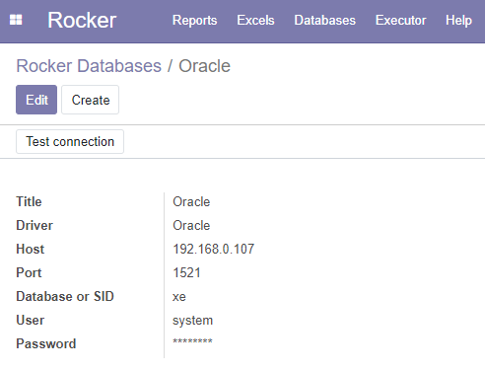
Create database / datasource for Oracle
Download and install Oracle instant client from: https://www.oracle.com/database/technologies/instant-client/downloads.html
Extract file to e.g. C:\Oracle\instantclient_19_5
Add C:\Oracle\instantclient_19_5 to PATH (System variables side)
Install Microsoft Visual C++ Redistributable from https://support.microsoft.com/en-us/help/2977003/the-latest-supported-visual-c-downloads
I installed both 32 & 64-bit
Install python drivers
C:\Program Files (x86)\Odoo 12.0\python\Scripts> pip install cx_Oracle –upgrade
Reboot
Select Databases from menu
Create…
Select Oracle driver, Change SID & other data when necessary
Save & Test connection
https://cx-oracle.readthedocs.io/en/latest/user_guide/installation.html

