Slide 1

2022-23 Final Budget Amendment and 2023-24 Proposed Budget
Presentation
June 13, 2023
Notes:
Frequently, presenters must deliver material of a technical nature to an audience unfamiliar with the topic or vocabulary. The material may be complex or heavy with detail. To present technical material effectively, use the following guidelines from Dale Carnegie Training®.
Consider the amount of time available and prepare to organize your material. Narrow your topic. Divide your presentation into clear segments. Follow a logical progression. Maintain your focus throughout. Close the presentation with a summary, repetition of the key steps, or a logical conclusion.
Keep your audience in mind at all times. For example, be sure data is clear and information is relevant. Keep the level of detail and vocabulary appropriate for the audience. Use visuals to support key points or steps. Keep alert to the needs of your listeners, and you will have a more receptive audience.

Slide 2

Truth In Taxation / Establishment of Millage Rates

Slide 3

8.35% Increase

Slide 7
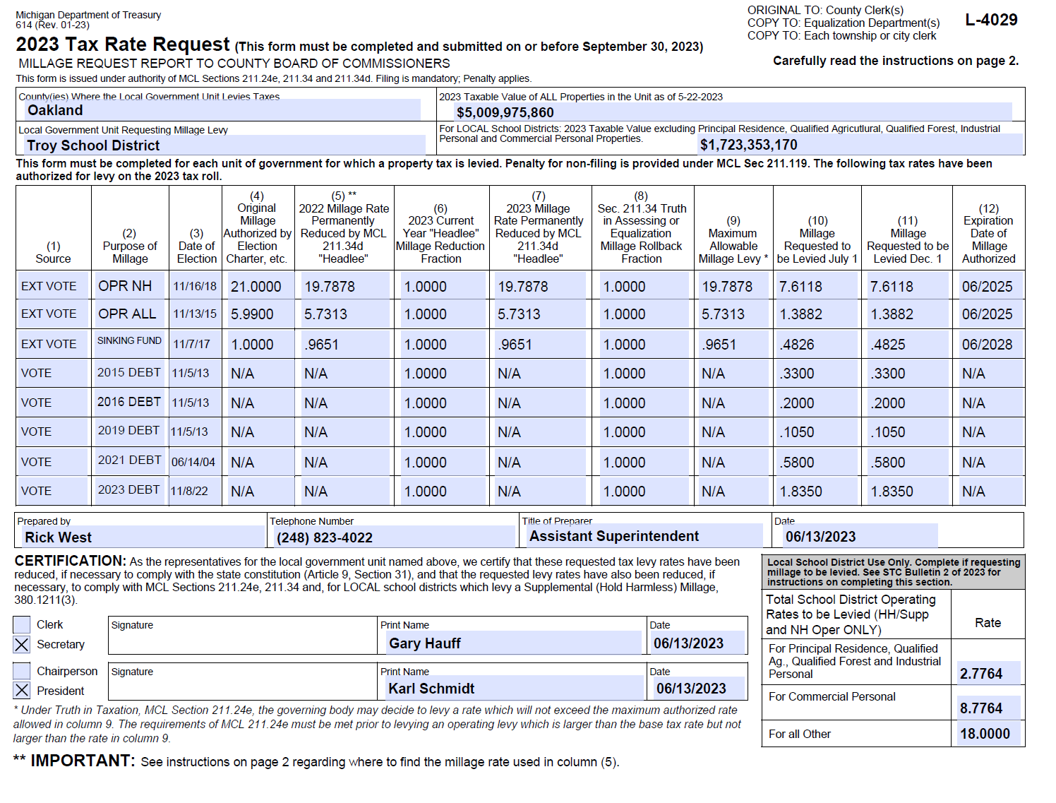
L-4029

Slide 8

General Fund

Slide 9
2022-23 General Fund Budget Adjustments
Federal Source Revenue:
98c Learning Loss grant
Benefits:
State Source Revenue:
147c2 MPSERS one-time deposit
Interdistrict Source Revenue:
VLAC reimbursement
IA cost-sharing agreement
Purchased Services
Student support aides
Title III | 41 Bilingual grants
Operations
SE Transportation
Adjusted for 147c2 retirement revenue increase

Slide 11
2023-24 General Fund Assumptions
Local Source Revenue:
State Source Revenue:
Enrollment Projection: 12,229 (-123)
Foundation Allowance: $458 per pupil (Governor’s budget)
Federal Source Revenue:
Salaries:
Benefits:
Retirement: Effective rate increase from 28.23% to 31.34%
Purchased Services:
Adjusted to reflect contractual obligations
Supplies:
Debt Service:
State Source Revenue:
Increases to Special Education formula, At-Risk and 147a Retirement revenue
Adjusted to reflect contractual obligations and known FTE adjustments
Health Insurance: 2.0% increase in PA 152 hard cap rate effective January 1, 2023
Adjusted to meet program needs
Includes the 2023-24 obligation
for TLC debt
Property tax revenue adjusted to reflect increasing property values
$3.5 million ESSER Equalization (11t) included (final year)

Slide 13

So What? Now What?
Federal Funding
Enrollment
Structural Budget
Staff Alignment
Strategic use of Fund Balance

Slide 19
COVID Stimulus Funds

Slide 20
Ancillary Funds

Slide 21
Capital Projects Funds
Capital Projects Bond Funds
Accounts for the bond proceeds, investment earnings and expenses associated with the District’s bond projects.
Capital Maintenance Fund
Accounts for expenses associated with the District’s unrestricted capital maintenance projects.
Sinking Fund
Accounts for the revenue and expenses associated with the District’s sinking fund millage.

Slide 26
Special Revenue Funds
Food Service Fund
Accounts for revenue and expenses associated with the District’s food service program.
Community Service Fund
Accounts for revenue and expenses associated with the District’s fee for service programs, including CARE company and community recreation .
Troy Preschool Fund
Accounts for the revenue and expenses associated with the operation of the Troy School District Preschool program.
Troy School and Student Activities Fund
Accounts for the transactions of student groups for school and school-related purposes.
TCC Grant Fund
Accounts for the revenue and expenses associated with operations of the Troy Career Center (Michigan Works! Troy)

Slide 32


