Slide 1

Student Assessment Data
Board Workshop
November 2023

Slide 2

Reviewing Consistent Measures Over Time
Standardized Assessment Data:
SAT Suite of Assessments
Scholastic Aptitude Test (SAT 11)
PSAT 8
MSTEP 3-7
Instructional/Benchmarking Data:
Fountas & Pinnell (ELA K-5)
Common Lit (ELA 6-12)
NWEA – Math (6-Alg1)
Exit Data:
Advanced Placement Assessments
Graduation Rate

Slide 3
SAT 11
Why SAT 11?
National norm-referenced assessment
Consistent content & structure overtime (unlike MSTEP/MEAP variance)
Leading collegiate admissions assessments
Suite of assessments with linkages from grade 8-11
What does it show us?
Programmatic impact overtime
Comparison data state/county/school/student group
Transparency in our work ahead

Slide 4
SAT Grade 11

Slide 5
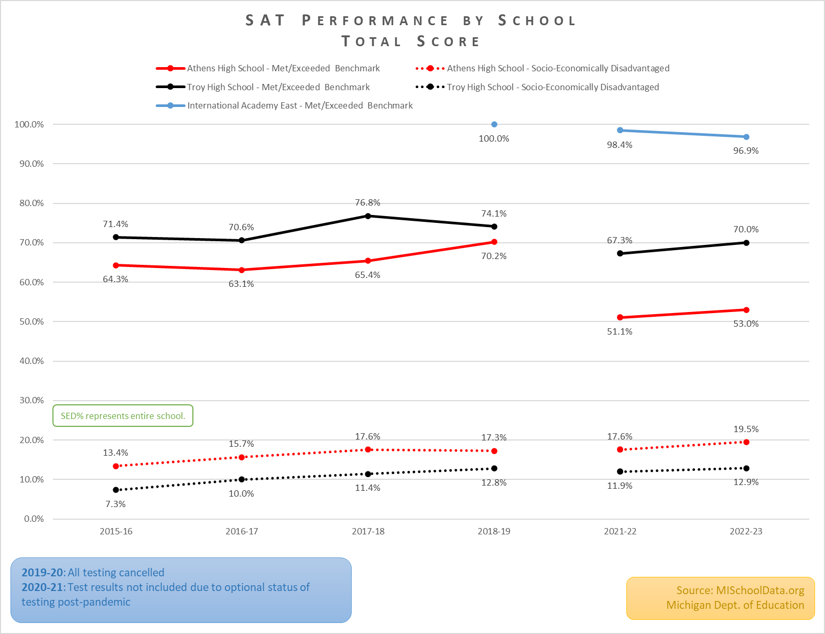
Represents % SED by Building

Slide 6
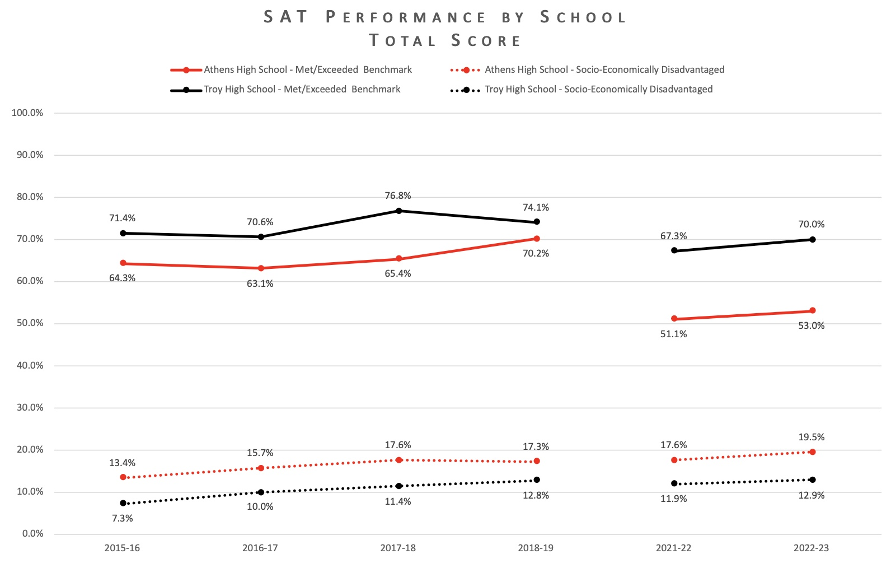
Represents % SED by Building
Notes:
Informing our work around ELA at the high school level
Common Lit Data

Slide 7
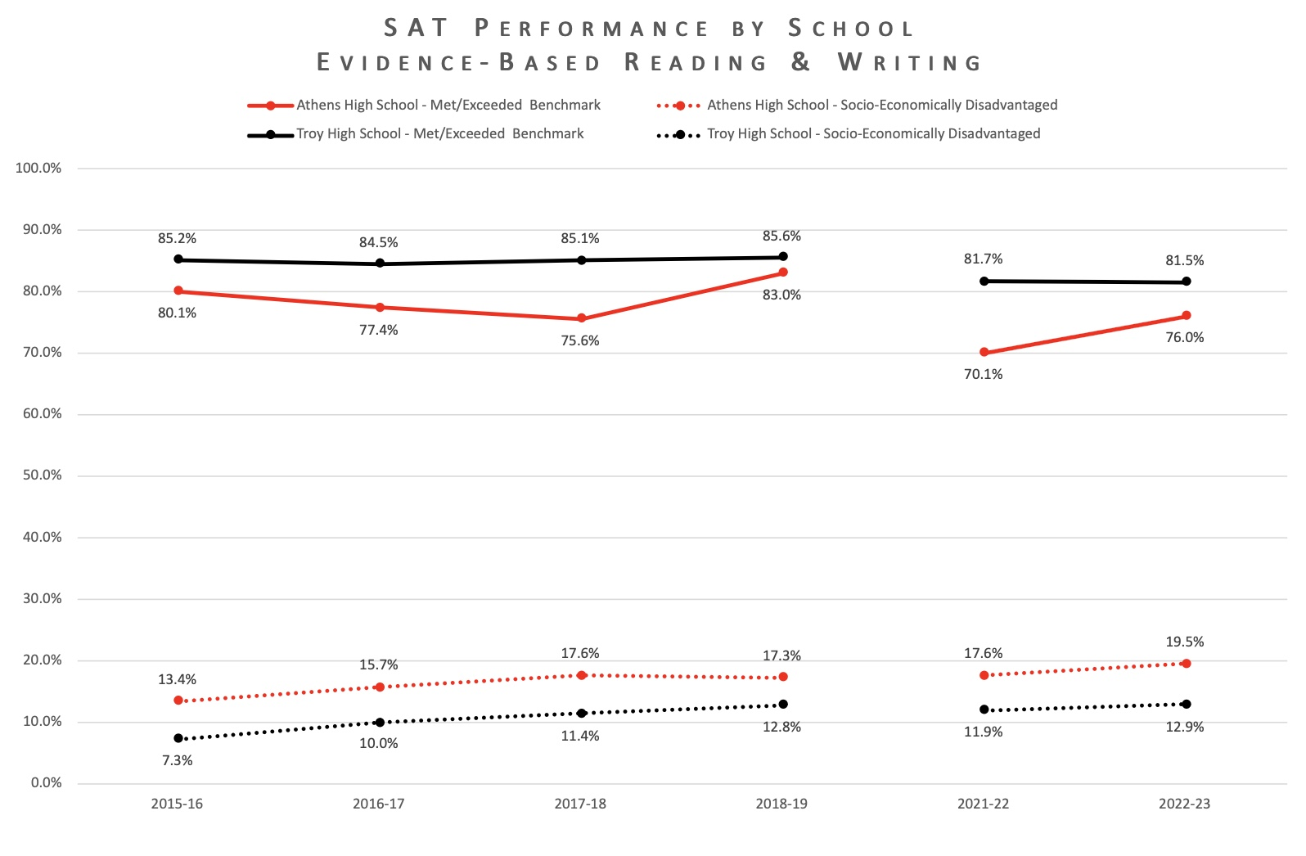
Represents % SED by Building

Slide 8
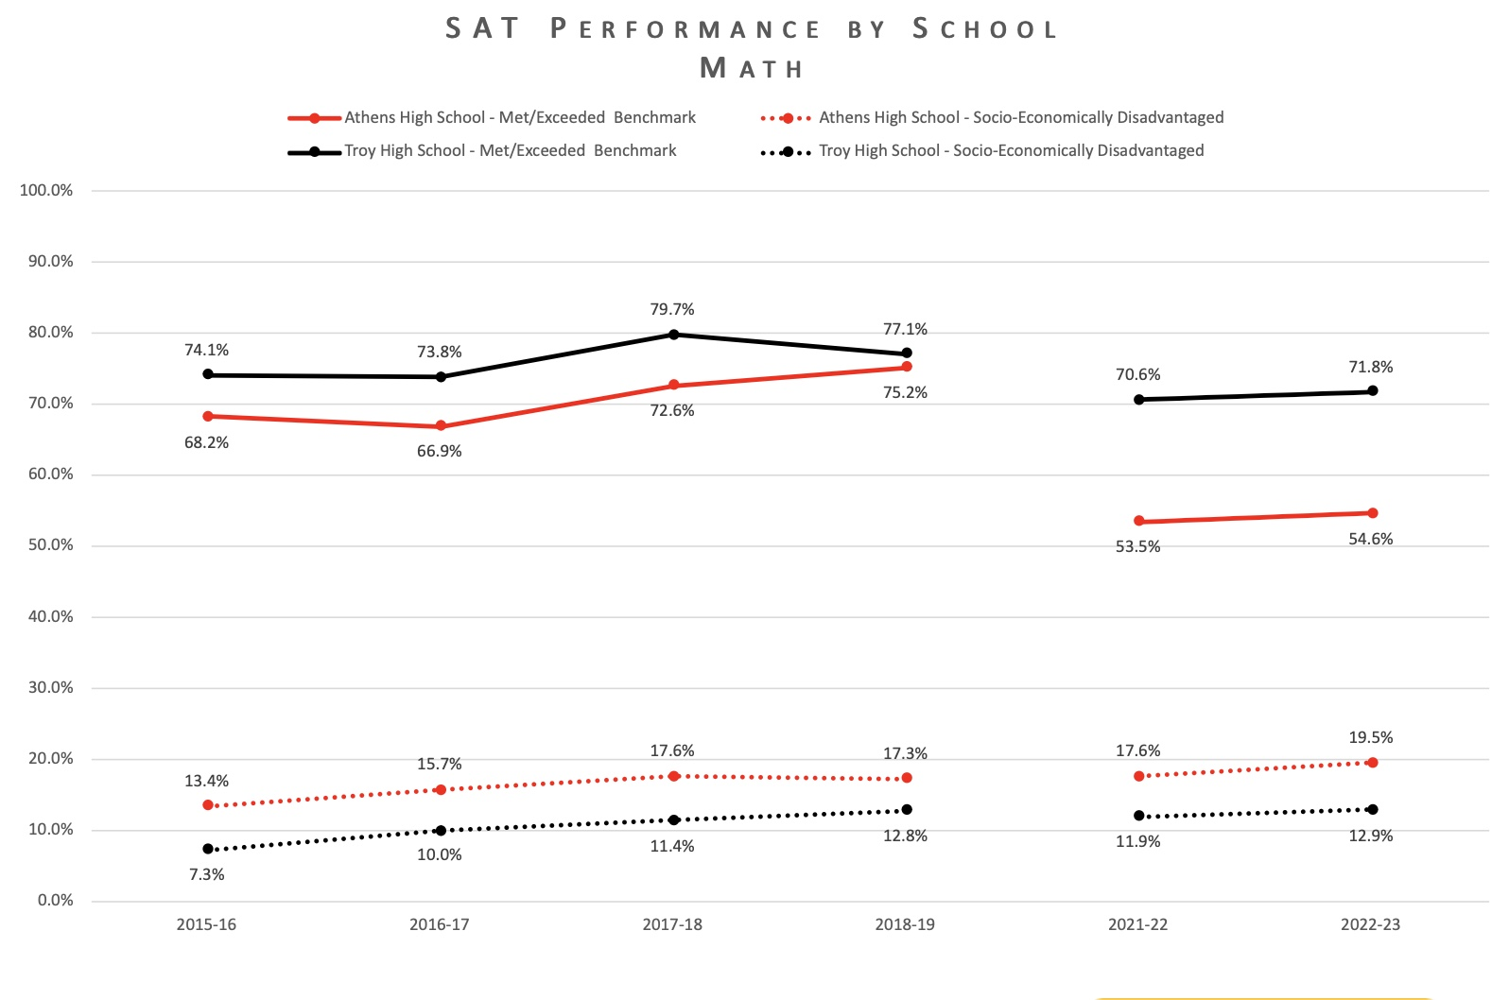
Represents % SED by Building

Slide 9
Using Data to Inform Instruction

Slide 10
SAT/PSAT Subcategory Data
Each assessment (SAT/EBRW) has subcategories that allow us to dig deeper into program assessment
We review this level of data to understand trends overtime in more narrow/focused areas of instruction
From the system level, this data is not useful for addressing specific student learning needs

Slide 11
SAT Math Subcategory Definitions
Heart of Algebra questions on the SAT Math Test focus on the mastery of linear equations, systems of linear equations, and linear functions. The ability to analyze and create linear equations, inequalities, and functions is essential for success in college and career, as is the ability to solve linear equations and systems fluently.
Passport to Advanced Math questions include topics that are especially important for students to master before studying advanced math. Chief among these topics is the understanding of the structure of expressions and the ability to analyze, manipulate, and rewrite these expressions. These questions also include reasoning with more complex equations and interpreting and building functions.
Problem Solving and Data Analysis includes using ratios, percentages, and proportional reasoning to solve problems in real-world situations, including science, social science, and other contexts. It also includes describing relationships shown graphically and analyzing statistical data. This group of skills is about being quantitatively literate and demonstrating a command of the math that resonates throughout college courses, career training programs, and everyday life.

Slide 12
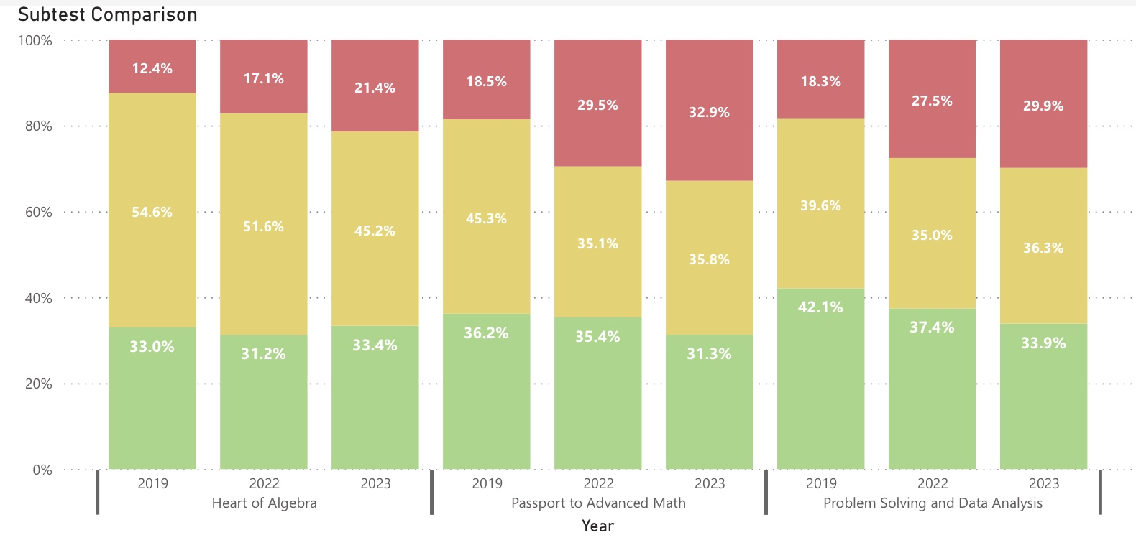
SAT Subcategory Comparison - Math
Green: Proficient or Advanced Yellow: Partially Proficient Red: Not Proficient

Slide 13
SAT Evidence Based Reading and Writing Subcategory Definitions
The Command of Evidence category includes questions that focus on: The best evidence for a specified conclusion (Reading Test); Interpreting data presented in informational graphics (such as tables, graphs, and charts) and drawing connections between words and data (Reading Test, Writing and Language Test); Understanding how the author of an argument uses (or fails to use) evidence to support claims (Reading Test); Revising a passage to clarify main ideas, strengthen support, or sharpen focus (Writing and Language Test)
Expression of Ideas questions on the Writing and Language Test focus on refining the substance of a writer’s message. Specifically, Expression of Ideas questions focus on topic development, organization, and effective language use in relation to the writer’s purpose. Collectively, these questions address rhetorical aspects of the passages on the test. When you answer the rhetorically oriented Expression of Ideas questions, you’re using your knowledge of and skill in writing to make each passage clearer, sharper, richer, and more engaging.
Standard English Conventions questions require you to edit passages for sentence structure, usage, and punctuation.
Words in Context asks you to consider both the meaning and role of words and phrases as they’re used in particular passages. You’ll be asked to think about how to make language use more effective. These questions focus on the following skills: Interpreting words and phrases in context (Reading Test), Analyzing word choice rhetorically (Reading Test), Making effective use of language (Writing and Language Test)

Slide 14
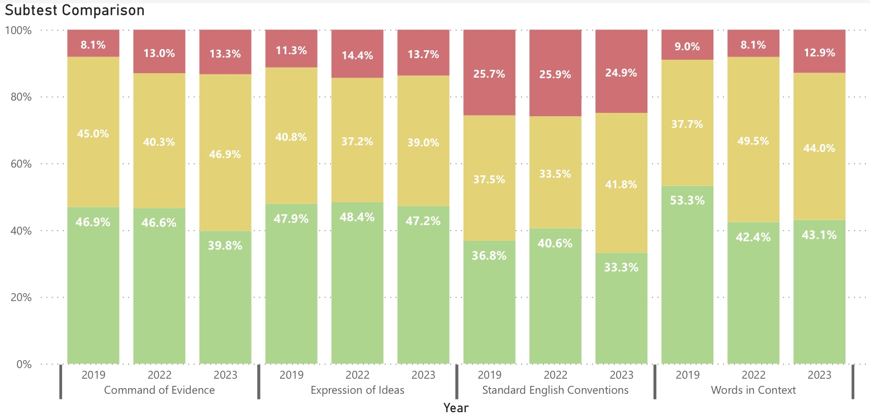
SAT Subcategory Comparison Evidence Based Reading & Writing
Green: Proficient or Advanced Yellow: Partially Proficient Red: Not Proficient

Slide 15
Math Benchmarking
PSAT 8 & Future NWEA

Slide 16
PSAT 8 & NWEA
As we move forward with our new K-8 math curriculum, we will utilize PSAT 8 Math performance as one data set to help understand student growth over time.
This winter we will introduce NWEA as a second data set for student performance in math. NWEA will replace district created benchmark assessments. NWEA assessments are given during the school day, during the student’s math class. NWEA is a norm-reference, computer adaptive assessment that is given nationally.
Engagement in program evaluation in partnership with Illustrative Math

Slide 17
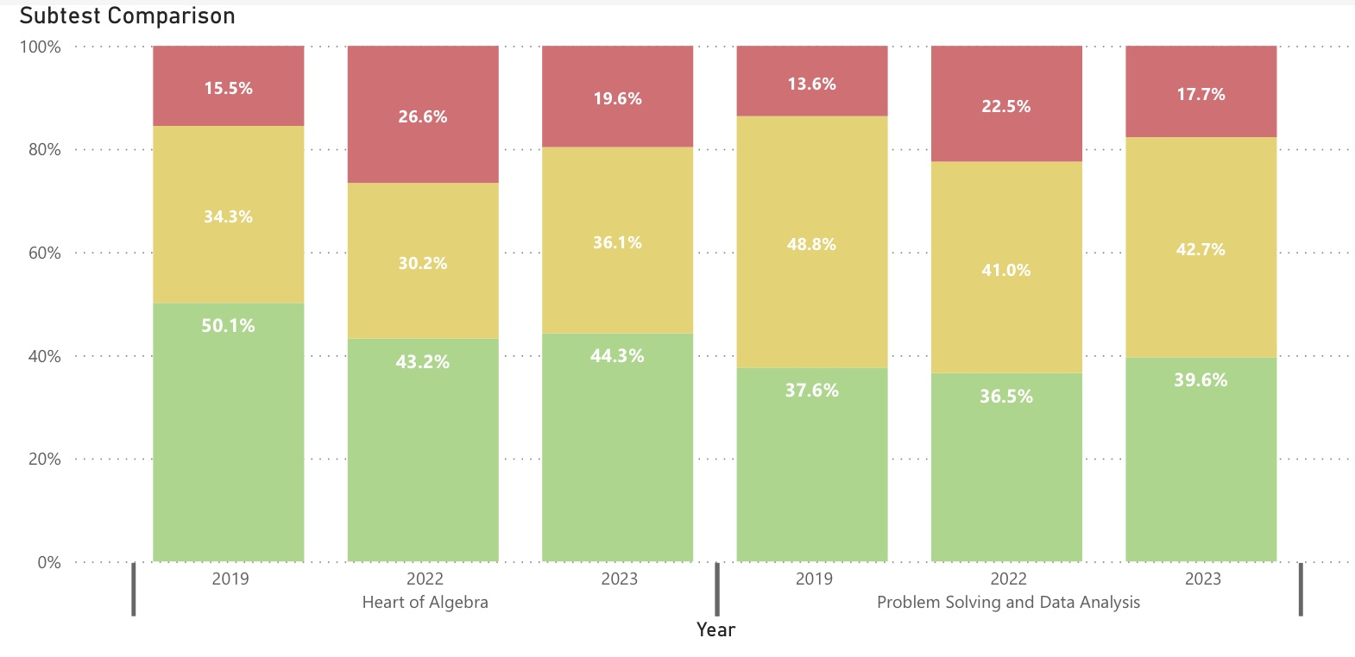
PSAT 8 Subcategory Comparison - Math
Green: Proficient or Advanced Yellow: Partially Proficient Red: Not Proficient

Slide 18
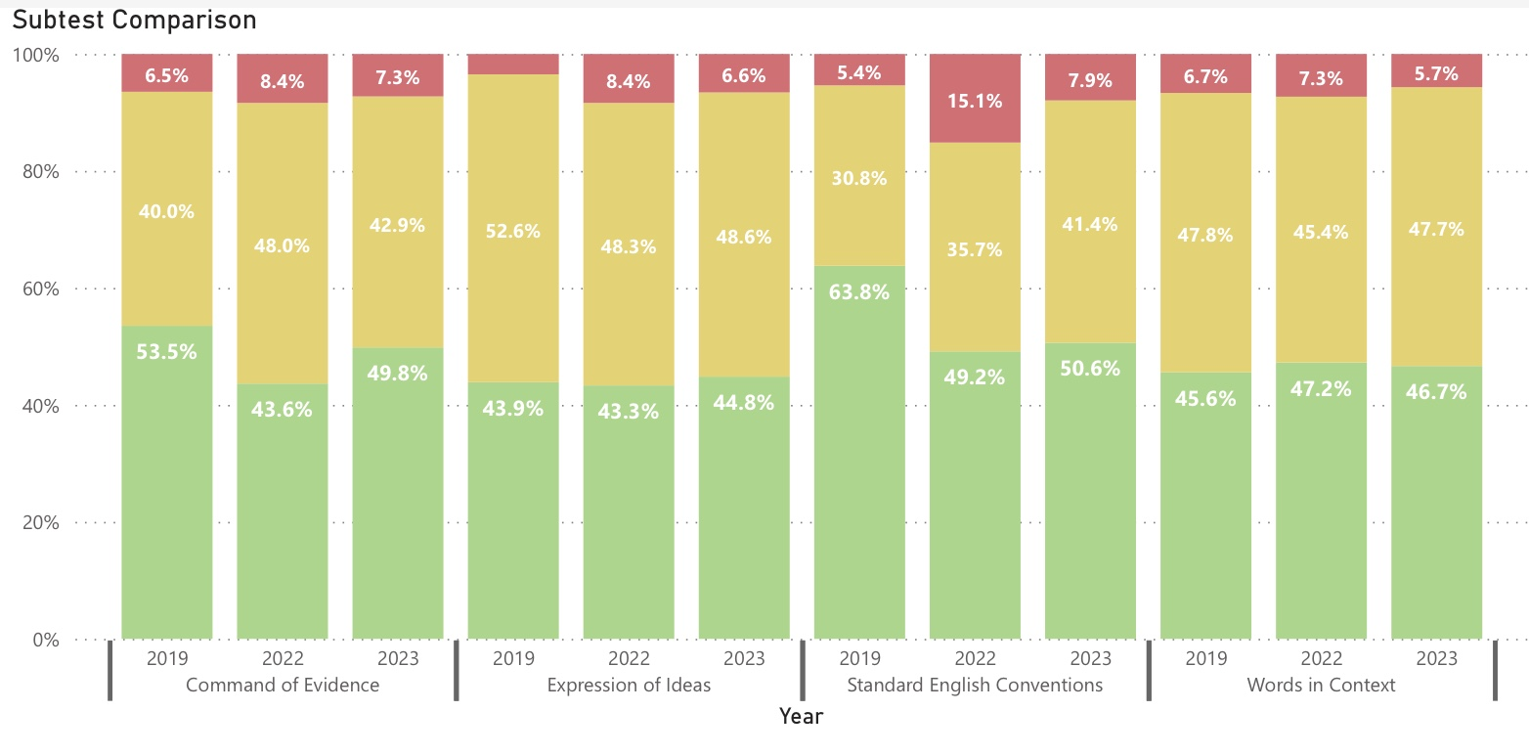
PSAT 8 Subcategory Comparison Evidence Based Reading & Writing
Green: Proficient or Advanced Yellow: Partially Proficient Red: Not Proficient

Slide 19
Oakland County Performance Data

Slide 20
MSTEP 3-8
MSTEP (3-7) and PSAT 8 ELA & Math data allow us to track the performance of student cohorts overtime. The pandemic has disrupted our data (19/20 and 20/21) sets. We have a new baseline to grow from beginning with the spring 2022 assessments.
We are able to use MSTEP data to see how we perform in comparison to other districts.
MSTEP data is not as useful for program assessment as it only encompasses the last three years of elementary and the first two years of middle school.
We are not able to drill down with the same level of consistency in MSTEP.

Slide 21
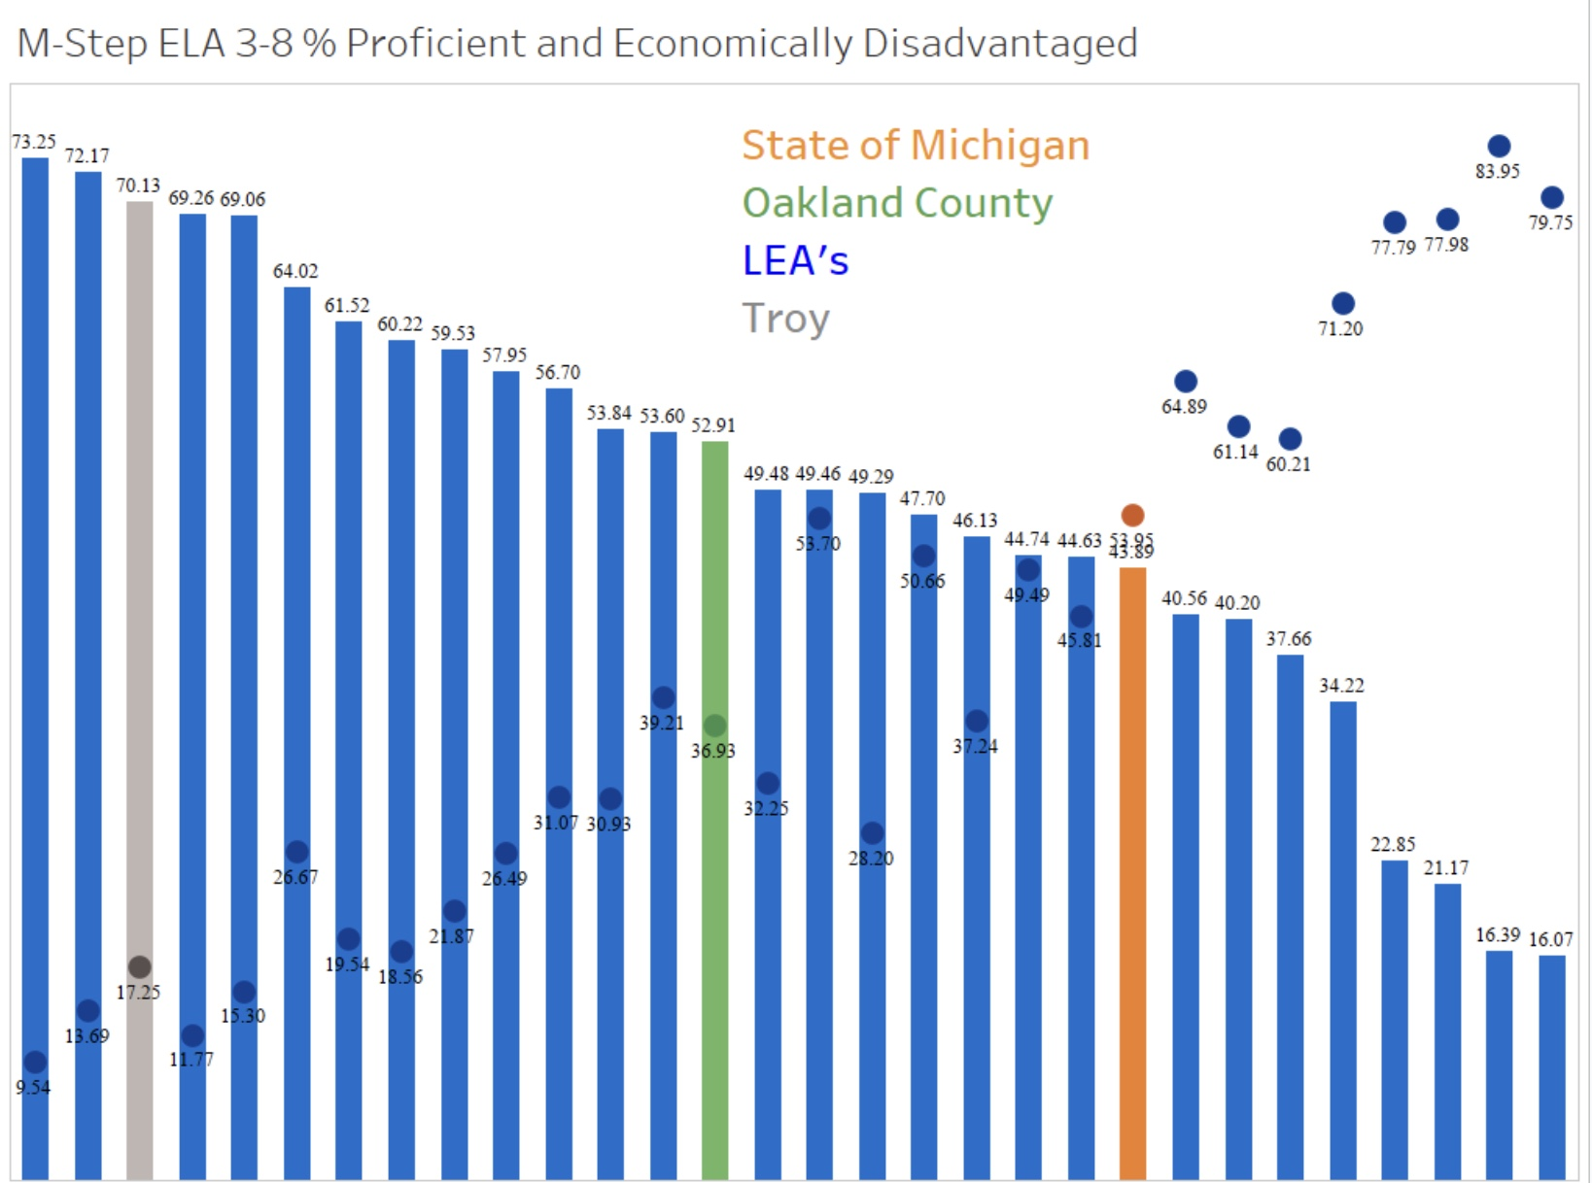
Oakland County Performance ELA MSTEP 3-8

Slide 22
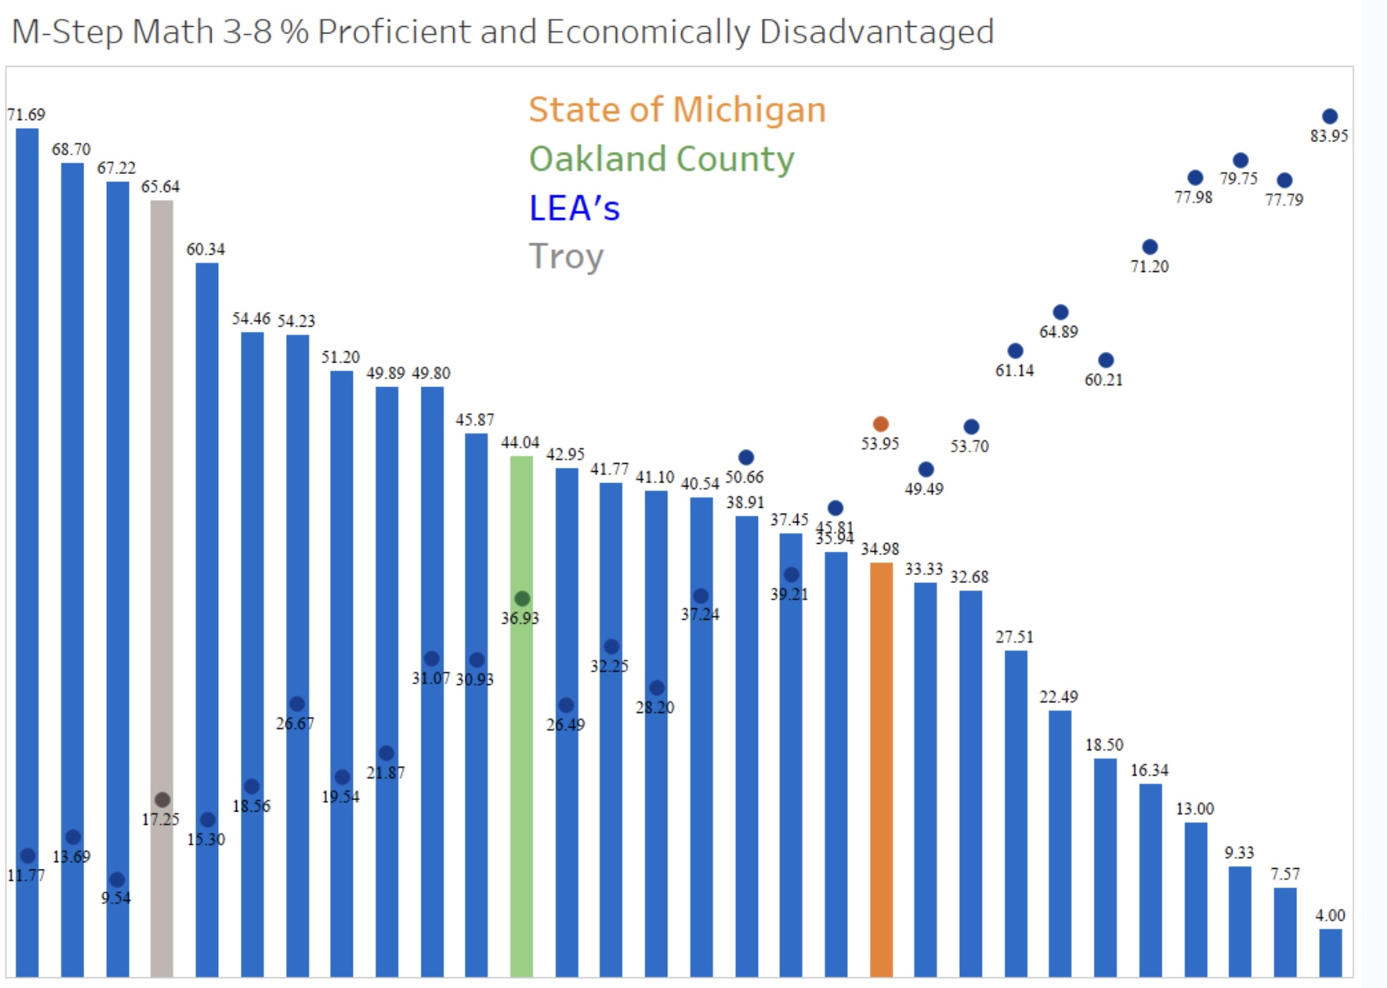
Oakland County Performance Math MSTEP 3-8

Slide 23
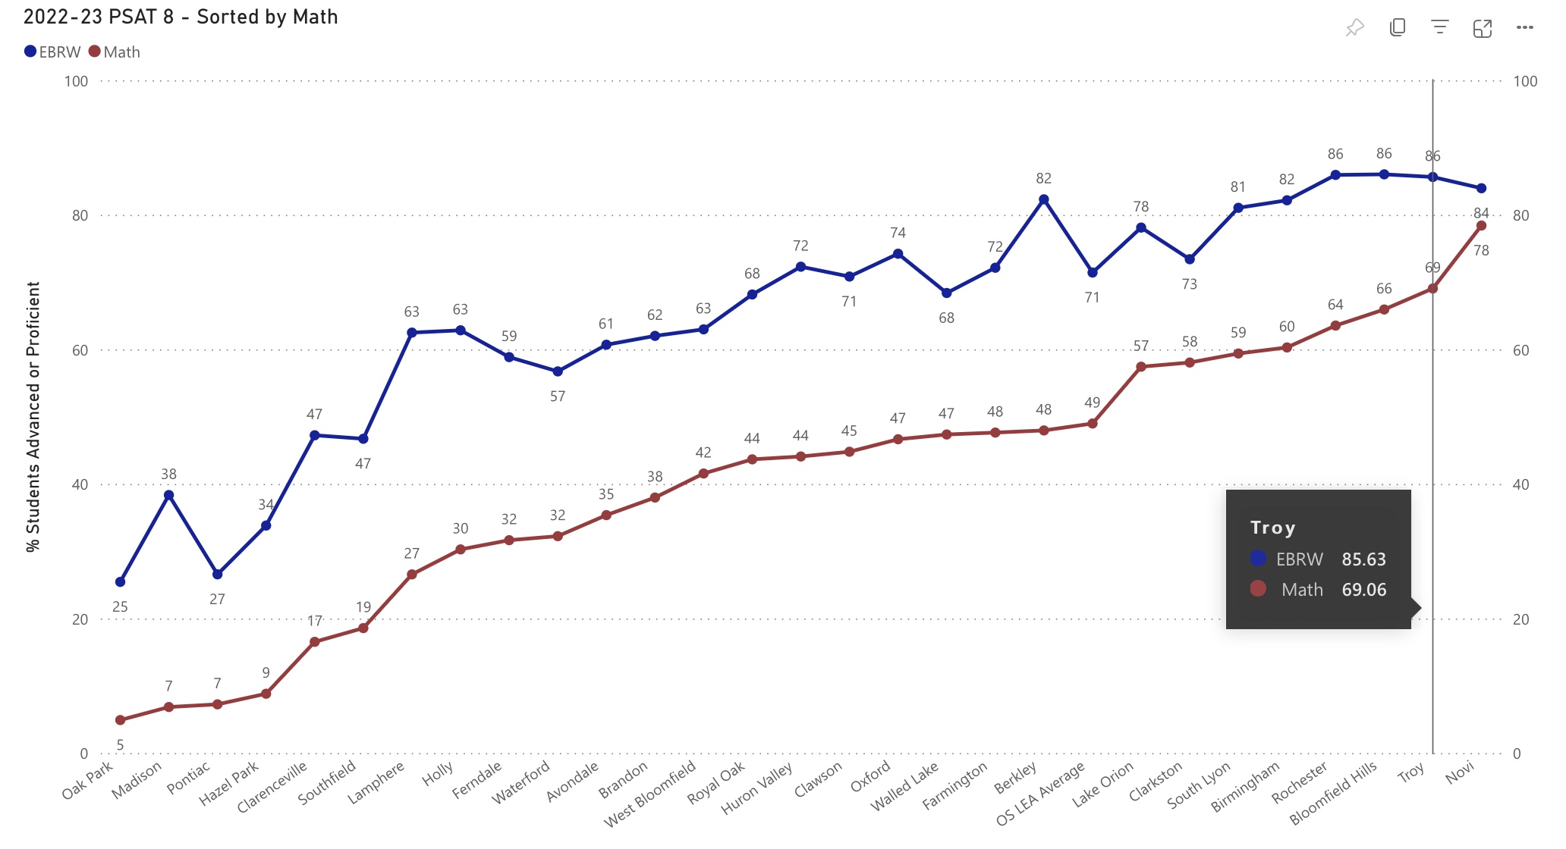
Oakland County Performance PSAT 8

Slide 24
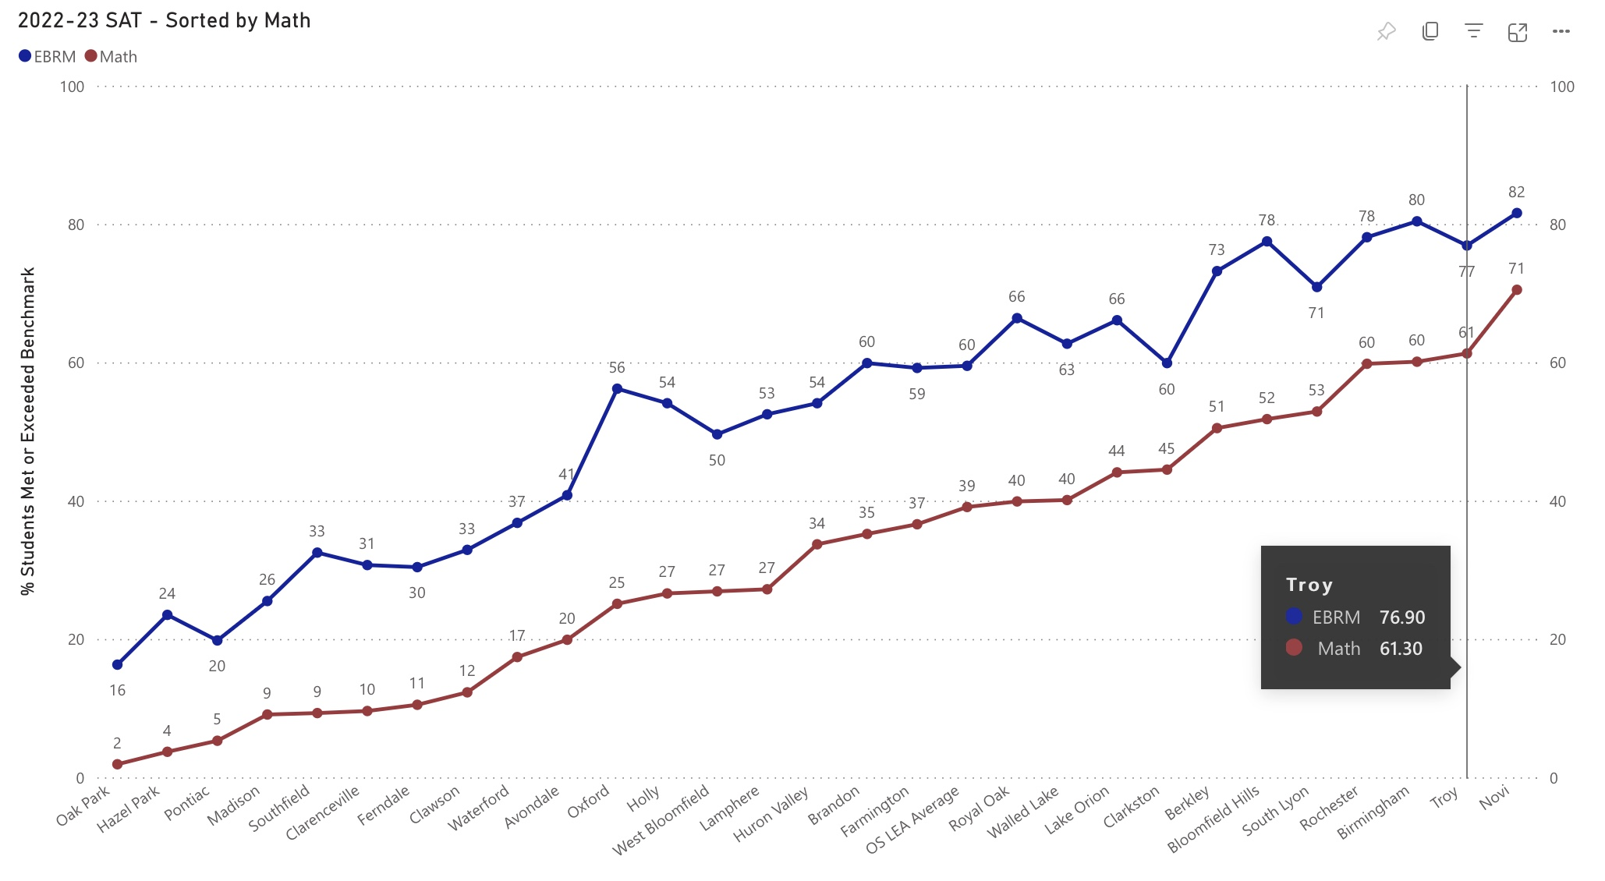
Oakland County Performance SAT 11

Slide 25
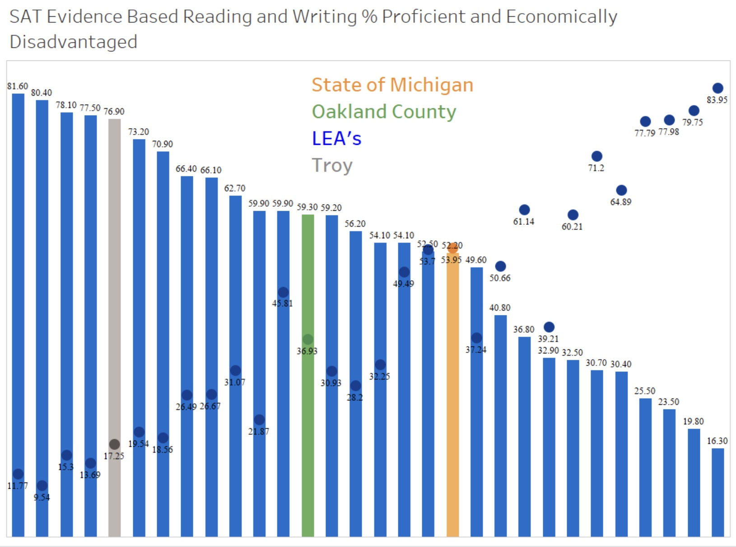
Oakland County Performance SAT 11 EBRW with ED

Slide 26
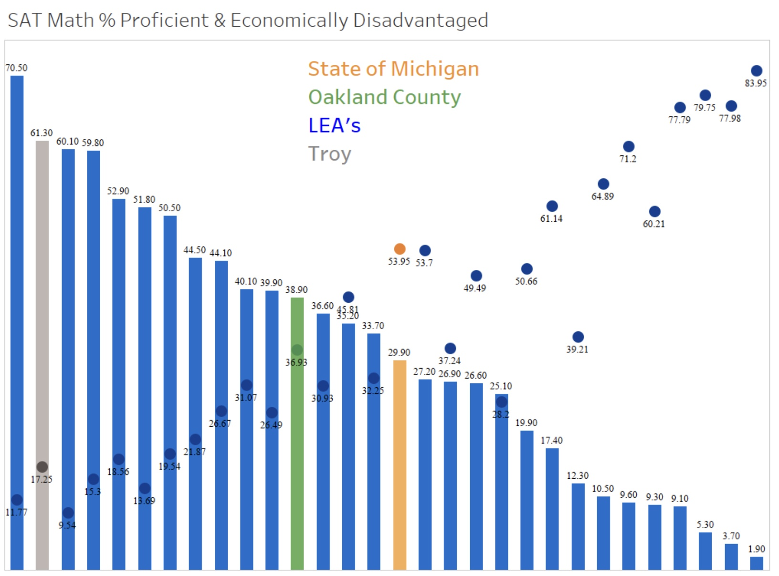
Oakland County Performance SAT 11 Math with ED

Slide 28
Out-performing expectations

Slide 29
Peer District Comparison Data

Slide 30
How are “peer” districts selected?
Comparison outside of Oakland County
Opportunity to reflect & learn from others
Areas of similarity in these districts:
Size
Economics (per pupil)
Performance/Achievement
Community expectations
Areas of difference:
Student need (ELD, SES)
Demographics

Slide 31
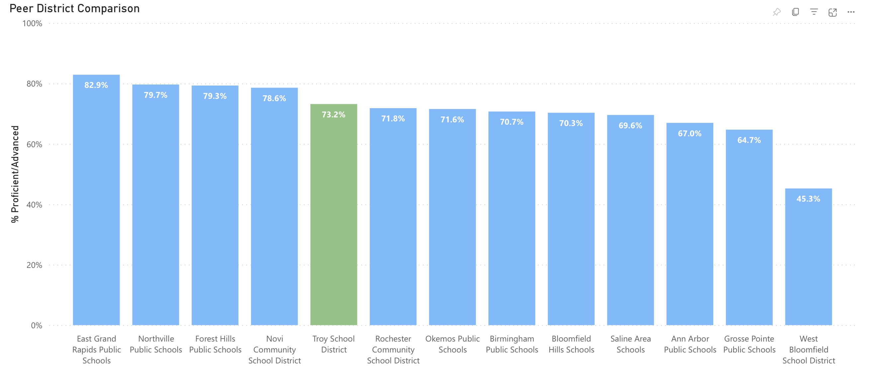
Peer District Performance PSAT 8 & SAT 11

Slide 32
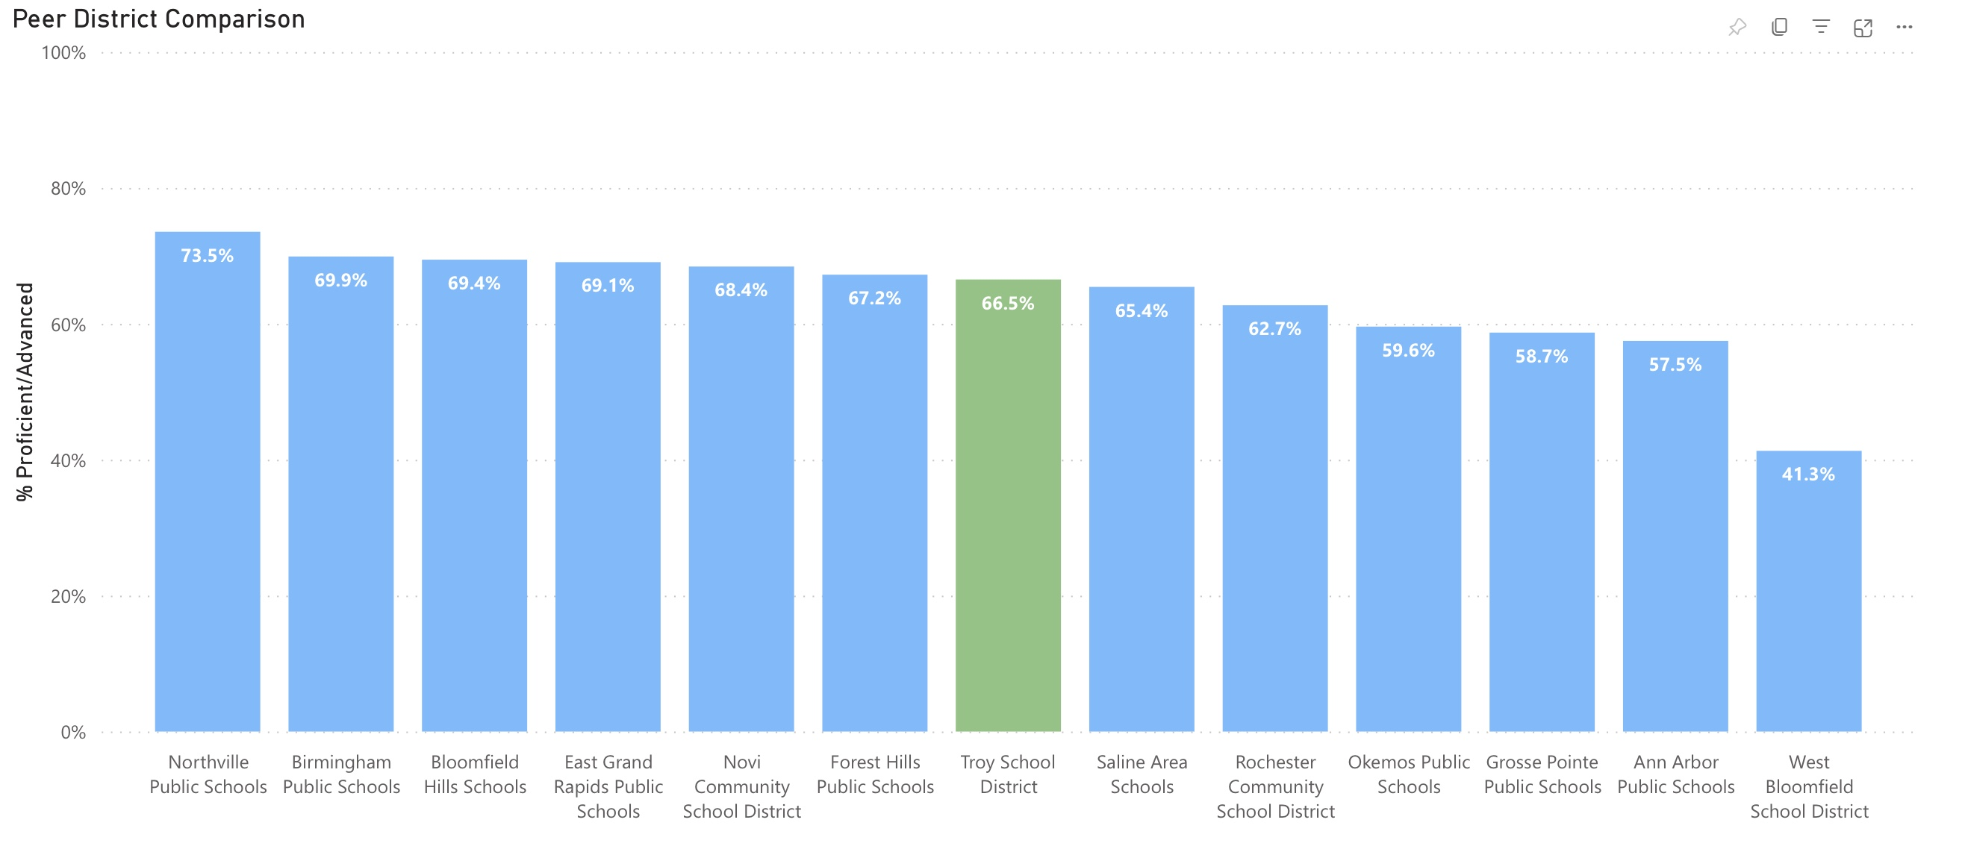
Peer District Performance MSTEP 3-7

Slide 33
Celebrations

Slide 34
International Baccalaureate Diploma Programme
IB Curriculum is internationally aligned and recognized
IB Diploma candidates test in six subject areas and the DP Core which includes creativity, activity, service, the extended essay, and theory of knowledge
IB Assessments are externally monitored and scored providing more objective feedback

Slide 35
International Academy East – IB Diploma Acquisition Rate
Global Acquisition Rate 75-78%
Year | % Diploma Acquisition
2023 | 72%
2022 | 88%
2021 | 87%
2020 | 90%
2019 | 82%

Slide 36
Advanced Placement Courses
Advanced Placement courses are specified courses approved by the College Board.
Student enrollment in AP courses in high school is shown to positively impact future student performance in college.
Our community highly values Advanced Placement courses and opportunities that align with AP courses.
Though AP course participation can be beneficial for students, too many AP courses or a schedule that is saturated with AP courses may be detrimental to students.

Slide 37
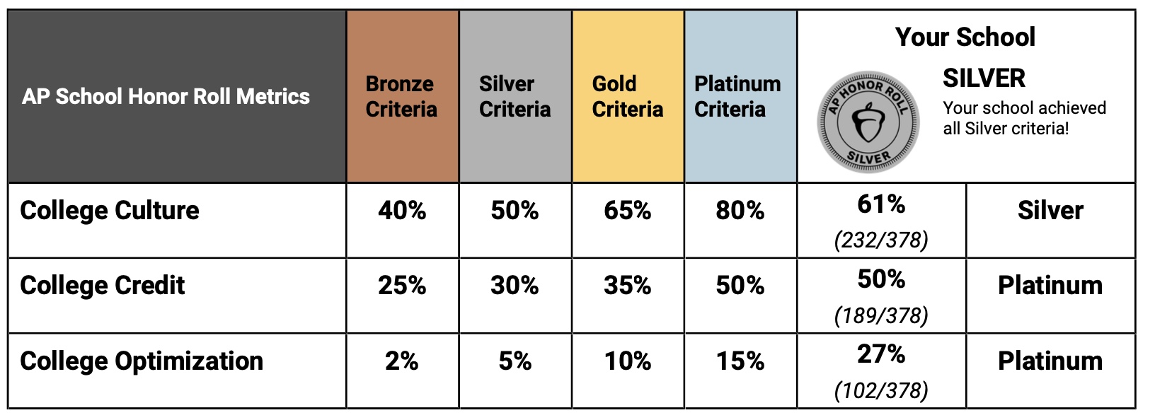
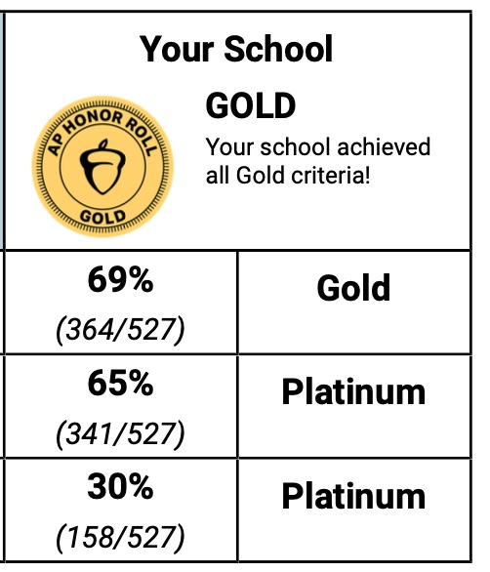
College Culture: Percent of students in the graduating class who took an AP exam at any point in high school, regardless of score. College Credit: Percent of students in the graduating class who scored 3 or higher on any AP Exam in high school. College Optimization: Percent of students in the graduating class who took 5 or more AP Exams in high school, where at least 1 exam was taken in 9th or 10th grade. Research finds that 6 or more APs do not improve college graduation rates beyond the optimal total of 5 such courses in high school. The Honor Roll also recognizes schools that encourage students earlier on their AP journey so as not to overload them with AP courses their junior and senior years.
AP Honor Roll
Athens High School
Troy High School

Slide 38
Graduation Rate – Troy College and Career High School
Over the last 4 years we have committed resources to reimagining the programming at TCCHS.
New facility, new leadership, new vision
Focus on belonging and flexibility in curriculum
Elevation of student voice and choice
Opportunity to learn and grow in a smaller, adaptive, supportive environment

Slide 39
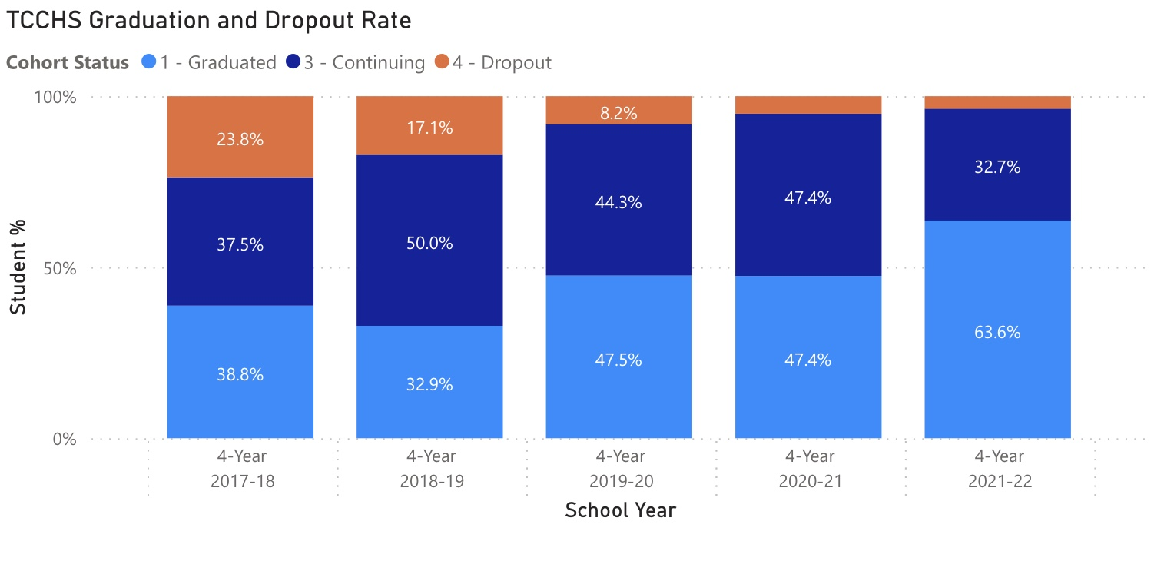
Troy College and Career High School: From 2017/18 to 2021/22 4-year graduation rate increased from 38% to 63% Student drop out rate decreased from 23% to 3%

