Slide 1

WHAT HAS HAPPENED? (Include data where applicable)
AT&T Representative approached us with interest in erecting a 110’ cell tower on the northern part of Boulan Park Middle School Property.
Rick West and Rob Carson walked the property with the representative to determine the precise recommended location and understand more details. AT&T has provided draft rendering (see next slide).
WHAT IS UPCOMING?
June 1, 2021 Board Workshop Discussion to gauge Board of Education interest in pursuing a lease agreement with AT&T for the purpose of erecting a cell tower.
If Board is interested in pursuing an agreement, Rick West will negotiate terms with AT&T representative and Jeremy Motz.
Board Resolution authorizing Lease Agreement with AT&T.
Rick West has had preliminary discussion with our attorney, Jeremy Motz, on next steps of negotiating a lease agreement.
Topic: ATT Cell Tower Lease
Date: TBD
Name(s): Rick West

Slide 2
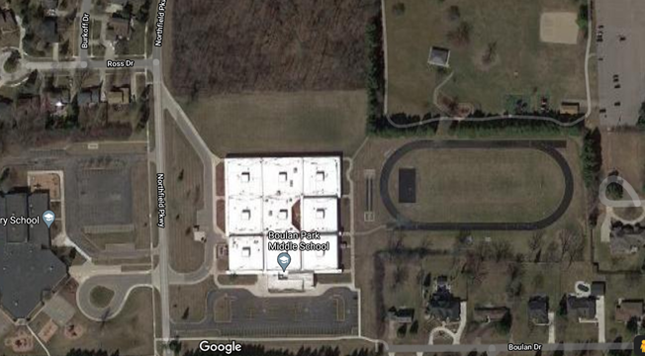
Approximate Placement of 110’ Cell Tower

