Slide 1
Troy SD G6-G7 Math
Has IM + Detracking Outperformed Its Characteristics?
Executive Summary — SEDA 2025.1 + M-STEP Data
Prepared May 2026 • 296-district national benchmark • 2009–2025 coverage
Repo: github.com/akarpo/tsd-g6g7math-choice
Troy SD G6-G7 Math — Executive Summary • github.com/akarpo/tsd-g6g7math-choice
1 / 16

Slide 2
The Question — and the One-Line Answer
G6+G7 Math: three independent lines of evidence converge
QUESTION
ANSWER
Has Troy’s Fall 2023 adoption of Illustrative Mathematics and detracking of G6+G7 math produced results that outperform its characteristics?
No.
Troy ranks 197 of 295 level-matched peers (bottom third) in math recovery during the exact IM adoption window.
197 / 295
6th of 8
−0.028
Level-matched peers rank Troy in the bottom third for IM-window recovery
MI peers outpaced Troy in IM-window recovery (+0.076 vs +0.080 median)
G7 Asian still declining under IM — only subgroup not recovering
Troy SD G6-G7 Math — Executive Summary • github.com/akarpo/tsd-g6g7math-choice
2 / 16

Slide 3
What Troy Did and When
Fall 2023: Illustrative Mathematics adopted, G6+G7 math detracked
Fall 2023
Spring 2024
Fall 2024
Spring 2025
Adopted Illustrative Mathematics; detracked G6 and G7 math
First IM cohort tested (G6 M-STEP)
Second IM year; first G7 IM cohort enters 7th grade
Second IM G6 + first IM G7 tested
Prior: Big Ideas Math 7, Math 7/8 Honors, small Algebra 1 cohort
Troy SD G6-G7 Math — Executive Summary • github.com/akarpo/tsd-g6g7math-choice
3 / 16

Slide 4
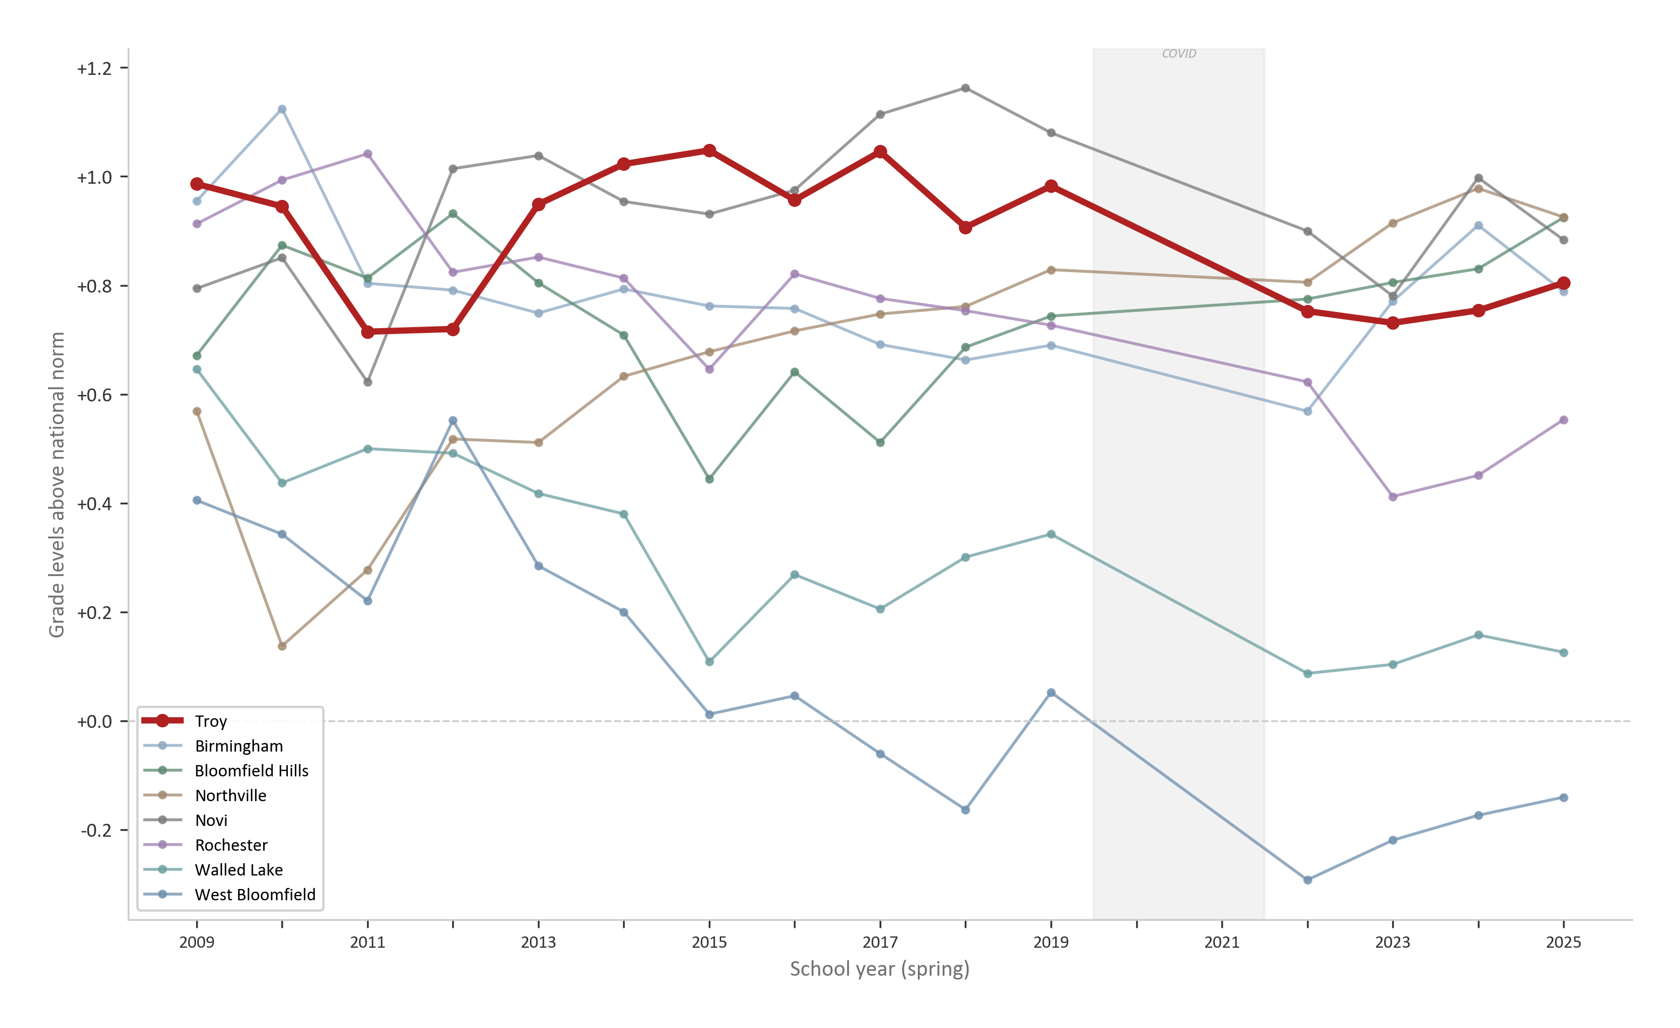
Troy’s Pre-COVID Math Position — Strong, Not Invincible
Pre-COVID G6+G7: +0.937 grade levels above national norm
+0.937
grade levels above national norm
2nd highest among MI affluent peers
Top quarter nationally (#76 / 296)
Troy SD G6-G7 Math — Executive Summary • github.com/akarpo/tsd-g6g7math-choice
4 / 16

Slide 5
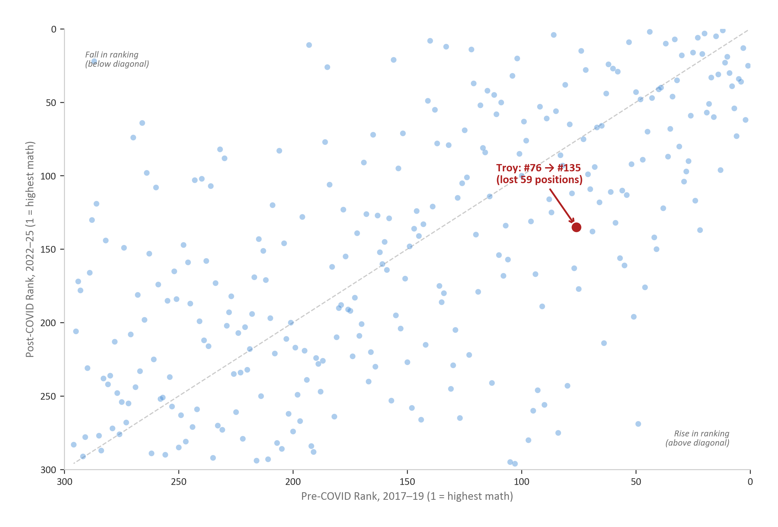
COVID Erased Troy's Math Advantage
G6+G7 Math: Pre-COVID #76 to Post-COVID #135 among 296 level-matched peers
#76 → #135
Lost 59 positions
Pre-COVID: top quarter
Post-COVID: mid-pack
COVID hit Troy harder than most peers. This is the deficit IM inherited.
Troy SD G6-G7 Math — Executive Summary • github.com/akarpo/tsd-g6g7math-choice
5 / 16

Slide 6
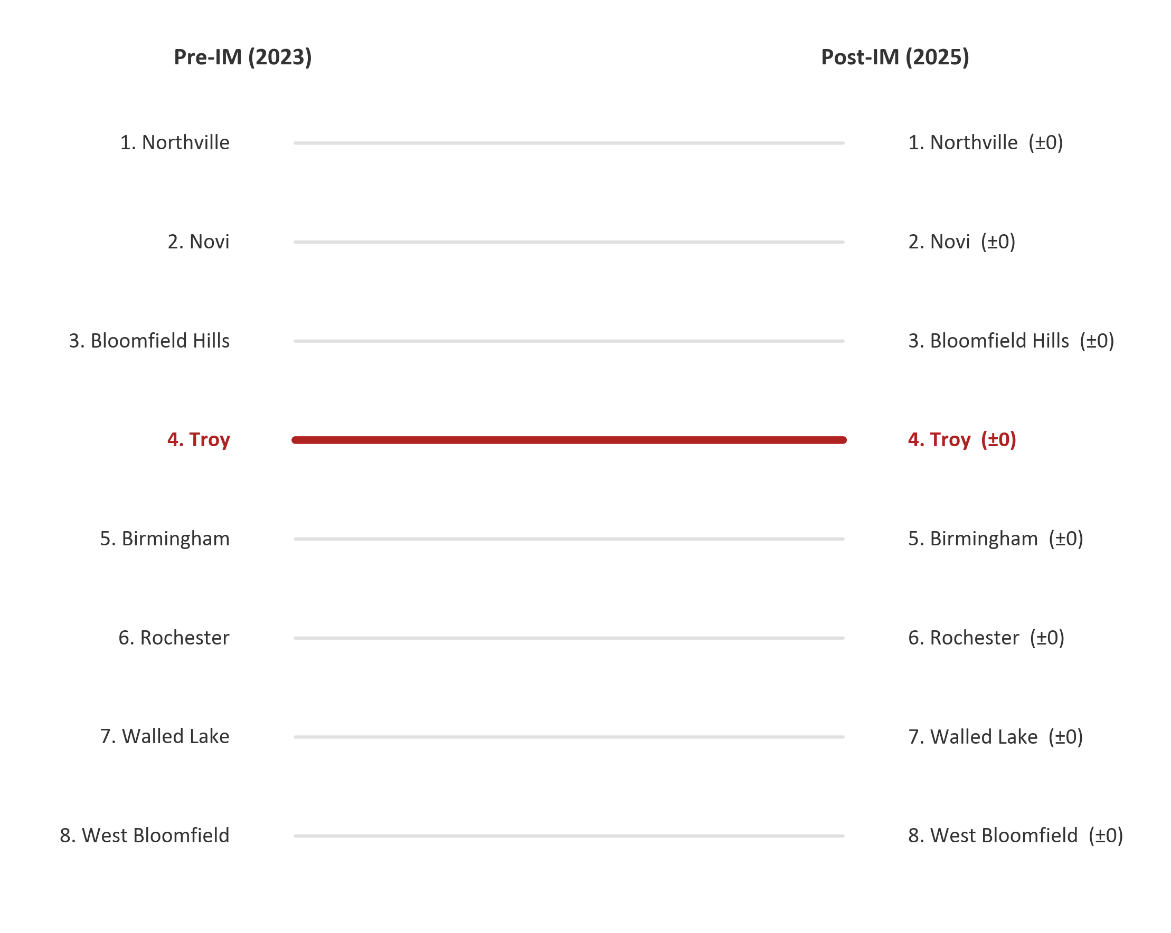
MI Peer Leaderboard: Troy Holds at 4th in IM Window
G6+G7 Math: rank unchanged from 2023 to 2025 — no ground gained or lost
Troy’s Rank Shift by Subgroup
Subgroup
Shift
Δ
All Students
4th→4th
±0
Asian
3rd→3rd
±0
White
4th→5th
−1
Econ Disadv
3rd→3rd
±0
Not Econ Disadv
3rd→3rd
±0
White subgroup dropped one spot (4th→5th). Rank stability = not closing the gap.
Troy SD G6-G7 Math — Executive Summary • github.com/akarpo/tsd-g6g7math-choice
6 / 16

Slide 7
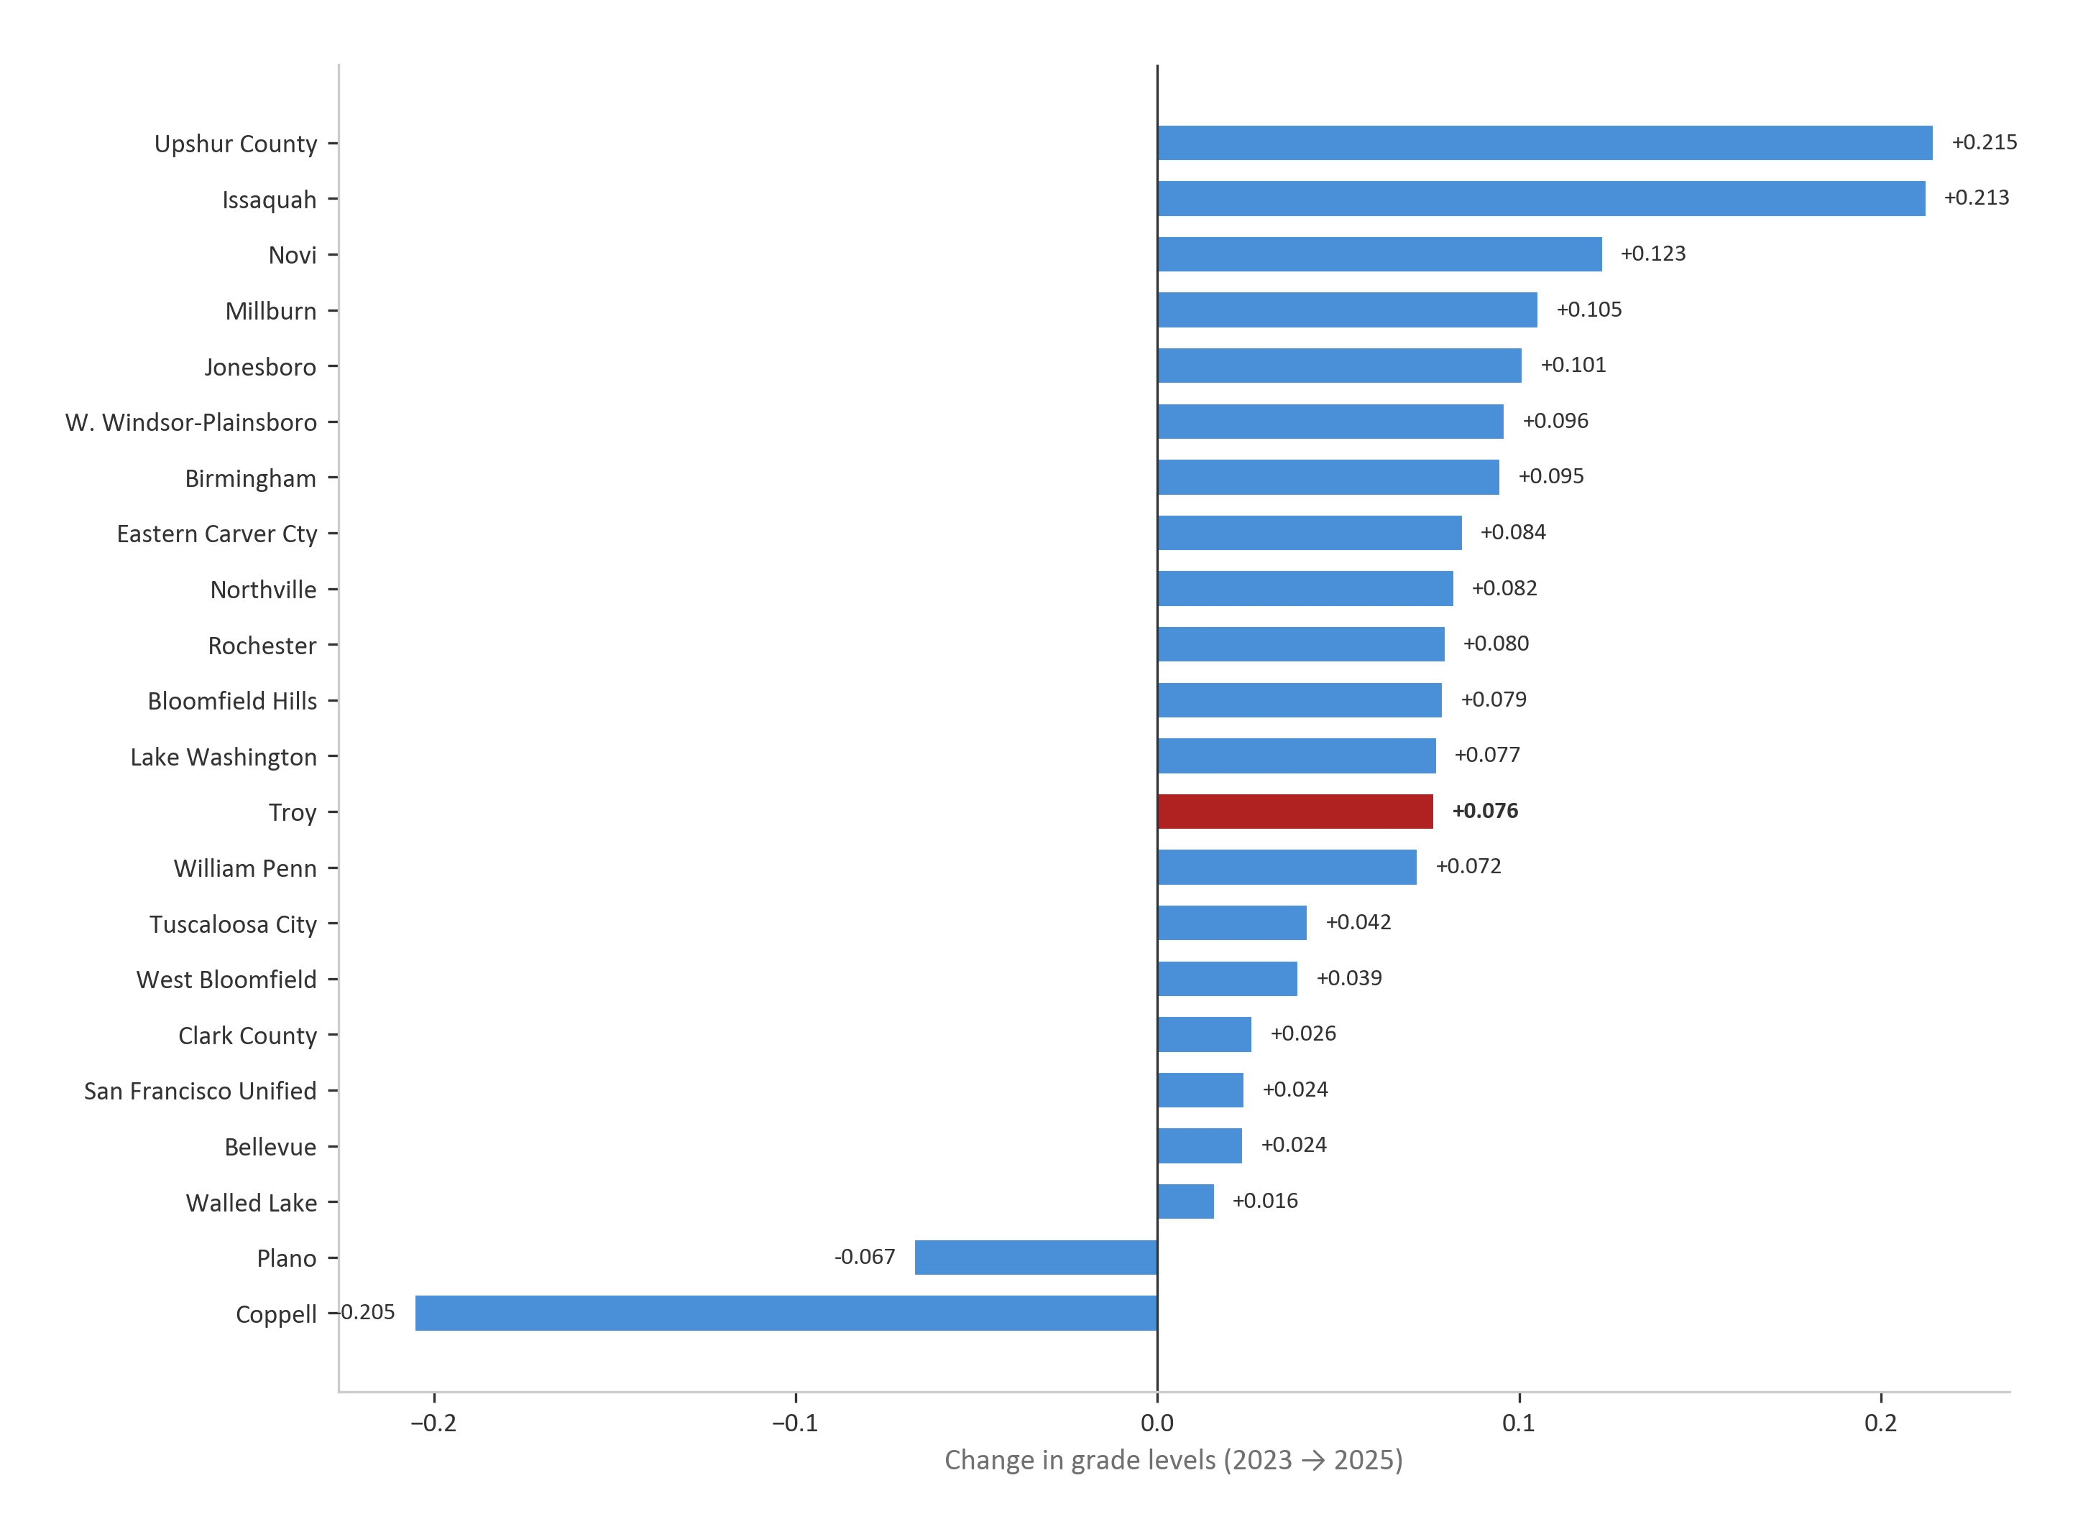
IM-Window Recovery: Troy Mid-Pack Among 22 Districts
G6+G7 Math: Troy +0.076 — 13th of 22 analysis districts (2023-2025)
+0.076
grade-level recovery
(2023 → 2025)
Rank 13 / 22
mid-pack among analysis districts
6th of 8 MI peers
Troy SD G6-G7 Math — Executive Summary • github.com/akarpo/tsd-g6g7math-choice
7 / 16

Slide 8
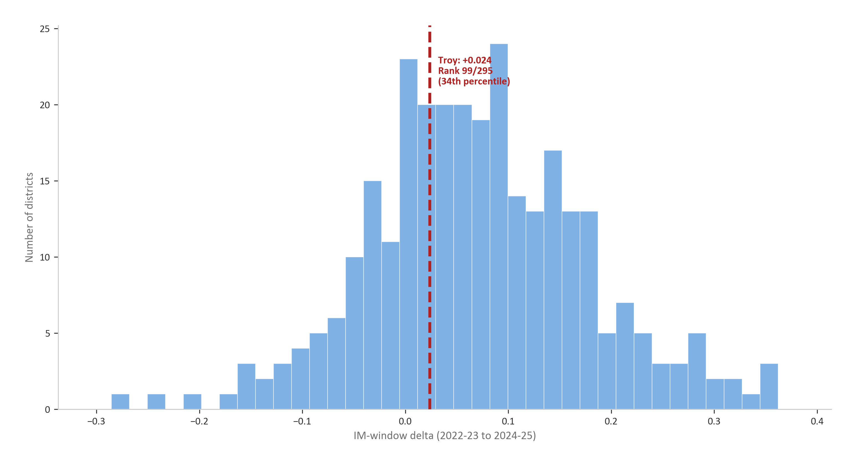
The Critical Test: Recovery During the IM Window
G6+G7 Math: 296-peer ranking of IM-window recovery — Troy in the bottom third
Rank 197 / 295
bottom third
Troy: +0.024
Peer median: +0.058
Most peers recovered 2–3× more
Troy SD G6-G7 Math — Executive Summary • github.com/akarpo/tsd-g6g7math-choice
8 / 16

Slide 9
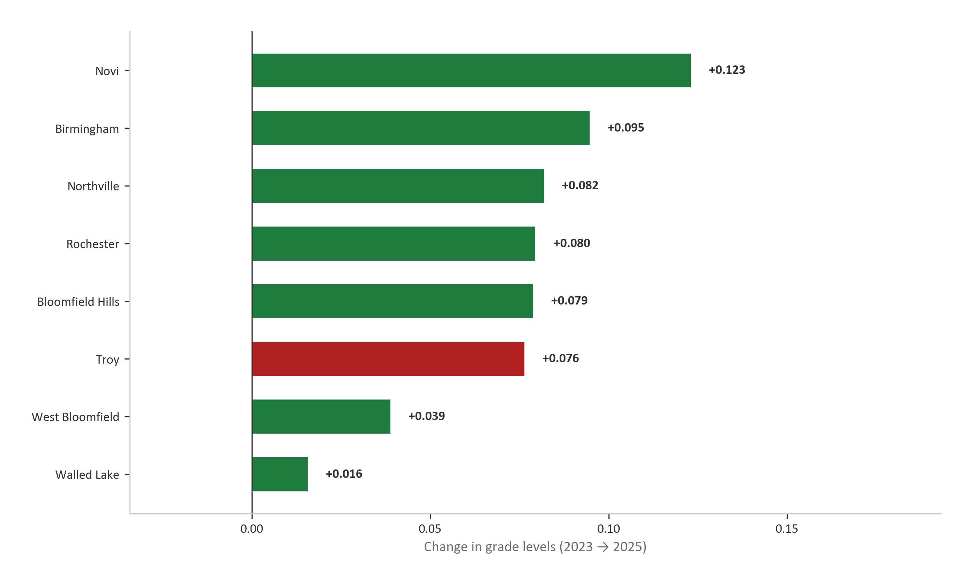
Among MI Peers, Troy Ranks 6th of 8 in Recovery
G6+G7 Math: Novi leads with 1.6x more recovery; Troy trails the median
IM-Window Recovery Ranking
Novi
+0.123
Birmingham
+0.095
(tracked)
Northville
+0.082
(tracked)
Rochester
+0.080
Bloomfield Hills
+0.079
(tracked)
Troy
+0.076
(IM+detracked)
West Bloomfield
+0.039
Walled Lake
+0.016
Troy SD G6-G7 Math — Executive Summary • github.com/akarpo/tsd-g6g7math-choice
9 / 16

Slide 10
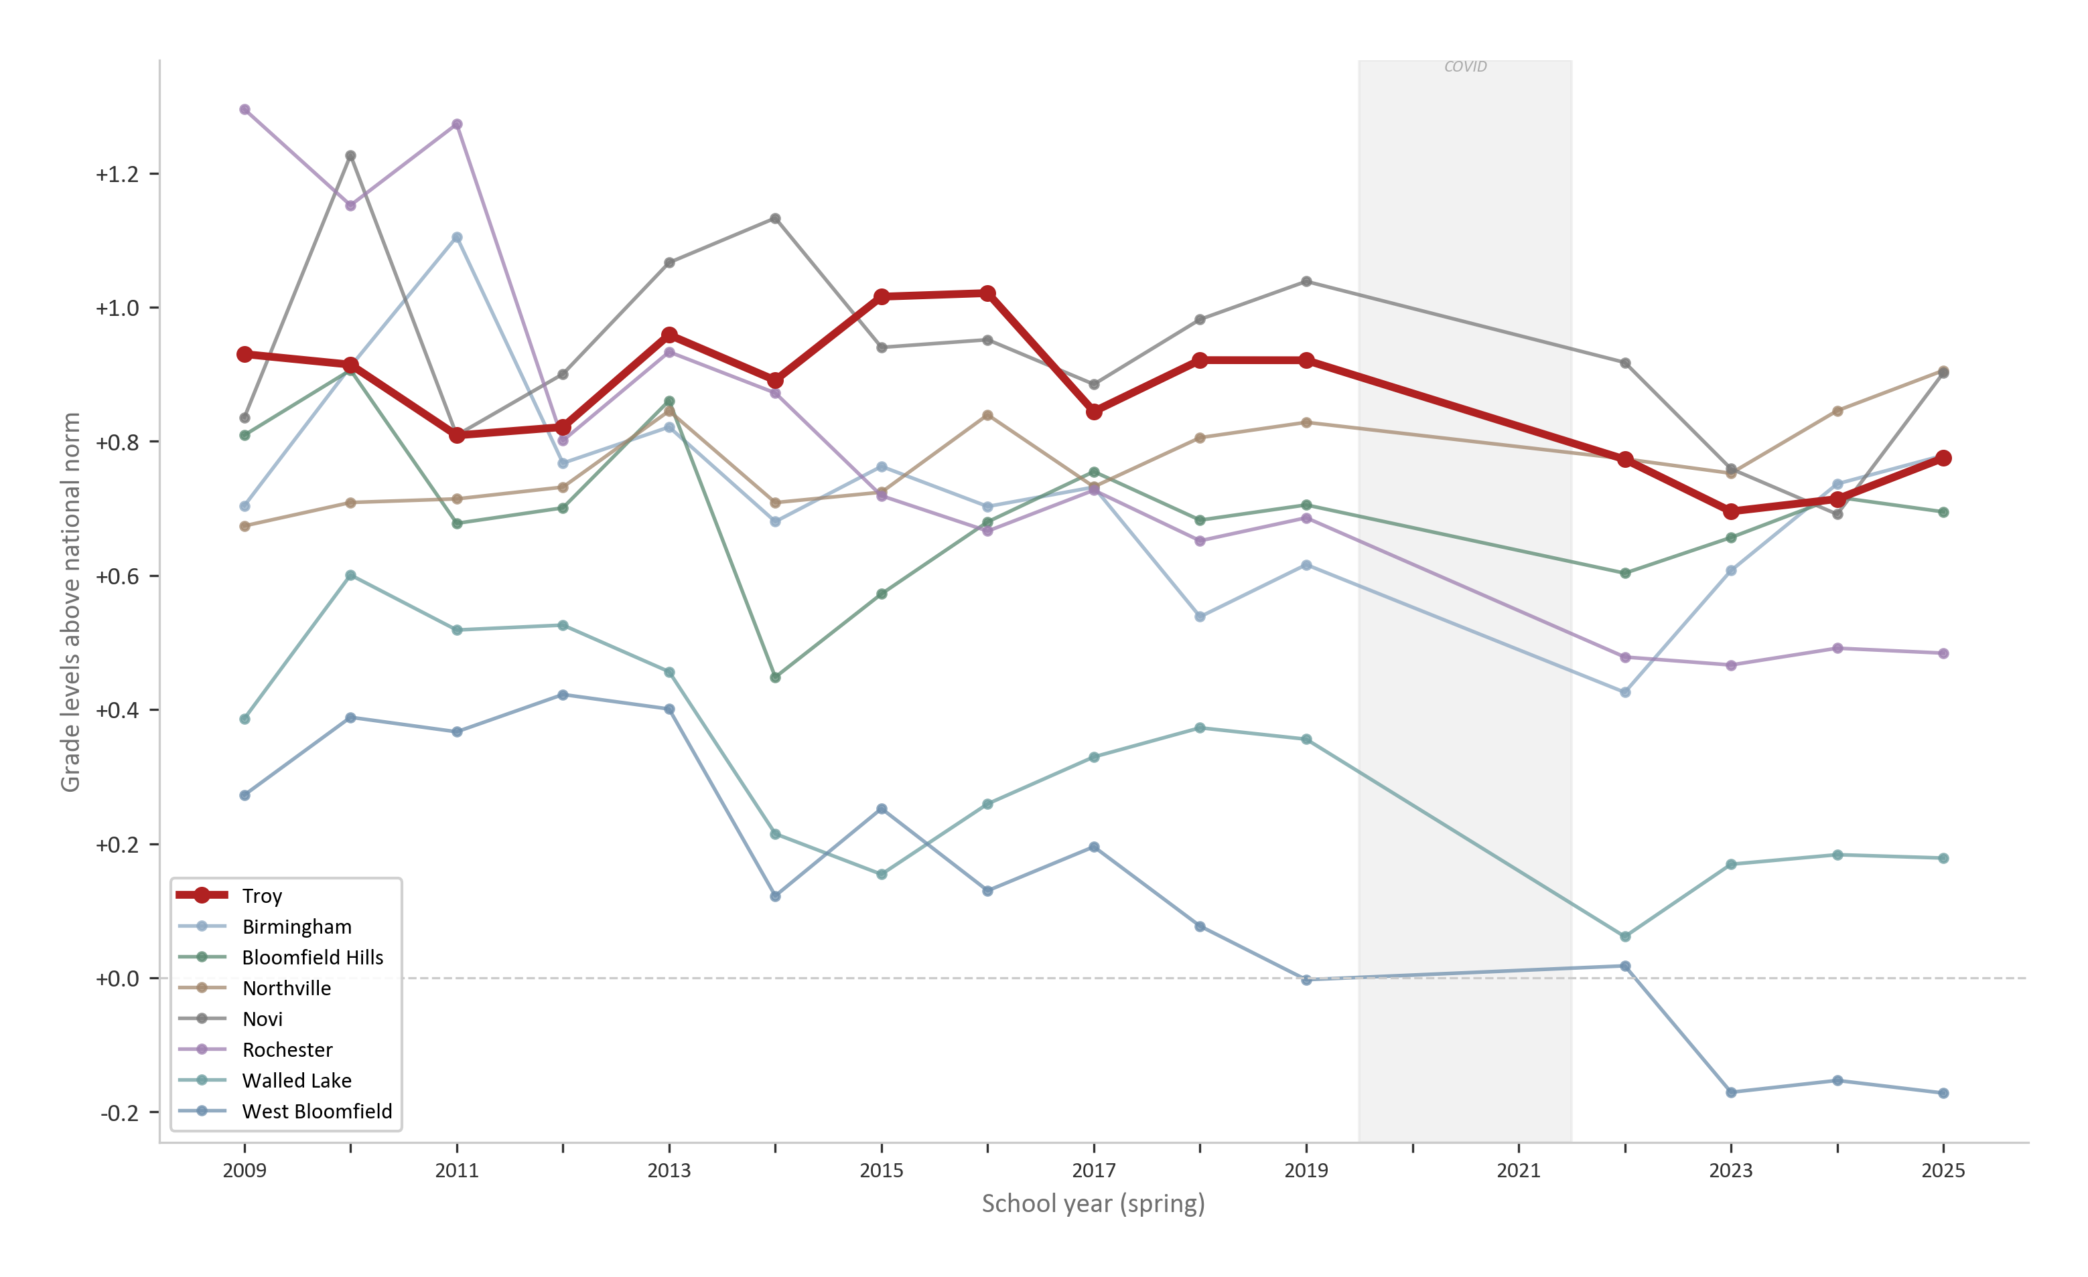
G7 Math: The Tracked-vs-IM Comparison Year
2023-24 G7 tracked (+0.018). 2024-25 first G7 IM cohort (+0.061)
2023-24: G7 still tracked
G7 still used Big Ideas Math with tracking. Troy gained +0.018 — 7th of 8 MI peers.
2024-25: First G7 IM cohort
Troy gained +0.061 — 2nd of 8 MI peers. Recovery accelerated under IM.
Troy SD G6-G7 Math — Executive Summary • github.com/akarpo/tsd-g6g7math-choice
10 / 16

Slide 11
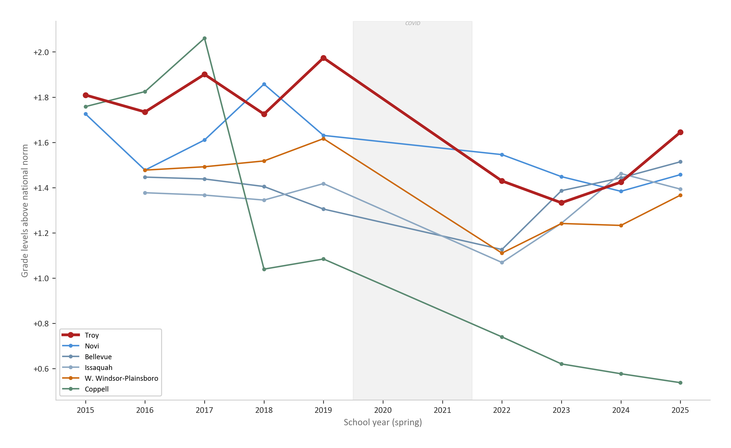
Asian Subgroup: G6 Leads Recovery, G7 Lags
36% of Troy — strongest G6 IM-window recovery of any subgroup
G6 Asian IM Δ:
+0.312
Strongest recovery of any Troy subgroup. #2 among MI peers in G6 Asian.
G7 Asian IM Δ:
−0.028
Only subgroup still declining. G7 had just one year of IM.
Gap from pre-COVID:
−0.340
G7 Asian still far below 2017-19 baseline despite G6 recovery.
Troy SD G6-G7 Math — Executive Summary • github.com/akarpo/tsd-g6g7math-choice
11 / 16

Slide 12
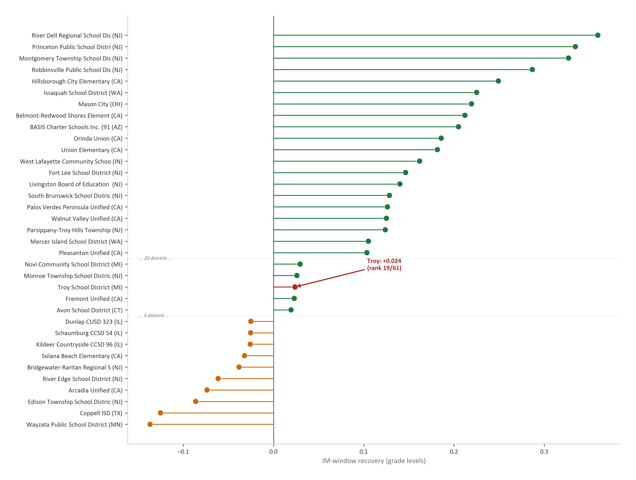
What High-Performing Math Districts Do Differently
G6+G7 Math: among 107 high-Asian (>=20%) peers, many recovered with tracking intact
Key Finding
Among 107 high-Asian (≥20%) districts nationally, many California and New Jersey districts recovered to or surpassed pre-COVID levels.
These districts maintained tracking and traditional acceleration pathways.
Troy is an outlier among its demographic peers — one of the few to adopt detracking.
The data does not support the claim that detracking is necessary for equitable outcomes.
Troy SD G6-G7 Math — Executive Summary • github.com/akarpo/tsd-g6g7math-choice
12 / 16

Slide 13
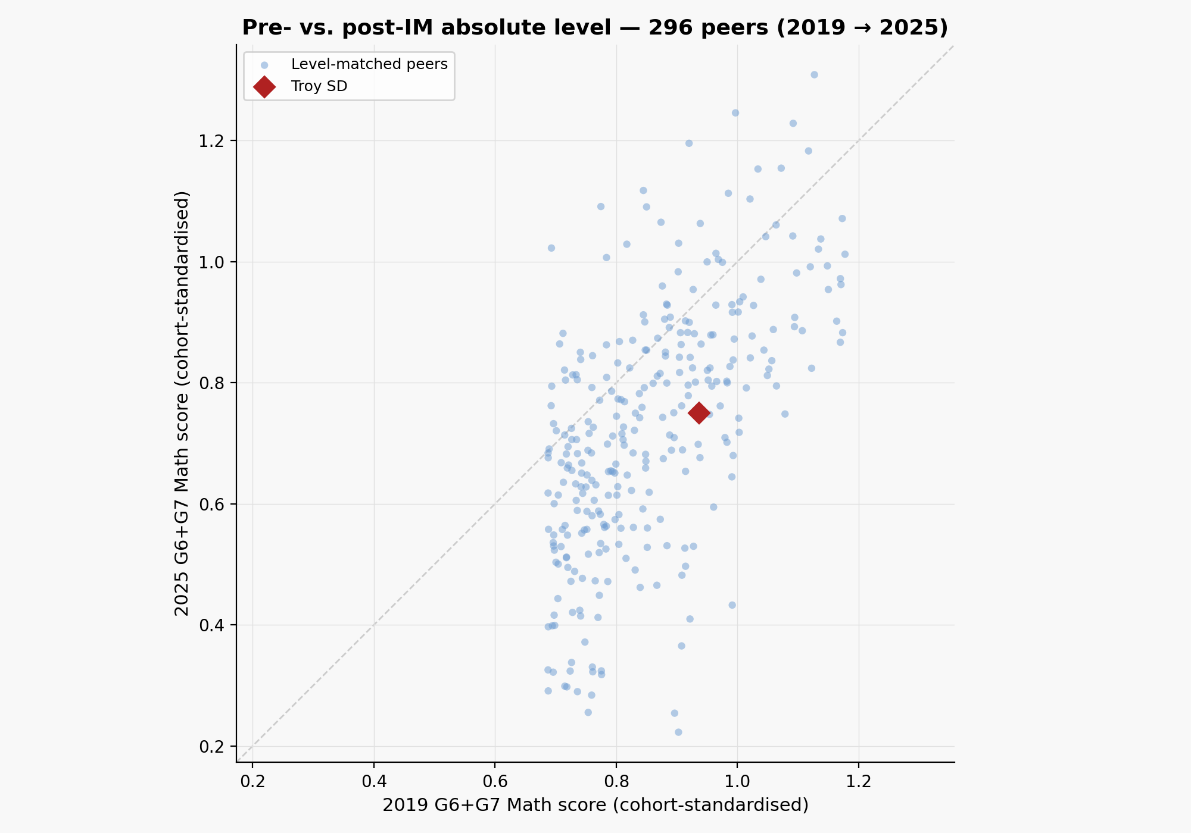
Troy Slid from Top 2% to Top 4% Nationally in G6+G7 Math
Year-by-year SEDA national ranking (all U.S. districts) + absolute level among 296 level-matched peers
National G6+G7 Math ranking trajectory
SEDA 2025.1 cs scale -- all U.S. districts with G6+G7 math data
Year
Score
Rank
Percentile
2019
+0.952
173 / 8,751
Top 2.0%
2022
+0.763
229 / 8,215
Top 2.8%
2023
+0.713
269 / 7,190
Top 3.7%
2024
+0.734
294 / 6,995
Top 4.2%
2025
+0.790
240 / 5,896
Top 4.1%
Dropped ~70 national places since 2019
Troy went from top 2% nationally to top 4%. Score declined -0.162 grade levels. 2025 rank ticks up as score partially recovered.
Pool note: ranking requires both G6 + G7 data. 9 states (IL, PA, OK, KS, ME, OR, MT, ND, UT) have no G7 math data in SEDA 2025.1, shrinking the pool from 8,751 to 5,896.
Among 296 level-matched peers
Michigan affluent peers -- score delta (2019 to 2025)
Pre-COVID rank: 76 / 296 (top quarter) Post-COVID rank: 135 / 296 (bottom 55%) 70 districts leapfrogged Troy
Birmingham
+0.131
Northville
+0.087
Bloomfield Hills
+0.085
Troy SD
-0.162
Novi
-0.167
W. Bloomfield
-0.181
Rochester
-0.188
Walled Lake
-0.197
Troy SD G6-G7 Math — Executive Summary • github.com/akarpo/tsd-g6g7math-choice
13 / 16

Slide 14
Conclusions
G6+G7 Math: four findings from SEDA and M-STEP data
1
Troy has NOT outperformed — 6th of 8 MI peers, 197/295 nationally
2
G7 Asian most concerning — only subgroup still declining (-0.028)
3
G6 Asian a bright spot — strongest recovery (+0.312), #2 MI peers
4
Recovery real but slow — all subgroups still below pre-COVID
Troy SD G6-G7 Math — Executive Summary • github.com/akarpo/tsd-g6g7math-choice
14 / 16

Slide 15
Methodology
G6+G7 Math — SEDA 2025.1 (Stanford CEPA) — NAEP-anchored cross-state comparison
Primary Metric
SEDA cs (cohort-standardized), NAEP-anchored, expressed in grade levels above/below the national average. Enables cross-state, cross-year comparison.
Time Windows
Pre-COVID baseline: 2017–19 mean. Post-COVID: 2022–25 mean. IM window: 2023 → 2025 (last pre-IM test to latest data).
Peer Groups
296 level-matched peers: pre-COVID G6+G7 math ±0.25 of Troy’s +0.937. 107 high-Asian peers: ≥20% Asian enrollment, pre-COVID ≥+0.50. 8 MI affluent peers: same state test, comparable demographics.
M-STEP Data
Michigan School Data (mischooldata.org). % proficient or advanced, grades 6 and 7, 2021–22 through 2024–25.
Troy SD G6-G7 Math — Executive Summary • github.com/akarpo/tsd-g6g7math-choice
15 / 16

Slide 16
References
Primary data sources
1.
SEDA 2025.1 -- Stanford Center for Education Policy Analysis (CEPA). edopportunity.org
2.
Education Scorecard 2026 -- Harvard-Stanford-Dartmouth collaboration. educationscorecard.org
3.
MI School Data / M-STEP -- Michigan Department of Education. mischooldata.org
Troy SD G6-G7 Math — Executive Summary • github.com/akarpo/tsd-g6g7math-choice
16 / 16

