Slide 1
Troy SD K-5 ELA
The Quantitative Case for Curriculum Change
Pressure-testing Collaborative Literacy + UFLI Foundations
Executive Summary — Citations + Appendix
Prepared May 2026 • 50-district national benchmark • 2009-2025 coverage
Repo: github.com/akarpo/tsd-k5ela-choice Live: tsd-k5ela-choice.karpowitsch.org

Slide 2
The question — and the one-line answer
Three independent pieces of evidence converge on the same answer
QUESTION
Is Collaborative Literacy 3rd Ed. + UFLI Foundations the right K-5 ELA choice for Troy's balanced-literacy → Science of Reading transition?
ANSWER
No.
The evidence converges from three independent directions:
0 of 50
19 of 20
3 of 3
outperformer + peer districts¹ use Collaborative Literacy as their K-5 core.
Education Scorecard 2026³ ELA-relevant outperformer districts run, supplement, or are transitioning to SoR-aligned curricula.
of Troy's stronger alternatives have named district adoptions with recovery evidence.
There is no national precedent for the combination Troy is considering.
Demographic-adjusted gain methodology — Harvard, Stanford, Dartmouth.
Only Wayne County NC stayed in pure balanced literacy.
Amplify CKLA — Marion Co KY³⁰, Fond du Lac WI³³
EL Education — Detroit DPSCD⁴²
Wit & Wisdom — W. Baton Rouge³⁷, Baltimore
Troy SD K-5 ELA — Executive Summary • github.com/akarpo/tsd-k5ela-choice
2 / 29

Slide 3
First, the honest pre-COVID picture — Troy gained on aggregate, but subgroups were uneven
SEDA cohort-standardized scale (cs): NAEP-anchored grade-level units. +1.0 = one grade above national norm.
Why this matters
Any argument for change has to start by acknowledging what's true: pre-COVID, Troy was healthy on the
only metric that compares across state tests fairly¹⁻². Calkins UoS didn't break Troy historically.
Pretending otherwise undermines the credibility of the post-COVID case (which IS strong).
Troy SD 2009 → 2019 on SEDA cs scale²
What this rules out
• All Students: +0.486 → +0.747 (+0.26)
• Asian: +0.712 → +1.063 (+0.35)
• White: +0.450 → +0.609 (+0.16)
• Black: −0.070 → −0.160 (−0.09)
• Hispanic*: +0.340 → +0.033 (−0.31)
• Econ Disadv: −0.210 → +0.078 (+0.29)
• Not-Econ Disadv: +0.552 → +0.853 (+0.30)
* Hispanic suppressed pre-2011 (N<10); baseline is 2011.
• "Calkins UoS has been failing Troy for a decade."
Mostly false. Aggregate + affluent gains 2009-2019.
(Caveat: Black + Hispanic subgroups stagnated.)
• "This is a long-running trend that COVID exposed."
False. 2019 was Troy's peak on the aggregate scale.
• "Troy was on a declining trajectory."
False. Troy outperformed every MI affluent peer
on aggregate 2009-2019.
The case for change is NOT retrospective.
The collapse is post-COVID (2019→2025) — and it hit
every subgroup.
Aggregate gains went to Asian, White, Not-ECD, and EconDis subgroups. Black + Hispanic subgroups stagnated or slipped slightly — the pre-COVID story was uneven.
Troy SD K-5 ELA — Executive Summary • github.com/akarpo/tsd-k5ela-choice
3 / 29

Slide 4
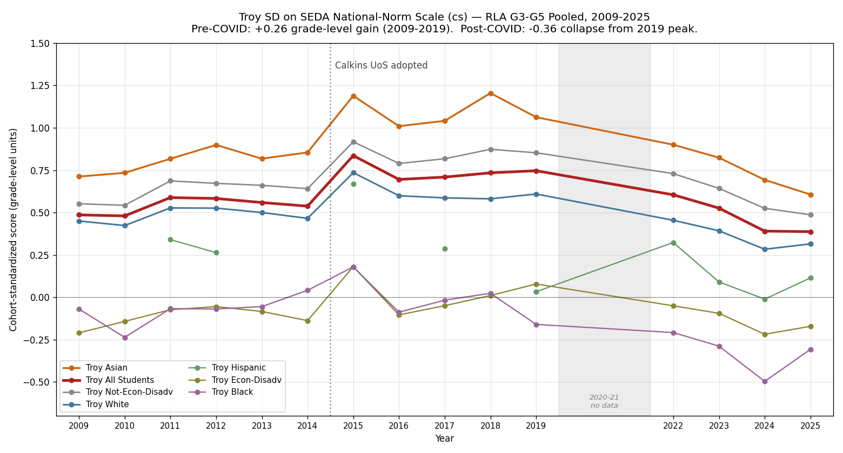
The post-COVID collapse is the real signal
Troy's 2019 peak was +0.747. By 2025: +0.387. Lost 16 years of slow gains in 3 years.
From 2019 peak to 2025¹
All Students −0.36
Asian −0.46
White −0.29
Not-ECD −0.37
EconDis −0.25
Black −0.15
Hispanic +0.08 †
(grade-level units)
† small-N subgroup (~3-4% of Troy)
Four straight years of decline
2022: +0.605
2023: +0.526
2024: +0.390
2025: +0.387
The 2025 Troy score (+0.387) is BELOW Troy's 2009 score (+0.486).
Sixteen years of slow gains erased in three years — and recovery has not started.
Troy SD K-5 ELA — Executive Summary • github.com/akarpo/tsd-k5ela-choice
4 / 29

Slide 5
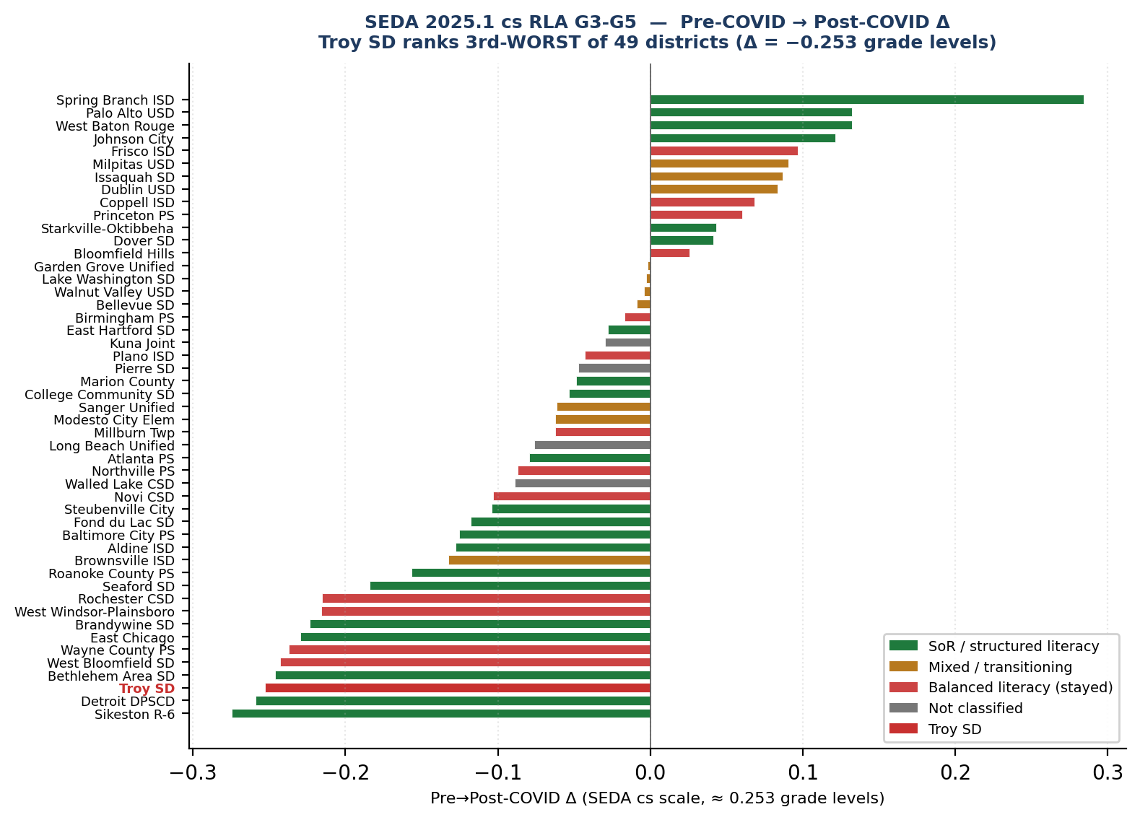
Of 50 demographically-comparable + outperformer districts, Troy ranks 47 of 49
Pre-COVID (2017-19 mean) vs Post-COVID (2022-25 mean) on SEDA cohort-standardized RLA scale
Bottom 5 districts (Δ pre→post)
48 Sikeston R-6 −0.275
47 Detroit DPSCD −0.259
46 Troy SD −0.253 ◄
45 Bethlehem Area SD −0.246
44 West Bloomfield −0.243
Top 5 districts (Δ pre→post)
1 Spring Branch ISD +0.284 (TX STR³⁶)
2 Palo Alto USD +0.132 (ESRI³⁵)
3 West Baton Rouge +0.132 (W&W³⁷)
4 Johnson City TN +0.121 (TN HQIM³⁹)
5 Frisco ISD +0.097 (BL)
Pattern
Districts that GAINED post-COVID all run structured-literacy cores.
Districts at the bottom either (a) face severe poverty headwinds (Sikeston, Detroit) or (b) are affluent BL districts (Troy, West Bloomfield).
Troy SD K-5 ELA — Executive Summary • github.com/akarpo/tsd-k5ela-choice
5 / 29

Slide 6
The comprehensive view — every district, every curriculum type
Curriculum alone doesn't determine recovery. But magnitude of gain correlates with structured literacy.
Of 49 districts with sufficient pre/post-COVID data¹:
13 gained on the SEDA scale • 36 declined • Many SoR-adopters also declined — recovery is not automatic.
Big gain (Δ ≥ +0.10)
Moderate gain (+0.05 to +0.10)
Flat or declined (Δ < +0.05)
4 districts — ALL SoR
6 districts — mixed
39 districts — both types
Spring Branch ISD
+0.284
TX STR³⁶
Frisco ISD
+0.097
BL
Detroit DPSCD
−0.259
EL Ed (SoR)
Palo Alto USD
+0.132
ESRI³⁵
Milpitas USD
+0.090
Benchmark
Aldine ISD
−0.034
CKLA (SoR)
West Baton Rouge
+0.132
W&W³⁷
Issaquah SD
+0.087
Benchmark '24
Baltimore PS
−0.213
W&W (SoR)
Johnson City TN
+0.121
TN HQIM³⁹
Dublin USD
+0.084
Bench+Heggerty
Fond du Lac
−0.014
CKLA (SoR)
Coppell ISD
+0.068
BL
Seaford SD
−0.180
Bookworms (SoR)
Princeton PS
+0.060
BL (NJ peer)
Troy SD
−0.253
Calkins UoS (BL)
100% of districts in this tier run structured-literacy programs.
Next-strongest gainer outside this tier: Frisco ISD (TX, BL) at +0.097.
Mix of BL, Benchmark-Advance, and recently-adopted structured literacy.
36 of 49 had Δ < 0; 3 held flat (Bloomfield Hills, Starkville, Dover). SoR alone is necessary but not sufficient — recovery also needs sustained PD, universal screeners, and a 2-3-year cohort lag (slide 19).
Honest finding: SoR doesn't guarantee recovery. But the only districts achieving STRONG recovery so far are SoR-aligned.
Troy SD K-5 ELA — Executive Summary • github.com/akarpo/tsd-k5ela-choice
6 / 29

Slide 7
A second independent benchmark — Education Scorecard 2026 'Districts on the Rise'
Demographic-adjusted gain methodology (Harvard-Stanford-Dartmouth³) — catches outperformers SEDA raw Δ misses
What DOTR measures (different from SEDA raw Δ):
Demographic-adjusted gain ≥ 0.3 grade levels in BOTH 2019–2025 AND 2022–2025, with ≥4 demographically-comparable peer districts in-state. Detroit DPSCD is a DOTR outperformer despite a SEDA raw Δ decline — it gained more than its demographics predicted.
Math + Reading outperformers (17)
Reading-Only outperformers (3)
East Hartford CT
Fundations + Heggerty + Fund. Unl.
SoR
Modesto City Elem CA
Benchmark Adv + UFLI + LETRS
→ SoR-patched
West Baton Rouge LA
Wit & Wisdom + Wilson Fundations
→ SoR
Roanoke County VA
W&W + Heggerty + Really Great Rdg
→ SoR
East Chicago IN
Heggerty + Reading Horizons + coaches
SoR
Marion County KY
Amplify CKLA + LETRS
SoR
Baltimore City MD
Wit & Wisdom K-8 (2018-)
SoR
Detroit DPSCD MI
EL Education K-5 (2018-)
SoR
Starkville MS
MS HQIM (BL→structured shift)
SoR
Pierre SD
Open Court + OG + Heggerty + Barton
SoR
Johnson City TN
TN HQIM (SoR mandate)
SoR
Spring Branch TX
TX STR framework
SoR
Fond du Lac WI
Amplify CKLA + DDI + UVA-PLE
SoR
Dover NH
Knowledge-building shift
SoR-lean
Brandywine DE
Explicit phonics K-2
SoR-lean
Summary across both groups
Sikeston R-6 MO
Teacher-developed + state LETRS
SoR-lean
Atlanta APS GA
Benchmark + HMH (Phase 2 SoR)
SoR-trans.
• 13 districts: clear SoR-aligned core
• 5 districts: SoR-leaning / patched / transitioning
• 1 district: future SoR adoption
• 1 district: unclear curriculum
• 1 district: stayed BL (Wayne County NC)
Kuna Joint ID
HMH Into Reading planned 2026-27
SoR-future
College Comm. IA
MTSS focus (curriculum unclear)
Unclear
Wayne County PS NC
Stayed BL
BL
19 of 20 = 95% SoR-aligned
Two independent methodologies converge: SEDA raw Δ + Education Scorecard demographic-adjusted gain both point at structured literacy.
Troy SD K-5 ELA — Executive Summary • github.com/akarpo/tsd-k5ela-choice
7 / 29

Slide 8
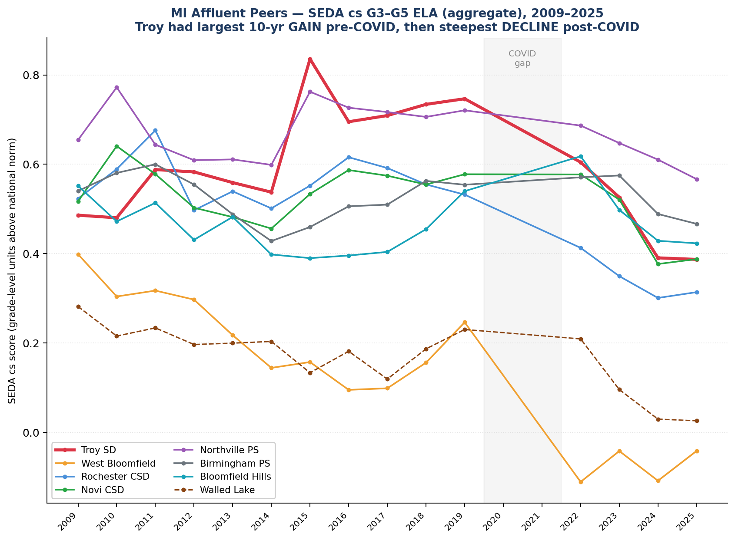
Of 8 Michigan affluent peers, Troy fell the furthest
Same state, same M-STEP test, similar demographics. Pre-COVID expected vs post-COVID actual (SEDA cs Δ).
Pre→Post COVID Δ (expected pre-COVID in parens)
District
All
Asian
White
Black
Troy SD
-0.25 (0.73)
-0.35 (1.10)
-0.23 (0.59)
-0.27 (-0.05)
West Bloomfield
-0.24 (0.17)
+0.07 (0.43)
-0.12 (0.38)
-0.27 (-0.28)
Rochester CSD
-0.21 (0.56)
-0.17 (0.76)
-0.23 (0.57)
-0.34 (0.07)
Novi CSD
-0.10 (0.57)
-0.03 (0.73)
-0.23 (0.59)
-0.34 (-0.08)
Northville PS
-0.09 (0.71)
-0.28 (1.17)
-0.08 (0.65)
—
Birmingham PS
-0.02 (0.54)
-0.10 (0.93)
-0.02 (0.59)
-0.06 (0.07)
Bloomfield Hills
+0.03 (0.47)
-0.02 (0.78)
+0.08 (0.46)
-0.45 (0.00)
District
Hisp
EconDis
Not-ECD
Troy SD
-0.03 (0.16)
-0.15 (0.01)
-0.25 (0.85)
West Bloomfield
-0.21 (-0.09)
-0.25 (-0.28)
-0.20 (0.41)
Rochester CSD
-0.11 (0.23)
-0.16 (-0.08)
-0.21 (0.64)
Novi CSD
+0.16 (0.16)
-0.24 (-0.07)
-0.05 (0.62)
Northville PS
+0.23 (0.29)
+0.02 (-0.04)
-0.08 (0.76)
Birmingham PS
-0.08 (0.58)
+0.03 (-0.02)
-0.01 (0.59)
Bloomfield Hills
—
+0.01 (-0.21)
+0.04 (0.54)
Troy SD K-5 ELA — Executive Summary • github.com/akarpo/tsd-k5ela-choice
8 / 29

Slide 9
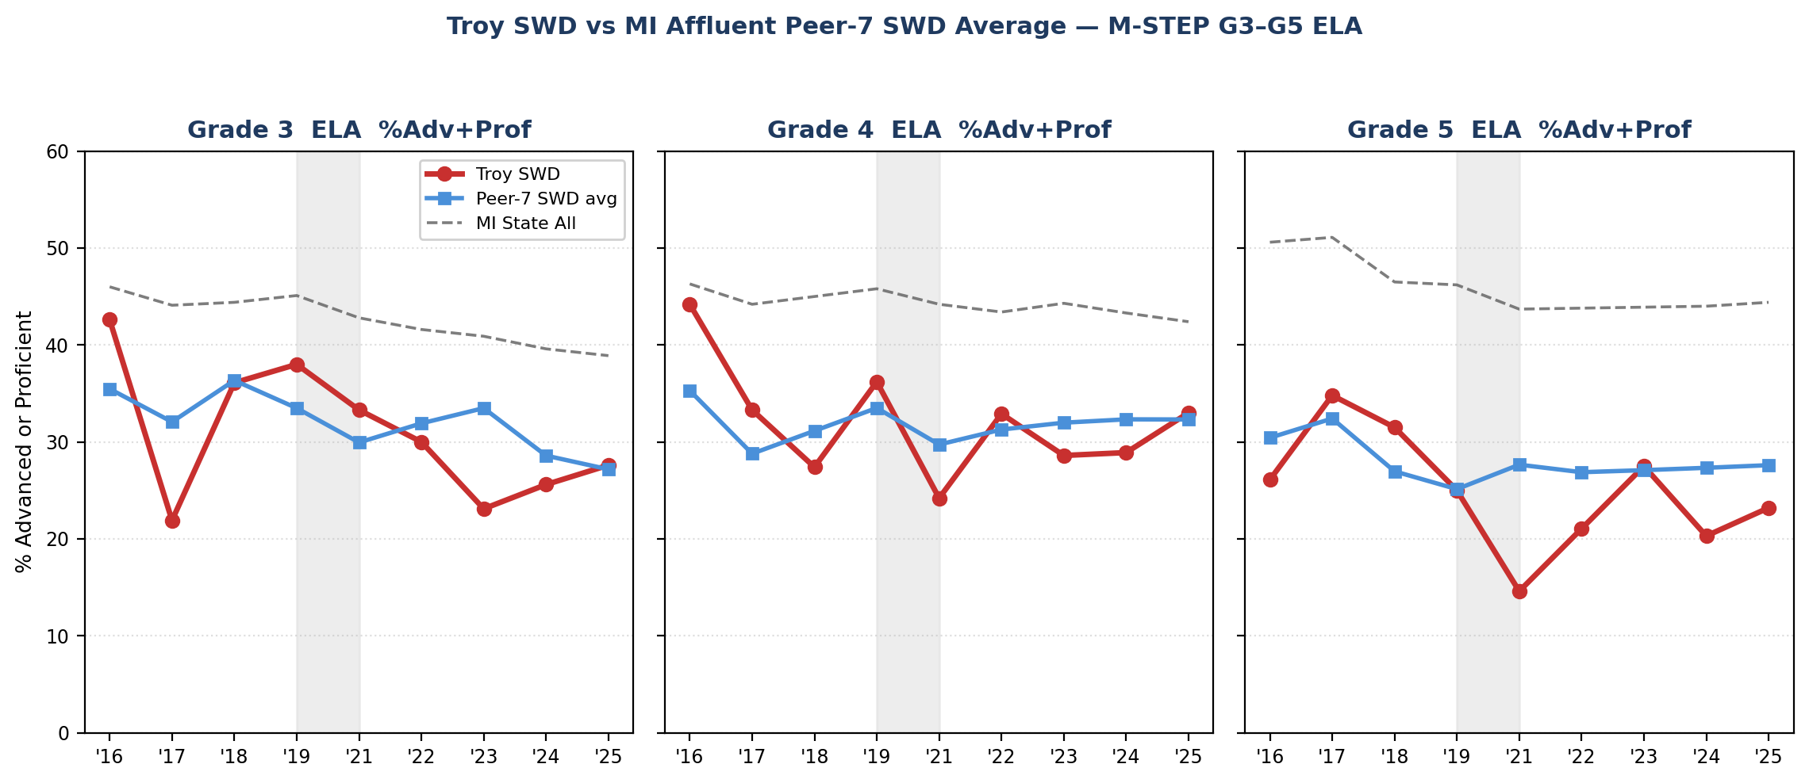
The Students-with-Disabilities subgroup tells the same story — only louder
MI School Data M-STEP %Adv+Prof¹⁰ (different metric from SEDA cs scale — direct MDE source for Troy SWD)
Pre→Post-COVID Δ (M-STEP %Adv+Prof)
Grade
Troy
Peer-7
Gap
Grade 3
−11.6 pp
−3.8 pp
−7.9 pp
Grade 4
−1.6 pp
−0.1 pp
−1.5 pp
Grade 5
−4.6 pp
+0.7 pp
−5.3 pp
G3: Troy SWD fell 3× faster than peers.
G5: Peers gained; Troy fell.
Why this matters
• Troy SWD G3: 37% pre-COVID → 25% today.
Peer-7 SWD G3: 35% → 31% (held much better).
• Pre-COVID Troy SWD ≈ Peer-7 SWD.
Post-COVID Troy SWD sits 4–7pp BELOW peers.
• SoR is engineered for struggling readers.
The students who benefit MOST from SoR
are falling FASTEST at Troy vs. same-state peers.
• Refutes "regression-to-mean" — SWD students
aren't high-achievers regressing.
Two independent sources converge: SEDA cs scale (49 districts) and MDE M-STEP %prof (Troy subgroups) both say the SoR-relevant subgroups are falling fastest.
Troy SD K-5 ELA — Executive Summary • github.com/akarpo/tsd-k5ela-choice
9 / 29

Slide 10
The subgroup data refutes the three common defenses
Each common defense of Troy's current trajectory is testable on the SEDA scale¹. Each fails the test.
"It's the ESL/ELL composition."
1
If true: Hispanic and EL subgroups should be hit hardest.
Data: Troy Hispanic Δ = −0.031. Rank 12 of 39 — best of Troy's subgroups¹.
REFUTED. The Hispanic subgroup is the most resilient at Troy.
"It's the disadvantaged students."
2
If true: EconDis subgroup should be hit harder than Not-ECD.
Data: Troy EconDis Δ = −0.147 (rank 32/47). Troy Not-ECD Δ = −0.252 (rank 42/46)¹.
REFUTED. Not-ECD declined MORE than EconDis.
"It's a demographic / COVID story."
3
If true: Affluent students with home-literacy environments should be PROTECTED.
Data: Troy Asian Δ = −0.347 (34/35), White Δ = −0.231 (44/46) — the affluent subgroups dropped MOST¹.
REFUTED. Affluence provides no protection at Troy. This points at instruction.
Troy SD K-5 ELA — Executive Summary • github.com/akarpo/tsd-k5ela-choice
10 / 29

Slide 11
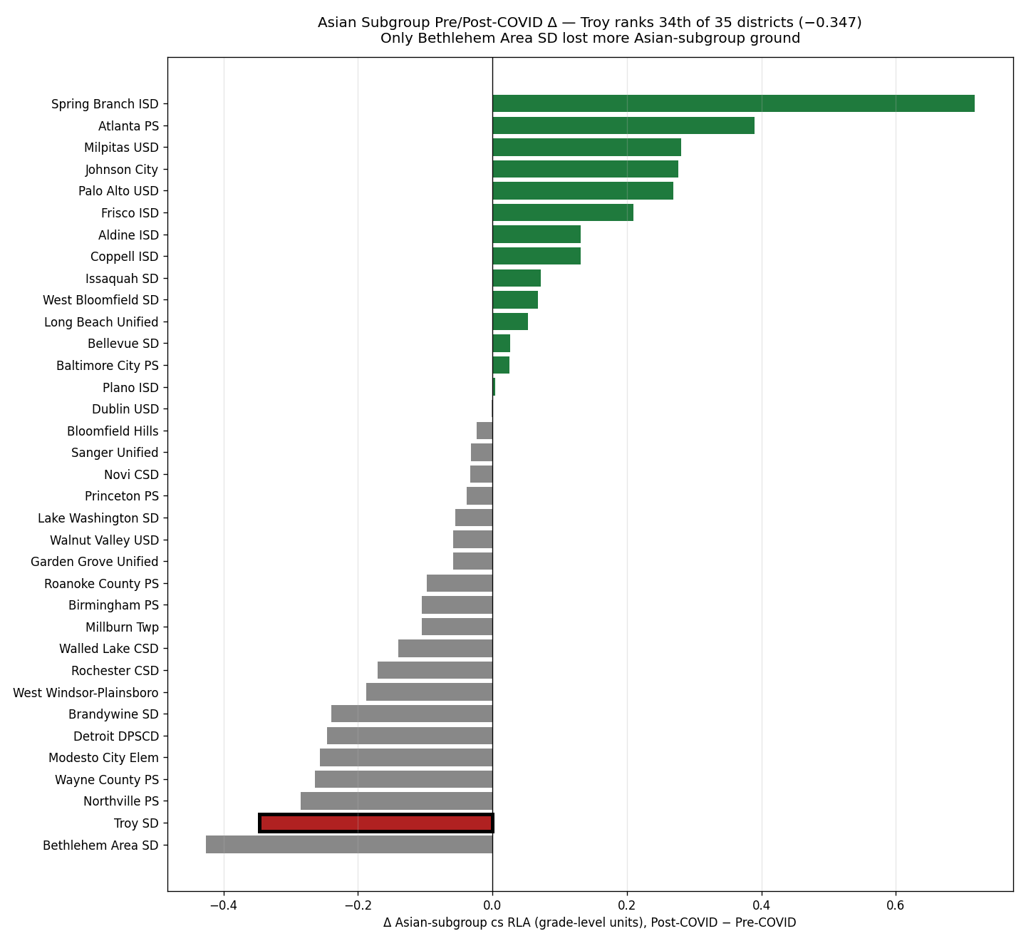
Asian subgroup: Troy ranks 34 of 35 districts on post-COVID Δ
Of 35 districts with Asian-subgroup data in SEDA 2025.1, only Bethlehem Area SD lost more ground.
Asian subgroup top 5 (gainers)
Spring Branch ISD +0.717 (TX STR³⁶)
Atlanta APS +0.390 (SoR PD)
Milpitas USD +0.281
Johnson City TN +0.277
Palo Alto USD +0.269 (ESRI³⁵)
Asian subgroup bottom 5
Bethlehem Area SD −0.426
Troy SD −0.347 ◄
Northville PS −0.285
Wayne County PS −0.264
Modesto City Elem −0.257
Direct affluent-peer signal
Palo Alto (Troy's closest demographic match by Asian %) exited Calkins UoS in 2021 via ESRI³⁵.
Result: +0.269 grade-level gain on Asian subgroup. Direct evidence the shift works.
Troy SD K-5 ELA — Executive Summary • github.com/akarpo/tsd-k5ela-choice
11 / 29

Slide 12
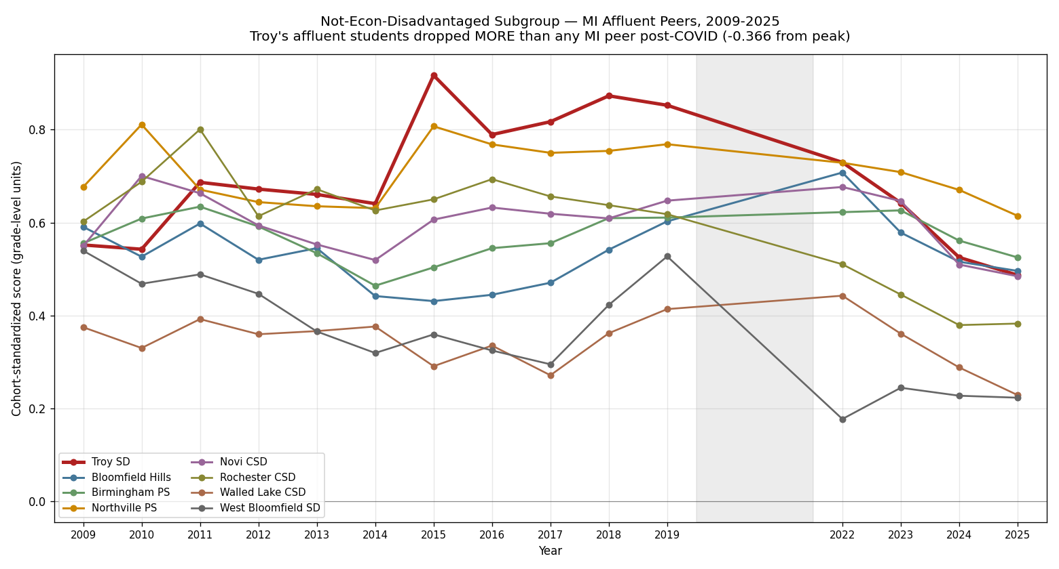
Not-Econ-Disadvantaged subgroup: Troy ranks 42 of 46
Troy's affluent students dropped −0.252 grade levels post-COVID — more than 90% of districts in our universe.
Not-ECD top 5 (recovery)
West Baton Rouge +0.315
Spring Branch +0.193
Palo Alto USD +0.138
Frisco ISD +0.133
Issaquah SD +0.124
Not-ECD bottom 5
Bethlehem Area −0.326
Wayne County PS −0.302
Seaford SD −0.301
Brandywine SD −0.267
Troy SD −0.252 ◄
Why this matters
These are the families with the most home-literacy resources. If Troy's curriculum design were sound, these are the kids who should recover first. They're recovering last.
Troy SD K-5 ELA — Executive Summary • github.com/akarpo/tsd-k5ela-choice
12 / 29

Slide 13
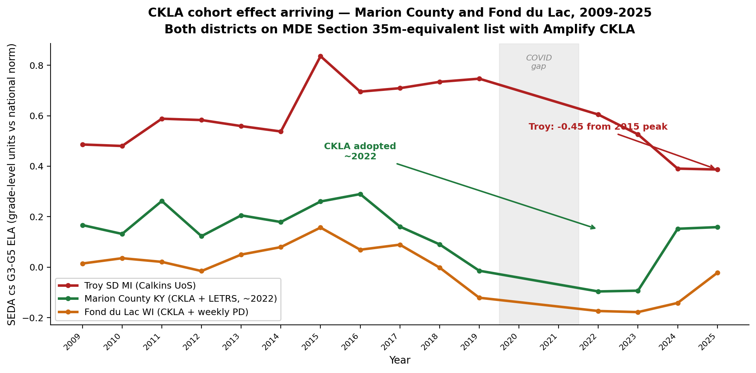
CKLA-adopting districts on the MDE-approved list are leapfrogging their states
Marion County KY and Fond du Lac WI both adopted Amplify CKLA. Both gained vs their state averages while Troy lost ground.
State-relative gain after CKLA¹
Marion County KY:
Pre-CKLA vs state +0.02
Post-CKLA vs state +0.19
Δ vs state +0.17
Fond du Lac WI:
Pre-CKLA vs state −0.02
Post-CKLA vs state +0.10
Δ vs state +0.12
Troy on the same scale
Troy SD MI (Calkins UoS):
Pre-COVID vs state +0.79
2025 vs state +0.67
Δ vs state −0.11
Troy is losing ~0.11 grade levels relative to MI state.
The two CKLA peers gained +0.12 and +0.17 relative to their states.
Troy SD K-5 ELA — Executive Summary • github.com/akarpo/tsd-k5ela-choice
13 / 29

Slide 14
How they did it — Marion County KY and Fond du Lac WI playbooks
Both districts adopted Amplify CKLA (Tier-1 on the MI MDE Section 35m approved list¹⁸)
Marion County KY — Chris Brady, Supt.³⁰,³²
Fond du Lac WI — Matt Steinbarth, Supt.³³,³⁴
~2,937 students • 61% econ-disadvantaged • 83% White, 11% Hispanic
~6,457 students • 49.5% econ-disadvantaged • 59% White, 21% Hispanic, 9% Black
Curriculum stack
Curriculum stack
Amplify CKLA K-5 + Amplify ELA 6-8 (single-vendor vertical alignment). District-wide rollout in 2022-23, aligned with KY Read to Succeed Act of 2022.
Amplify CKLA K-5 + Amplify ELA 6-8 + Bridges Math + TCI Social Studies + Mystery Science (K-8 coherent stack). Adoption aligned with August 2022 Strategic Plan.
Teacher PD
Leadership development partnership
LETRS Volumes 1 & 2 via Kentucky Reading Academies³¹ (state-paid, no cost to district) — 44 teachers AND administrators trained since 2022. Principals went through LETRS WITH teachers so they can evaluate foundational instruction in the same vocabulary.
Partnered with the UVA Darden Partnership for Leaders in Education (UVA-PLE)³⁴. Single biggest differentiator: CKLA embedded in a multi-year leadership and instructional-redesign program, NOT adopted as a standalone literacy textbook.
Coaching restructure
Teacher PD
Coaches moved from building-based to content-driven, operating in 6-9 WEEK CYCLES with teachers on standards-aligned instruction and diagnostic data. The single most unusual structural choice — most rural KY districts kept building-based coaching.
Weekly Data-Driven Instruction (DDI) cycles trained via UVA-PLE. ~$20M ESSER funds deployed for curriculum + after-school + classroom libraries + AVID. WI Act 20 (2023) added a state legal forcing function³⁸.
Implementation
Result
Full district-wide rollout, NOT a pilot. Tech use reduced to reclaim student-teacher engagement time. G3-7 ELA proficient +10pp 2021-22 → 2024-25.
Jumped from 375th to 175th of 421 WI districts. "Exceeds Expectations" on 2024-25 WI report card — first time since 2016-17. Highest reading growth of all 421 WI districts 2022-2024.
Result on SEDA scale
Leadership transition
Pre-CKLA: −0.01 vs KY state. 2024-25: +0.19 vs state. +0.17 grade-level state-relative gain in 3 years. Marion County MS jumped 221→57 in KY state rank.
Supt Fleig led the redesign 2022-2025; retired May 2025. Board promoted CAO Matt Steinbarth (25-yr district insider) 7-0 to protect continuity. Credit the turnaround to Fleig + Steinbarth + UVA-PLE.
Troy SD K-5 ELA — Executive Summary • github.com/akarpo/tsd-k5ela-choice
14 / 29

Slide 15
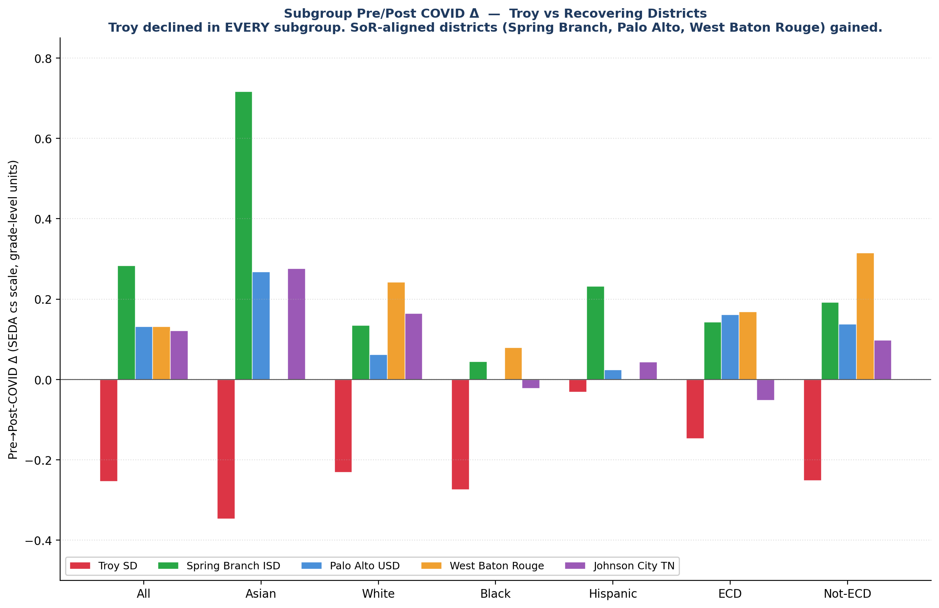
Recovery is possible — and it tracks with curriculum choice
Four districts gained post-COVID. All four run structured-literacy programs.
Spring Branch ISD (TX)³⁶
+0.284 overall / +0.717 Asian / +0.193 Not-ECD
TX STR-aligned framework, K paraprofessionals trained in evidence-based instruction.
Palo Alto USD (CA)³⁵
+0.132 overall / +0.269 Asian / +0.138 Not-ECD
Exited Calkins Units of Study in 2021 via Every Student Reads Initiative. Direct Troy parallel.
West Baton Rouge (LA)³⁷
+0.132 overall / +0.315 Not-ECD / +0.242 White / +0.079 Black
Wit & Wisdom + Wilson Fundations K-3. K-3 literacy 57% → 68% in single year.
Johnson City TN³⁹
+0.121 overall / +0.277 Asian / +0.165 White
Tennessee HQIM SoR mandate. +22pp above TN state on G4 ELA in 2025.
Troy SD K-5 ELA — Executive Summary • github.com/akarpo/tsd-k5ela-choice
15 / 29

Slide 16
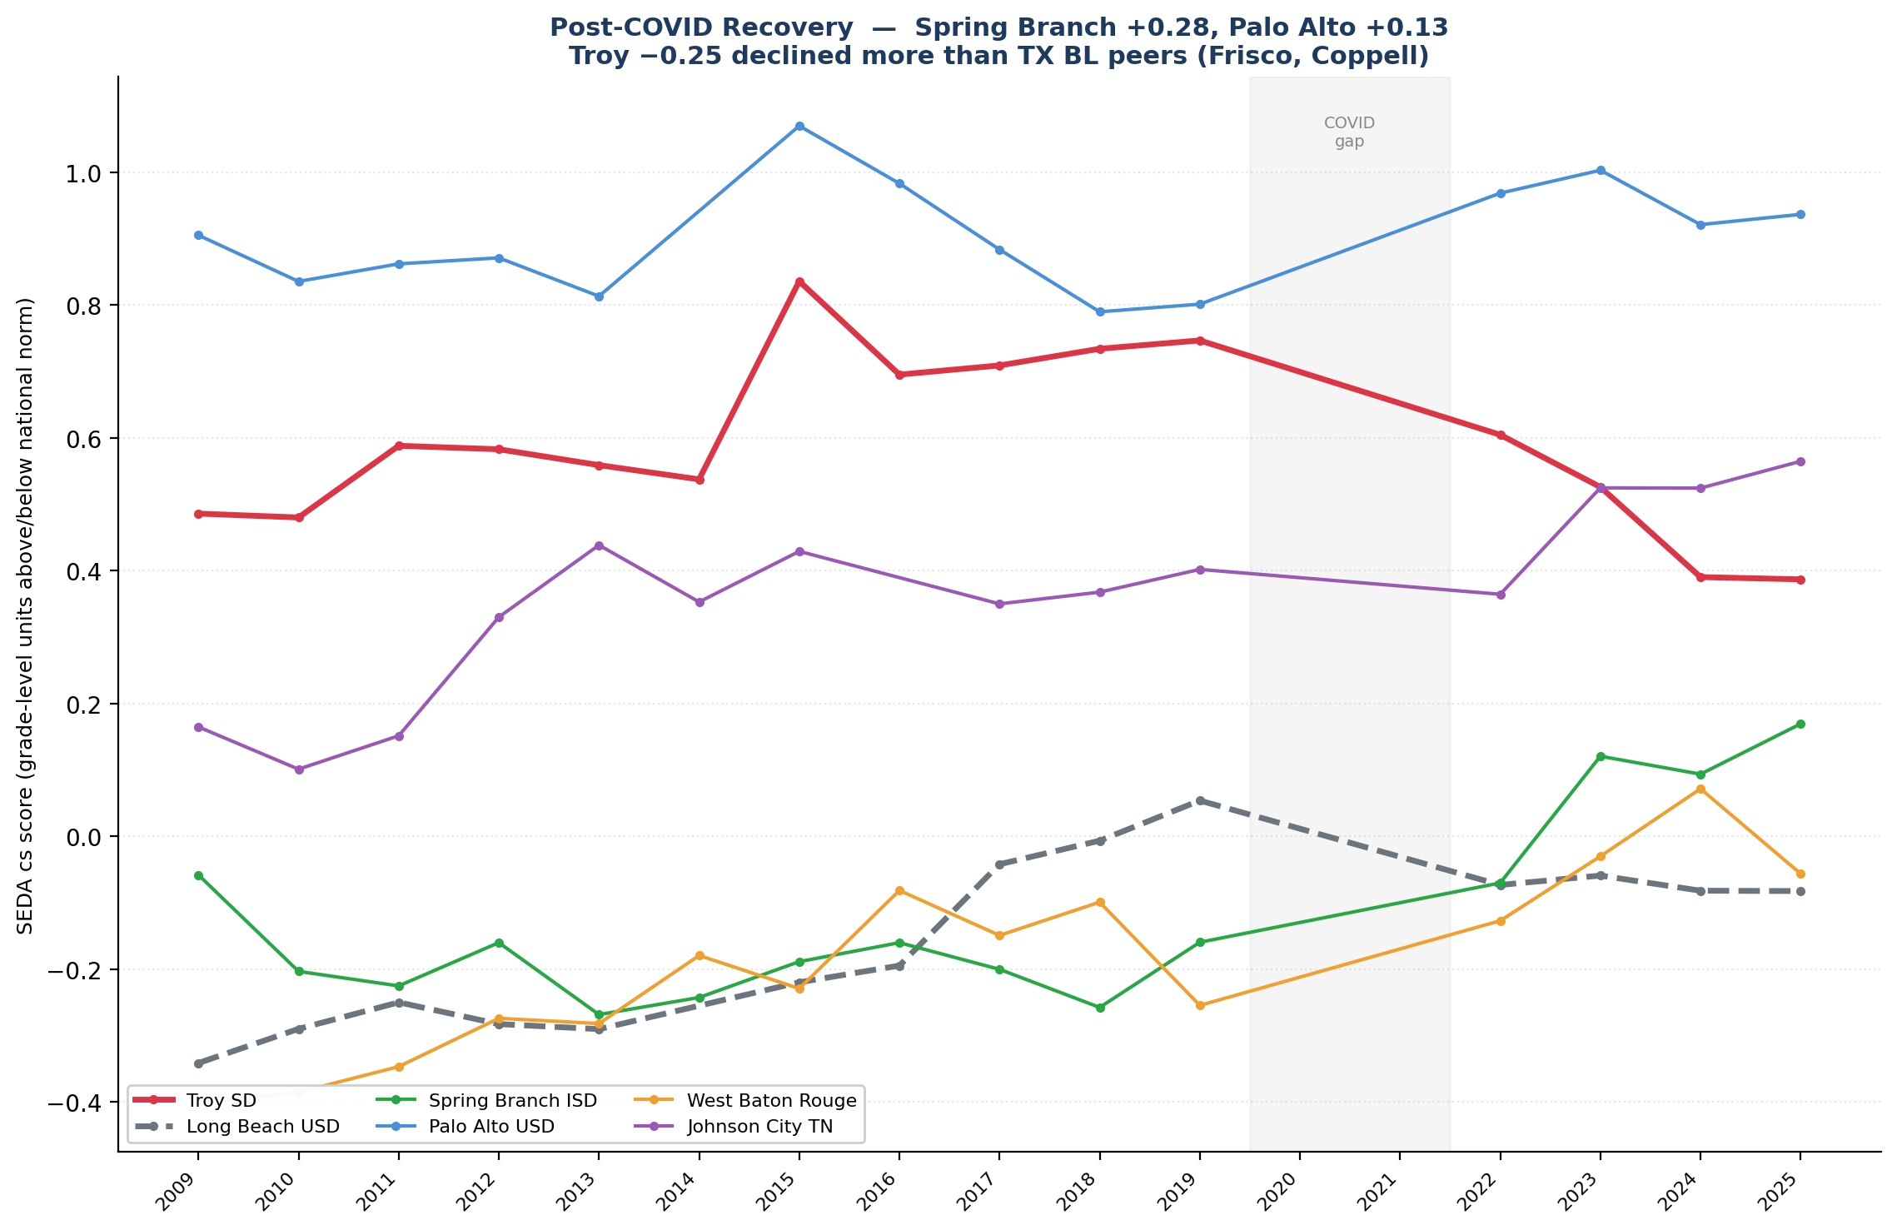
Long Beach USD — the natural experiment is now empirically visible
Same district, same Carl Cohn-era leadership culture, same demographics. Only the curriculum changed.
Long Beach trajectory
1992-2002 (Cohn era): Open Court basal
→ Broad Prize 2003
2010s drift: Teachers College Units of Study (Calkins)
→ same program Troy adopted 2014
Pre/Post-COVID Δ: −0.076 grade levels
Why this matters for Troy
Long Beach is the closest thing to a controlled trial against Calkins UoS in U.S. K-5 ELA data.
Same district. Same insider supt tradition. Same demographics. The pre-COVID period worked.
Post-COVID, the Calkins-derived core failed to support recovery — same pattern as Troy.
Troy SD K-5 ELA — Executive Summary • github.com/akarpo/tsd-k5ela-choice
16 / 29

Slide 17
Why balanced literacy fails when school and home reading routines both break down
A plain-English causal story that's consistent with every subgroup finding
How Calkins UoS works²⁰,²³
What COVID broke²¹
Why SoR districts recovered²²,²⁵
• Workshop-model, student-led discovery
• Leveled-text independent reading
• Comprehension strategies (predict, infer, etc.)
• Minimal explicit phonics in core
• Relies on rich home language environment to fill gaps in explicit instruction
• Reading-aloud, book access, parent-supported reading time
• Classroom delivery — interrupted
• Home reading routines — disrupted
• Book access at home — limited
• Parent time for reading — fragmented
• Balanced literacy assumed BOTH school AND home would teach reading — when home routines broke down, school's part alone wasn't designed to do the whole job
• Most-affluent students had the MOST home reading support to lose, so they fell furthest
• Explicit phonics scope and sequence
• Decodable texts at K-2
• Knowledge-building core that doesn't assume background knowledge
• Cohesive sequence — same content in every classroom
• Doesn't depend on home support — designed to teach reading in school
• When classroom delivery returned, the curriculum was still intact and could rebuild skills
Troy SD K-5 ELA — Executive Summary • github.com/akarpo/tsd-k5ela-choice
17 / 29

Slide 18
Tested hypothesis — does SoR help only early grades, not later ones?
If the 'BL for later grades' hypothesis were correct, BL districts should hold up at G5. They don't.
The hypothesis
"Maybe SoR helps for K-2 phonics, but balanced literacy still has a role at G3-G5 where comprehension + rich text matter more." — pedagogically plausible. Testable on this data.
Mean SEDA Δ by grade × curriculum type
Top 5 G5 gainers — 100% SoR-aligned
Type G3 Δ G4 Δ G5 Δ n
─────────────────────────────────────────────────
SoR-clear −0.088 −0.117 −0.065 21
SoR-recent/lean +0.031 −0.011 −0.036 5
Mixed/Benchmark +0.113 +0.133 +0.062 3
Balanced lit. −0.102 −0.107 −0.083 15
Reading:
• BL districts decline at EVERY grade — they don't hold up
better at G5. They decline less, but still decline.
• SoR-clear shows its SMALLEST decline at G5, not G3.
• SoR-recent adopters (Bellevue, Issaquah, Lake Wash.,
Modesto, College Comm.) actually GAINED at G3 (+0.031)
— cohort effect from new-K students reaching G3 in '24-25.
1 Spring Branch ISD +0.284 TX STR
2 Johnson City TN +0.221 TN HQIM
3 West Baton Rouge +0.207 W&W + Fundations
4 Steubenville City +0.176 Success for All (25 yr)
5 Starkville-Oktibbeha +0.126 MS HQIM
Top 5 G3 gainers (for comparison):
1 Palo Alto USD +0.205 SoR (ESRI)
2 West Baton Rouge +0.142 SoR
3 Milpitas USD +0.099 Mixed/Benchmark
4 Issaquah SD +0.087 SoR-recent
5 College Community +0.075 SoR-recent
The strongest G5 gainers are EXCLUSIVELY SoR.
The strongest G3 gainers are 4/5 SoR + 1 mixed.
Confounders this data can't resolve:
Cohort effects (G5 had K 5 yrs ago); cross-grade scale differences; COVID hit early grades hardest (K-1 missed foundational year); small SoR-recent/Mixed n.
Troy SD K-5 ELA — Executive Summary • github.com/akarpo/tsd-k5ela-choice
18 / 29

Slide 19
Curriculum verdict — Troy's options on the MI Section 35m list
Ranked by evidence strength + alignment with recovery patterns
#
Curriculum
EdReports
Recovery proof points
Comp.
Grade
1
Amplify CKLA 3rd Ed.
All Green¹⁴
Aldine⁴¹ G4+11pp; Fond du Lac #1 WI³³
Single
A+
2
EL Education K-5
All Green¹⁴
Detroit DPSCD⁴²; NYC Reads Dist 11⁴³
Single
A
3
Wit & Wisdom + Fundations + Geodes
All Green¹⁴
West Baton Rouge³⁷; Baltimore W&W since 2018
2-3 vendor
A
4
UFLI Foundations (component)
Not reviewed¹⁴
RRQ 2025 ES >1.0 SD²⁴
Supplement
A
5
Really Great Reading
196/198¹⁴
NYC Reads foundational core⁴³
Supplement
A−
…
(…)
11
Collaborative Literacy 3rd Ed. + UFLI
2016 ed.: Partial¹⁴
Zero of 50 outperformers use it¹
2-vendor
B / B−
12
HMH Into Reading 2025
All Green (v1.0)¹⁴
Contested by APM Reports²¹
Single
B−
Collab Lit + UFLI is the weakest comprehensive option on the Section 35m list for a district moving OUT of balanced literacy.
Of 50 districts in the post-COVID national benchmark, zero use Collaborative Literacy as their K-5 core.
Of the 4 districts that GAINED on the SEDA scale 2017-19 → 2022-25, all four use structured literacy.
Of Troy's stronger alternatives — CKLA, EL Education, Wit & Wisdom — each has direct post-COVID recovery evidence.
Troy SD K-5 ELA — Executive Summary • github.com/akarpo/tsd-k5ela-choice
19 / 29

Slide 20
Recommendation — three paths ranked
Each leg of the evidence base points the same direction
RECOMMENDED PRIMARY PATH
Amplify CKLA 3rd Edition K-5
Single vendor, integrated foundations + knowledge. All-green EdReports (first ELA program to earn it).
Marion County KY³⁰: +10pp G3-7 ELA 2021-25 with CKLA + LETRS. Fond du Lac WI³³: #1 reading growth statewide.
STRONG ALTERNATIVE — BEST OF BREED
Wit & Wisdom + Wilson Fundations K-3 + Geodes
West Baton Rouge LA³⁷: K-3 literacy 57%→68% in ONE year. Best Not-ECD recovery (+0.315) in our universe.
Roanoke County VA³: closest demographic peer to Troy. Baltimore City: longest urban track record (since 2018).
HONORABLE MENTION
EL Education K-5 (+ phonics supplement)
Direct in-state Michigan validator: Detroit DPSCD⁴² adopted 2018, outpaced state.
NYC Reads natural experiment⁴³: District 11 (EL Education) outperformed both Into Reading and Wit & Wisdom.
IF TEACHER BUY-IN OR LOCAL POLITICS BLOCKS A CLEAN CHANGE
The least-bad fallback
Keep Collab Lit as a transitional core; drop Making Meaning in G3-5; substitute a knowledge-building supplement.
Use SIPPS for Tier-2 only and UFLI as Tier-1 K-2 phonics (avoid duplication). Commit to a 2-3 year sunset review.
Troy SD K-5 ELA — Executive Summary • github.com/akarpo/tsd-k5ela-choice
20 / 29

Slide 21
Curriculum is necessary but not sufficient — and what to track
Five execution factors + the real-time peer benchmarks
Five execution factors in every winning district
Track these districts in real time
1
Stack, don't bolt
Lake Washington WA
Knowledge core + systematic phonics + teacher PD as ONE system
Board adoption Spring 2026
→ Closest demographic peer mid-shift
2
60+ hours structured PD
Bellevue SD WA
LETRS most-cited³¹ (3 of 20 DOTRs); brand varies; depth doesn't
Year 2 of ARC Core + UFLI + Heggerty
→ Year-2 SBA fall 2026
3
Universal screeners + MTSS
Issaquah SD WA
MDE-approved K-3 screeners: mCLASS/DIBELS 8, Amira, MAP Reading Fluency
First post-Benchmark Advance SBA
→ Fall 2026
4
Plan for a 2-3 year lag
Palo Alto USD CA
Bethlehem K-change 2015 → G3 bounce 2018²⁶
Year 5 post-ESRI CAASPP trend
→ Annual CAASPP
5
Fidelity is the binding constraint
Fond du Lac WI
NYC Phase 1 conf 55% vs Phase 2 38%⁴³ = real outcome gap
Continued CKLA + DDI trajectory
→ WI Forward fall 2026
Aldine ISD TX
Watch G5+G6 STAAR 2026 (full post-CKLA cohort)
→ TEA TAPR fall 2026
Troy SD K-5 ELA — Executive Summary • github.com/akarpo/tsd-k5ela-choice
21 / 29

Slide 22
Appendix — Methodology
Datasets, metrics, time windows, district universe
Primary metric
District universe — 50 targeted, 49 with valid SEDA Δ
SEDA cohort-standardized score (cs): NAEP-anchored grade-level units. 0.0 = at-grade national norm; +1.0 = one grade above national norm.
This is the only metric that is genuinely cross-state comparable in absolute terms — it normalizes M-STEP, CAASPP, STAAR, LEAP, MAAP, TCAP, NJSLA, SBA, OST against a common NAEP-anchored scale.
• Troy SD + 7 MI affluent peers (8)
(Bloomfield Hills, Birmingham, Northville, Novi, Rochester, Walled Lake, West Bloomfield)
• 4 CA workbook peers + 4 CA outperformers (8)
(Palo Alto, Milpitas, Walnut Valley, Dublin + Modesto, Sanger, Garden Grove, Long Beach)
• 6 TX districts (6)
(Aldine, Brownsville, Coppell, Plano, Frisco, Spring Branch)
• 3 NJ peers + 3 WA SoR-shift peers (6)
(WW-Plainsboro, Millburn, Princeton + Bellevue, Issaquah, Lake Washington)
• Steubenville (OH gold standard) + Detroit DPSCD (MI in-state) (2)
• 15 additional Education Scorecard 2026 DOTR districts (15)
(CT, DE, GA, IA, ID, IN, KY, MD, MO, MS, NC, NH, SD, TN, WI — Detroit + Spring Branch already counted)
• 2 DOTR Reading-Only adds (2) (West Baton Rouge LA, Roanoke County VA — Modesto already in CA)
• 3 sustained / early-SoR comparators (3) (Seaford DE, Valley Stream 30 NY, Bethlehem PA)
Time windows
Pre-COVID baseline: 2017-2019 (3-year mean)
Post-COVID window: 2022-2025 (4-year mean)
Δ = post − pre (units: grade levels)
2020 and 2021 omitted from SEDA — state tests were canceled or partially administered nationwide. This is the SEDA team's standard recovery-window convention.
Grade pooling
G3-G5 ELA only. Pooled within district × year, weighted by tested-student count per grade. Math excluded (this analysis is about ELA).
Counts referenced elsewhere in the deck:
20 = ELA-relevant DOTR districts (17 Math+Reading + 3 Reading-only). 28 = predecessor state-test analysis (raw % proficient on M-STEP/CAASPP/STAAR/etc., before SEDA expansion) — see reports/quantitative_analysis.md.
Troy SD K-5 ELA — Executive Summary • github.com/akarpo/tsd-k5ela-choice
22 / 29

Slide 23
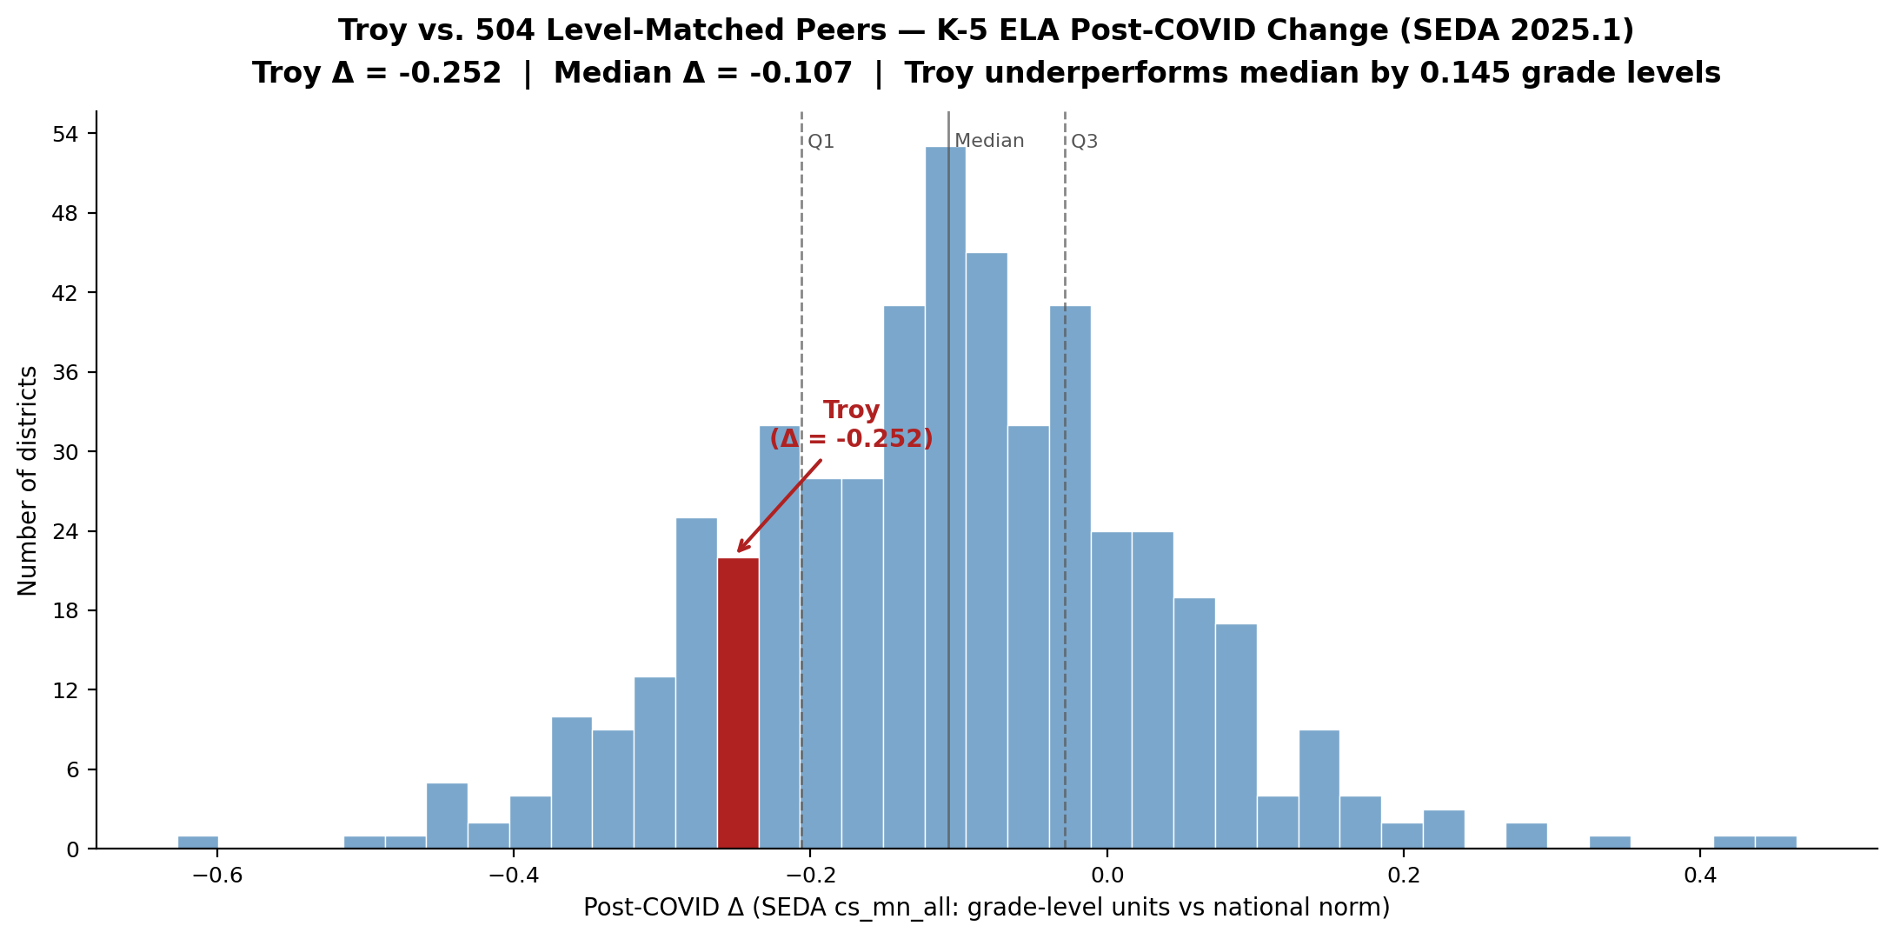
Appendix — Troy vs. 504 level-matched peers: post-COVID decline (SEDA 2025.1)
2019 → 2025 change analysis • Pre-COVID baseline ±0.25 of Troy, enrollment ≥150/grade-year
Key findings
504
level-matched peer districts nationwide
81 / 504
Troy's Δ rank (16th percentile) — bottom sixth
-0.252
Troy's post-COVID Δ (grade levels vs national norm)
-0.107
Peer median Δ — Troy underperforms by 0.145 grade levels
Subgroup Δ ranks — higher rank = worse decline
All Students
424 / 504
84th pct
Asian
243 / 265
92nd pct
White
401 / 496
81st pct
Black
114 / 156
73rd pct
Hispanic
99 / 321
31st pct
Econ Disadv
208 / 444
47th pct
Not Econ Disadv
428 / 495
86th pct
Peers derived independently from Math (44% overlap). Troy ELA baseline
(+0.729) lower than Math (+0.937) — different peer universe.
Troy SD K-5 ELA — Executive Summary • github.com/akarpo/tsd-k5ela-choice
23 / 29

Slide 24
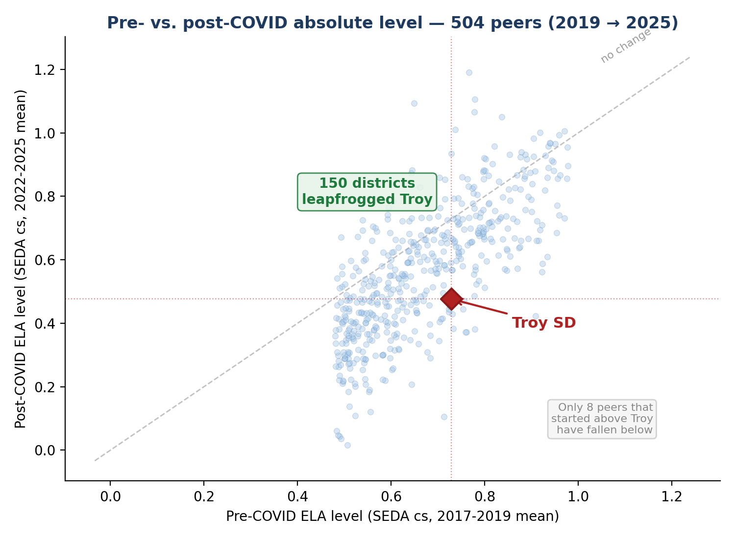
Appendix — Troy slid from top 3% to top 11% nationally in K-5 ELA
Year-by-year SEDA national ranking (all U.S. districts) + absolute level among 504 level-matched peers
National K-5 ELA ranking trajectory
SEDA 2025.1 cs scale — all U.S. districts with G3-G5 ELA data
Year
Score
Rank
Percentile
2019
+0.747
380 / 12,241
Top 3.1%
2022
+0.605
604 / 10,588
Top 5.7%
2023
+0.526
740 / 10,632
Top 7.0%
2024
+0.390
1,106 / 10,457
Top 10.6%
2025
+0.387
969 / 8,921
Top 10.9%
Dropped ~600 places in 4 years
Troy went from top 3% nationally to the edge of the top decile.
Score declined −0.360 grade levels (nearly half a grade).
2025 rank ticks up slightly only because fewer districts reported.
Among 504 level-matched peers
Michigan affluent peers — all declined, Troy fell furthest
Pre-COVID rank: 171 / 504 (top third)
Post-COVID rank: 313 / 504 (bottom 40%)
150 districts leapfrogged Troy
Byron Center
▲ 41
Spring Lake
▲ 21
E. Grand Rapids
▼ 12
Birmingham
▼ 39
Troy SD
▼ 142
Novi
▼ 60
Rochester
▼ 80
Troy SD K-5 ELA — Executive Summary • github.com/akarpo/tsd-k5ela-choice
24 / 29

Slide 25
References (1 of 5) — Primary datasets
Each cited claim in the deck is anchored to one of these sources
1
Stanford Education Data Archive 2025.1
Reardon, S. F., et al. (2026). SEDA v2025.1. https://edopportunity.org/trends/data/downloads/ • Coverage 2009-2025; cohort-standardized scale anchored to NAEP.
2
SEDA 6.0 (geographic district file)
Reardon, S. F., et al. (2026). SEDA v6.0. https://edopportunity.org/opportunity/data/downloads/ • Coverage 2009-2019; used to validate pre-COVID baseline.
3
Education Scorecard 2026 "Districts on the Rise"
Harvard / Stanford / Dartmouth. https://educationscorecard.org/districts-on-the-rise/ • 17 demographically-adjusted post-COVID outperformer districts.
4
Troy achievement workbook (8 districts)
tsd-achievement.karpowitsch.org master workbook • G3-G7 × subgroup × year, 2019-2025, 5,497 demographic cells.
5
CAASPP Smarter Balanced Research Files
https://caaspp-elpac.ets.org/caaspp/ResearchFileListSB • CA district-level ELA, 2019-2025; used for Modesto, Sanger, Garden Grove, Long Beach.
6
Texas TAPR / TEA
https://rptsvr1.tea.texas.gov/perfreport/tapr/ • STAAR reading G3-G5 for Aldine, Brownsville, Spring Branch, Plano, Frisco, Coppell.
7
Louisiana DOE LEAP
https://doe.louisiana.gov/students/assessments/ • West Baton Rouge Parish 2022-2025 LEAP Mastery+.
8
Mississippi DOE MAAP
https://reports.mdek12.org/ • Starkville-Oktibbeha 2019-2025 (via tpcref.org compilation).
9
Tennessee Department of Education TCAP
https://www.tn.gov/education/ • Johnson City Schools 2019-2025 district assessment files.
10
Michigan School Data CEPI / M-STEP
https://www.mischooldata.org/ • Troy SD trajectory + statewide G3-G5 averages.
11
Ohio Department of Education / OST
education.ohio.gov • Steubenville City Schools + statewide G3-G5 OST averages.
12
Washington OSPI Smarter Balanced
https://washingtonstatereportcard.ospi.k12.wa.us/ • Bellevue / Issaquah / Lake Washington SBA.
13
Oakland County 115 — MI affluent peer 2025
https://oaklandcounty115.com/2025/09/14/test-results-show-reading-proficiency-among-third-and-fourth-graders-across-oakland-county/ • G3+G4 ELA 2025 head-to-head.
Troy SD K-5 ELA — Executive Summary • github.com/akarpo/tsd-k5ela-choice
25 / 29

Slide 26
References (2 of 5) — Curriculum evidence sources
EdReports / Reading League / ESSA / WWC / MDE / Knowledge Matters
EdReports.org curriculum reviews
14
https://edreports.org/ • Green/Yellow/Red gateway ratings: Text Quality / Building Knowledge / Foundational Skills / Usability. v2.0 rubric (2024-25) explicitly assesses SoR alignment.
The Reading League — Curriculum Navigation Reports
15
https://www.thereadingleague.org/curriculum-navigation-reports/ • SoR-only evaluation: "red flag practices" (three-cueing, leveled-text decoding, lack of phoneme-grapheme systematicity).
Evidence for ESSA
16
https://www.evidenceforessa.org/ • ESSA tiers (Strong, Moderate, Promising, Rationale) for K-5 ELA programs. Used for 95 Phonics (ESSA Strong), IMSE OG+ (Promising), etc.
What Works Clearinghouse / IES
17
https://ies.ed.gov/ncee/wwc/ • Federal evidence registry. Reviewed Orton-Gillingham-based interventions; found insufficient qualifying studies.
Michigan MDE Section 35m Tier-1 list
18
https://www.michigan.gov/mde/services/academic-standards/literacy/literacy-grants/section-35m • State-approved K-5 evidence-based ELA curricula (Dec 2025 release).
Knowledge Matters Campaign
19
https://knowledgematterscampaign.org/ • Recognized knowledge-building K-5 ELA programs: CKLA, EL Education, Wit & Wisdom, ARC Core, Bookworms, Fishtank.
Troy SD K-5 ELA — Executive Summary • github.com/akarpo/tsd-k5ela-choice
26 / 29

Slide 27
References (3 of 5) — Science of Reading research & journalism
Independent scholarly + investigative sources cited in mechanism slide and curriculum evaluation
20
Emily Hanford / APM Reports
"Sold a Story" podcast series + investigations. https://features.apmreports.org/sold-a-story/ • Documented Calkins UoS / F&P / Reading Recovery critiques.
21
APM Reports — EdReports & SoR (March 2025)
https://www.apmreports.org/story/2025/03/06/edreports-reading-curriculum-reviews-science-of-reading • Investigation of EdReports all-green ratings on basal programs (Wonders, myView, Into Reading).
22
Natalie Wexler — The Knowledge Gap
Avery (2019). https://nataliewexler.com/the-knowledge-gap/ • Framework that comprehension depends on background knowledge built via coherent content sequence.
23
Tim Shanahan — Shanahan on Literacy
https://www.shanahanonliteracy.com/ • Reading research and instructional practice. Strategy instruction critique cited in mechanism slide.
24
Mark Seidenberg — Language at the Speed of Sight
Basic Books (2017). https://seidenbergreading.net/ • Cognitive science of reading; critique of balanced literacy.
25
Lane et al. (2025) — UFLI Foundations RRQ study
Reading Research Quarterly. https://ila.onlinelibrary.wiley.com/doi/10.1002/rrq.607 • ES > 1.0 SD on early-literacy outcomes; districtwide Florida pilot.
26
Karin Chenoweth — Districts That Succeed
Harvard Education Press (2021) • Sustained-outperformer district case studies (Steubenville, Seaford, Lane OK, etc.).
27
Success for All Foundation — Steubenville case study
https://www.successforall.org/wp-content/uploads/2025/05/CS_Steubenville-1.pdf • 25-year SFA implementation; 93-100% G3 reading proficient.
28
The 74 Million — Steubenville coverage
https://www.the74million.org/article/why-steubenville-ohio-might-be-the-best-school-district-in-america/ • Independent journalism on Steubenville.
29
Karen Vaites — Southern Surge analysis
https://www.karenvaites.org/p/the-southern-surge-understanding • Mississippi / Louisiana / Tennessee NAEP gains tied to SoR adoption.
Troy SD K-5 ELA — Executive Summary • github.com/akarpo/tsd-k5ela-choice
27 / 29

Slide 28
References (4 of 5) — District case-study sources
Specific districts cited in the deck: adoption + outcomes
30
Kentucky Teacher — Marion County coverage (May 2026)
https://www.kentuckyteacher.org/news/2026/05/kentucky-ranks-among-nations-best-for-student-recovery-5th-in-reading-8th-in-mathematics/
31
Kentucky Reading Academies / Lexia LETRS
https://www.lexialearning.com/kentucky-letrs • https://www.education.ky.gov/curriculum/EarlyLiteracy/Pages/ky_reading_Academies.aspx
32
Education Scorecard PDFs — case studies
Marion County: https://educationscorecard.org/wp-content/uploads/2026/05/KY_Marion-County_Case-Study.pdf • 20 DOTR district PDFs in /research/escorecard_pdfs/
33
Fond du Lac SD — Strategic Plan + Studer Education
https://www.fonddulac.k12.wi.us/page/strategic-plan • Aug 2022 strategic plan; CKLA + Amplify ELA + Bridges + TCI + Mystery Science stack.
34
UVA-PLE / Darden Partnership for Leaders in Education
https://www.darden.virginia.edu/uva-ple/ • Leadership and instructional-redesign partnership underlying Fond du Lac's turnaround.
35
Palo Alto USD — Every Student Reads Initiative (ESRI)
https://www.pausd.org/learning/esri • Exited Calkins UoS 2021; mandatory Orton-Gillingham K-3 training.
36
Spring Branch ISD — Texas STR framework
https://www.springbranchisd.com/studentsfamilies/literacy • TX Science of Teaching Reading state mandate.
37
West Baton Rouge / LA DOE Wit & Wisdom adoption
https://doe.louisiana.gov/docs/default-source/curricular-resources/great-minds-pbc---wit-wisdom-with-fundations-and-geodes-ela-grades-k-3-(-2023).pdf
38
WI Act 20 / Wisconsin Reads
https://dpi.wi.gov/wi-reads/curriculum • State science-of-reading mandate (2023) with approved curriculum list.
39
Tennessee Department of Education — Reading 360 + HQIM mandate
https://www.tn.gov/education/reading-360.html • State SoR PD (60 hours) + approved K-5 curriculum list.
40
EdWeek — "Inside the Long Beach Way" (2007)
https://www.edweek.org/leadership/inside-the-long-beach-way/2007/09 • Carl Cohn era Open Court tradition documented.
41
Amplify — Aldine ISD CKLA adoption (Jul 2020)
https://amplify.com/news/aldine-isd-adopts-amplifys-integrated-early-literacy-suite-supports-students-in-learning-to-read-confidently-by-third-grade/
42
Detroit DPSCD + EL Education — Skillman Foundation grant
https://www.skillman.org/blog/standardswork-receives-grant-to-support-implementation-of-transformative-literacy-curriculum-in-detroit-public-schools/ • https://www.detroitk12.org/academics/core-curriculum/english-language-arts-and-literacy
43
NYC Reads — Chalkbeat / EdWeek / K-12 Dive
Chalkbeat: https://www.chalkbeat.org/newyork/2025/07/07/nyc-reads-solves-screener-data-eric-adams-school-curriculum-mandate/ • EdWeek: Phase 1 vs Phase 2 confidence data (Jul 2025).
Troy SD K-5 ELA — Executive Summary • github.com/akarpo/tsd-k5ela-choice
28 / 29

Slide 29
References (5 of 5) — Project artifacts + how to verify
Every claim is reproducible from the public GitHub repository
github.com/akarpo/tsd-k5ela-choice
Web presentation
Processed data (data/)
README.md
Project README + slide map
seda_2025_pooled.json
SEDA cs G3-G5 pooled by year × subgroup
index.html
Vanilla-JS slide viewer
seda_2025_state.json
State-level SEDA averages by year
slides/*.png
28 rendered slide PNGs (144 DPI)
seda_subgroup_delta.csv
Pre/post-COVID Δ per subgroup × district
deck/Troy_K5_ELA_Executive_Summary.pptx
Source PowerPoint deck
master_dataset.csv
2,544 rows: dist × year × grade × subgroup
Reproducibility pipeline
seda_2009_2025_extract.csv
Raw SEDA 2025.1 extract (50 dists × G3-G5)
troy_swd_ela.csv
Troy SWD M-STEP %prof, G3-G5 2015-25
analysis/extract_seda_subset.py
SEDA 2025.1 → 50-district subset
analysis/compute_deltas.py
Pre/post-COVID Δ matrix
Supporting reports (reports/)
analysis/build_deck.py
Builds the .pptx deck
synthesis.md
Master synthesis report
docs/REPRODUCIBILITY.md
How to reproduce in 3 commands
quantitative_analysis.md
28-district state-test analysis
docs/METHODOLOGY.md
Metrics, time windows, district universe
education_scorecard_2026_dotr.md
20 DOTR outperformer case studies
docs/DISTRICT_UNIVERSE.md
All 50 districts with NCES LEA IDs
curriculum_evaluations.md
14 Section 35m curricula evaluated
collab_lit_ufli_pressure_test.md
Collab Lit + UFLI critique
Troy SD K-5 ELA — Executive Summary • github.com/akarpo/tsd-k5ela-choice
29 / 29

