Slide 1


BINARY SEARCH
MAHARAJA INSTITUTE OF TECHNOLOGY THANDAVAPURA
DEPARTMENT OF COMPUTER SCIENCE AND ENGINEERING
COMPUTER GRAPHICS LABORATORY MINI – PROJECT PRESENTATION
Presented by,
AKARSH S AMBLE 4MN17CS002
PRASHANTH H N 4MN17CS024
Under the guidance of
Prof. Bharath Bharadwaj B S,
Assistant Professor,
Department of CSE,
MITT, Mysore

Slide 2
Contents
Abstract
Introduction
Overview
Flowchart
Snapshots
Conclusion
Future Enhancement

Slide 3
ABSTRACT
Computer Graphics is one of the ever emerging fields with the new inventions in the display technologies. Computer Graphics is an effective medium for communication between man and computer.
The main aim of this project is developing a Binary Search using OpenGL. The features of the Binary Search revolve searching the element. The project involves the following features
Taking the input from the users.
Sorting the given inputs.
Searching the key element and displaying it.
In Binary Search algorithm, a sorted array by repeatedly dividing the search interval in half. Begin with an interval covering the whole array. If the value of the search key is less than the item in the middle of the interval, narrow the interval to the lower half. Otherwise narrow it to the upper half. Repeatedly check until the value is found or the interval is empty.

Slide 4
INTRODUCTION
Computer Graphics become a powerful tool for the rapid and economical production of pictures. There is virtually no area in which Graphical displays cannot be used to some advantage so it is not surprising to find the use of CG so widespread.
Although early application in engineering & science had to rely on expensive & cumbersome equipment, advances in computer technology have made interactive computer graphics a practical tool. Computer Graphics is used in a diverse area such as science, engineering, medicine, business, industry, government, art, entertainment, education and training. Now it can be answered about computer graphics as generalized tool for drawing and creating pictures and simulates the real world situations within a small computer window.

Slide 5
OVERVIEW
The project involves the following features:
Taking the input from the users
Sorting the given inputs.
Searching the key element and displaying it.
The above features are supported by an easy to use mouse interface.
The user enters the project by using the keyboard interface.
And using the mouse interface the user can view the sorted list or the find the key element.

Slide 6
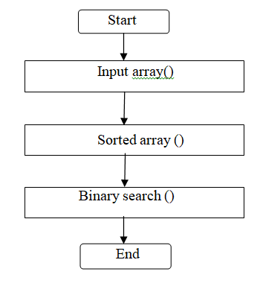
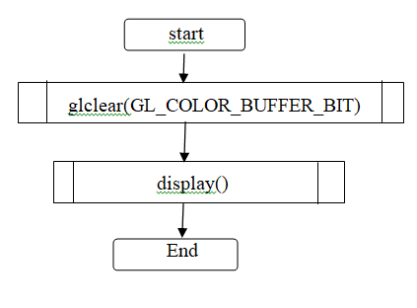
FLOW CHART

Slide 7
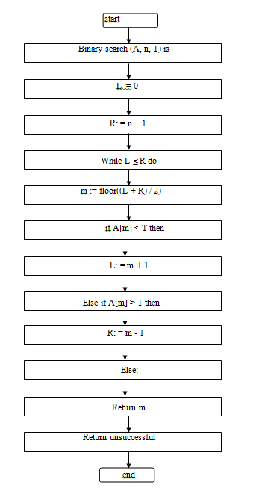
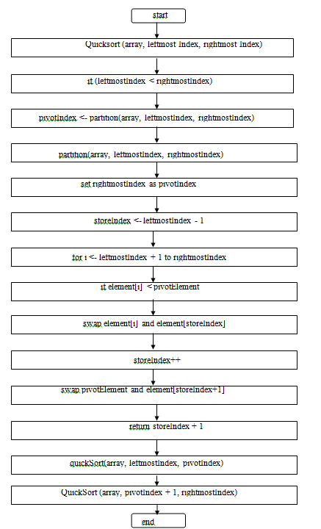

Slide 8
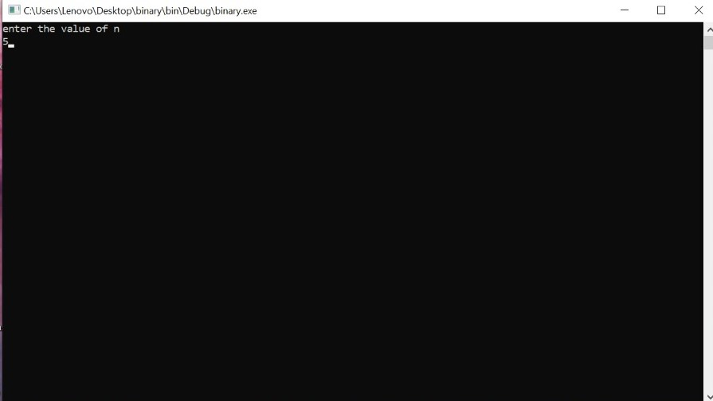
SNAPSHOTS

Slide 9
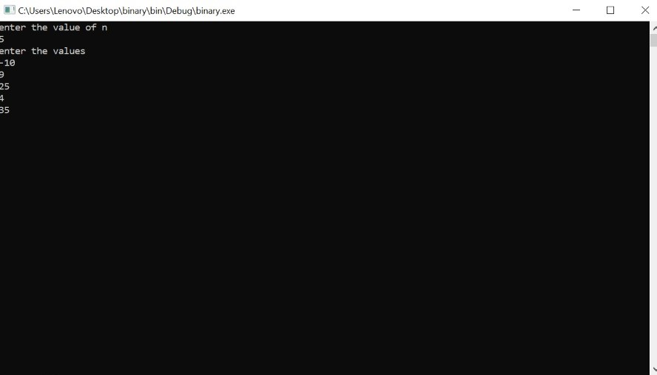

Slide 10
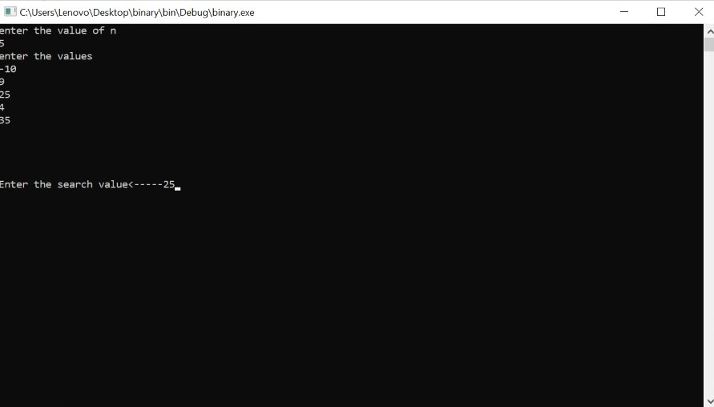

Slide 11
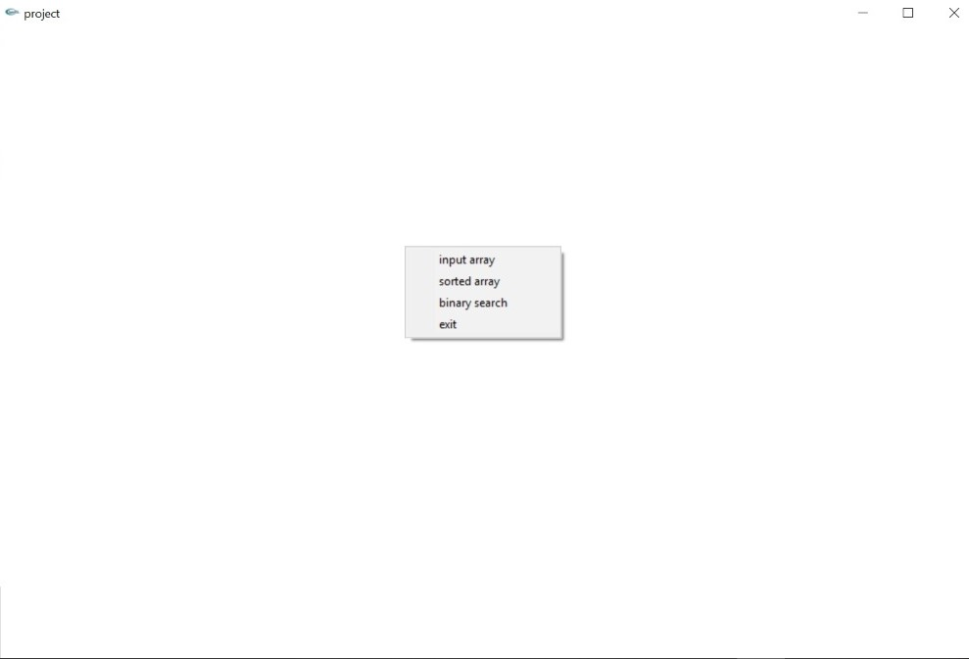

Slide 12
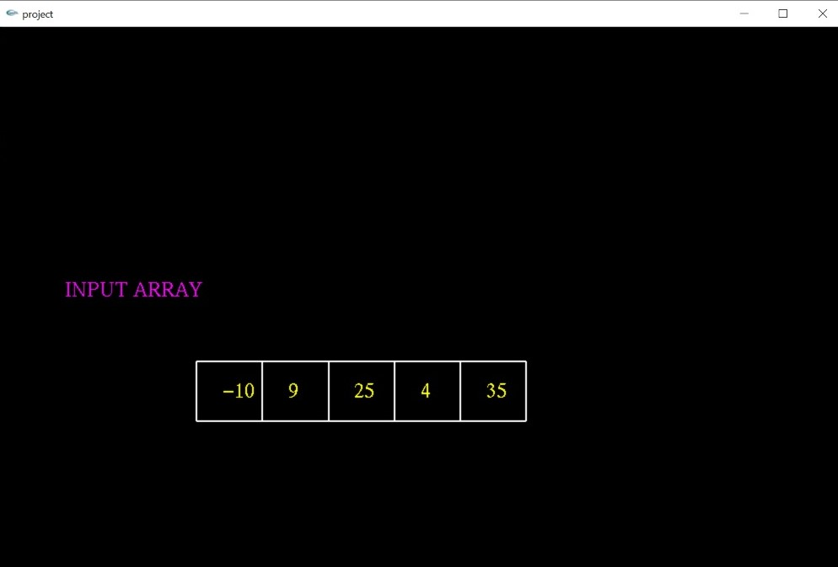

Slide 13
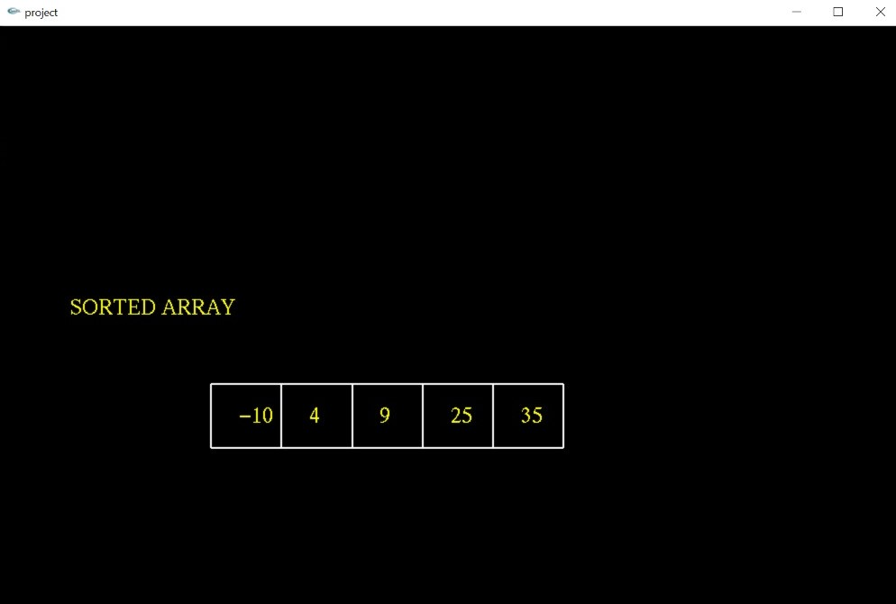

Slide 14
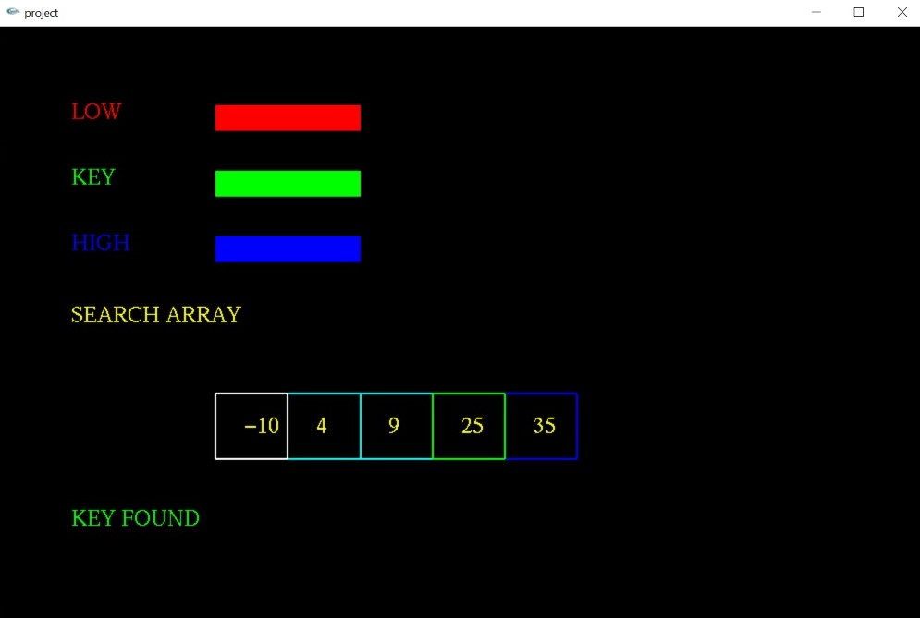

Slide 15
CONCLUSION
The Binary search algorithm implementation has been drawn and displayed using the computer graphics how it works in general. The demo is made more interactive with a keyboard and mouse interaction module in the program.

Slide 16
FUTURE ENHANCEMENT
Even though demo designed is enriched with many options, it is a two dimensional demo, in future it can be redesigned with 3D animation and sound effects.
This project can be modified with a lot of features like finding the medicines quickly and it can be implemented in parking grounds where the owner can find his vehicle more quickly it can also be incorporated in finding words in the dictionary in chat applications.
Support for time management & more efficient. Support for transparency of the layer and originality.

