Slide 1
AWS-Based DevOps Monitoring Dashboard
Cloud-Native DevOps Monitoring Platform using React, Flask, Docker, Terraform & AWS

Slide 2
Team Introduction
Areas | Answers
Team Name: | Devopsy
Batch / Area of Training: | Devops
Internship Start Date: | 13-03-26
Internship Location | Chennai
Team Members: | Akarsh Gururaju

Slide 3
Problem Statement
Questions | Answers
What problem are you trying to solve? | Organizations face difficulty in monitoring cloud infrastructure, Docker containers, and deployments from a single platform in real time.
Please define the identified business need and importance to business | Businesses need a centralized monitoring system to reduce downtime, improve reliability, and quickly identify infrastructure issues.
Who is affected by this problem? What improvements are assumed to be brought by implementation? | DevOps engineers, cloud administrators, and development teams are affected. The solution improves monitoring efficiency, deployment visibility, and system uptime.
What made you choose this problem? | Modern applications heavily depend on cloud and container technologies, making monitoring and deployment automation an important industry requirement.
Please elaborate any market research conducted help frame the problem. | Research on tools like Grafana, Prometheus, and Datadog showed the increasing need for automated monitoring solutions.

Slide 4
Solution Overview/ Idea
Questions | Answers
Please provide short description of the solution | A cloud-native DevOps monitoring dashboard that provides real-time infrastructure monitoring, Docker container tracking, deployment monitoring, and centralized log management.
What are the key objectives you are planning to achieve | Real-time infrastructure monitoring Docker container tracking Automated CI/CD deployment
How does your solution achieve to address the problem statement? | The platform combines monitoring APIs, Docker tracking, and deployment automation into a single dashboard with real-time updates.
Please explain the technology stack selected. | Frontend: React Backend: Flask Containerization: Docker Reverse Proxy: Nginx Cloud: Amazon Web Services Infrastructure: Terraform CI/CD: GitHub Actions
Please provide justification on why your approach is best. | The solution is scalable, lightweight, cost-effective, and follows modern DevOps practices with automation and containerization.
What is the state you were able to achieve? | Successfully deployed a working cloud-native monitoring platform on AWS with Docker, Terraform, Nginx, and automated CI/CD integration.

Slide 5
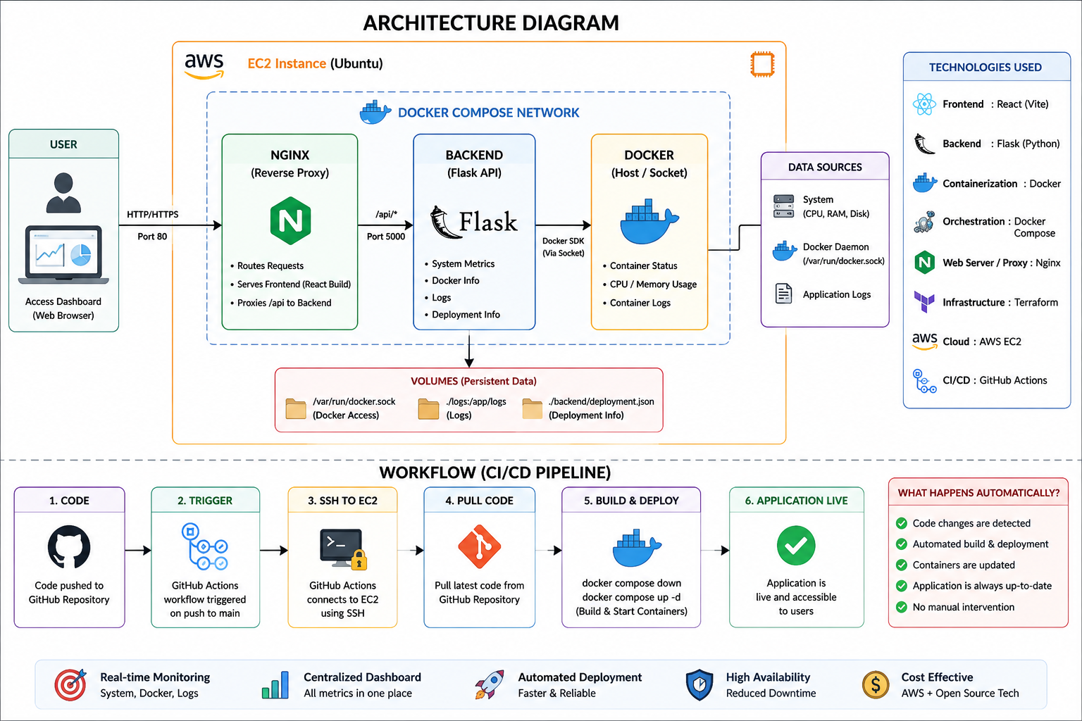
Solution Implementation

Slide 6
Three Key Features
Questions | Answers
Please elaborate Feature1: | Name: Real-Time Infrastructure Monitoring Business description: The platform continuously monitors CPU usage, RAM utilization, storage consumption, uptime, and system load in real time, helping administrators quickly identify system issues and performance bottlenecks.
Please elaborate Feature2: | Name: Docker Container Monitoring Business description: The dashboard tracks active Docker containers, container status, resource usage, and logs, providing centralized visibility into containerized applications running on the server.
Please elaborate Feature3: | Name: Automated CI/CD Deployment Business description: Using GitHub Actions, the project automatically deploys updated code to the AWS server whenever changes are pushed to the GitHub repository, reducing manual deployment effort and improving deployment reliability.

Slide 7
Demo
Short demo video/screenshots
User flow walkthrough
Record the videos with transcripts

Slide 8
Outcomes
Questions | Answers
Business impact | Improved infrastructure visibility, reduced manual monitoring effort, and faster issue detection.
Achieved Technical benefits | Real-time monitoring Automated deployments Containerized architecture Cloud deployment automation
Cost/time/value improvements | Reduced deployment time Faster troubleshooting Lower operational effort through automation
Key Metrics | Real-time CPU, RAM, storage, and container monitoring Automated deployment through GitHub Actions Successful AWS EC2 production deployment

