Slide 1

L-3 Nature of moral judgments and reactions
Research and Publication Ethics
Dr. Divya Singh
Designation- Associate Professor
divya.singh@mygyanvihar.com

Slide 2
Objective
. The students will understand nature of moral judgments and reactions

Slide 3
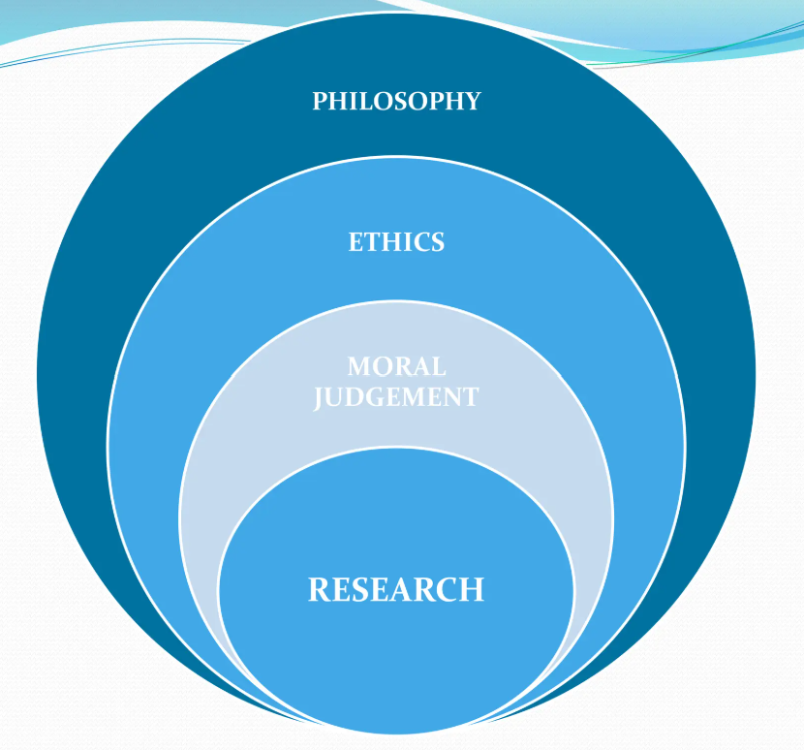

Slide 4
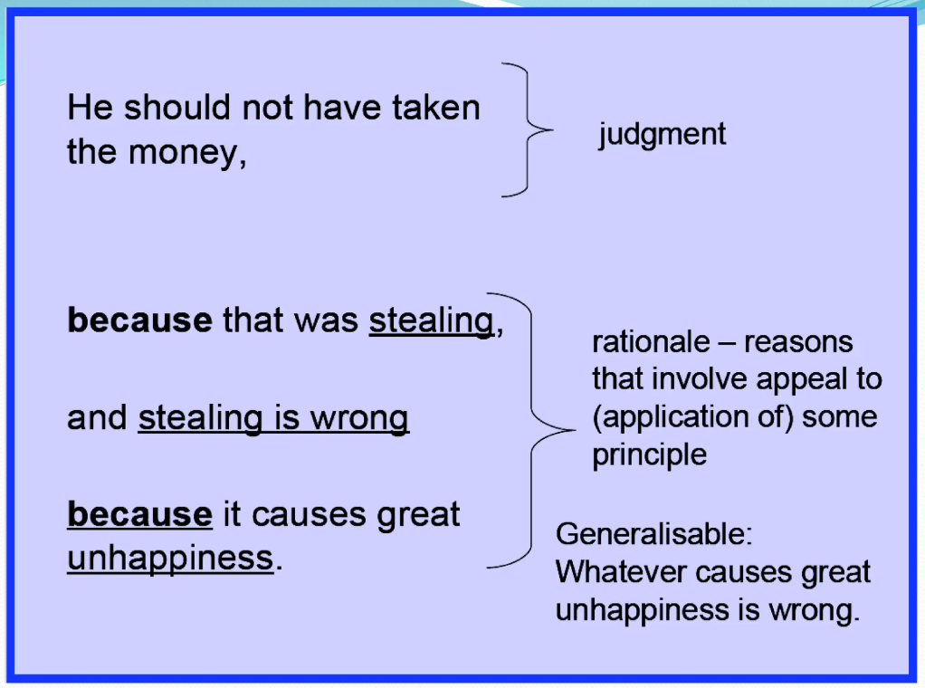

Slide 5
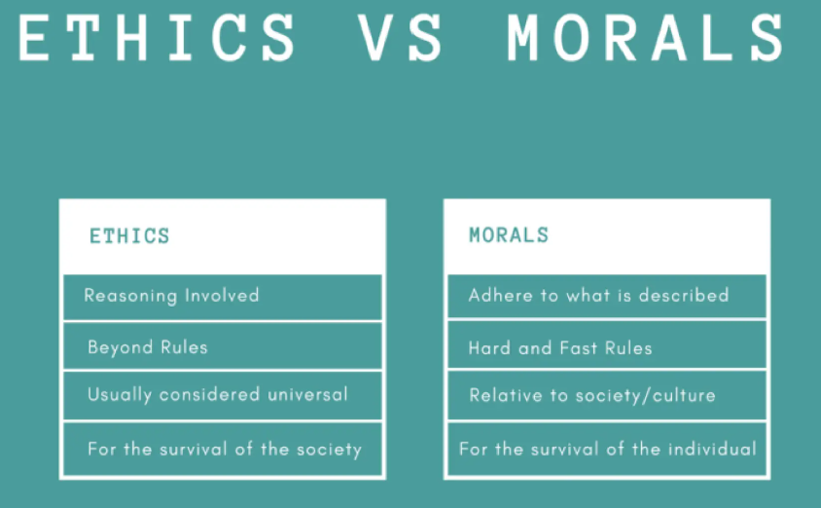

Slide 6


Slide 7


Slide 8


Slide 9


Slide 10


Slide 11


Slide 12


Slide 13


Slide 14
Which of the following is a key feature of moral judgments?
A) They are based solely on personal preferences.
B) They involve assessments of right and wrong.
C) They are irrelevant to ethical decision-making.
D) They are influenced only by legal standards.
What is the primary focus of deontological ethics in moral judgment?
A) The consequences of actions
B) The inherent nature of actions themselves
C) The intentions behind actions
D) The overall happiness produced
In utilitarianism, what is considered the basis for moral judgment?
A) The adherence to duty or rules
B) The promotion of individual rights
C) The greatest overall happiness or utility
D) The cultural norms and traditions
Which philosopher is most closely associated with the principle of “the greatest happiness for the greatest number”?
A) Immanuel Kant
B) John Stuart Mill
C) Aristotle
D) Friedrich Nietzsche

Slide 15
What does the concept of "moral relativism" assert about moral judgments?
A) Moral judgments are universal and unchanging.
B) Moral judgments are dependent on individual or cultural perspectives.
C) Moral judgments should be based solely on legal standards.
D) Moral judgments are irrelevant to ethical decisions.
Which of the following best represents a consequentialist approach to moral judgment?
A) Evaluating actions based on adherence to moral rules
B) Assessing the outcomes of actions to determine their morality
C) Considering the character traits of individuals
D) Following religious commandments
In virtue ethics, what is the primary concern in making moral judgments?
A) The rules and duties one must follow
B) The outcomes and consequences of actions
C) The character and virtues of the individual making the decision
D) The legal implications of the actions
What is the term for a moral principle that emphasizes respect for individual autonomy?
A) Beneficence
B) Justice
C) Respect for Persons
D) Fidelity

Slide 16
Which ethical theory is concerned with fulfilling one’s duties and obligations regardless of the outcome?
A) Utilitarianism
B) Virtue Ethics
C) Deontology
D) Relativism
What does the principle of "moral integrity" generally refer to in moral judgment?
A) Adhering strictly to legal standards
B) Consistently applying one’s moral principles and values
C) Following the majority opinion
D) Focusing on personal gain
Which term describes the ethical approach that focuses on the fairness and equality of outcomes?
A) Virtue Ethics
B) Utilitarianism
C) Justice Ethics
D) Existentialism
What role do cultural norms play in moral judgments according to cultural relativism?
A) They are irrelevant to moral judgment.
B) They provide the sole basis for moral judgments.
C) They can offer guidance but are not definitive.
D) They should be overridden by universal moral principles.

Slide 17
In moral judgment, what is "ethical egoism" concerned with?
A) The greater good for the greatest number
B) Acting in one's own self-interest
C) Adhering to universal moral principles
D) Promoting equality and fairness
Which principle suggests that moral judgments should consider the context and nuances of each situation?
A) Absolute Morality
B) Moral Universalism
C) Situational Ethics
D) Divine Command Theory
What is the primary concern of "care ethics" in moral judgments?
A) Adherence to universal moral laws
B) Maximizing overall happiness
C) The importance of interpersonal relationships and care
D) The pursuit of personal success

Slide 18
