Slide 1
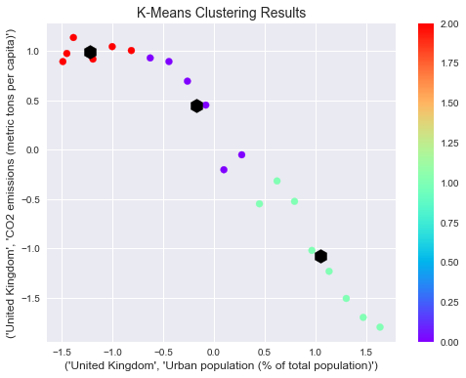
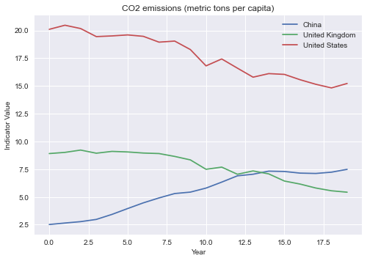
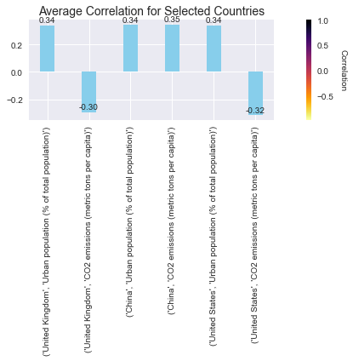
Environmental Synthesis: Unraveling Relationships in Urbanization and Carbon Emissions
ABSTRACT:
This study explores the interplay of selected environmental indicators, focusing on "Urban Population (% of Total Population)" and "CO2 Emissions (Metric Tons per Capita)," across multiple countries. The analysis employs data visualization techniques, clustering algorithms, and correlation matrices to unveil patterns and relationships. By examining these indicators, the study aims to provide insights into the environmental dynamics of chosen nations, contributing to a better understanding of the global environmental landscape.
INTRODUCTION:
Two important topics in the current environmental discourse are the increasing rate of urbanization and the rise in carbon emissions. In this work, we examine the dynamics of "CO2 Emissions (Metric Tons per Capita)" and "Urban Population (% of Total Population)" for three particular Nations: the US, China, and the UK. We seek to identify trends, correlations, and possible clusters among the chosen environmental indicators by utilizing data analytic methodologies. Comprehending these dynamics is essential to formulating well-informed approaches to tackle environmental issues.
METHODOLOGY:
Data Processing:
World Bank data on "Urban Population (% of Total Population)" and "CO2 Emissions (Metric Tons per Capita)" are cleaned and subsetted for 1999-2018.
Analysis:
Normalization and Clustering:
Indicators normalized with StandardScaler.
K-means clustering identifies distinct patterns.
Correlation Analysis:
Correlation matrix explores relationships.
Results presented via a clustered bar chart.
:
RESULT:
Clustering:
K-means clustering applied to the normalized data reveals three distinct clusters, highlighting unique environmental behavior patterns among the selected countries.
Correlation:
Significant relationships are uncovered through correlation analysis between "Urban Population (% of Total Population)" and "CO2 Emissions (Metric Tons per Capita)." The clustered bar chart visually captures the average correlation values for each indicator, offering a comprehensive view of their interdependence.
CONCLUSION AND CONTACT DETAILS:
This study provides valuable insights into the environmental dynamics of urbanization and carbon emissions for the United Kingdom, China, and the United States. The identified clusters and correlation patterns contribute to a nuanced understanding of how these countries navigate environmental challenges. The findings underscore the importance of tailored strategies for sustainable urban development and carbon emission reduction. Future research could extend this analysis to include additional indicators and a broader range of countries for a more comprehensive global perspective.
STUDENT ID: 22078150 NAME: Akarsha Nalupurakkal Anjanasudhan
GITHUB LINK:https://github.com/akarshanalupurakkalanjanasudhan98/ADS1-ASSIGNMENT-3-Clustering-and-fittings.git

