Slide 1

Being
A Bot to help with welbeing

Slide 2
Motivation
Possible integration with the Web3.0 based healthcare repository term project
Ability to integrate mindfulness , nutrition and physical health in one platform
Used case allows use of multiple API calls and small talk

Slide 3
Chatbot Config
3
Database - SQLite
RASA - 3.1
API’s used :-
Body Mass Index (BMI) Calculator
Nutrition by API-NINJA (nutrition)
Spooacular API (label image)
Exercise by API-NINJA
Youtube Search API
Text Sentiment Analysis Method API

Slide 4
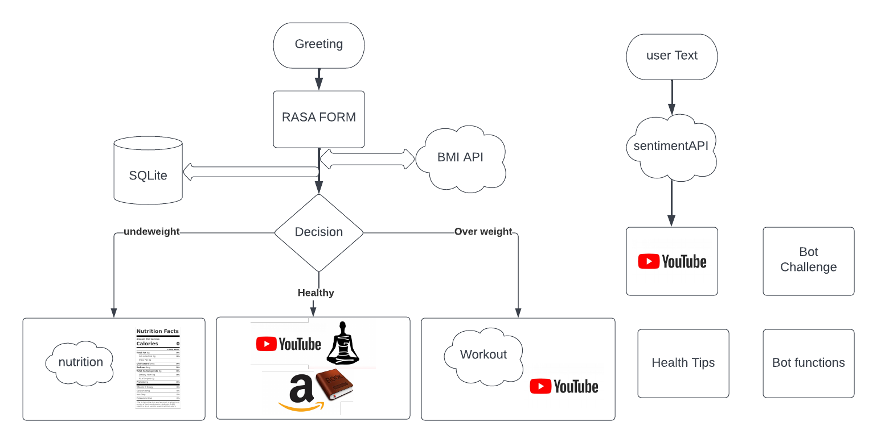

Slide 5
Challenges
Issue with misclassified intent
Slack deployment issues
Difficulties with debugging and train times in RASA

Slide 6
Lessons learned
Intents require effort
Cautious use of API’s
Small bugs like use of relative path can take a lot of time to resolve
SQlite is light and easy to use

Slide 7
Thanks!
Any questions?

