Slide 1
BI & Analytics in Action using QlikView , QlikSense & D3.js

Slide 2























QlikTech – A New Kind of Software Company
Broad Base of 25,000 Customers
U.S.-based company, founded 1993 in Sweden
25,000 customers in 100 countries
1,400 global partners
1,100+ employees across 28 offices in 23 countries
NASDAQ: QLIK
Change Their World Grant and Philanthropic Programs
Notes:
QlikTech is a whole new kind of software company.
Our QlikView Business Discovery platform solves critical business problems for companies of all sizes, including some of the largest global enterprises.
It delivers true self-service BI that empowers business users and drives innovative decision making.
It’s generating significant results for users worldwide.
The proof is that QlikView users are the most successful and satisfied in the industry.
That’s why QlikView has been adopted at more than 25,000 customers.
A lot of people ask us ”Why does QlikView have so much market traction and growth?”
It’s because we take a totally different approach to BI.
Think about Google.
They simplified the process of searching information for hundreds of millions of consumers.
Like Google, QlikView has simplified accessing and analyzing business information.

Slide 3
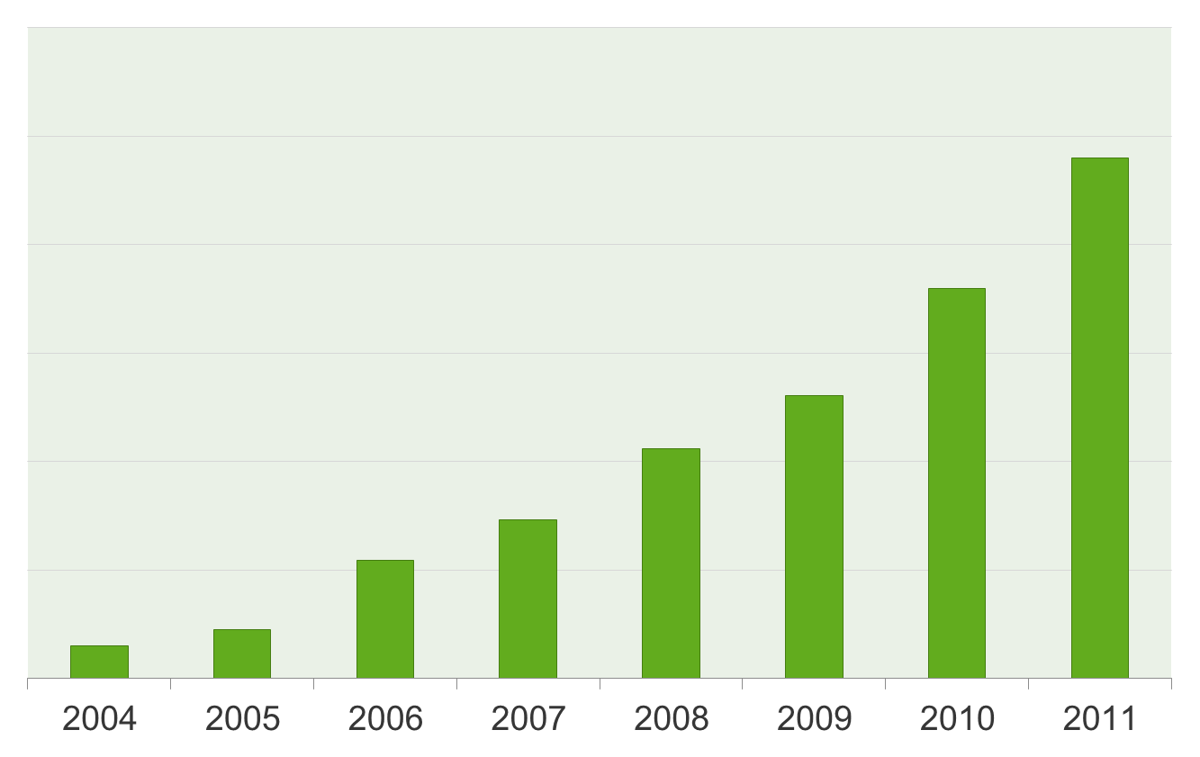
Growing Customer Base
Customer Growth
25,000
18,000
13,024
10,585
7,306
5,436
2,239
1,500
*Historical results not indicative of future results.
Notes:
QlikTech is adding new customers, large and small, every day.
It’s a sign of a healthy business and a value proposition that’s really resonating.
In contrast, we believe our competitors are sustaining themselves mostly by selling to existing customers, through maintenance revenue, and through huge professional services engagements.

Slide 4




Innovations Are Remaking Markets
Search
Mobile Devices
CRM
BI
PageRank
Search
iPhone/iPad
SAAS-based
CRM
Business Discovery
SIMPLICITY
SIMPLICITY
SIMPLICITY
SIMPLICITY
Notes:
When we think about growth companies like Google, salesforce.com, and of course, Apple, and the success they achieved, it was based on innovation, and remaking a market based on that innovation.
For Google, in the search market, it was pagerank search. For Apple, it was the iPhone and iPad, not to mention iTunes. For salesforce.com, it was SAAS-based CRM. And for QlikTech it was Business Discovery.
Underlying these innovations and remaking of markets is simplicity.
Each company delivers a consumer-like experience through simplicity.
And that’s the hallmark of everything we do at QlikTech.
We deliver a consumer BI experience focused on the business user.
.

Slide 5
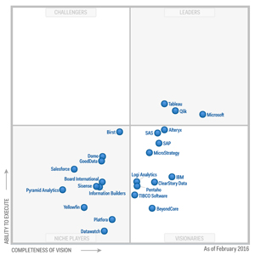
Qliktech: Gartner 2016 BI Magic Quadrant Leader
Data Discovery momentum continues to accelerate
QlikTech and Tableau only Data Discovery vendors in leader quadrant
Customers report strong delivery of business benefits
#1 in ease of use
Increased global and enterprise adoption
Magic Quadrant for Business Intelligence Platforms:
February 2016
Notes:
Gartner talks about the BI market splitting into two parts.
One is the traditional BI solution focused on delivering reports.
The second is a BI solution focused on the serving the business user, which they call data discovery and we call Business Discovery.
QlikView is the only “data discovery” vendor in the leader quadrant.
We call it Business Discovery to reflect who actually uses it, what they do with it, and the value it delivers.
Gartner recommends that organizations take a portfolio approach because traditional BI is not comprehensively serving the business.
Traditional BI offerings are based on report-centric architectures.
They aren’t well-suited to meeting the changing needs of business users who need to directly interrogate or interact with data in a self-sufficient manner.
It’s why Gartner notes that Data Discovery momentum continues to accelerate.
Gartner acknowledges that business users are now more vocal, demanding and influential than ever.
It also says we are number one in ease of use among all BI vendors with expanding enterprise adoption.

Slide 6
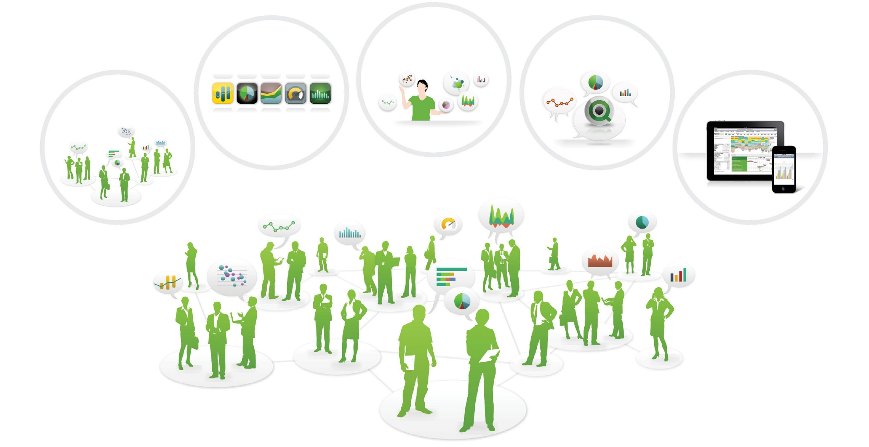
Business Discovery: Business User-Driven BI
Remixability and Reassembly
Social and
Collaborative
App Model
Insight
Everywhere
Mobility
IT
Finance
Production
HR
Marketing
Sales
Notes:
Business Discovery is a whole new way of doing things for BI designed to meet today’s heightened technology expectations.
It focuses on the business user and the groups and organizations they exist in, rather than the top-down approach of traditional BI.
QlikView takes an approach that provides information and analysis precisely focused on the business problems business users are trying to solve.
It’s also about helping users share knowledge and analysis across individuals, groups and organizations.
Imagine the dramatic impact this could have if it was deployed across organizations throughout the world.
Business Discovery is about delivering Insight Everywhere.
QlikView takes insight creation to the very edges of the organization, shifting from a few people who have the skills and tools to create insights from data, to everyone creating insight specific to their business problems.
It’s also based on an App Model, providing lightweight apps that are easy to create and quick to deploy for specific people and groups that need them.
QlikView is also Remixable, meaning users remix and reassemble data in new views and create new visualizations on the fly for deeper understanding, allowing individuals to constantly shift the analysis to meet their new and changing business requirements
Social and Collaborative capabilities are another hallmark.
Decisions are rarely made in a vacuum or based on a single dashboard or report.
They’re often made collaboratively in groups and meetings.
QlikView enables collaborative decision-making through social Business Discovery. It enables organizations to create a community of users who co-create apps, communicate with each other in context of their decision apps, and explore business data collaboratively, to drive knowledge that can cascade across an organization. More on that in a minute.
QlikView also offers total Mobility, delivering anywhere, anytime Business Discovery on virtually any device.

Slide 7
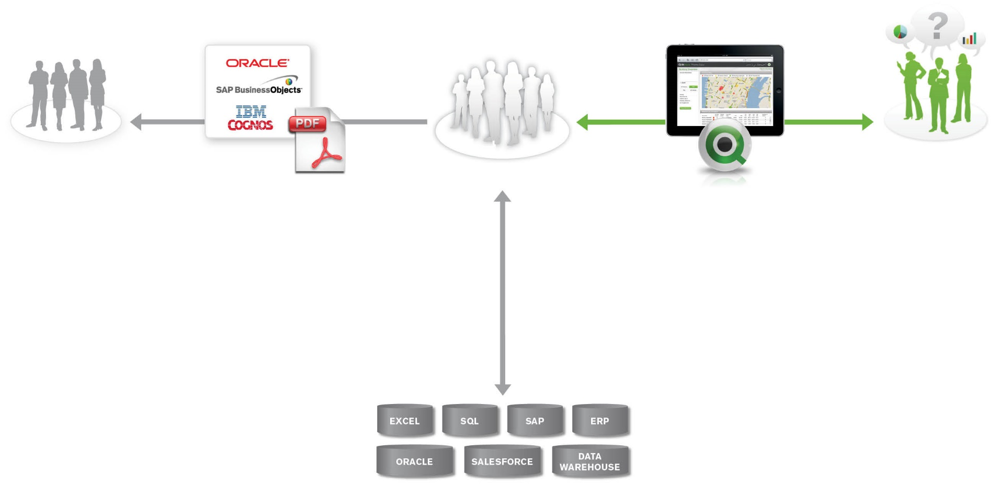
The Evolving BI Landscape
REPORT-CENTRIC ARCHITECTURE
(IT-driven, tightly controlled)
END USER
Pre-calculated dashboards
STACK VENDOR BI
Managed reporting
IT DEPARTMENT
IT ROLE
Data preparation and governance
+
Responsible for building all the analyses
OPERATIONAL DATA SOURCES
Notes:
Business Discovery reflects how the world of BI is rapidly evolving.
Historically, BI has been about a report-centric architecture that’s IT-driven and highly controlled.
It's an important model that serves essential business needs.
In this model, IT departments take operational data and create data models, establish semantic layers, and build reports, all while tightly controlling the data.
IT implements and leverages stack vendor BI to provide managed compliance reporting and locked-down data definitions.
What this architecture delivers to business users are pre-calculated, pre-configured dashboards and queries, and operational metrics.

Slide 8
The Evolving BI Landscape and IT’s Changing Role
REPORT-CENTRIC ARCHITECTURE
(IT-driven, tightly controlled)
BUSINESS DISCOVERY ARCHITECTURE
(Business user-driven, self-service)
END USER
Pre-calculated dashboards
STACK VENDOR BI
Managed reporting
IT DEPARTMENT
BUSINESS USER
Self-service analysis
Create analysis relevant to specific business problems
Change analysis on the fly
QLIKVIEW
Dynamic dashboards
Search live data
Any device
IT ROLE
Data preparation and governance
+
Responsible for building all the analyses
IT ROLE
Data preparation and governance
+
Enable business users to create their own analyses
OPERATIONAL DATA SOURCES
Notes:
Businesses are finding that the report-centric model of traditional BI isn't satisfying their business users.
This problem is magnified by the fact that most organizations are talking about deploying analytics much more broadly to better run their businesses. And Traditional BI is not well-suited to meet that need.
This is why Gartner recommends a portfolio approach that includes traditional BI and what they call a data discovery solution—and we call Business Discovery.
It’s not about one solution or the other. Rather, Gartner emphasizes the need for both types.
Business Discovery is about self-service BI, focused squarely on the business user.
It provides a consumer-style approach in which business users are empowered to conduct analysis in a self-sufficient manner.
It’s why Gartner calls QlikView a poster child for this emerging model.
It’s also why so many businesses are implementing QlikView's Business Discovery architecture in addition to traditional report-centric systems.
Let’s examine the role of IT in Business Discovery.
Business Discovery frees up IT professionals from many routine tasks and enables them to focus on their core competencies.
Historically, with report-centric architectures, IT’s role has been to take on the burden of providing for ALL of the needs of the business when it came to BI.
While the focus on data preparation, governance and infrastructure provisioning is central, IT was also responsible for performing the analysis and building the reports for the business.
IT also typically deals with a massive backlog of requests from the business. Why? Because historically, they were the only people who had the skills to use the complex BI tools.
Business Discovery liberates IT and enables it to focus on areas that are core to its skill set: data preparation, data and application governance, and infrastructure provisioning and monitoring.
Because Business Discovery enables a true self-service approach to BI, IT professionals can remove the backlog of requests for new reports and new queries from the business.
With Business Discovery, IT enables business users to customize and change analysis on the fly to address their exact business problems.
It lets IT deliver a much more real-time approach for business users that alllows them to optimize the business through improved decision making.

Slide 9
QLIKVIEW OVERVIEW
QlikView data access solution enables you to analyse and use information from different data sources.
With QlikView, it is easy to grasp the overall picture and spot the connections, even when working with large and complex data sets. You can integrate information from different sources and the information can quickly be made available through the network.
The right information gets to the right person. The associative technology allows you to create a unique interface for interactive presentation and analysis of any kind of information.
QlikView manages information in a way that resembles and supports the way the human brain works. Just like the human brain, it gradually makes associative connections in the information being processed.
You - not the database - decide which questions to ask. Just click on the item you want to know more about.

Slide 10
Why QlikView differs from Traditional BI?

Slide 11
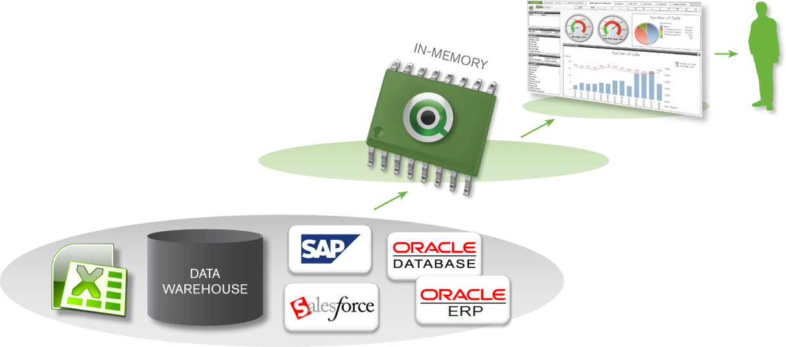
QlikView’s Core Technology: The Basics
Easily consolidates multiple data sources
Loads all data into memory (millions of rows)
Massive (10-to-1) data compression
Enables real-time associative search and analysis
Connectors to applications like SAP and Salesforce.com

Slide 12
QlikView’s Associative Experience Puts Users in Control
Traditional
Associative
Region
Region
State
Sales
Person
State
Product
Sales
Person
Product
IT Driven
Linear, pre-defined thinking
Insights missed in hidden data
Months to change
Data-centric
User Driven
User decides where to start
All data, always visible
Minutes to change
Insight driven

Slide 13
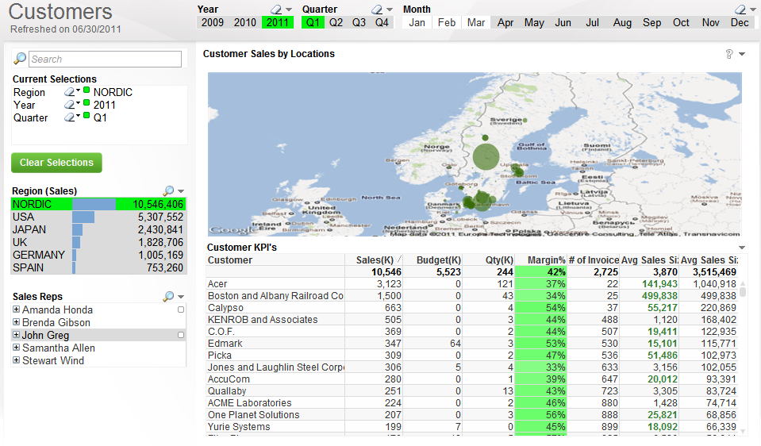
QlikView Shows You What’s Associated - and Not
Associated: white
Selections: green
Unassociated: gray

Slide 14
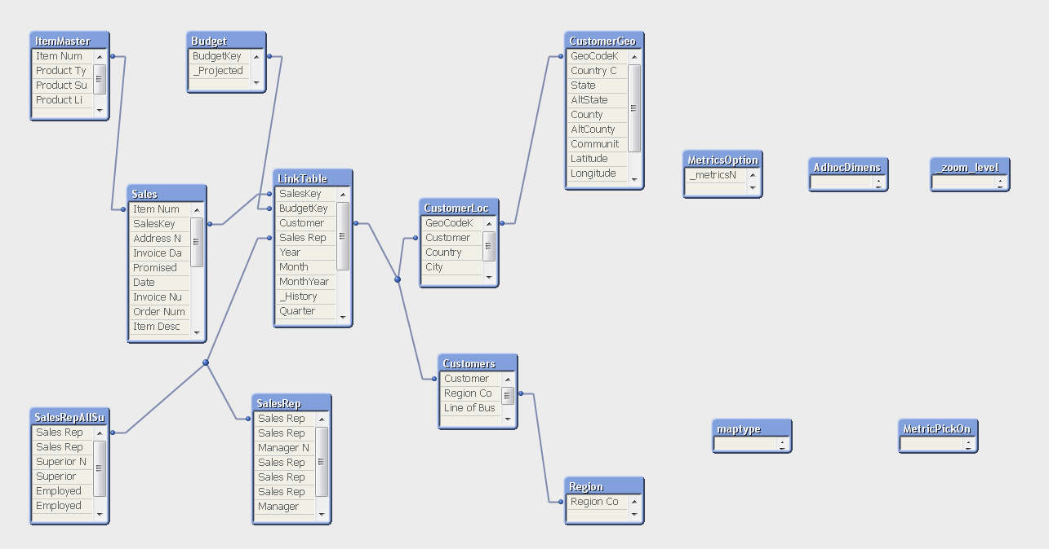
QlikView’s Core Technology: The Secret Sauce
Maintains associations in the data automatically
Calculates aggregations on the fly as needed

Slide 15
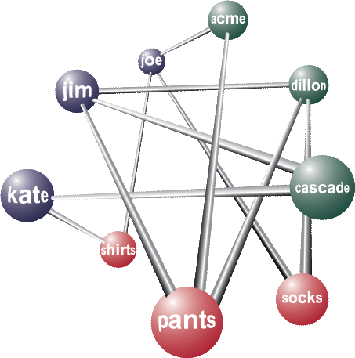
How Is The Data Stored? QlikView Approach
Database
How Does QlikView Do it?
QlikView extracts the requested data from the source and retains the metadata that describes the relationships between the various data elements.
The data is fully normalized (i.e. each data value is only stored once), resulting in a memory requirement that is 5-15% of the original data source’s size.
The data is stored in its own file which resides in memory (RAM) during runtime.
Customer | Product | Vendor
Kate | Shirts | Cascade
Jim | Pants | Cascade
Jim | Pants | Dillon
Joe | Socks | Acme
Joe | Shirts | Acme
QlikView File Structure
Why Is This Better?
Increased performance because all calculations are done in memory without reading from disk
You do NOT have to predefine hierarchies (i.e. cubes)
You empower your end users to drive their analysis needs rather than your IT department
You rarely have to go back to the IT department to have your QlikView file rebuilt because it doesn’t cover all your analysis needs

Slide 16
QlikView Shortens Cycle Time…Significantly
One Time
Daily
Run Time
ETL Script
Define Dimensions
Define Measures
Build Reports
Build Dashboards
Extract data
Calculate cube
Render UI
Traditional
OLAP
2 Months
4 Hours
Seconds
Data Bound
Process Bound
Memory/Processor
Bound
One Time
Daily
Run Time
ETL Script
Define Dimensions
Define Measures
Build Reports
Build Dashboards
Extract data
Calculate cube
Render UI
QlikView
1 Day
1 Hour
Seconds

Slide 17
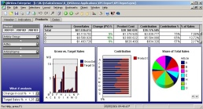
QlikView in action
User Interface
QlikView File
Data Warehouse
Notes:
Internal Use Only!

Slide 18

QlikView in action
User Interface
Relational database inside QlikView document.
QlikView File
Data Warehouse is not needed. Any data source will do.
Data Source
Notes:
Internal Use Only!

Slide 19

QlikView in action
User Interface
2. Every click is a query. Extremely fast, and very flexible.
QlikView File
Click !
The selection propagates through the relational database
Data Source
… then work off-line
1. Load the Data.
Notes:
Internal Use Only!

Slide 20
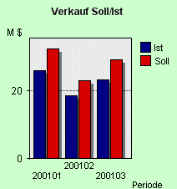
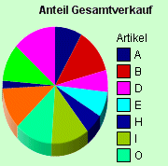
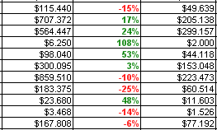
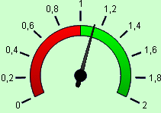
QlikView in action
Any number of Virtual hypercubes (Pivot tables, Diagrams, Gauges etc.) can be put in the QlikView document.
User Interface
QlikView File
These are calculated on demand, i.e. on every click.
Data Source
Notes:
Internal Use Only!

Slide 21
QlikView in action
User Interface
AQL is the patented techno-logy of how to quickly evaluate the data when a click is made.
QlikView File
AQL
AQL
AQL
AQL
AQL
AQL
AQL
AQL
AQL
Data Source
Notes:
Internal Use Only!

Slide 22
QlikView Architecture

Slide 23
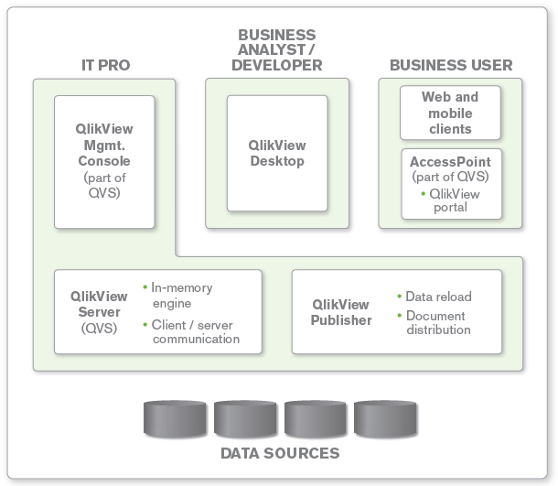
QlikView architecture overview

Slide 24
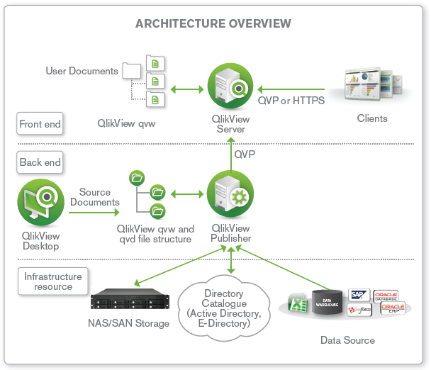
Typical QlikView deployment

Slide 25
AREAS OF APPLICATION OF QLIKVIEW
QlikView has many areas of application. QlikView helps us acquire a unified and coherent overview of the data in different databases QlikView can be used with virtually any database.
With QlikView we can -
create a flexible end user interface to an information warehouse
get snapshots of data relations
make presentations based on your data
create dynamic graphical charts and tables
perform statistical analysis
link descriptions and multimedia to your data
build your own expert systems
create new tables, merging information from several sources
build our own business intelligence system

Slide 26
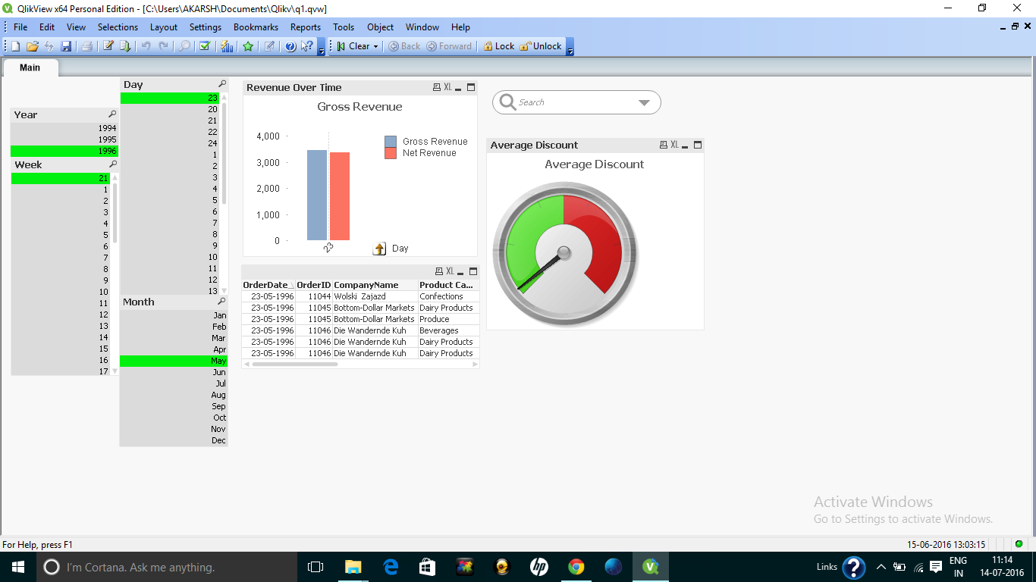
Screenshots

Slide 27
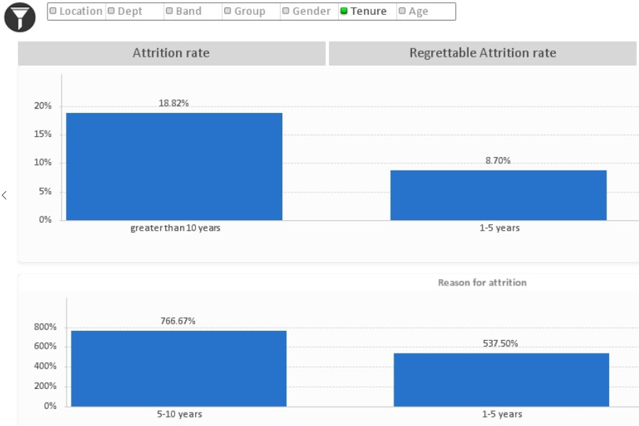
Screeshots(Cont) -

Slide 28
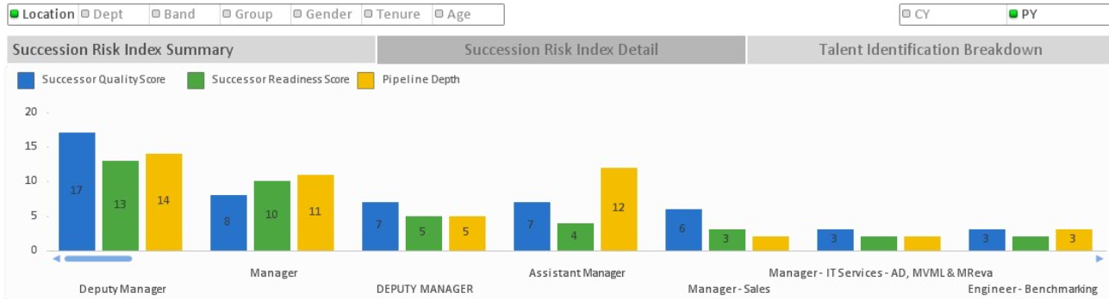
Screeshots(Cont) -

Slide 29
Qlik Sense : Self-Service Data Visualization

Slide 30
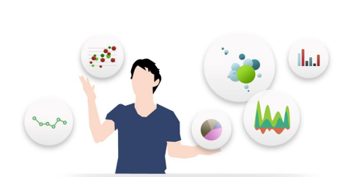
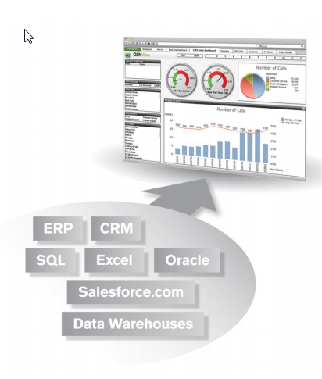
Why Qlik Sense?
Fast development and deployment.
Easy and intuitive user interface.
Associative search and analysis
Can connect to multiple data sources.

Slide 31
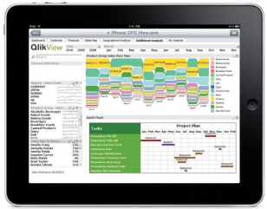
Why Qlik Sense?
In-memory analysis – quick answers.
Dashboards and detailed analysis.
Make presentations.
Link descriptions and multimedia to data.
Build your own BI system
Collaboration and Mobility

Slide 32
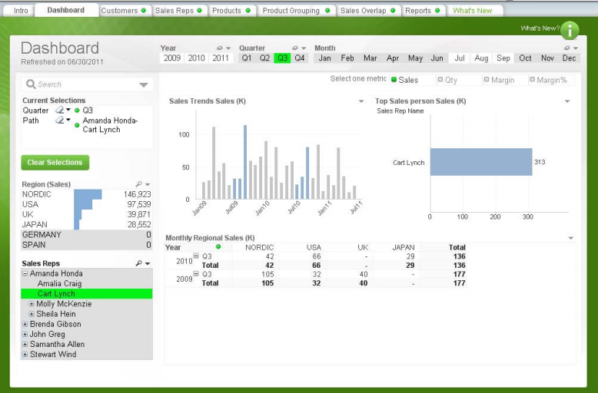
The Associative Experience

Slide 33
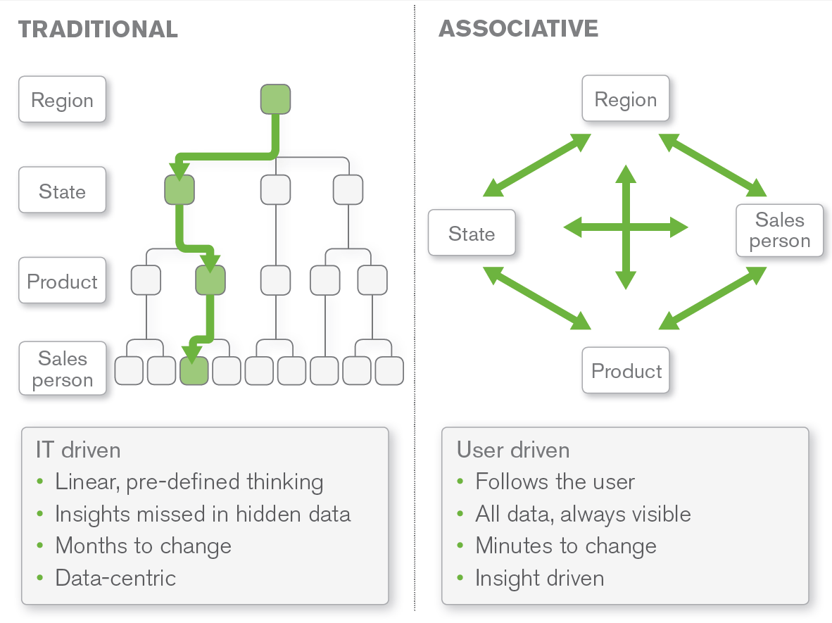
The Associative Experience

Slide 34

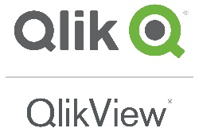


Consider the spectrum of BI tools
Self-Service BI
Traditional Products
Agile BI
Visualization
Catered BI

Slide 35
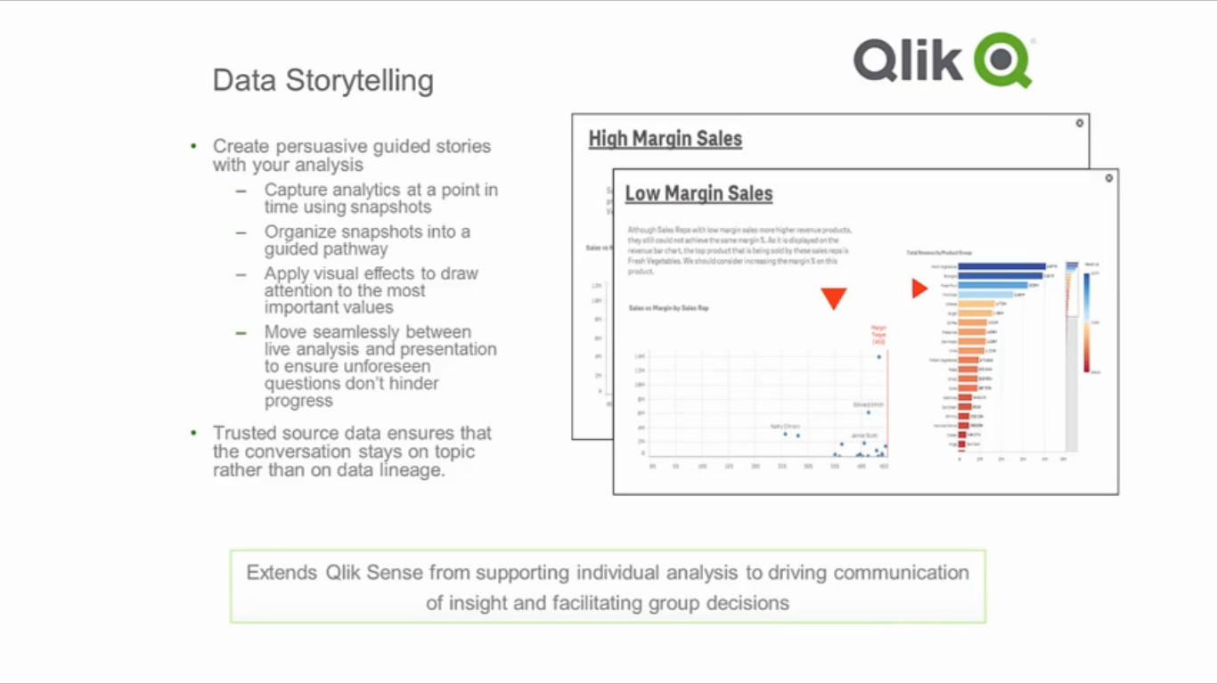
Qlik Sense promotes data literacy through storytelling

Slide 36
What more does Qlik Sense bring?
The Next Generation of Visual Analytics
Self-Service Visualization and Discovery
Sharing of Knowledge and Insights
Broad Adoption and Organizational Intelligence
See Qlik Partner Portal
“Qlik Sense Product Presentation – Summary Level”
https://eu1.salesforce.com/sfc/#version?selectedDocumentId=069D0000001DTs8

Slide 37
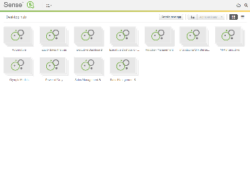
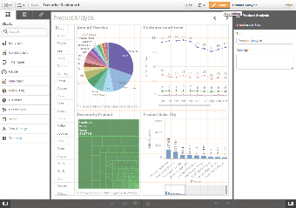
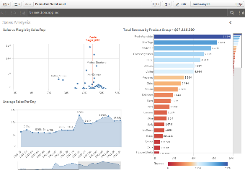
Qlik® Sense – the next generation of visual analytics
Qlik Sense is a next-generation self-service data visualization application that empowers people to easily create a range of flexible, interactive visualizations that drive exploration and discovery using one’s intuition.
Source: Qlik Partner Portal

Slide 38
Value for everyone
Individuals Self-service visualization and discovery
Groups Sharing of knowledge and insights
Organizations Broad adoption and organizational intelligence
Organizations
Groups
Individuals
Source: Qlik Partner Portal

Slide 39
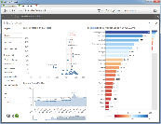
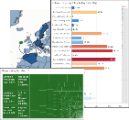
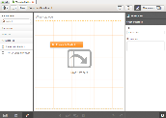
Individuals – self-service visualization and discovery
Exploration and Discovery
Ask questions and explore information to understand what’s happening and why
Clean and Modern User Experience
Global Smart Search
Associative Exploration
Advanced Navigation
Data Visualization
Utilize high quality visualizations and summarizations to reveal meaning in data
Rich Charting
Visual Interactivity
Smart Visualizations
User-Driven Creation
Build new visualizations through self-service with fast time-to-value
Drag and Drop Creation
Library and ‘Progressive’ Creation
Quick Data Load
Source: Qlik Partner Portal

Slide 40






Groups – sharing of knowledge and insights
Collaboration
Share analysis across teams to make better group decisions
Information Hub
Collaborative Creation
Qlik Cloud
Communication
Better communicate findings and persuade audiences
Data Storytelling
Mobility
Explore, analyze, and collaborate anywhere, anytime there is a question
Mobile Analysis and Creation
Gesture-based Touch UI
Responsive Design
Small Devices Mode
Source: Qlik Partner Portal

Slide 41


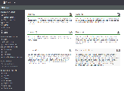

Organizations – broad adoption and organizational intelligence
App Development
Quickly and effectively build visual analysis apps using Qlik Sense
Rapid API Development
Embedded Analytics
Custom Extensions
Powerful, Multi-Source Data Integration
Direct Discovery
Management and Governance
Centrally manage and govern small to large, simple to complex deployments
Qlik Management Console
Qlik Sense Monitoring
Deployment Console
Data Governance
Security & Scalability
Ensure security of data and applications and robustly scale deployments
Centralized, Rules Based Security
Dynamic Data Reduction
Unified, Browser Based Client
Elastic Scaling Architecture
Source: Qlik Partner Portal

Slide 42





Qlik Sense can be an interim solution
Qlik power user
Restricted by internal policy
Needs a quick solution
Develops Qlik Sense app
Hosts on Qlik Cloud

Slide 43

Data Driven Documents
Introduction to visualising data with D3.js

Slide 44
D3.js Overview
A JavaScript library for creating data visualization
Transformation of data into interactive visualizations
A kind of clever "jQuery for SVG“
Developed by Mike Bostock
Based on standard Web technology
HTML Hypertext Markup Language
CSS Cascading Style Sheets
JS JavaScript
SVG Scalable Vector Graphics
DOM The Document Object Model

Slide 45
D3.js Features
Solves the fundamental problem of data visualisation
Creates SVG (or HTML) DOM elements where Scalable Vector Graphics (SVG) is an XML-based vector image format for two-dimensional graphics with support for interactivity and animation. The SVG specification is an open standard developed by the World Wide Web Consortium (W3C) since 1999.
SVG images and their behaviors are defined in XML text files. This means that they can be searched, indexed, scripted, andcompressed. As XML files, SVG images can be created and edited with any text editor, but are more often created with drawing software.
Manipulates the DOM with data
Supports differential data update
Fast, simple and efficient
Support for animations and transitions
A lot of existing chart/graph layouts • Modularity
Extensions with functions and plugins
Active community support

Slide 46
Data In D3.js
Data are arrays
Array of numbers
Array of objects
Array of arrays (matrix)
Use JavaScript‘s built-in array methods array.{filter,map,sort,…}
JSON
Embed JSON data
Loading JSON data
Loading Comma-Separated Values (CSV)
Loading XML data using XMLHttpRequest

Slide 47
Various Functions Implemented in D3
Selection & Manipulation
Selectors to simplify DOM access
Method chaining
Shorter (and more readable) code
Data Binding
Select elements and join with data
Pairs a data object and a visual element
Generation of visual elements
.enter().append()
Set properties using functions of data
Attributes (and styles) control position and appearance
Scales
Scales are functions that map from an input domain to an output range
Input is data-driven
Output range controls visual properties

Slide 48
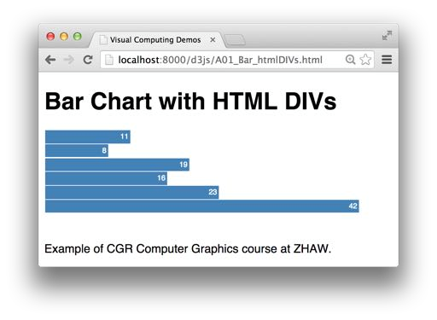

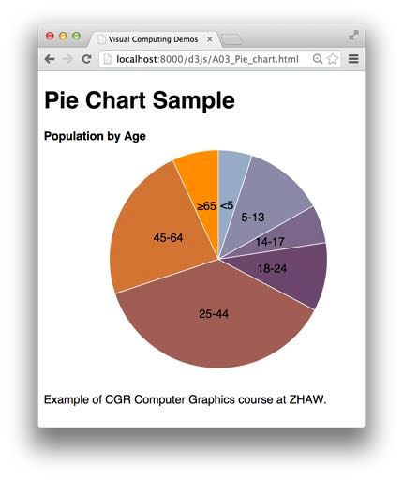
Things Which Could be Made in D3
Bar Chart
-By generating HTML div elements.
-By generating SVG rect elements and axes
Layout
-Layouts do transform data to visual elements
-They do not draw, they make the data uplift by generating, positioning, and sizing visual elements.
Pie Chart
-By using a d3.js pie layout

Slide 49
Transitions and Interactions
Make your charts change smoothly
– Data changes become animated
– Smooth movements
– Fade-in / fade-out
Add event handlers to generated SVG elements
– On over à Tooltips
– On click à Follow URL link
– On dblclick à Drill-down
– On drag à Move / rearrange
– ...

Slide 50
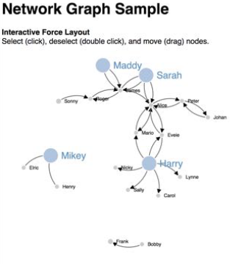
Visualizing a Network Graph
Using directional force layout
– Dynamic network layout
• Nodes as circles
• Links as curved arrows
– Event handlers
• Click
• Dblclick
• Drag
– Transition
• Node resizing

Slide 51
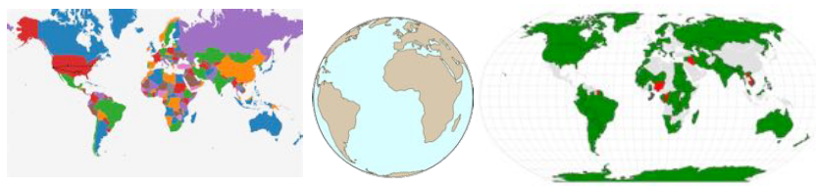
Geographical Maps
GeoJSON
– Maps geographic data to SVG polygon elements
TopoJSON
– Borders are stitched together from segments called arcs
– Arcs are shared by borders à compact data
Many different geo projections in d3.geo.js available

Slide 52
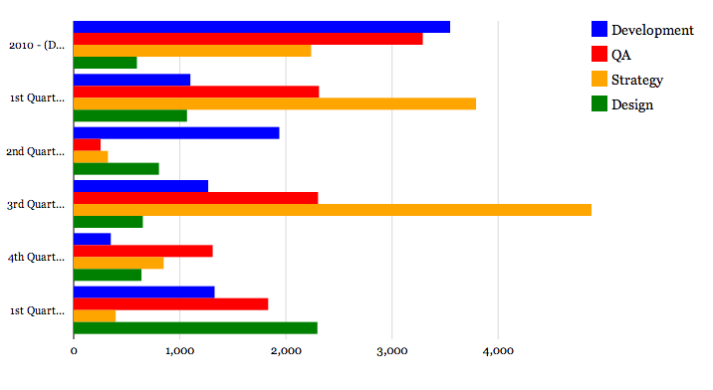
Sample bar chart with the d3 module

Slide 53
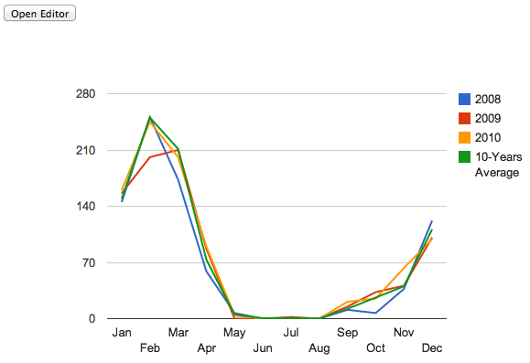
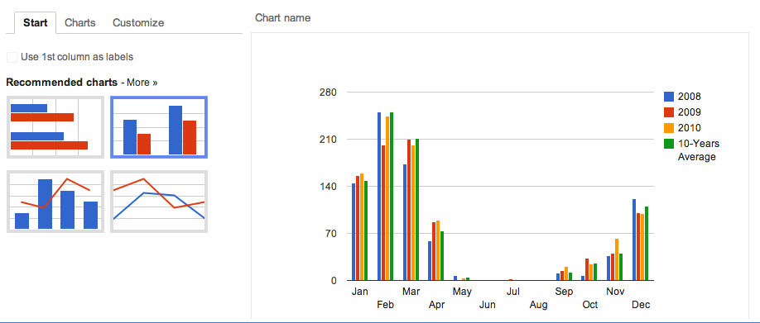
Sample Charts Generated Using D3.js
Notes:
Uses ChartWrapper, and ChartEditor classes.
Google chart tools always assumes DataTable.

Slide 54
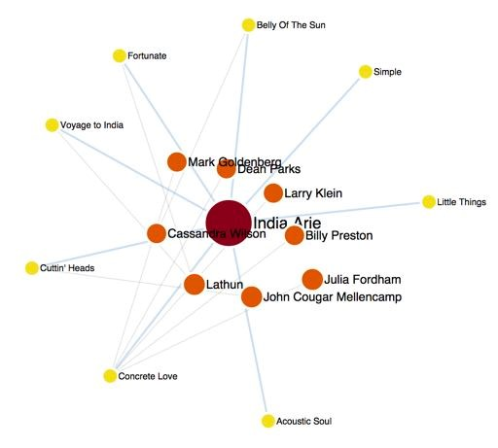
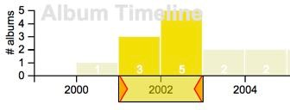
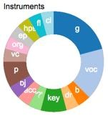
A Typical D3.js Application
Data Flow
– Import of raw data
Optional: Data pre processing
– Data filtering
By user interaction
By animation (timer)
– Visual mapping
Preparation for visualization
– Chart-specific data arrays
– Calculate scales and axes
Several parallel charts
– Main chart
– Side charts
raw data
interactive
filtering
animated
selection
selection
filtered data
prep
chart data 1
chart data 2
chart data 2
chart data 2
main
side
chart
charts

Slide 55
Comparing Qlik View, Qlik Sense and D3.js

Slide 56
Use Case
Use Case | QlikView | Qlik Sense | D3.js
Ad-hoc personal visualization |  | 
Rapid visualization and sharing |  |  | 
Mobile discovery & exploration |  |  | 
Governed data discovery |  |  | 
Structured IT managed dashboards |  |  | 

Slide 57
Features
Feature | QlikView | Qlik Sense | D3.js
Story-telling |  |  | 
Collaboration |  |  | 
Mobile |  |  | 
Filter pane |  |  | 
Sort on expression |  |  | 
Section Access |  |  | 
Radar Chart / Funnel Chart / Grid Chart / Mekko Chart |  |  | 
Button |  |  | 
Container |  |  | 
Slider |  |  | 
Input Box |  |  | 
Triggers |  |  | 
Comparative Analysis (State) |  |  | 

Slide 58
Features(cont-)
Feature | QlikView | Qlik Sense | D3.js
Highlight table rows in bold |  |  | 
Highlight table rows in color |  |  | 
Condition visible on dimension and measures | 
Only one value selected |  |  | 
Image in charts arrows up/down |  |  | 

