Slide 1


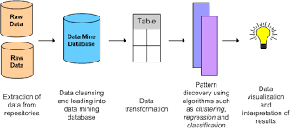
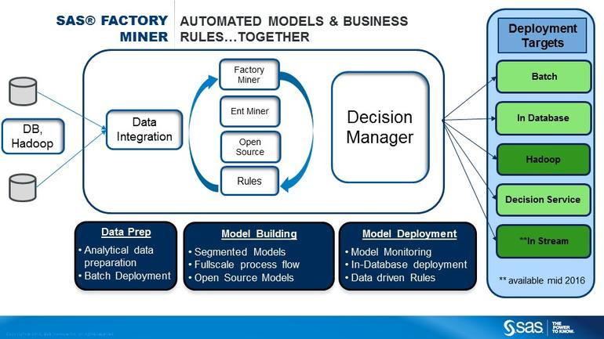
Team 3
Machine learning [Factory Process]
Intelligent Production Line [Factory Process]
All these data can be converted into useful information using techniques like data mining, BIG data analytics, etc.
Data mining - extraction of patterns and knowledge from large amounts of data, not the extraction (mining) of data its Following data can be stored-
whenever a part is used, the database gets updated
separate entries can be maintained for each
technicians working in the factory
information like time of entry in the factory ,
time spent in the factory and Work status
Data mining techniques can be used to cluster
and classify these data and generate useful
information like:
Which technician has high efficiency.
Reason for companies success and
failures in the past.
All this could be put to great use in plotting
graphs combination which result in good profit margins for company and from where
and doing deep mining to givee the chances of losses are less.
We observed that for every product assembled at the factory manual record is kept for every parts assembled.
This data collected can be stored digitally.in a database.

Slide 2
Team 3
Siemens Healthcare Factory observations
Innovation Think tank workshop - Siemens Goa 20 April 2016
Determination of sales
Sales are determined by region representatives, based on stats.
Sale Policy
Make to Store, due to limited models and high supply time for parts.
Inspection
Based on sampling plan and manual inspection. Mostly related to dimensioning while PCBs are visually examined.
Sampling plan
As per this method, only a few samples out of full lot is testes and not complete lot.
Customer servise
Service franchise is responsible for CS during and after warranty
Factory vist - Observations
Sandal Kotawala; Akarsh Goyal[VIT University]
Slow updation and innovation
Most of the machines being developed, were designed 20-30 years ago and since then only “ most necessary” changes are made
Information from Mr. Rizwan Kazi and Mr. Mahesh Borkar
Siemens healthcare factory , Goa :
What is done here? …Testing and assembly of “Diagnostic X-Ray products”
Parts and supplier classification…based on part use by volume. Class A parts : Responsible for 80% volume and proper working of production line. Class B: 15%; Class C: 5%
Inventories required…WIP (work in progress), raw material storage and final product storage.
Major challenges?…Procuring parts in time from supplier, unplanned rejections, No direct contact to customer.
“Assembling consumes most time”
-Where does parts come from?…Most parts are supplied by local or Indian suppliers, while special parts like Imaging Intensifier (II), tube are imported.
- Making for rural India?…Projects like Multiphase-Mitra offers effective X-ray solution for rural ares with no electricity supply.
Research and Development
- Project Manager has to do initial assessment and technical requirements must be specified in the SRS.
Risk Analysis is the main thing. Operator , patient and Environmental Safety is a must.
V-shaped model is used which is good for the production as again and again verification is done. So low chance of software error is there.
Budget is decided by management and should be strictly adhered to.
Mobile Products
stationary products
Imaging Products
1
2
3
What determines factory quality?… KPI : Keep performance indication
Delivery Reliability
Onetime delivery
First pass Yield
Low defects
1
2

Slide 3

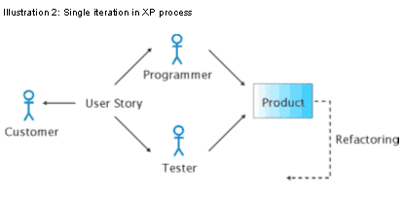
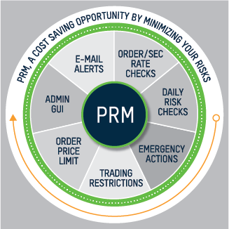
Team 3
Factory visit observations
Factory work flow
Representatives responsible for different regions forecast sales
Raw material ordered
Research And Development (Cont)
- PI is the link between production and R&D.
RS serial production to final customers. Sometimes phase-out of products is there.
End of product development life cycle is the end of the product. But upgrades to different products are regularly introduced.
Testing of design and endurance testing is performed.
SDS is formulated. The different unit-tests are particular to a component.
Parts replacement phase and reliability tests are performed.
Future portfolio planning is done by the management.
Limited R&D resources are there.
PRM department is important.
XP model and RAD model is used for development.
Materials received from various suppliers
Counting and verification
GRN generated : Goods received note
Inspection required?
Yes
Inspection
If part NOT OK… move part to Red tag Area. Create NC/PSR
Return defected part to supplier
Store
Part Ok
Material feeding on assembly as per “Kanban”
Products assembly
Products testing
Packaging
Final inspection and product release by QC team
Storage or customer service area

