Slide 1


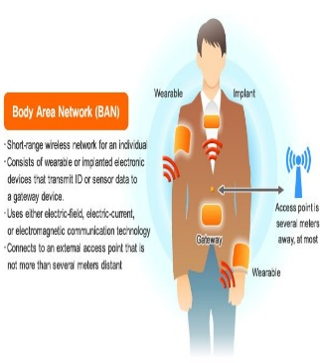
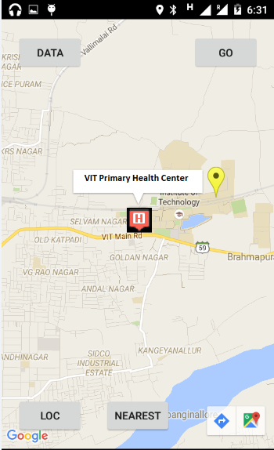
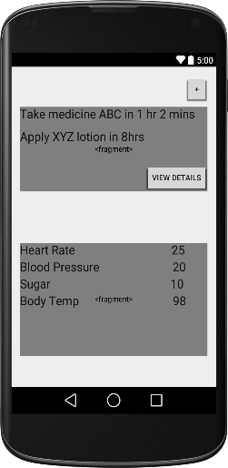
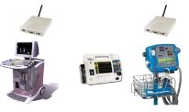
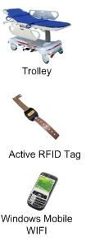


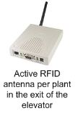


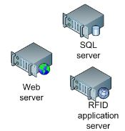
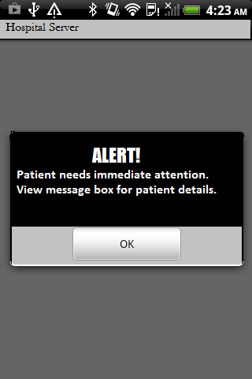

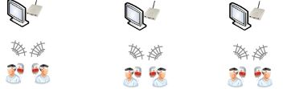

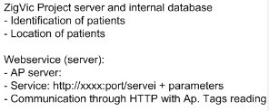

Team 3
Working app : Nearest hospital [Future Hospital]
RFID based patient traffic monitor [Future Hospital]
A cheap body automation network(BAN) could be created for a specific person in which different sensors will be connected to a person’s body. They will monitor pulse rate body temperature ,diabetes,stress and other things.
Asset Control
RFIDs can be incorporated into the infrastructure of an already existing hospital. The medical equipment must embed RFID tags. The doctors, nurses, caregivers and other staff members wear a “smart badge”2 storing their employee ID number.
On arrival, each patient receives a wristband with an embedded RFID tag storing a unique identiﬁer, and some information about him)All the patients’ medical histories (aka paper medical ﬁles) and other important
documents are tagged with self-adhesive RFID labels containing a unique number.
It will send the real time data to the web server using MQTT protocol. The web server will link the data directly to the app. If any of the parameters being monitored cross their threshold then the GPS coordinates of the patient along with his unique id will get automatically sent to the nearest hospital server using an Arduino and GSM shield.
The blister packs and other drugs’ packages all contain RFID labels. These transponders should preferably be EPC compliant.The bags of blood are attached with a self-adhesive RFID label holding a unique identiﬁer, the hospital tracking number and some important information about the contained type of blood
Furthermore, RFID readers are placed at strategic places within the hospital:
RFID gates are disposed at entrances and exits of the hospital.
Each operating theater contains a least one RFID reader.
RFID sensors are placed in strategic galleries and important ofﬁces.
This will be achieved by an app running in the background. The hospital server will show an alert stating that a patient needs immediate attention and his location and identity will be in the message transmitted along with the alert giving the whereabouts of the patient.

