Slide 1


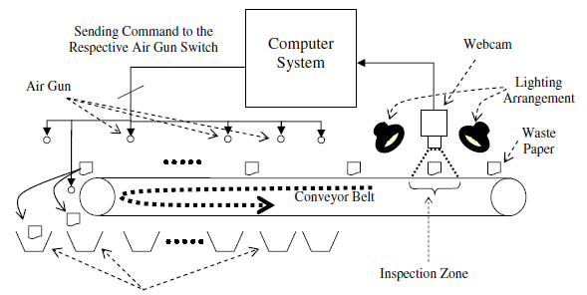
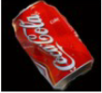

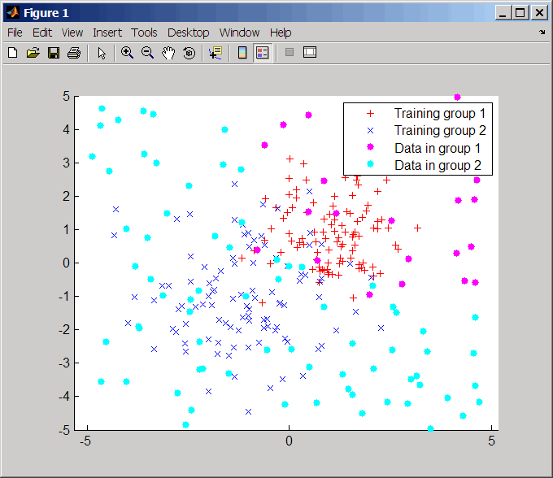
Team 3
Sample transfer via Hyperloop with Smart labelling [Pathology]
Segregation of bio medical waste [Pathology]
Using automated high speed sample tube transfer to prevent sample deterioration during pathological testing
Conveyor Belt
The elements are placed on the conveyor belt that moves them up to where the webcam is, the webcam is in charge of telling the conveyor belt when to start and stop. Once the object is right under the camera, the system will analyze the image and determine which kind of object it is, and its shape
to tell the robotic arm the coordinates for picking it up and placing it in the appropriate container..
Path Hyper loop
Blood Sample quality decays with time
Problem Observed : At max within an hour sample must be processed in lab for accurate results
Solution?…Tube is created from sample collection room to lab, and assign as sample is collected, it is transferred to pathology lab, via air blower.
Feasibility?… Low cost material such as PVC can be used along with air blower to make low cost device to transfer samples and also temperature of tube can be maintained.
User Interface
User interface could be given with the help of technology such as Windows Presentation Foundation and Matlab. From the point of view of the functionality of the system, it offers 3 manners of functioning:
Way of Classification: where the user sees the system work and classification it shows the images directly from the camera.
Way of Training: where the user can train the system
Way of configuration: where the user can prepare the system.
The system separates inorganic elements using four different components: computer vision, user interface and conveyor belt.
Computer Vision
Computer Vision can be put to good use. In order to properly classify
the objects, we need to isolate them from the background and somehow characterize them. The most relevant characteristic we have considered and have decided to use is the objects shape, so the system can recognize objects by their shapes in
a similar way as humans do. After this training, we can characterize an arbitrary object and compare it to known
objects in order to determine what type of object it is. The first processing step (segmentation) involves
distinguishing objects from the background and from other objects. In this step, quite generic image processing methods
are used.

