Slide 1
CONTINUOUS ASSESSMENT II · CYBER SECURITY · CASE STUDY
> nmap -sT -Pn 127.0.0.1
Network Reconnaissance and Security Assessment Using Nmap
A practical case study on a Windows endpoint
Group 36
Akarsh Khot (PRN 23070123012)
Amreet Anooj (PRN 23070123018)
Dept. of Electronics & Telecommunication Engineering
Batch 2023–2027 · Semester VII
Notes:
[Akarsh] Good day everyone. We are Group 36 — I am Akarsh Khot, and with me is Amreet Anooj. Our Cyber Security case study is titled 'Network Reconnaissance and Security Assessment Using Nmap'. In it we scanned our own Windows laptop with Nmap, then used built-in Windows tools to understand what each open port actually belongs to, and checked the firewall and file-sharing settings. We will walk you through the problem, our method, the results and what we recommend.

Slide 2
Why an open port needs context
1
Which process owns the port?
Open port
Nmap shows the port, not the program behind it
≠
2
Is the service actually needed?
Vulnerability
Background services serve OS, devices, file sharing
A scan is an inventory step.
3
Can another device reach it?
Depends on binding address and firewall policy
Group 36 · Nmap Case Study
2
Notes:
[Akarsh] Network reconnaissance means gathering information about systems and services. Defenders use it to keep an inventory and spot unexpected listeners; attackers use the same techniques to find entry points, which is why scanning must always be authorized. A Windows laptop runs many background services — operating-system functions, device utilities, file sharing. A list of open ports alone does not tell you three things: which process owns each port, whether the service is needed, and whether another device can actually reach it. Our problem statement is exactly this: how do we do a basic, repeatable port inventory and interpret it properly using local process, firewall and SMB evidence.

Slide 3
Aim and objectives
1
Scan
2
Save
3
Detect
Loopback interface, common TCP ports
Store scan output as repeatable evidence
Light service / version detection
4
Compare
5
Inspect
6
Recommend
Nmap vs. Windows sockets and processes
Firewall profiles, SMB settings, shares
State limits, suggest defensive actions
Group 36 · Nmap Case Study
3
Notes:
[Akarsh] The aim is to demonstrate a beginner-friendly, authorized Nmap-based assessment of one Windows laptop. We set six objectives. One: scan the loopback interface for common TCP ports. Two: save the scan output so the evidence can be repeated and compared. Three: run light service and version detection on the ports we found. Four: compare Nmap's results with Windows' own list of listening sockets and processes. Five: inspect the firewall profiles, the SMB protocol settings and the configured shares. And six: identify the limitations and recommend proportionate defensive actions.

Slide 4
Scope and authorization
✓
What we did
✕
What we did not do
Assessed our own laptop only
Target: 127.0.0.1 (localhost)
Observation and configuration checks
Enabled firewall; verified the result
Scan any external or third-party host
Exploit any service
Attempt credential access
Change SMB settings
Group 36 · Nmap Case Study
4
Notes:
[Akarsh] Scope matters a lot in security testing. We assessed only our own Windows laptop. The main target was 127.0.0.1, the loopback address, which simply refers to the same computer. We did not scan any external address, third-party host or other device. The work was limited to observation and configuration checks — we did not exploit any service, attempt to get credentials, or change any SMB settings. The one change we did make was enabling the firewall through Windows Security, and we verified the result afterwards. Nmap's own guidance stresses understanding the legal and authorization boundaries before scanning, and we followed that.

Slide 5
Background: what guided the work
Nmap guide
NIST SP 800-115
Ports are open, closed or filtered; connect scans and service probes; save output to compare
Plan, conduct in scope, analyze, then recommend mitigations
Windows Firewall & SMB
MITRE ATT&CK T1046
Host-based filtering by profile; limit SMB exposure; disable SMB1
Adversaries enumerate services, so defenders must know what listens
Group 36 · Nmap Case Study
5
Notes:
[Akarsh] We grounded the work in four sets of references. Nmap's official guide explains that ports are classified as open, closed or filtered based on probe responses, and that this is not a vulnerability rating. It also explains TCP connect scanning, service detection, and saving output so results can be compared later. NIST SP 800-115 gives the testing lifecycle: plan, conduct within scope, analyze, and recommend mitigations. Microsoft's documentation describes Windows Firewall as a host-based control with Domain, Private and Public profiles, and recommends limiting SMB exposure and disabling SMB1. Finally, MITRE ATT&CK technique T1046, Network Service Discovery, shows attackers enumerate services too — so defenders should know what is listening. The full report lists 32 references.

Slide 6
Methodology: a staged workflow
1
2
3
4
5
6
Install & verify Nmap 7.992
TCP connect scan
Save output
Service detection
PowerShell inspection
Repeat after firewall
Non-destructive · Local machine only · No exploitation or remote-host testing
Group 36 · Nmap Case Study
6
Notes:
[Akarsh] Our method was a staged, non-destructive workflow in six steps, aligned with NIST guidance. First we installed Nmap and verified the version — it returned 7.992. Second, we ran a TCP connect scan against localhost. Third, we saved the output to a text file for evidence. Fourth, we ran a focused service-detection scan only on the four ports we discovered. Fifth, we used PowerShell to inspect listening sockets, owning processes and services, the firewall profiles, the network category, and the SMB configuration and shares. Sixth, after confirming the firewall profiles were enabled, we repeated the scan to compare. Everything stayed on the local machine.

Slide 7
Tools and commands used
# initial scan
> nmap -sT -Pn 127.0.0.1
# save output
> nmap -sT -Pn 127.0.0.1 -oN nmap_results.txt
# after firewall
> nmap -sT -Pn 127.0.0.1 -oN nmap_after_firewall.txt
# service detection
> nmap -sT -Pn -sV --version-light -p 135,445,1042,7778 127.0.0.1
-oN nmap_service_verification.txt
-sT
-Pn
-sV
-p
-oN
TCP connect
skip host discovery
version detection
chosen ports
save to file
Windows 10.0.26200 · Nmap 7.992 · PowerShell · Target 127.0.0.1
Group 36 · Nmap Case Study
7
Notes:
[Akarsh] Here is the toolset. We used Windows with Nmap 7.992 and PowerShell, targeting 127.0.0.1. The first command, nmap -sT -Pn, does a TCP connect scan and skips host discovery. We then ran it again with -oN to save human-readable output, and again after the firewall check. The focused service scan adds -sV for service and version detection, with --version-light to reduce probe intensity, and -p to scan only the four discovered ports. On the Windows side we used Get-NetTCPConnection, Get-Process and Get-CimInstance for ports and processes, Get-NetFirewallProfile for the firewall, and Get-SmbServerConfiguration and Get-SmbShare for file sharing. That lets us compare Nmap's view with the system's own view.

Slide 8
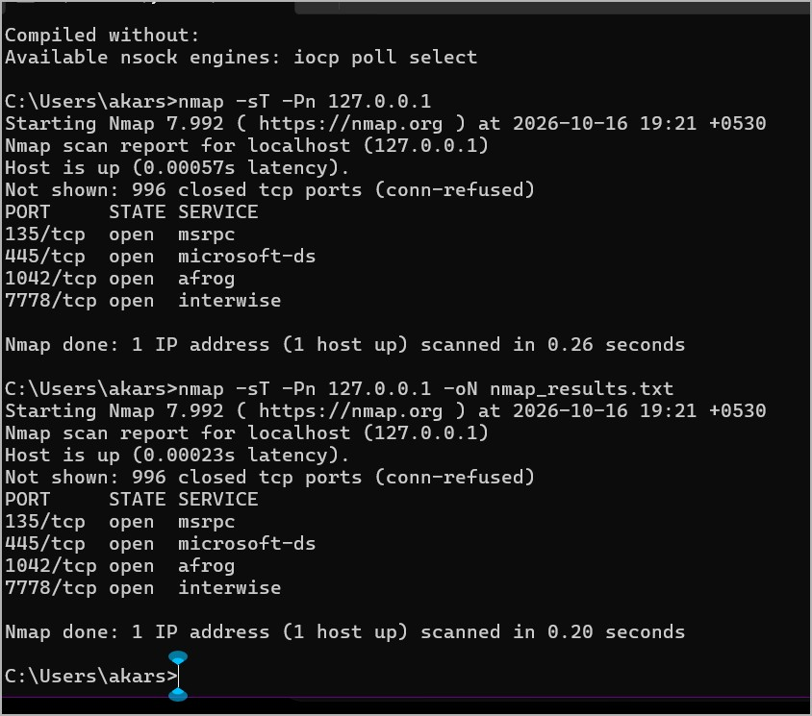
Result: four open TCP ports
4
open TCP ports
996
closed of 1,000 scanned
0.26 s
scan duration
Nmap output for 127.0.0.1
Group 36 · Nmap Case Study
8
Notes:
[Amreet] Now the results. The first scan of localhost completed in about a quarter of a second — 0.26 seconds — and reported the host up. Nmap scans its default 1,000 most common TCP ports. Of those, 996 were closed and four were open: ports 135, 445, 1042 and 7778. On the right is the actual terminal output. We saved this scan as nmap_results.txt. A caution already: the service names in this standard output, like microsoft-ds or interwise, can come only from Nmap's port-number database, so they are not proof of what is really running. That is why we verified further.

Slide 9
Matching each port to a process
Port | Nmap result | Local evidence
135 | Open · Windows RPC identified | PID 1788 svchost.exe · RpcEptMapper, RpcSs
445 | Open · microsoft-ds? (uncertain) | PID 4 System · Server service running
1042 | Open · afrog? (unrecognized) | PID 5104 asus_framework.exe · 127.0.0.1
7778 | Open · interwise? (uncertain) | PID 6172 ArmouryCrateControlInterface · 127.0.0.1
Local-only: ports 1042 and 7778 listen on 127.0.0.1, so they are not shown to be network-exposed.
Group 36 · Nmap Case Study
9
Notes:
[Amreet] Next we matched each port to a real process using PowerShell. Port 135: Nmap's service detection confirmed Microsoft Windows RPC, and PowerShell showed it belongs to process 1788, svchost.exe, running the RPC Endpoint Mapper and RPC services. Port 445: Nmap labelled it microsoft-ds with a question mark, meaning uncertain; PowerShell showed process ID 4, the System process, with the Server service running, SMB1 off and SMB2 on. Ports 1042 and 7778: Nmap guessed afrog and interwise, again uncertain. PowerShell showed they belong to ASUS software — asus_framework.exe and the Armoury Crate control interface — and both are bound to 127.0.0.1 only. So these two are local-only listeners, and we should not call them network-exposed based on this test.

Slide 10
Firewall profiles: before and after
Before
After enabling
Domain
ENABLED
Domain
ENABLED
→
Private
DISABLED
Private
ENABLED
Public
DISABLED
Public
ENABLED
Repeat scan: same four ports. Expected — a localhost scan cannot show whether other devices can reach them.
Group 36 · Nmap Case Study
10
Notes:
[Amreet] Then the firewall. The first PowerShell check showed the Domain profile enabled, but Private and Public disabled — and our Wi-Fi network was classified as Public. We then enabled the firewall through Windows Security, and a later check showed all three profiles enabled. We repeated the Nmap scan and it returned the same four open ports. This is expected, and it does not mean the firewall failed. A localhost scan tests listeners on the same computer, not whether a remote device can connect through the network interface. So the lesson is that the target and scope of a test decide what it can prove.

Slide 11
SMB configuration
Running
SMB1 off
SMB2 on
3 shares
Server service (LanmanServer)
Old protocol disabled
ADMIN$ · C$ · IPC$
A share or open port is not proof of exposure. Firewall rules, permissions and reachability from a second host must also be checked.
Group 36 · Nmap Case Study
11
Notes:
[Amreet] Port 445 belongs to SMB, Windows file sharing, so we checked its configuration. The Server service, LanmanServer, was running. SMB version 1 was disabled, which is good because it is the old, weak version, and SMB version 2 was enabled. PowerShell listed three shares: ADMIN$, C$ and IPC$. These are standard Windows administrative and communication shares, and their presence is not automatically a vulnerability. A proper exposure assessment would also need the inbound firewall rules, access permissions, and a test from an authorized second device. We did not have a second device, so remote reachability was outside our scope.

Slide 12
Security recommendations
Keep Windows Firewall enabled on all profiles; review inbound rules
Keep SMB1 disabled; keep SMB2/SMB3 patched
1
2
Review need for SMB server and admin shares, check dependencies first
Review ASUS listeners (1042, 7778) via vendor documentation
3
4
Re-scan after changes; compare saved outputs and keep records
Scan only systems you are explicitly authorized to scan
5
6
Group 36 · Nmap Case Study
12
Notes:
[Amreet] From these findings we make six proportionate recommendations. One, keep Windows Firewall enabled on all profiles and review inbound allow rules. Two, keep SMB1 disabled unless there is a documented legacy need, and keep SMB2 or SMB3 patched. Three, review whether SMB server functions and admin shares are needed — but check dependencies first, and do not remove them blindly. Four, review the ASUS listeners on ports 1042 and 7778 through vendor documentation. Five, repeat the scan after software or configuration changes and compare the saved outputs, keeping a record of date, target, command and results. And six, only scan systems you have explicit authorization to scan.

Slide 13
Limitations
No second device for a controlled remote test
!
127.0.0.1
Services on 1042 and 7778 not conclusively identified; 445 label uncertain
!
Every scan targeted localhost, so remote reachability is untested.
No vulnerability scan or credential testing
!
Not every firewall rule inspected; router not tested
!
Group 36 · Nmap Case Study
13
Notes:
[Amreet] It is important to be honest about limitations. The main one is that every scan targeted 127.0.0.1. A loopback scan shows services reachable through the local loopback interface, not necessarily services reachable from other computers. We had no second computer for a controlled remote test. Nmap did not conclusively identify the services on ports 1042 and 7778, and the label for 445 carried a question mark. We also did not run a vulnerability scan, test credentials, inspect every firewall rule, or test the router. So our findings are a local inventory and configuration review — not a penetration test and not proof of exploitable vulnerabilities.

Slide 14
Conclusion
1
4 open ports found
“A port scan is an inventory step, not proof of a vulnerability.”
135, 445, 1042, 7778 — same after firewall check
2
Context makes them meaningful
Process identity, SMB settings, firewall policy, scope
3
Next step: remote test
Thank you · Questions?
Scan from an authorized second device
Notes:
[Amreet, then both] To conclude: we demonstrated a basic, repeatable Nmap workflow on a Windows laptop. The scan found four open TCP ports on localhost. Service detection confirmed Windows RPC on port 135 but not every other service. PowerShell tied the listeners to Windows RPC and ASUS processes, and the SMB checks showed SMB1 disabled, SMB2 enabled and three standard shares. After verifying the firewall was enabled, the repeat scan returned the same ports. The key lesson is that open ports must be read together with process identity, configuration, firewall policy and test scope. Remote reachability remains untested, and that is the natural next step. [Akarsh] Thank you for listening — we are happy to take any questions.

