Slide 1
Search Engines
Information Retrieval in Practice
All slides ©Addison Wesley, 2008

Slide 2
Beyond Bag of Words
“Bag of Words”
a document is considered to be an unordered collection of words with no relationships
Extending representation
feature-based models
dependency models
document structure
question structure
other media

Slide 3
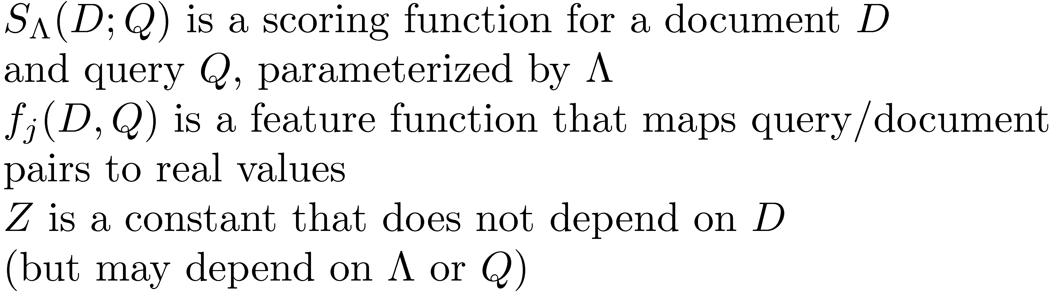
Feature-Based Retrieval Models
Linear feature-based model
Some models support non-linear functions, but linear is more common

Slide 4

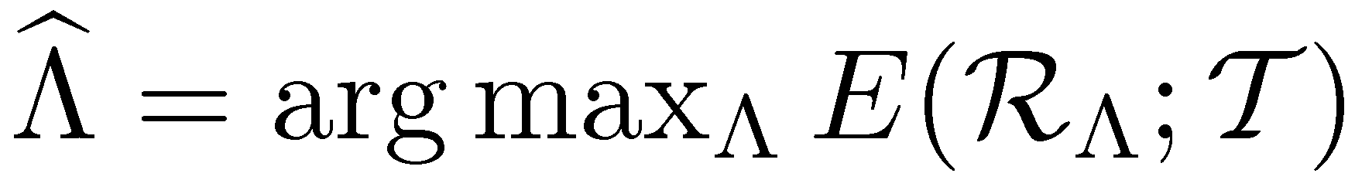
Linear Feature-Based Models
To find best values for parameters
need a set of training data T
an evaluation function
where R_{Λ} is the set of rankings produced by the scoring function for all the queries
Goal of a linear feature-based retrieval model is to find a parameter setting that maximizes E for the training data

Slide 5
Term Dependence Models
Term dependence models do not assume that words occur independently of each other
e.g., Markov Random Field (MRF) model
construct a graph that consists of a document node and one node per query term
undirected graphical model
models the joint distribution over the document random variable and query term random variables
models dependencies between random variables by drawing an edge between them

Slide 6
MRF Model Assumptions
independence
sequential dependence
full dependence
general dependence

Slide 7
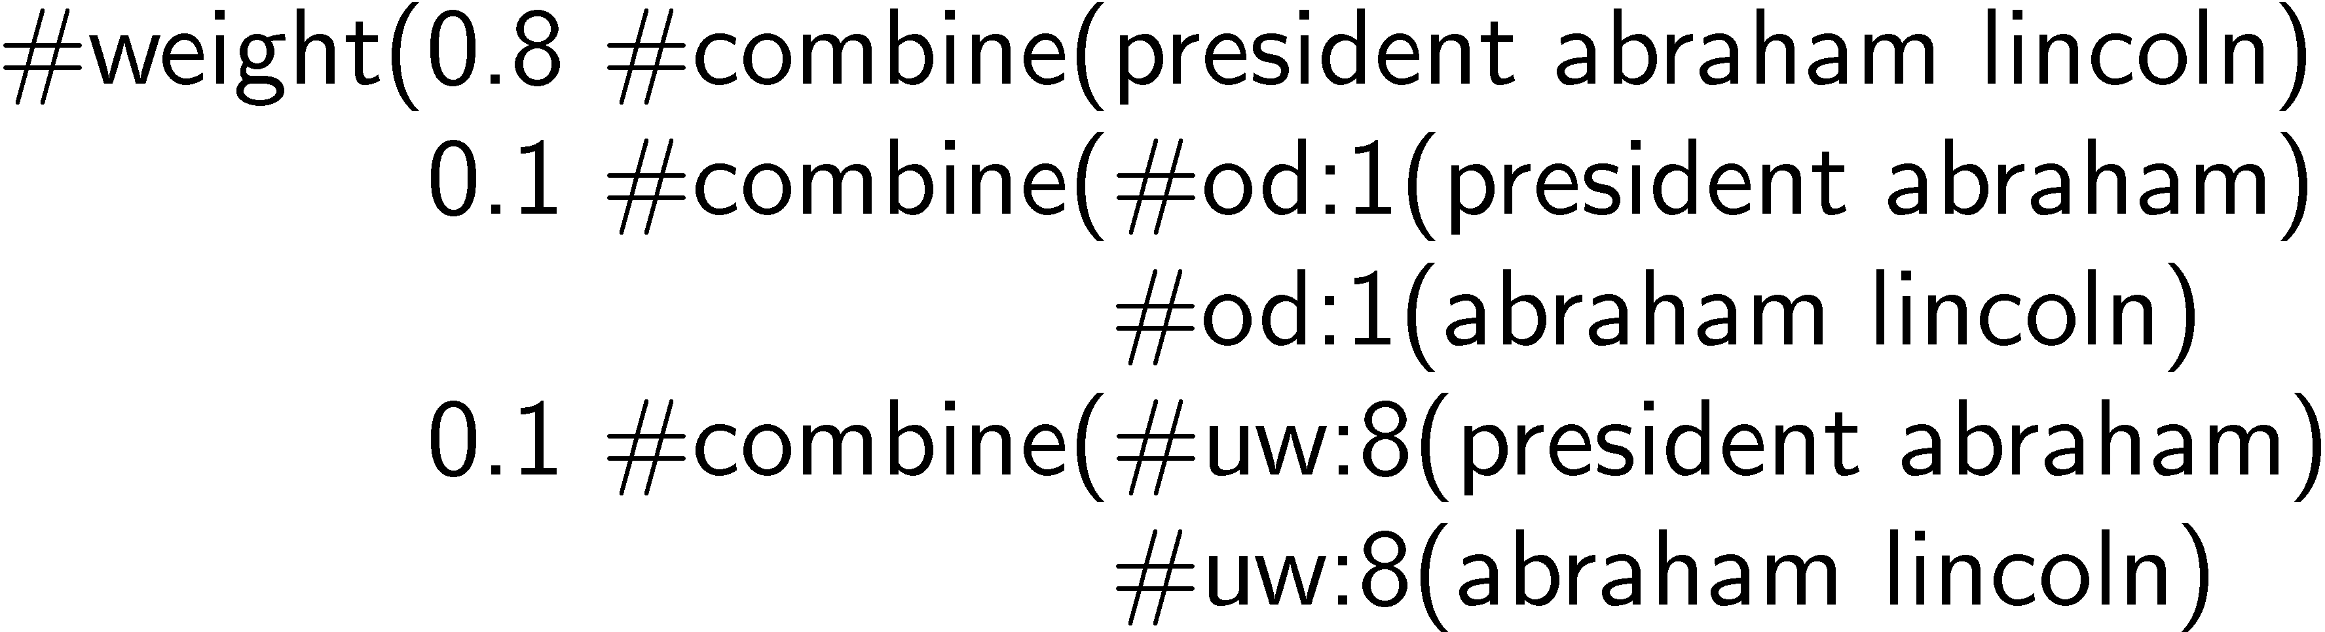
MRF Model
Define a set of potential functions over the cliques of the graph
these are the features of the linear feature-based model
e.g. sequential dependence model in Galago for query “president abraham lincoln”

Slide 8
Latent Concept Expansion
Generalized version of pseudo-relevance feedback and relevance models
Latent, or hidden, concepts are words or phrases that users have in mind but do not mention explicitly when they express a query
latent concept expansion graph shows dependencies between query words and expansion words
better probability estimates for expansion terms
expansion features not just terms

Slide 9
Pseudo-Relevance Feedback Graphs
Relevance model
LCE model

Slide 10
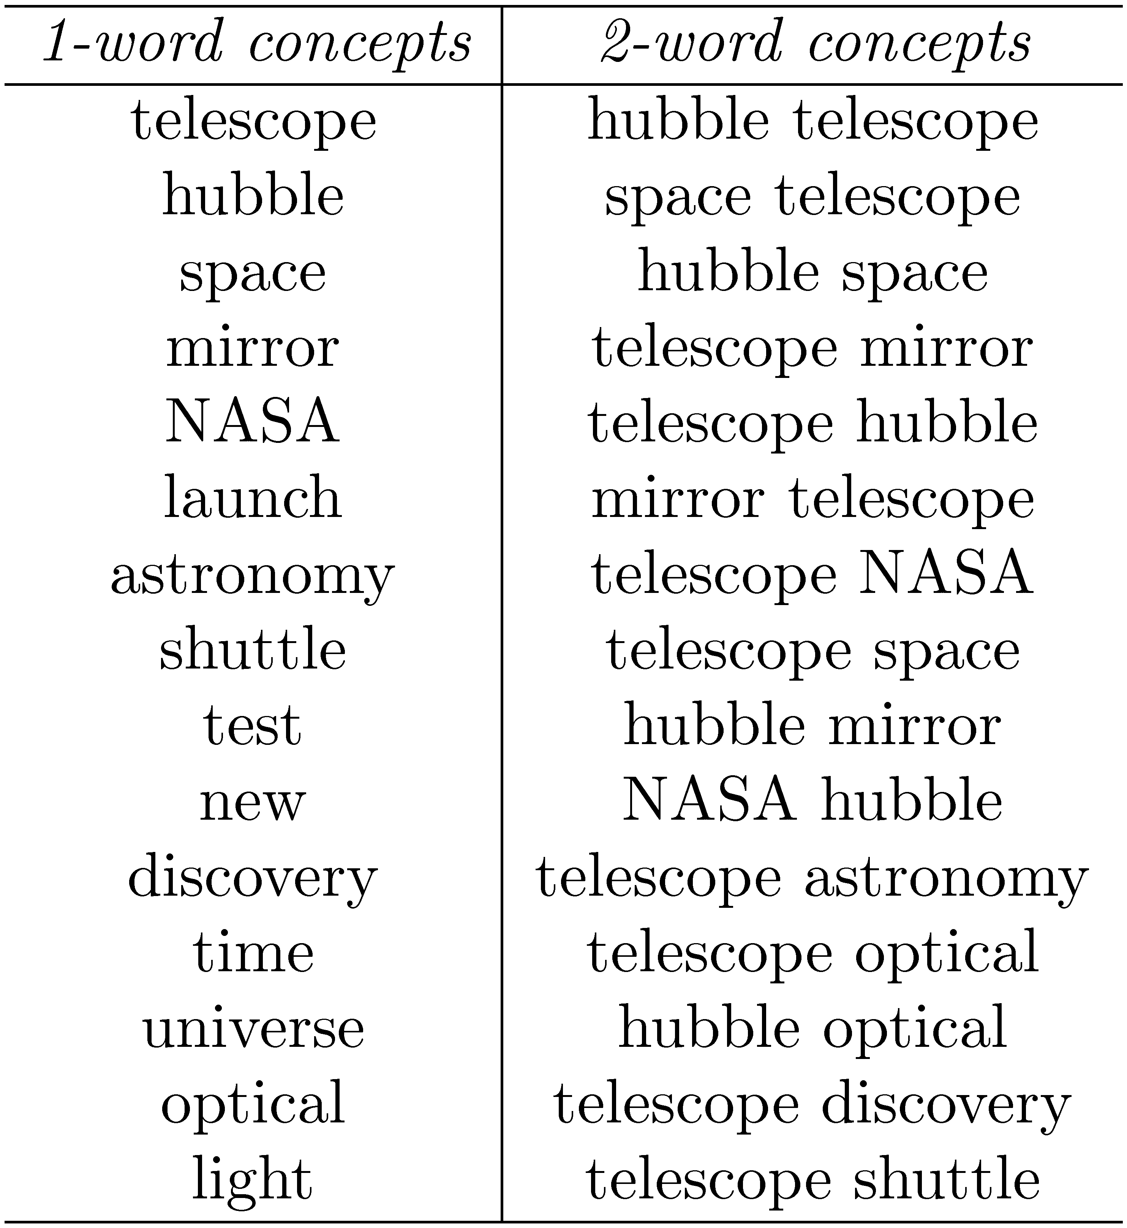
LCE Example

Slide 11
Integrating Databases and IR
Possible approaches
Extending a database model to more effectively deal with probabilities
Extending an information retrieval model to handle more complex structures and multiple relations
Developing a unified model and system
Applications such as web search, e-commerce, and data mining provide testbeds

Slide 12
Interaction of Search and Databases
e.g., e-commerce applications such as Amazon

Slide 13
XML Retrieval
XML is an important standard for both exchanging data between applications and encoding documents
Database community has defined languages for describing the structure of XML data (XML Schema), and querying and manipulating that data (XQuery and XPath)
query languages similar to SQL but must handle hierarchical structure
XPath restricted to single document type

Slide 14
XML Retrieval
INEX project studies XML retrieval models and techniques
similar evaluation approach to TREC
queries are specified using a simplified version of XPath called NEXI
NEXI constructs include paths and path filters
A path is a specification of an element (or node) in the XML tree structure
A path filter restricts the results to those that satisfy textual or numerical constraints

Slide 15
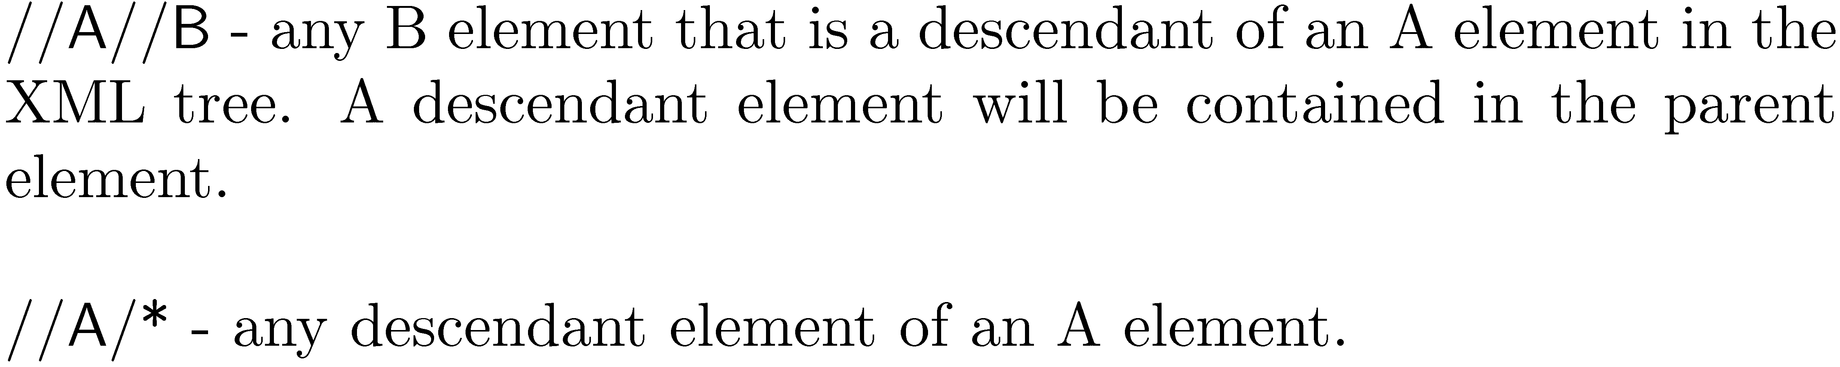
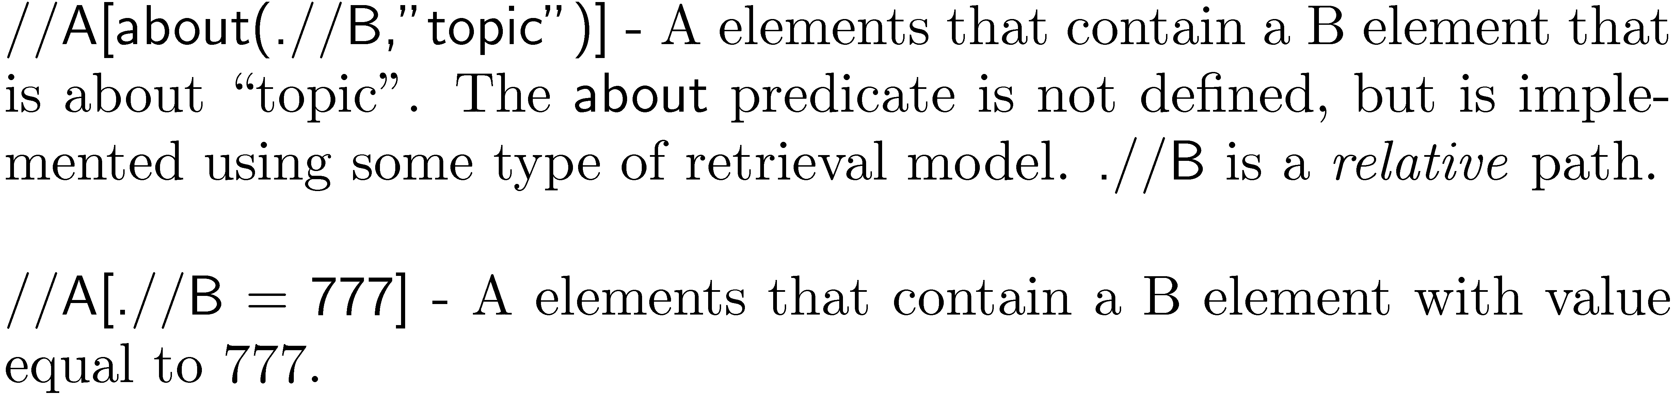
NEXI Examples

Slide 16
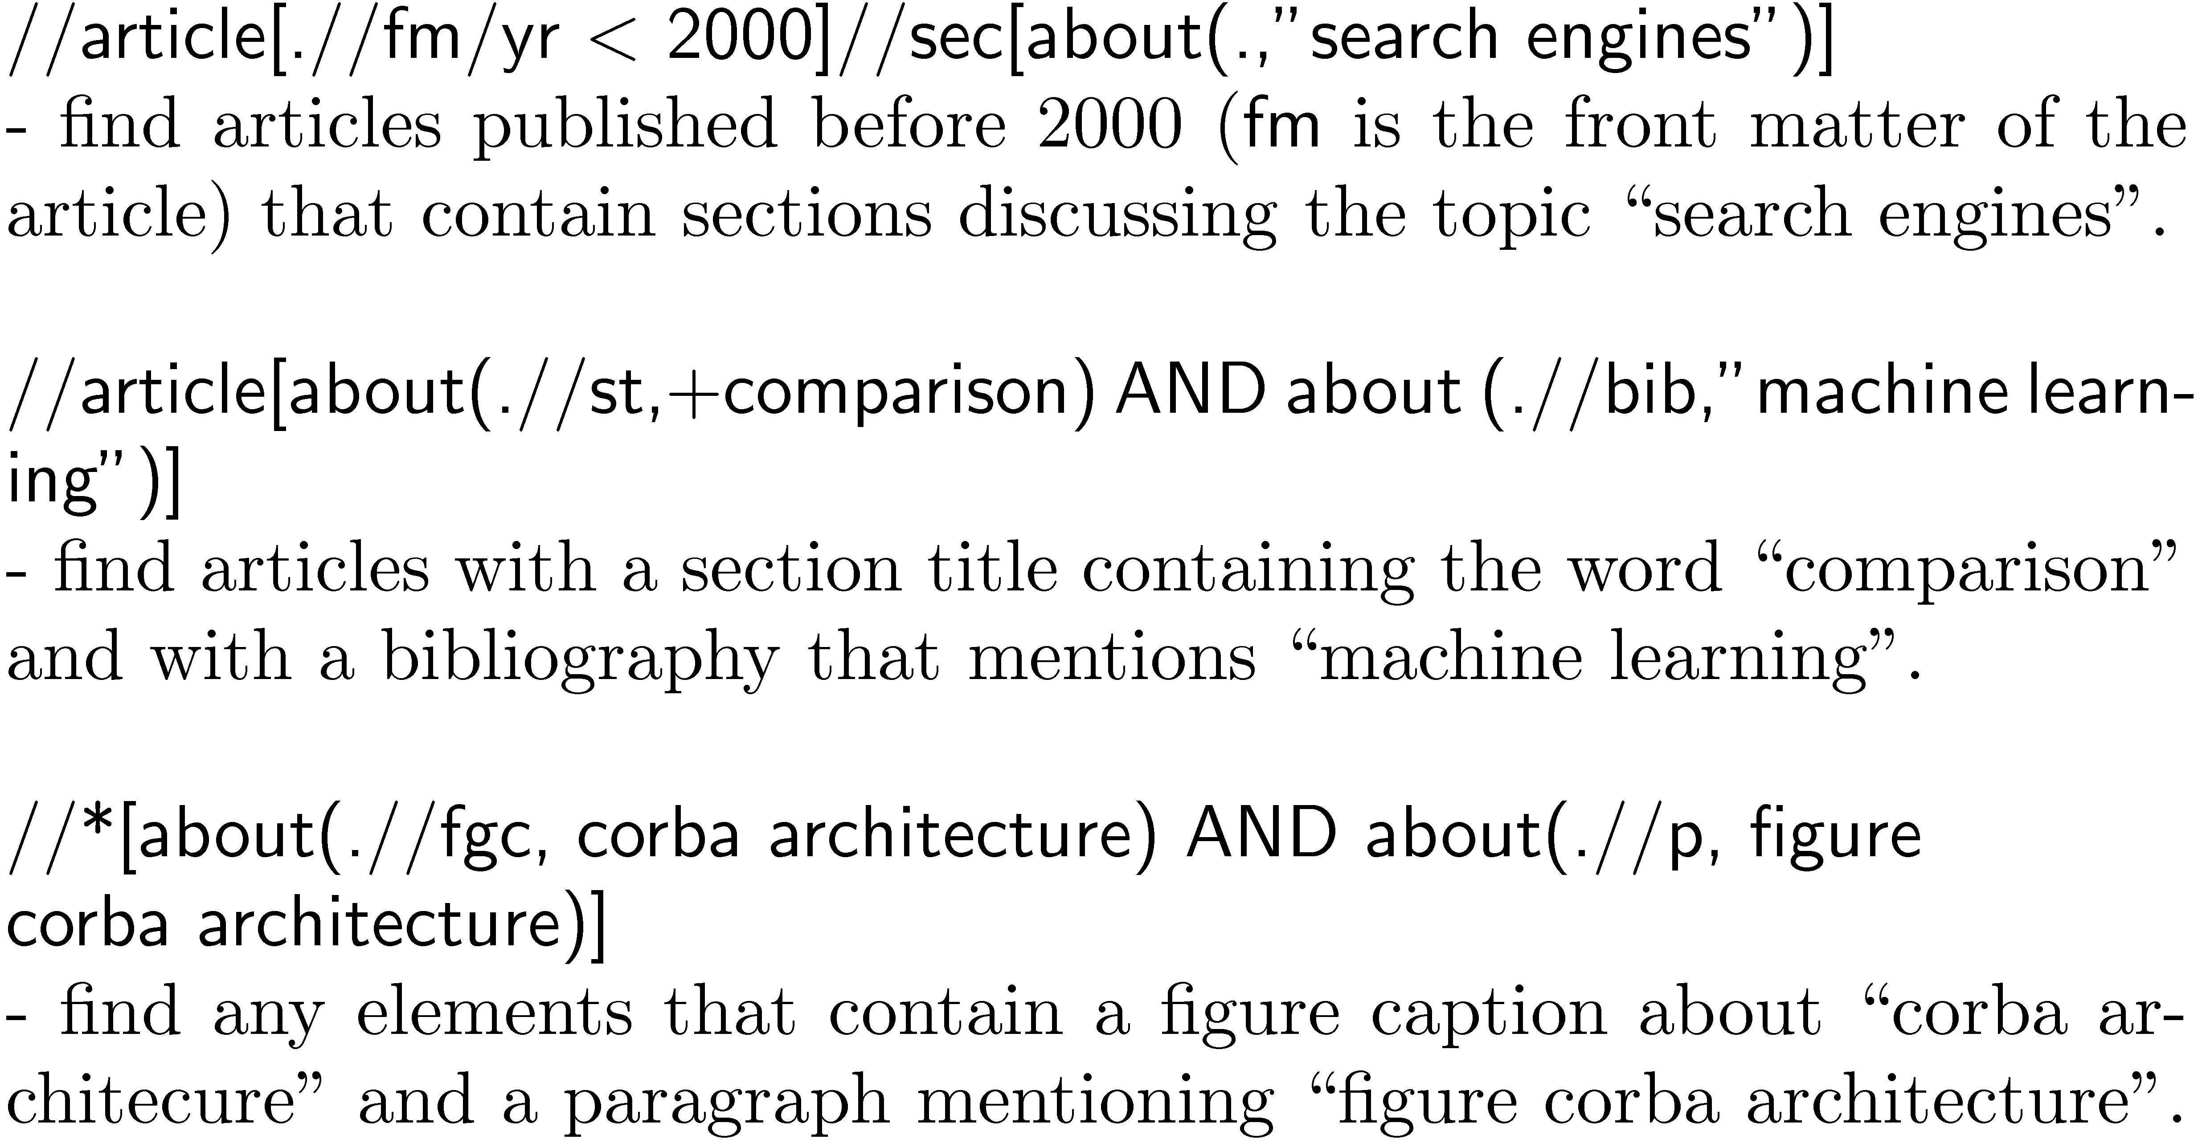
INEX Examples

Slide 17
Entity Search
Identify entities in text
Construct “pseudo-documents” to represent entities
based on words occurring near the entity over the whole corpus
also called “context vectors”
Retrieve ranked lists of entities instead of documents

Slide 18
Entity Search Example
(organization search based on a TREC news corpus)

Slide 19
Expert Search
Find “experts” for a given topic
recent TREC track
Rank candidate entities e by the joint distribution P(e, q) of entities and query terms
P(q|e,d) involves ranking entities in those documents with respect to a query
P(e|d) component corresponds to finding documents that provide information about an entity

Slide 20

Expert Search
Assuming words and entities are independent leads to poor performance
Instead estimate the strength of association between e and q using proximity of co-occurrence of the query words and the entities

Slide 21
Question Answering
Providing answers instead of ranked lists of documents
Older QA systems generated answers
Current QA systems extract answers from large corpora such as the Web
Fact-based QA limits range of questions to those with simple, short answers
e.g., who, where, when questions

Slide 22
QA Architecture

Slide 23
Fact-Based QA
Questions are classified by type of answer expected
most categories correspond to named entities
Category is used to identify potential answer passages
Additional natural language processing and semantic inference used to rank passages and identify answer

Slide 24
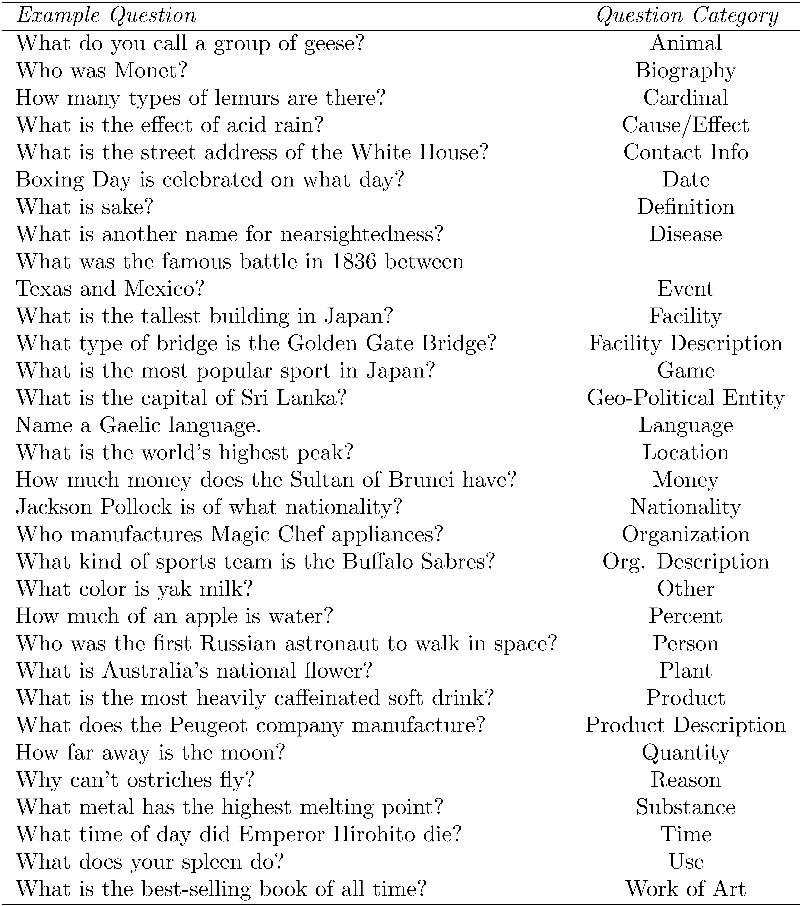

Slide 25
Other Media
Many other types of information are important for search applications
e.g., scanned documents, speech, music, images, video
Typically there is no associated text
although user tagging is important in some applications
Retrieval algorithms can be specified based on any content-related features that can be extracted

Slide 26
Noisy Text
OCR and speech recognition produce noisy text
i.e., text with numerous errors relative to the original printed text or speech transcript
With good retrieval model, effectiveness of search is not significantly affected by noise
due to redundancy of text
problems with short texts

Slide 27
OCR Examples

Slide 28
Speech Example

Slide 29
Images and Video
Feature extraction more difficult
Features are low-level and not as clearly associated with the semantics of the image as a text description
Typical features are related to color, texture, and shape
e.g., color histogram
“quantize” color values to define “bins” in a histogram
for each pixel in the image, the bin corresponding to the color value for that pixel is incremented by one
images can be ranked relative to a query image

Slide 30
Color Histogram Example
peak in yellow

Slide 31
Texture and Shape
Texture is spatial arrangement of gray levels in the image
Shape features describe the form of object boundaries and edges
Examples:
shape

Slide 32
Video
Video is segmented into shots or scenes
continuous sequence of visually coherent frames
boundaries detected by visual discontinuities
Video represented by key frame images
e.g., first frame in a shot

Slide 33
Image Annotation
Given training data, can learn a joint probability model for words and image features
Enables automatic text annotation of images
current techniques are moderately effective
errors

Slide 34
Music
Music is even less associated with words than images
Many different representations
e.g., audio, MIDI, score
Search based on features such as spectrogram peaks, note sequences, relative pitch, etc.

