Slide 1
Search Engines
Information Retrieval in Practice
All slides ©Addison Wesley, 2008

Slide 2
Information Needs
An information need is the underlying cause of the query that a person submits to a search engine
sometimes called information problem to emphasize that information need is generally related to a task
Categorized using variety of dimensions
e.g., number of relevant documents being sought
type of information that is needed
type of task that led to the requirement for information

Slide 3
Queries and Information Needs
A query can represent very different information needs
May require different search techniques and ranking algorithms to produce the best rankings
A query can be a poor representation of the information need
User may find it difficult to express the information need
User is encouraged to enter short queries both by the search engine interface, and by the fact that long queries don’t work

Slide 4
Interaction
Interaction with the system occurs
during query formulation and reformulation
while browsing the result
Key aspect of effective retrieval
users can’t change ranking algorithm but can change results through interaction
helps refine description of information need
e.g., same initial query, different information needs
how does user describe what they don’t know?

Slide 5
ASK Hypothesis
Belkin et al (1982) proposed a model called Anomalous State of Knowledge
ASK hypothesis:
difficult for people to define exactly what their information need is, because that information is a gap in their knowledge
Search engine should look for information that fills those gaps
Interesting ideas, little practical impact (yet)

Slide 6
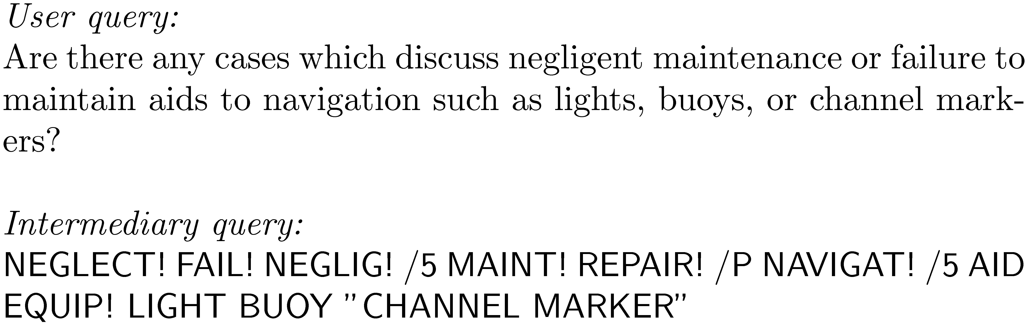
Keyword Queries
Query languages in the past were designed for professional searchers (intermediaries)

Slide 7
Keyword Queries
Simple, natural language queries were designed to enable everyone to search
Current search engines do not perform well (in general) with natural language queries
People trained (in effect) to use keywords
compare average of about 2.3 words/web query to average of 30 words/CQA query
Keyword selection is not always easy
query refinement techniques can help

Slide 8
Query-Based Stemming
Make decision about stemming at query time rather than during indexing
improved flexibility, effectiveness
Query is expanded using word variants
documents are not stemmed
e.g., “rock climbing” expanded with “climb”, not stemmed to “climb”

Slide 9
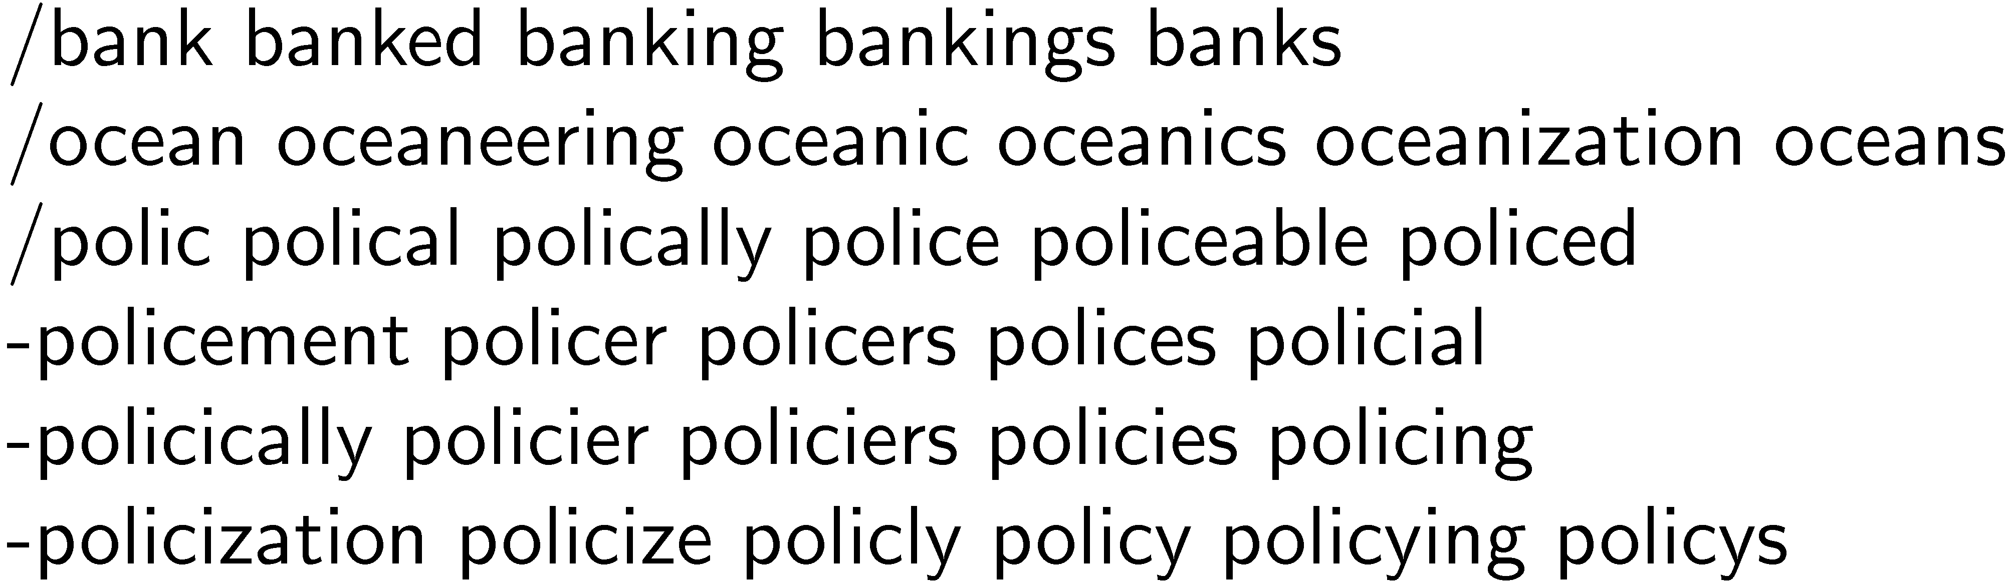
Stem Classes
A stem class is the group of words that will be transformed into the same stem by the stemming algorithm
generated by running stemmer on large corpus
e.g., Porter stemmer on TREC News

Slide 10
Stem Classes
Stem classes are often too big and inaccurate
Modify using analysis of word co-occurrence
Assumption:
Word variants that could substitute for each other should co-occur often in documents

Slide 11
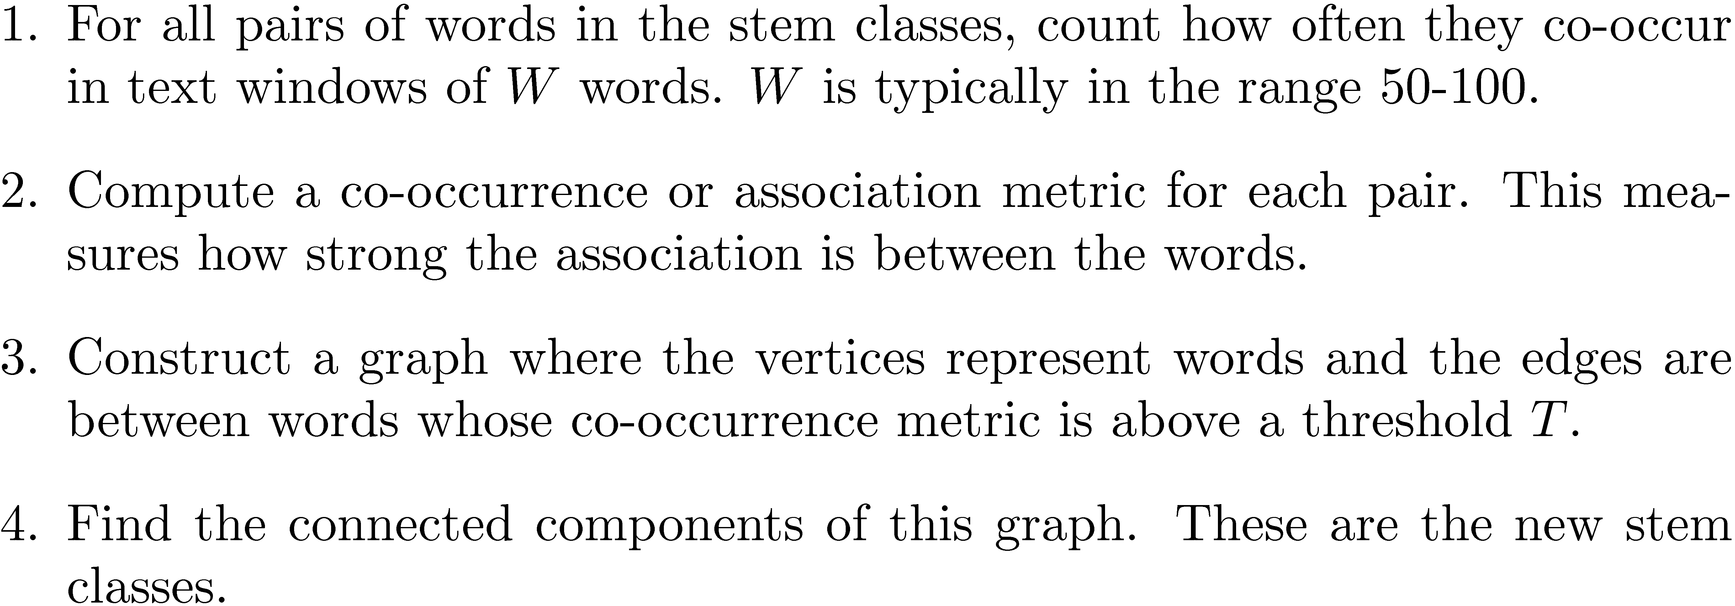
Modifying Stem Classes

Slide 12
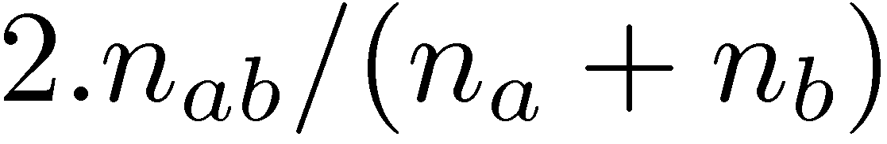
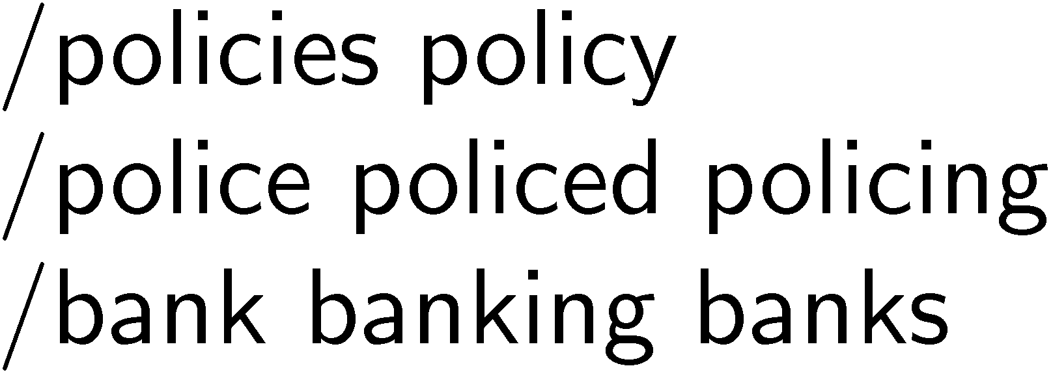
Modifying Stem Classes
Dices’ Coefficient is an example of a term association measure
where n_{x} is the number of windows containing x
Two vertices are in the same connected component of a graph if there is a path between them
forms word clusters
Example output of modification

Slide 13
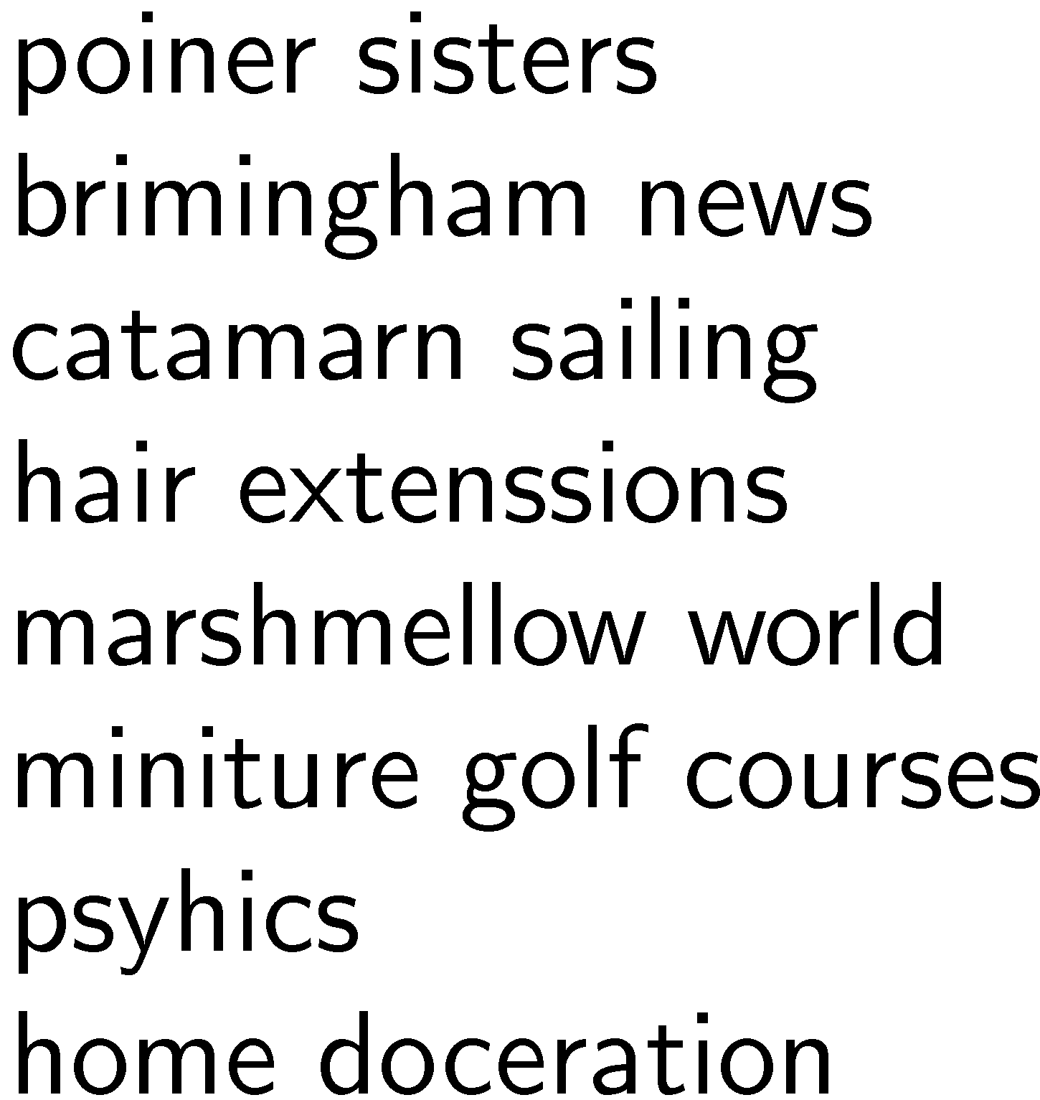
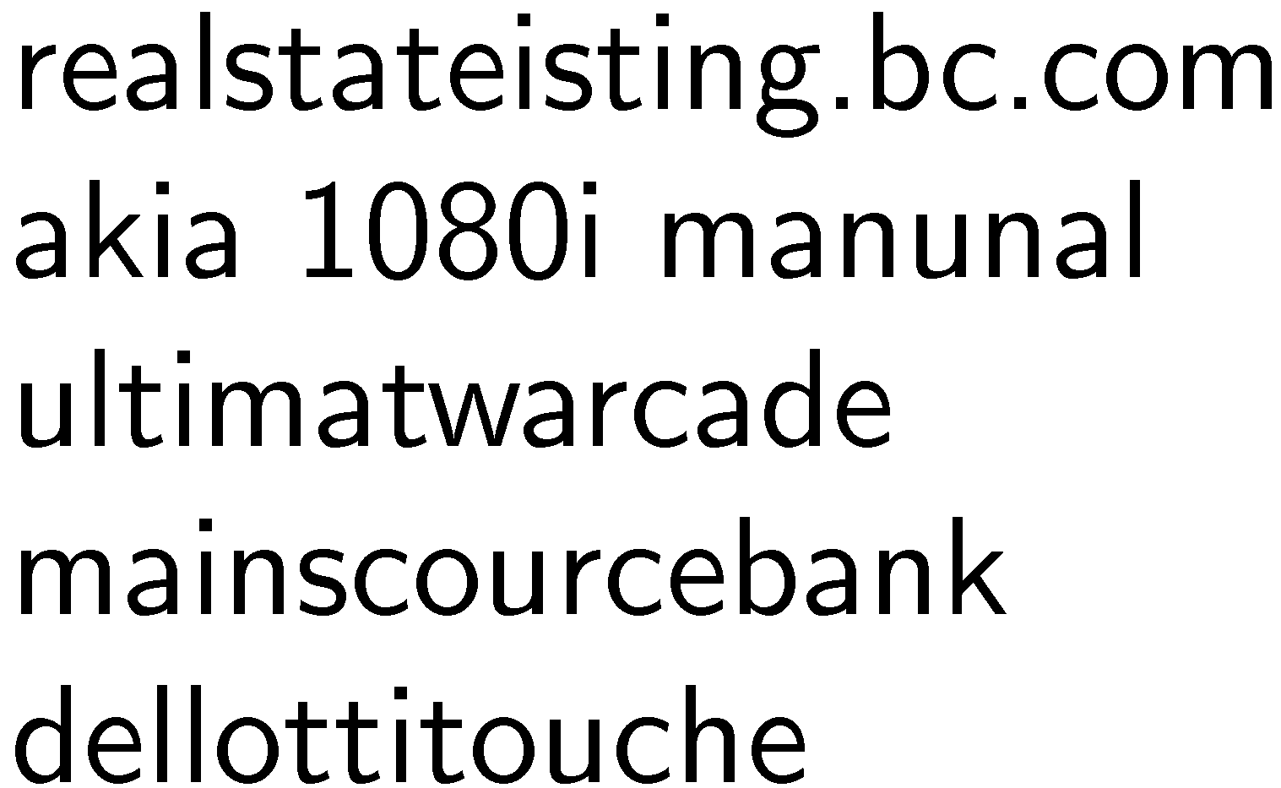
Spell Checking
Important part of query processing
10-15% of all web queries have spelling errors
Errors include typical word processing errors but also many other types, e.g.

Slide 14
Spell Checking
Basic approach: suggest corrections for words not found in spelling dictionary
Suggestions found by comparing word to words in dictionary using similarity measure
Most common similarity measure is edit distance
number of operations required to transform one word into the other

Slide 15
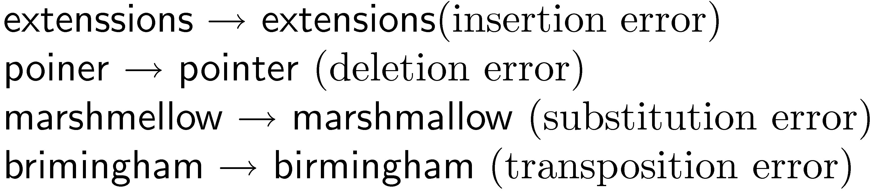

Edit Distance
Damerau-Levenshtein distance
counts the minimum number of insertions, deletions, substitutions, or transpositions of single characters required
e.g., Damerau-Levenshtein distance 1
distance 2

Slide 16
Edit Distance
Number of techniques used to speed up calculation of edit distances
restrict to words starting with same character
restrict to words of same or similar length
restrict to words that sound the same
Last option uses a phonetic code to group words
e.g. Soundex

Slide 17
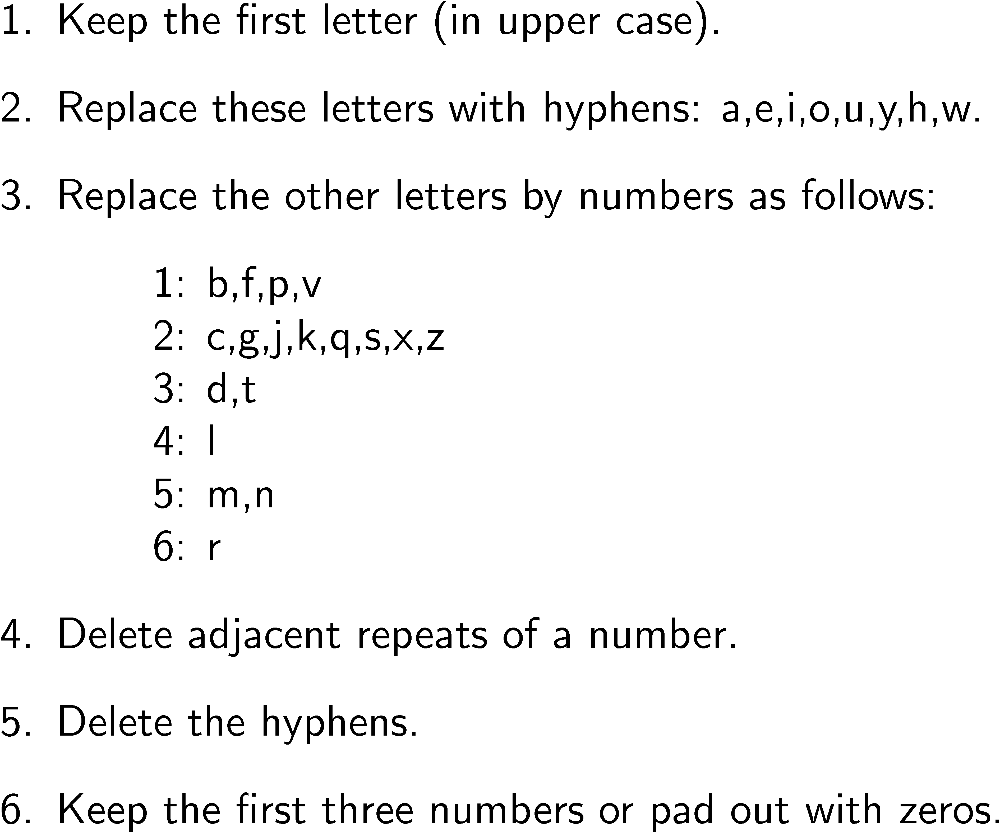
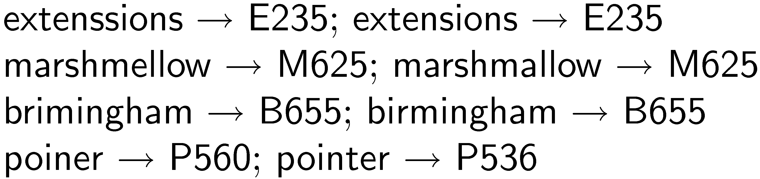
Soundex Code

Slide 18
Spelling Correction Issues
Ranking corrections
“Did you mean...” feature requires accurate ranking of possible corrections
Context
Choosing right suggestion depends on context (other words)
e.g., lawers → lowers, lawyers, layers, lasers, lagers but trial lawers → trial lawyers
Run-on errors
e.g., “mainscourcebank”
missing spaces can be considered another single character error in right framework

Slide 19
Noisy Channel Model
User chooses word w based on probability distribution P(w)
called the language model
can capture context information, e.g. P(w₁|w₂)
User writes word, but noisy channel causes word e to be written instead with probability P(e|w)
called error model
represents information about the frequency of spelling errors

Slide 20
Noisy Channel Model
Need to estimate probability of correction
P(w|e) = P(e|w)P(w)
Estimate language model using context
e.g., P(w) = λP(w) + (1 − λ)P(w|w_{p})
w_{p} is previous word
e.g.,
“fish tink”
“tank” and “think” both likely corrections, but P(tank|fish) > P(think|fish)

Slide 21
Noisy Channel Model
Language model probabilities estimated using corpus and query log
Both simple and complex methods have been used for estimating error model
simple approach: assume all words with same edit distance have same probability, only edit distance 1 and 2 considered
more complex approach: incorporate estimates based on common typing errors

Slide 22
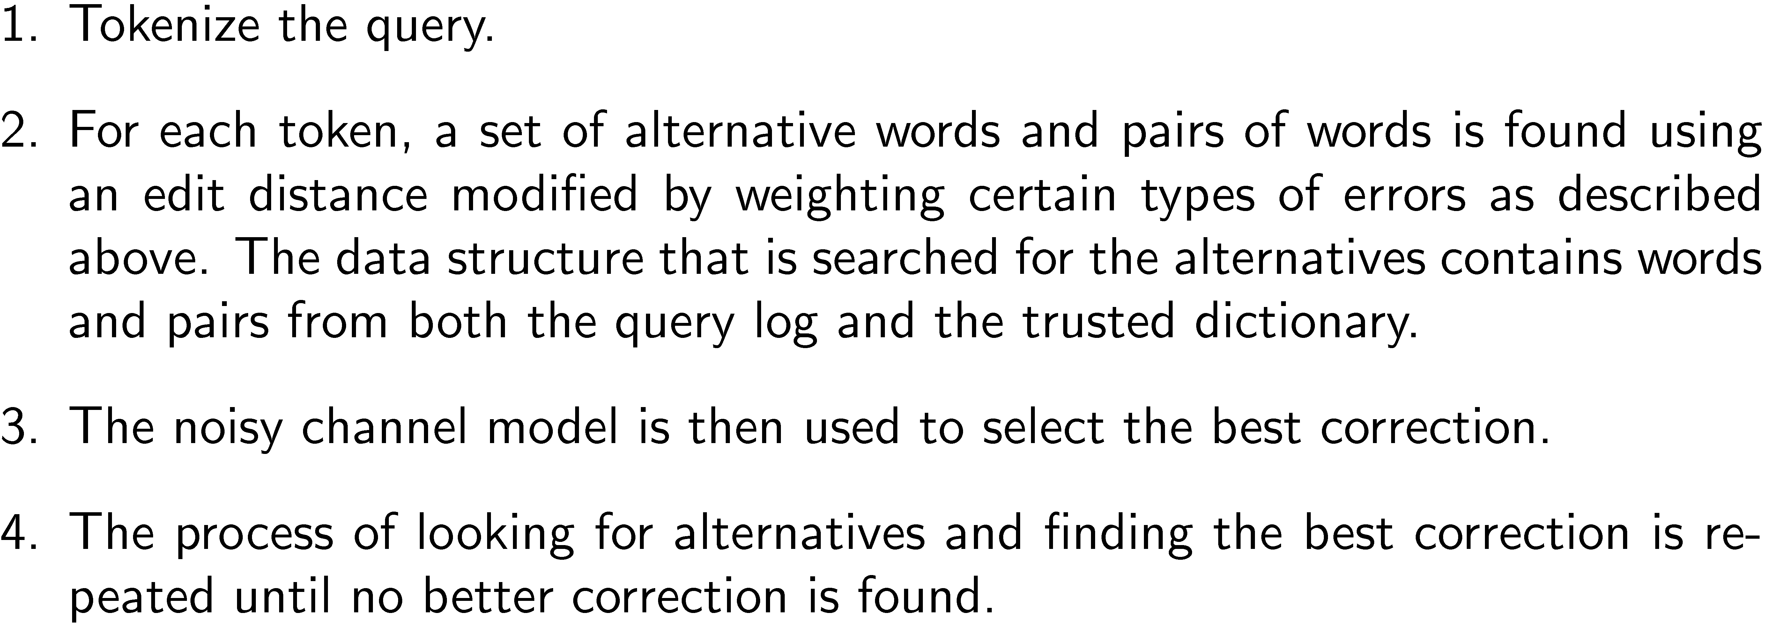
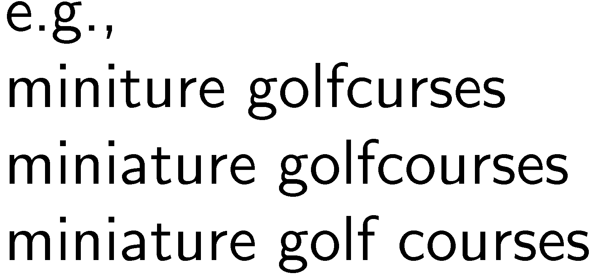
Example Spellcheck Process

Slide 23
The Thesaurus
Used in early search engines as a tool for indexing and query formulation
specified preferred terms and relationships between them
also called controlled vocabulary
Particularly useful for query expansion
adding synonyms or more specific terms using query operators based on thesaurus
improves search effectiveness

Slide 24
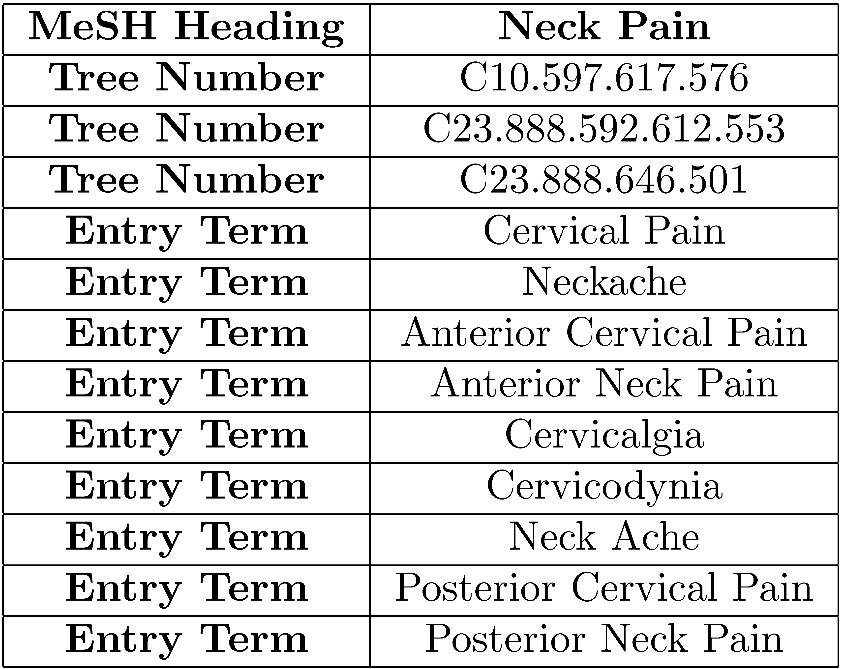
MeSH Thesaurus

Slide 25
Query Expansion
A variety of automatic or semi-automatic query expansion techniques have been developed
goal is to improve effectiveness by matching related terms
semi-automatic techniques require user interaction to select best expansion terms
Query suggestion is a related technique
alternative queries, not necessarily more terms

Slide 26
Query Expansion
Approaches usually based on an analysis of term co-occurrence
either in the entire document collection, a large collection of queries, or the top-ranked documents in a result list
query-based stemming also an expansion technique
Automatic expansion based on general thesaurus not effective
does not take context into account

Slide 27
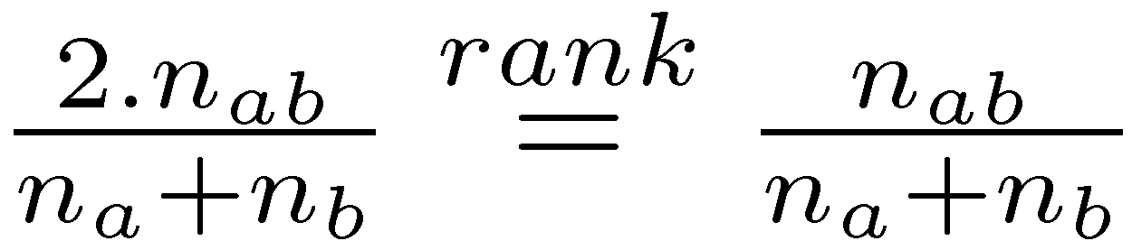
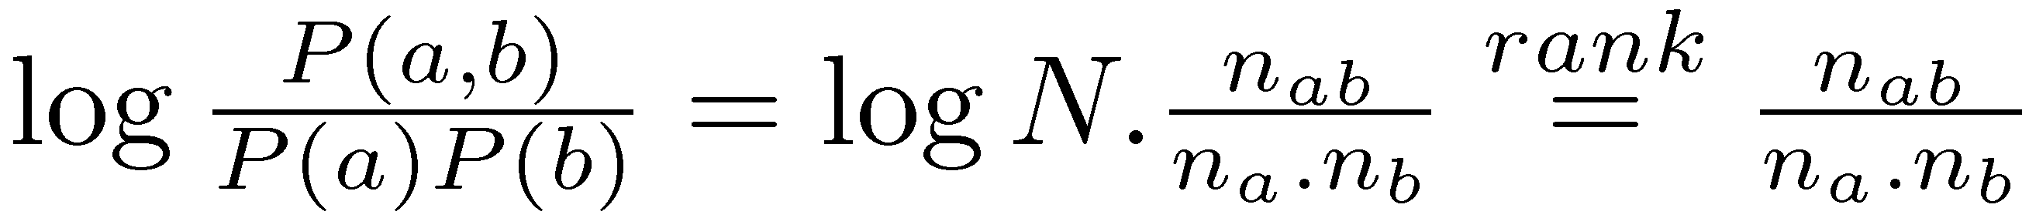
Term Association Measures
Dice’s Coefficient
Mutual Information

Slide 28
Term Association Measures
Mutual Information measure favors low frequency terms
Expected Mutual Information Measure (EMIM)
actually only 1 part of full EMIM, focused on word occurrence

Slide 29
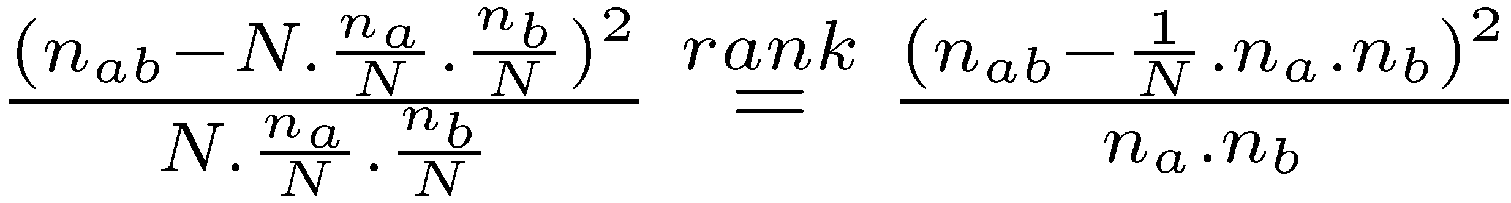
Term Association Measures
Pearson’s Chi-squared (χ²) measure
compares the number of co-occurrences of two words with the expected number of co-occurrences if the two words were independent
normalizes this comparison by the expected number
also limited form focused on word co-occurrence

Slide 30
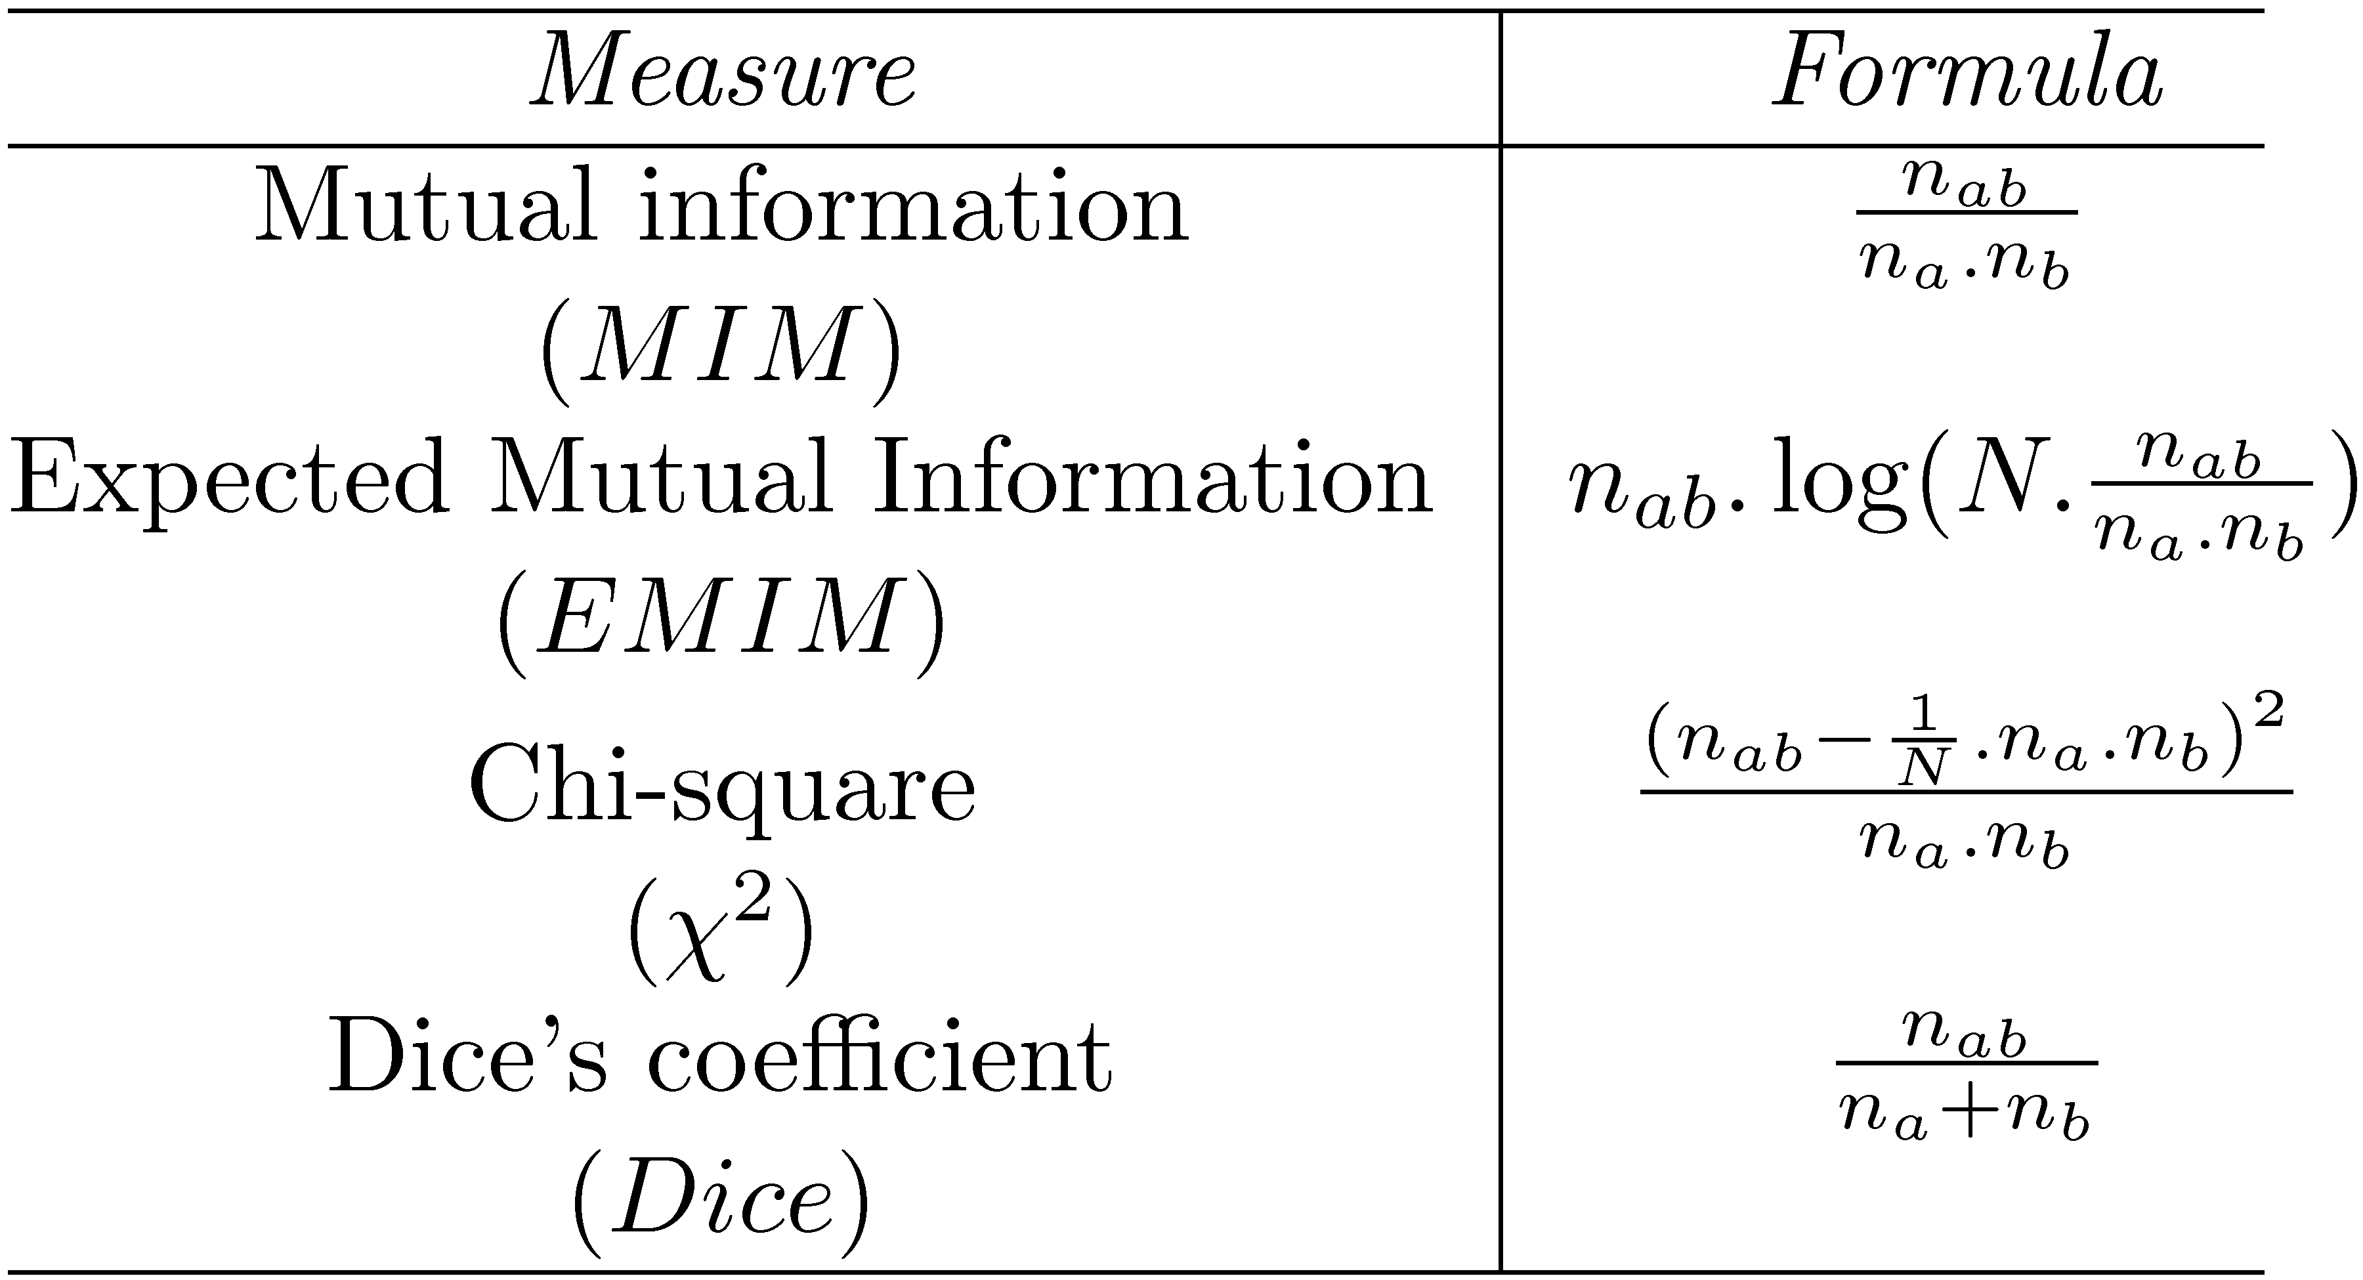
Association Measure Summary

Slide 31
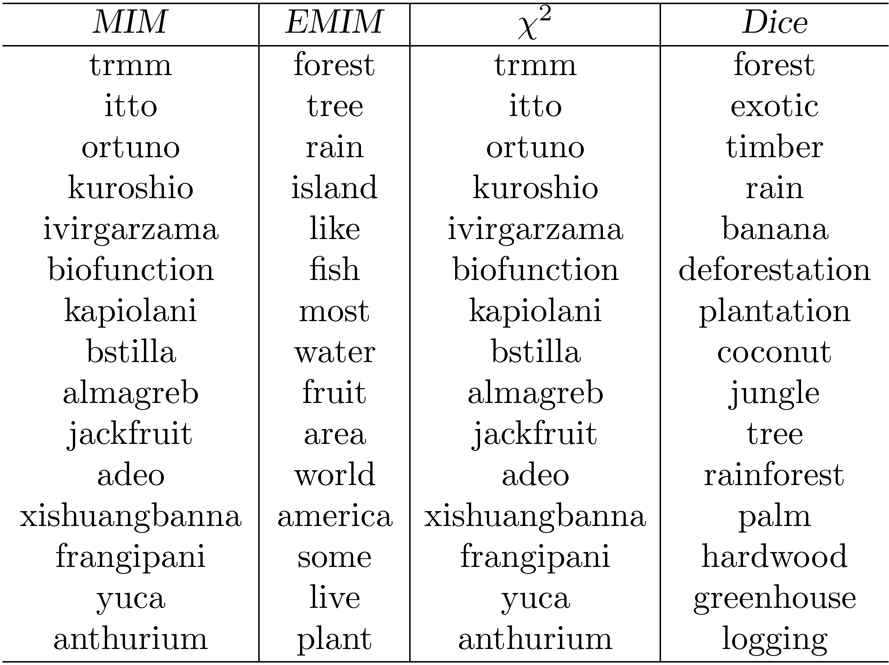
Association Measure Example
Most strongly associated words for “tropical” in a collection of TREC news
stories. Co-occurrence counts are measured at the document level.

Slide 32
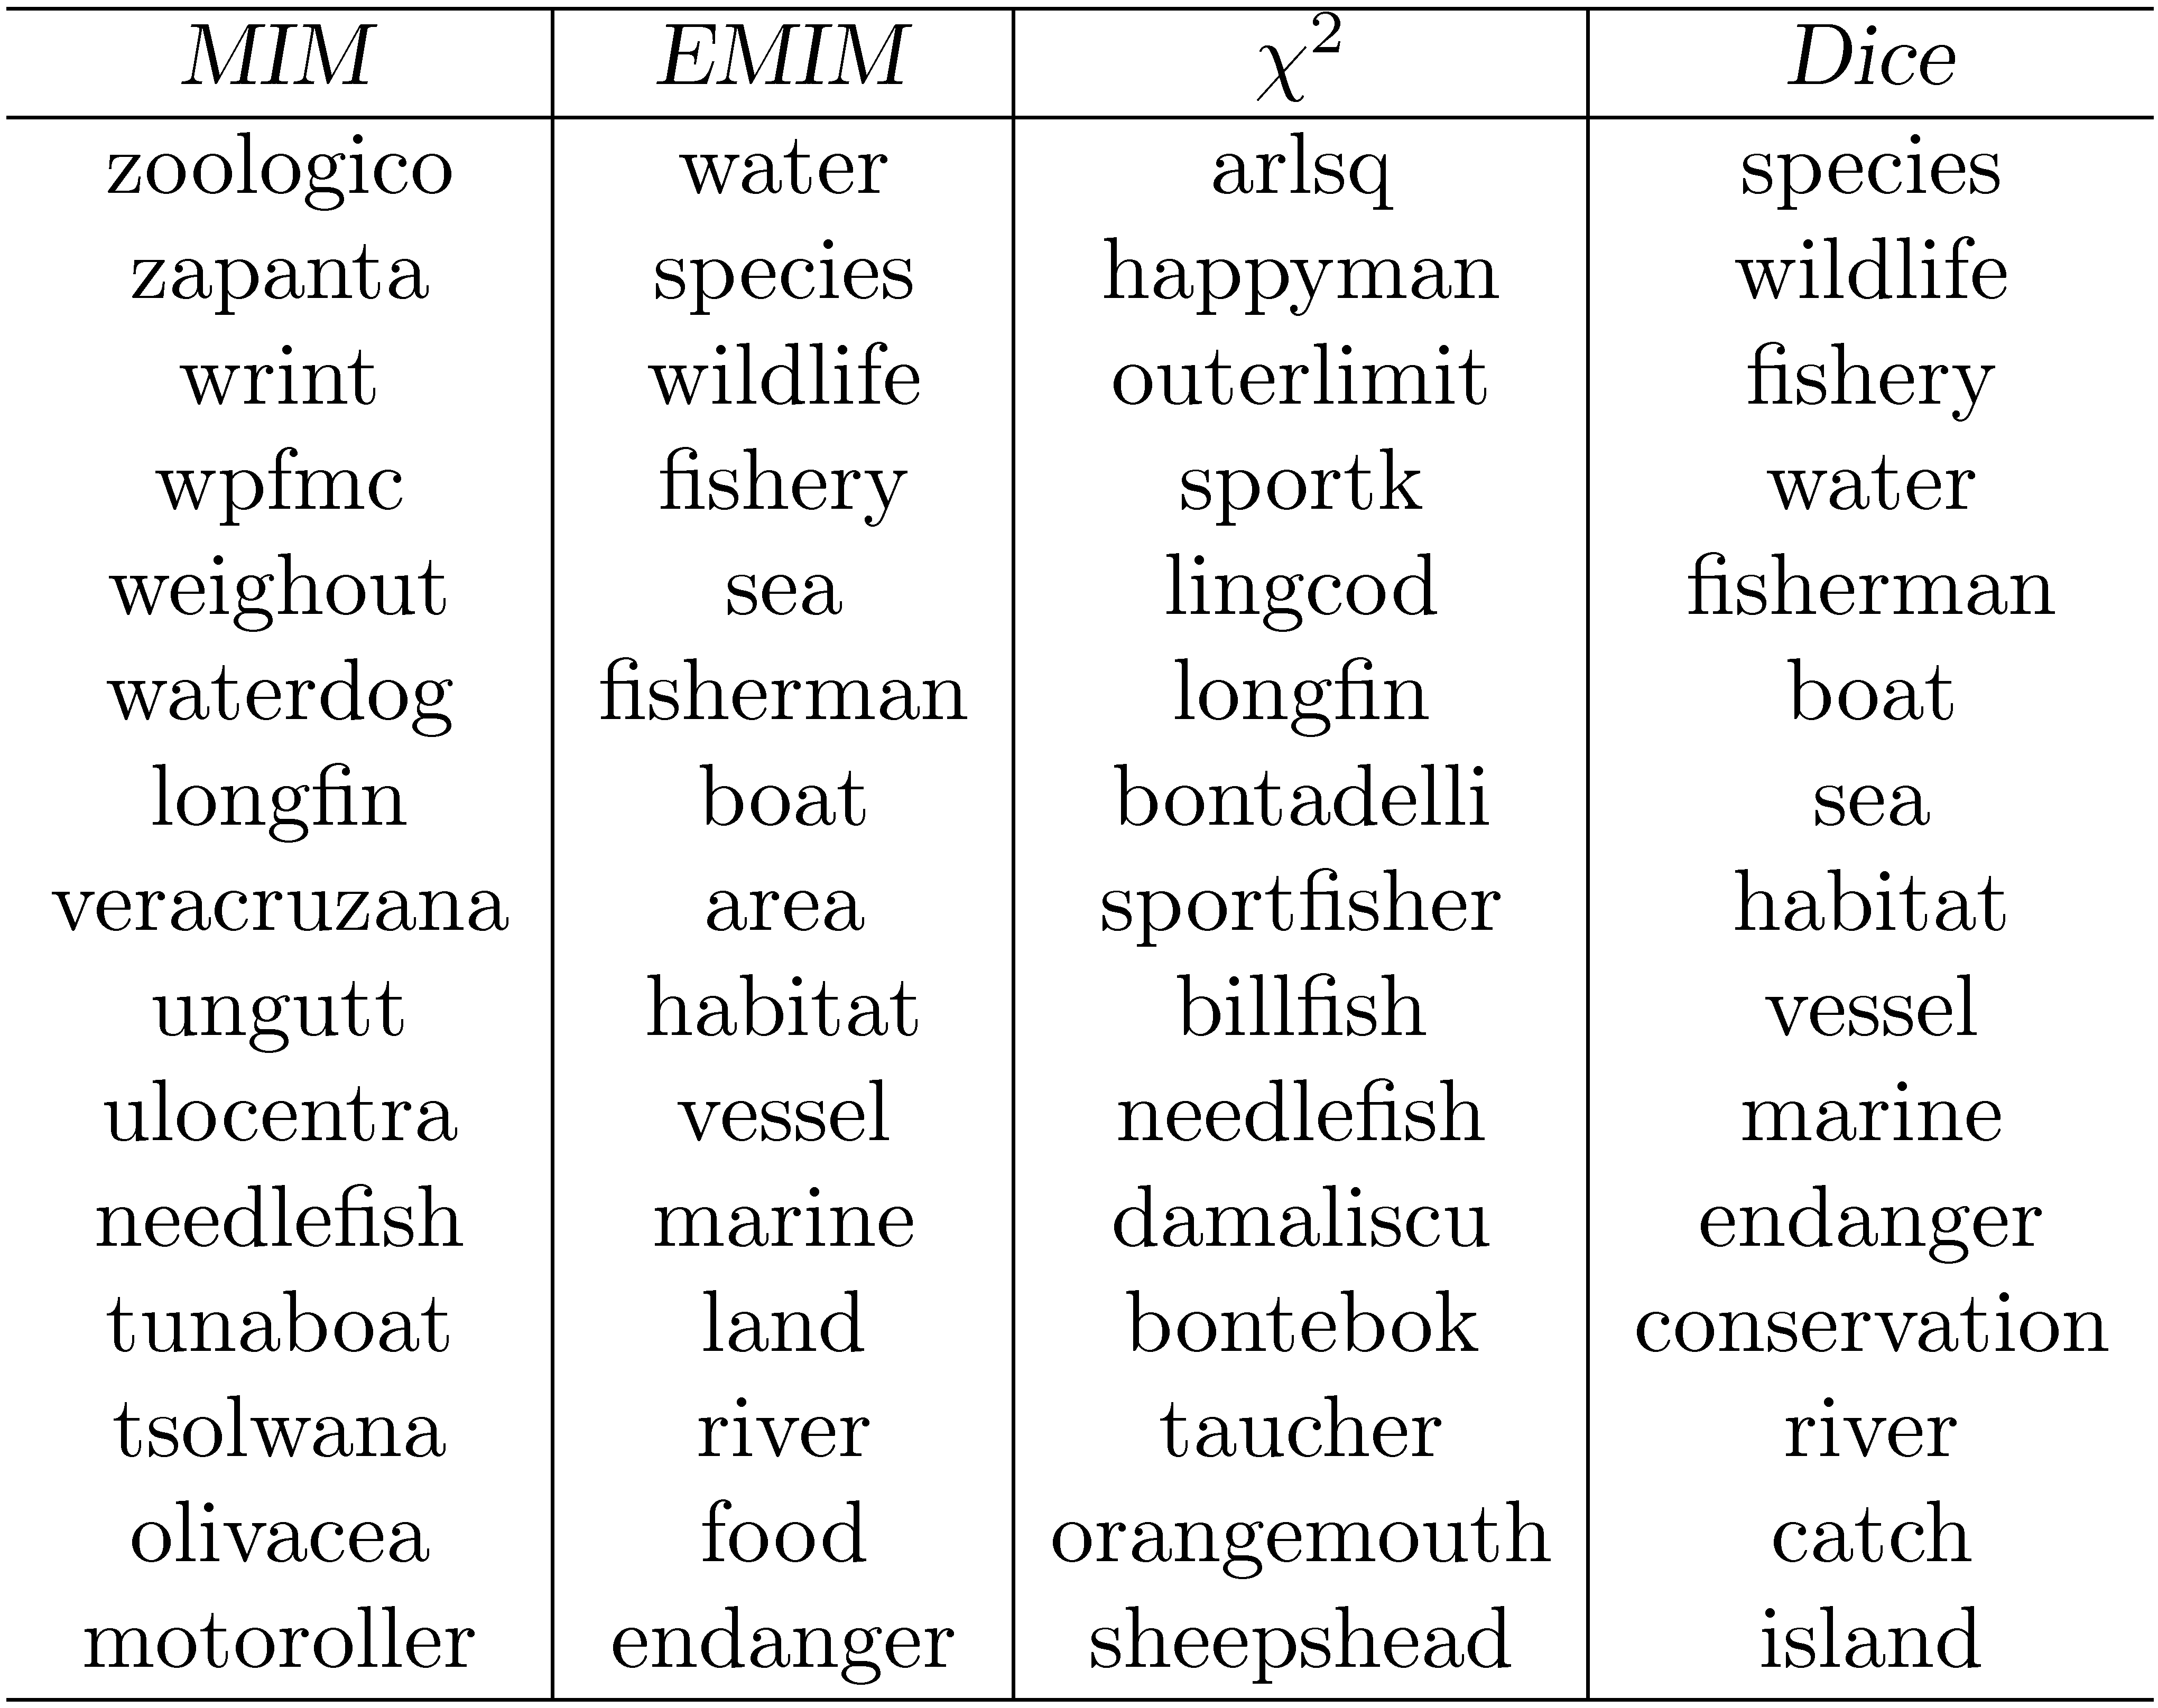
Association Measure Example
Most strongly associated words for “fish” in a collection of TREC news stories.

Slide 33
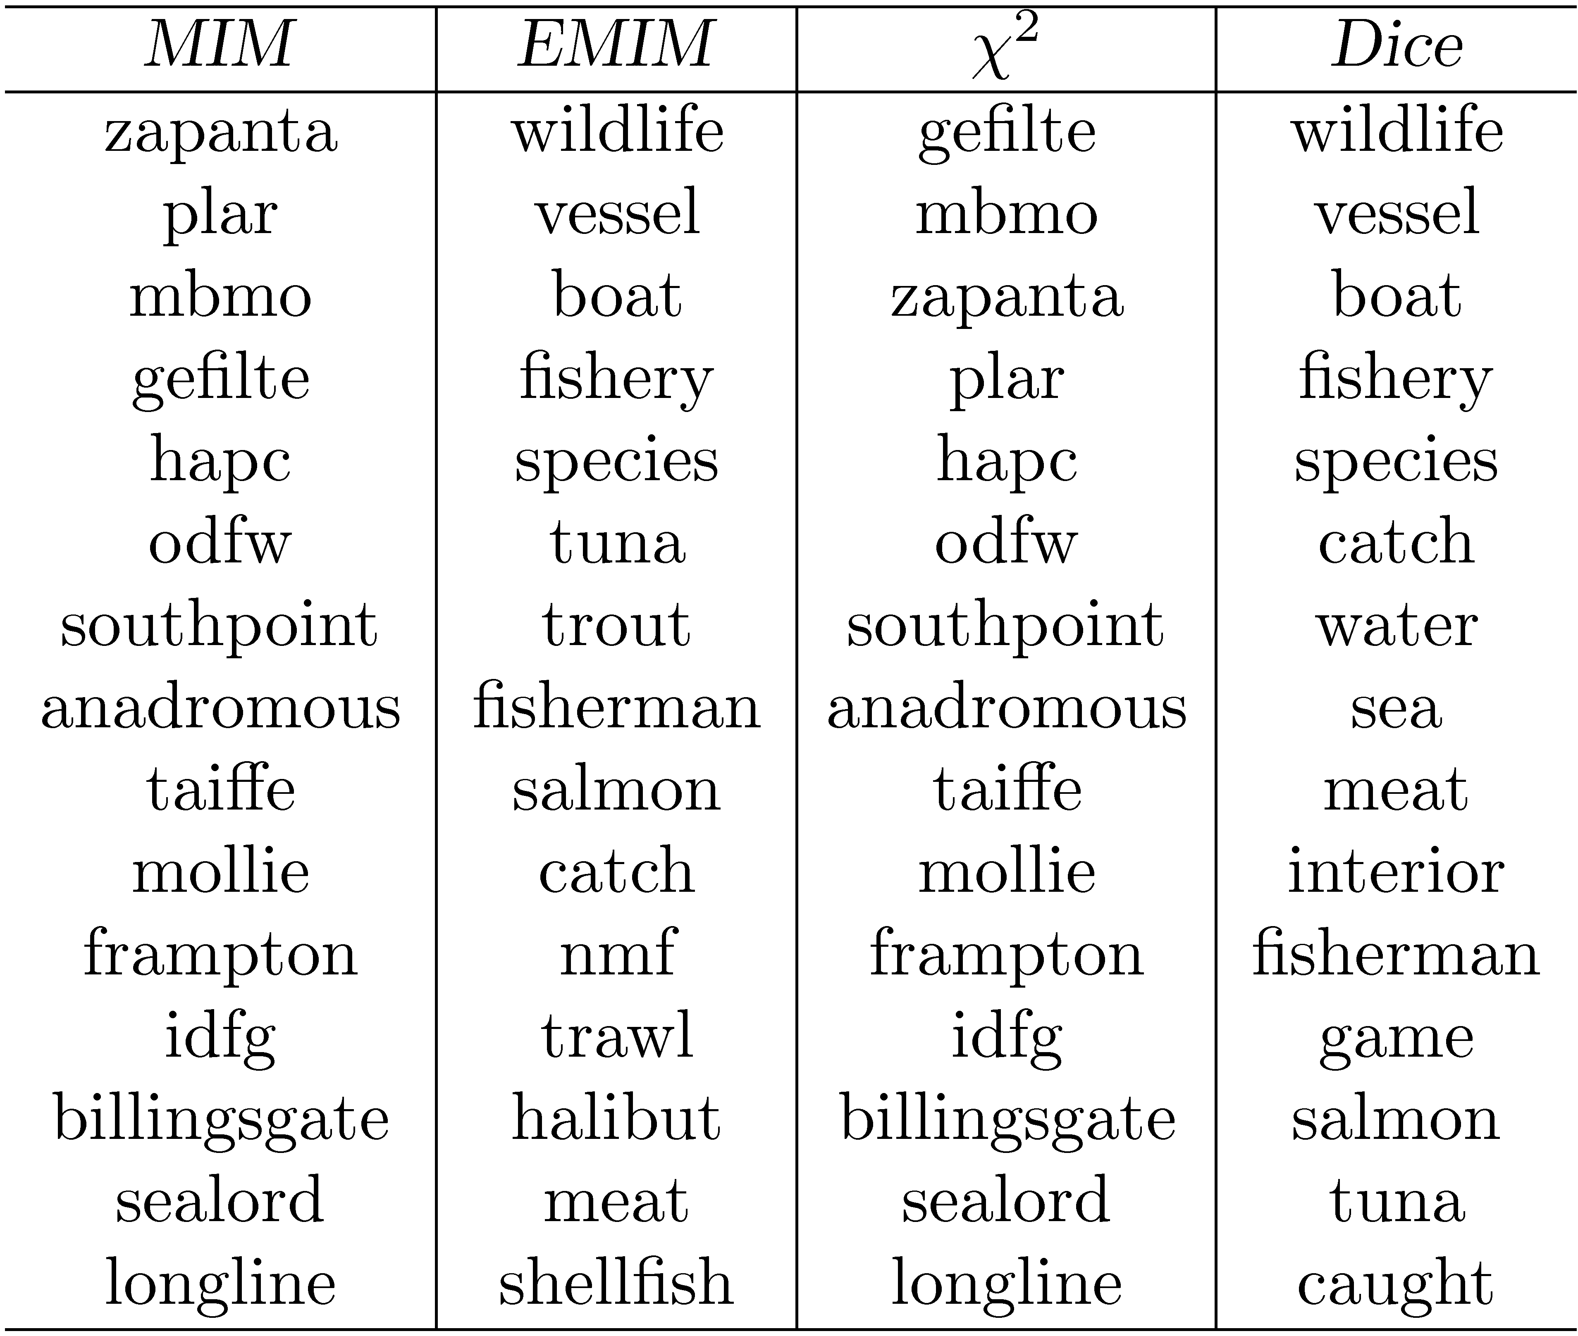
Association Measure Example
Most strongly associated words for “fish” in a collection of TREC news stories. Co-occurrence counts are measured in windows of 5 words.

Slide 34
Association Measures
Associated words are of little use for expanding the query “tropical fish”
Expansion based on whole query takes context into account
e.g., using Dice with term “tropical fish” gives the following highly associated words:
goldfish, reptile, aquarium, coral, frog, exotic, stripe, regent, pet, wet
Impractical for all possible queries, other approaches used to achieve this effect

Slide 35
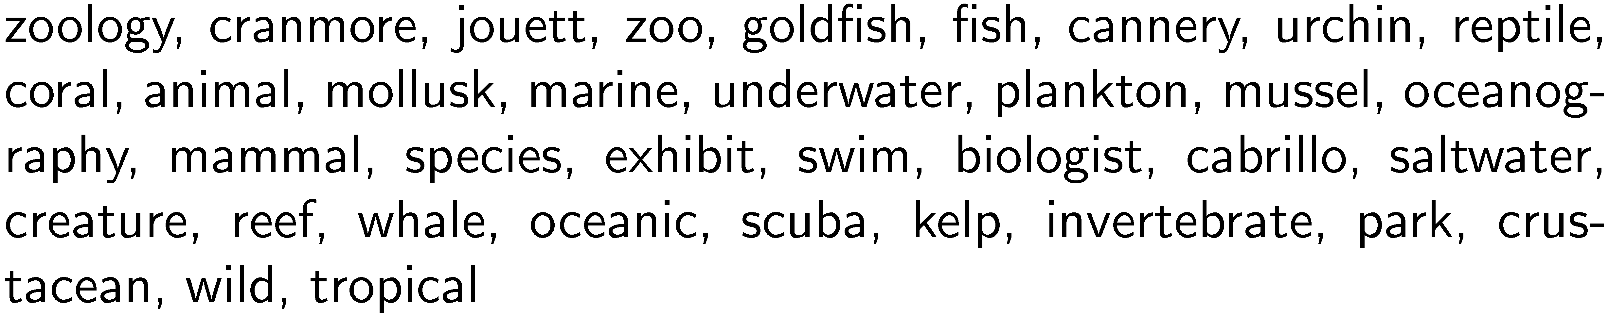
Other Approaches
Pseudo-relevance feedback
expansion terms based on top retrieved documents for initial query
Context vectors
Represent words by the words that co-occur with them
e.g., top 35 most strongly associated words for “aquarium” (using Dice’s coefficient):
Rank words for a query by ranking context vectors

Slide 36
Other Approaches
Query logs
Best source of information about queries and related terms
short pieces of text and click data
e.g., most frequent words in queries containing “tropical fish” from MSN log:
stores, pictures, live, sale, types, clipart, blue, freshwater, aquarium, supplies
query suggestion based on finding similar queries
group based on click data

Slide 37
Relevance Feedback
User identifies relevant (and maybe non-relevant) documents in the initial result list
System modifies query using terms from those documents and re-ranks documents
example of simple machine learning algorithm using training data
but, very little training data
Pseudo-relevance feedback just assumes top-ranked documents are relevant – no user input

Slide 38
Relevance Feedback Example
Top 10 documents
for “tropical fish”

Slide 39
Relevance Feedback Example
If we assume top 10 are relevant, most frequent terms are (with frequency):
a (926), td (535), href (495), http (357), width (345), com (343), nbsp (316), www (260), tr (239), htm (233), class (225), jpg (221)
too many stopwords and HTML expressions
Use only snippets and remove stopwords
tropical (26), fish (28), aquarium (8), freshwater (5), breeding (4), information (3), species (3), tank (2), Badman’s (2), page (2), hobby (2), forums (2)

Slide 40
Relevance Feedback Example
If document 7 (“Breeding tropical fish”) is explicitly indicated to be relevant, the most frequent terms are:
breeding (4), fish (4), tropical (4), marine (2), pond (2), coldwater (2), keeping (1), interested (1)
Specific weights and scoring methods used for relevance feedback depend on retrieval model

Slide 41
Relevance Feedback
Both relevance feedback and pseudo-relevance feedback are effective, but not used in many applications
pseudo-relevance feedback has reliability issues, especially with queries that don’t retrieve many relevant documents
Some applications use relevance feedback
filtering, “more like this”
Query suggestion more popular
may be less accurate, but can work if initial query fails

Slide 42
Context and Personalization
If a query has the same words as another query, results will be the same regardless of
who submitted the query
why the query was submitted
where the query was submitted
what other queries were submitted in the same session
These other factors (the context) could have a significant impact on relevance
difficult to incorporate into ranking

Slide 43
User Models
Generate user profiles based on documents that the person looks at
such as web pages visited, email messages, or word processing documents on the desktop
Modify queries using words from profile
Generally not effective
imprecise profiles, information needs can change significantly

Slide 44
Query Logs
Query logs provide important contextual information that can be used effectively
Context in this case is
previous queries that are the same
previous queries that are similar
query sessions including the same query
Query history for individuals could be used for caching

Slide 45
Local Search
Location is context
Local search uses geographic information to modify the ranking of search results
location derived from the query text
location of the device where the query originated
e.g.,
“underworld 3 cape cod”
“underworld 3” from mobile device in Hyannis

Slide 46
Local Search
Identify the geographic region associated with web pages
use location metadata that has been manually added to the document,
or identify locations such as place names, city names, or country names in text
Identify the geographic region associated with the query
10-15% of queries contain some location reference
Rank web pages using location information in addition to text and link-based features

Slide 47
Extracting Location Information
Type of information extraction
ambiguity and significance of locations are issues
Location names are mapped to specific regions and coordinates
Matching done by inclusion, distance

Slide 48
Snippet Generation
Query-dependent document summary
Simple summarization approach
rank each sentence in a document using a significance factor
select the top sentences for the summary
first proposed by Luhn in the 1950’s

Slide 49
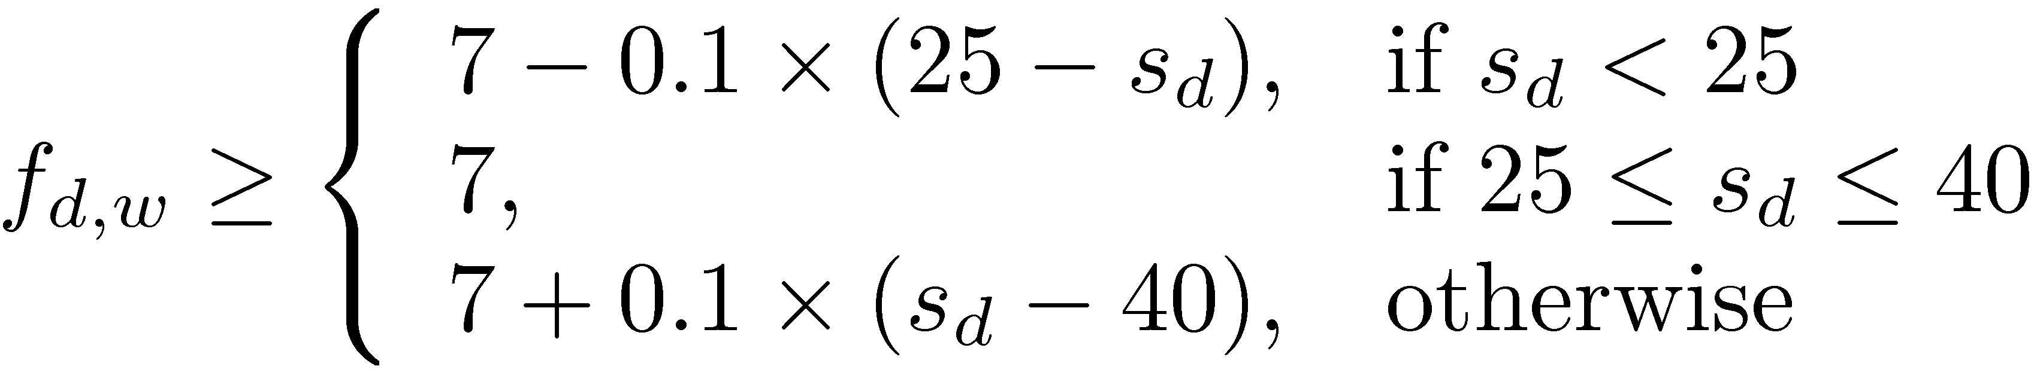
Sentence Selection
Significance factor for a sentence is calculated based on the occurrence of significant words
If f_{d,w} is the frequency of word w in document d, then w is a significant word if it is not a stopword and
where s_{d} is the number of sentences in document d
text is bracketed by significant words (limit on number of non-significant words in bracket)

Slide 50
Sentence Selection
Significance factor for bracketed text spans is computed by dividing the square of the number of significant words in the span by the total number of words
e.g.,
Significance factor = 4²/7 = 2.3

Slide 51
Snippet Generation
Involves more features than just significance factor
e.g. for a news story, could use
whether the sentence is a heading
whether it is the first or second line of the document
the total number of query terms occurring in the sentence
the number of unique query terms in the sentence
the longest contiguous run of query words in the sentence
a density measure of query words (significance factor)
Weighted combination of features used to rank sentences

Slide 52
Snippet Generation
Web pages are less structured than news stories
can be difficult to find good summary sentences
Snippet sentences are often selected from other sources
metadata associated with the web page
e.g., <meta name="description" content= ...>
external sources such as web directories
e.g., Open Directory Project, http://www.dmoz.org
Snippets can be generated from text of pages like Wikipedia

Slide 53
Snippet Guidelines
All query terms should appear in the summary, showing their relationship to the retrieved page
When query terms are present in the title, they need not be repeated
allows snippets that do not contain query terms
Highlight query terms in URLs
Snippets should be readable text, not lists of keywords

Slide 54
Advertising
Sponsored search – advertising presented with search results
Contextual advertising – advertising presented when browsing web pages
Both involve finding the most relevant advertisements in a database
An advertisement usually consists of a short text description and a link to a web page describing the product or service in more detail

Slide 55
Searching Advertisements
Factors involved in ranking advertisements
similarity of text content to query
bids for keywords in query
popularity of advertisement
Small amount of text in advertisement
dealing with vocabulary mismatch is important
expansion techniques are effective

Slide 56
Example Advertisements
Advertisements retrieved for query “fish tank”

Slide 57
Searching Advertisements
Pseudo-relevance feedback
expand query and/or document using the Web
use ad text or query for pseudo-relevance feedback
rank exact matches first, followed by stem matches, followed by expansion matches
Query reformulation based on search sessions
learn associations between words and phrases based on co-occurrence in search sessions

Slide 58
Clustering Results
Result lists often contain documents realted to different aspects of the query topic
Clustering is used to group related documents to simplify browsing
Example clusters for
query “tropical fish”

Slide 59
Result List Example
Top 10 documents
for “tropical fish”

Slide 60
Clustering Results
Requirements
Efficiency
must be specific to each query and are based on the top-ranked documents for that query
typically based on snippets
Easy to understand
Can be difficult to assign good labels to groups
Monothetic vs. polythetic classification

Slide 61
Types of Classification
Monothetic
every member of a class has the property that defines the class
typical assumption made by users
easy to understand
Polythetic
members of classes share many properties but there is no single defining property
most clustering algorithms (e.g. K-means) produce this type of output

Slide 62
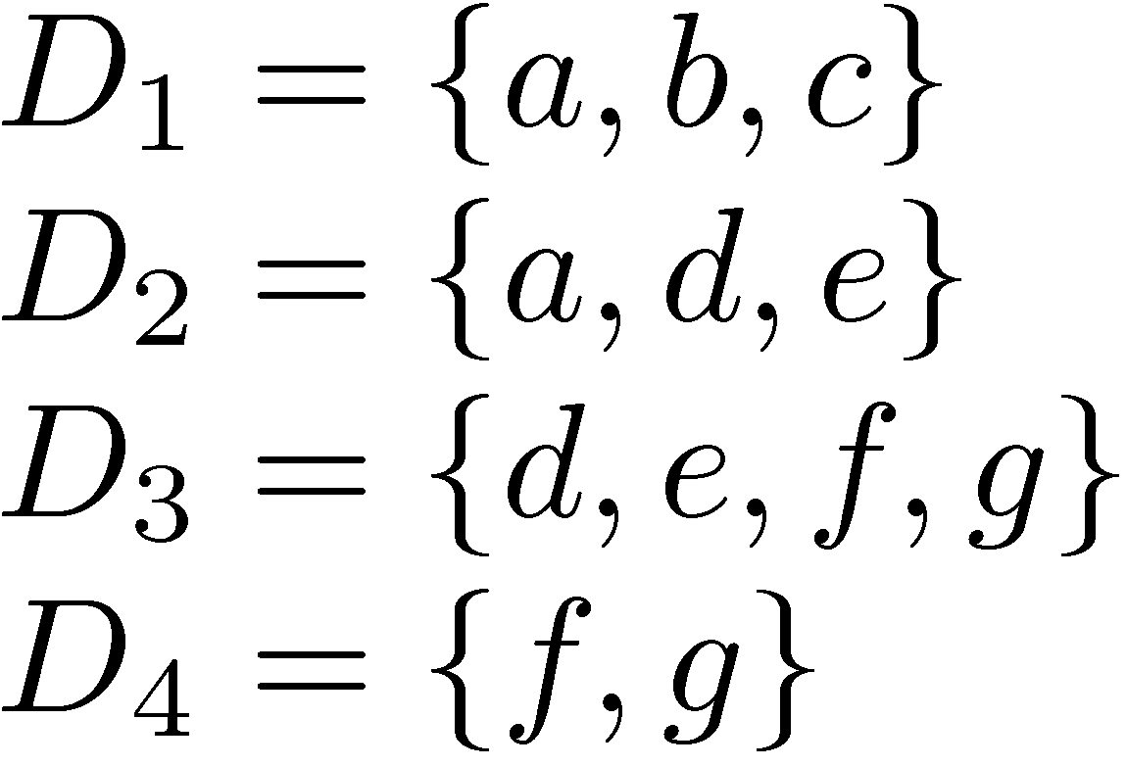
Classification Example
Possible monothetic classification
{D₁,D₂} (labeled using a) and {D₂,D₃} (labeled e)
Possible polythetic classification
{D₂,D₃,D₄}, D₁
labels?

Slide 63
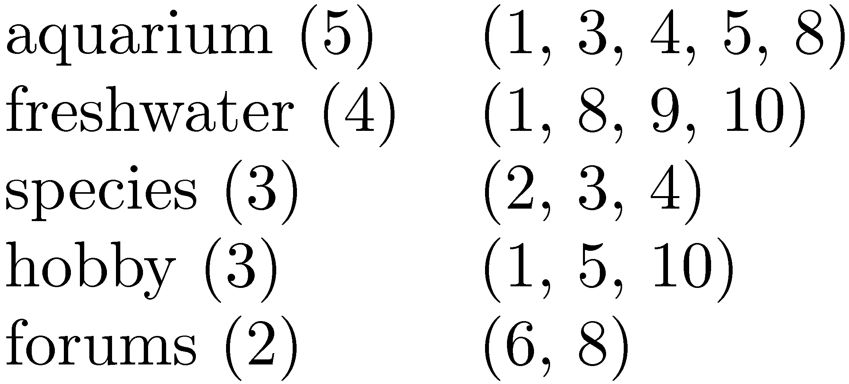
Result Clusters
Simple algorithm
group based on words in snippets
Refinements
use phrases
use more features
whether phrases occurred in titles or snippets
length of the phrase
collection frequency of the phrase
overlap of the resulting clusters,

Slide 64
Faceted Classification
A set of categories, usually organized into a hierarchy, together with a set of facets that describe the important properties associated with the category
Manually defined
potentially less adaptable than dynamic classification
Easy to understand
commonly used in e-commerce

Slide 65
Example Faceted Classification
Categories for “tropical fish”

Slide 66
Example Faceted Classification
Subcategories and facets for “Home & Garden”

Slide 67
Cross-Language Search
Query in one language, retrieve documents in multiple other languages
Involves query translation, and probably document translation
Query translation can be done using bilingual dictionaries
Document translation requires more sophisticated statistical translation models
similar to some retrieval models

Slide 68
Cross-Language Search

Slide 69
Statistical Translation Models
Models require parallel corpora for training
probability estimates based on aligned sentences
Translation of unusual words and phrases is a problem
also use transliteration techniques
e.g., Qathafi, Kaddafi, Qadafi, Gadafi, Gaddafi, Kathafi, Kadhafi, Qadhafi, Qazzafi, Kazafi, Qaddafy, Qadafy, Quadhaffi, Gadhdhafi, al-Qaddafi, Al-Qaddafi

Slide 70
Translation
Web search engines also use translation
e.g. for query “pecheur france”
translation link translates web page
uses statistical machine translation models

