Slide 1
Altering Images with Python: Graphics Programming Assignment 00
Akarsh Kumar

Slide 2
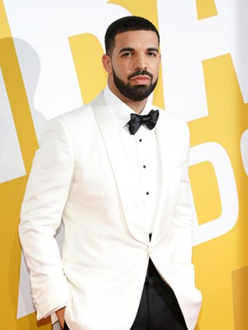
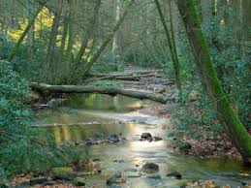
Chosen Images for Altering

Slide 3
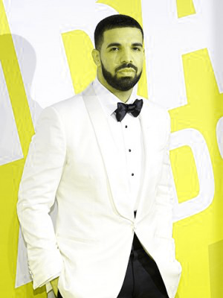
Switching Red and Green Channels
Switch the red and green channels of image1 and save it to the output folder as pic_1_a.png.
The red and green channels of image 1 were switched by saving all the red values of the image into a 3d array derived from the original 4d array. The green values of the image were saved into another array.
The green channels of the image were replaced with data from the red array and the red channels were replaced with the green array.
Code:
red = img1[:,:,2]
green = img1[:,:,1]
img1[:,:,1] = red
img1[:,:,2] = green
original
transformed

Slide 4
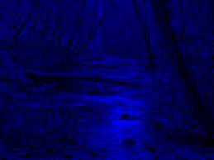
Monochromatic Blue Image
The monochromatic blue image version of the original image was derived by setting the red and green channels of the original image to 0.
Using simple python slicing syntax, this was done in two lines. Since cv2 uses BGR to save color values, the 1 and 2 index of the image pixels were set to zero.
Code:
img2[:,:,1] = 0
img2[:,:,2] = 0
original
transformed

Slide 5
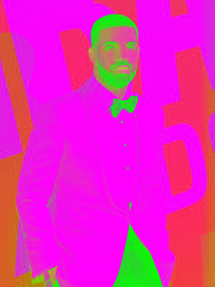
Inverting Intensity of Green
The intensity of green was inverted in the image by first creating an array containing the inverted green values.
The image’s green values were then replaced with this new inverted data.
Using python, this was done in three simple lines.
Code:
green = img1[:,:,1]
green = 255-green
img1[:,:,1] = green
original
transformed

Slide 6
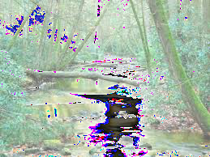
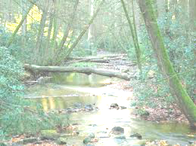
Brightening an Image
100 was added to all values of the pixels in the image. Every place where the value was greater than 255, it was clipped to 255. This method, however, did not work correctly because of how uint8 works.
Code:
Another method is available, however. Before adding 100, if you cap the pixels above 155 to 255, then the desired effect will be achieved.
Code:
img2+=100
img2[img2>255] = 255
original
transformed
img2[img2>155] = 255
img2[img2<=155] +=100
transformed

Slide 7
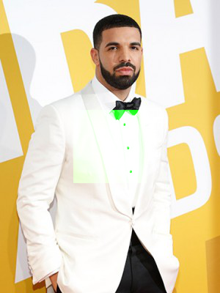
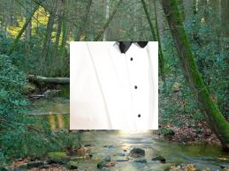
Changing Center of Image
To get the top left corner of the middle 100x100 pixel box of the image, the following code was used:
Afterwards, the green channel of the central box was changed to the full 255 by simply assigning 255 to the green array data of the image:
The middle box of the other image was copied and pasted into the new image by replacing the data in the center of the image with data from the other image’s central box:
h,w = img1.shape[:2]
x = int(w/2-50)
y = int(h/2-50)
img1[y:y+100,x:x+100,1] = 255
img2[y2:y2+100,x2:x2+100] = img1[y1:y1+100,x1:x1+100]

Slide 8
Statistics of Image 1
The statistics of the number of pixels, as well as the min/max intensities, standard deviation of the intensities, and the average intensity was calculated using built in numpy functions on the image array.
Code:
The resulting values were:
pixels: 120000.0
min intensity: 0
max intensity: 255
standard dev. of intensity: 66.3180418677
mean intensity: 210.039377778
All of these values were expected given the diversity in color and the brightness of image 1. The standard deviation in this context means the average deviation from the 210 intensity mean of the color intensities.
print("pixels: "+ str(math.size(img1ori)/3))
print("min intensity: "+ str(math.min(img1ori)))
print("max intensity: "+ str(math.max(img1ori)))
print("standard dev. of intensity: "+ str(math.std(img1ori)))
print("mean intensity: "+ str(math.mean(img1ori)))

Slide 9
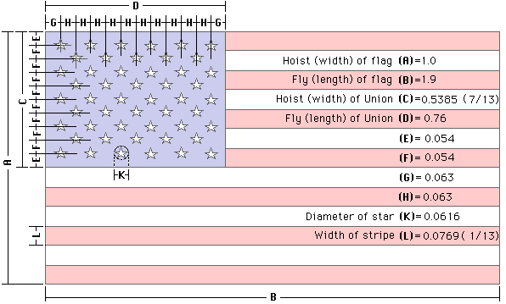
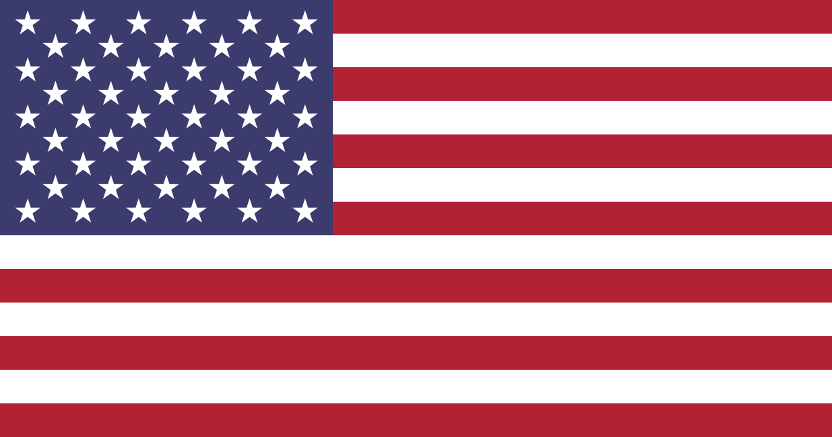

Programming the US Flag
By using the following dimensions online, I was able to recreate the US flag to near perfection.
I found the color values of the US flag through a program online that let you see the color code at any given pixel.
Official US Flag
My version

Slide 10
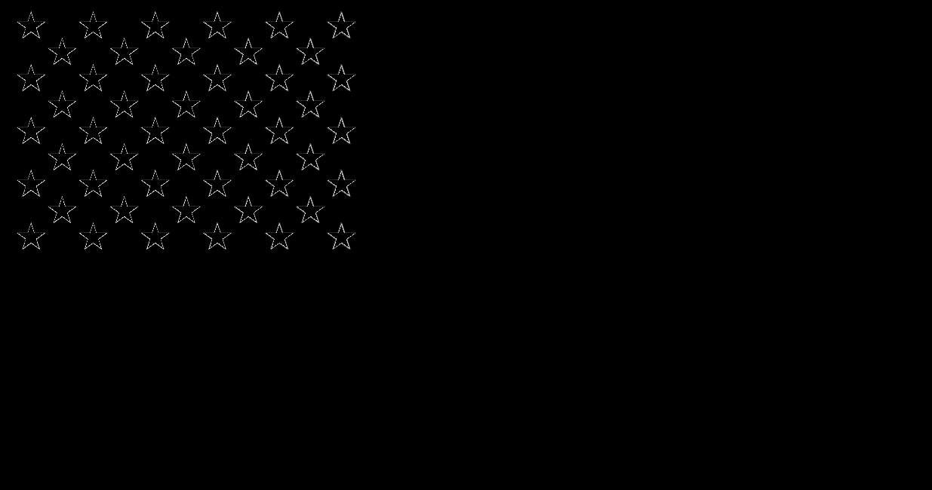
Difference in the Flags
The difference in the flags was calculated by subtracting off the original flag from my version and scaling those values from 0 to 255.
By doing so, the following image was created.
The near complete blackness of the image shows the accuracy of my flag’s design and color. The stars on the top left are caused by a slight error in my star creation code that causes imperfect edges. Changing the size of the stars made no difference.

