Slide 1
Compressing XKCD Images
By Akarsh Kumar

Slide 2
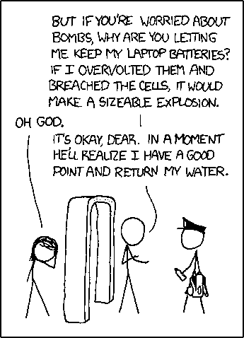
XKCD Image example

Slide 3

Compression and Decompression Algorithm
Stored height and width
Stored location and length of horizontal black strips
Used 1st bit to tell if the integer ahead was 7 bits long or 15 bits long. (0 for 7 and 1 for 15, giving a total of 8 or 16)
Decompressed image:

Slide 4
Efficiency
For the example xkcd image, it reduced the size of the image from an original 21 kb to 19 kb.
This is less than 1 bit per pixel.
.9 bits per pixel for the example image
Compression (compressed kb/original kb):
532: 16/29
758: 11/22
809: 27/48
889: 13/20
1067: 13/27

