Slide 1

Team: “The F-Society”
(Team ID: 7NwDmMxOdB)
Team Members:
Akarsh Tripathi
Satyam Negi
Akhil Sharma

Slide 2
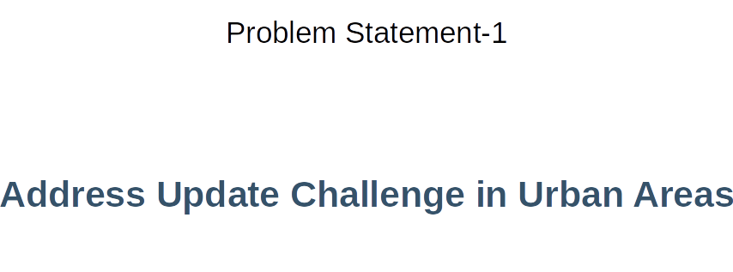

Slide 3
The soul of this problem lies in the security of the whole updation process.
The mentioned process requires exchange of address, which is an important endpoint to consider when implementing a solution.
To make this request secure we use end to end encryption. (The whole process is auditable)
Encrypt introducer’s data.
Accessible only to requesting user upon consent.
Another challenge would be to handle any spam requests.
Option for introducer to mark the request as fraudulent
Fraudulent requests blacklist the requestor raising a red flag.
Geolocation of the user compared to the address being requested to further verify authenticity.
Modified address verified again with the original address to avoid major changes.
The logs would contain the total number of change requests by a user till date and could restrict them to a maximum limit to prevent fraudulent/spam usage.

Slide 4
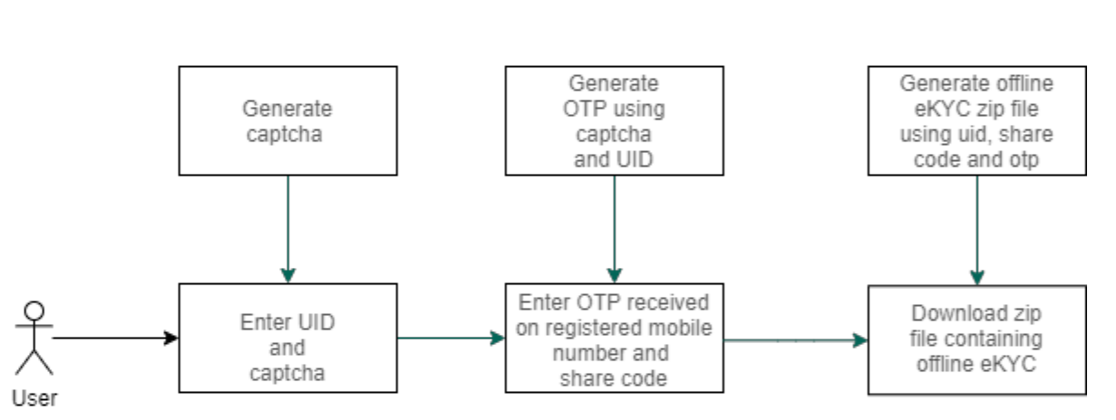
Step1: Authentication using eKYC API
The user is first prompted to a login page.
He/She is asked to enter their Aadhaar number along with the captcha below.
Upon submitting the details, his/her aadhaar is authenticated using the eKYC API.

Slide 5
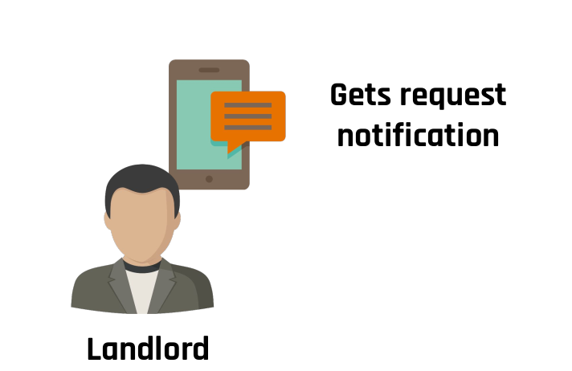
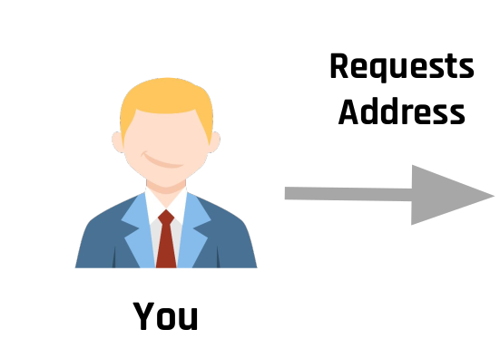
Step2(a): Change Address Request
(For the User)
On the left side of the page, a user can see the “Change Address” button which will prompt them to a page where they have to enter their and their landlord’s phone number if requesting for address.
Upon doing so a private key is generated for the specific request and is automatically downloaded as a .txt file.

Slide 6
Step2(b): View Request
(For the Landlord)
The landlord on the other hand can view all the requests (pending/approved/rejected) on his/her dashboard.

Slide 7
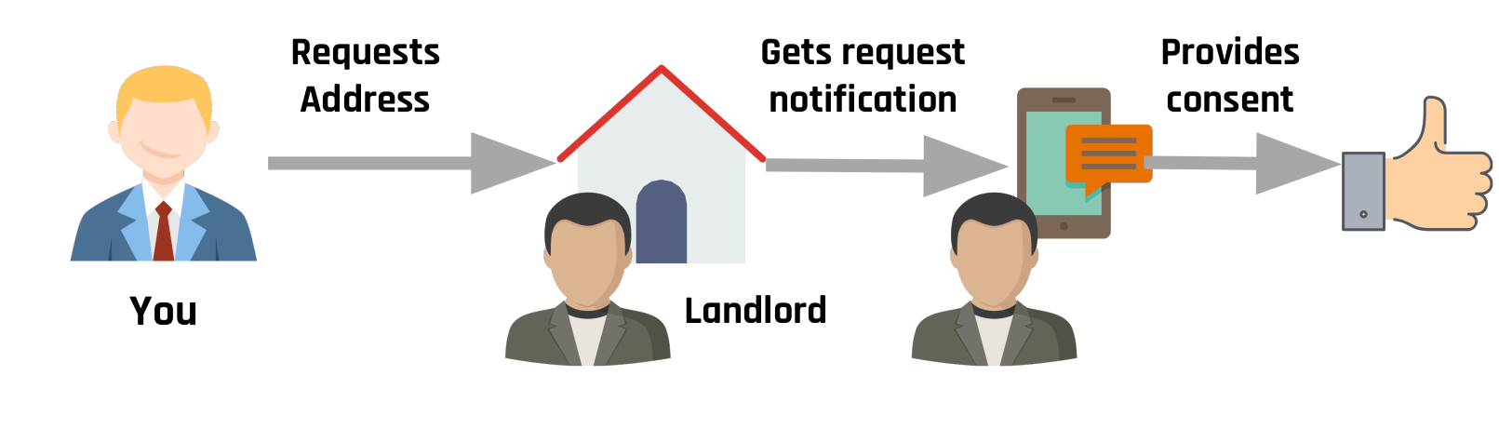
Step3(a): Wait for Approval of Request
(For the User)
The user waits while the landlord makes his/her decision regarding the address request.

Slide 8
Step3(b): Approval/Rejection of Request
(For the Landlord)
The landlord can:
Approve the request (thus providing his address)
Reject the request
Mark request as fraudulent (blocking the user and raising a red flag against him/her)

Slide 9
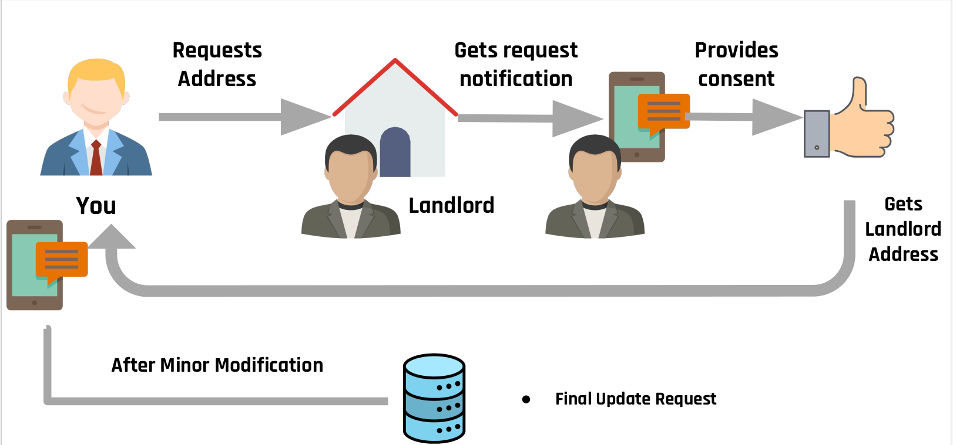

Step4: Decrypting address and minor changes
Upon acceptance of the request by the landlord, the user will see its accepted request in his/her dashboard, and will have to click on it to make any further changes.
Upon clicking on the request, the user will be prompted to enter(or upload) the private key they were earlier given.
On successfully entering the private key, the user will have an option to make minute changes to the provided address(house number) and submit it further.

Slide 10
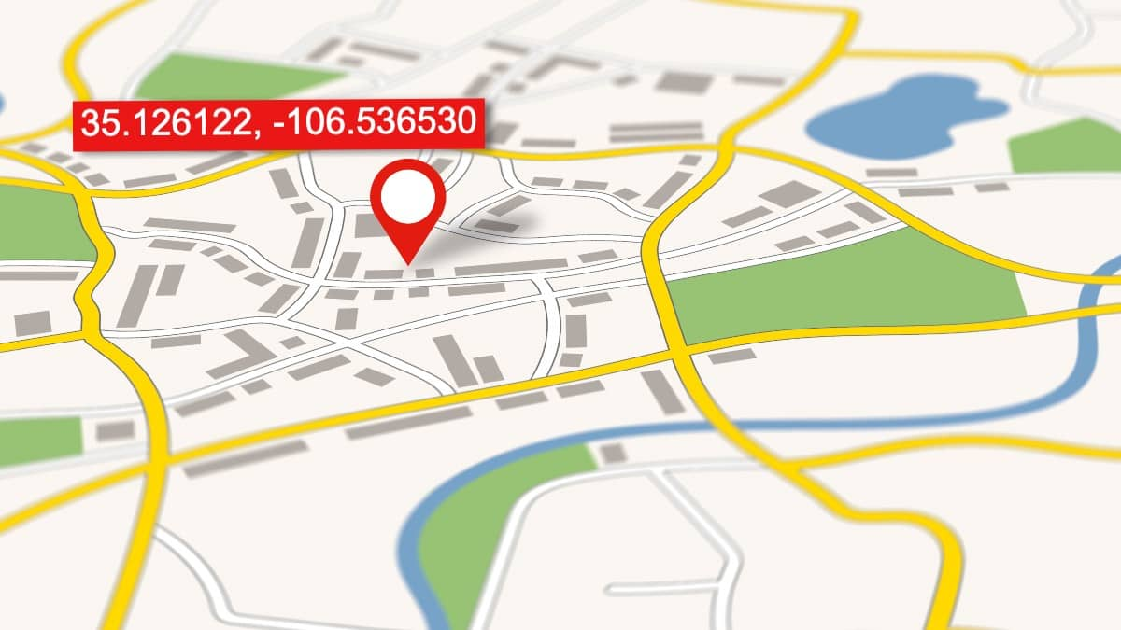
Step5: New address verification through GeoCode API
The address is then verified using the GeoCode API.
If the distance between the old and the new address is less than 100 meters, the data is sent to the UIDAI server for updation.
Otherwise the request is rejected and the user has to go through the whole process again.

