Slide 1

Sensorium
A visual guide for the blind

Slide 2
Introduction
The World Health Organization (WHO) Fact reported that there are 285 million visually-impaired people worldwide. Among these individuals, there are 39 million who are blind in the world. India is home to a third of the world’s blind population.
Our aim is to provide the blind with all the information and features for safe mobility, which is available to people with sight.
Depth data collected from Microsoft’s Kinect.
Data collected is then outsourced as vibrations into the gloves to detect the proximity of an obstacle.

Slide 3
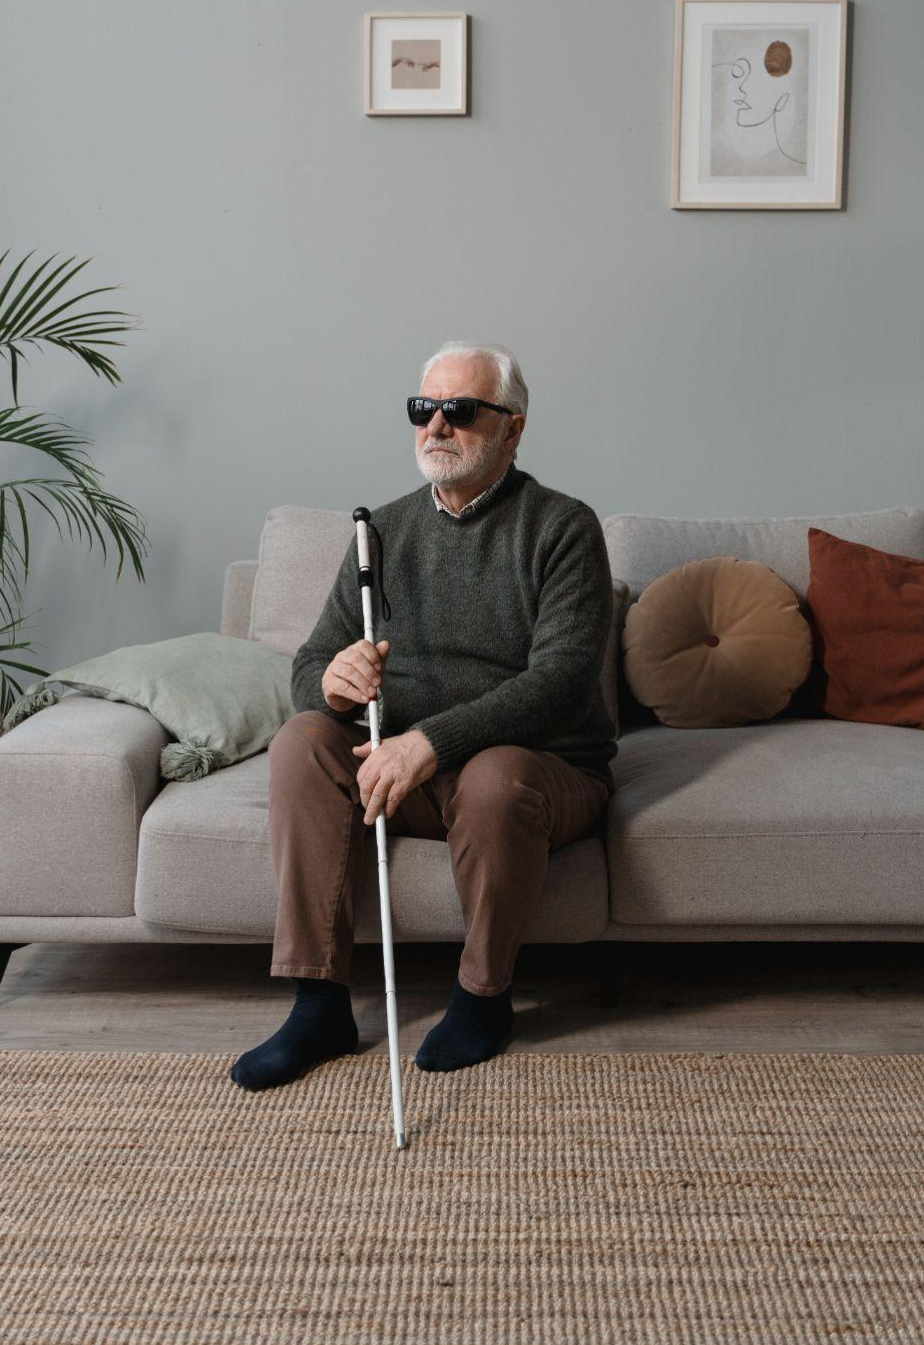
Problem Statement
Developing solutions for the visually impaired to augment their lives.

Slide 4
Solution
A sensor camera fitted on a belt coveys the surrounding obstacle information through haptic vibrations on a glove.

Slide 5
Working

Slide 6
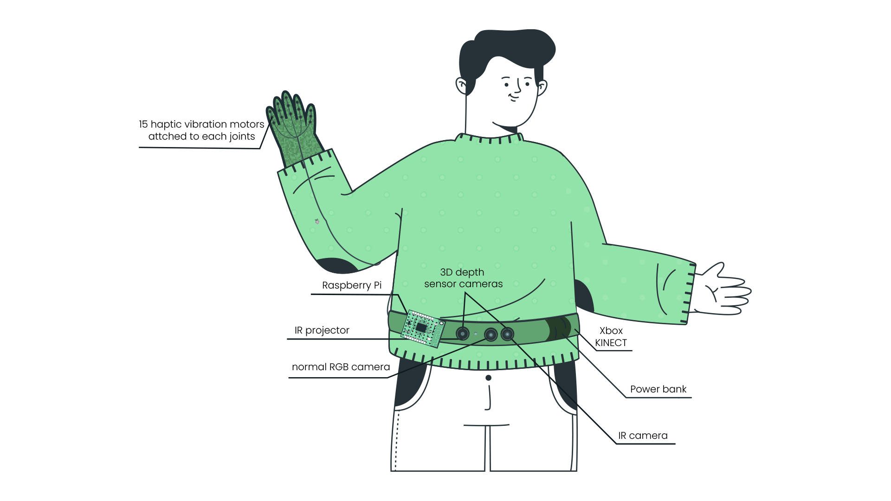
Product

Slide 7
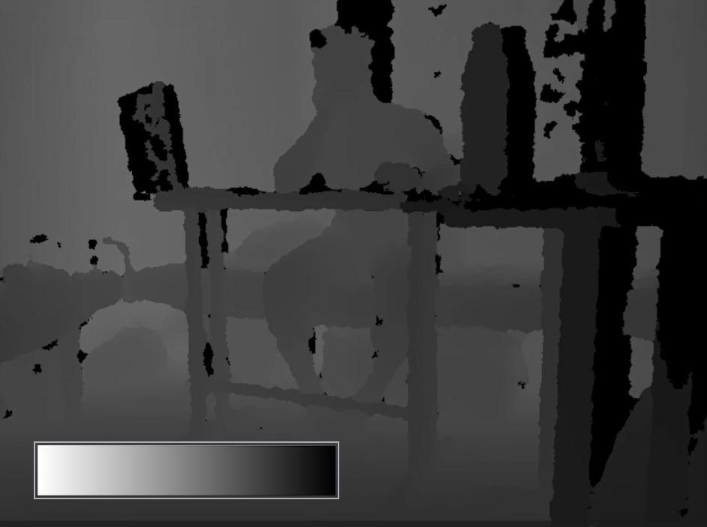

Slide 8


Slide 12
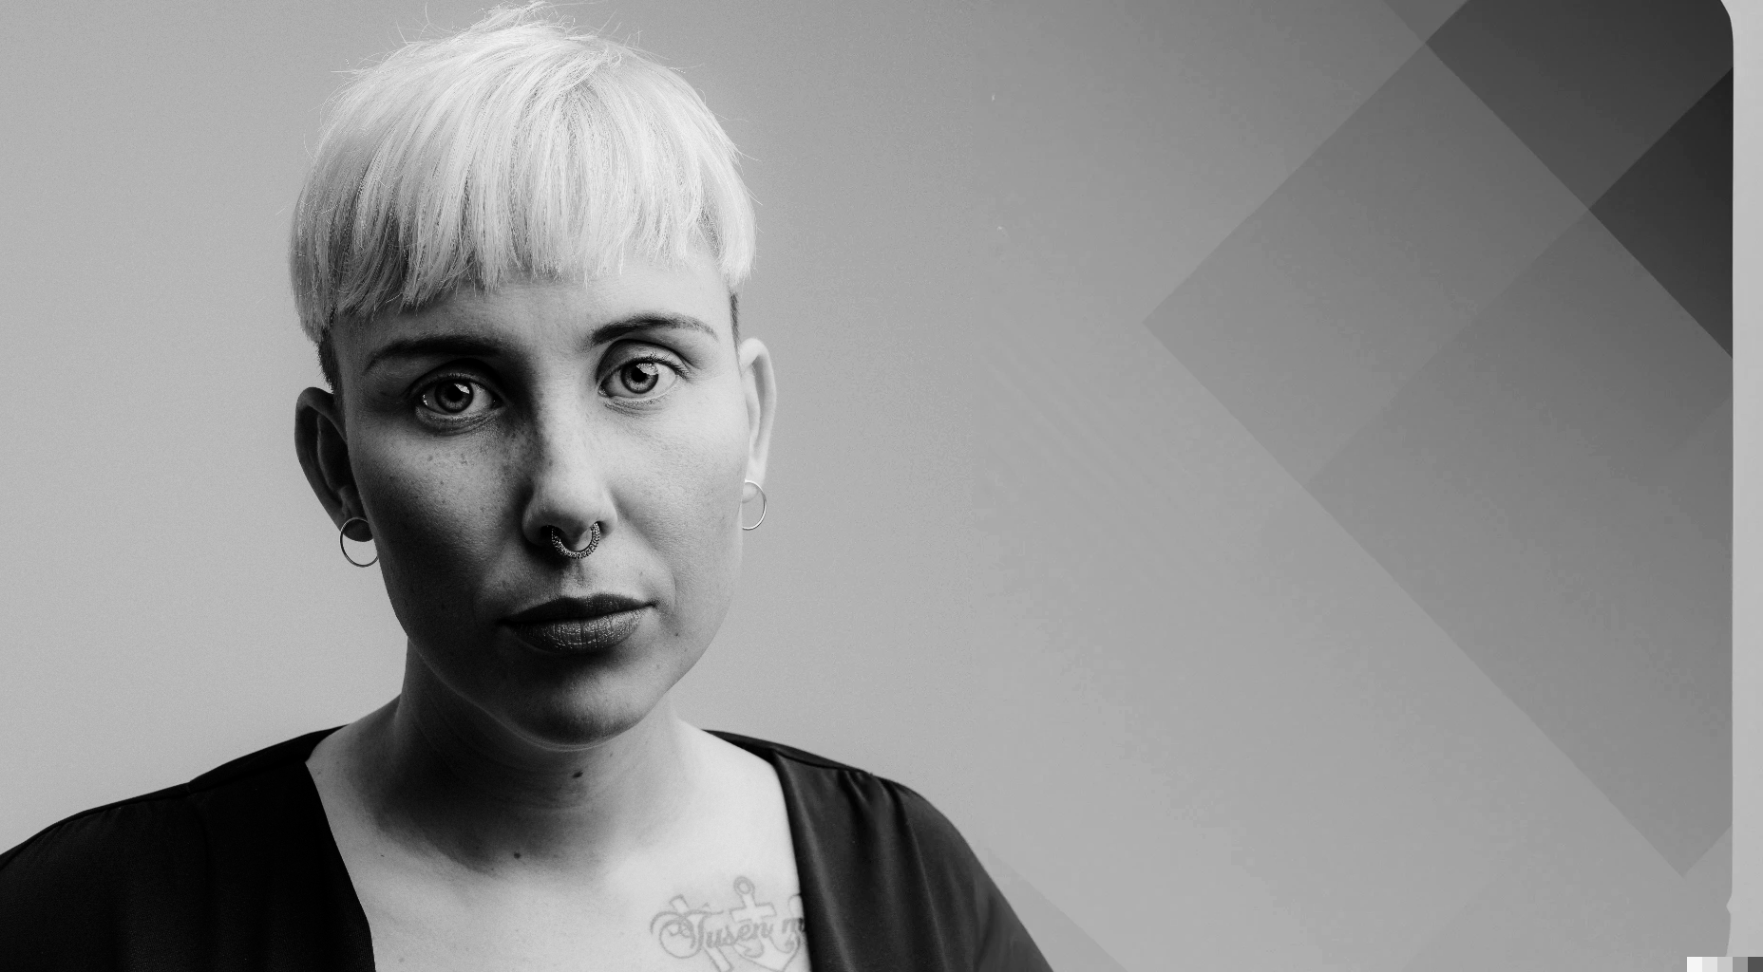
value proposition

Slide 13
current
market
01
White Cane
02
Ultrasonic Sensor Based Devices
03
GPS Integrated Devices
04
Voice Feedback Devices

Slide 14
Disadvantages
Ultrasonic sensor devices have limited object detection capabilities.
Voice assistance can be less efficient and may cause processing lag.
Inability to detect objects above ground level
Canes require contact with objects for detection, limiting range of motion

Slide 15
Advantages
Equivalent to using 15 ultrasonic sensors together
More accuracy and more portability
Although image processing required, there’s usually no processing lag.
Can detect objects above ground level
Provides information about objects 3D position
Increased range of detection

Slide 16
target market
39 M
⅓ rd
Persons with visual disabilities in India rely on white canes and guide dogs.
We intend to educate and train them in the product's usage
It could be modified for the gaming and augmented reality markets, which are rapidly expanding.
Blind population in the world
India has one third of the blind population
$ 8.4 B
$ 43.1 B
Market share of AR in the gaming industry in 2022
Market share of AR in the gaming industry in 2028

Slide 17
Revenue model
Kinect sensor model 1414 | 8000 INR
Raspberry Pi 4 Model B | 2,800-4,400 INR
15 small coin size vibrating ERM | 800-1,600 INR
Li-ion rechargeable battery | 1,600-2,400 INR
The total estimated cost | 15000 - 17000 INR.
Customizing IR projector, camera or using low-cost ToF sensors can replace Kinect's depth sensor and reduce costs while maintaining accurate depth information.
Buying components at wholesale rate would significantly lower the cost of the final product.

Slide 18
Challenges
Steep Learning Curve
Concern regarding system's effectiveness in conveying visuo-spatial information for movement along the sagittal axis.
The product includes tutorials in simple audio books, braille manuals of it as well as training centres.
Accuracy
Higher accuracy compared to simple ultrasonic and voice assistance based products
Improve accuracy by using more motors and increasing the resolution

Slide 19

Milestones
Introduce the product directly to the healthcare industry, particularly to regional supply chains for medical equipment.
With proper marketing and awareness it could take up to 1-2 years to enter the system.
With the success in the healthcare sector and adequate renditions of the product, we plan to launch the product into the gaming industry.

Slide 20
Sensorium represents a step forward in the field of assistive technology and has the potential to make a real difference in the lives of millions of people.

