Slide 1
COLLEGE HACKATHON 2026 • THEME 1 (AI-04)
JobShield AI
Autonomous Multi-Layer Verification Engine for Local Job Scams & Vacancies
Presented by Team Parakram (5 Members) • Protecting students and job seekers against fraudulent digital employment
PRESENTATION ROADMAP & TOPICS COVERED:
01
The Epidemic: Campus Job Scams
Rising student victimization, ₹1,850 Cr+ national loss, and deposit traps.
02
Our Solution: 4 Pillars of Defense
Omni-input vision, heuristic rule audits, live OSINT, and explainable trust index.
03
System Pipeline & Flowchart
Under-the-hood FastAPI architecture, Gemini Vision OCR, and verification layers.
04
Beyond Generic Chatbots
Why asking ChatGPT fails: Live WHOIS DNS checks and Google Places geo-auditing.
05
Live Test Bench & Demonstrations
Side-by-side comparison: 94% threat Telegram task vs. 96% authentic campus hiring.
06
Civic Scalability & Roadmap
Integration with National Cyber Crime Portal 1930 and college TPO portals.

Slide 2
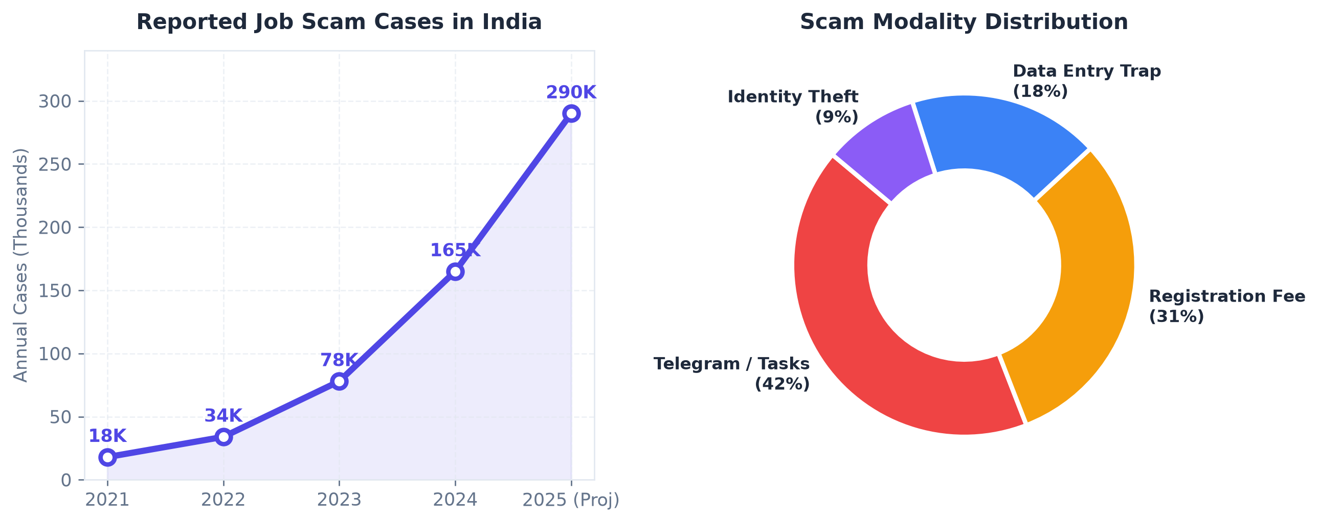
THEME 1: AI & SMART SOLUTIONS | CODE: AI-04
The Epidemic: Job & Task Scams on Campus
Upfront Deposit Extortion
Students coerced into paying ₹500 - ₹5,000 for 'registration', 'laptop dispatch', or 'interview kits'. Money vanishes immediately.
Telegram / WhatsApp Task Scams
'Earn ₹3,000/day for liking YouTube videos'. Uses micro-payouts to build false trust before freezing lakhs in fraudulent portal accounts.
The Local Vacancy Blindspot
Street flyers on coaching walls and unverified local walk-ins lack registered corporate footprints, leaving victims with zero recourse.

Slide 3
THEME 1: AI & SMART SOLUTIONS | CODE: AI-04
JobShield AI: 4 Pillars of Defense
01
02
03
04
Omni-Input Vision
Extracts structured text from physical posters, WhatsApp chats, and PDF offer letters using Gemini Vision + EasyOCR without manual typing.
Heuristic Audit
Scans for extortion red flags: security deposits, interview kit charges, urgency triggers, and impossible pay-to-work ratios.
Live OSINT Checks
Inspects live DNS with WHOIS to catch newly minted scam domains (< 30 days old) and verifies physical shop/office addresses on Google Places.
Trust Score & Report
Provides a comprehensive 0-100% Trust Index with clear evidence badges and a 1-click Cyber Crime reporting template (Portal 1930).

Slide 4
THEME 1: AI & SMART SOLUTIONS | CODE: AI-04
System Engineering & End-to-End Pipeline
01
02
03
04
➔
➔
➔
INGESTION
User Upload
WhatsApp Screenshot
Street Poster Photo
PDF Offer Letter
VISION & OCR
Gemini 1.5 API
Multimodal Extraction
Company & VPA Handles
Salary & Contact Info
FASTAPI ENGINE
Tri-Tier Audit
Heuristic Rule Regex
WHOIS Domain Age
Google Places Maps
TRUST REPORT
Output Delivery
0-100% Trust Meter
Red Flag Breakdown
1930 Complaint Draft
CORE ARCHITECTURAL STACK & COMPONENT INTEGRATION:
Frontend (Lightweight & Instant)
Vanilla HTML5 / Modern CSS Grid / ES6 JS. Zero build compilation, loaded in <200ms on any mobile or desktop browser.
Backend & Intelligence Engine
Python FastAPI (Asynchronous), Google Gemini 1.5 Flash Vision for OCR, and Python-WHOIS DNS inspection library.
Outreach & Civic Integration
python-telegram-bot for instant message forwarding, plus pre-formatted reporting templates for National Cyber Portal 1930.

Slide 5
THEME 1: AI & SMART SOLUTIONS | CODE: AI-04
Why Asking ChatGPT or a Generic Chatbot Fails
Verification Capability | Asking ChatGPT / Generic LLM | JobShield AI (Our Solution)
Live Domain Age (WHOIS) | ❌ Blind - Cannot query live DNS records. Completely misses domains registered 2 days ago. | ✅ Live Query - Flags domains registered < 30 days instantly with 50% trust penalty.
Physical Address Verification | ❌ Hallucinates fake validation for non-existent shops and coaching centers. | ✅ Google Places API - Cross-verifies physical shop / office coordinates on map.
Free Email Spoofing | ⚠️ Weak - Overlooks @gmail.com or @yahoo.com claiming to be corporate HR. | ✅ Strict Enforcement - Demotes trust score by 50% for free mail providers.
Street Flyer / Image OCR | ❌ Tedious - Requires user to transcribe entire flyer manually into prompt. | ✅ Native Vision - Upload raw camera photo of posters without manual typing.
Mobile Chatbot Forwarding | ❌ None - Requires user to log into website interface. | ✅ 1-Click - Forward messages straight to Telegram bot for instant verdict.

Slide 6
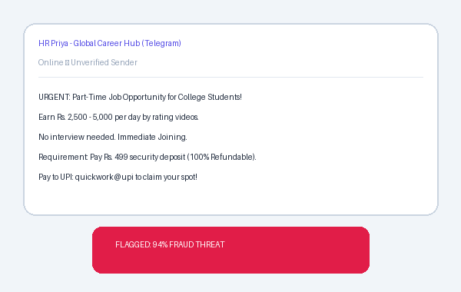
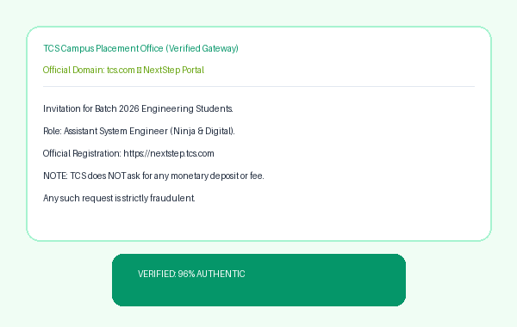
THEME 1: AI & SMART SOLUTIONS | CODE: AI-04
Live Demonstration & Test Bench (Real-World Audits)
JobShield AI Detected Threat Indicators:
🚩 Upfront Extortion: Demands Rs. 499 deposit before work begins.
🚩 Impossible Wage Ratio: Rs. 5,000/day for casual video clicks.
🚩 Anonymous Routing: Directs students to Telegram instead of domain.
JobShield AI Verified Safety Metrics:
🛡️ Established Domain Authority: tcs.com registered > 25 years ago.
🛡️ Zero Fee Policy: Explicit disclaimer against monetary demands.
🛡️ Official Corporate Gateway: Directs to standard NextStep portal.

Slide 7
THEME 1: AI & SMART SOLUTIONS | CODE: AI-04
Future Roadmap & Civic Scalability
🏛️ Cyber Cell 1930 Sync
Auto-generate pre-filled police complaint reports formatted according to National Cyber Crime Reporting Portal guidelines, containing extracted transaction handles and timestamps.
👥 Crowdsourced Fraud Blacklist
A peer-vetted community registry allowing students across universities to report recurring scammer UPI IDs, phone numbers, and WhatsApp recruiter handles.
🎓 College TPO Bulletin Widget
A lightweight browser extension that automatically verifies off-campus hiring drives and internship alerts posted on college WhatsApp groups.
Thank You! We are Ready for Q&A.
JobShield AI — Securing Student Careers Against Digital Employment Extortion.

