Slide 1
COLLEGE HACKATHON 2026 • AI-04
JobShield AI
Autonomous Multi-Layer Intelligence Engine for Local Job Scam Detection & Vacancy Verification
Safeguarding students and freshers from fake offer letters, deposit fee traps, and predatory task scams.
ENGINEERED BY 5-MEMBER CORE TEAM:
M1
M2
M3
M4
M5
Member 1 (Lead)
AI Vision & System Architecture
Gemini 1.5 Vision / LangChain
Member 2
Backend & Rule Engine
Python FastAPI / Security Rules
Member 3
OSINT & DNS Auditor
WHOIS Protocol & Google Places API
Member 4
Frontend UI / UX
HTML5 / Modern JS / Threat Visuals
Member 5
Bot Interface & QA
Telegram Bot API / Cyber Crime Sync

Slide 2
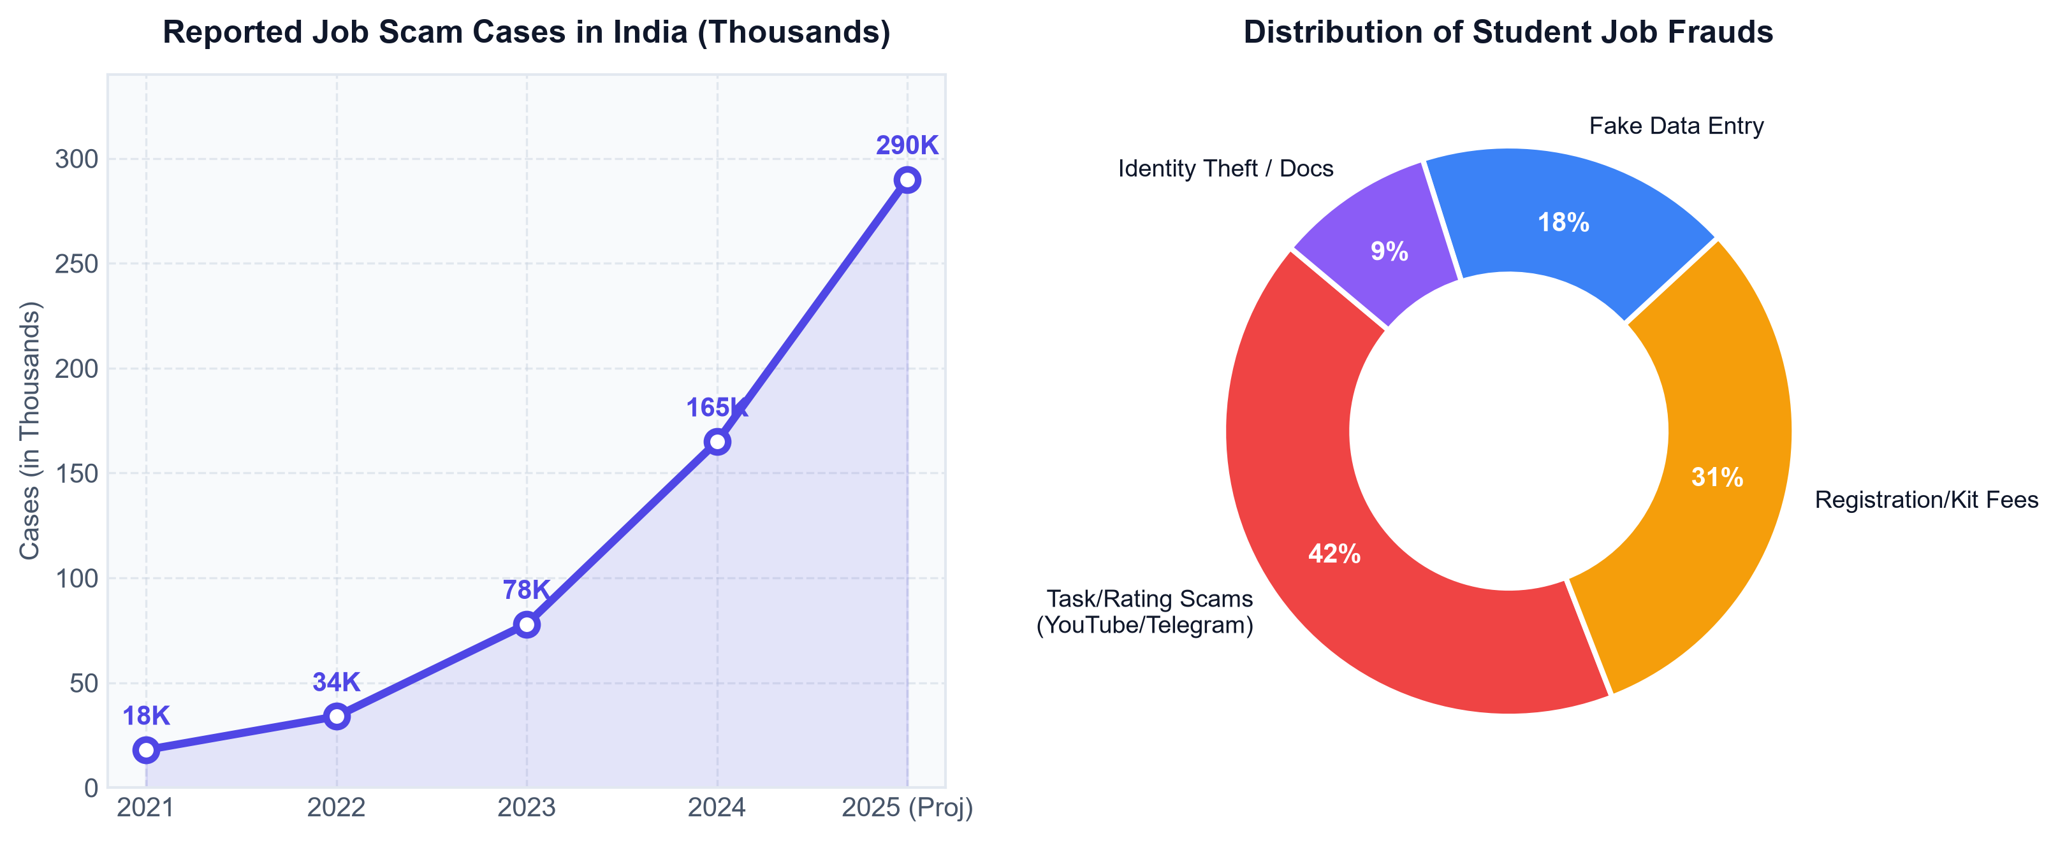
THEME 1: AI & SMART SOLUTIONS | CODE: AI-04
The Epidemic of Employment & Job Scams
Upfront Fee & Deposit Extortion
Scammers pose as recruiters demanding ₹500 - ₹5,000 for 'registration', 'laptop delivery', or 'mandatory verification kit'. Money disappears immediately.
Telegram & WhatsApp Task Scams
'Earn ₹3,000/day for liking YouTube videos'. Exploits young students with small initial payouts before locking thousands in fake crypto accounts.
The Local Vacancy Digital Void
Coaching notices, street flyers, and local walk-in postings operate in a total regulatory blindspot with zero public verifiability.

Slide 3
THEME 1: AI & SMART SOLUTIONS | CODE: AI-04
JobShield AI: 4 Pillars of Defense
📷
🔍
🌐
🛡️
1. Omni-Input Vision
Extracts structured text from physical posters, WhatsApp chats, and PDF offer letters using Gemini Vision + EasyOCR without manual typing.
2. Heuristic Audit
Scans for extortion red flags: security deposits, interview kit charges, urgency triggers, and impossible pay-to-work ratios.
3. Live OSINT Checks
Inspects live DNS with WHOIS to catch newly minted scam domains (< 30 days old) and verifies physical shop/office addresses on Google Places.
4. Explainable Score
Provides a comprehensive 0-100% Trust Index with clear evidence badges and a 1-click Cyber Crime reporting template (Portal 1930).

Slide 4
THEME 1: AI & SMART SOLUTIONS | CODE: AI-04
System Engineering & End-to-End Pipeline
Stage 1: Multi-Input Ingestion
Upload Poster / WhatsApp screenshot / Offer letter PDF or Telegram forward
Stage 2: Vision & Extraction
Gemini 1.5 Flash Vision / OCR parses salary, company, URL, email, and phone
Stage 3: FastAPI Verification Engine
Tri-tier validation: Rule-based regex + WHOIS Domain Audit + Maps verification
Stage 4: Trust Score & Action
0-100% Trust Meter + Red flag badges + 1-Click Police complaint draft
➔
➔
➔
TECHNOLOGY STACK & INTEGRATIONS
Frontend (Light & Responsive)
Vanilla HTML5, Modern CSS Grid, Clean JavaScript. Zero build steps, instant load under 200ms.
Backend & AI Core
Python FastAPI (async), Google Gemini 1.5 Flash Vision API, Python-WHOIS DNS library.
Bot & Civic Integrations
python-telegram-bot for mobile forwarding, Google Places API for address verification.

Slide 5
THEME 1: AI & SMART SOLUTIONS | CODE: AI-04
Why Asking ChatGPT or a Generic Chatbot Fails
Verification Capability | Asking ChatGPT / Generic LLM | JobShield AI (Our Solution)
Live Domain Age (WHOIS) | ❌ Blind - Cannot query live DNS records. Misses domains created 2 days ago. | ✅ Live Query - Flags domains registered < 30 days immediately.
Physical Address Verification | ❌ Hallucinates fake validation for non-existent addresses. | ✅ Google Places API - Cross-verifies physical shop / office coordinates.
Free Email Spoofing | ⚠️ Weak - Ignores @gmail.com or @yahoo.com claiming to be corporate HR. | ✅ Strict Enforcement - Demotes trust score by 50% for free mail providers.
Street Flyer / Image OCR | ❌ Tedious - Requires user to transcribe entire flyer manually. | ✅ Native Vision - Upload raw photo taken from mobile camera directly.
Mobile Chatbot Forwarding | ❌ None - Requires user to log into web platform. | ✅ 1-Click - Forward messages straight to Telegram bot for instant verdict.

Slide 6
THEME 1: AI & SMART SOLUTIONS | CODE: AI-04
Live Demonstration & Test Bench
⚠️ HIGH RISK SCAM (94%)
✅ VERIFIED SAFE (96%)
Sample Input (Telegram Task Offer):
"Earn ₹3,000 - ₹5,000/day by liking YouTube videos! Pay ₹499 security deposit (100% refundable with first salary). Contact HR on Telegram @earn_quick_india."
Detected Threat Indicators:
🚩 Upfront Extortion: Demands ₹499 deposit before work begins.
🚩 Impossible Wage Ratio: ₹5,000/day for casual video clicks.
🚩 Anonymous Channel: Routes candidates to Telegram instead of verified domain.
Sample Input (Official Campus Placement):
"TCS National Qualifier Test 2026 for Batch 2026. Register exclusively on nextstep.tcs.com. No fee is charged at any point of recruitment. Official emails only from @tcs.com."
Verified Safety Metrics:
🛡️ Established Domain Authority: tcs.com registered > 25 years ago.
🛡️ Zero Fee Policy: Explicit disclaimer against monetary demands.
🛡️ Official Corporate Gateway: Directs to standard NextStep portal.

Slide 7
THEME 1: AI & SMART SOLUTIONS | CODE: AI-04
Future Roadmap & Civic Scalability
🏛️ Cyber Cell 1930 Integration
Auto-generate pre-filled police complaint reports formatted according to National Cyber Crime Reporting Portal guidelines, containing extracted transaction handles and timestamps.
👥 Crowdsourced Fraud Blacklist
A peer-vetted community registry allowing students across universities to report recurring scammer UPI IDs, phone numbers, and WhatsApp recruiter handles.
🎓 College TPO Bulletin Widget
A lightweight browser extension that automatically verifies off-campus hiring drives and internship alerts posted on college WhatsApp groups.
Thank You! We are Ready for Q&A.
JobShield AI — Securing Student Careers Against Digital Employment Extortion.

