Slide 1

CAR TRADE
SECOND HANDS CARS ANALYSIS
BY
ARVIND KOMPELLI

Slide 2
BUSINESS PROBLEM AND USE CASE
The used car market is growing rapidly, with buyers and sellers seeking fair pricing and transparency.
Business Problem:
Understand how car features (brand, year, fuel type, mileage) influence resale prices.
Identify pricing trends and market insights from online car listings.
Use Case:
Helping buyers make data-driven decisions.
Assisting sellers to set competitive prices.

Slide 3
OBJECTIVE OF THE PROJECT
To scrape used car data from online sources, clean and analyze it using EDA techniques, and uncover insights into pricing patterns, popular brands, and factors influencing car prices.

Slide 4
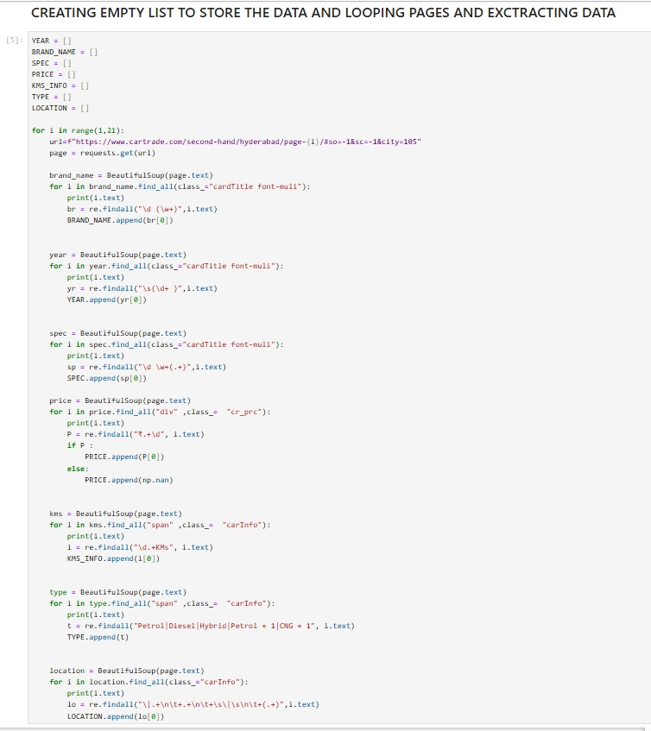
WEB SCRAPPING DETAILS
Data Source: Car trade website.
Python libraries : Beautiful Soup, Requests, Pandas ,numpy ,matplot, seaborn.
Process : Extracted car details (brand, year, model, price, kms driven, fuel type, and location).
Cleaned and making into structured the scraped data into a Pandas DataFrame for analysis.

Slide 5
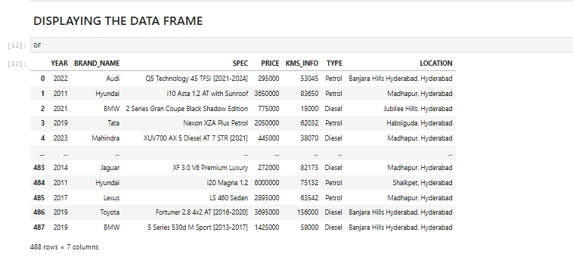
DATA FRAME

Slide 6
SUMMARY OF DATA
Total Records: 488 cars
Columns: Year, Brand Name, Specification, Price, KMS Info, Type, Location
Sample Insights:
Data contains both luxury and economy brands.
Prices vary .
Locations include multiple areas in Hyderabad.

Slide 7
EXPLORATORY DATA ANALYSIS OVERVIEW
Steps Followed:
1. Data Cleaning – Handled null values and corrected data types.
2. Data Manipulation – Standardized columns and formatted prices.
• Histogram shows most car prices.
• Boxplot identifies multiple high-priced outliers (luxury cars).
• Hyundai, Mahindra, and Maruti are the most listed brands.
• Positive correlation between manufacturing year and price.​
• Cars with lower kilometers driven tend to have higher prices.​​

Slide 8
• Cars with lower kilometers driven tend to have higher prices.​
• Fuel type (Petrol vs Diesel) shows price variation across brands.​
• Visualization: Scatterplots, Boxplots, and Catplots for Brand vs Location.
• Weak correlation observed between price and year.
• Negative correlation between year and kilometers driven.
• Visualization: Heatmap highlighting relationships among numerical variables.​

Slide 9
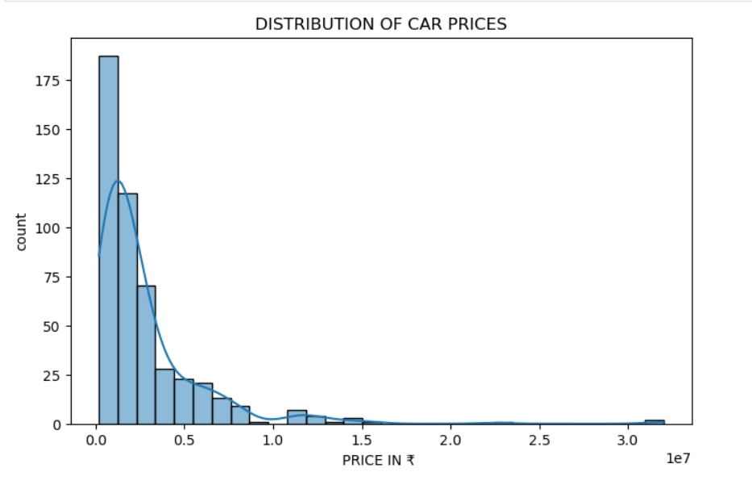
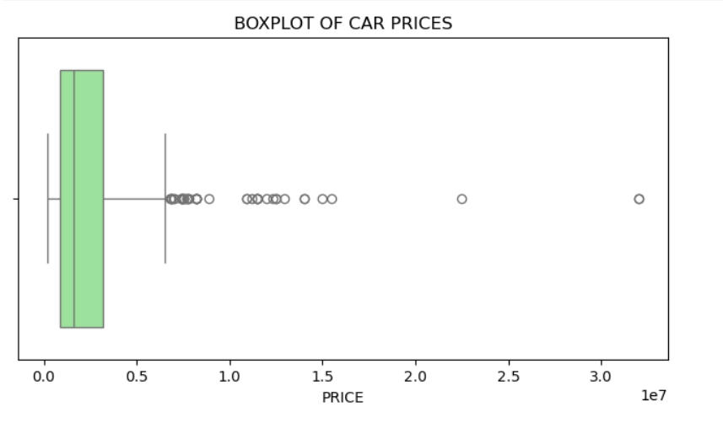
Univariate Analysis – Distribution and outlier detection for car prices.

Slide 10
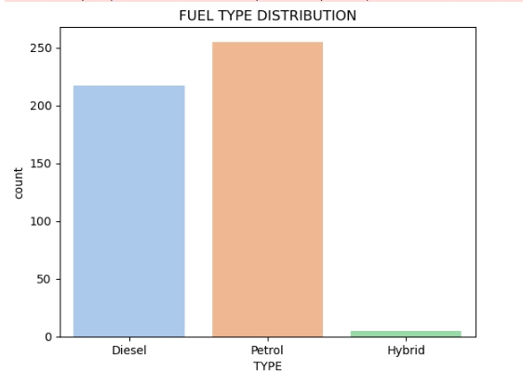
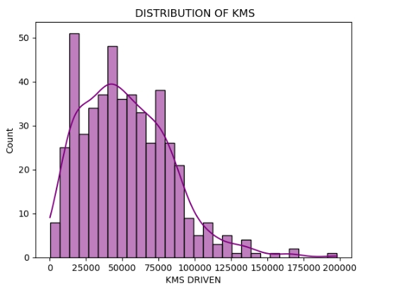
Univariate Analysis – Distribution and outlier detection for car prices.

Slide 11
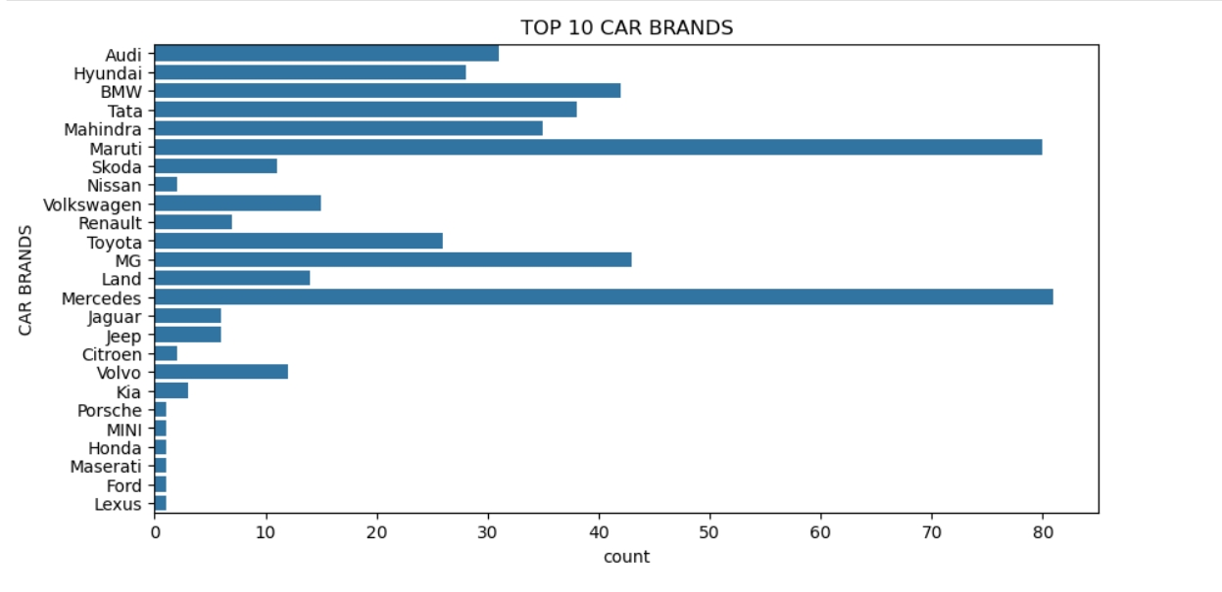
Univariate Analysis – Distribution and outlier detection for car prices.

Slide 12
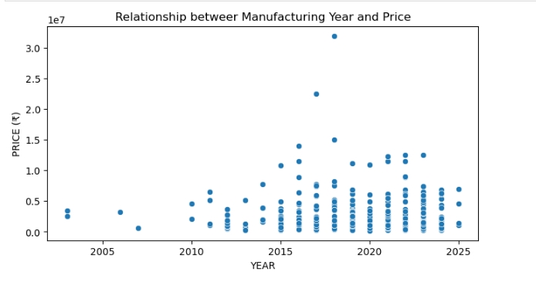
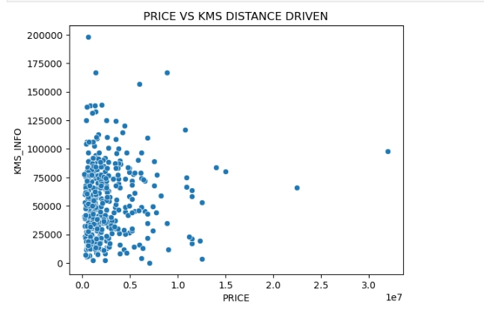
Bivariate Analysis – Studied relationships between price, year, brand, and fuel type

Slide 13
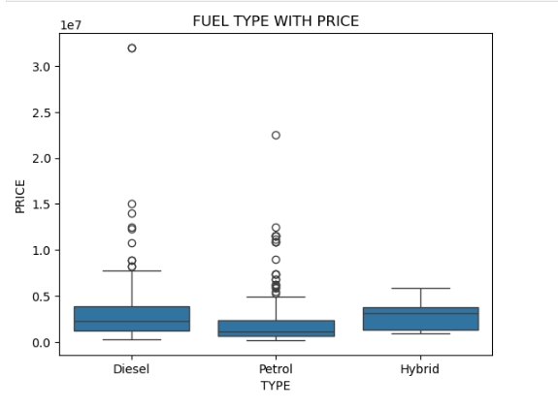
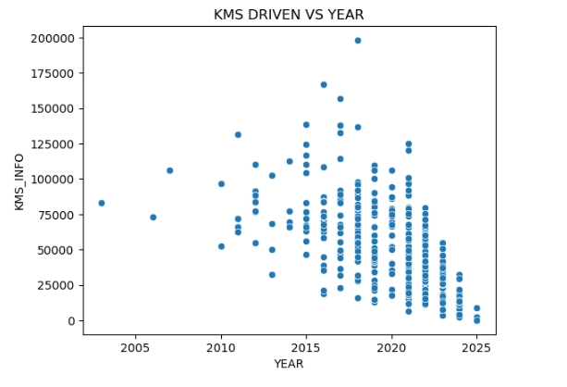
Bivariate Analysis – Studied relationships between price, year, brand, and fuel type

Slide 14
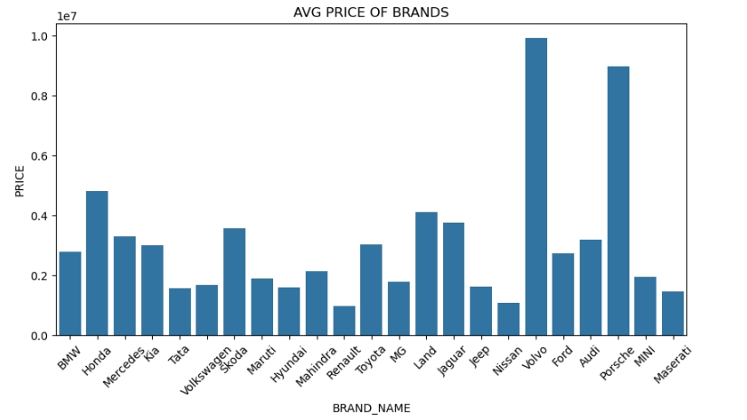
Bivariate Analysis – Studied relationships between price, year, brand, and fuel type

Slide 15
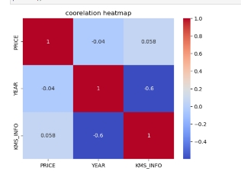
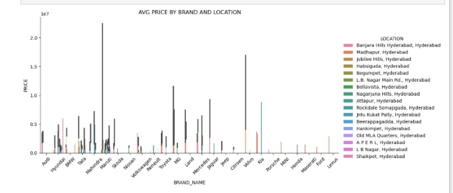
MULTI VARIATE PLOTS CORREALTION
COREALTION HEATMAP ON YEAR , PRICE , KMS
CATPLOT ON BRAND AND LOCATION

Slide 16
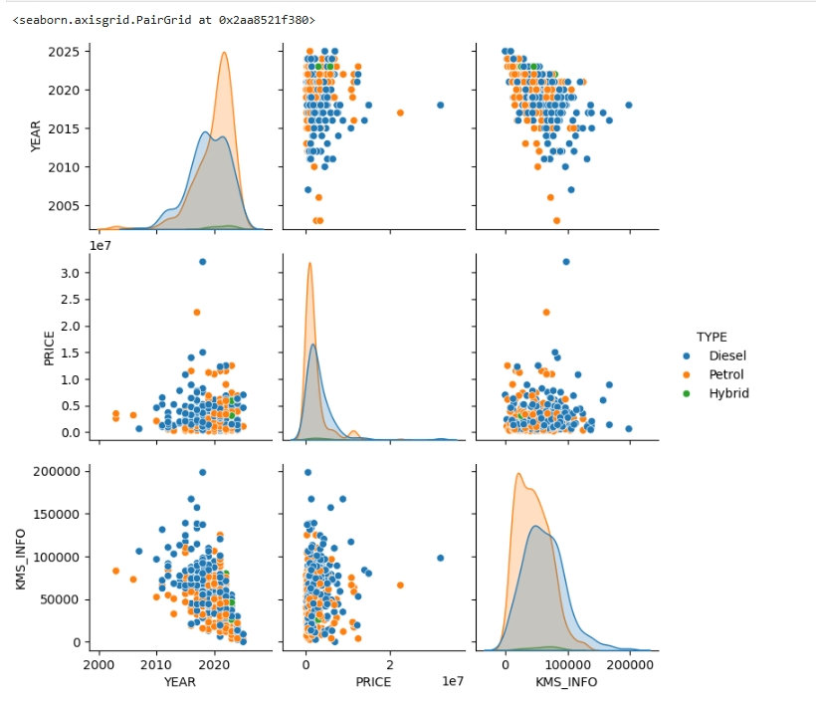
MULTI VARIATE PLOTS CORREALTION

Slide 17
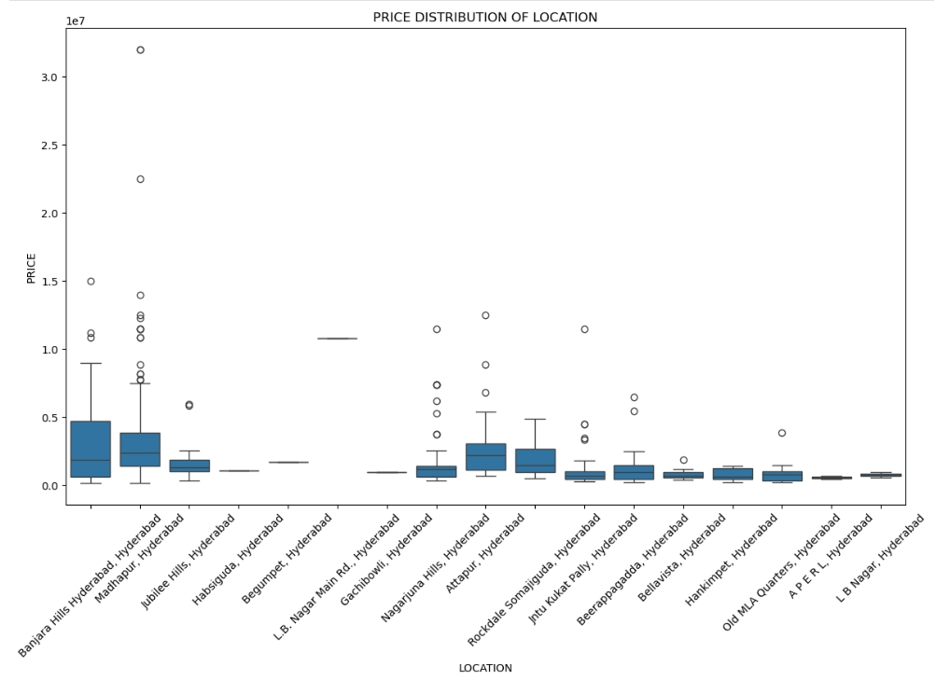
MULTI VARIATE PLOTS CORREALTION

Slide 18
KEY BUSINESS INSIGHTS
Recent-year cars command higher resale value.
Brand and location heavily impact price variation.
Diesel cars show slightly higher prices compared to petrol models.
High-end brands (BMW, Audi, Mercedes) are clear outliers in price distribution.

Slide 19
CONCLUSION
Web scraping helped gather real-world data on used cars.
EDA revealed key trends in brand, pricing, and car conditions.
Data-driven insights can aid in better decision-making for buyers and sellers.
Overall, this project demonstrates how Python-based data scraping and analysis can uncover actionable insights from unstructured online data.

Slide 20
EXPERIENCE AND CHALLENGES
Handling inconsistent data formats during scraping.
Cleaning and transforming mixed data types.
Managing large HTML data.
Learned advanced data visualization interpretation.

Slide 21

THANK YOU

