Slide 1
VetAssist
VA Benefits & Forms AI Assistant Wilcore Innovation Challenge | April 2026
Understand benefits. Prepare paperwork. Connect with the VA or a VSO.
Prototype only. VetAssist prepares veterans for VA/VSO conversations; it does not make eligibility determinations.

Slide 2
Agenda
1
Problem Why veterans still struggle before the VA adjudication clock starts
2
Solution VetAssist: understand, prepare, connect
3
MVP What is already working in the prototype
4
Impact Expected value, originality, and federal fit
5
Roadmap Implementation path, risks, and Q&A
Demo walkthrough and video-link coverage intentionally omitted from this draft.

Slide 3
Team & Roles
Team roster
TBD: add confirmed names and departments before submission. Also confirm each person is a Wilcore employee, active through May 1, and only on this team.
Product / Story
Problem framing, veteran journey, impact narrative
Backend / AI
FastAPI routes, benefit discovery, rules fallback, Claude integration
Forms / Data
VA form catalog, field prefill, source-document mapping
UX / Accessibility
Task flow polish, prototype notice, Section 508 path
Recommendation: keep contribution notes in this deck once the roster is final so judges can see collaboration directly.
Source: repository docs and challenge checklist. Actual team metadata was not present in the project files.

Slide 4
Problem / Opportunity
Veterans are slowed down before the claim even starts.
125+
days: VA threshold for a backlogged claim
141.5
days average processing time in Jan. 2025
• No single entry point explains which benefits are worth exploring for a specific veteran.
• Forms require repeated name, SSN, service dates, branch, address, and condition details.
• Many useful source documents are paper records, scans, or flat PDFs, not structured data.
• Incomplete or wrong-form submissions can delay an already high-stakes benefits process.
~80
days reported after VA processing improvements in early 2026
1M+
VA disability claims processed annually
VetAssist targets the preparation gap before adjudication: knowing what to pursue, what forms to use, and what information is missing.
Sources summarized from README: VA.gov press room, VA FY2023 Benefits Report. Current claims should be verified before final submission.

Slide 5
Before: The Painful Journey Today
Suspects benefits exist
A veteran thinks help may be available.
Searches VA.gov / Google
Finds programs, pages, and PDFs without a guided path.
Downloads forms
May face a long PDF or paper-first process.
Re-enters data
Same identity and service data across 3-5 forms.
Submits and waits
Wrong or incomplete packages can create delay.
If incomplete
Rejected, corrected, resubmitted, or delayed before real review can begin.
If correct
Claim enters VA adjudication; VetAssist does not claim to shorten this official review.
Copied conceptually from README Diagram 1: the confusion is upstream of VA adjudication.

Slide 6
Solution: Understand, Prepare, Connect
Understand
Reads a profile or self-entered information and surfaces benefits worth exploring in plain language, with VA.gov links and VSO guidance.
Prepare
Matches benefits to VA forms, prefills known fields, flags gaps, and suggests source documents such as a DD-214 for missing values.
Connect
Creates a reviewable preparation package and points veterans to VSO/VA next steps. The veteran verifies every value; the VA decides.
The differentiator is the combined session: discovery + form matching + prefill + document vision + conversational gap filling.
Framing used throughout: “worth exploring,” never “eligible.”

Slide 7
Before / After User Journey
Before VetAssist
With VetAssist
Guess benefit
Load or enter profile
Search pages
See benefits worth exploring
Find long PDFs
Review matched forms
Re-type data
Scan docs + confirm fields
Hope package is complete
Bring package to VSO/VA
Hours or days of confusion
Target: under 30 minutes
Copied conceptually from README Diagram 3.

Slide 8
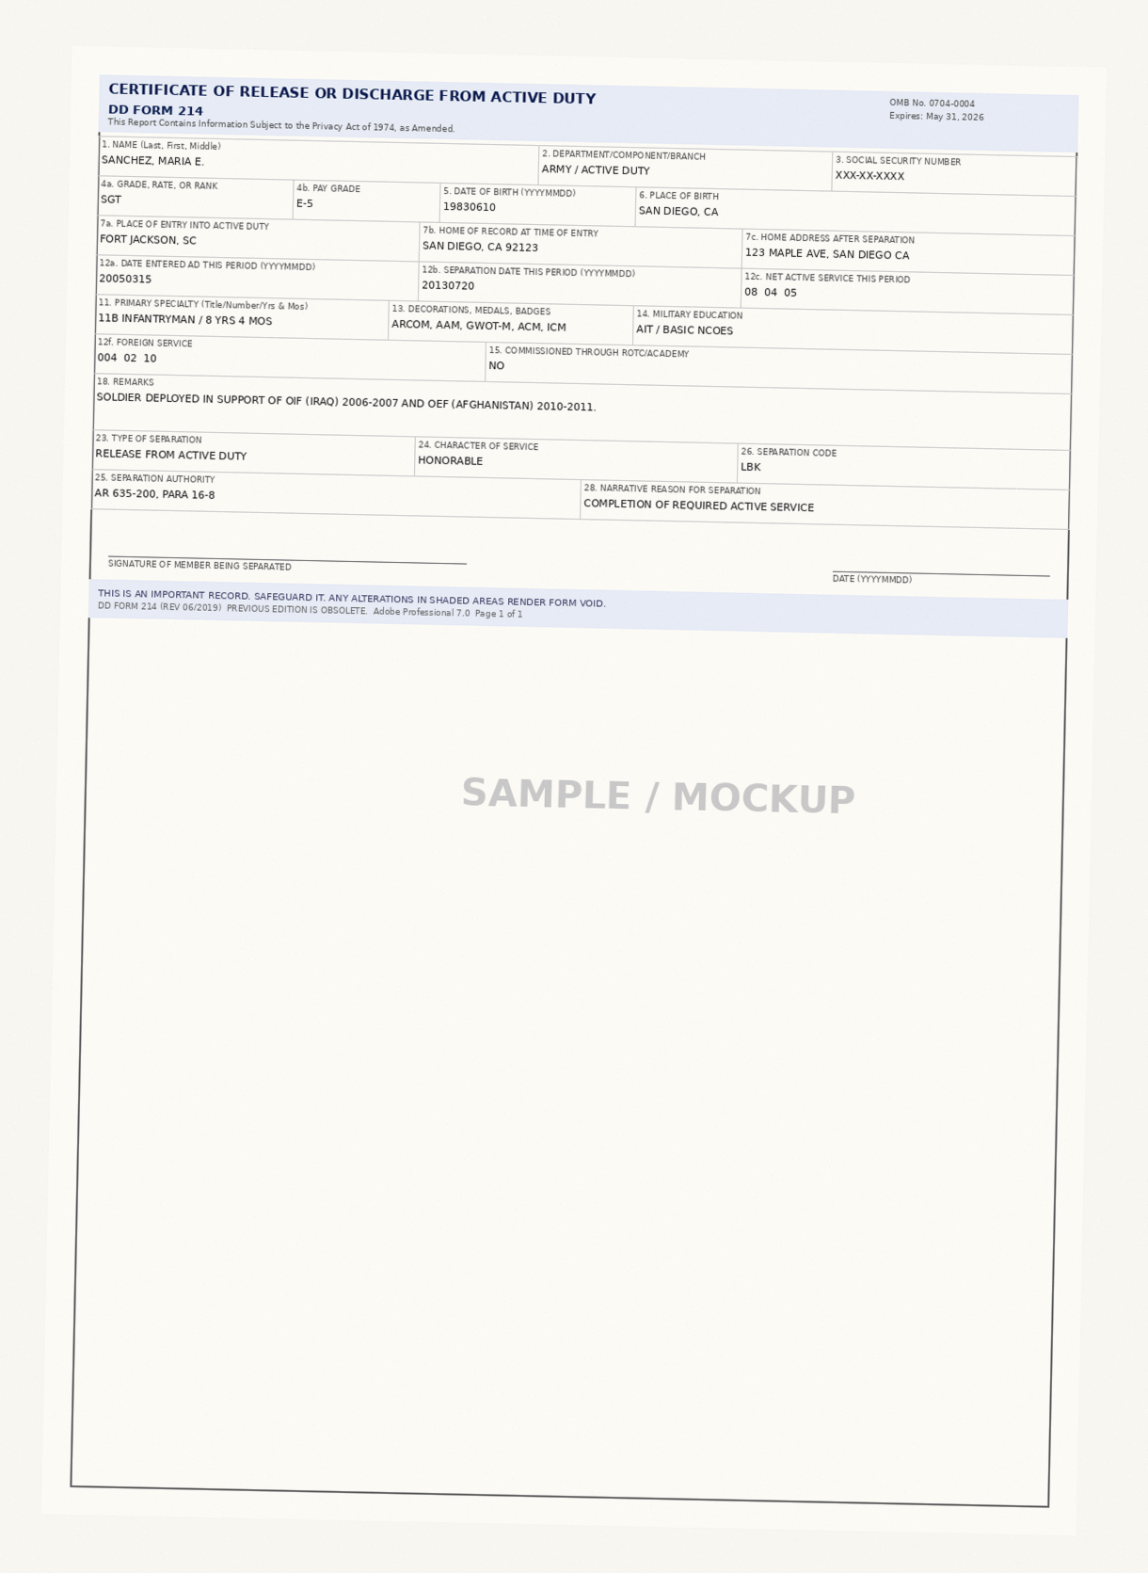
What Is Real In The MVP
Profile paths
3 synthetic demo profiles, manual entry, and Step 1 document scan with API key
Benefit discovery
Claude-first when configured; deterministic rules fallback without an API key
Forms + prefill
5 VA forms, 16-34 fields each, with required flags and source-document hints
Document vision
Claude reads DD-214 / 21-4142 photos and returns fields for veteran review
Output package
ReportLab PDF cover page + field summary; not XFA-filled official forms
Synthetic DD-214 mockup used for document photo-to-prefill testing.
Source: README, CLAUDE.md, data/forms_catalog.json, services/document_vision.py, services/pdf_generator.py.

Slide 9
MVP Architecture
Browser
templates/index.html vanilla JS, no build step
FastAPI
main.py profile, benefits, forms, upload, chat, PDF
Services
benefit_discovery form_matcher document_vision claude_chat pdf_generator
Data
JSON catalogs synthetic veterans branch contacts
Claude
Optional API text + vision rules fallback if unavailable
JSON → database
PostgreSQL or DynamoDB when persistence matters.
Anthropic → Bedrock
Federal-ready model runtime path; SDK change, not a rewrite.
Local → GovCloud
AWS GovCloud + FISMA/FedRAMP authorization path.
Copied conceptually from README Diagrams 4, 5, and 7; implementation details verified in service files.

Slide 10
Impact & Originality
200k
veteran-hours recovered/year if 10% of ~1M annual disability claims save 2 hours
5
VA forms cataloged with field-level metadata and VA.gov links
3
profile entry modes: demo, manual, document scan
1
guided session instead of disconnected tools
User value
• Veterans spend less time figuring out what to file and what information is missing.
• VSOs receive a clearer starting package instead of scattered forms and memories.
• Wilcore gets a working federal-service prototype aligned with SDVOSB mission and VA modernization.
Why it differs
• VA.gov explains programs but does not combine discovery, prefill, document vision, and chat.
• VA Form Wizard is form-by-form; benefits.gov is broad program lookup.
• A VSO remains essential, but VetAssist makes the appointment more prepared.
Quantification from README: 10% of ~1M annual claims x 2 hours saved = ~200,000 hours. Validate assumptions before final submission.

Slide 11
Federal Applicability
Primary fit
Department of Veterans Affairs benefits intake, VSO preparation, claims package readiness, and “Benefits at First Ask” style service flows.
Privacy
MVP uses synthetic data only. Production would need explicit consent, minimum necessary extraction, encryption, retention limits, audit logs, and PII handling.
Security / compliance
Section 508 accessibility baseline, FedRAMP-authorized hosting/model runtime, FISMA Low/Moderate ATO, and VA identity/login.gov integration.
Wilcore path
SDVOSB background makes the veteran-service mission credible and potentially relevant to VA task-order or pilot conversations.
Sources: README, CLAUDE.md, VA_DESIGN_PRESENTATION_POINTS.md, VA_DESIGN_UI_AUDIT.md.

Slide 12
Feasibility & Roadmap
Today
Local MVP 5-6 developer-days synthetic data no auth/cloud
Weeks 2-4
Hosted app conversation persistence expanded document types Postgres/DynamoDB
Months 2-3
VA Forms API Bedrock Claude swap Section 508 baseline VSO handoff
Months 4-6
VA Benefits API login.gov / VA identity GovCloud path ATO prep
6-9 months
VA pilot 3-4 engineers security/accessibility program sponsorship
Dependencies: VA API access, cloud/security authorization, identity integration, production data model, updated form metadata, and a Wilcore rate-card based cost estimate.
Roadmap derived from README and CLAUDE.md. Dollar cost was not present in project files.

Slide 13
Risks, Mitigations, Q&A
Eligibility precision
Mitigation: “worth exploring” framing, VA.gov links, VSO/VA confirmation on every benefit.
Model/API availability
Mitigation: rules fallback for benefit discovery; clear manual path when document vision lacks an API key.
Form drift / XFA limits
Mitigation: versioned catalog, VA.gov links, summary package instead of unreliable filled XFA PDFs.
PII/security
Mitigation: synthetic MVP; production requires identity, encryption, retention policy, audit logs, FedRAMP/FISMA path.
• One-sentence answer: VetAssist helps veterans understand benefits worth exploring and prepare the right paperwork before meeting the VA or a VSO.
• Security answer: the MVP stores no real veteran data; a federal pilot would move model use to an approved environment and add identity, logging, retention, and ATO controls.
• Cost answer: implementation cost needs Wilcore rate-card and pilot-scope decisions; effort estimate is 3-4 engineers over 6-9 months for a VA pilot.
Full Q&A copy is in VetAssist_Presentation_Material.md.

