Slide 1


Karnataka Science and Technology Academy ( KSTA)
Extractive spectrophotometric method for the determination of Oseltamivir phosphate in pure and pharmaceutical formulations
NANDEESHA I M
Ph.D. Scholar
Dr. MANJUNATHA D H
Dept. of Chemistry
Ramaiah institute of technology
Bangalore - 560054
01-02-2019 to 02-02-2019

Slide 2
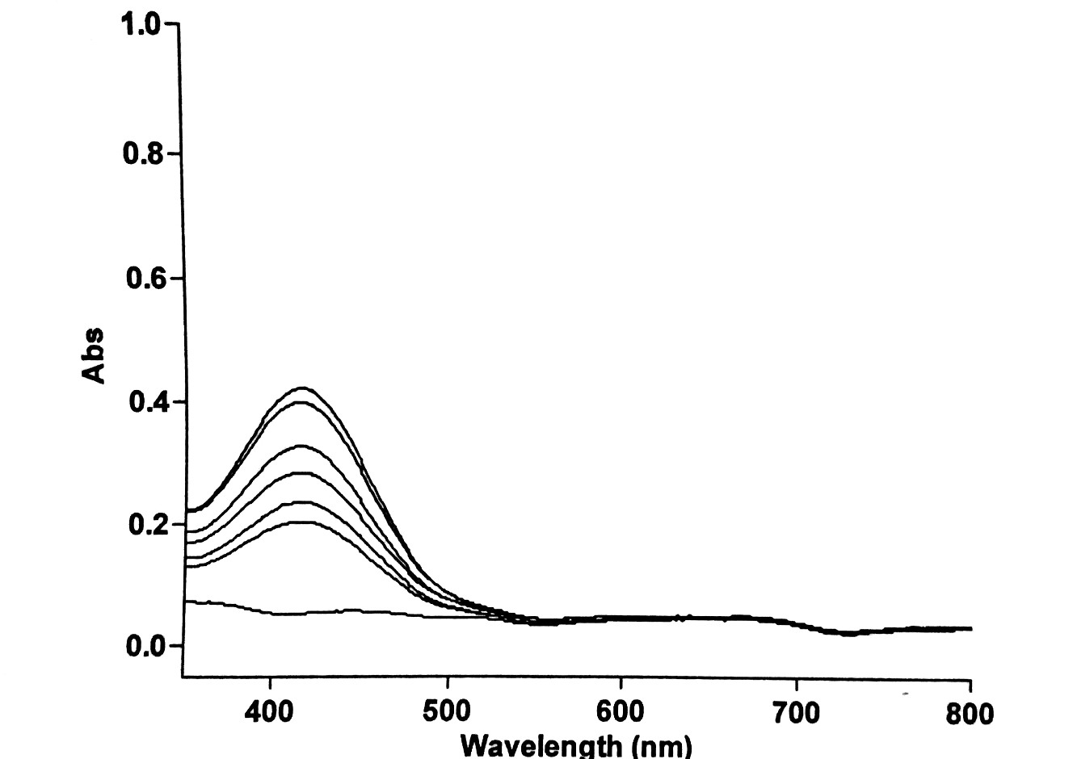
INTRODUCTION
Oseltamivir Phospahte (OP) is an antiviral drug which is used in the healing and prophylaxis of both influenza A and influenza B.
It is efficient and considered as the treatment for the bird flu disease, including pandemic influenza viruses.
OP is the first drug discovered for the inhibition of influenza virus-neruaminidase.
To date there are no spectroscopic methods published for determination of OP in both bulk and formulation.

Slide 3
METHOD:
An aliquot of the solution containing 10-80 g of OP was transferred into a series of 125 mL separating flasks.
A volume of 4 mL of KCl:HCl buffer of pH-2.2 and 0.5 mL of 0.1% BTB was added.
Chloroform (10 mL) was added to each of the separating flask; the contents were shaken well and left at room temperature for a minute.
The two phases were allowed to separate and the chloroform layer was passed through anhydrous sodium sulphate.
The absorbance of the yellow colored complexes were measured at 416 nm against a corresponding reagent blank and the calibration graph was constructed.

Slide 4
RESULTS AND DISCUSSION:
Method optimization was done by different modifications such as change in concentration and volume of dye and different buffers and pH of the acidic buffer.
A linear response was obtained in the concentrations 1.0-8.0 μgmL⁻¹.
The regression co-efficient value is R²=0.997.
The LOD and LOQ were found to be 0.5 µgmL⁻¹ and 1.7 µgmL⁻¹ respectively.
The results of the system suitability tests and the regression statistics assured the adequacy of the proposed UV-Spectrophotometer method for routine analysis of OP.
The percent relative standard deviation (%RSD) values for intra-day precision for drug were shown less than 2%.

Slide 5
Parameters:
Limit of detection (LOD)
Limit of detection (LOQ)
Linearity
Accuracy
Precision
Ruggedness
Robustness
Assay

Slide 6
UV-Visible Overlap spectra

Slide 7
Linearity graph

Slide 8
PARAMETER | OSELTAMIVIR PHOSPHATE
Linear dynamic range µgmL⁻¹ | 1.0-5.0
Slope (b) | 0.046
Intercept (c) | 0.145
Correlation coefficient (r) | 0.997
LOD (µgmL⁻¹) | 0.5
LOQ (µgmL⁻¹ ) | 1.7
% RSD | 0.44

Slide 9
Conclusion
The present study is framed to develop simple, sensitive, rapid and cost effective analytical methods for the assay of OP drug.
The proposed validated method will be compared with Official Pharmacopoeia methods.
The proposed validated analytical methods could be alternative methods for the assay of selected drugs in industries.
The results of the proposed work will be published in reputed peer reviewed international journals.

Slide 10
Selected References
[01] Joseph-Charles J et al., Development and validation of a rapid HPLC method for the determination of oseltamivir phosphate in Tamiflu and generic versions. Jornal of Pharmceutical and Biomediacal Analysis. (2007) 15;44(4):1008-13.
[02] Chourasia A et al., Method Development and validation of oseltamivir phosphate in bulk drug by UV spectroscopy, International Journal of Pharmaceutical and Biological Research, (2011) 2(5):132-136.

Slide 11
THANK YOU..

