Slide 1
Topics to cover
Project option and problem statement
Existing Architecture
Why to migrate to AWS Cloud
Proposed Architecture and components
Benefits after migrating to AWS Cloud

Slide 2
Project Option A: Design and Implement a Cloud Solution
Problem Statement: A start-up education software company has created a knowledge sharing app for students in Australia, the US, and Europe. However, their current on-premises IT infrastructure is not scalable and lacks high availability and resilience. To address these issues, the company needs to adopt a cloud infrastructure that can meet their requirements and provide the necessary scalability and reliability.

Slide 3
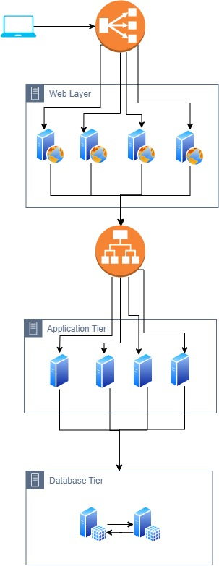
EXISTING Architecture

Slide 4
Why is the customer migrating to AWS?
The customer is facing several issues with their existing business infrastructure, which is based on on-premises IT infrastructure and a Three-Tier application architecture.
The main drawbacks of existing architecture includes:
Scalability
Insufficient availability
Resilience
Limited business continuity

Slide 5
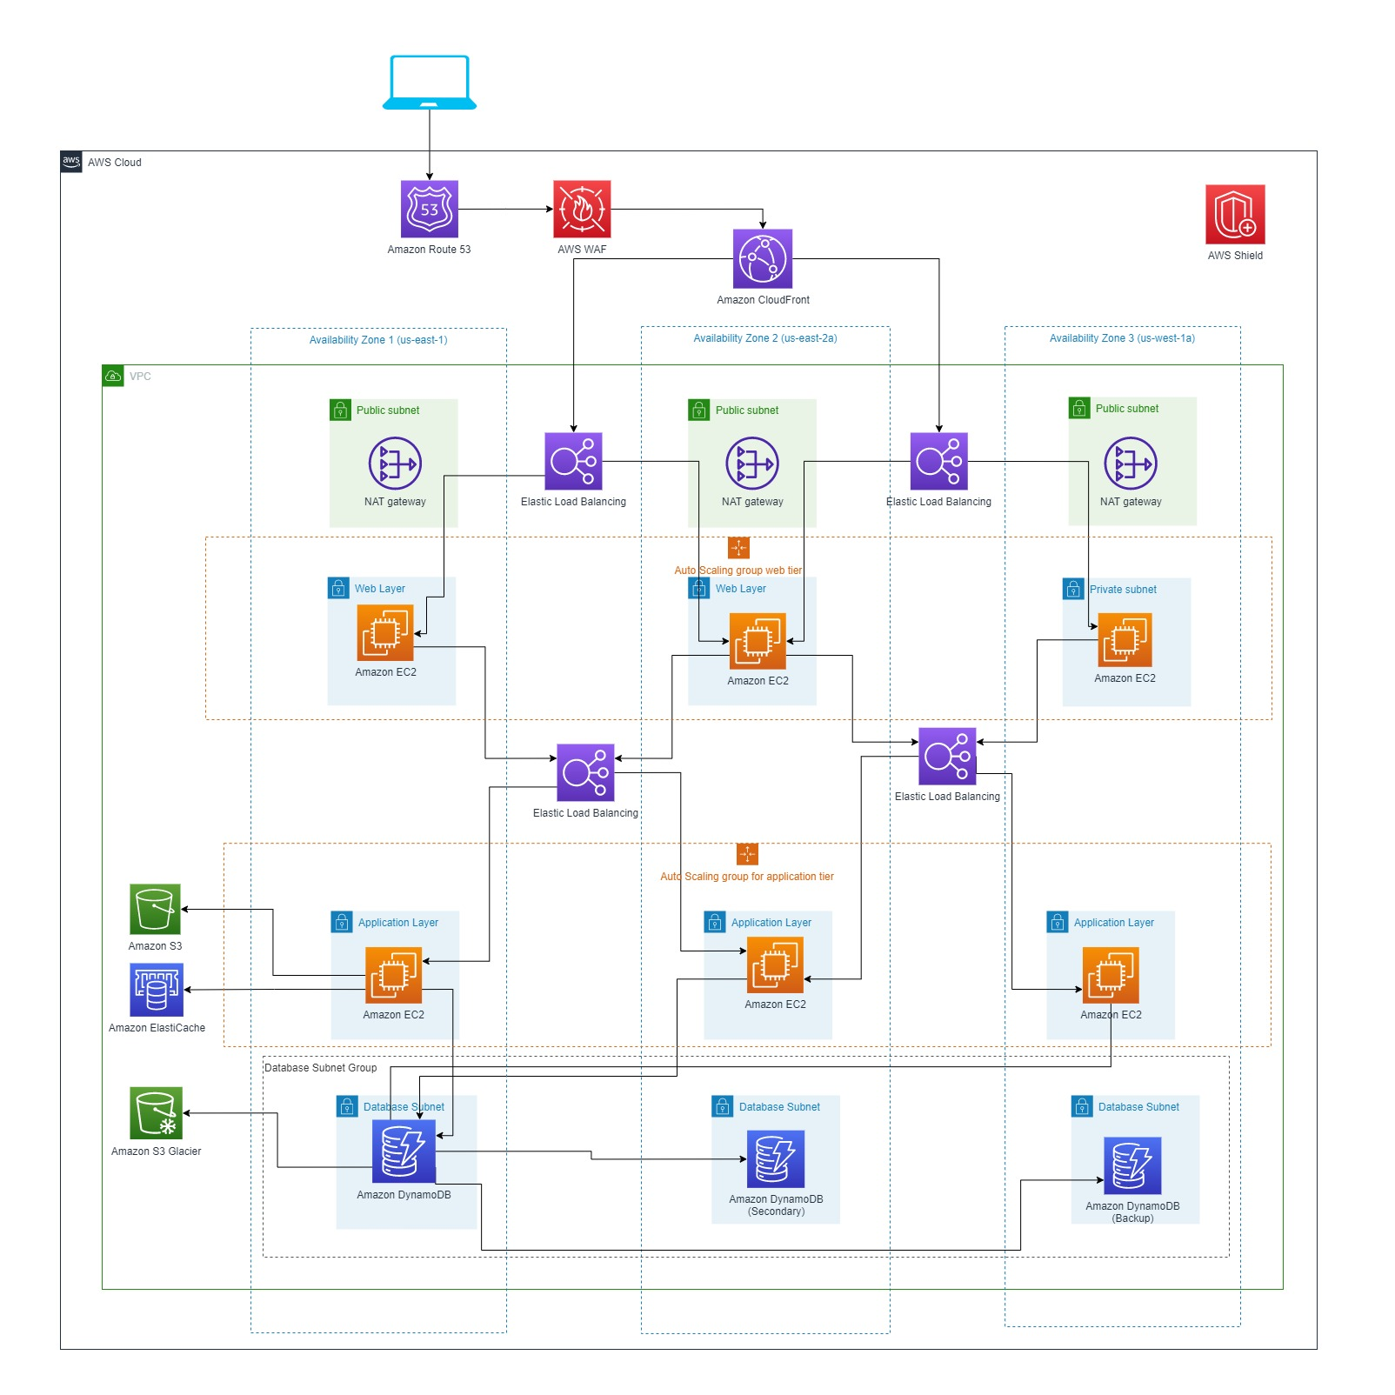
Proposed Architecture (US Region)

Slide 6
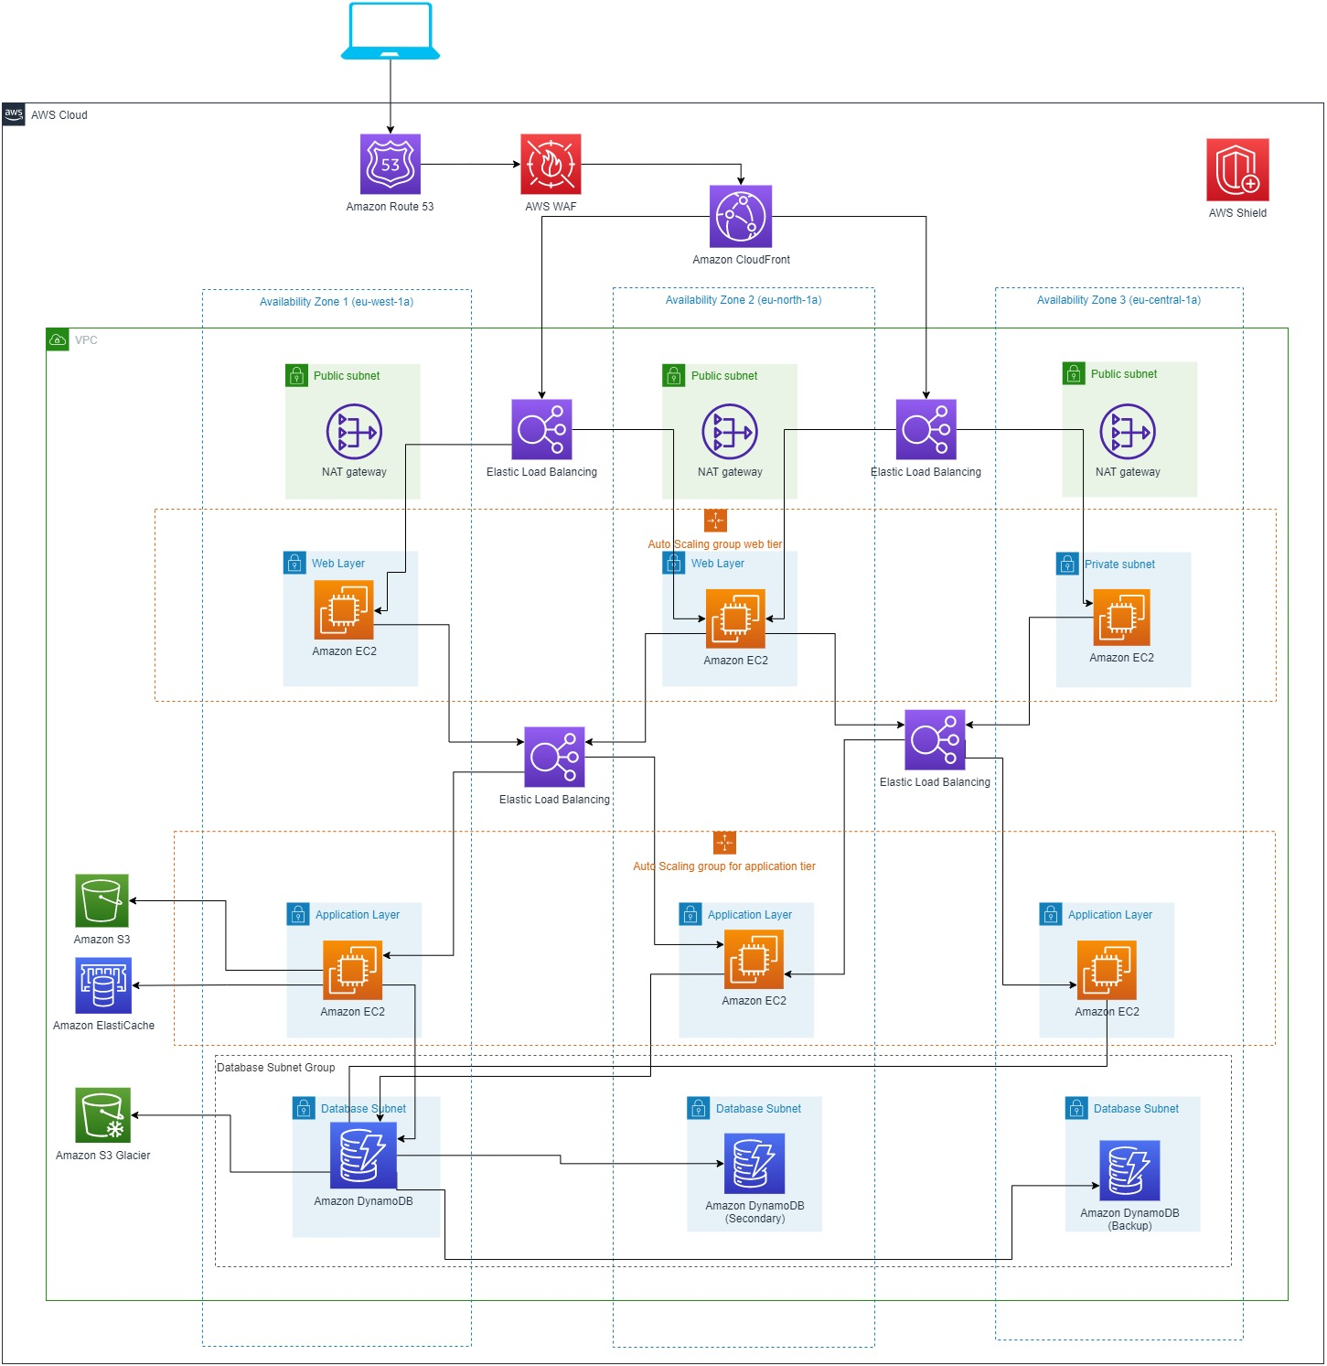
Proposed Architecture (Europe Region)

Slide 7
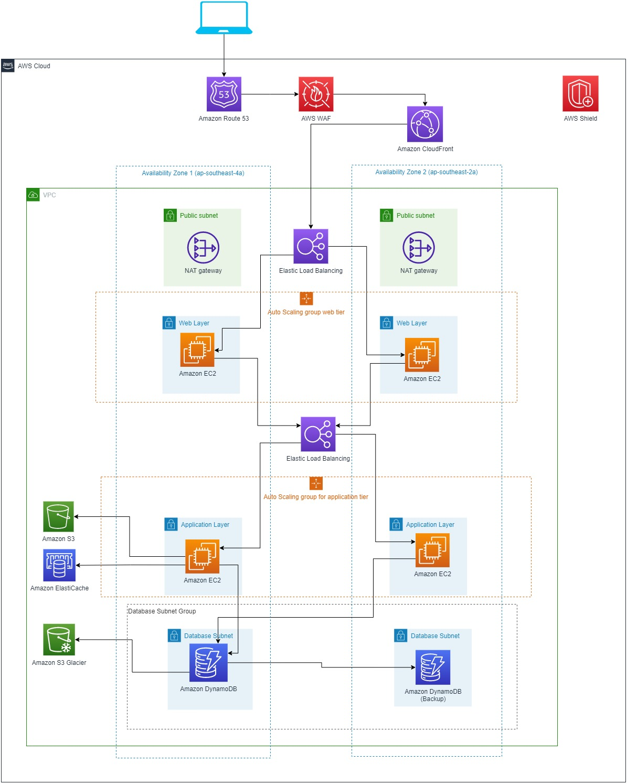
Proposed Architecture (Australia Region)

Slide 8
Components included in proposed architecture
AWS Regions and Availability Zones
Web Application Firewall (WAF)
AWS Shield
Amazon CloudFront
VPC (Virtual Private Cloud)
Availability Zone
Public Subnet
NAT Gateway
Private Subnet
Amazon EC2 (Elastic Compute Cloud
Auto Scaling group
S3 (Simple Storage Service)
Amazon ElastiCache
AWS DynamoDB
Glacier
(As US and Europe has large geographical area it will contain 3 availability zones. Australia will have 2 availability zone.)

Slide 9
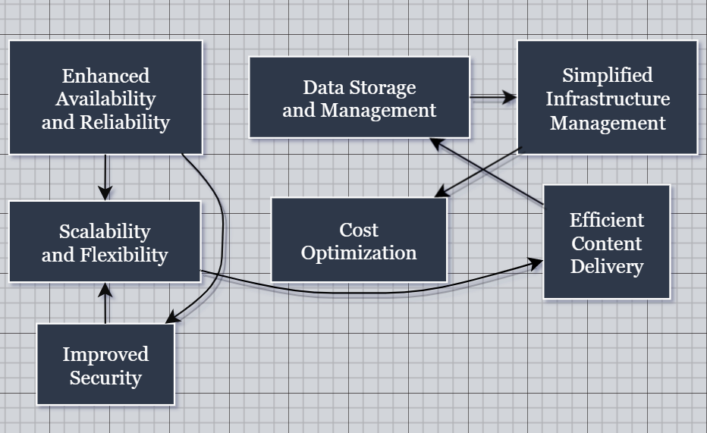
Benefits of proposed solution
We aim to deliver a wide range of benefits and profitability to the customer.
Our cloud architecture not only supports the company's objectives but also enhances profitability and delivers value to the customer.

Slide 10

Thank you! Any Questions & Feedback?

