Slide 1
GenC Mentorship Program
Gaming App Case Study

Slide 2
Gaming App
Introduction:
Gaming App is a popular online fantasy sports platform that allows users to create and manage their own virtual teams based on real-life players from various sports, such as cricket, football, basketball, and more. Users participate in contests by selecting a team of players, who earn points based on their actual performance in real-world matches.

Slide 3
Gaming App Functionalities
User registration and authentication: The app should allow users to register and log in using their email, mobile number.
Profile management: Users should be able to update their personal information, change passwords, and manage their payment methods.
Team creation and editing: Users should be able to create and edit their virtual teams, selecting players based on the available budget and position constraints.
Contest creation and participation: The app should offer various contest formats and allow users to join or create contests with customizable entry fees, prize pools, and rules.
Live match updates and scoring: The app should display live match updates and automatically calculate team scores based on player performance data.
Leaderboard and rankings: Users should be able to view contest leaderboards and their overall rankings based on their team’s performance.

Slide 4
Tools and Technologies
Tools Required
Technology Used
Eclipse & STS
MS Visual Studio Code
Google Devtools
MySQL Workbench
Postman
Angular 13
Spring Boot & Spring Services
Rest APIs
HTML5, CSS3, JS, Bootstrap
MySQL

Slide 5
User Registration Screen
First Name
Last Name
Email
Password
Phone Number
Login
Sign Up

Slide 6
User Login Screen
Username
Password
Forgot password ?
Login
Sign Up

Slide 7
Admin Login Screen
Username
Password
Forgot password ?
Login

Slide 8
Admin Screen
Admin Logo
Total Contest 0
Total Users Joined 0
Total Sales 0
Match Fixtures
Screen for each link in the Left Nav menu
Match Results
Live Match
Users
Point Dist
Players
Teams
Create contest
Change Passwd

Slide 9
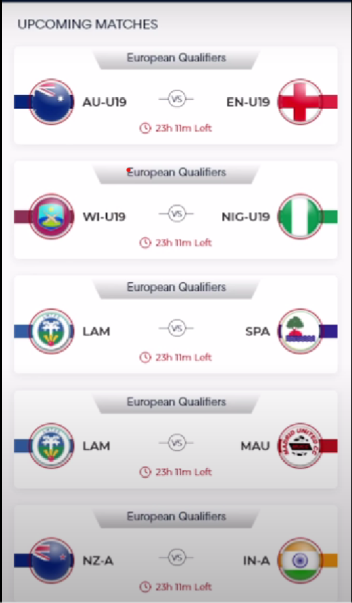

User Landing Screen

Slide 10
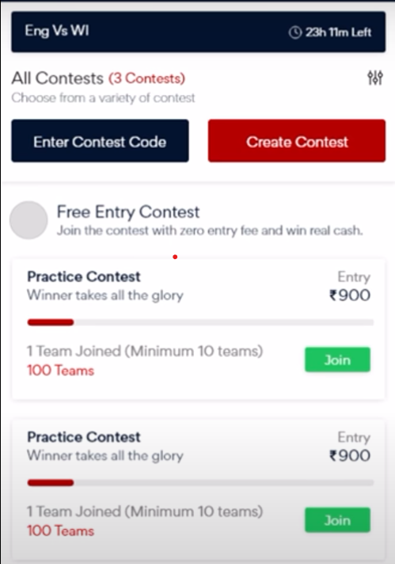
User Screen #2

Slide 11
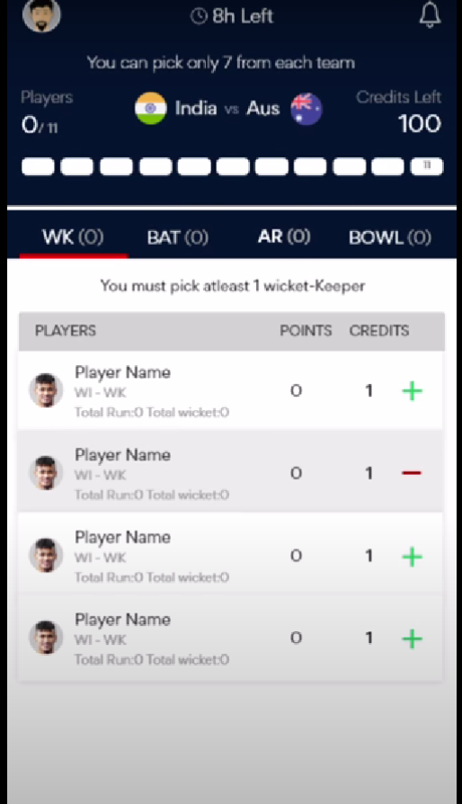
User Screen #3

Slide 12
Sprint #1
User Story # | User Story Name | User Story | Development
US_01 | User Functionality | As an public user I should be able to register to Gaming app | Front end, Backend and DB
US_02 | User Functionality | As an gaming app user I should be able to login to Gaming app | Front end, Backend and DB

