Slide 1


Super-market Sales Data analysis
Key insights from Super-market data
By: Akash C

Slide 2
Overview of Data
Over 1000 observations
Over 15+ features
Goal: Understand customer behavior, sales patterns, and product performance
This dataset captures sales from 3 branches, 3 cities and 6 product categories across 1000+ transactions giving us a strong foundation to spot customer and sales trends.

Slide 3
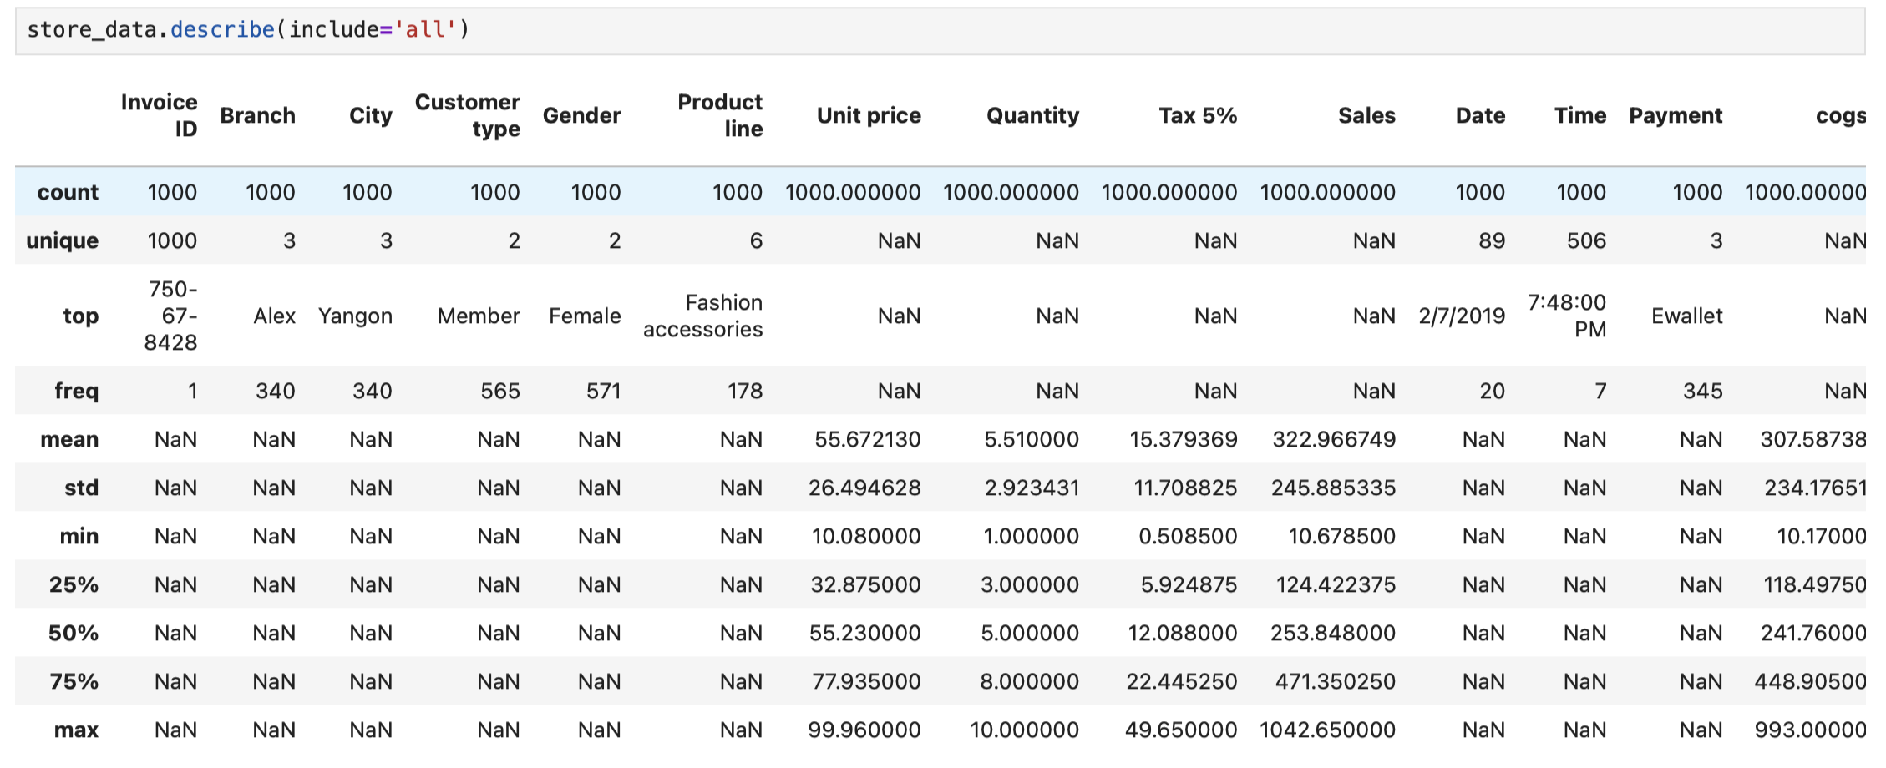
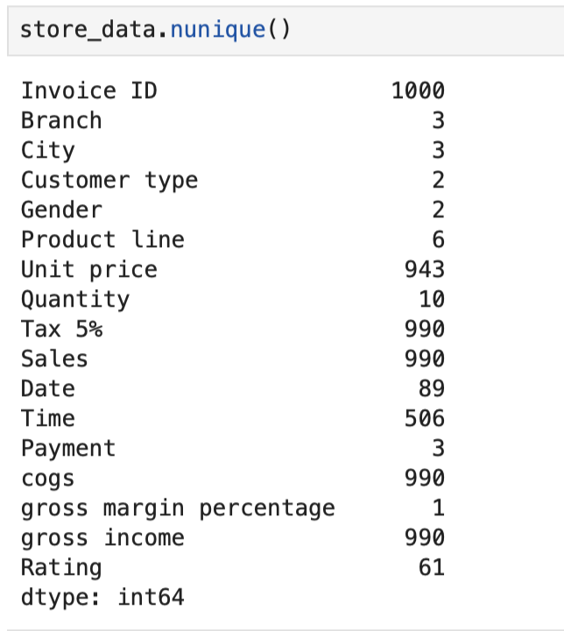
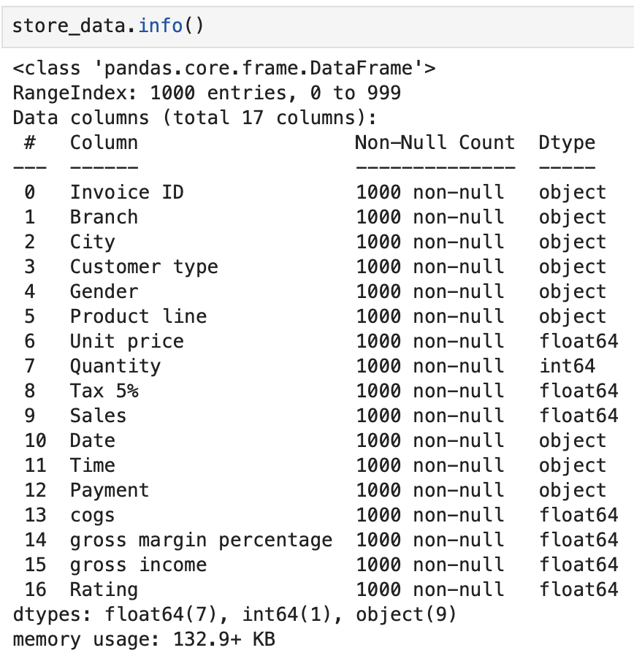
Exploratory Data Analysis
Fig 2
The dataset is complete and it has no NAN data In any features.
All the data types are correctly assigned.
Features like Branch, City, Gender, Product line, Payment, and Customer type has unique values(like Branches: 3, Cities: 3, Product lines: 6, Payment methods: 3).
The dataset is clean and organized, no missing values which means the insights we get from it are reliable.
Fig 3
Fig 4

Slide 4

Data Analysis and Data Visualization

Slide 5
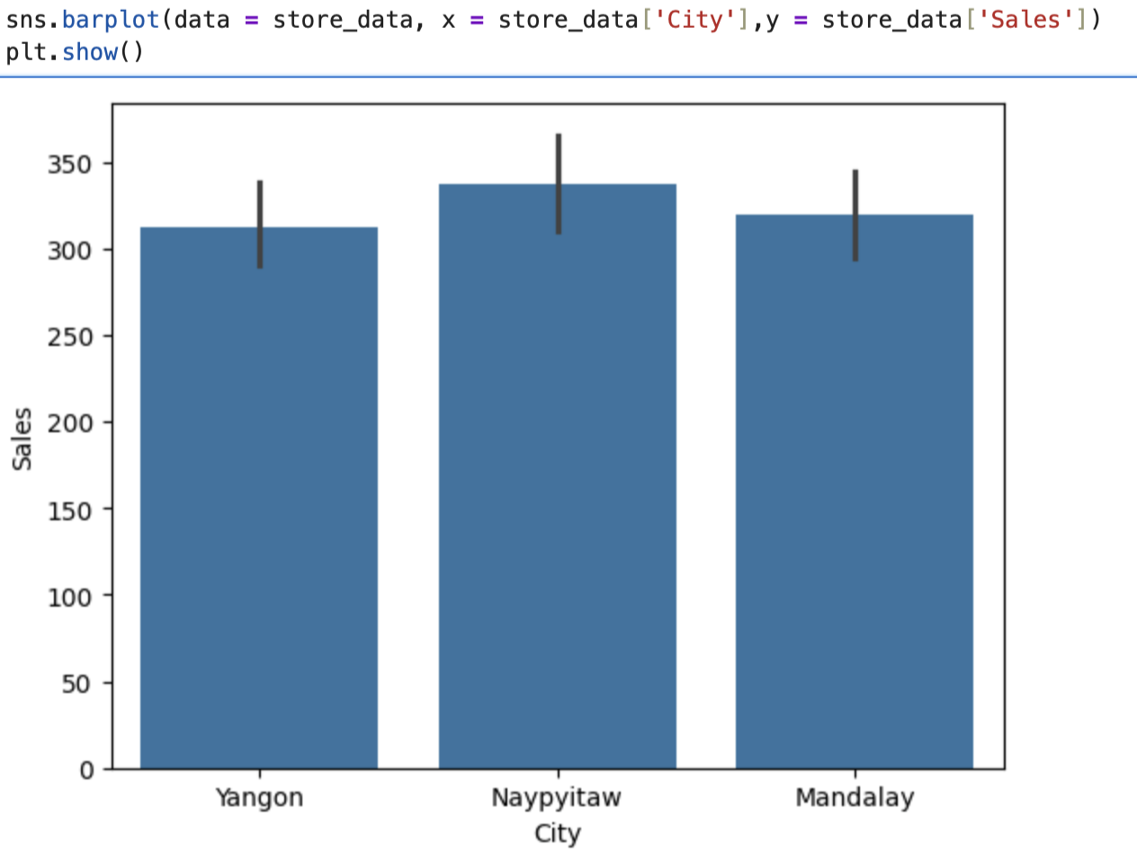
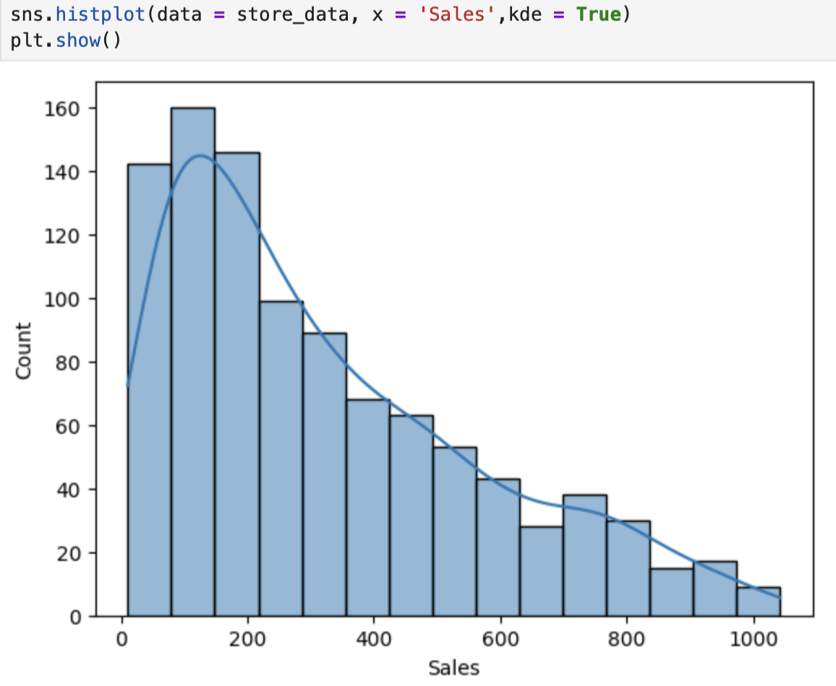
Average Sales by City & Overall Sales Distribution
Insights:
On fig 5, Naypyitaw records the highest average sales of nearly 350, followed by Naypyitaw and Mandalay.
It’s shows that rest of the branches have to increase the sales by doing promotion and offers on products
On fig 6, The overall sales shows that most sales are small around 150-200, few high-value transactions
Most of the buyers are small scale buyers, company have to give extra offers for high buying customers to attract small scale buyers.
Fig 5
Fig 6

Slide 6
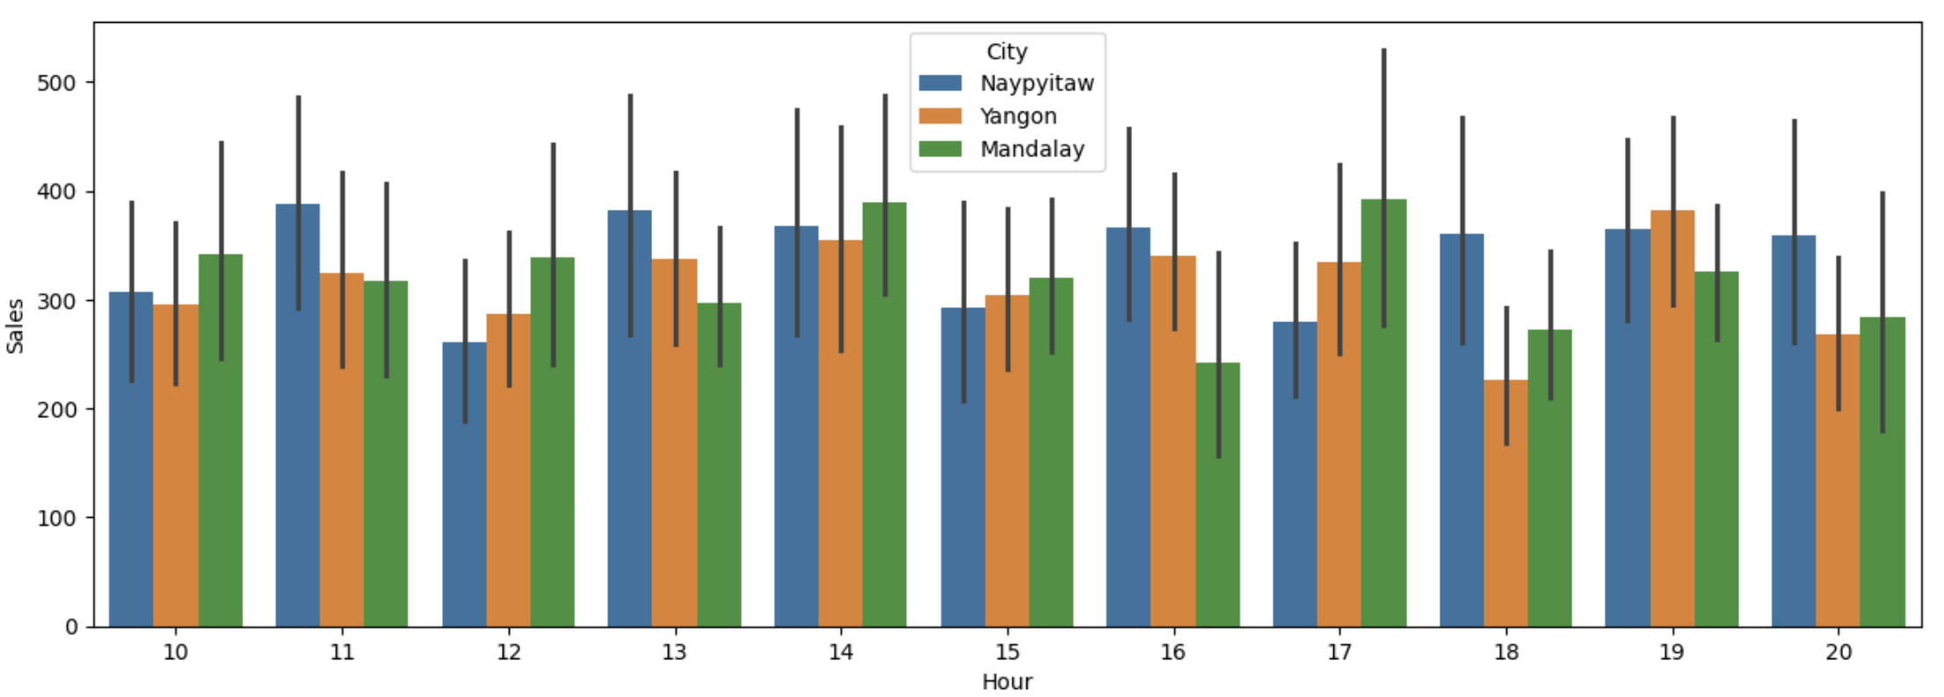
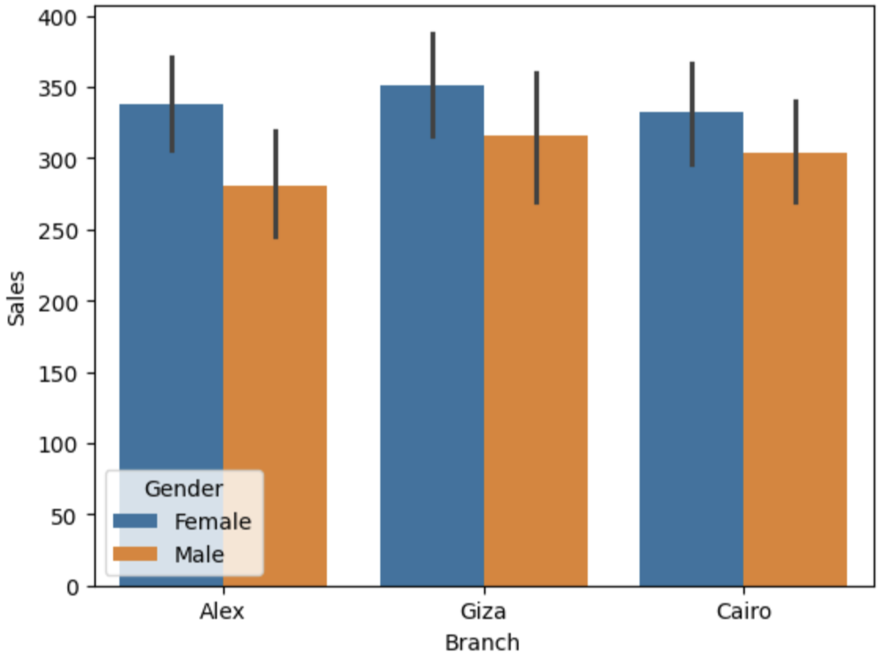
Sales by Hour and City & Gender-wise Sales in Cities
In fig 7, Sales trends vary by hour and city — Mandalay leads overall, especially during afternoon hours. Yangon peaks in the evening, while Naypyitaw performs best mid-day. These patterns offer valuable guidance for location-specific promotions and staffing schedules
In fig 8, Sales trends peak in Gaza, especially females being the highest spenders in all the cities. In terms of male Gaza and Alex is at peak. These patterns says that the potential of targeted campaigns for Female Members has done well.
fig 7
Fig 8

Slide 7
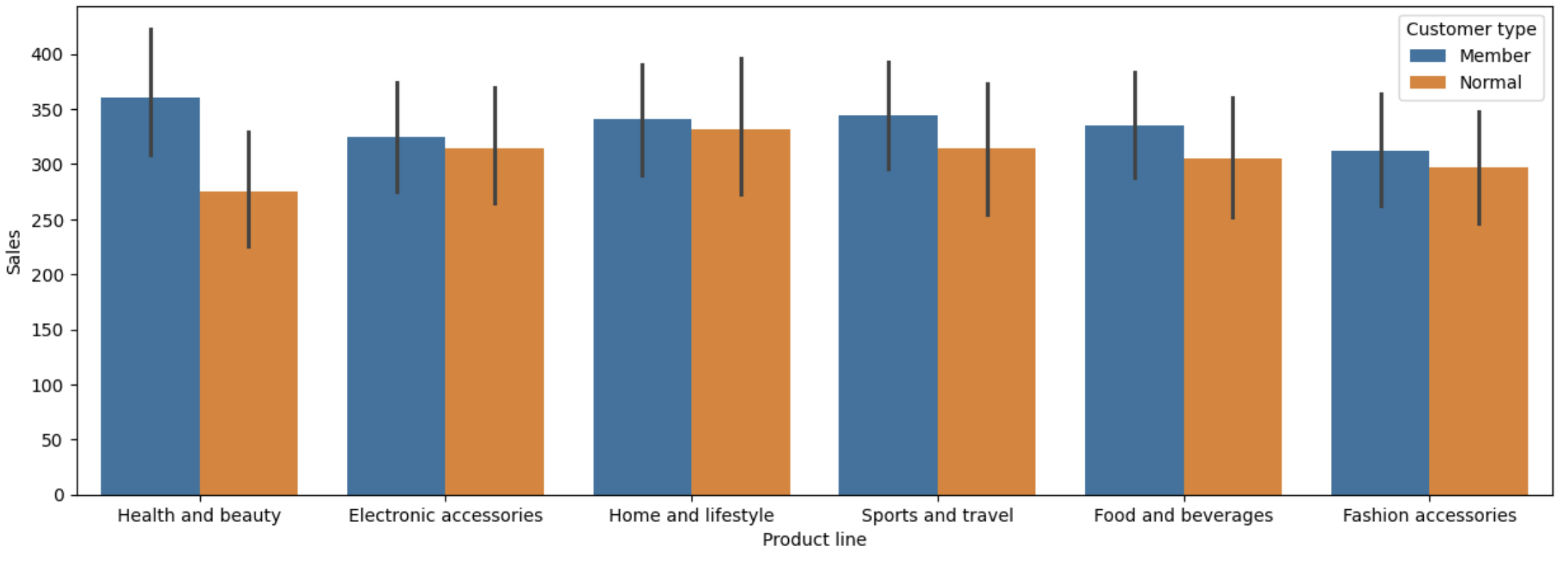
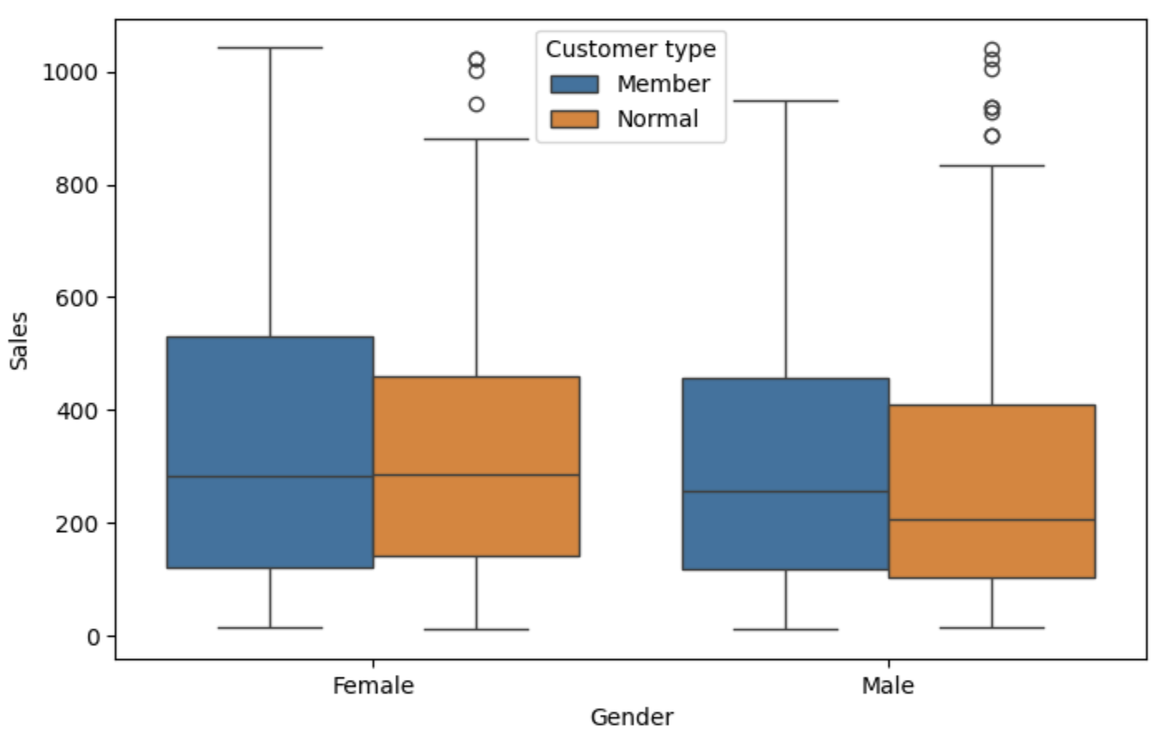
Product Line vs Membership & Gender + Membership Spending
From fig 9, Across all product lines, Members spend more than Normal customers, proving the value of the loyalty program. Health and Beauty stands out as the highest earning category, especially among Members, while Fashion Accessories shows the lowest engagement and may need re-evaluation.
From fig 10, The plot shows that Members consistently spend more than Normal customers, with Female Members being the highest spenders on average. This suggests a strong return on loyalty programs and highlights the potential of targeted campaigns for Female Members
Fig 9
Fig 10

Slide 8
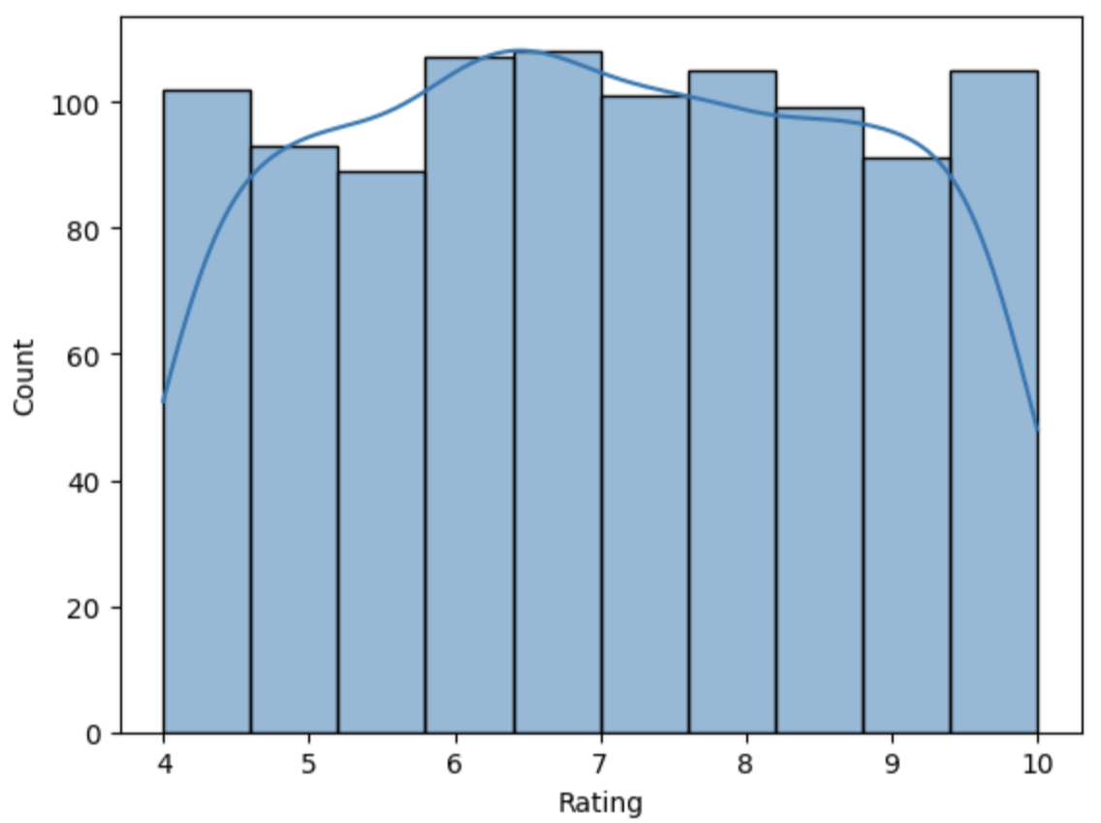
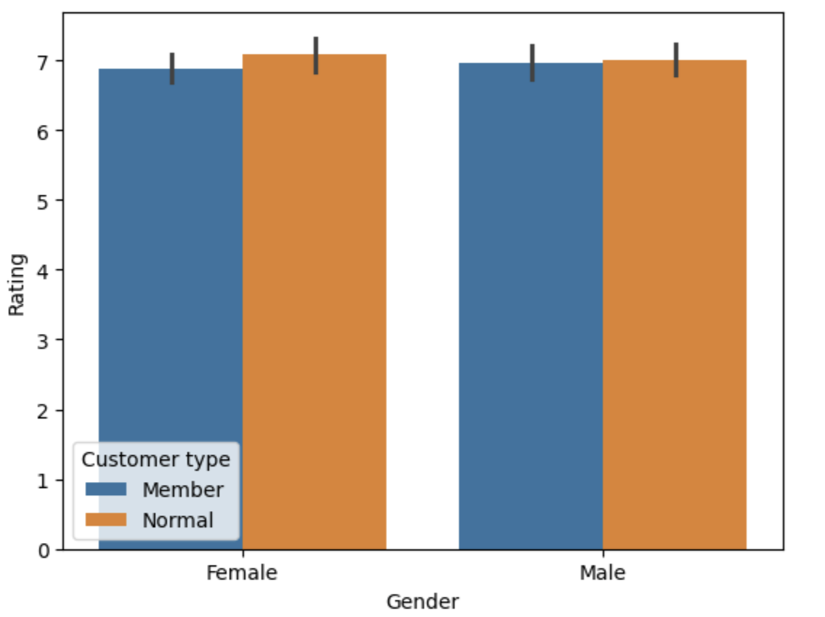
Customer Ratings
In fig 11, Customer ratings follow a nearly normal distribution centered around 7, with very few low ratings. This highlights overall satisfaction and strong customer experience consistency
In fig 12, Customer ratings are consistently positive across all segments, averaging around 7.0. There’s no major difference by gender or membership status, although Normal customers tend to rate slightly higher, suggesting broad satisfaction with service quality.
Fig 11
Fig 12

Slide 9
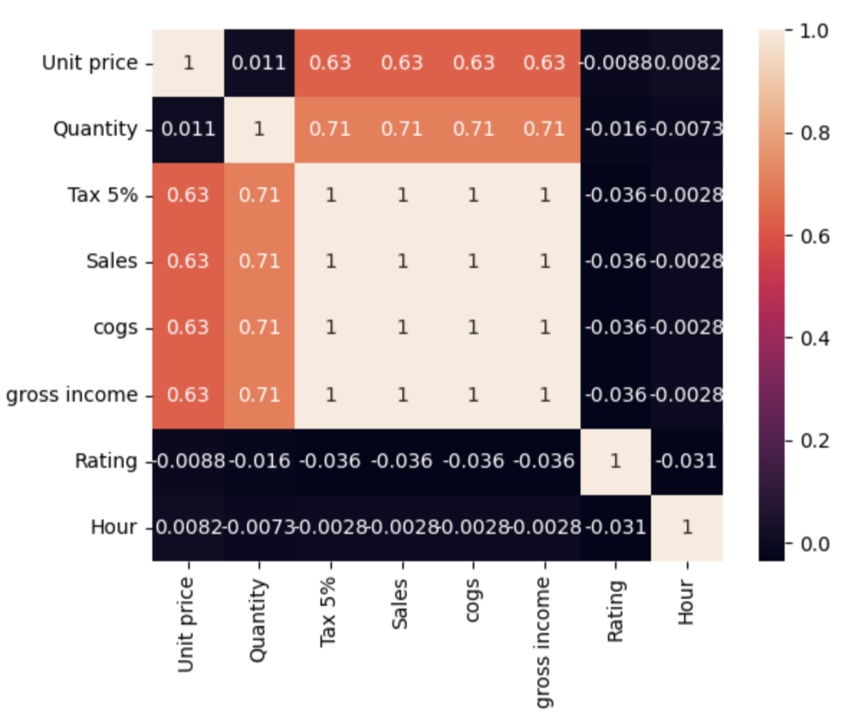
Correlation relationship between each features
The heatmap reveals strong internal relationships among financial metrics (Sales, Tax, Income) and a moderate link between Quantity and Sales. Surprisingly, customer Ratings and Hour of Purchase have little to no correlation with spending or purchase behavior, indicating that satisfaction is independent of sales volume or timing.
Fig 13

Slide 10
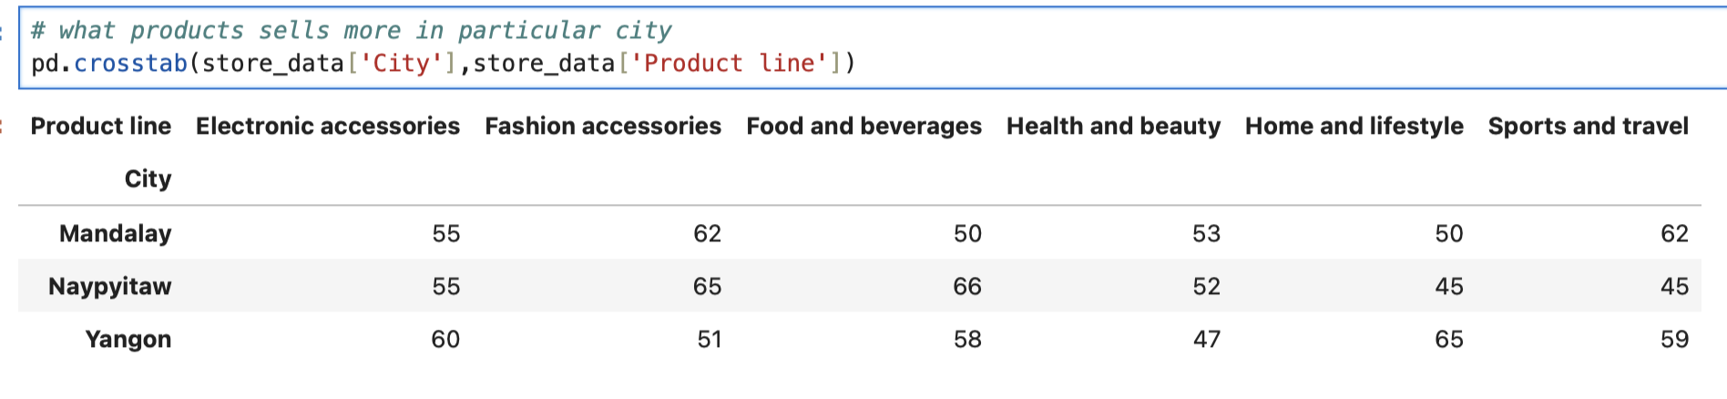
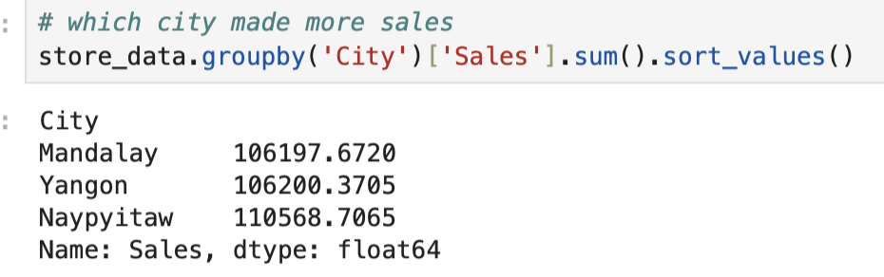
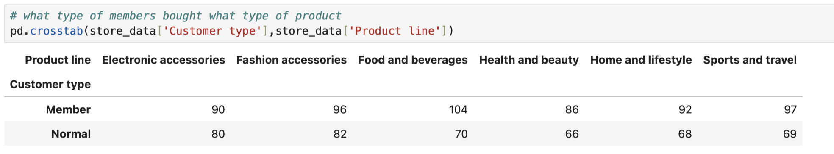
Product Line & City Preferences
In fig 14, Mandalay prefers Sports and Travel, Naypyitaw dominates in Food and Fashion, while Yangon leads in Home and Lifestyle. This emphasizes the importance of city-specific inventory and marketing strategies.
In fig 15, Naypyitaw has the highest sales record, while Yangon has least sales record.
In fig 16, the results shows that members bought food and beverages, Sports and travel stuffs. In terms of normal members bought fashion accessories than other items. This shows the members with loyalty program provides offers which pull them to buy products.
Fig 14
Fig 15
Fig 16

Slide 11
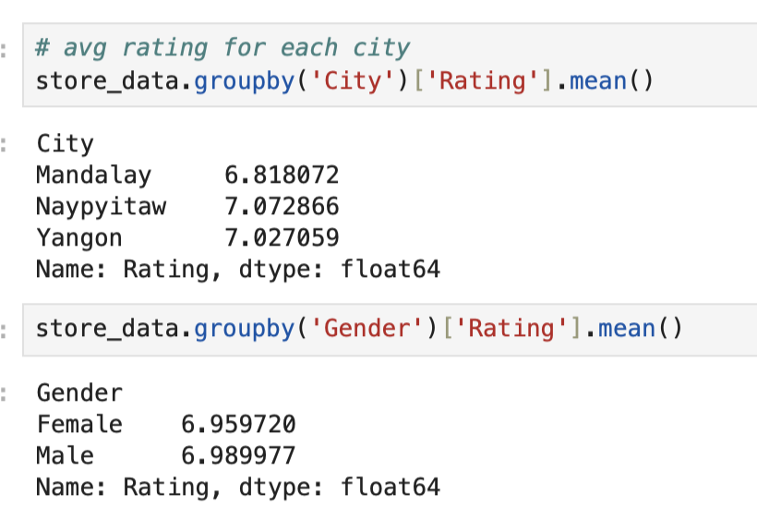
Rating by City
In fig 17, In Naypyitaw city has got good rating than other cities, it’s shows that that particular city providing better customer experience and services for the customer.
In terms of Gender aspect there is not at all difference in average rating, confirming consistent service quality across male and female shoppers.
Fig 17

Slide 12
Conclusion
Members are consistently spend more and buy more quantity than normal members.
Female spends more overall.
Peak shopping happens between 12 PM and 6 PM, especially in Mandalay and Yangon.
Health & Beauty is the top-performing product line, especially among members.
Quantity and Unit Price moderately influence Sales, proving both volume and price drive revenue.
Naypyitaw customers are most satisfied, while Mandalay has slightly lower ratings.
Finally, This analysis highlights how membership, location, and product preference play a major role in revenue and customer satisfaction. A data-driven approach can guide smarter marketing, inventory, and loyalty strategies

