Slide 1
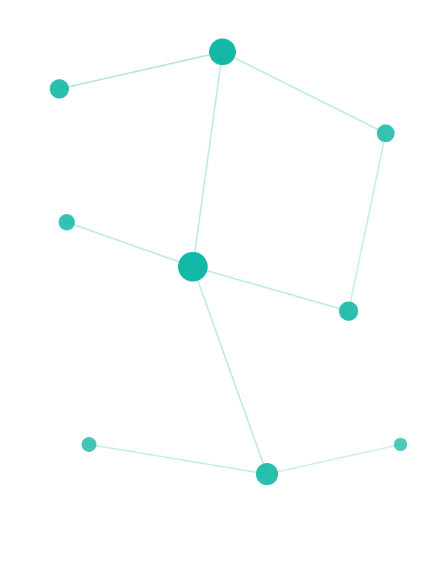
VERIFIED ON STRANDS-AGENTS 1.42.0
Agent-to-Agent (A2A)
When your agents stop working alone
From protocol fundamentals to production on AWS, built on Strands plus Amazon Bedrock AgentCore.
Every code snippet here was run, not recalled. Anchor use case: TravelMind airline support.
Notes:
Set expectations. We built single agents, gave them tools and MCP, then Swarm, Graph and Workflow to make several agents cooperate inside one program. Today we cross the last boundary: agents that live in different processes, frameworks, even companies, talking over a standard wire. Everything in this deck was verified on strands-agents 1.42.0.

Slide 2
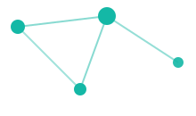
PART 0 · FRAMING
Where A2A sits in your journey
You already built | What it gave you
Single agent + tools | One brain, local capabilities
MCP | A standard socket for tools and data
Agents-as-Tools | One agent calls another, in-process
Swarm | Peers self-organize and hand off, in-process
Graph / Workflow | Deterministic multi-agent pipelines, in-process
A2A (today) | Agents talk across process, framework and org boundaries
The one-line takeaway: every pattern so far lives inside one Python program. A2A is the first one that does not have to. It is the network layer for agents.
A2A · IBS Agentic AI Practitioner Bootcamp
1
Notes:
Anchor the new thing to the known. The key word is in-process. Everything they learned shares one memory space and one runtime. A2A is the network layer for agents.

Slide 3
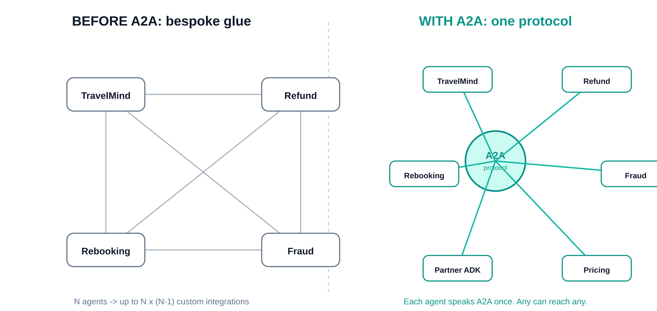
PART 0 · FRAMING
The problem A2A solves: the island
Your TravelMind support agent is brilliant. It still cannot talk to:
the Payments team refund agent (different codebase, different deploy)
a partner airline rebooking agent (LangGraph, not Strands)
a fraud-scoring agent owned by Risk (separate VPC, separate release cadence)
Before A2A: bespoke REST glue for every pair. N agents means up to N×(N−1) custom integrations.
After A2A: one shared protocol. Each agent speaks it once. Any agent can discover and call any other.
Skeptic: “Can I just expose a REST endpoint and call it?” You can, then reinvent discovery, capability description, task lifecycle, streaming and auth for every pair, forever. A2A is that contract, written once by 150+ companies.
A2A · IBS Agentic AI Practitioner Bootcamp
2
Notes:
This is the why-should-I-care slide. The pain is integration sprawl and framework lock-in. Make it concrete with TravelMind plus named teams.

Slide 4
01
Mental Model
One open standard. Three verbs. Four nouns. The cleanest line you will ever draw between MCP and A2A.

Slide 5



PART 1 · MENTAL MODEL
What is A2A, in one breath
An open standard for how AI agents discover each other, exchange messages and coordinate work, regardless of who built them or what framework they run on.
Discover
Communicate
Coordinate
Agents find each other by reading a published Agent Card. No prior arrangement.
One standard message format. Send a request, get a reply, regardless of stack.
Track long jobs, stream progress, hand off work between peers.
The analogy: it is to agents what HTTP is to web servers. Nobody asks what language a website is written in before loading it. A2A makes agents that boring to connect to, on purpose.
A2A · IBS Agentic AI Practitioner Bootcamp
3
Notes:
Keep it to three verbs. If they remember nothing else, they remember discover, communicate, coordinate.

Slide 6


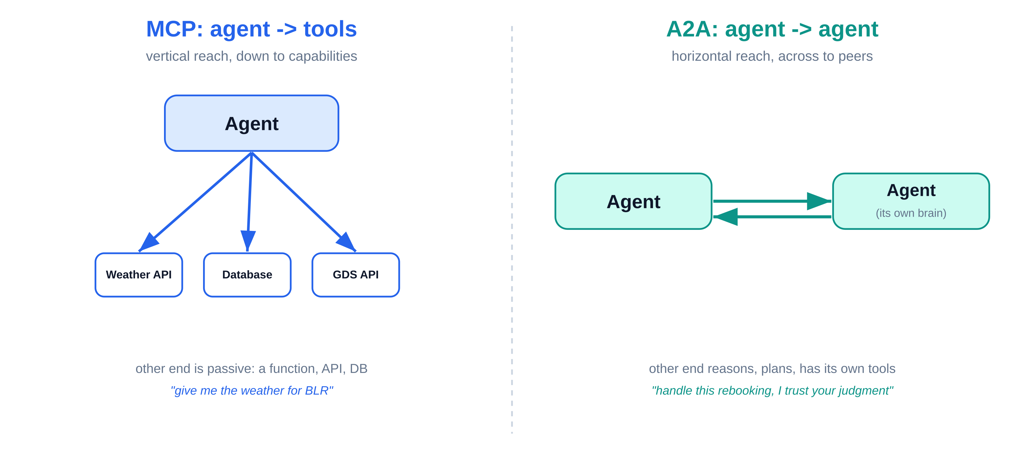
PART 1 · MENTAL MODEL
MCP vs A2A: the cleanest line you will ever draw
MCP | A2A
Connects an agent to tools and data | Connects an agent to other agents
The other end is passive: a function, API, DB | The other end is an agent: it reasons, plans, has its own tools
“Give me the weather for BLR” | “Handle this rebooking, I trust your judgment”
Vertical: agent reaches down to capabilities | Horizontal: agent reaches across to peers
MCP = down to tools
A2A = across to agents
Punchline: they are complementary, not rivals. A real system uses both. Your A2A agent calls peers over A2A and uses its own tools over MCP.
A2A · IBS Agentic AI Practitioner Bootcamp
4
Notes:
This is the single most common confusion. Drill it. MCP is down to tools. A2A is across to agents. AWS positions both as first-class on AgentCore for exactly this reason.

Slide 7

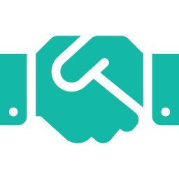
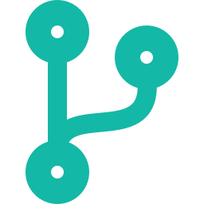

PART 1 · MENTAL MODEL
How A2A became a standard, and why that matters
Apr 9, 2025
Jun 23, 2025
Aug 2025
Mid-2025 on
Google announces A2A with 50+ founding partners.
Donated to the Linux Foundation. LF members include AWS, Cisco, Google, Microsoft, Salesforce, SAP.
IBM's competing ACP protocol merges into A2A.
150+ organizations supporting and growing.
Why governance matters: a protocol owned by one vendor is a lock-in risk. Neutral governance is why AWS, Google and Microsoft can all commit without handing a rival the keys.
Skeptic: “Is this just hype that will fade?” Its largest competitor, IBM ACP, folded into it rather than fight. That is the opposite of a fad.
A2A · IBS Agentic AI Practitioner Bootcamp
5
Notes:
Founders care about lock-in. The ACP merge is the strongest single signal of staying power. AWS being a founding member is why AgentCore support is real, not bolted on.

Slide 8


PART 1 · MENTAL MODEL
The four pillars of A2A
Discovery
Messaging
Coordination
Security
Agents advertise identity and capabilities; others find them. The Agent Card.
One standard format for requests and responses. JSON-RPC 2.0 over HTTP.
Track long-running work, stream progress, hand off tasks. Tasks plus streaming.
Authenticate and authorize every call. OAuth 2.0 or IAM SigV4 in production.
Transport reality: HTTP for the wire, JSON-RPC 2.0 for the message shape. Nothing exotic. Your existing infra already knows how to route, load-balance and secure HTTP.
These four pillars map one-to-one onto the four core objects on the next slide, and onto what Strands gives you for free.
A2A · IBS Agentic AI Practitioner Bootcamp
6
Notes:
These four map directly to the four core objects on the next slide and to what Strands gives you for free.

Slide 9
PART 1 · MENTAL MODEL
The four nouns of A2A
Object | What it is | TravelMind example
Agent Card | JSON metadata: name, capabilities, skills, endpoint, auth | “I am the Rebooking Agent, I speak text, here is my URL”
Message | A single request/response turn (role + parts) | “Rebook PNR JX48Q2 to the next BLR flight”
Task | A long-running unit with a lifecycle and progress | “Process this refund” (minutes, streams updates)
Artifact | The output a Task produces | the refund confirmation plus receipt
Mental shortcut
Card = who you are. Message = a quick exchange. Task = a job you track. Artifact = the job's result.
A2A · IBS Agentic AI Practitioner Bootcamp
7
Notes:
These are the building blocks. Everything in the SDK is just creating, sending or reading these four things.

Slide 10
02
How It Works
The Agent Card, the message-versus-task choice, and the full discover-send-work-return handshake on the wire.

Slide 11
PART 2 · HOW IT WORKS
The Agent Card: an agent's business card
Served at a fixed, well-known path, so discovery needs zero prior arrangement:
GET /.well-known/agent-card.json
Real card from a Strands A2AServer (captured live)
{
"name": "Calculator Agent",
"description": "Basic arithmetic operations.",
"protocolVersion": "0.3.0",
"preferredTransport": "JSONRPC",
"capabilities": { "streaming": true },
"defaultInputModes": ["text"],
"defaultOutputModes": ["text"],
"skills": [],
"url": "http://127.0.0.1:9000/",
"version": "0.0.1"
}
Compatibility note: Strands 1.42 serves the card at /.well-known/agent-card.json (current spec) and /.well-known/agent.json (legacy alias), so older clients keep working.
Why it works: a client that knows only the base URL fetches the card and learns everything else. Note protocolVersion 0.3.0 and streaming:true.
A2A · IBS Agentic AI Practitioner Bootcamp
8
Notes:
The well-known path is the whole trick of discovery. A client that knows only the base URL can fetch the card and learn everything else. Point out protocolVersion 0.3.0 and streaming true.

Slide 12
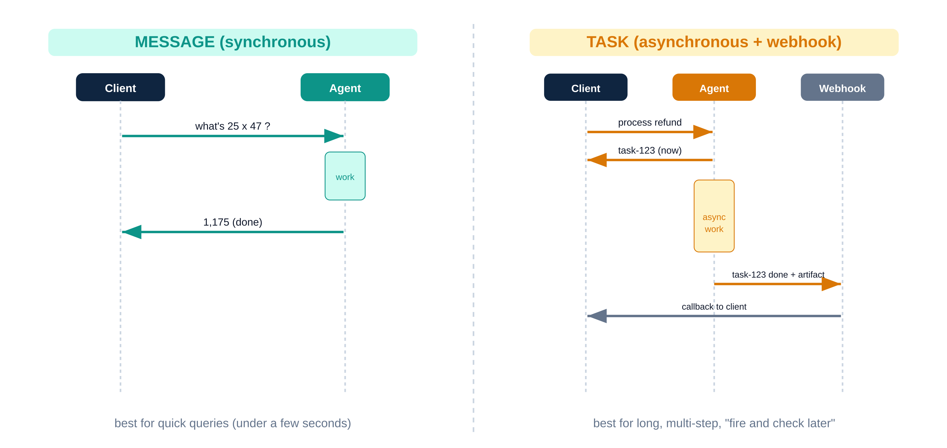
PART 2 · HOW IT WORKS
Message vs Task: synchronous vs async
Message (synchronous)
Client sends, agent processes now, agent returns the answer. Best for quick queries.
“What is 25 × 47?” → “1,175.” Done.
Task (asynchronous)
Client sends, agent returns a task ID immediately, works in the background, then pushes the result to a webhook. Best for long or multi-step work.
“Process this refund” → task-123 → ...work... → webhook: “done + artifact.”
Rule of thumb: under a few seconds, use a Message. Long, multi-step, or fire-and-check-later, use a Task with push notifications.
A2A · IBS Agentic AI Practitioner Bootcamp
9
Notes:
This maps to a real design choice. TravelMind answering what is my baggage allowance is a Message. Rebook me across three carriers is a Task.

Slide 13
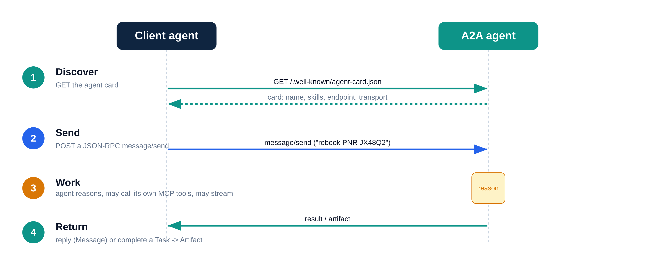
PART 2 · HOW IT WORKS
The full handshake, end to end
1
Discover client GETs /.well-known/agent-card.json
2
Send client POSTs a JSON-RPC message/send
3
Work agent reasons, may call its own MCP tools, may stream
4
Return agent responds, or completes a Task and emits an Artifact
Raw JSON-RPC on the wire (verified format):
{ "jsonrpc": "2.0", "id": "req-001", "method": "message/send",
"params": { "message": {
"role": "user",
"parts": [{ "kind": "text", "text": "what is 101 * 11?" }],
"messageId": "..." } } }
A2A · IBS Agentic AI Practitioner Bootcamp
10
Notes:
This is the what-actually-goes-over-the-wire slide for the advanced folks. The bare-Python folks can ignore the JSON; the SDK writes it for them. Both groups served by one slide.

Slide 14
03
A2A in Strands
Three building blocks, hands-on. Publish a server, consume a peer, and let an orchestrator route. Every snippet runs.

Slide 15
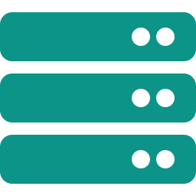

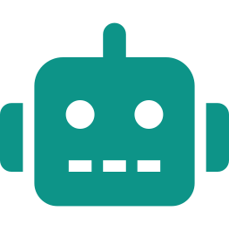
PART 3 · A2A IN STRANDS
Strands gives you three building blocks
A2AServer
A2AAgent
A2AClientToolProvider
Wrap any Strands agent, expose it over A2A. The supply side: you publish.
Call a remote A2A agent as if it were local. The simplest consumer: you name the agent.
Give an orchestrator tools to discover and call A2A agents in natural language. The model names the agent.
Install
pip install 'strands-agents[a2a]' # server + A2AAgent client
pip install 'strands-agents-tools[a2a_client]' # the client tool provider
A2A · IBS Agentic AI Practitioner Bootcamp
11
Notes:
Three things, three roles. Server is you publish. A2AAgent is you call one known agent. ToolProvider is your agent decides which agents to call. The next slides are one per role plus patterns.

Slide 16

PART 3 · A2A IN STRANDS
Build a server in 6 lines (tools become skills, free)
from strands import Agent
from strands.multiagent.a2a import A2AServer
from strands_tools import calculator
agent = Agent(
name="Calculator Agent",
description="Performs basic arithmetic.",
tools=[calculator],
callback_handler=None,
)
A2AServer(agent=agent).serve() # defaults: 127.0.0.1:9000, streaming on
The payoff
Every tool you attach is auto-published as an A2A skill in the card. You do not hand-write skill metadata. Add http_request as a tool, and the card grows an http_request skill automatically.
Why port 9000 matters: this default lines up exactly with what AgentCore expects in production. The server you test on your laptop is already shaped for the cloud. We use this later.
A2A · IBS Agentic AI Practitioner Bootcamp
12
Notes:
Stress the auto-skill behavior, it is the wow of the Strands wrapper. Verified live in 1.42.0. Default port 9000 matters later for AgentCore.

Slide 17

PART 3 · A2A IN STRANDS
Consume a remote agent: A2AAgent
from strands.agent.a2a_agent import A2AAgent
remote = A2AAgent(endpoint="http://localhost:9000")
# 1) Synchronous, call it like a local agent
result = remote("Show me 10 ^ 6")
print(result.message) # {'role':'assistant', 'content':[...]}
# 2) Inspect who you are talking to
card = await remote.get_agent_card()
print(card.name, card.skills)
# 3) Stream the response
async for event in remote.stream_async("Explain quantum computing"):
if event.get("type") == "a2a_stream":
... # protocol event (message / task update)
elif "result" in event:
print(event["result"].message) # AgentResult, emitted last
Gotcha worth its own line
In 1.42.0 the stream yields {"type":"a2a_stream", ...} events, then a final {"result": ...}.
Older blog snippets that read
event["data"] are stale and will silently print nothing. We verified the correct shape by reading the source.
A2A · IBS Agentic AI Practitioner Bootcamp
13
Notes:
This is the fact-check payoff. The official docs example uses event[data]; the real SDK uses this structure. We verified by reading the source. Teach the correct one.

Slide 18
PART 3 · A2A IN STRANDS
Let the orchestrator pick: A2AClientToolProvider
from strands import Agent
from strands_tools.a2a_client import A2AClientToolProvider
provider = A2AClientToolProvider(
known_agent_urls=["http://127.0.0.1:9000"] # optional seed list
)
orchestrator = Agent(tools=provider.tools)
orchestrator("Find an agent that can do math and compute 25 * 47")
It injects exactly three tools into your agent:
Tool | Job
a2a_discover_agent | Fetch a remote agent's card and capabilities
a2a_list_discovered_agents | List everything discovered so far
a2a_send_message | Send a message to a chosen agent, get the reply
What this buys you: the orchestrator reads cards, decides who is fit, and routes, in natural language. Contrast: A2AAgent means you name the agent. ToolProvider means the model names the agent.
Three tools, verified by introspection of strands-agents-tools 0.8.0.
A2A · IBS Agentic AI Practitioner Bootcamp
14
Notes:
This is the dynamic-routing path. Contrast with A2AAgent (you name the agent) vs ToolProvider (the model names the agent). Three tools, verified by introspection.

Slide 19

PART 3 · A2A IN STRANDS
A2AAgent as a tool in your own orchestrator
When you want explicit control, wrap a known remote agent as a normal tool:
from strands import Agent, tool
from strands.agent.a2a_agent import A2AAgent
calc = A2AAgent(endpoint="http://calculator-service:9000", name="calculator")
@tool
def calculate(expression: str) -> str:
"""Perform a mathematical calculation."""
return str(calc(expression).message["content"][0]["text"])
orchestrator = Agent(
system_prompt="Use the calculate tool for any math.",
tools=[calculate],
)
A2AAgent
“I know exactly which agent, and when.” Fixed topology, deterministic routing.
ToolProvider
“Let the model decide.” Dynamic discovery and routing. Pick per use case.
A2A · IBS Agentic AI Practitioner Bootcamp
15
Notes:
Two flavors of consumption now on the table. This one is for when the topology is fixed and you want determinism.

Slide 20
PART 3 · A2A IN STRANDS
A2A inside Strands multi-agent patterns
Pattern | Remote A2A agent supported? | Use it when
As a tool | Yes | Orchestrator calls a fixed remote specialist
Graph | Yes (Python) | A deterministic pipeline with one or more remote nodes
Swarm | No | handoff needs capabilities A2A does not yet expose
The honest caveat: you cannot drop a remote A2A agent into a Swarm today. Swarm handoffs rely on shared tool-based control that the A2A wire does not carry. For remote peers, use Graph or the tool pattern.
Skeptic: “So A2A replaces Swarm and Graph?” No. Those orchestrate agents you own in one process. A2A reaches agents you do not. Different jobs.
A2A · IBS Agentic AI Practitioner Bootcamp
16
Notes:
Manage expectations and prevent a real bug: someone will try A2AAgent in a Swarm. State the limitation plainly. This is verified from the Strands docs.

Slide 21
04
The Big Decision
When A2A is the right call, when it is the wrong one, and how it sits next to everything else in your toolbox.

Slide 22
PART 4 · THE BIG DECISION
Your multi-agent toolbox, all at once
Pattern | Scope | Coupling | Picks the next agent
Agents-as-Tools | One process | Tight | Orchestrator (you)
Swarm | One process | Tight, shared context | Agents themselves
Graph | One process | Explicit edges | The graph (deterministic)
Workflow | One process | Sequential | The pipeline
MCP | Agent → tool | Not agents | You
A2A | Across processes / frameworks / orgs | Loose, over a wire | Orchestrator or model
One sentence: the first five live in your codebase. A2A is the one that crosses the wall.
A2A · IBS Agentic AI Practitioner Bootcamp
17
Notes:
This is the consolidation slide before the decision. Everyone should be able to place all six on one mental map after this.

Slide 23
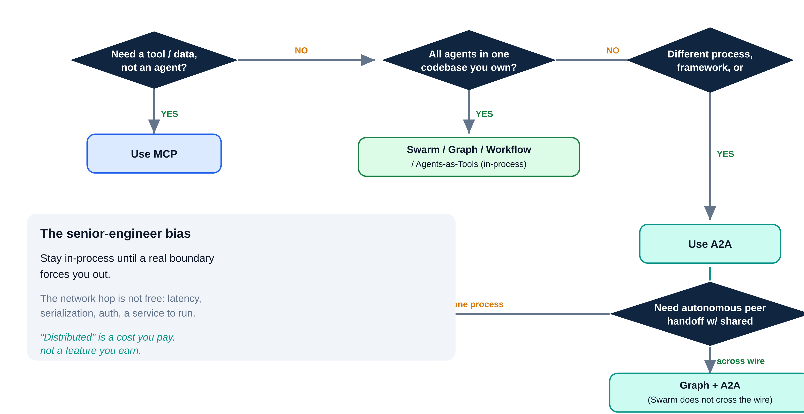

PART 4 · THE BIG DECISION
THE decision: in-process pattern or A2A?
Read it top down
Tool or agent?
Tool → MCP. Agent → keep going.
One codebase you own?
Yes → Swarm / Graph / Workflow / Agents-as-Tools.
Different process / framework / team?
Yes → A2A.
Default bias: stay in-process until a boundary forces you out. The network hop is not free.
A2A · IBS Agentic AI Practitioner Bootcamp
18
Notes:
This is the slide they photograph. The bias line is the senior-engineer takeaway: do not reach for A2A because it is new; reach for it when a real boundary exists.

Slide 24



PART 4 · THE BIG DECISION
When A2A is the right call
Cross-team ownership
Cross-framework
Payments owns the refund agent, Support owns TravelMind. Each ships on its own schedule. A2A integrates them without sharing a repo.
Your Strands agent must call a partner's LangGraph or Google ADK agent. A2A is the only thing they both speak.
Independent lifecycle and scale
Agent marketplace / discovery
The fraud agent gets 100x your traffic and scales alone. Separate deploy, separate autoscaling, one contract.
Add a vendor's agent by URL, read its card, use it. No SDK coupling at all.
Common thread: a boundary you do not control, whether team, framework, deploy or org, sits between the agents.
A2A · IBS Agentic AI Practitioner Bootcamp
19
Notes:
Each card is a real scenario. Tie to TravelMind plus named internal teams to keep it grounded.

Slide 25



PART 4 · THE BIG DECISION
When A2A is the wrong call
One codebase you control
You need a tool, not an agent
Ultra-low-latency or tight shared state
All agents in the same service. A2A adds a network hop, serialization and auth for zero benefit. Use Agents-as-Tools or Graph.
Fetching weather, querying a DB, calling a REST API. That is MCP. Wrapping a passive API as an agent is cargo-culting.
Sub-100ms loops, or agents mutating shared memory every step. The wire kills you. Stay in-process.
The bill you are signing: an extra HTTP round trip, JSON serialization, auth handshakes, a service to operate, and version skew between card and client.
Skeptic: “If A2A is the future, why not use it everywhere?” Because distributed is a cost you pay, not a feature you earn. Microservices taught us this. Same lesson, new layer.
A2A · IBS Agentic AI Practitioner Bootcamp
20
Notes:
This is the slide that separates a thoughtful architect from a hype-follower. This is the pause. Spend time here.

Slide 26
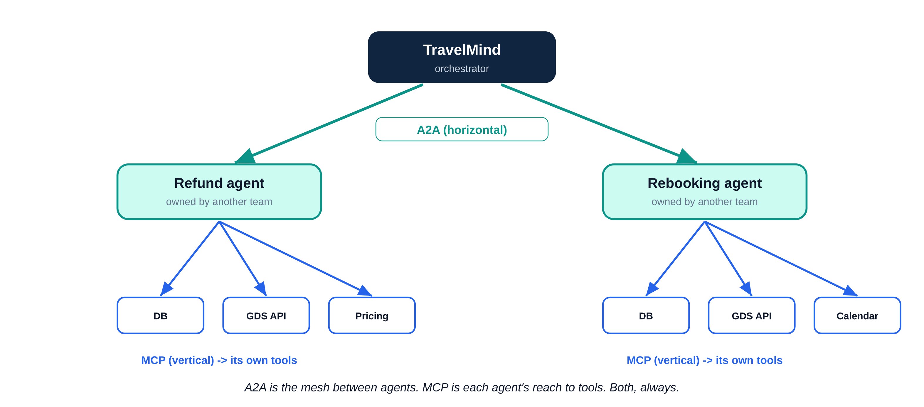

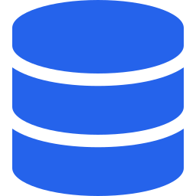
PART 4 · THE BIG DECISION
A2A and MCP together: the real architecture
Horizontal: A2A
The TravelMind orchestrator talks to the Refund and Rebooking agents over A2A, across teams.
Vertical: MCP
Each of those agents internally uses MCP to hit its own database, the GDS API and a pricing service.
Both, always, in a serious system: A2A is the horizontal mesh between agents. MCP is each agent's vertical reach to its tools.
A2A · IBS Agentic AI Practitioner Bootcamp
21
Notes:
Reinforce slide 5 with a concrete combined picture. This is the architecture they will actually build.

Slide 27
PART 4 · THE BIG DECISION
Three quick scenarios, mapped
Scenario | Right choice | Why
TravelMind needs current weather at the destination | MCP tool | It is data, not an agent
TravelMind delegates a refund to the Payments team's agent | A2A | Different team, different deploy
TravelMind has three sub-skills (FAQ, baggage, status) you own | Agents-as-Tools or Graph | One codebase, no boundary
Strands orchestrator must call a partner's LangGraph agent | A2A | Only shared language across frameworks
The rule: same product, four different correct answers. The pattern follows the boundary, not the brand.
A2A · IBS Agentic AI Practitioner Bootcamp
22
Notes:
Pure reinforcement through the running example. If they can do this table cold, they understand the decision.

Slide 28
05
Production on AWS
From localhost:9000 to a managed endpoint. AgentCore Runtime as a transparent proxy, the deploy flow, and the errors that will bite.

Slide 29


PART 5 · PRODUCTION ON AWS
From localhost to production: the gap
Your A2AServer().serve() runs on 127.0.0.1:9000. To put it in front of real traffic you need:
Authentication
Scale and isolation
Discovery at a real URL
Operations
Not “anyone on the network can call it.”
Many concurrent sessions, no cross-talk.
A stable, secured public endpoint.
Logs, retries, lifecycle, error semantics.
You could build all of this yourself.
Or you deploy the same server to Amazon Bedrock AgentCore Runtime and get every line of it managed.
A2A · IBS Agentic AI Practitioner Bootcamp
23
Notes:
Set up AgentCore as the answer to now make it real. This is where their AgentCore training from earlier in the bootcamp pays off.

Slide 30
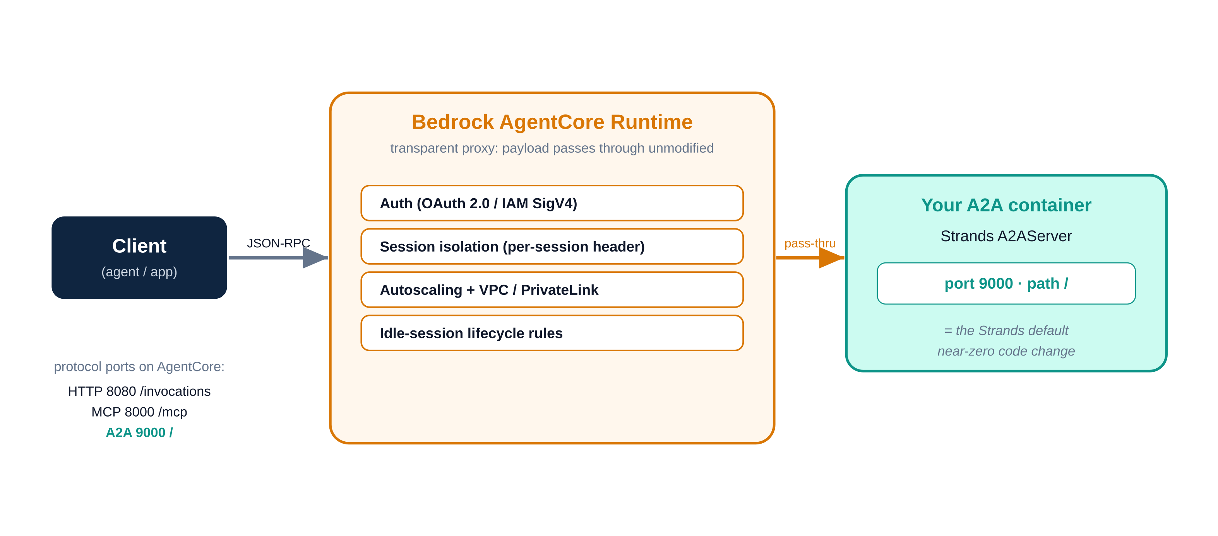
PART 5 · PRODUCTION ON AWS
AgentCore Runtime + A2A: a transparent proxy
Announced Nov 2025: Bedrock AgentCore Runtime natively hosts A2A servers. It acts as a transparent proxy. Your JSON-RPC payloads pass through to your container unmodified, while AgentCore adds auth, scaling and session isolation around them.
The lucky alignment: AgentCore expects an A2A server on port 9000 at root path /. That is exactly the Strands A2AServer default. The server you tested locally is already shaped for production.
client → AgentCore (auth + isolation + scale) → your A2A container (port 9000)
Protocol | Port | Mount path
HTTP | 8080 | /invocations
MCP | 8000 | /mcp
A2A | 9000 | /
A2A · IBS Agentic AI Practitioner Bootcamp
24
Notes:
The port-9000 match is the punchline: near-zero code change from laptop to cloud. AgentCore now hosts MCP, A2A and, since Mar 2026, AG-UI. Three protocols, one runtime.

Slide 31
PART 5 · PRODUCTION ON AWS
The AgentCore-ready server (runs locally too)
import os
from strands import Agent
from strands.multiagent.a2a import A2AServer
from strands_tools.calculator import calculator
from fastapi import FastAPI
import uvicorn
runtime_url = os.environ.get(
"AGENTCORE_RUNTIME_URL", "http://127.0.0.1:9000/")
agent = Agent(name="Calculator Agent", description="Arithmetic.",
tools=[calculator], callback_handler=None)
a2a_server = A2AServer(agent=agent, http_url=runtime_url, serve_at_root=True)
app = FastAPI()
@app.get("/ping")
def ping(): return {"status": "healthy"}
app.mount("/", a2a_server.to_fastapi_app())
if __name__ == "__main__":
uvicorn.run(app, host="0.0.0.0", port=9000)
Two production touches
http_url from the AGENTCORE_RUNTIME_URL env var, so the card advertises the right public URL. /ping health check, and serve_at_root handles load-balancer path prefixes.
Verified: this exact code runs locally. /ping returns healthy and the card serves with protocolVersion 0.3.0. Same artifact ships to AgentCore.
A2A · IBS Agentic AI Practitioner Bootcamp
25
Notes:
This exact code was executed in prep: ping returns healthy, card serves with protocolVersion 0.3.0. The serve_at_root True handles load-balancer path prefixes.

Slide 32

PART 5 · PRODUCTION ON AWS
Deploy it
pip install bedrock-agentcore-starter-toolkit
# requirements.txt:
# strands-agents[a2a]
# bedrock-agentcore
# strands-agents-tools
agentcore configure -e my_a2a_server.py --protocol A2A
agentcore deploy
# returns an ARN:
# arn:aws:bedrock-agentcore:us-west-2:ACCOUNT:runtime/my_a2a_server-xyz123
Auth: configure a Cognito user pool (OAuth 2.0) or use IAM SigV4. AgentCore injects a per-session header (X-Amzn-Bedrock-AgentCore-Runtime-Session-Id) so concurrent callers never bleed into each other.
Newer path: the AgentCore CLI (npm install -g @aws/agentcore) is now AWS's recommended tooling, with hot reload and broader framework support.
One configure, one deploy, an ARN comes back. Session isolation is the multi-tenant safety net.
A2A · IBS Agentic AI Practitioner Bootcamp
26
Notes:
One configure, one deploy, an ARN comes back. Session isolation header is the multi-tenant safety net. Mention both the pip toolkit and the newer npm CLI so they are not surprised by either in docs.

Slide 33
PART 5 · PRODUCTION ON AWS
Production concerns that will bite you
Symptom | Likely cause | Move
403 | Auth method mismatch (SigV4 vs OAuth) | Match the scheme the agent was configured with
404, -32501 | Wrong ARN or path | Re-check the runtime ARN and /invocations URL
400, -32502 | Malformed JSON-RPC | Validate request shape against the spec
429, -32503 | Throttling / quota | Backoff and retry with jitter
424, -32505 RuntimeClientError | Runtime client error | Check CloudWatch logs (you have seen this one)
The trap: A2A returns errors as JSON-RPC error objects with HTTP 200. Do not trust the HTTP status alone. Read the JSON-RPC error.code.
A2A · IBS Agentic AI Practitioner Bootcamp
27
Notes:
The 424 ties directly to the 424 orchestration errors debugged earlier in the bootcamp. Same family. The HTTP 200 with an error body point catches people who only check status codes.

Slide 34
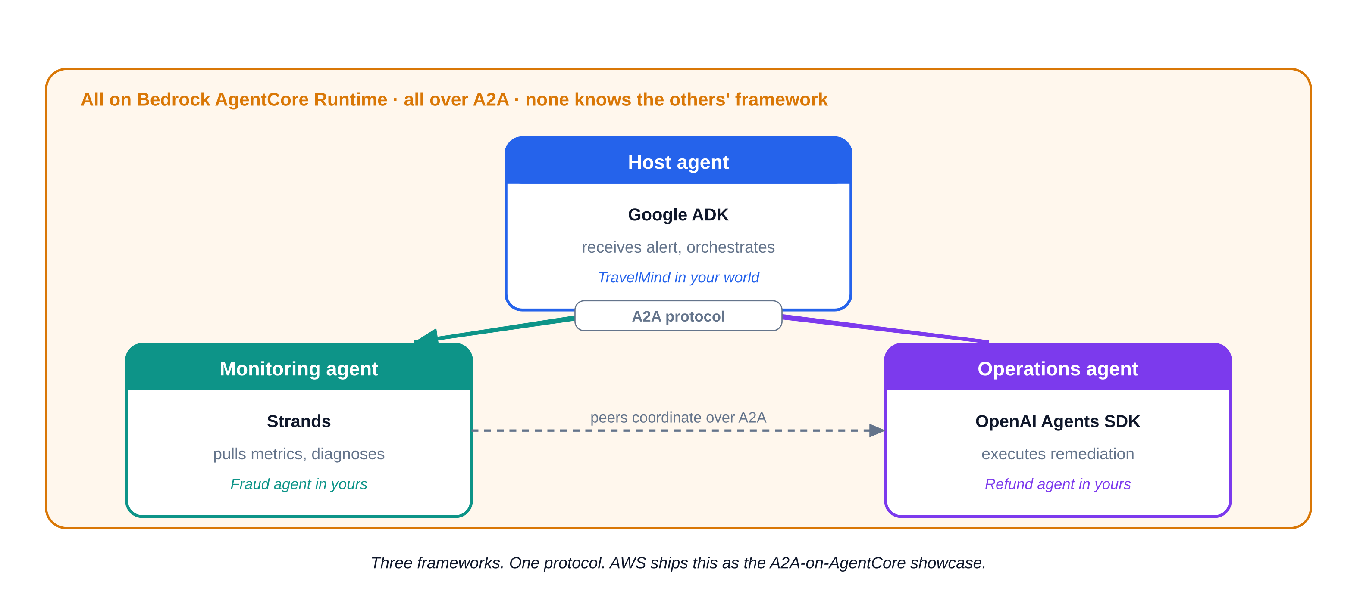

PART 5 · PRODUCTION ON AWS
Reference architecture: incident response (AWS's own demo)
Host agent (Google ADK)
receives the alert, orchestrates
Monitoring agent (Strands)
pulls metrics, diagnoses
Operations agent (OpenAI Agents SDK)
executes the remediation
All different frameworks. All talk over A2A. All run on AgentCore with managed auth and isolation. No agent knows what framework its peers use.
Mapped to you: swap in TravelMind (host), a Fraud agent (monitoring), a Refund agent (ops). Same shape, your product.
A2A · IBS Agentic AI Practitioner Bootcamp
28
Notes:
This proves the cross-framework promise is not theoretical, AWS runs it. The mapping to TravelMind makes it theirs.

Slide 35
06
Wrap
The pitfalls that save a debugging session, the whole deck on one card, and the two notebooks you build next.

Slide 36

PART 6 · WRAP
Pitfalls and gotchas (keep this slide)
Gotcha | What happens | Guard
Streaming event key | event["data"] prints nothing in 1.42 | Use event["type"]=="a2a_stream", then event["result"]
A2AAgent in a Swarm | Not supported | Use Graph or the tool pattern for remote peers
Card drift | Client expects skills the agent dropped | Treat the card as a contract; version it
Auth mismatch | 403 in production | Same scheme on both ends (OAuth or SigV4)
Reaching for A2A too early | Latency and ops cost for no gain | Stay in-process until a boundary forces you out
HTTP 200 with error body | Silent failures | Read JSON-RPC error.code, not just HTTP status
Every row is something we verified live, or that AWS documents. This is the save-you-a-debugging-session slide.
A2A · IBS Agentic AI Practitioner Bootcamp
29
Notes:
This is the save you a debugging session slide. Every row is something we verified or that AWS documents.

Slide 37
ONE-SLIDE CHEAT SHEET
If you keep one slide, keep this one
Need a tool or data?
MCP
Agents in one codebase?
Swarm / Graph / Workflow / Agents-as-Tools
Agents across process / framework / org?
A2A
A2A in production?
AgentCore Runtime: port 9000, root path, OAuth/SigV4, session isolation
Always: A2A across, MCP down. Stay in-process until a wall forces you out.
A2A · IBS Agentic AI Practitioner Bootcamp
30
Notes:
If they keep one slide, keep this one. It is the whole deck in five lines.

Slide 38


PART 6 · WRAP
What to do next
Notebook 1: A2A with Strands
Notebook 2: A2A on AgentCore
Try it live
Stand up a server. Consume it three ways: A2AAgent sync/async/stream, ToolProvider, tool wrapper. Build a TravelMind orchestrator that delegates a refund to a peer over A2A.
Take the same server, make it AgentCore-ready, deploy, fetch the card from the runtime URL, invoke it remotely.
Point your orchestrator at a teammate's running agent by URL. Watch discovery work with zero shared code.
Both notebooks are verified against strands-agents 1.42.0. Every snippet runs.
The teammate exercise is the one that makes the magic tangible: discovery and a call, across two codebases that never imported each other.
A2A · IBS Agentic AI Practitioner Bootcamp
31
Notes:
This tees up the two notebooks (the next deliverables). Close on the point-at-a-teammate exercise, it makes the magic tangible.

Slide 39
PART 6 · WRAP
References (all verified)
Strands A2A docs: strandsagents.com/docs/user-guide/concepts/multi-agent/agent-to-agent/
Strands native A2A samples: github.com/strands-agents/samples (03-integrate/protocols/a2a-native)
A2A protocol (Linux Foundation): a2a-protocol.org · github.com/a2aproject/A2A
AgentCore A2A deployment: aws.github.io/bedrock-agentcore-starter-toolkit (runtime/a2a)
AWS announcement: Introducing A2A protocol support in Amazon Bedrock AgentCore Runtime (Nov 2025)
Danilo Poccia reference demo: github.com/danilop/strands-a2a-demo
Shakir, Simple A2A implementation with Strands: dev.to (verified on 1.42.0)
Note on sources: authoritative sources only. The DZone architecture article was read for framing, but its code samples are illustrative pseudo-code, not the real SDK, so it is not cited for implementation.
A2A · IBS Agentic AI Practitioner Bootcamp
32
Notes:
Authoritative sources only. The DZone architecture article was read but its code samples are illustrative pseudo-code, not the real SDK, so it is intentionally not cited for implementation.

