Slide 1
SOFTWARE · PRODUCT MANAGERS AND PRODUCT OWNERS · DAY 3
The Agentic Artefact Set
What you hand engineering when you move from “we are building an agent” to “build this one”.
1
Which documents do I owe at P1, and which are optional?
2
How do I fill each one for my own feature?
3
How do these evolve as the agent moves from P0 to P3?
By the end you can draft the mandatory set for one feature in your own backlog.
Notes:
Open on the three questions. Day 2 decided the thing is an agent. Today is the paperwork that decision creates, and the paperwork is the product owner's, not the architect's. Two hours, one break at the sixty minute mark.

Slide 2
TODAY'S ROADMAP
One sheet, then how to fill it
One anchor artefact, then each document on it, taught the same way each time.
THE SHEET
FILL THE CORE
ADD WHEN NEEDED
MAKE IT LIVE
What you owe at P1
The mandatory set
The conditional set
Evolve and gate
Mandatory five
Problem brief
Autonomy spec
P0 to P3 maturity
Conditional three
Agent spec
Acceptance plan
The P1 gate
Optional two
The three lines
Registry
Your own feature
By the end of the session you will have drafted an agent spec and know exactly which optional artefacts your feature triggers.
2
Software · Day 3 · The Agentic Artefact Set
Notes:
Point at each zone once. Say the whole day hangs off zone A, the sheet. Do not read the sub-bullets aloud, they are for the learner reading the deck later.

Slide 3
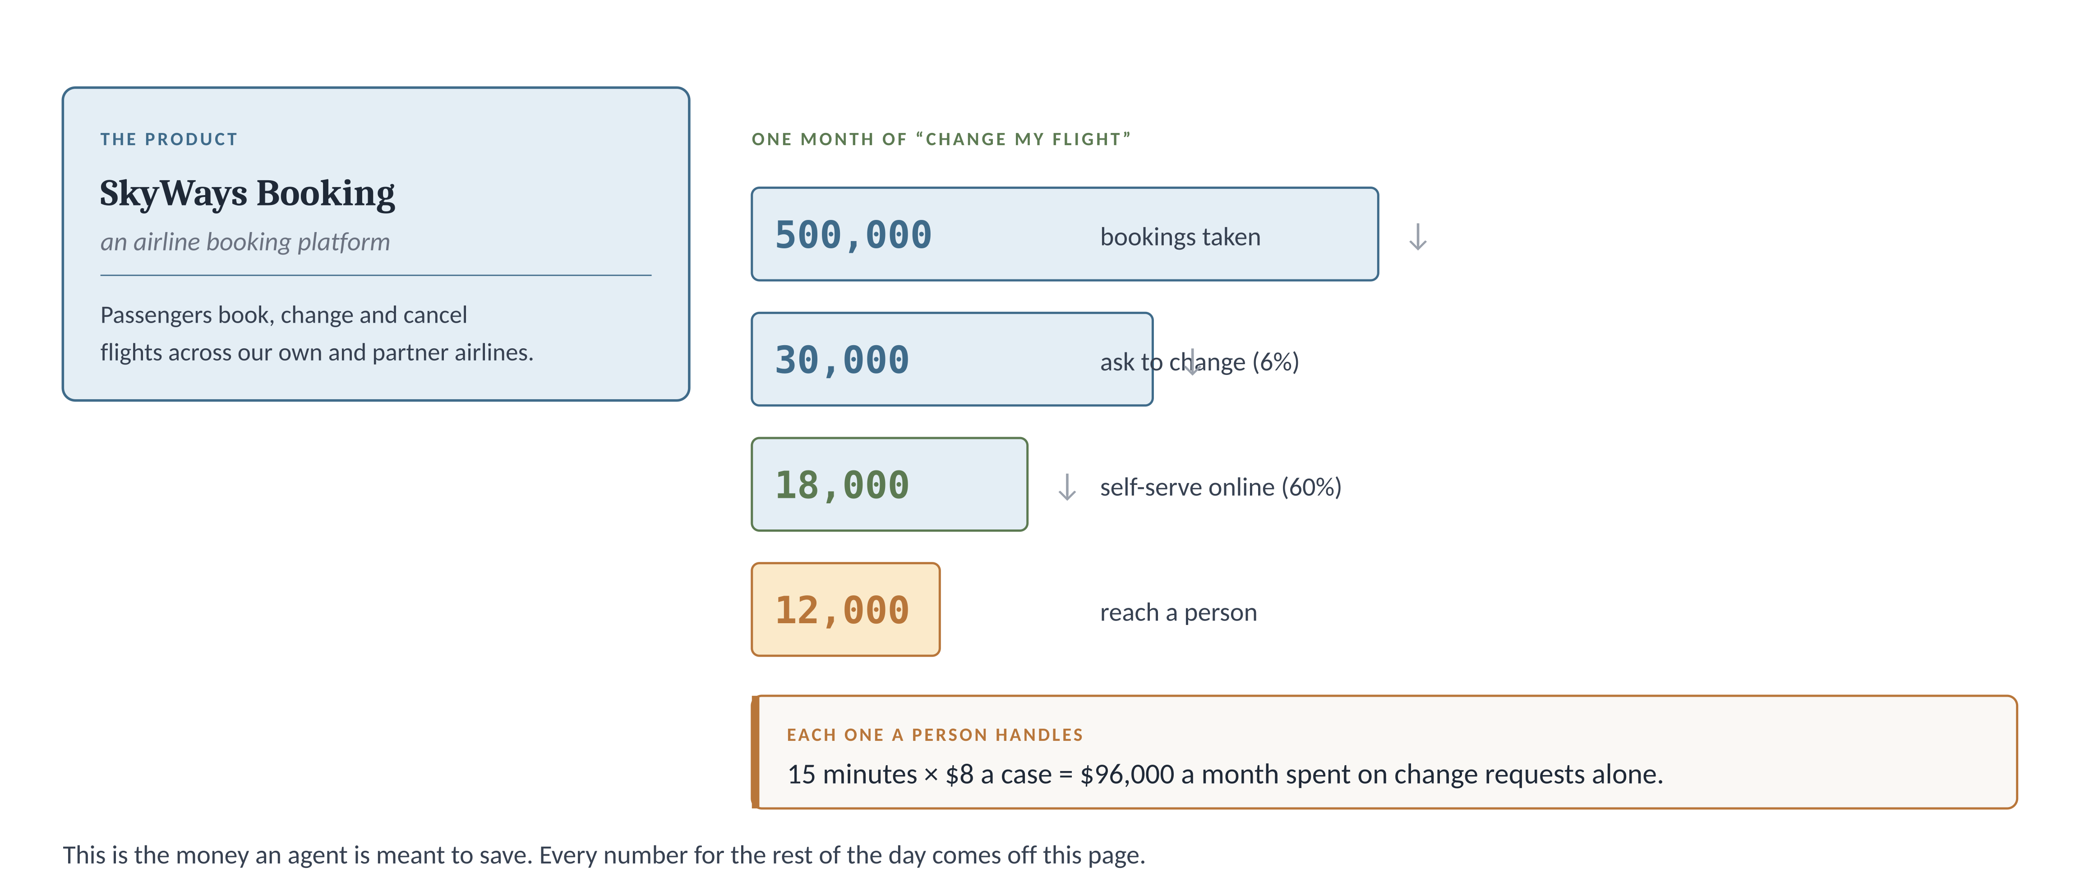
THE FEATURE WE WILL USE · 1 OF 2
SkyWays Booking, and the change-flight problem
One product, one expensive problem, and the money an agent is meant to save.
This is the SkyWays change-flight agent, the same one you scoped on Day 2. Today you build the full artefact set around it.
3
Software · Day 3 · The Agentic Artefact Set
Notes:
Ground the scenario properly. SkyWays is our airline booking platform. The problem is the 12,000 change requests a month that reach a person. Say the funnel out loud: half a million bookings, 6% ask to change, most self-serve, 12,000 land on a human at $8 each. Backward hook: you gave this agent a level, a bar and a tool contract on Day 2. You are completing it, not starting over.

Slide 4
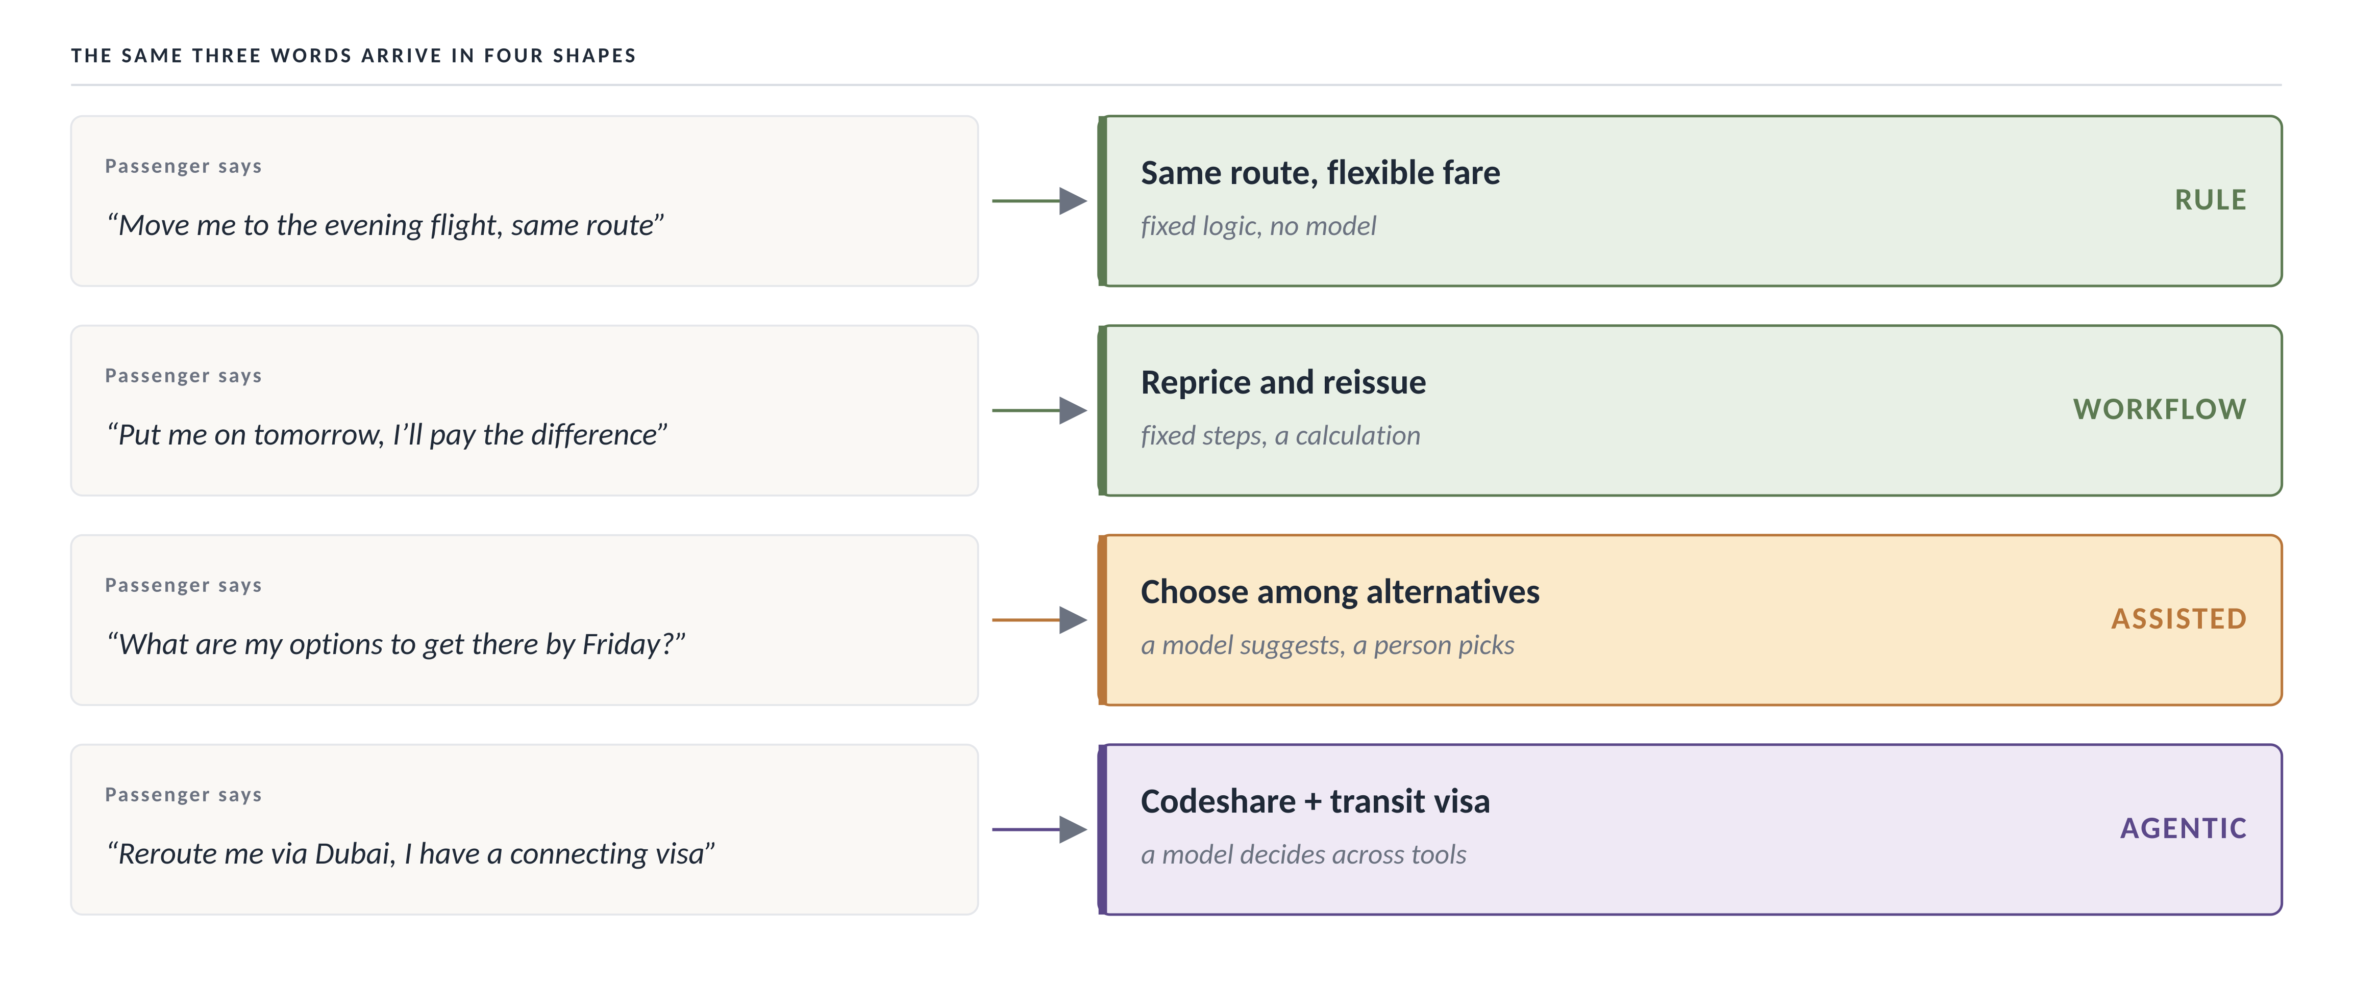
THE FEATURE WE WILL USE · 2 OF 2
The same request arrives in four shapes
“Change my flight” is four different problems, and Day 2 put each on a different build.
The agentic shape, the codeshare-and-visa case, is the hard one. It is why this agent needs the full artefact set and a simple rule would not.
4
Software · Day 3 · The Agentic Artefact Set
Notes:
Read each passenger quote aloud, then the build it maps to. The point: the same three words hide four problems. A rule handles the top two, a person-plus-model the third, and only the fourth needs a real agent. This is the callback to Day 2 section two. Ask the room to name the agentic one before you reveal the colour.

Slide 5
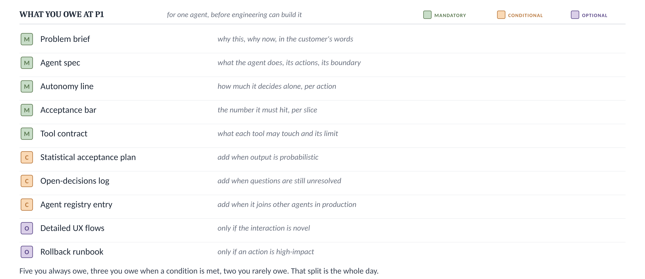
01 · THE ARTEFACT SET
The artefact set: ten documents, three duties
Every document you might owe at P1, sorted by duty: always, on a condition, or rarely.
This sheet is the whole day. Every slide after this fills one row or decides whether a row applies to you.
Read the colour, not the row. Green you always owe, terracotta you owe on a condition, purple you rarely owe.
5
Software · Day 3 · The Agentic Artefact Set
Notes:
This is the deliverables-sheet equivalent. Spend time here. Say: a PM who loses in review usually owed a green row and skipped it, or argued about a purple one that never mattered. The colour tells you where to spend effort. Ask the room to guess which five are mandatory before you walk them.

Slide 6
01 · THE ARTEFACT SET
Which of these do you always owe?
Answer from the sheet you just saw.
An agent that reads a booking and drafts a reply for a person to send. Which document can you skip?
a
The problem brief
b
The agent spec
c
The autonomy line
d
The rollback runbook
Type one letter in the chat.
6
Software · Day 3 · The Agentic Artefact Set
Notes:
Answer is d. A draft-only agent takes no high-impact action, so the rollback runbook (optional) does not apply. The other three are mandatory whatever the agent does. This checks that they read the colour, not the row.

Slide 7
01 · THE ARTEFACT SET
Why the runbook is the one you can skip
The three mandatory rows are owed by every agent regardless of what it does. The rollback runbook is optional, owed only when an action is high-impact, and a draft-only agent has none.
WHY THE OTHERS DO NOT HOLD
The problem brief
Mandatory. Every agent needs a reason it exists, whatever it does. Skipping it is how agents get built that nobody asked for.
The agent spec
Mandatory. Without it there is nothing for engineering to build against, draft-only or not.
The autonomy line
Mandatory. Even a draft-only agent has a level, and writing it down is what confirms it is only drafting.
REMEMBER IT AS Mandatory rows are owed by what the agent IS. Conditional and optional rows are owed by what it DOES.
7
Software · Day 3 · The Agentic Artefact Set
Notes:
Close the loop. Bridge: before we fill the rows, one reassurance. This set is not invented, it is a standard architecture template in disguise.

Slide 8
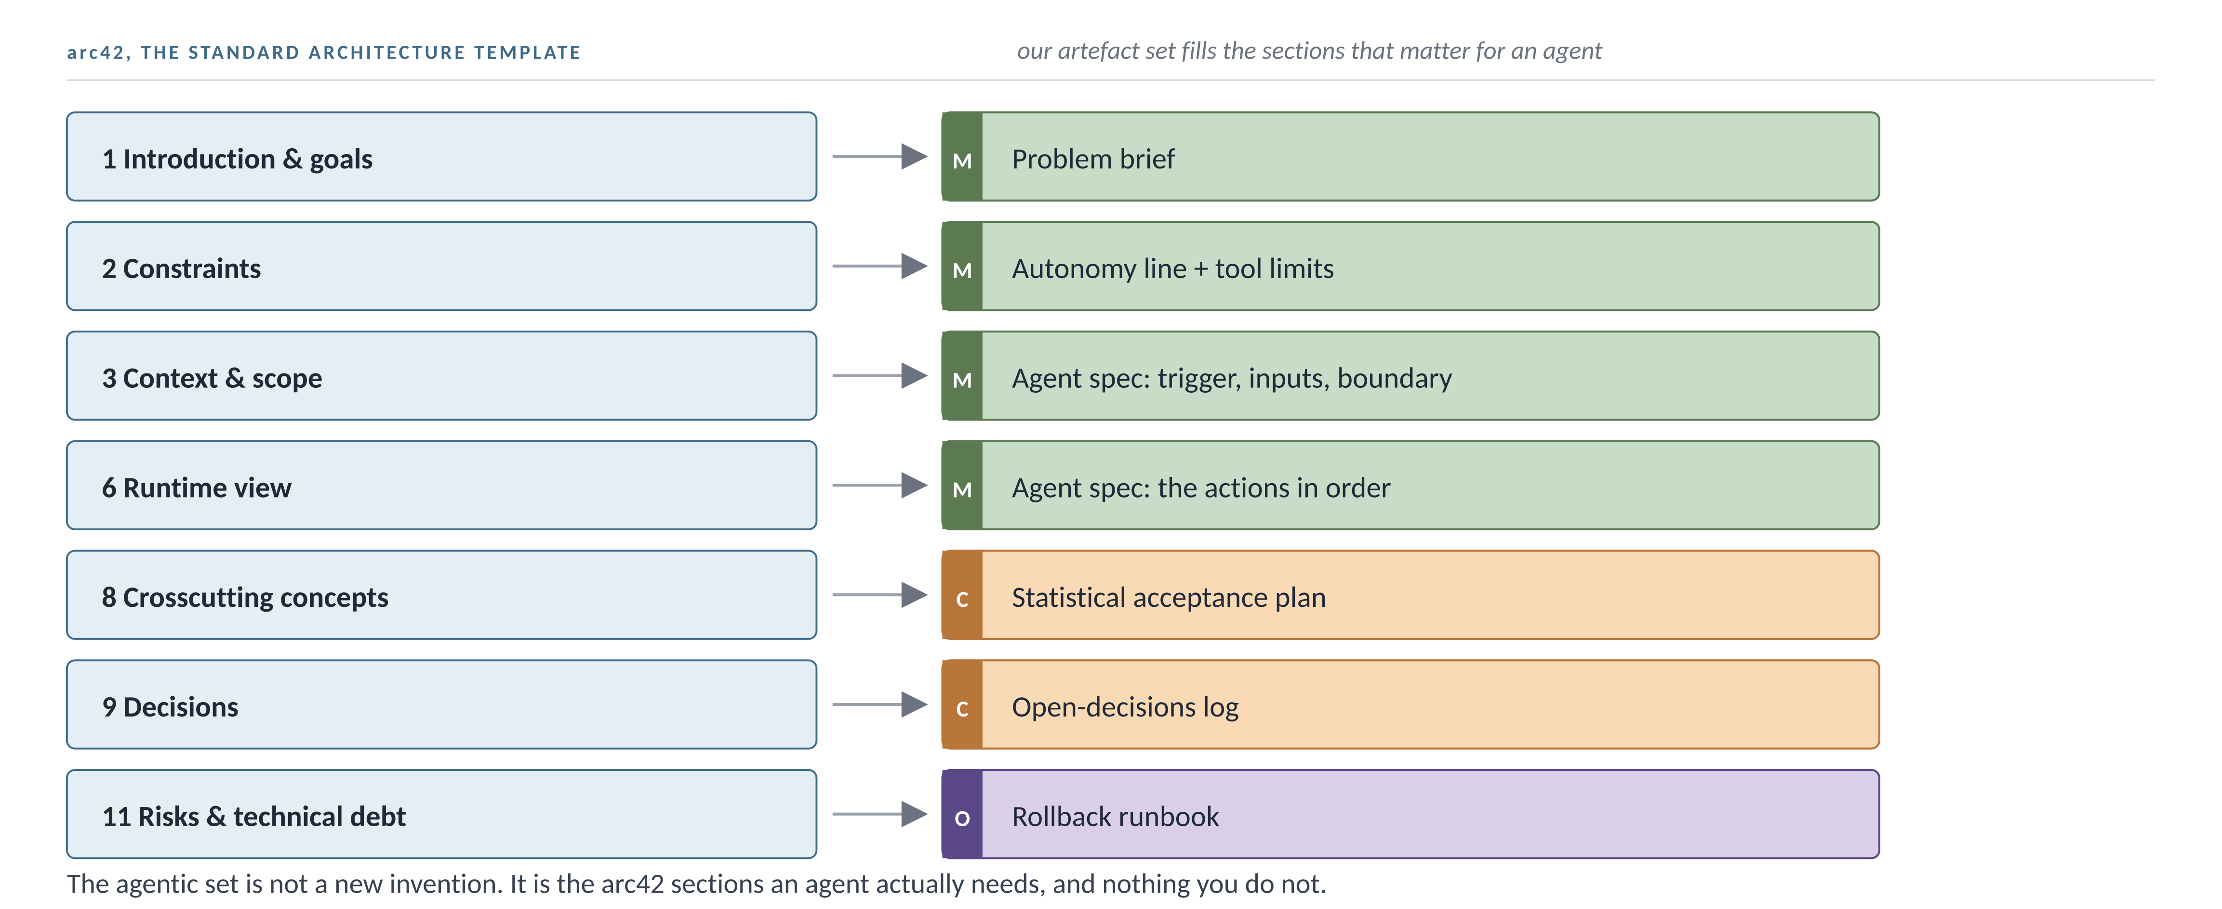
01 · THE ARTEFACT SET · WHERE IT COMES FROM
This set is arc42, the standard template, in disguise
arc42 is the industry-standard way to document any architecture. The agentic set fills the sections an agent needs.
You are not learning a new bureaucracy. You are filling the arc42 sections that matter for an agent, and skipping the ones that do not.
CONFIDENCE · Established. arc42 is a widely used open architecture-documentation template, not this course’s invention. The mapping to agentic artefacts is the teaching aid.
8
Software · Day 3 · The Agentic Artefact Set
Notes:
This is the iSAQB / solution-architecture anchor. Many in a senior product room have seen arc42 or heard of it. Say: the reason the set feels like a lot is that good architecture documentation is a lot. The colour-coding tells you which sections an agent actually forces. Read the mapping as: arc42 section on the left, the artefact that fills it on the right, its duty in colour.

Slide 9
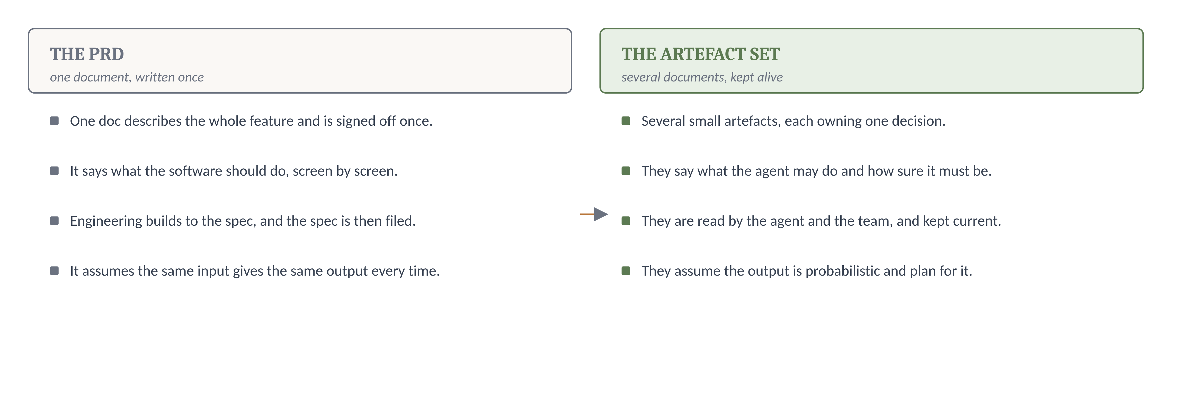
02 · WHY THE SET, NOT A PRD
A PRD describes software, the set describes an agent
The document you already know assumes something an agent breaks.
A PRD assumes the same input gives the same output. An agent does not, so a single document cannot hold it, and the set exists to cover the gap.
9
Software · Day 3 · The Agentic Artefact Set
Notes:
This is the old-world new-world move from the SAP FTS slide. The one line that lands: a PRD is written once and filed, and the artefact set is read by the agent and the team and kept alive. That is the AiDD idea, a living spec. Say: you are not abandoning the PRD skill, you are splitting it into pieces that can each be tested.

Slide 10
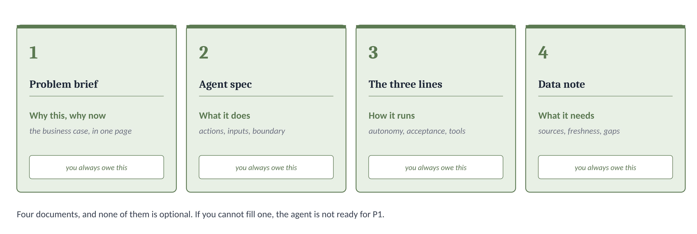
03 · THE MANDATORY SET
The five you always owe, as four cards
The three lines from Session 3 are one card here, so four cards cover all five documents.
If you cannot fill one of these four for a feature, that feature is not ready to leave P1, whatever the demo looks like.
10
Software · Day 3 · The Agentic Artefact Set
Notes:
Say each card's question aloud: why this, what does it do, how does it run, what does it need. The three-lines card is a callback. Say: you already built that on Day 2, so you are one card ahead.

Slide 11
03 · THE MANDATORY SET
Filling the mandatory set, in five steps
Fifteen minutes per feature once you know the agent. Step two is the one people skip.
WHAT YOU DO
THE QUESTION BEHIND IT
WHAT YOU END UP WITH
1
Write the problem in the customer's words
Whose problem is this, and why now?
A one-paragraph brief
2
List every action the agent can take
What can this thing actually do?
The spine of the agent spec
3
Carry over the three lines from Day 2
How much does it decide, how good, what may it touch?
Autonomy, acceptance, tools
4
Name the data it reads and how fresh it is
What does it depend on, and can that go stale?
A data note with a freshness figure
5
State what done looks like as a number
How would a reviewer measure ready?
The bar, per slice, with a sample size
Step 2 turns a feature into an agent. A feature is what the user gets; an action is what the agent does to deliver it, and only actions can be scored.
11
Software · Day 3 · The Agentic Artefact Set
Notes:
Step 2 is the decomposition move from Day 2. Prompt them to use verbs. Step 4 is the new one for this session. Stale partner data is what broke the codeshare slice, so freshness is a first-class field.

Slide 12
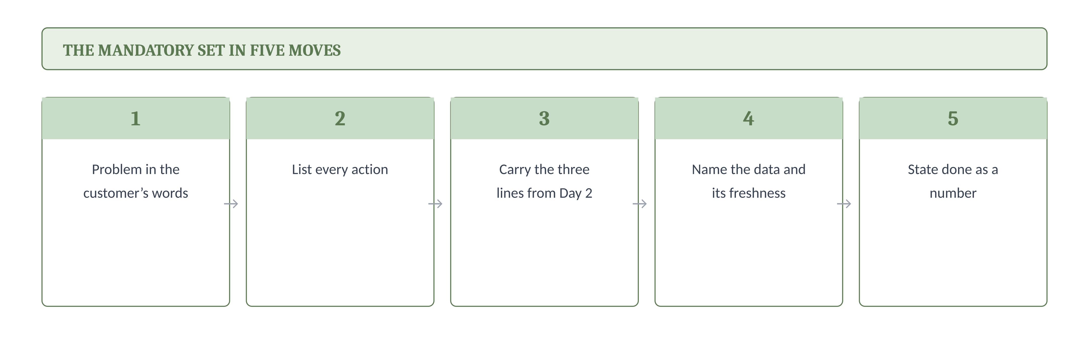
03 · THE MANDATORY SET · SUMMARY
The five moves, on one row
The whole mandatory set, in the order you fill it, as a strip you can photograph.
If you can complete these five for a feature, its mandatory set is done and it can leave P1.
12
Software · Day 3 · The Agentic Artefact Set
Notes:
This is the summarise-the-steps slide after the first major topic. Read the strip left to right once. Say: whenever you finish a feature, run this strip. Five green boxes, all filled, and you are through P1 on the paperwork.

Slide 13
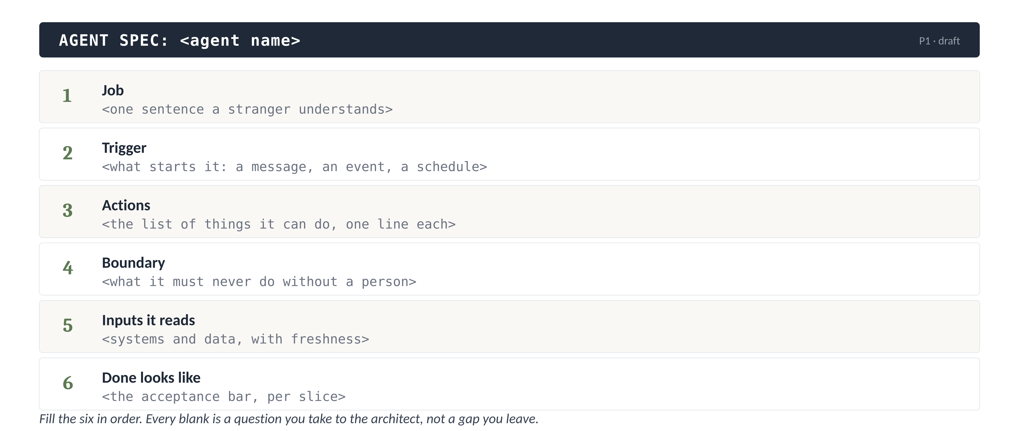
04 · THE AGENT SPEC
The agent spec has six fields, and no more
The one artefact people over-think. Six fields cover it, and every field is a question.
There is no published standard for an agent spec. These six fields are what an architect needs to start building, gathered into one shape.
13
Software · Day 3 · The Agentic Artefact Set
Notes:
Skeleton before instance, the Q-Gate-anatomy move. Read the six field names and stop. The next slide fills them for the flight agent.

Slide 14
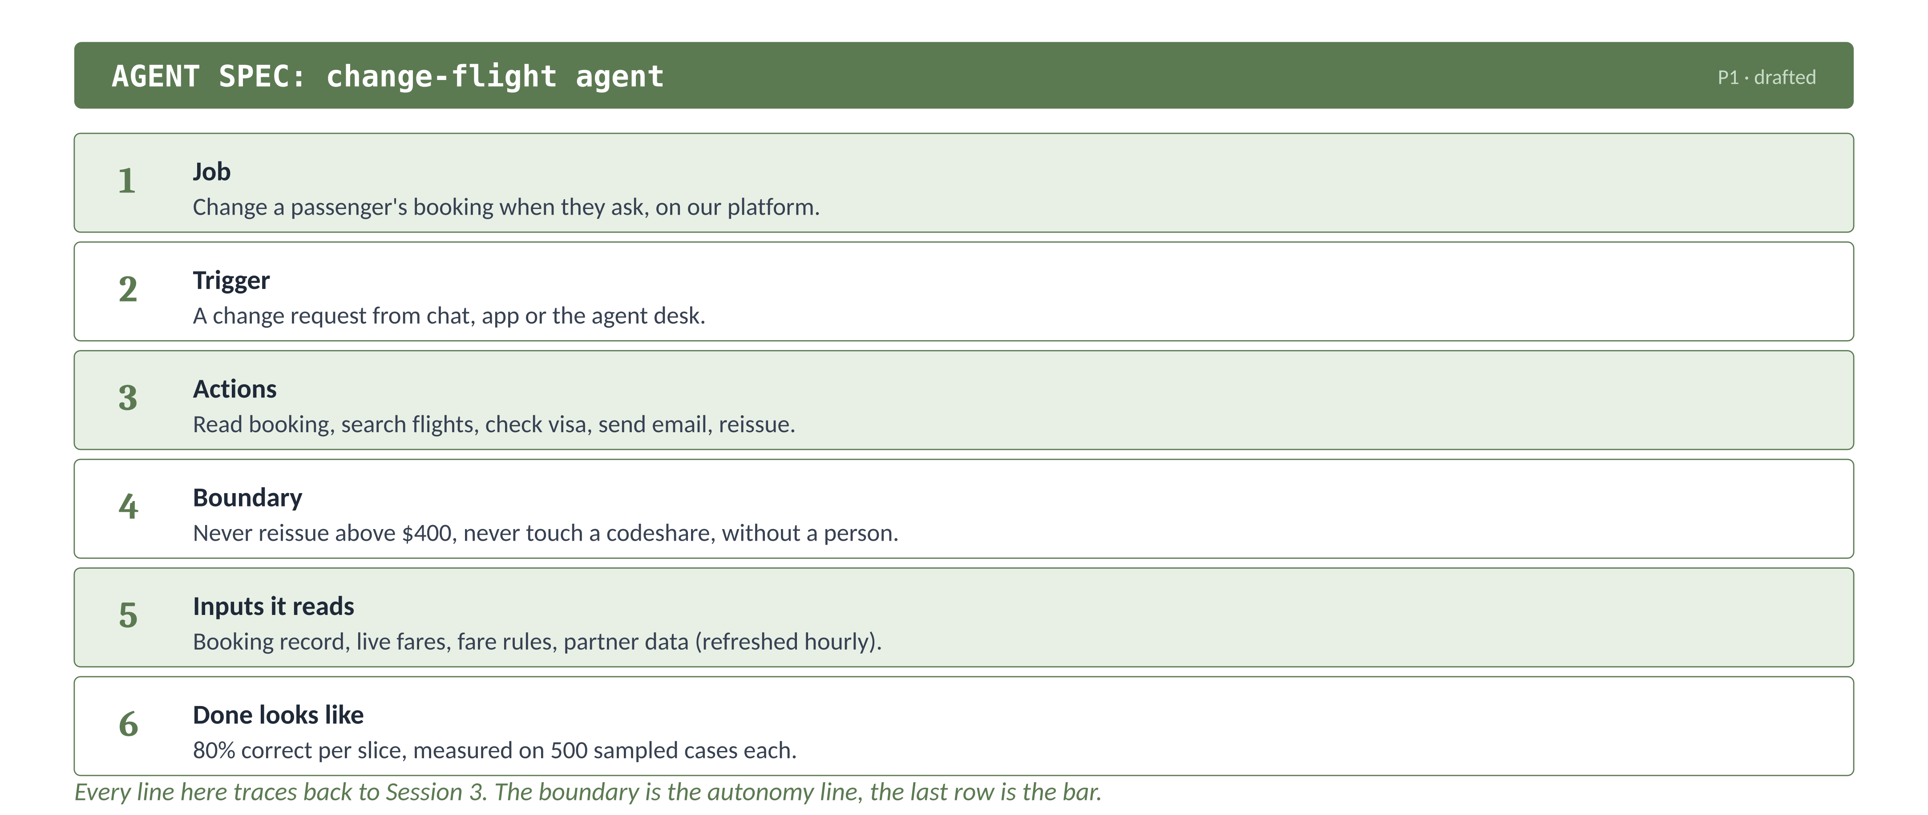
04 · THE AGENT SPEC
The same six fields, filled for the flight agent
Every line traces back to a decision you already made on Day 2.
The boundary field is the autonomy line. The done field is the acceptance bar. The spec is where Session 3's three lines come together.
14
Software · Day 3 · The Agentic Artefact Set
Notes:
Walk field by field and point at where each came from. Boundary is the autonomy line, done is the bar. Say: this is a complete, buildable spec, and it took six sentences.

Slide 15
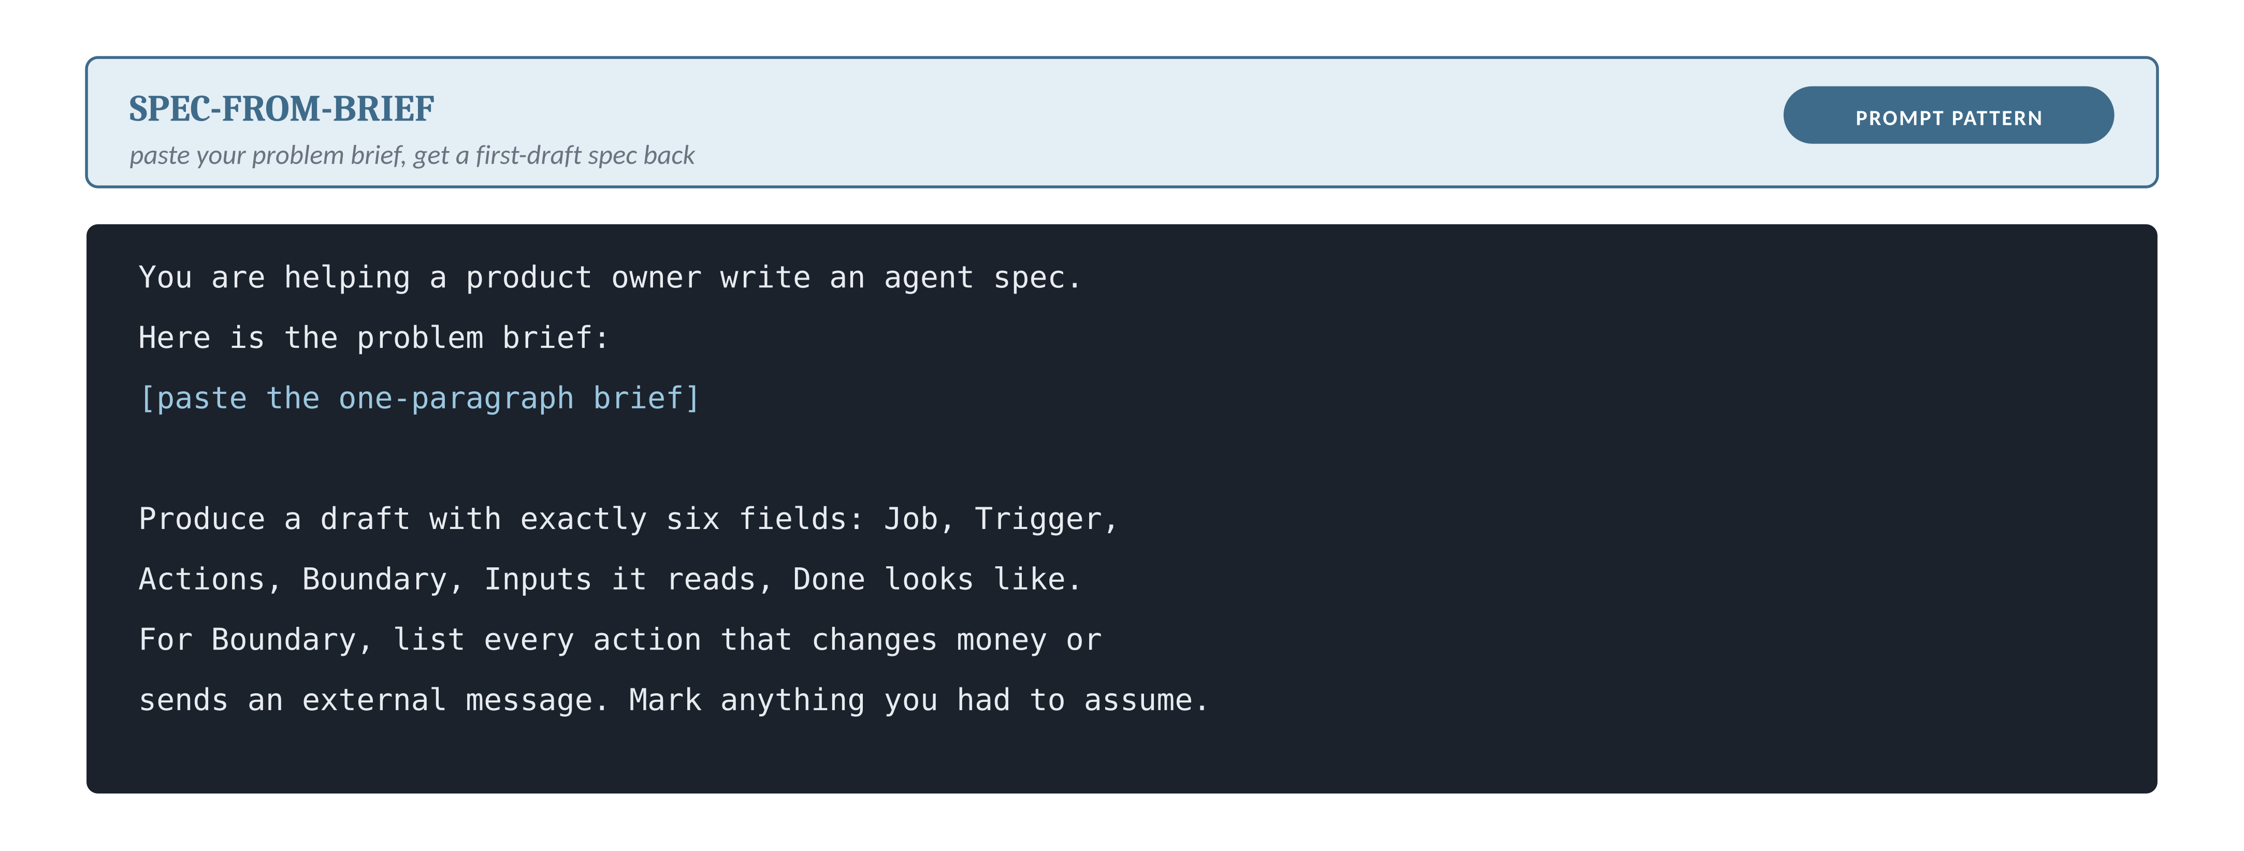
04 · THE AGENT SPEC · EVOLVED
Drafting the spec faster, with one prompt
For the confident half of the room, the spec is a first draft an assistant can produce and you correct.
The assistant drafts, you own the corrections. The Boundary field is where its guess is most often wrong, which is exactly the field you must own.
15
Software · Day 3 · The Agentic Artefact Set
Notes:
This is the evolved layer for this concept. Say plainly it is a first draft, not a spec. The value is speed on the parts you would write anyway. The trap to name: the model under-fills the boundary, because it does not know what hurts your business. That judgement stays yours.

Slide 16
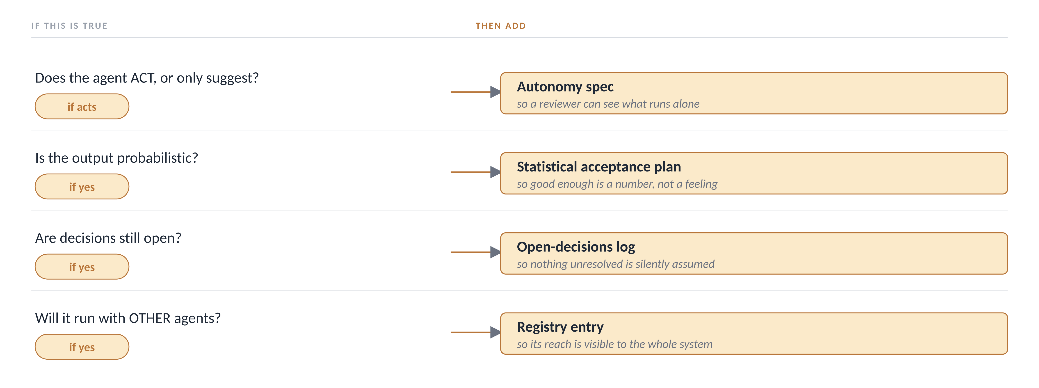
05 · THE CONDITIONAL SET
Four questions decide which extras you owe
The terracotta rows are not always owed. Each one is triggered by a yes to one question.
You do not add a conditional artefact because it looks thorough. You add it because a condition is true, and you can name the condition.
16
Software · Day 3 · The Agentic Artefact Set
Notes:
This is a decision rule with a threshold, the SAP diagnostic style. Walk the four questions against the flight agent: it acts, so autonomy spec yes; output is probabilistic, so acceptance plan yes; codeshare is unresolved, so open-decisions log yes; it runs alone for now, so registry no.

Slide 17
05 · THE CONDITIONAL SET · HOW TO READ IT
Reading the rule, as four if-then checks
A decision rule is read one row at a time. If the condition is true, you owe the artefact; if not, you skip it.
IF the agent takes an action
→
THEN add the autonomy spec
a reviewer must see what runs without a person
IF the output is probabilistic
→
THEN add the acceptance plan
good enough has to become a number
IF decisions are still open
→
THEN add the open-decisions log
nothing unresolved may be silently assumed
IF it runs with other agents
→
THEN add the registry entry
its reach must be visible to the whole system
For the SkyWays agent the first three are true and the fourth is not, so it owes three conditional artefacts and skips the registry.
17
Software · Day 3 · The Agentic Artefact Set
Notes:
This is the read-the-decision-tree-in-words slide. Say each line as a full if-then sentence. The habit to teach: never eyeball a rule. Walk every row, answer yes or no, and the artefacts you owe fall out. That is what stops both over-documenting and missing one.

Slide 18
05 · THE CONDITIONAL SET
Does this feature owe a statistical plan?
Apply the rule you just saw.
An agent that only routes a ticket to the right team (no free text, fixed rules) owes a statistical acceptance plan.
T
TRUE
F
FALSE
Type T or F.
18
Software · Day 3 · The Agentic Artefact Set
Notes:
False. Fixed rules are deterministic, so the output is not probabilistic and the trigger for a statistical plan is not met. This is the same not-everything-is-an-agent lesson from Day 2, applied to artefacts.

Slide 19
05 · THE CONDITIONAL SET
Why a rule-based router owes no statistical plan
False. The statistical acceptance plan is triggered only when the output is probabilistic. A router on fixed rules gives the same answer every time, so it is tested like any rule, pass or fail, and the plan does not apply.
WHY THE OTHERS DO NOT HOLD
What triggers the plan
Probabilistic output, where the agent is right a share of the time. A fixed-rule router is not that.
What this router owes instead
The mandatory five, and an ordinary test that the rules route correctly. Nothing conditional.
The trap in the question
It calls the router an agent, and the word agent does not decide the artefact. The behaviour does.
REMEMBER IT AS The word agent triggers nothing. A probabilistic output triggers the plan; an action triggers the autonomy spec.
19
Software · Day 3 · The Agentic Artefact Set
Notes:
Bridge: you now know which artefacts you owe. The rest of the session is how they change over time and how they get signed off.

Slide 20
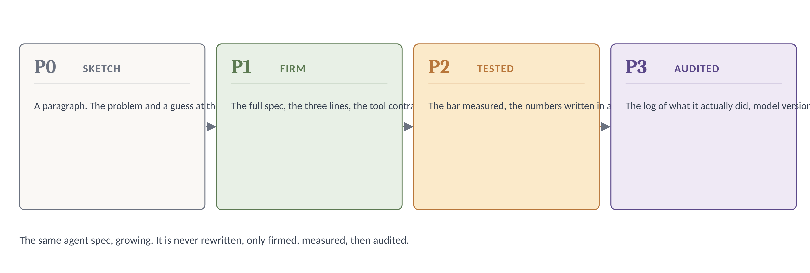
06 · HOW ARTEFACTS EVOLVE
One artefact, four states, P0 to P3
The spec is not written once. It is firmed, measured, then audited, and never rewritten.
This is the living-spec idea. The artefact grows with the agent, so “done” means something different at each phase.
20
Software · Day 3 · The Agentic Artefact Set
Notes:
This answers where the artefacts come from and where they go, which the TOC calls out. Say: at P0 the spec is a paragraph, and demanding the full thing at P0 is why teams stall before they have learned anything. Firm it at P1, not before.

Slide 21
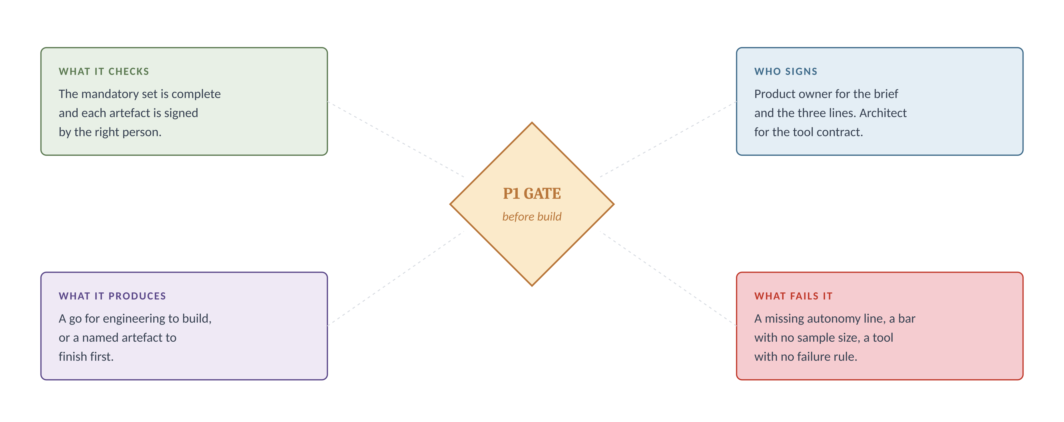
07 · THE P1 GATE
The gate that lets the set through to build
Before engineering builds, one checkpoint confirms the mandatory set is complete and signed.
The gate is not a meeting. It is four checks, and a fail names the one artefact to finish rather than sending the whole thing back.
21
Software · Day 3 · The Agentic Artefact Set
Notes:
This is the Q-Gate anatomy applied to agentic work. Say: the gate is cheap and a failure here costs an hour. The same gap found after launch costs a quarter, which is why the gate exists.

Slide 22
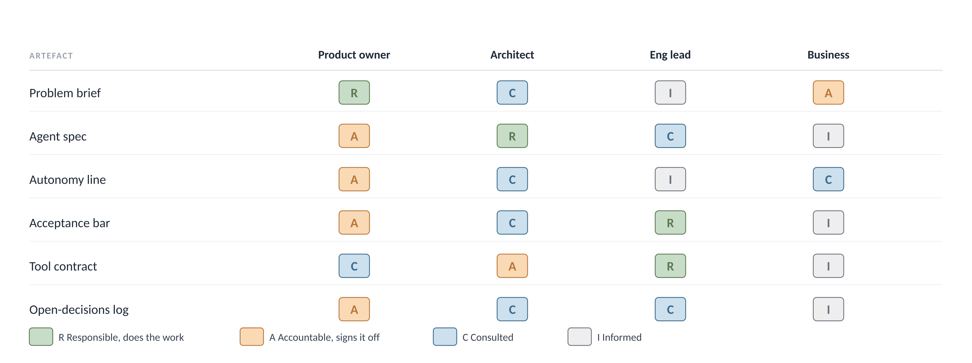
07 · THE P1 GATE · WHO SIGNS WHAT
A RACI matrix settles who owns each artefact
The gate needs one accountable name per artefact. RACI is the standard way to write that down.
You are accountable for the brief, the spec, the autonomy line and the acceptance bar. The architect is accountable for the tool contract. Everything else you are consulted on.
CONFIDENCE · Established. RACI (responsible, accountable, consulted, informed) is a standard responsibility-assignment matrix, not this course’s invention.
22
Software · Day 3 · The Agentic Artefact Set
Notes:
This is the second iSAQB / solution-architecture anchor, and it answers the permeable-barriers question directly: the barrier is which cell you sit in, and it moves as proficiency grows. Read one row: for the tool contract, the architect is accountable, eng lead responsible, you consulted. For the autonomy line it flips, you are accountable. Say: exactly one A per row, always. Two accountable names is how an artefact falls between two people.

Slide 23
07 · THE P1 GATE
Air Canada shipped without the acceptance check
A real consequence of letting an artefact through a gate it should have failed.
WHAT HAPPENED
In November 2022 a passenger asked Air Canada's website chatbot about bereavement fares and was told he could claim within 90 days of the ticket being issued. The real policy did not allow a claim after travel, and his claim was refused.
THE RULING
In February 2024 the British Columbia Civil Resolution Tribunal found negligent misrepresentation and awarded about CA$812. The tribunal held the company responsible for everything on its website, whether it comes from a static page or a chatbot.
THE ARTEFACT THAT WAS MISSING
A statistical acceptance plan for policy answers. The chatbot stated a policy, which is a commitment, and no artefact set the bar for how often a policy answer must be right before it could ship.
A policy answer is a conditional trigger. It is probabilistic and it is a commitment, so it owes an acceptance plan, and skipping it is a gate that should have failed.
CONFIDENCE · Established. A published tribunal decision, not a press report, and quotable in a review.
23
Software · Day 3 · The Agentic Artefact Set
Notes:
Say the tribunal's own line if asked: a chatbot is still part of the website, and it makes no difference whether the information comes from a static page or a chatbot. The transfer: run your own agent's policy-stating actions through the conditional rule before the gate.

Slide 24
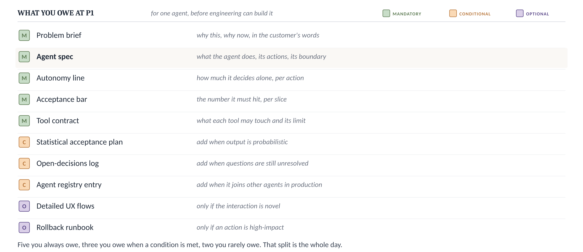
THE SET, DECIDED
The flight agent's set, marked up
For this agent: all five mandatory, three conditional triggered, both optional skipped.
Before the next session, mark this sheet for one feature of your own and draft its agent spec. Bring the spec.
24
Software · Day 3 · The Agentic Artefact Set
Notes:
Walk the sheet one last time as the flight agent. Five green owed, autonomy spec and acceptance plan and open-decisions log owed on their triggers, UX flows and rollback skipped. The task is one spec. Anybody who marks the whole sheet has done more than asked.

Slide 25
WHAT TO KEEP
Four rules from today
1
You owe the mandatory five for every agent, because they are owed by what the agent is, not by what it does.
2
You owe a conditional artefact only when you can name the condition that triggers it, never because it looks thorough.
3
An agent spec is six fields, and its boundary field is the autonomy line you already wrote on Day 2.
4
An artefact is firmed at P1, measured at P2 and audited at P3, and it is never rewritten, only grown.
25
Software · Day 3 · The Agentic Artefact Set
Notes:
This is the slide people photograph. Read the four and stop.

Slide 26
STILL OPEN
What the set does not yet decide
?
How you show a reviewer evidence rather than a claim at the gate
?
How the set is kept current once the model version changes underneath it
?
How several agents' registry entries fit together once more than one is live
Session 4 takes one feature from your own backlog through the full set, in Productboard, on screen.
Notes:
End here. Do not add a closing thought.

