Slide 1
Internet Applications
Looking at web application through the eyes of a developer.

Slide 2
URI
URI (Uniform Resource Identifier): Uniform naming schema to identify resources on the Internet.
e.g : http://www.cs.wisc.edu/~dbbook/index.html
URI has three parts:
  Naming schema (http)
  Name of the host computer (www.cs.wisc.edu)
  Name of the resource (~dbbook/index.html)
URLs are a subset of URIs

Slide 3
HTTP (HyperText Transfer Protocol)
Client (web browser) sends HTTP request to server
Server receives request and replies
Client receives reply; makes new requests

Slide 4
HTTP (HyperText Transfer Protocol)
Note that, HTTP is stateless:
No “sessions”
Every message is completely self-contained
No previous interaction is “remembered” by the protocol

Slide 5
Web Data Formats
HTML:
  The presentation language for the Internet.
  HTML is a markup language. Commands are tags
XML: A self-describing, hierarchal data model
  DTD: Standardizing schemas for Xml

Slide 6
Web Data Formats
XML – The Extensible Markup Language
Language: A way of communicating information
Markup: Notes or meta-data that describe your data or language
Extensible: Limitless ability to define new languages or data sets

Slide 7
Web Data Formats
The point is that you can include your data and a description of what the data represents. This is useful for defining your own language or protocol
e.g. Chemical Markup Language
<molecule>
<weight>234.5</weight>
<Spectra>…</Spectra>
<Figures>…</Figures>
</molecule>

Slide 8
Components of Data-Intensive Systems
Three separate types of functionality:
Data management
Application logic
Presentation
The system architecture determines whether these three
components reside on a single system (“tier) or are
distributed across several tiers.

Slide 9
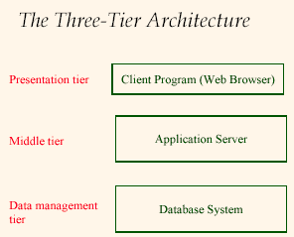

Slide 10
The Three-Tier Architecture
The Three Layers
Presentation tier
  Primary interface to the user
  Needs to adapt to different display devices (PC, PDA, cell phone, voice access?)
Middle tier
  Implements business logic (implements complex actions, maintains state between different steps of a workflow)
  Accesses different data management systems
Data management tier
  One or more standard database management systems

Slide 11
The Three-Tier Architecture
A course enrollment system:
Database System: Student info, course info, instructor info, course availability, pre-requisites, etc.
Application Server: Logic to add a course, drop a course, create a new course, etc.
Client Program Log in different users (students, staff, faculty), display forms and human-readable output

Slide 12
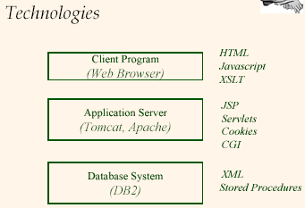

Slide 13
Presentation Tier
HTML Forms: How to pass data to the middle tier
JavaScript: Simple functionality at the presentation tier
Style sheets: Separating data from formatting

Slide 14
Presentation Tier - HTML Forms
Common way to communicate data from client to middle tier. General format of a form:
< FORM ACTION = “page.jsp” METHOD= “GET” NAME = “LoginForm” >
…
</FORM>
Components of an HTML FORM tag:
  ACTION: Specifies URI that handles the content
  METHOD: Specifies HTTP GET or POST method
  NAME: Name of the form; can be used in client-side scripts to refer to the form.

Slide 15
Presentation Tier - HTML Forms
Inside HTML forms, there may be the INPUT tag. It has the following attributes:
  TYPE: text (text input field), password (text input field where input is displayed as stars), reset (resets all input fields)
  NAME: symbolic name, used to identify field value at the middle tier.
  VALUE: default value

Slide 16
Presentation Tier - HTML Forms
Example : A form that has two text input fields, one submit and one reset button.
<form method="POST" action="Welcome.jsp">
<input type="text" name="userid">
<input type="password" name="password">
<input type="submit" value="Login“ name="submit">
<input type=“reset” value=“Clear”>
</form>

Slide 17
Presentation Tier - HTML Forms
Passing Arguments
Two methods: GET and POST. Form contents go into the submitted URI.
Structure:
action?name1=value1&name2=value2&name3=value3
Action: Name of the URI specified in the form. Note that the page named action needs to be a program, script, or page that will process the user input
(name,value)-pairs: These come from INPUT fields in the form; empty fields have empty values (“name=“)
e.g. Welcome.jsp?userid=john&password=johnpw

Slide 18
Presentation Tier - JavaScript
Goal: Add functionality to the presentation tier. Sample applications:
  Detect browser type and load browser-specific page
  Form validation: Validate form input fields
  Browser control: Open new windows, close existing windows (example: pop-up ads)
Usually embedded directly inside the HTML with the <SCRIPT>… </SCRIPT> tag.

Slide 19
Middle Tier
Encodes business logic
Connects to database system(s)
Accepts form input from the presentation tier
Generates output for the presentation tier.

Slide 20
Middle Tier
Technologies:
CGI: Protocol for passing arguments to programs running at the middle tier
Application servers: Runtime environment at the middle tier
Servlets: Java programs at the middle tier
JavaServerPages: Java scripts at the middle tier
PHP: PHP scripts at the middle tier.

Slide 21
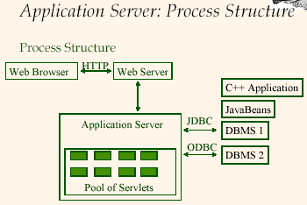

Slide 22
Middle Tier - PHP
PHP is a widely-used general-purpose scripting language that is especially suited for Web development and can be embedded into HTML.
<html>
<head>
<title>PHP Test</title>
</head>
<body>
<?php
echo '<p> Hello World</p>';
?>
</body>
</html>

Slide 23
Middle Tier - PHP
<html>
<head><title> EXAMPLE PAGE</title></head>
<body>
Hello World!!! This is my first PHP script as a CS352 student.... <br> <br>
Here is the list of all employees in our company database: <br> <br>
<?php .....

Slide 24
Middle Tier - PHP
<?php
// Connect to server where your DB is, login and password to the DBMS (Here it is MySQL)
$connection = mysql_connect('139.179.21.74','company_user','123');
// Give an error if you can not connect
if(!connection)
die("Could not connect");
....

Slide 25
Middle Tier - PHP
// Choose the database among those databases to use. As a
//company_user, we are allowed to use the company database.
mysql_select_db('company');

Slide 26
Middle Tier - PHP
// Prepare a query string, just like we have done in Java
$query = "SELECT * FROM Employee";
// Send & execute the query, again this is similar to saying:
// "ResultSet rs =stmt.executeQuery($query)" in our java
//example
$result = mysql_query($query);
// This counts the number of tuples in the result
$result_no = mysql_num_rows($result);

Slide 27
Middle Tier - PHP
// if some results are found, write them
if ($result_no >0)
{
for($i = 1; $i<=$result_no; $i++)
{
// Fetch the contents of current record into the variables $employee_no, etc.
list($employee_no, $name…) = mysql_fetch_row($result);
// This is to write the output to HTML so that it is viewed by the browser
echo "NO: $employee_no NAME: $name SKILL: $skill …“;
echo "<br>";
}
}

Slide 28
Middle Tier - PHP
// If no results are found
else
echo “no employee in the company database”
// Close the php tag
?>
//Close the body and html tags
</body>
</html>

Slide 29
Maintaining State in HTTP
HTTP is stateless.
Advantages
Easy to use: don’t need anything
Great for static-information applications
Requires no extra memory space
Disadvantages
No record of previous requests means
No shopping baskets or user logins
No custom or dynamic content
Security is more difficult to implement

Slide 30
Maintaining State in HTTP
Server-side state: Information is stored in a database, or in the application layer’s local memory
Client-side state: Information is stored on the client’s computer in the form of a cookie
Hidden state: Information is hidden within dynamically created web pages

