Slide 1
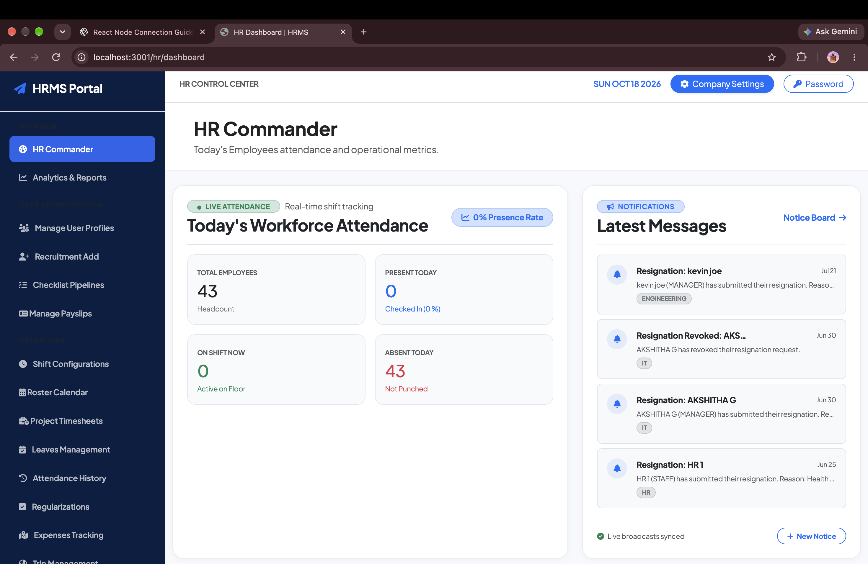
AURA HRMS ENTERPRISE
Next-Gen Workforce Operating System
Unified Web Commander + Native iOS & Android Mobile Suite + Live GPS Travel Telemetry & Statutory Payroll.
TURNKEY COMPLIANCE
100% Automated Payroll
Auto-calculates PF, PT, TDS & LOP deductions with single-click bulk payslips.
ZERO FAKE CLAIMS
Live Field Telemetry
Real-time satellite GPS tracking of employee trips & linked expense receipts.

Slide 2
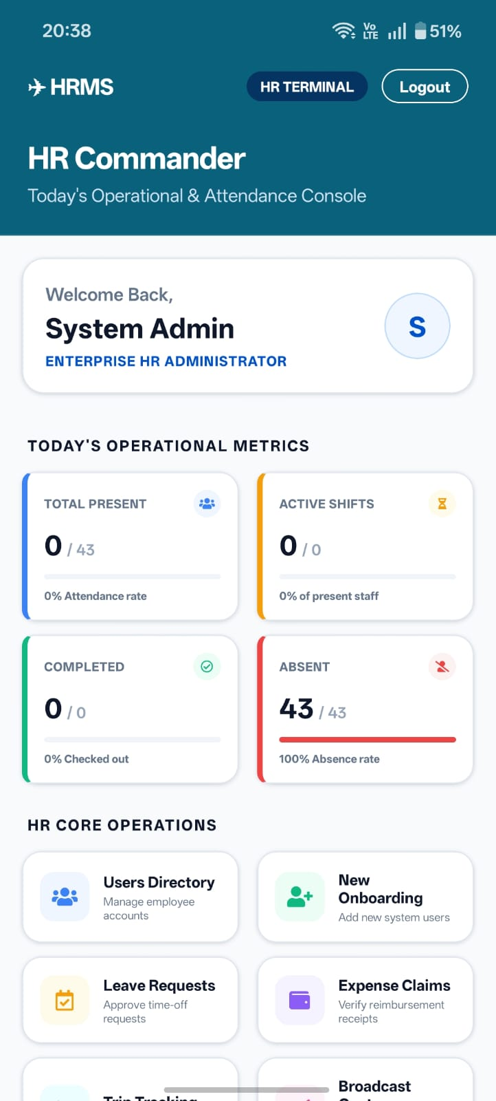
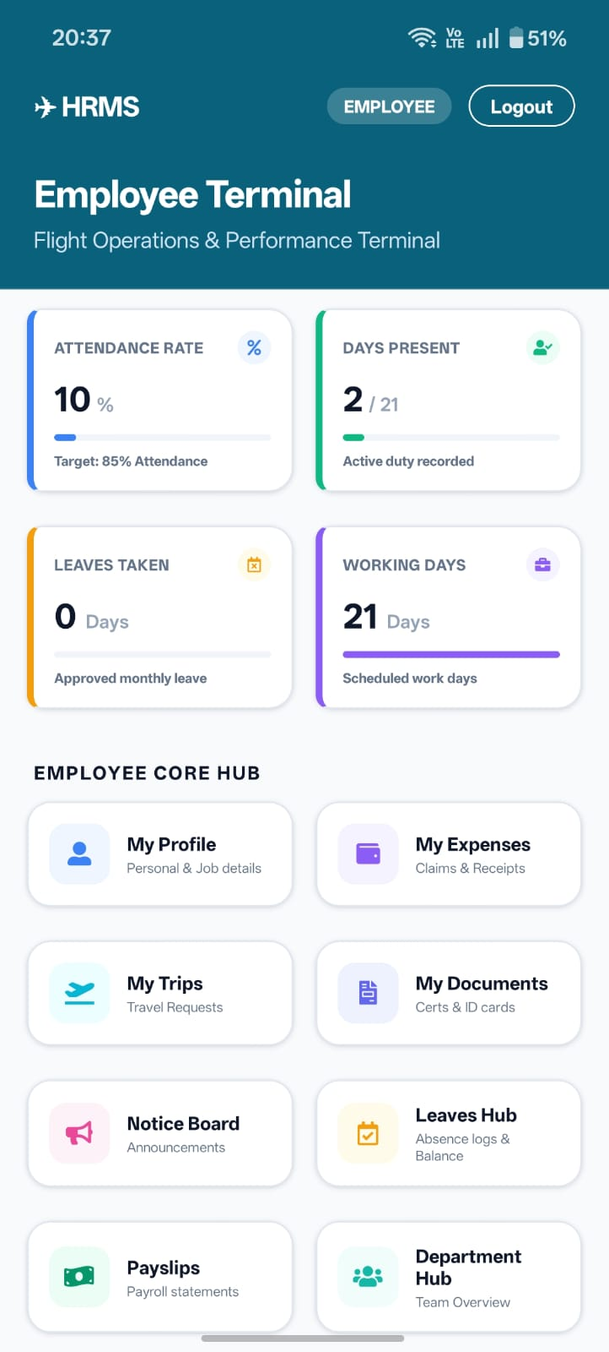
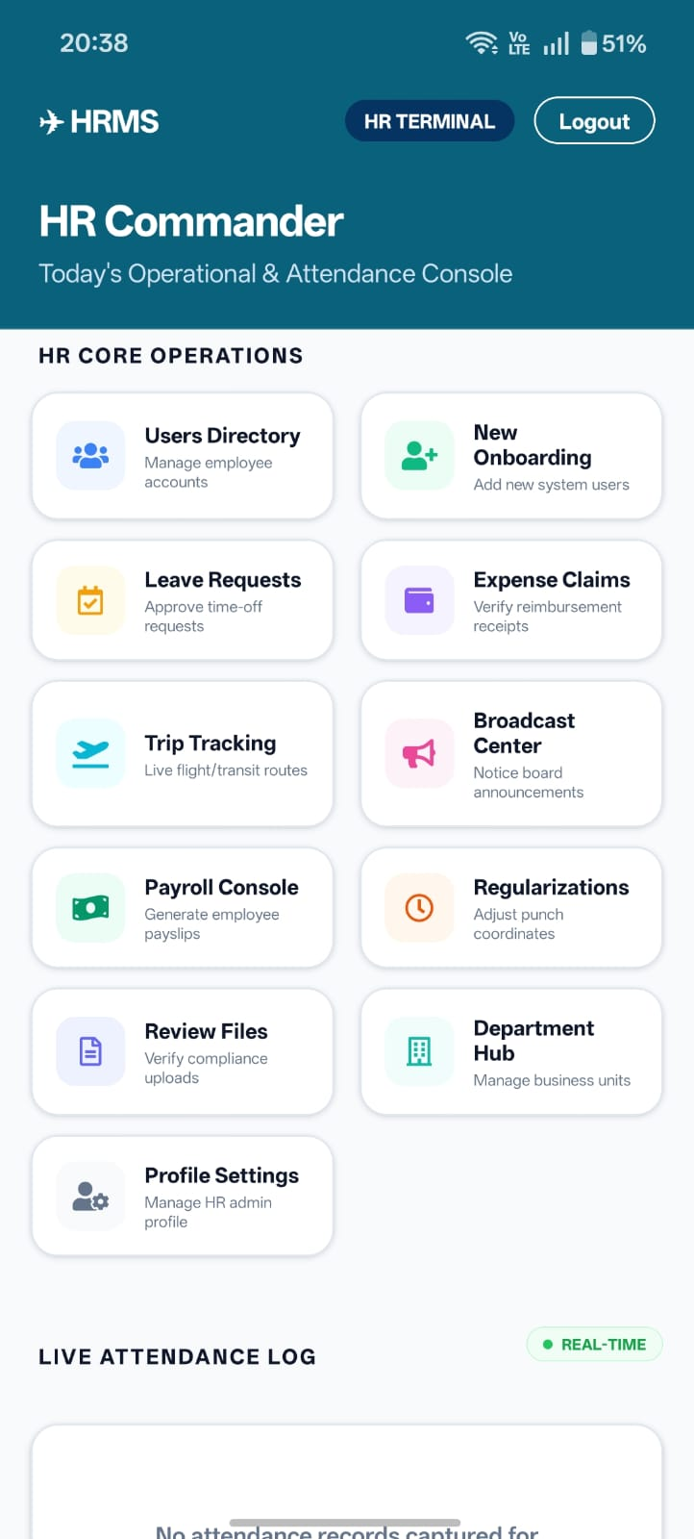
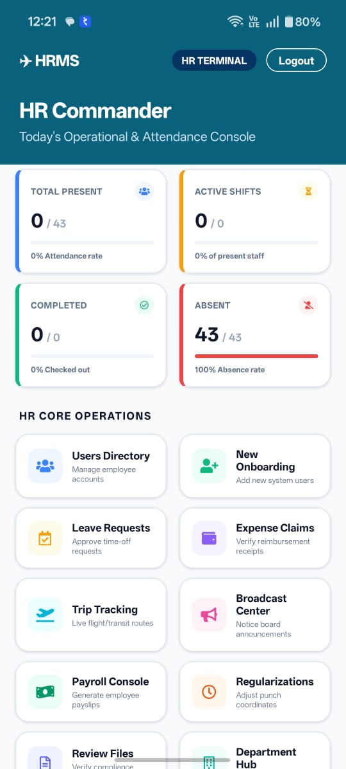
NATIVE MOBILE SUITE (IOS & ANDROID)
Employee Self-Service, Geofenced Attendance & Field Operations
Equip your workforce with a fast, modern mobile app. Punch attendance, apply for leaves, download payslips, and track business trips on the go.
1-Tap Geofenced Punch
Mobile Self-Service Hub
Field Trip & Mission Logs
Employee ID & Leave Vault

Slide 3
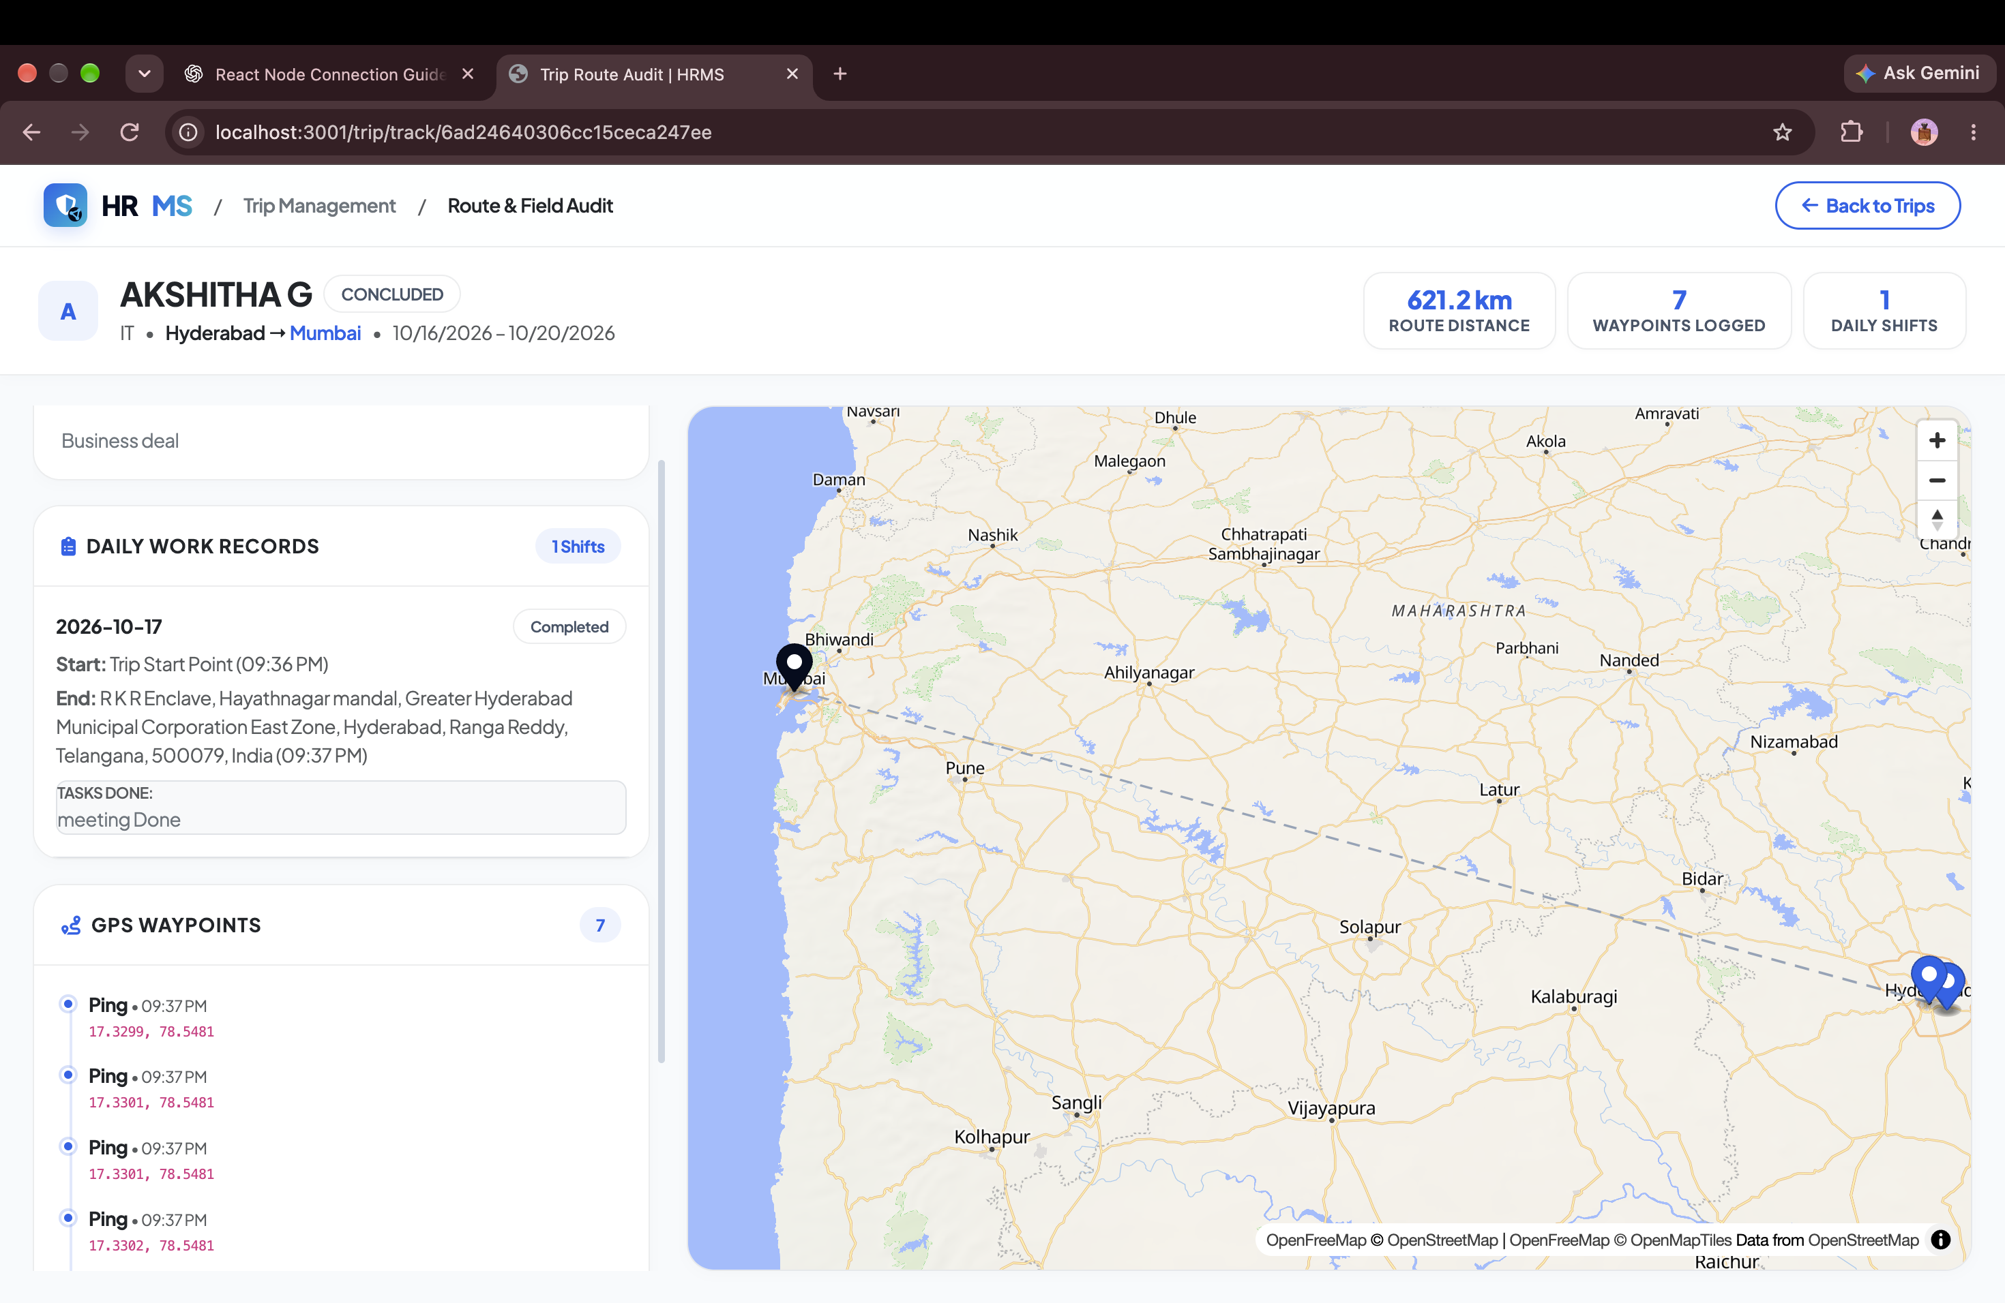
MARKET DIFFERENTIATOR
Live Field Travel & Interactive GPS Route Telemetry
Monitor sales reps, field engineers, and executive business trips in real time. Eliminate fake mileage and fraudulent meal vouchers.
LIVE TELEMETRY
Live HR Satellite Operations Map
View active traveling personnel with interactive GPS breadcrumb trails, vehicle routes, and destination milestones.
FRAUD ELIMINATION
Trip-Locked Expense Reimbursements
Reimbursements are strictly attached to verified travel route IDs with camera receipt captures. No receipts, no travel movement = no reimbursement.
COMPLETE DOSSIER
Executive Mission Dossiers
Generates comprehensive travel dossiers with boarding passes, hotel bookings, and client deliverables.

Slide 4
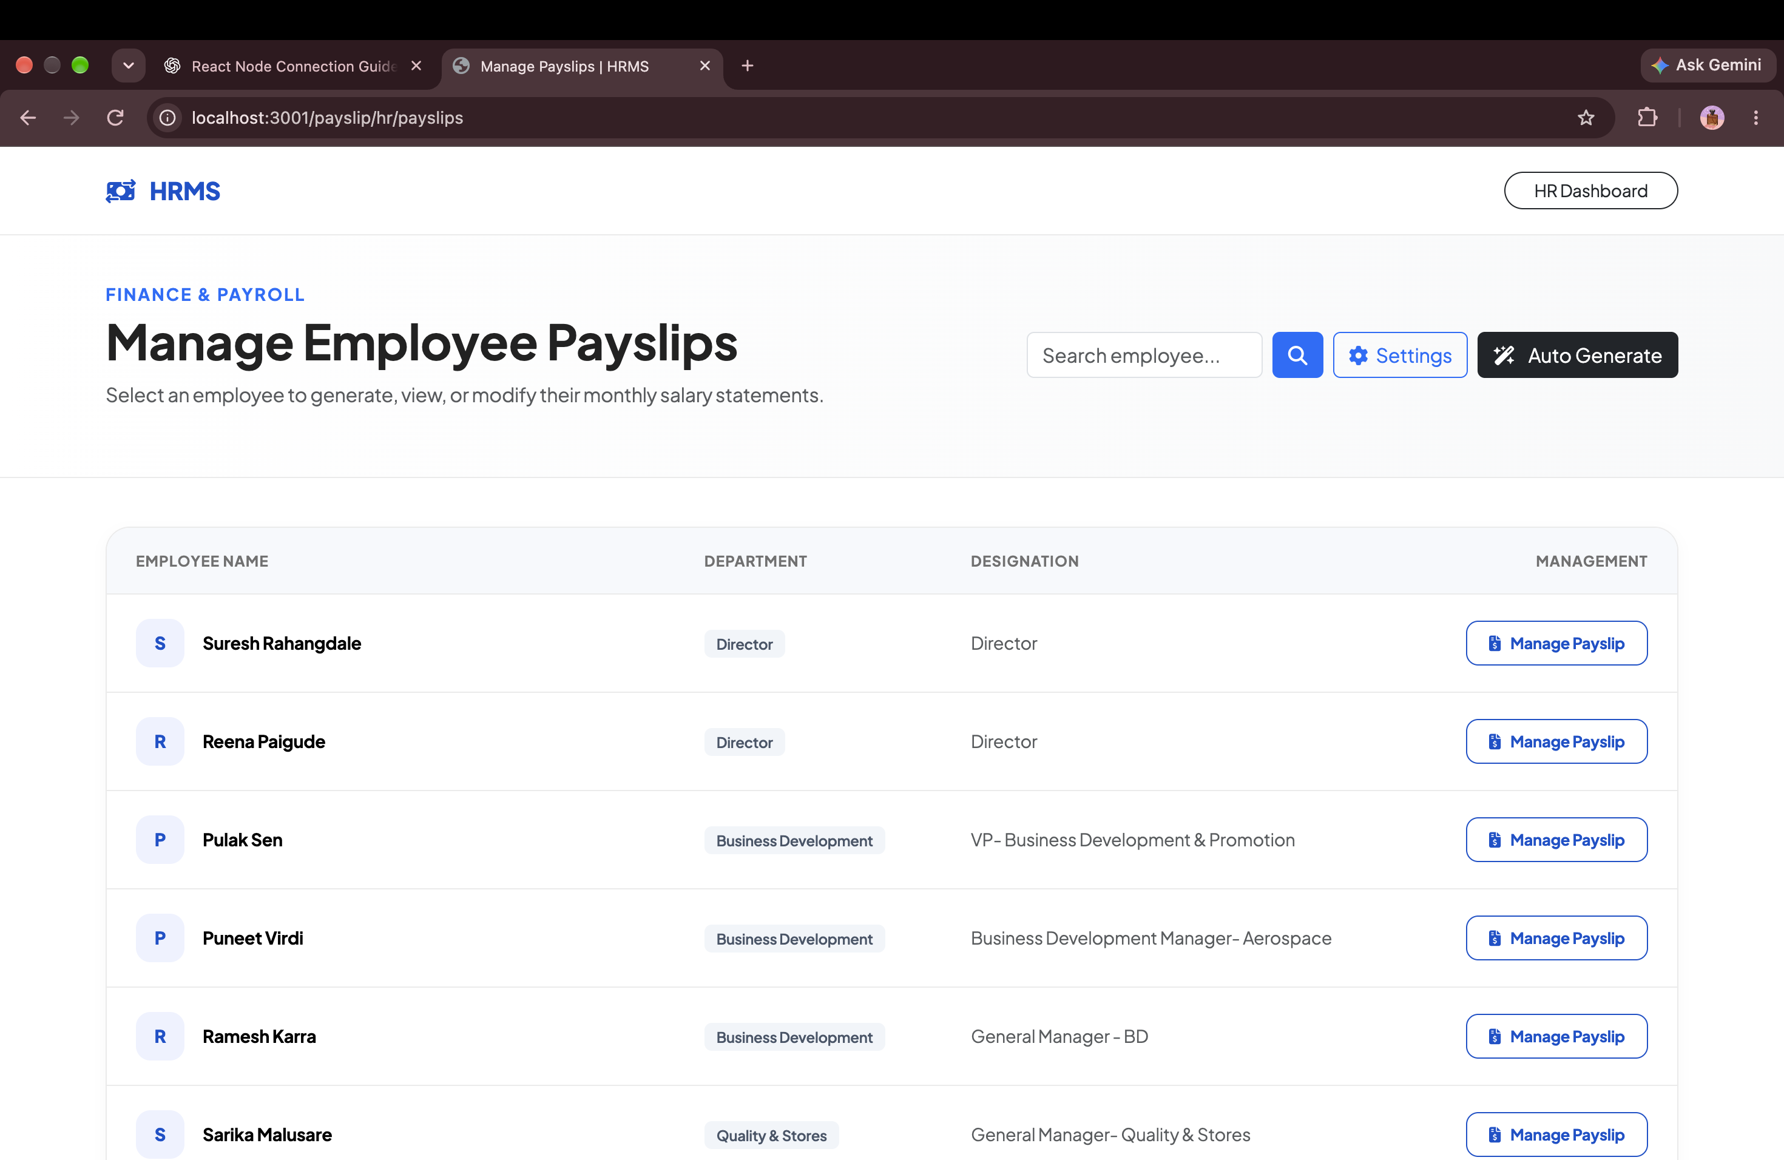
STATUTORY INDIAN PAYROLL
Single-Click Bulk Payroll Processing & Compliance Engine
Automatically calculate PF, Professional Tax, TDS slabs, and dynamic Loss-of-Pay (LOP) deductions.
ZERO HUMAN ERROR
Dynamic LOP Salary Deductions
Unpaid leaves (Loss-of-Pay) automatically deduct daily wages from base salary without tedious manual spreadsheet math.
FAST-TRACK PAYROLL
Single-Click Bulk Generation
Generate 50 to 5,000+ payslips in a single click. The system audits tax thresholds, generates PDFs, and distributes them securely.
EMPLOYEE SELF-SERVICE
Encrypted Payslip Vault
Employees view historical breakdown (Basic, HRA, Travel Allowance, Net In-Hand) on web or mobile.

Slide 5
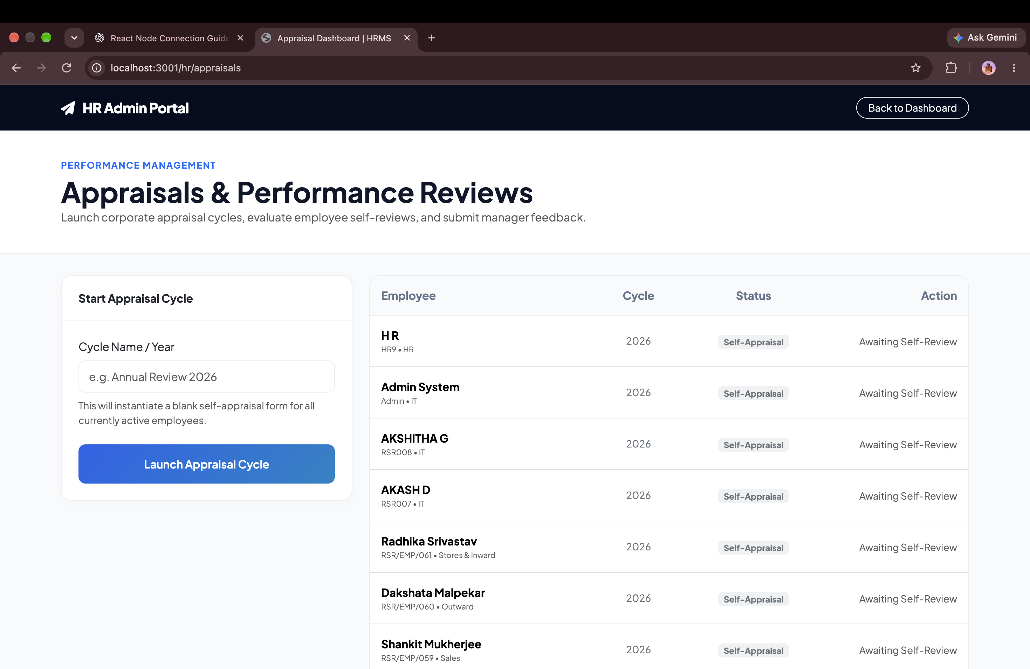
PERFORMANCE MANAGEMENT
Appraisal Review Cycles & 360 Monthly Review Dossiers
Objective, continuous performance management that aligns employee outcomes with corporate revenue goals.
FAIR EVALUATIONS
Two-Stage Review Cycles
Self-appraisal ratings (1 to 5) followed by managerial score and qualitative feedback notes for fair, documented reviews.
OUTCOME DRIVEN
Objectives & Key Results (OKRs)
Employees set measurable quarterly goals with checkable key results and progress bars to monitor milestone completions.
1-ON-1 EXECUTIVE SHEET
360 Monthly Review Dossier (PDF)
A one-click printable executive sheet combining attendance rate, leaves, trips, OKRs, and manager notes for 1-on-1 meetings.

Slide 6
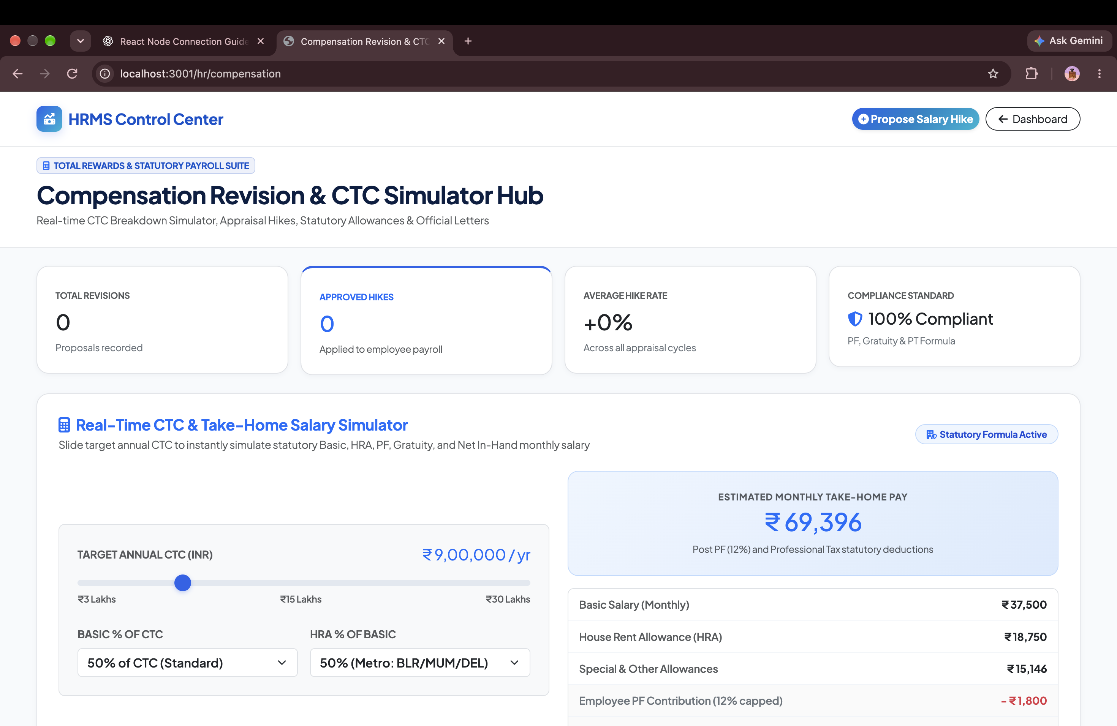
COMPENSATION ENGINEERING
Real-Time CTC Simulation & Branded Increment Letters
Automates salary hike math, promotions, and formal legal documentation seamlessly.
INSTANT MATH
Real-Time CTC Simulator
Test hike percentages (10%, 15%) or target CTCs. The engine automatically recalculates Basic (50%), HRA, PF, Gratuity, and Net In-Hand.
AUTOMATED MASTER
1-Click Master Record Sync
Once HR approves a proposed hike or promotion, the employee's master salary, designation, and tax deductions update immediately.
FORMAL DOCUMENTATION
Branded Increment Letters
Generates formal, print-ready increment and promotion letters on corporate letterhead with full component breakdown tables.

Slide 7
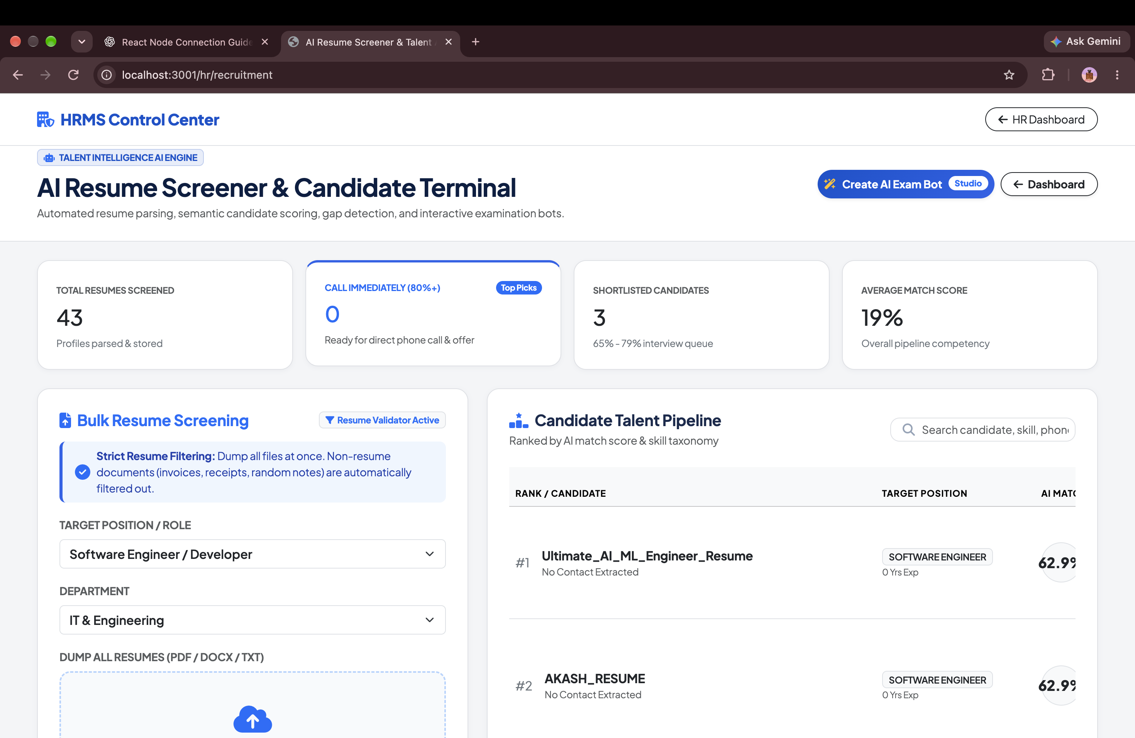
ARTIFICIAL INTELLIGENCE
AI Candidate Resume Screener & Policy RAG Engine
Harness vector search and machine intelligence directly inside your HR operations.
FAST HIRING
Automated Batch Resume Parser
Upload 50+ candidate PDF resumes. The system parses work history, skills, and scores candidates against the Job Description in seconds.
80% LESS HR QUERIES
AI Policy RAG Chatbot
Employees ask questions about maternity leave, notice period, or travel perks. The vector AI engine cites exact handbook clauses instantly.
AUTOMATED SCREENING
Candidate Interview Bot
Send automated screening tokens (/interview/:token) for AI-driven preliminary interviews before manager rounds.

Slide 8
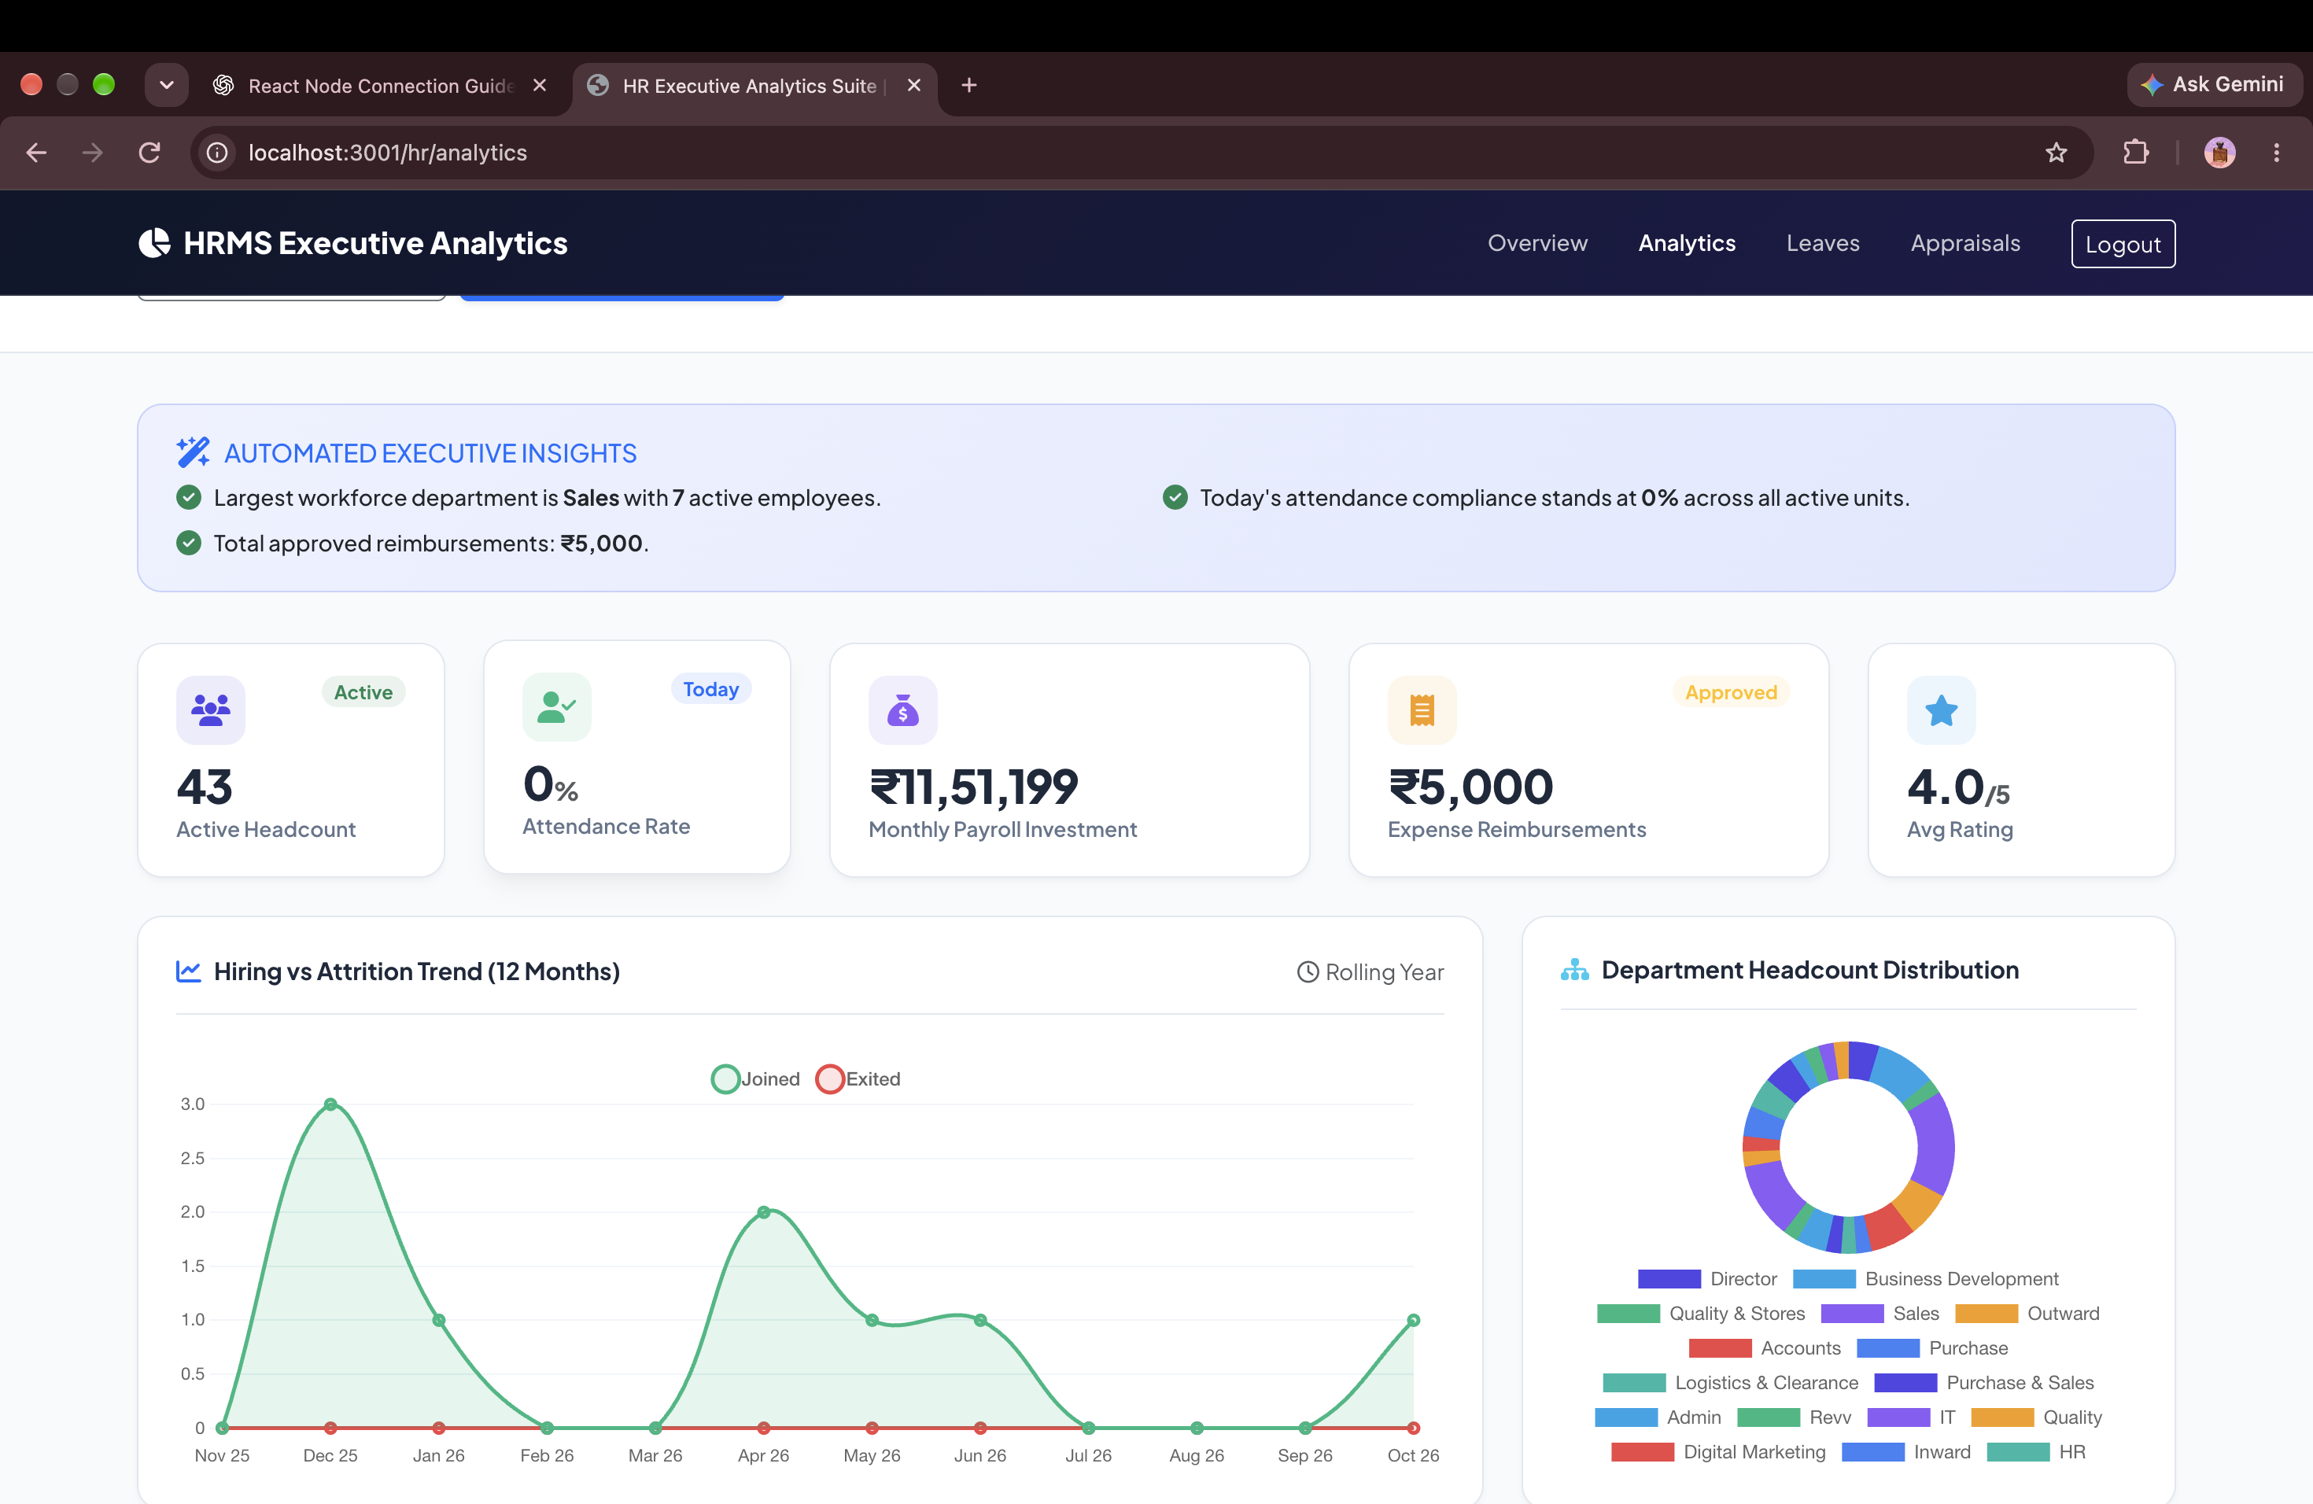
EXECUTIVE INTELLIGENCE
Workforce Telemetry, Department Headcounts & Attrition Trends
Gives executive leadership complete visibility into organizational health, salary bands, and attendance compliance.
RETENTION ANALYTICS
Hiring vs Attrition Trends
Track 12-month rolling joins vs exits to detect turnover hotspots before they impact revenue.
COST CONTROL
Department & Salary Band Split
Instant breakdown of payroll distribution, average employee tenure, and age/gender demographics.
OPERATIONAL HEALTH
Real-Time Attendance Rate
Daily attendance compliance rate across all company branches and field teams.

Slide 9
SECURITY & COMPLIANCE
Bank-Grade Privacy: DPDP Act 2023 & Zero Data Sharing
Your employee records, salary data, and identity proofs are protected by strict legal and technical controls.
ARCHITECTURE
Dedicated Tenant Isolation
Each company operates in an isolated, partitioned database. Cross-tenant data leakage is architecturally impossible.
CRYPTOGRAPHIC GUARD
AES-256 & TLS 1.3
Military-grade encryption at rest for databases and documents, with TLS 1.3 encryption across all network transmissions.
NON-MONETIZATION
Strict Non-Sharing Pledge
We never sell, rent, monetize, or share client data with third parties or data brokers. The client retains 100% data ownership.
LEGAL SHIELD
Enterprise SaaS Agreement
Comprehensive Master Subscription Agreement with liability caps, mutual hold-harmless defense, and New Delhi arbitration.

Slide 10
MARKET COMPARISON
How AURA HRMS Compares to Legacy Competitors
High enterprise functionality without exorbitant multi-year contract traps.
Core Feature | AURA HRMS (Our Platform) | Keka HR | Darwinbox | greytHR
Mobile App (iOS & Android) | Included Free (Full Feature) | Yes (Base features) | Yes (Complex) | Yes (Basic)
Live Field GPS Map Telemetry | Native Built-in Map | Paid Add-on (High cost) | Third-party plugin only | Not Available
AI Policy RAG & Resume Screener | Built-in Core Engine | Limited Chatbot | Enterprise Custom Tier | Not Available
Implementation Timeline | Under 24 Hours | 3 to 6 Weeks | 2 to 4 Months | 2 to 3 Weeks
Pricing & Contract Lock-In | Zero Lock-In (Monthly Billing) | Min. Rs 60,000+ Annual Lock | Min. Rs 2,50,000+ Annual Lock | Min. Rs 35,000+ Annual Lock

Slide 11
SPECIAL INTRODUCTORY OFFER
Experience Aura HRMS with a Risk-Free 30-Day Free Pilot
Zero upfront setup fees. We configure your company's dedicated workspace, migrate your employee records, and deploy the native mobile app for your entire workforce completely free for 30 days.
Dedicated Account Onboarding Specialist assigned to your team
Full access to Native Mobile Apps (iOS & Android) with live geofenced punch
Complete Indian statutory payroll processing (PF, PT, TDS, LOP)
Zero long-term contract lock-in — continue only if you love the platform

