Slide 1
★ EXECUTIVE DECISION & ADOPTION DECK
AURA HRMS ENTERPRISE
The Autonomous Workforce Operating System
Unified Web Commander • Native iOS & Android Mobile Suite • OpenStreetMap GPS Telemetry • Automated Statutory Indian Payroll
NATIVE MOBILE APP
iOS & Android with 1-Tap Geofenced Punch
ZERO MAP COSTS
Pure OpenStreetMap Vector Engine
INDIAN PAYROLL
100% Automated PF, ESI, TDS & PT
MULTI-TENANT
Isolated Dynamic DB per Company
Notes:
Executive Presentation Goal: Convince stakeholders that adopting Aura HRMS immediately consolidates our workforce operations, slashes software sprawl, eliminates travel expense fraud, and delivers a modern mobile experience for all employees.

Slide 2
● EXECUTIVE CHALLENGE
Why Traditional HR & Operations are Costing Us Millions
Fragmented tools, manual spreadsheets, and unverified field claims drain organizational productivity.
1
Spreadsheet & Tool Sprawl
HR uses 5+ disconnected tools for attendance, payroll, travel slips, leaves, and emails. Data reconciliation takes days every month.
40+ Hours Wasted/Mo
2
Attendance & Buddy Punching
Traditional biometric machines or manual logbooks fail for hybrid, remote, and field employees, leading to untracked absenteeism.
₹3.8L Annual Leakage
3
Opaque Travel & Travel Claims
Field staff submit estimated mileage and paper taxi bills with zero route verification. Impossible to audit authenticity.
₹5.4L Fraudulent Claims
4
Statutory Payroll Calculation Errors
Manual computation of PF, ESI, Professional Tax, TDS slabs, and Loss of Pay leads to compliance notices and penalties.
High Compliance Risk
5
Skyrocketing SaaS Costs
Legacy enterprise solutions (Keka, Darwinbox, Workday) charge heavy per-module fees and lock companies into multi-year contracts.
Overpriced Subscriptions
Notes:
Talking Point: Walk leadership through the 5 critical pain points. Highlight that our problem is not lack of effort, but tool fragmentation. Replacing this with Aura HRMS saves over ₹14 Lakhs annually in direct leakage and hundreds of productive hours.

Slide 3
● PLATFORM ARCHITECTURE
One Unified Autonomous Ecosystem: Web + Native Mobile + AI
An integrated architecture eliminating third-party software subscriptions and data silos.
1. Web Commander Portal
Full Administrative Terminal
✔ Executive Workforce Live Telemetry
✔ Automated Indian Statutory Payroll
✔ Geofence Polygon Configuration
✔ IT Asset & SLA Helpdesk Suite
✔ Role-Based Access (Admin/HR/Dept)
2. Native Mobile Suite
iOS & Android (React Native)
✔ 1-Tap Geofenced OpenStreetMap Punch
✔ Real-Time Field Trip & Route Tracing
✔ Digital Employee ID Card Badge
✔ Instant Leave & Expense Claim Filing
✔ Manager Mobile Approvals on-the-go
3. Autonomous AI Engine
Machine Intelligence & RAG
✔ AI Resume Screener & Fit Scoring
✔ Candidate Skills Taxonomy Extraction
✔ 1-Click Candidate to Employee Onboarding
✔ Departmental AI Workspaces
✔ DPDP Act 2023 Isolated DB Multi-Tenancy
Notes:
Talking Point: Present the 3-pillar ecosystem. Unlike competitors who sell separate modules for mobile app, GPS tracking, and payroll, our platform provides all three in a cohesive, unified system.

Slide 4
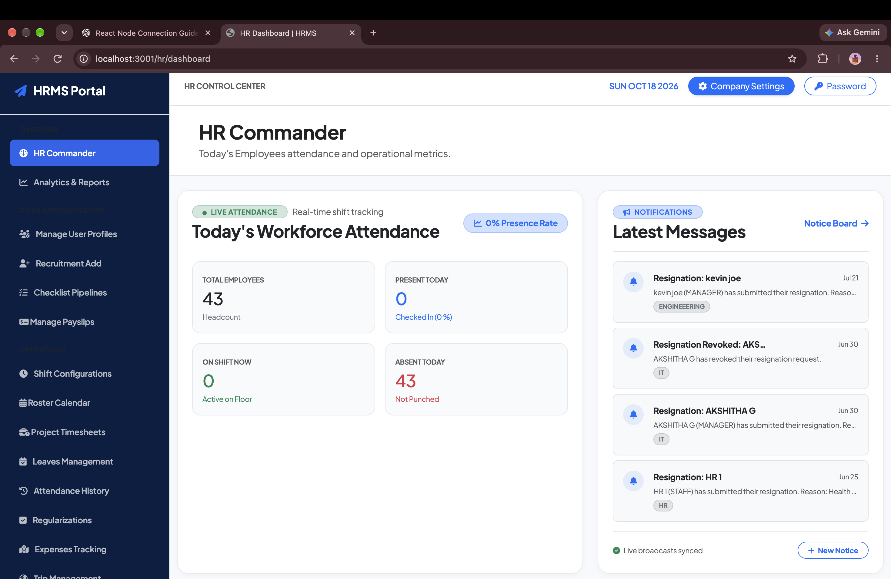
● EXECUTIVE COMMAND CENTER
Real-Time Workforce Radar & Operational Pulse
A single-pane-of-glass executive console giving HR managers instant workforce visibility.
✔ Live Workforce Telemetry
Monitor today's total present headcount, active rotational shifts, checked-out employees, and absenteeism in real time.
✔ One-Click Action Center
Instant access to employee onboarding, document compliance, leave approvals, salary simulations, and branch settings.
✔ Integrated Search & Direct Routing
Search employees, departments, or shifts instantly with role-based administrative safeguards.
Real-Time Feed
ATTENDANCE AUDIT
100% Accurate
HEADCOUNT TRACKING
Notes:
Demonstrate the HR Commander dashboard. This is the central nerve center for our HR team, replacing manual morning phone calls and paper attendance sheets.

Slide 5
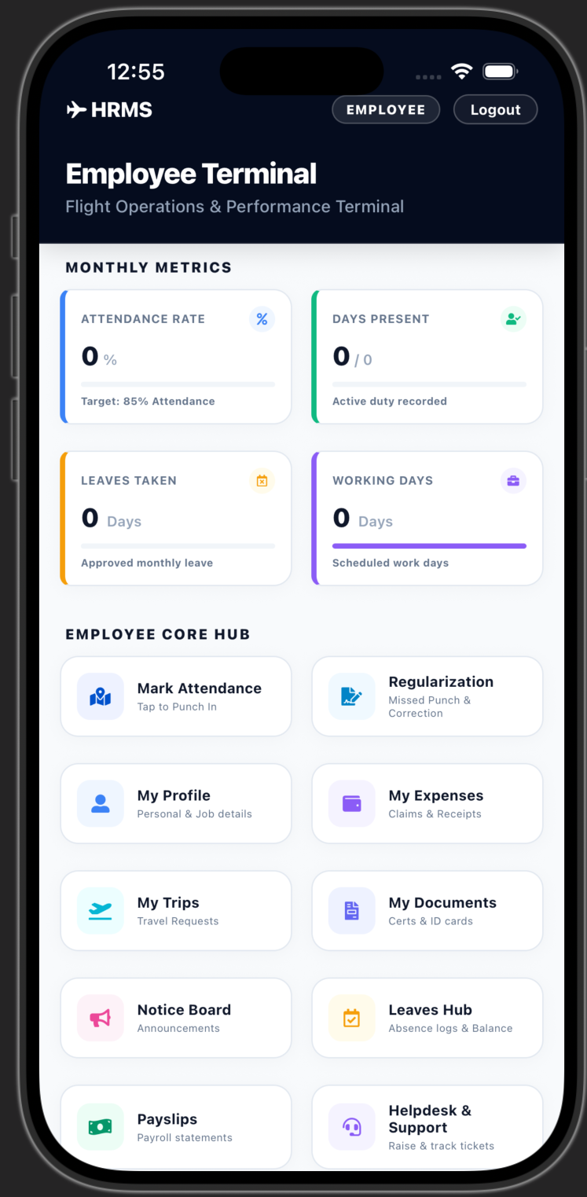
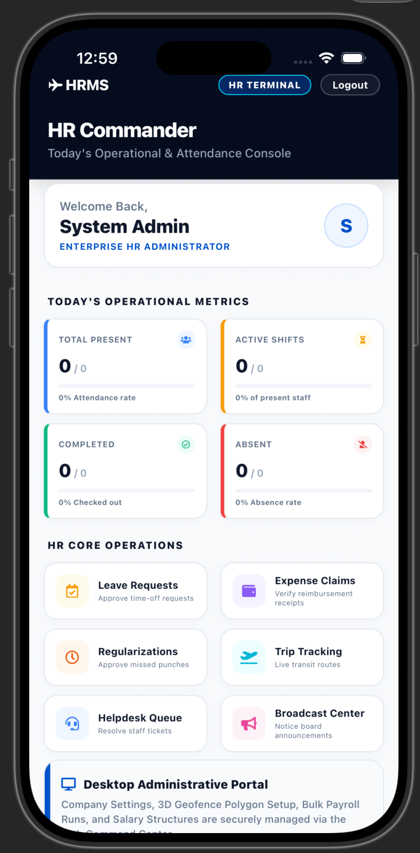
● NATIVE MOBILE SUITE (IOS & ANDROID)
Empowering Every Employee & Manager In Their Pocket
A high-performance React Native mobile app available on both iOS and Android platforms.
★ Dual-Persona Architecture
Single mobile app switches seamlessly between Employee Self-Service and HR Commander terminal based on user permissions.
★ 1-Tap Attendance Punch
Employees clock in with GPS coordinates. Validates office geofence before marking attendance.
★ Real-Time KPI Metric Cards
View monthly attendance rate, days present, approved leaves, and working days on dynamic cards.
★ On-The-Go Approvals
Managers can approve leaves, review expense receipts, and verify travel requests directly from their phone in seconds.
★ Digital ID & Payslip Viewer
Access digital ID badge with QR credentials and view complete monthly payslip breakdowns anytime.
Notes:
Emphasize the Mobile App! We have a real, fully native React Native mobile app running on iOS and Android. Screen 1 shows Employee Terminal; Screen 2 shows HR Commander on mobile. Employees love the convenience; managers love approving requests on the go.

Slide 6
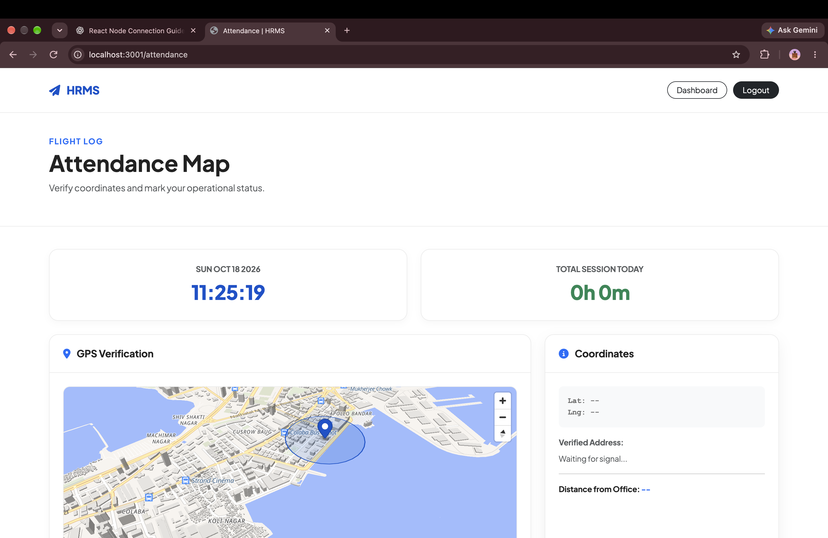
● MOBILE ATTENDANCE & SECURITY
Geofenced Clock-In: Eliminate Buddy-Punching Permanently
Employees can only punch in when physically present within authorized office coordinates.
✔ High-Precision GPS Boundary
Configurable office radius (50m, 100m, 250m) rendered on interactive OpenStreetMap vector circles.
✔ Anti-Spoofing & Mock Location Guard
Built-in hardware location checks detect and reject GPS mockers, VPN tunnels, and spoofed coordinates.
✔ Zero Biometric Hardware Costs
Eliminates physical fingerprint scanners that break down and require annual vendor maintenance contracts.
100% Eliminated
BUDDY PUNCHING
₹0 Machine Cost
HARDWARE CAPEX
Notes:
Highlight how geofenced punch completely replaces biometric hardware machines that cost thousands to maintain, while ensuring staff are physically at the workplace.

Slide 7
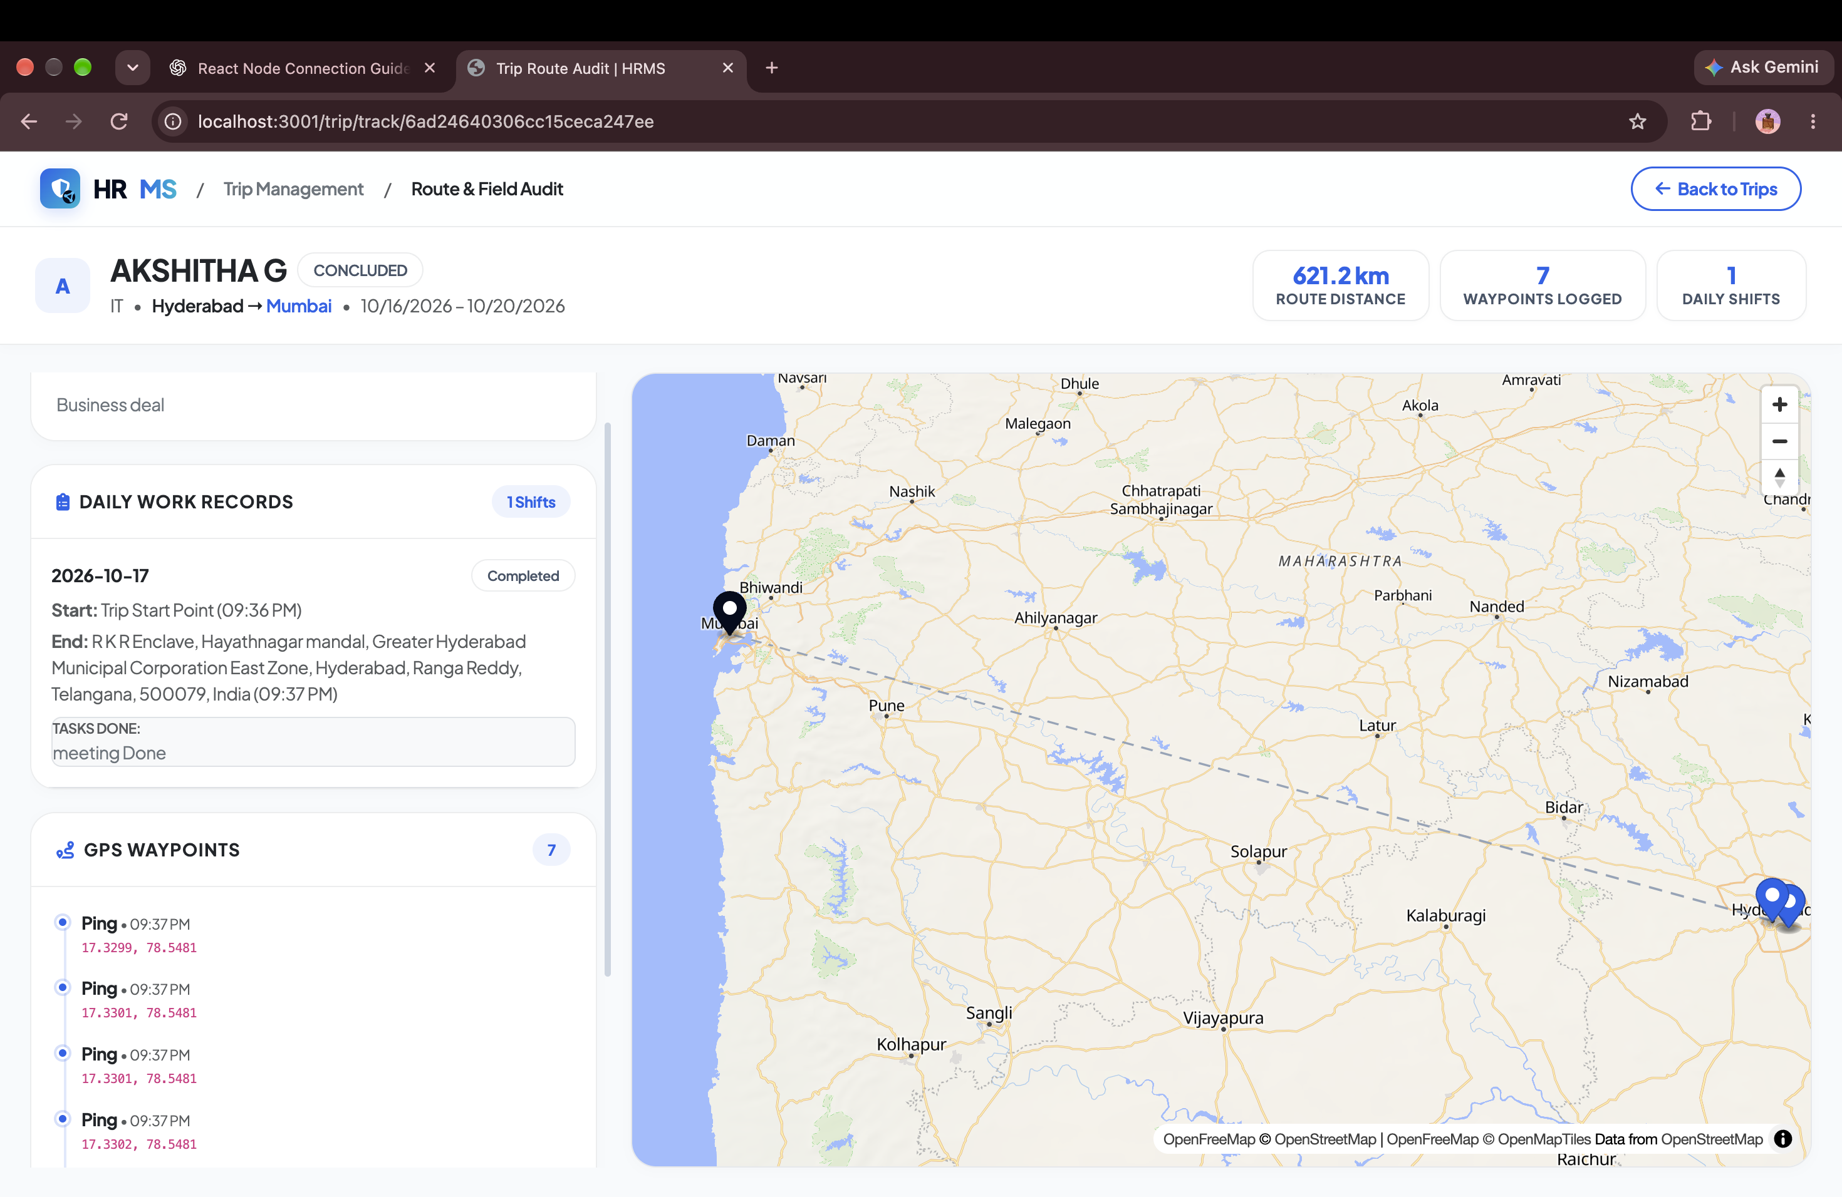
● FIELD MOBILITY & LOGISTICS
Live GPS Fleet Telemetry & Breadcrumb Route Auditing
Track sales visits, site inspections, and executive business trips in real time.
✔ Breadcrumb Route Tracing
Record live transit checkpoints with timestamped GPS coordinates, stop durations, and total odometer distance.
✔ Zero Google Maps API Surcharges
Built on pure OpenStreetMap vector tiles, saving thousands of dollars in proprietary Google Maps billing.
✔ Automated Mileage Expense Calculation
System automatically calculates verified travel reimbursement based on actual GPS kilometers traversed.
100% Verified
TRAVEL CLAIMS
₹0 Surcharge
MAP API TAX
Notes:
Point out this huge competitive advantage: our field tracking uses OpenStreetMap vector tiles. Competitors charge extra or hit you with Google Maps bills. Aura HRMS includes this out-of-the-box.

Slide 8
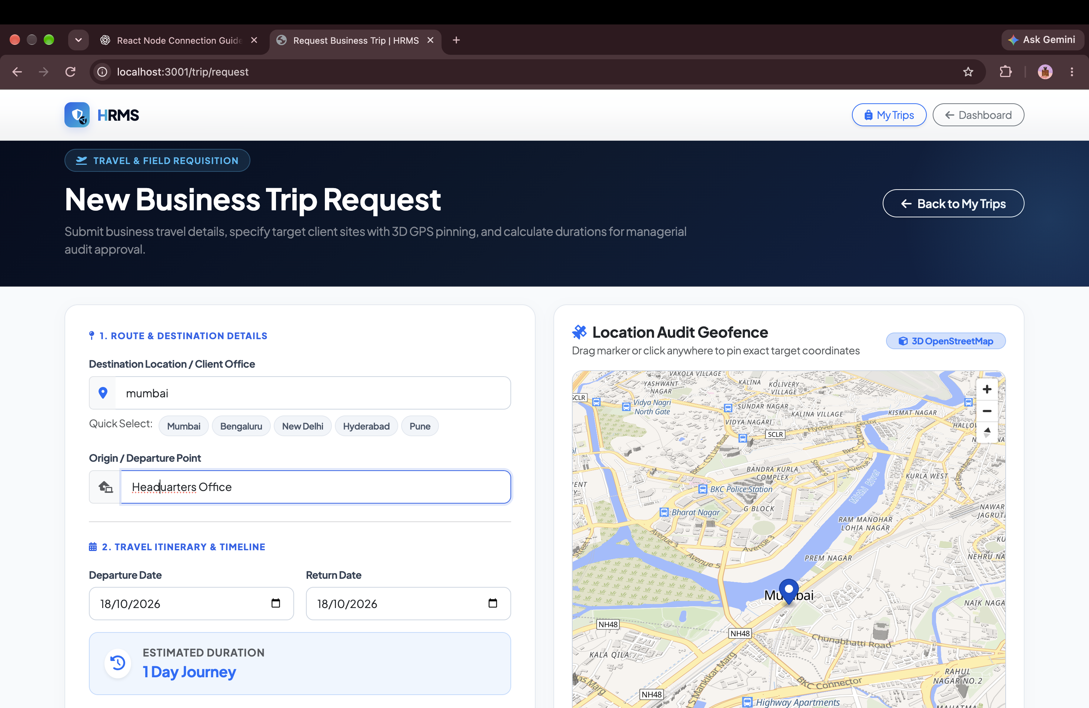
● TRAVEL GOVERNANCE
End-to-End Business Travel Requisitions & Budget Controls
Structured multi-city itinerary creation with per-diem allowance calculations.
✔ Multi-City Travel Wizard
Captures origin, destination, business objectives, transit modes (flight, rail, cab), and planned itinerary dates.
✔ Daily Allowance & Lodging Estimation
Automatically calculates per-diem allowances, hotel lodging ceilings, and client hospitality budgets.
✔ Multi-Tier Manager Approval Routing
Managers review proposed budget, route, and rationale before release of travel advances.
Policy-Controlled
TRAVEL ADVANCES
< 4 Hours
APPROVAL TIME
Notes:
Walk through the business trip booking workflow. Employees plan their itineraries; budgets are pre-approved; expenses are tracked automatically.

Slide 9
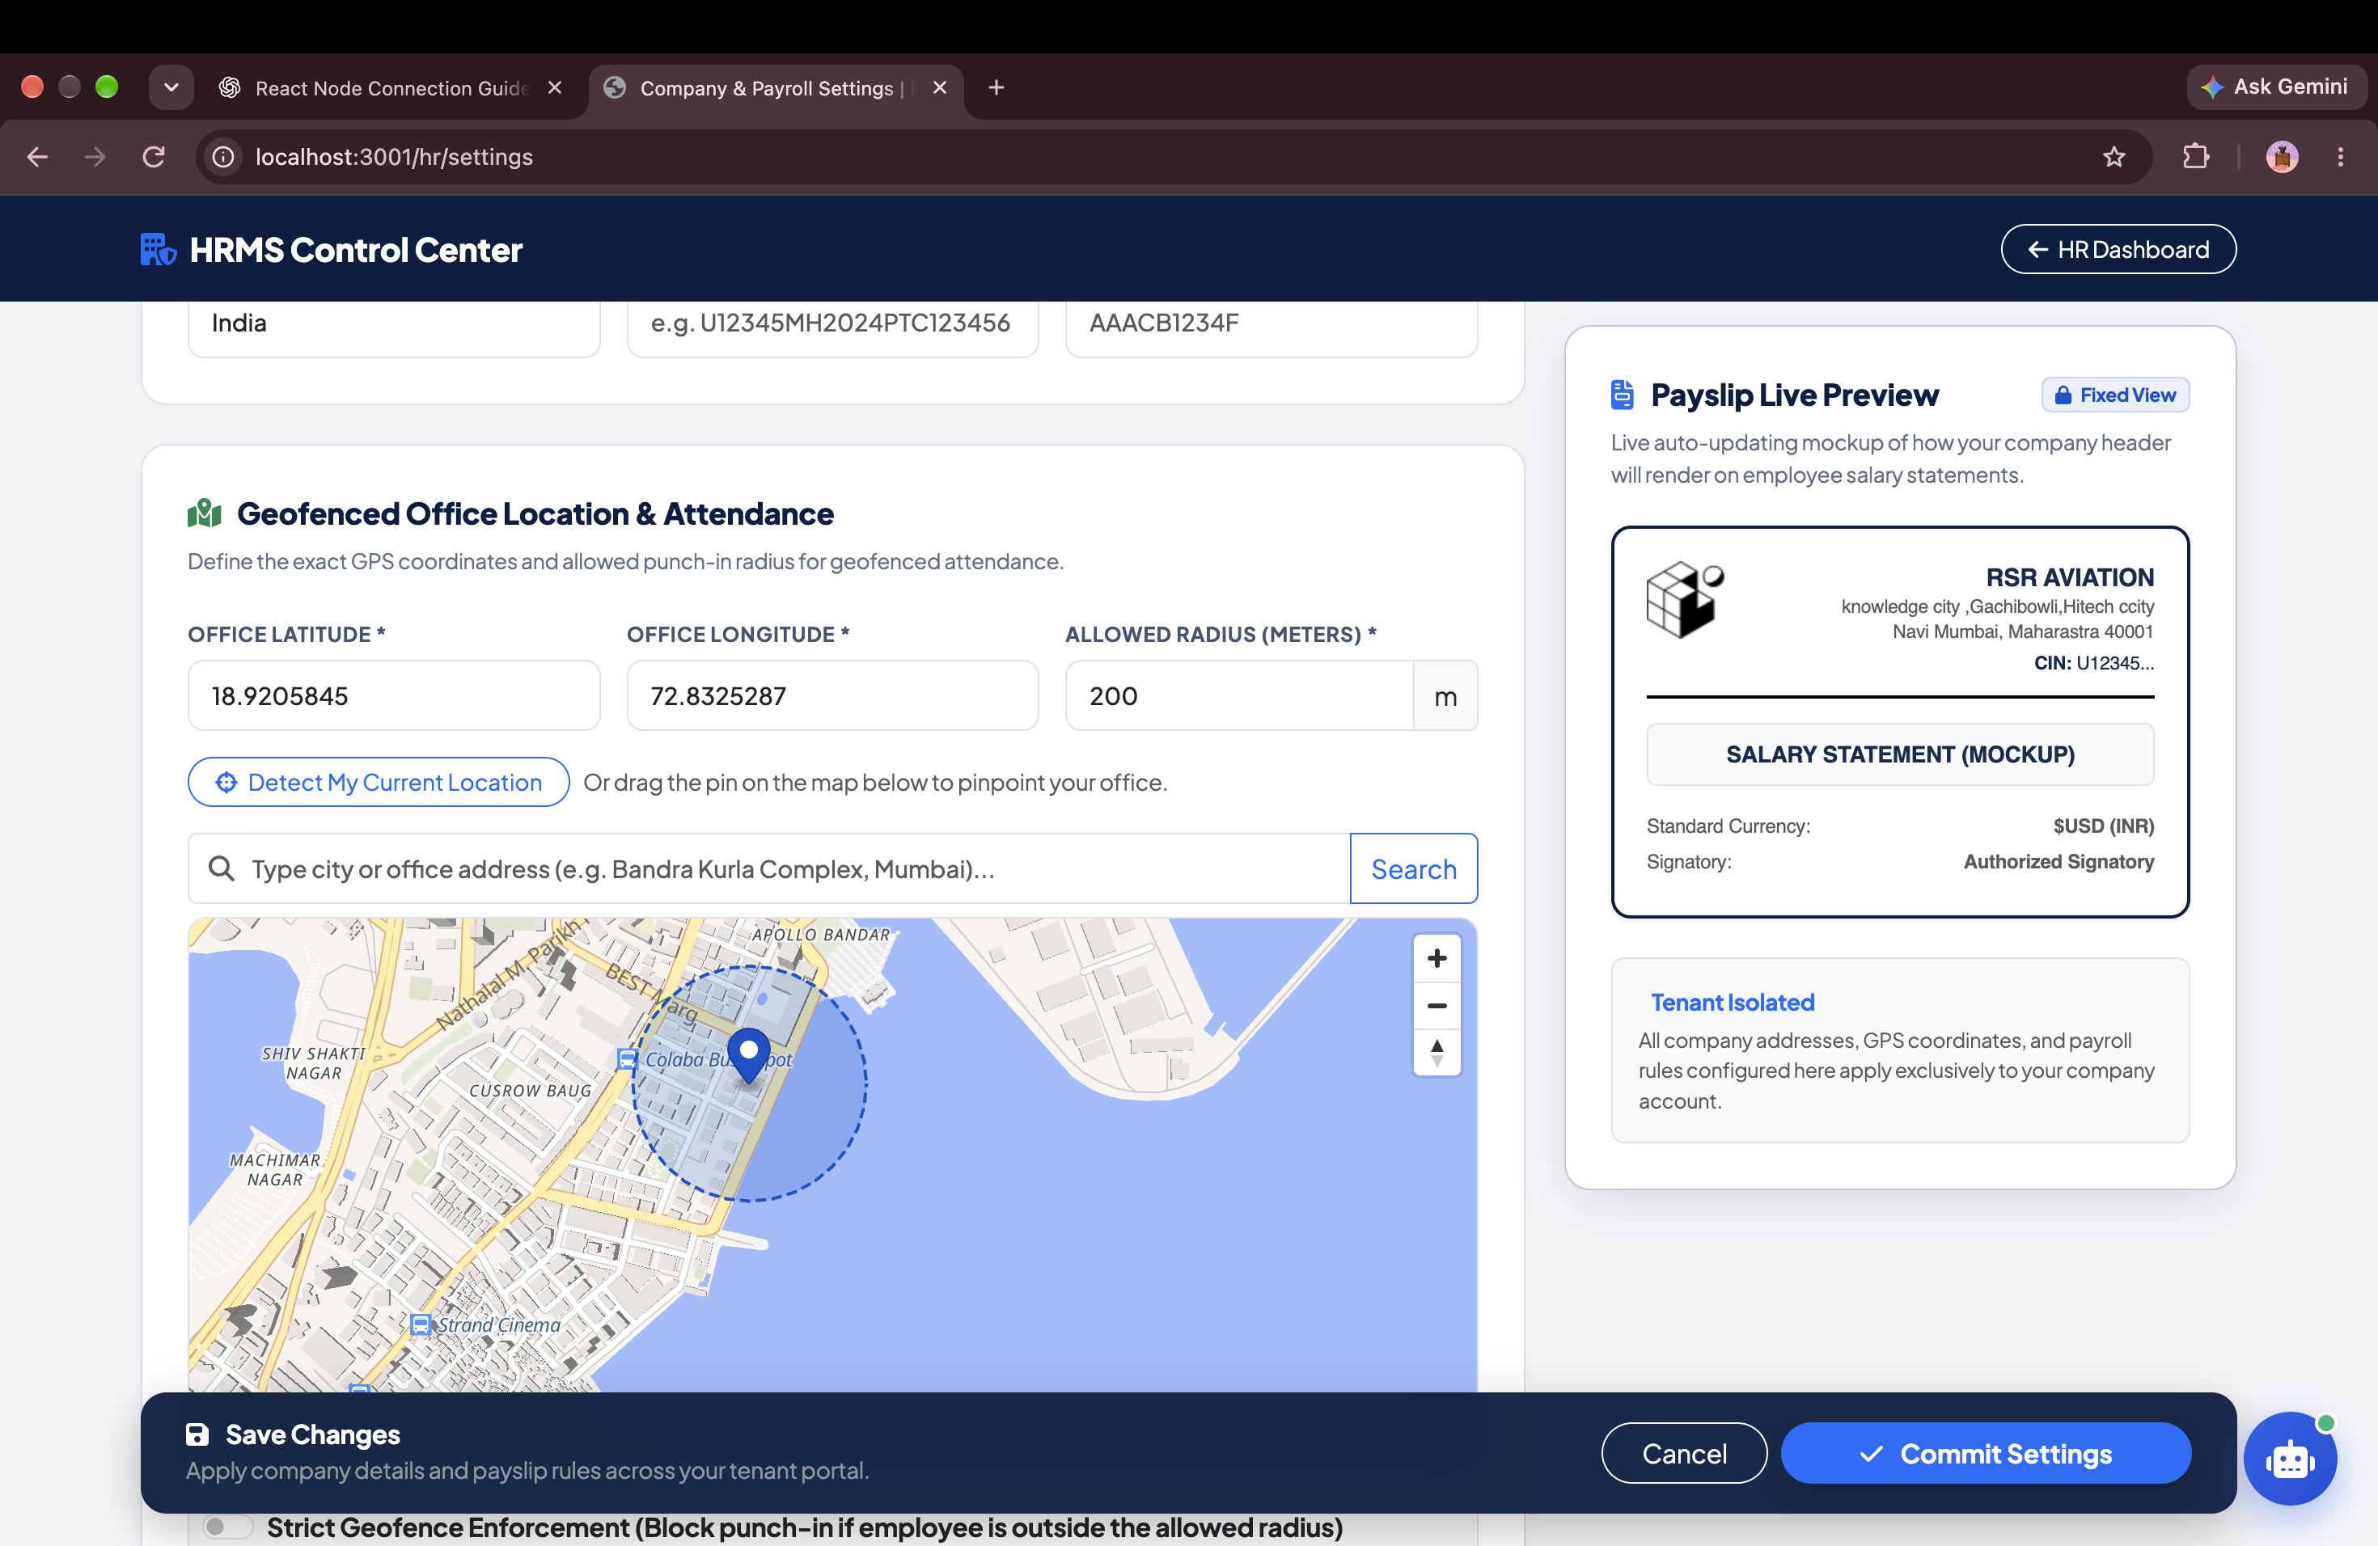
● WORKFORCE SCHEDULING
Flexible Shift Scheduling & Rotational Roster Management
Easily manage General, Morning, Evening, and Night shifts across multi-branch teams.
✔ Custom Shift Configurations
Define shift start/end times, lunch duration, minimum half-day hours, and full-day work thresholds.
✔ Grace Period & Early Departure Rules
Automated late-coming thresholds with grace minutes (e.g. 15 mins) before Loss of Pay triggers.
✔ Overtime Multiplier Logic
Configurable standard and holiday overtime multipliers (1.5x, 2.0x) fed directly into the payroll engine.
24/7 Rotational
SHIFT COVERAGE
Automated
OVERTIME ACCURACY
Notes:
Showcase shift scheduling. Handles complex enterprise roster needs, night shifts, and overtime calculations automatically.

Slide 10
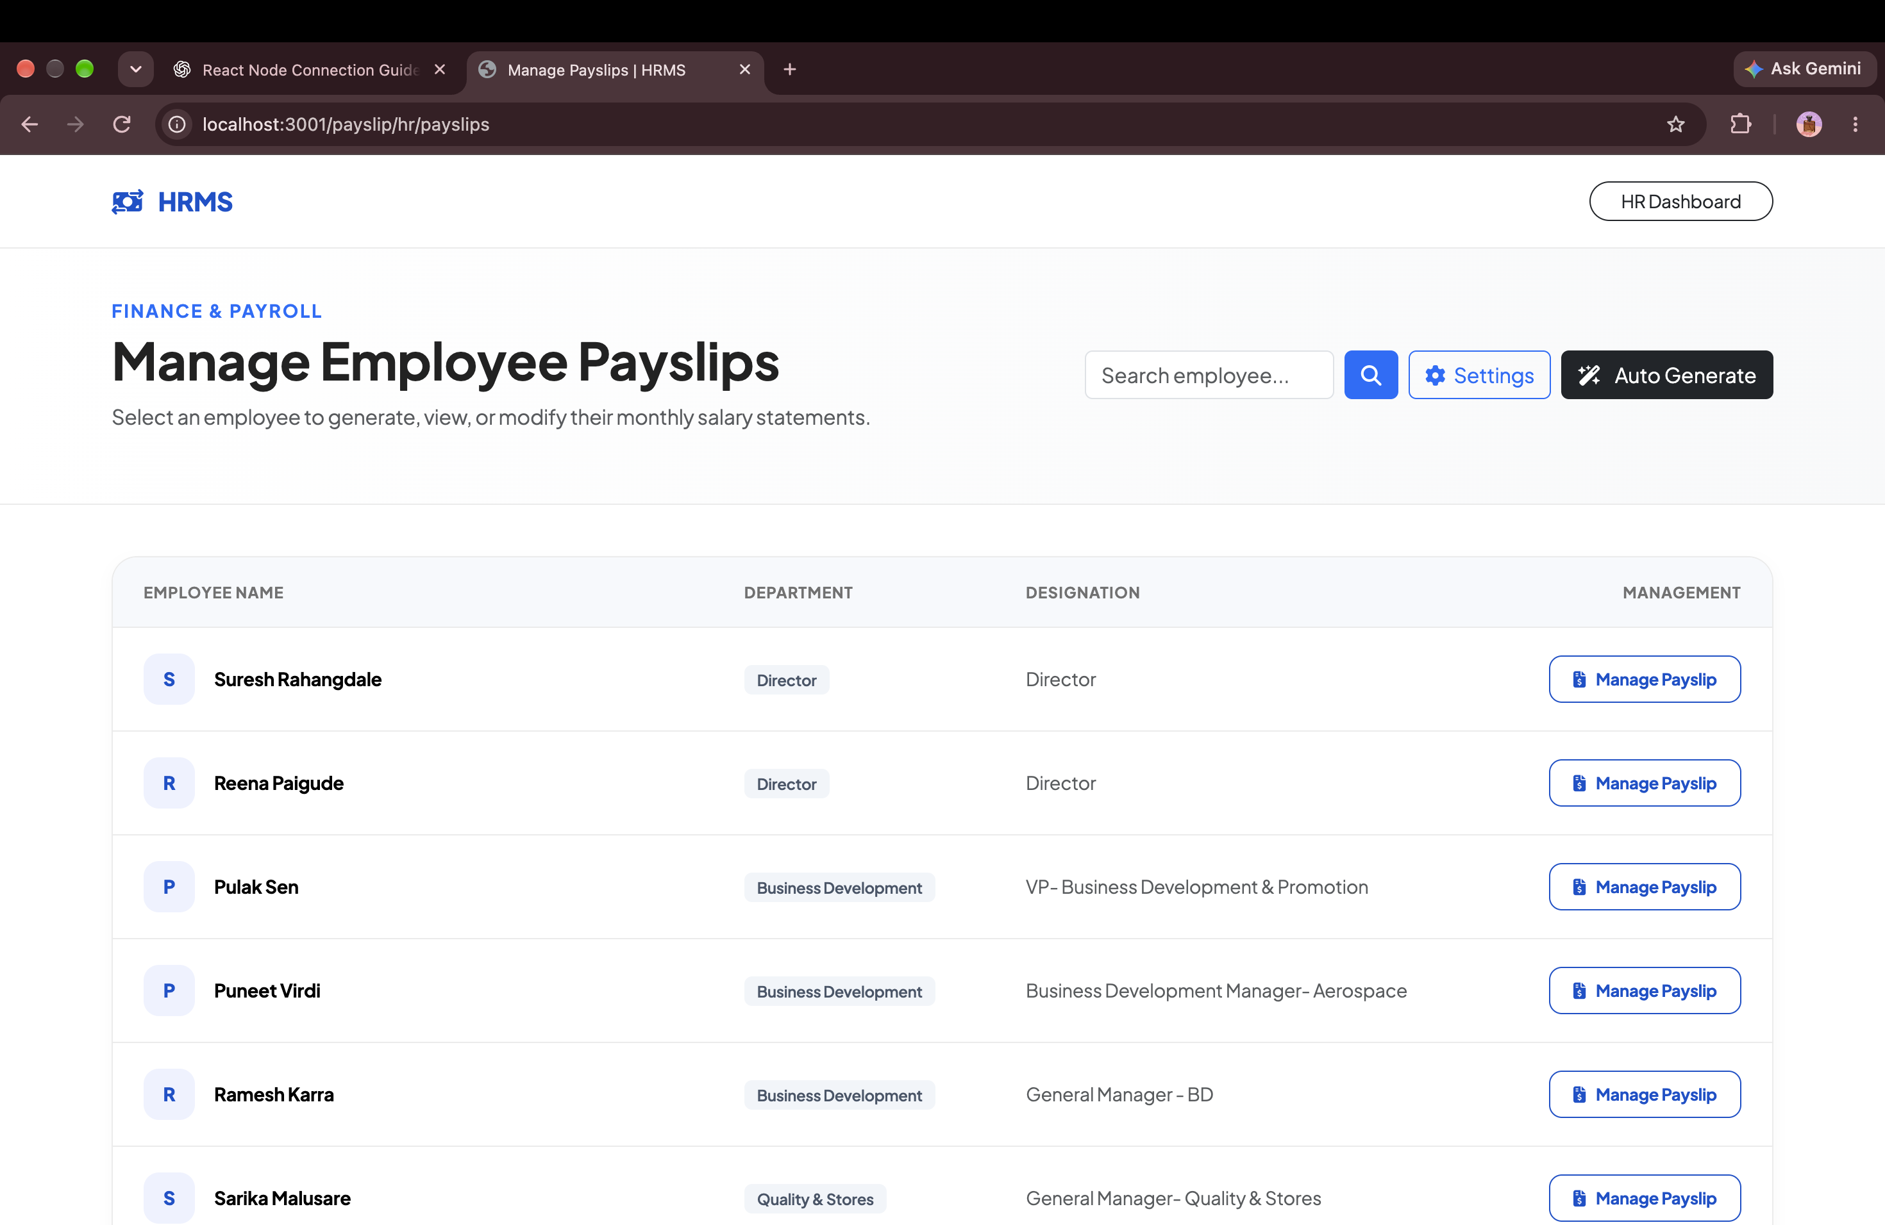
● PAYROLL & COMPLIANCE
Autonomous Indian Statutory Payroll & 1-Click Disbursals
Full statutory compliance with automated computation of PF, ESI, PT, TDS, and Loss of Pay.
✔ 100% Indian Statutory Compliance
Automated calculation of Employee PF (12%), Employer PF (12%), ESI, State Professional Tax, and Income Tax TDS.
✔ Automated Loss of Pay (LOP) Sync
Attendance logs, unapproved leaves, and half-days automatically compute accurate prorated deductions.
✔ Bank Disbursal Export & Branded Payslips
Generate standard bank NEFT/RTGS disbursal CSVs and publish password-protected PDF payslips instantly.
< 15 Minutes
PAYROLL RUN TIME
Zero Risk
COMPLIANCE ERRORS
Notes:
Explain payroll capabilities. Our engine eliminates Excel payroll calculations and guarantees full Indian statutory tax compliance.

Slide 11
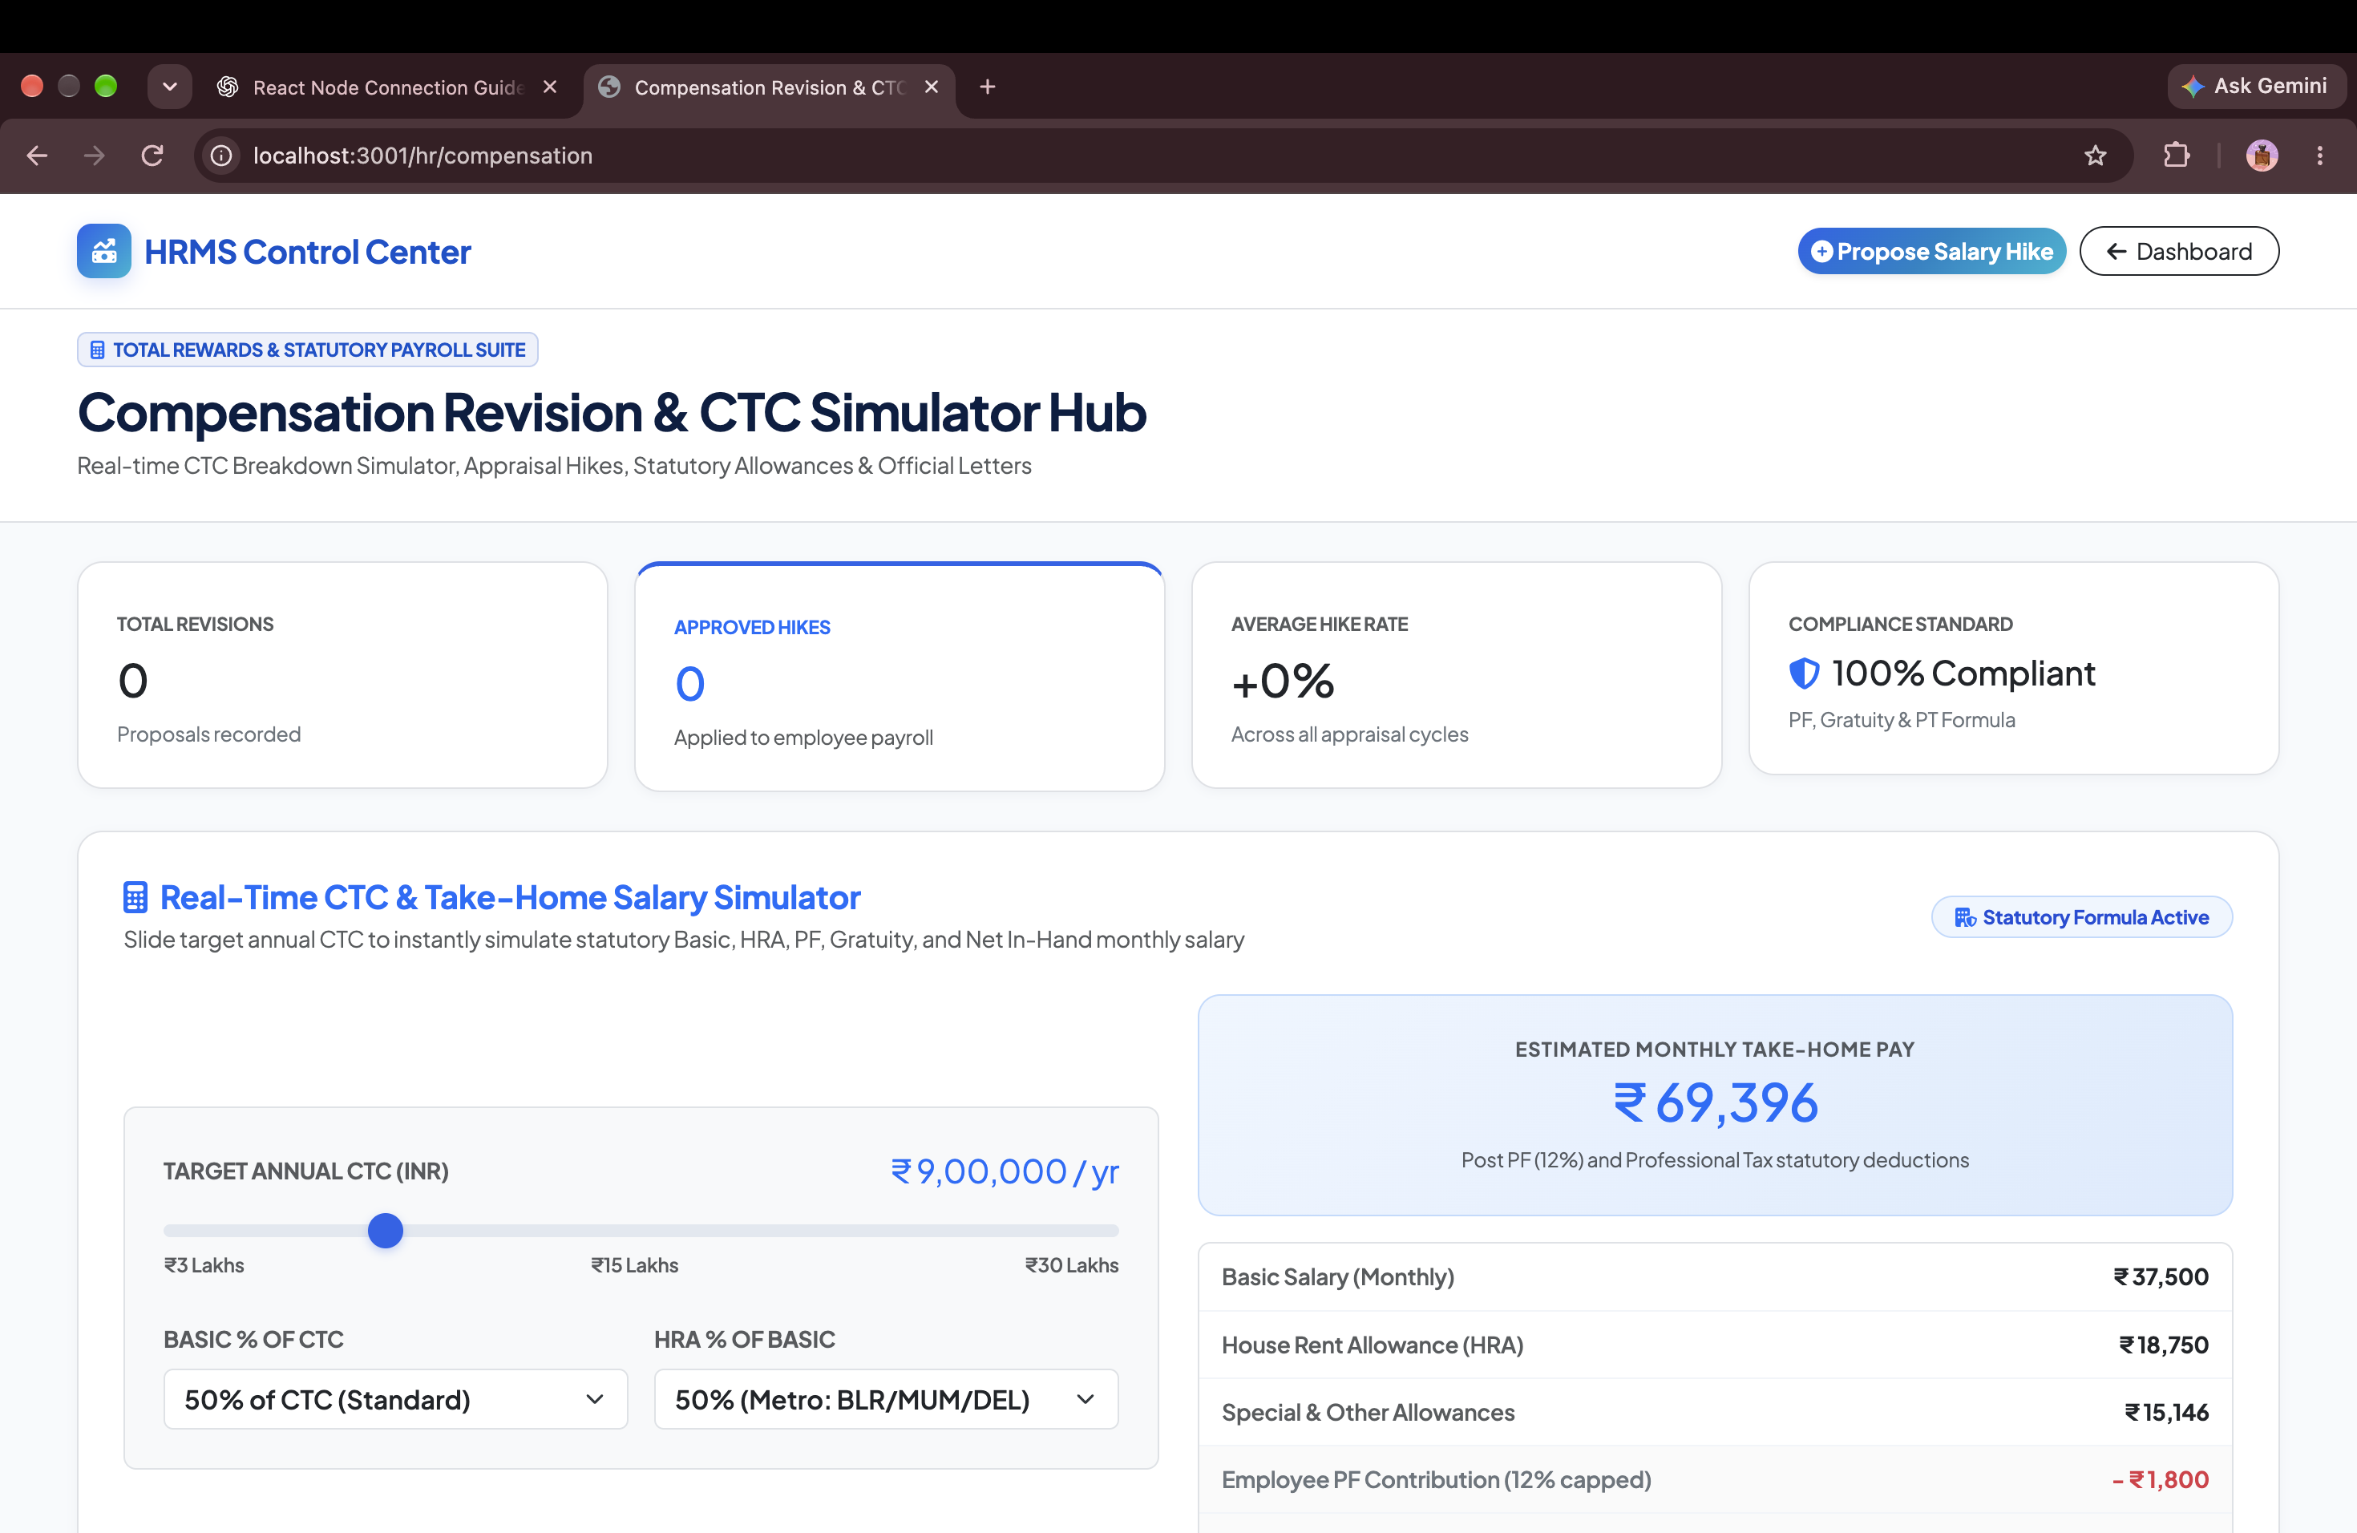
● COMPENSATION ENGINEERING
Interactive CTC Hike Simulator & Branded Increment Letters
Model salary revisions with real-time budget forecasting and automated letter generation.
✔ Real-Time 'What-If' CTC Simulator
Slide percentage increments (e.g. 8%, 12%, 18%) and instantly see revised Basic Pay, HRA, and employer liabilities.
✔ Promotion & Designation Alignment
Seamlessly upgrade employee job levels, bands, and departmental designations alongside salary revisions.
✔ 1-Click PDF Increment Letters
Instantly produce professionally formatted, branded compensation revision letters ready for executive sign-off.
Instant Math
HIKE MODELING
1-Click PDF
LETTER GEN
Notes:
Demonstrate the CTC simulator. During appraisal cycles, management can model salary budgets in real time and generate official increment letters with a single click.

Slide 12
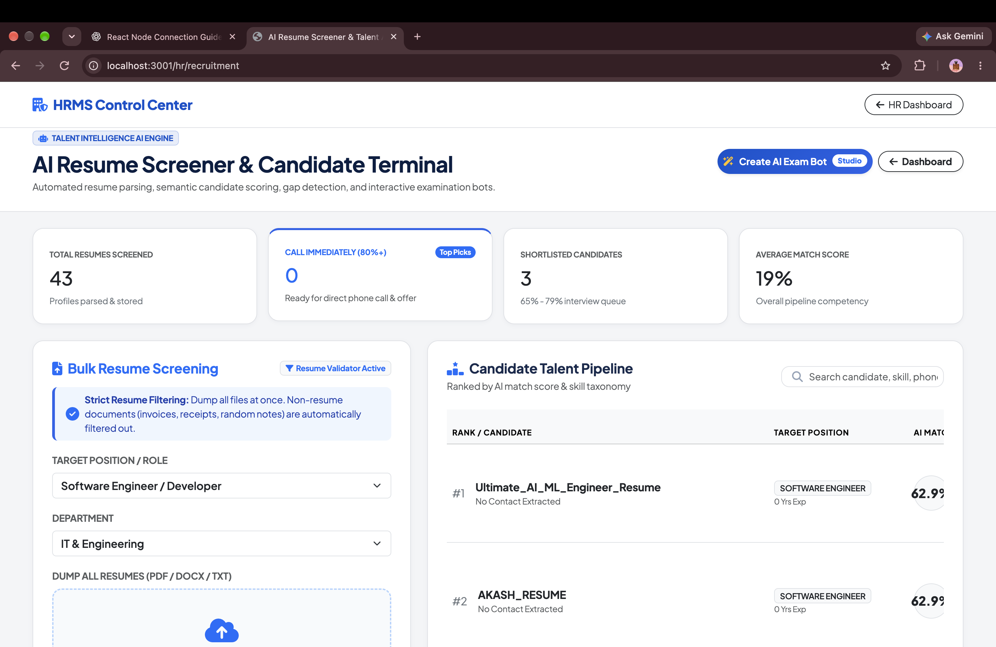
● AI TALENT INTELLIGENCE
AI Resume Screener & Candidate Scrutiny Engine
Screen hundreds of candidate resumes in minutes with AI weighted skill matching.
✔ Bulk Drag-and-Drop Resume Parsing
Upload up to 20 candidate resumes (PDF/DOCX) simultaneously or paste raw CV text for instant NLP analysis.
✔ Scientific Multi-Factor Fit Score (0-100%)
Evaluates candidate Skill Coverage (40%), Domain Experience (25%), and Academic Credentials (15%).
✔ 1-Click Employee Onboarding
Instantly convert high-scoring candidates into active employee accounts with auto-generated credentials.
10x Faster
SCREENING SPEED
STRONG_HIRE Tag
RECOMMENDATION
Notes:
Highlight the AI Resume Screener. HR teams save dozens of recruiter hours by screening bulk resumes automatically and onboarding shortlisted talent in 1 click.

Slide 13
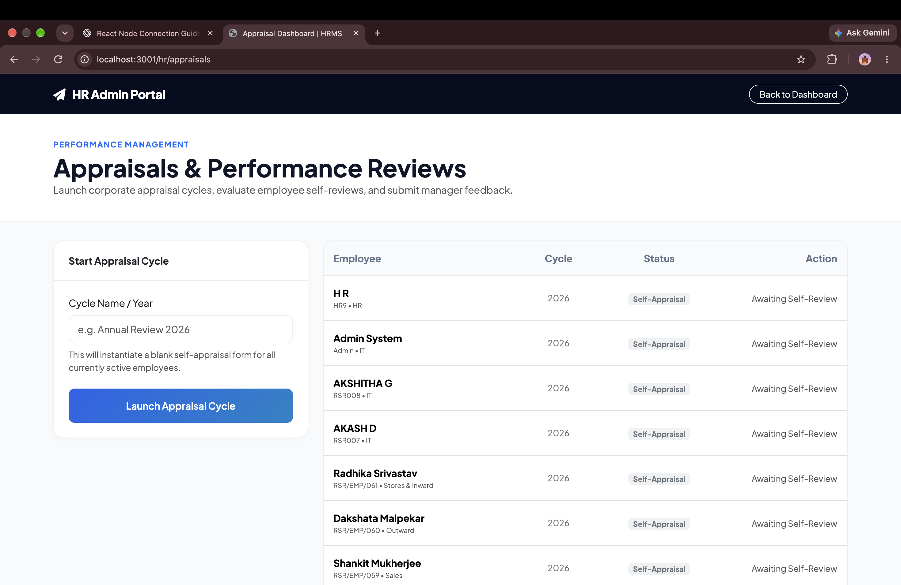
● PERFORMANCE MANAGEMENT
360° Appraisal Framework & Continuous OKR Tracking
Align individual employee goals with departmental OKRs and company revenue targets.
✔ Multi-Tier Performance Evaluation
Self-appraisals, reporting manager ratings, and peer reviews compiled into a comprehensive merit score.
✔ Quantitative & Qualitative Metrics
Track revenue milestones, project delivery SLAs, leadership competencies, and behavioral feedback.
✔ Historical Merit Dossier
Maintain multi-year appraisal scorecards to support data-driven promotion and retention decisions.
Paperless
APPRAISAL CYCLE
Objective Data
MERIT ACCURACY
Notes:
Show how PMS bridges everyday employee productivity with annual merit increments and organizational goals.

Slide 14
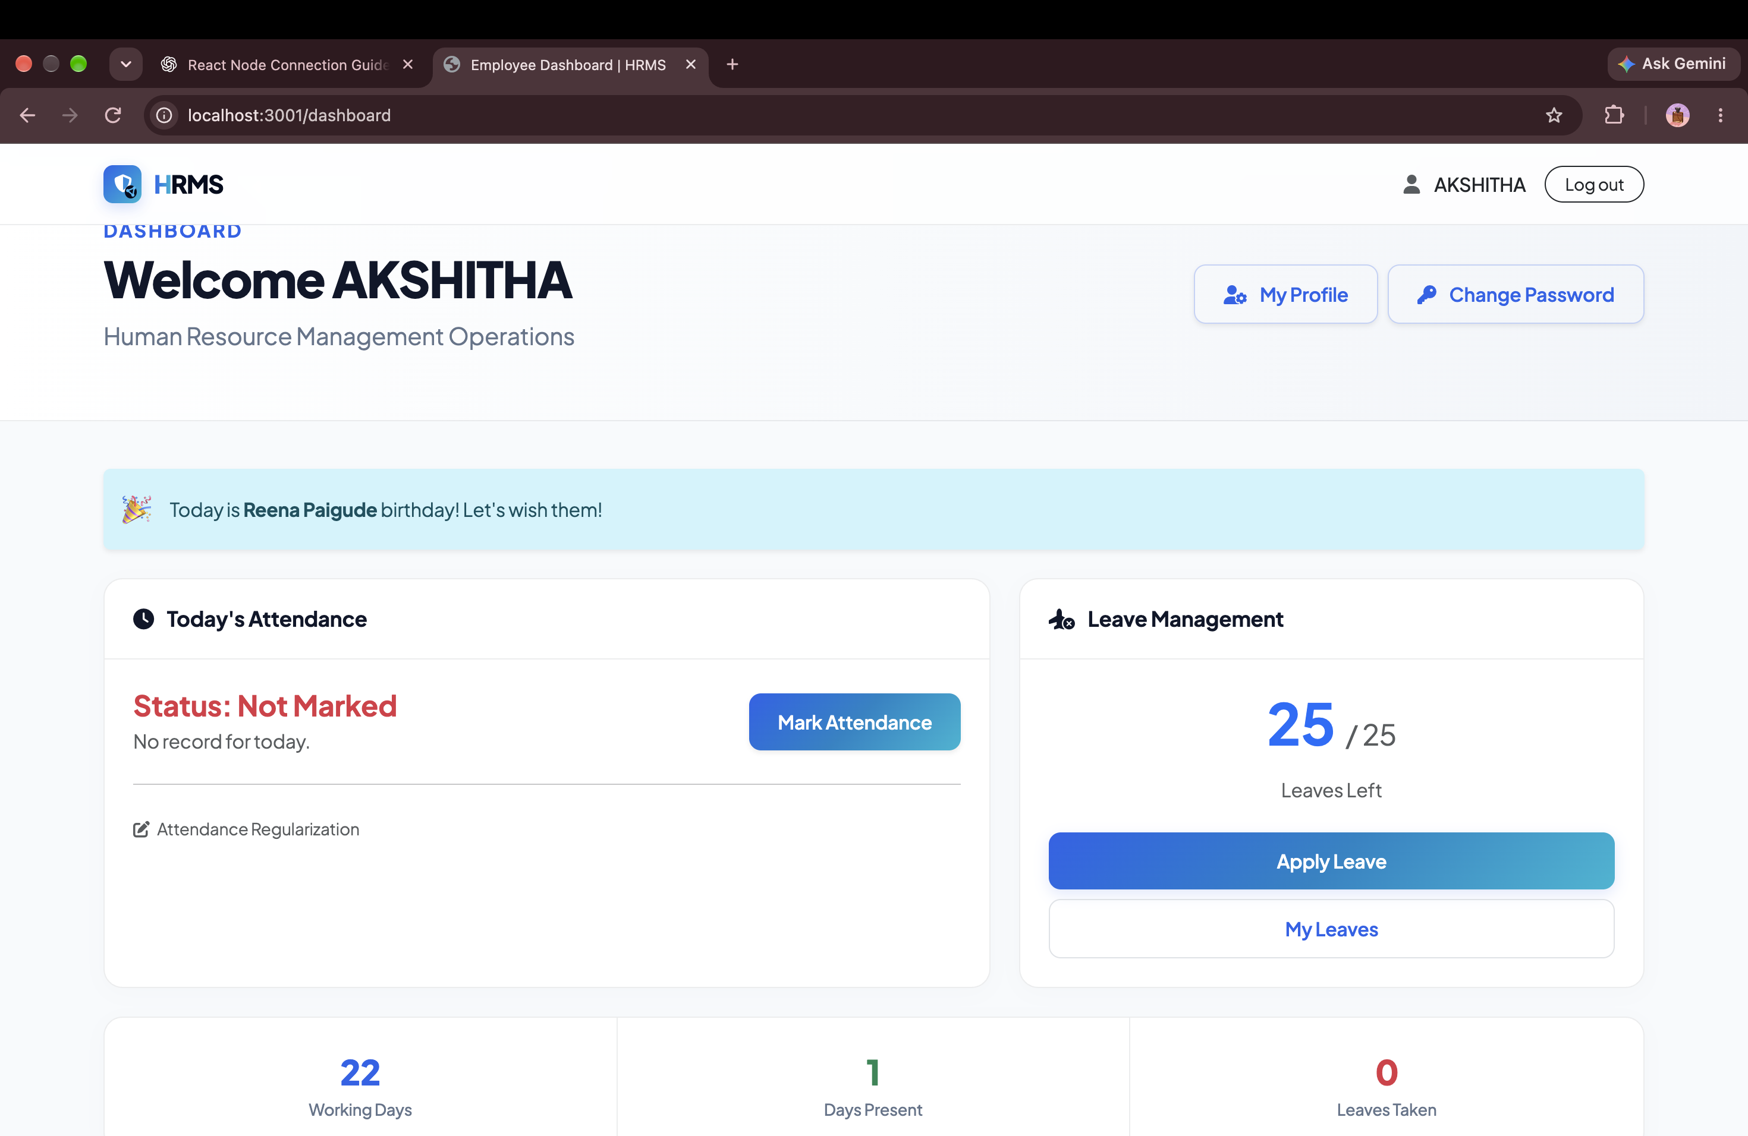
● EMPLOYEE EXPERIENCE
Modern Employee Self-Service (ESS) & Digital Workplace
A consumer-grade portal where employees manage leaves, payslips, and daily tasks.
✔ Transparent Salary Breakdown
Employees view detailed payslips with earnings, tax deductions, and download signed PDF salary slips.
✔ Frictionless Leave & Absence Requests
Check real-time leave quotas (Casual, Sick, Earned) and submit leave applications with 1 click.
✔ Company Broadcast Notice Board
Receive organization-wide announcements, policy updates, holiday calendars, and executive townhall notices.
-65% Queries
HR TICKET REDUCTION
4.9/5 Rating
SATISFACTION
Notes:
Explain the Employee Self-Service experience. Eliminates repetitive HR inquiries about leave balances and payslips.

Slide 15
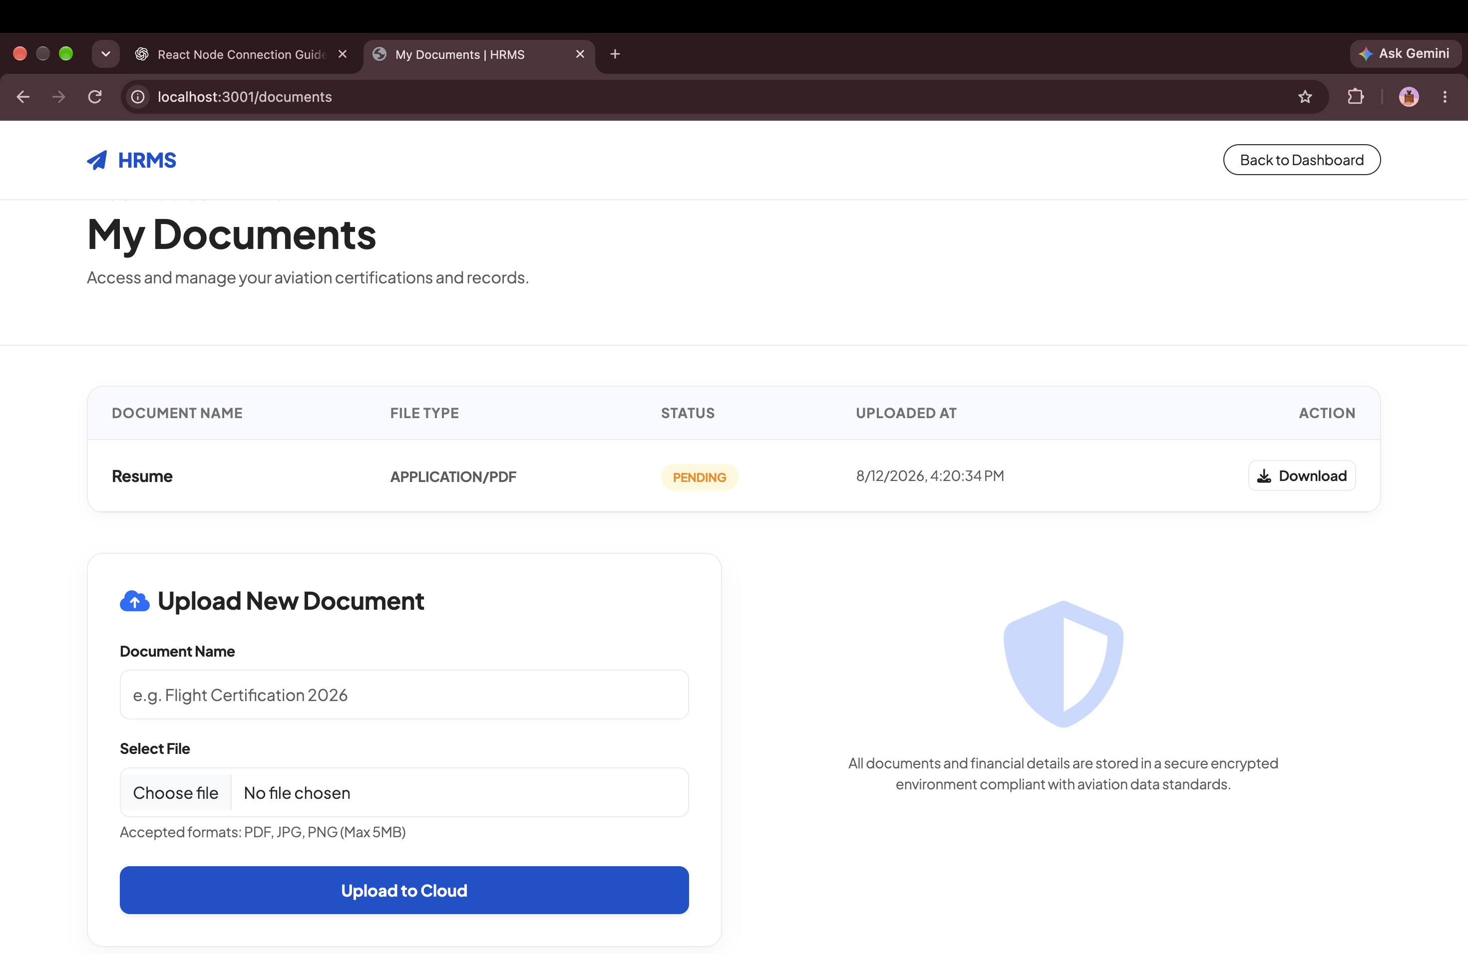
● SECURITY & COMPLIANCE
Bank-Grade Security: Dynamic Database Isolation per Tenant
Engineered for stringent enterprise security standards and India's DPDP Act 2023.
✔ Dynamic Tenant Database Isolation
Each company's records are housed in an isolated MongoDB database (HRMS_<tenantId>), guaranteeing zero data leakage.
✔ Encrypted Digital Document Vault
Encrypted storage for Aadhaar, PAN, educational credentials, NDAs, and employment contracts.
✔ Role-Based Access Control (RBAC)
Strict privilege tiers separating Super-Admin, HR Manager, Department Head, and Employee permissions.
100% Dedicated DB
DATA ISOLATION
DPDP Act 2023
COMPLIANCE
Notes:
Assure leadership and IT/Security that employee personal data is completely segregated and encrypted with zero co-mingling across tenants.

Slide 16
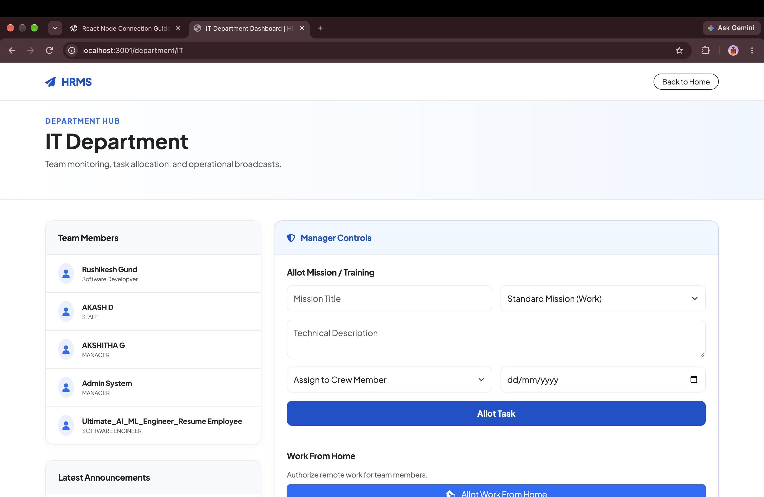
● IT OPERATIONS & HELPDESK
Integrated IT Asset Tracking & Multi-Department Helpdesk
Prevent hardware asset loss and streamline internal employee service requests.
✔ Hardware Inventory & Custodian Logs
Track laptops, monitors, mobile devices, serial numbers, warranty dates, and custodian handovers.
✔ Multi-Department SLA Ticketing
Unified helpdesk routing tickets to IT, HR, Finance, or Admin with priority triage and resolution SLAs.
✔ Offboarding Asset Recovery Checklist
Automated asset recovery workflow during employee offboarding before releasing final settlement.
100% Accounted
ASSET RECOVERY
Avg < 24 Hours
TICKET SLA
Notes:
Highlight the IT asset management and helpdesk ticketing. Replaces costly Jira Service Desk or Freshdesk subscriptions.

Slide 17
● MARKET BENCHMARK
How Aura HRMS Outperforms Legacy Enterprise Alternatives
Side-by-side capability and cost matrix against Keka, Darwinbox, and Workday.
Capability / Requirement | AURA HRMS (Ours) | Keka HR | Darwinbox | Workday
Native iOS & Android Mobile Suite | ✔ Built-in (Dual Persona) | ✔ Included | ✔ Included | ✔ Included
Live OpenStreetMap GPS Tracking | ✔ 100% Free ($0 API Tax) | ❌ Not Available | ⚠ Expensive Add-on | ❌ Not Available
Indian Statutory Payroll (PF/ESI/TDS) | ✔ Fully Automated | ✔ Included | ✔ Complex Setup | ⚠ High Customization
AI Resume Screener & Fit Score | ✔ Integrated Engine | ❌ Third-Party Add-on | ⚠ Enterprise Add-on | ⚠ High Enterprise Cost
Database Multi-Tenancy Architecture | ✔ Dynamic Isolated DB | ❌ Shared Schema | ❌ Shared Cluster | ⚠ Shared Cloud
Estimated Annual Cost (150 Staff) | ₹75,000 / year total | ₹2,16,000 / year | ₹3,80,000 / year | $25,000+ USD
Notes:
Talking Point: This table proves our value proposition. We match or exceed enterprise capabilities at a fraction of the cost, without the extortionate add-on fees or lock-ins of Keka and Darwinbox.

Slide 18
● BUSINESS IMPACT & ROI
Quantifiable Financial Return on Investment: ₹14.5L+ Annual Savings
Measurable reduction in administrative overhead, timecard fraud, and vendor subscription fees.
ELIMINATE TRAVEL FRAUD
₹5.4 Lakhs / yr
Live GPS route tracking and OpenStreetMap odometer telemetry prevent inflated taxi and mileage claims permanently.
STOP BUDDY-PUNCHING
₹3.8 Lakhs / yr
Geofenced radar validation eliminates unverified check-ins, false overtime claims, and manual register tampering.
CONSOLIDATE SOFTWARE
₹3.2 Lakhs / yr
Replace separate subscriptions for ticketing, GPS tracking, notice boards, and HR software into one unified platform.
REDUCE HR ADMIN HOURS
₹2.1 Lakhs / yr
Save 40+ HR hours per month on manual payroll reconciliation, paper leave forms, and employee inquiry emails.
Notes:
Talking Point: Present this slide to the CFO and CEO. For an organization of our size, adopting Aura HRMS pays for itself in less than 30 days while generating over ₹14 Lakhs in net annual operational savings.

Slide 19
● ROLLOUT TIMELINE
Frictionless 30-Day Implementation & Zero-Downtime Migration
Structured 3-phase deployment ensuring continuous payroll continuity and smooth employee onboarding.
Phase 1: Setup & Policy (Days 1–5)
Provisioning & Rules Setup
✔ Dynamic Tenant Database Provisioning
✔ Configure Office Geofence Coordinates & Radius
✔ Set up Company Shifts, Rosters & Overtime Rules
✔ Configure Indian Statutory Tax Slabs (PF/ESI/PT)
Phase 2: Migration & Mobile (Days 6–15)
Data & Mobile Rollout
✔ Bulk CSV Import of Employee Records & CTC Structures
✔ Distribute Native Mobile App (iOS / Android APK)
✔ Conduct 30-Minute Department Manager Training
✔ Test Geofenced Attendance & Field Trip Tracking
Phase 3: Parallel Run & Launch (Days 16–30)
Full Production Go-Live
✔ Execute Parallel Payroll Run with Historical Data
✔ Verify Exact PF, ESI, TDS, and Net Pay Consistency
✔ Switch Off Legacy Paper / Spreadsheet Systems
✔ Full Company-Wide Production Launch
Notes:
Talking Point: Address the 'transition risk' objection. We do not disrupt existing operations. Phase 3 executes a parallel payroll run to verify 100% mathematical consistency before switching over.

Slide 20
EXECUTIVE RECOMMENDATION
Approve Immediate Deployment of Aura HRMS
Everything is built, verified, and operational. Adopting this unified suite secures our workforce data, slashes administrative costs, and arms our teams with a modern mobile app.
★ Zero Setup Risk: Our workspace and multi-tenant isolated database are ready to provision in under 5 minutes.
★ Immediate Cost Savings: Consolidate 4+ vendor bills immediately, saving ₹14.5L+ annually.
★ Mobile App Ready: Employees download the iOS/Android app on Day 1 with zero IT friction.
★ Full Statutory Safety: Automated Indian payroll eliminates compliance fines and audit anxiety.
Notes:
Closing Call to Action: Summarize the decision. The system is ready, the mobile app is built, the ROI is mathematically proven. Ask for approval to begin Phase 1 setup today.

