Slide 1
ENTERPRISE WORKFORCE SUITE v4.5
Unified Autonomous HR, AI Talent Intelligence,
Field Mobility & Statutory Payroll
A modern enterprise platform engineered to replace 7 disparate SaaS subscriptions with 1 unified, high-performance ecosystem.
01. AI Resume Screening
Autonomous RAG semantic matching & 1-click tailored exam bots
02. Statutory Payroll
100% error-free tax slabs, overtime rules & instant payslips
03. Field Mobility & GPS
OpenStreetMap breadcrumb route audits with zero Google API fees
04. Geofenced Attendance
Radius-bounded mobile punches preventing buddy-punching & fraud
HRMS ENTERPRISE SUITE • Confidential & Proprietary • Enterprise Workforce Operating System
Slide 1 of 41

Slide 2
BUSINESS IMPACT & QUANTIFIABLE ROI
Eliminate Administrative Bottlenecks, Fraud & Software Sprawl
78%
Hiring Velocity Increase
Cut time-to-hire from weeks to hours via automated RAG screening & technical exam bots.
100%
Payroll Calculation Accuracy
Zero manual errors in tax deductions, PF/ESI, overtime multipliers, and CTC disbursals.
42%
Travel Expense Leakage Eliminated
Real-time OpenStreetMap route breadcrumbs & GPS timestamps eliminate inflated vouchers.
99.4%
Attendance Compliance Rate
Strict radius geofencing eliminates buddy-punching and remote punch spoofing.
HRMS ENTERPRISE SUITE • Confidential & Proprietary • Enterprise Workforce Operating System
Slide 2 of 41

Slide 3
TECHNICAL ARCHITECTURE & SECURITY
Built on Modern, Resilient, Cloud-Native Engineering
ENTERPRISE CORE
Multi-Tenant Node.js & MongoDB
• Complete tenant data isolation preventing cross-organization leakage
• High-throughput asynchronous architecture handling 10,000+ concurrent requests
• Helmet HTTP security headers, CORS protection, and rate-limiting guards
TALENT INTELLIGENCE
FastAPI & ChromaDB AI Microservice
• Dedicated Python AI service running ChromaDB vector database
• Sentence-transformers semantic resume matching and automated fit scoring
• Automated candidate exam bot generation across multiple engineering domains
ZERO API BILLING
Pure OpenStreetMap Telemetry Engine
• OpenFreeMap Bright vector tiles replacing expensive proprietary Google Maps API
• Zero monthly map billing charges regardless of employee tracking volume
• Millimeter-level geofence polygon checks and real-time breadcrumb rendering
MOBILE WORKFORCE
Cross-Platform React Native Mobile App
• Single codebase for iOS and Android built on modern React Native Expo
• Offline-resilient attendance and trip logging with background sync
• Full mobile trip management, receipt photos, and field expense claim vouchers
HRMS ENTERPRISE SUITE • Confidential & Proprietary • Enterprise Workforce Operating System
Slide 3 of 41

Slide 4
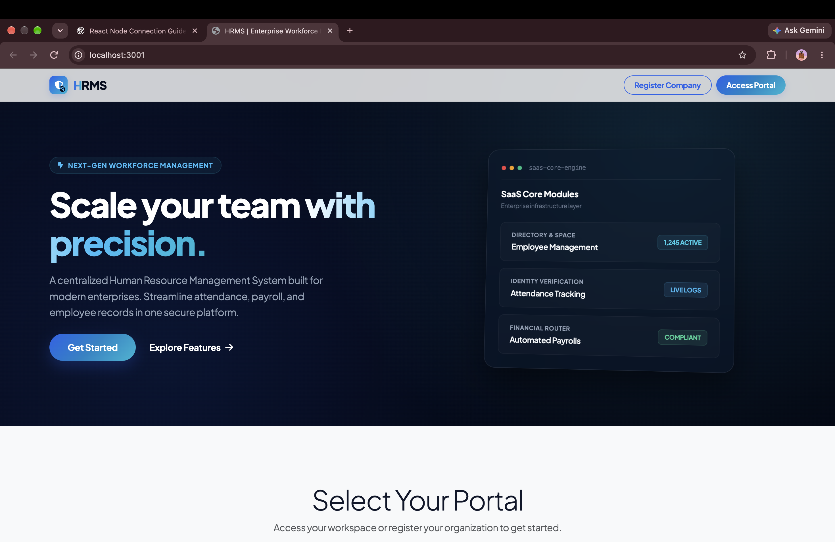
OPERATIONS & SECURITY
Access Portal & Multi-Tenant Authentication
EXECUTIVE SUMMARY
Enterprise security gate providing role-based login (SuperAdmin, HR Admin, Employee, Manager) with session hardening and encrypted credential management.
CORE BUSINESS ADVANTAGES
✔ Zero-Trust Security: BCrypt salted hashing, session token rotation, and brute-force rate-limiting protection.
✔ Role-Based Workspaces: Dynamic redirection to role-specific interfaces ensuring strict data segregation.
✔ Tenant Isolation: Ensures enterprise credentials and sessions remain completely separated across corporate tenants.
ENTERPRISE IMPACT • SECURITY
MFA-Ready & SOC2 Principles
HRMS ENTERPRISE SUITE • Confidential & Proprietary • Enterprise Workforce Operating System
Slide 4 of 41

Slide 5
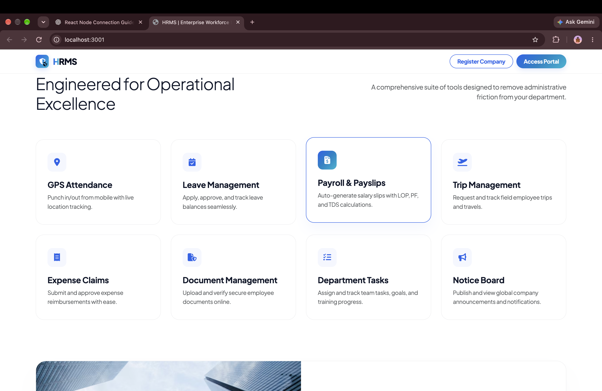
OPERATIONS & TENANCY
Instant Company Onboarding & Tenant Provisioning
EXECUTIVE SUMMARY
Self-service enterprise registration wizard creating isolated tenant data boundaries, company policies, and automated database schemas.
CORE BUSINESS ADVANTAGES
✔ Autonomous Tenant Setup: Provisions tenant workspace, database collections, and administrative super-user in seconds.
✔ Company Customization: Upload corporate branding, configure domain parameters, and establish legal company entity.
✔ Turnkey Configuration: Automatically initializes default shift structures, leave categories, and payroll models.
ENTERPRISE IMPACT • EFFICIENCY
0-Minute DevOps Provisioning
HRMS ENTERPRISE SUITE • Confidential & Proprietary • Enterprise Workforce Operating System
Slide 5 of 41

Slide 6
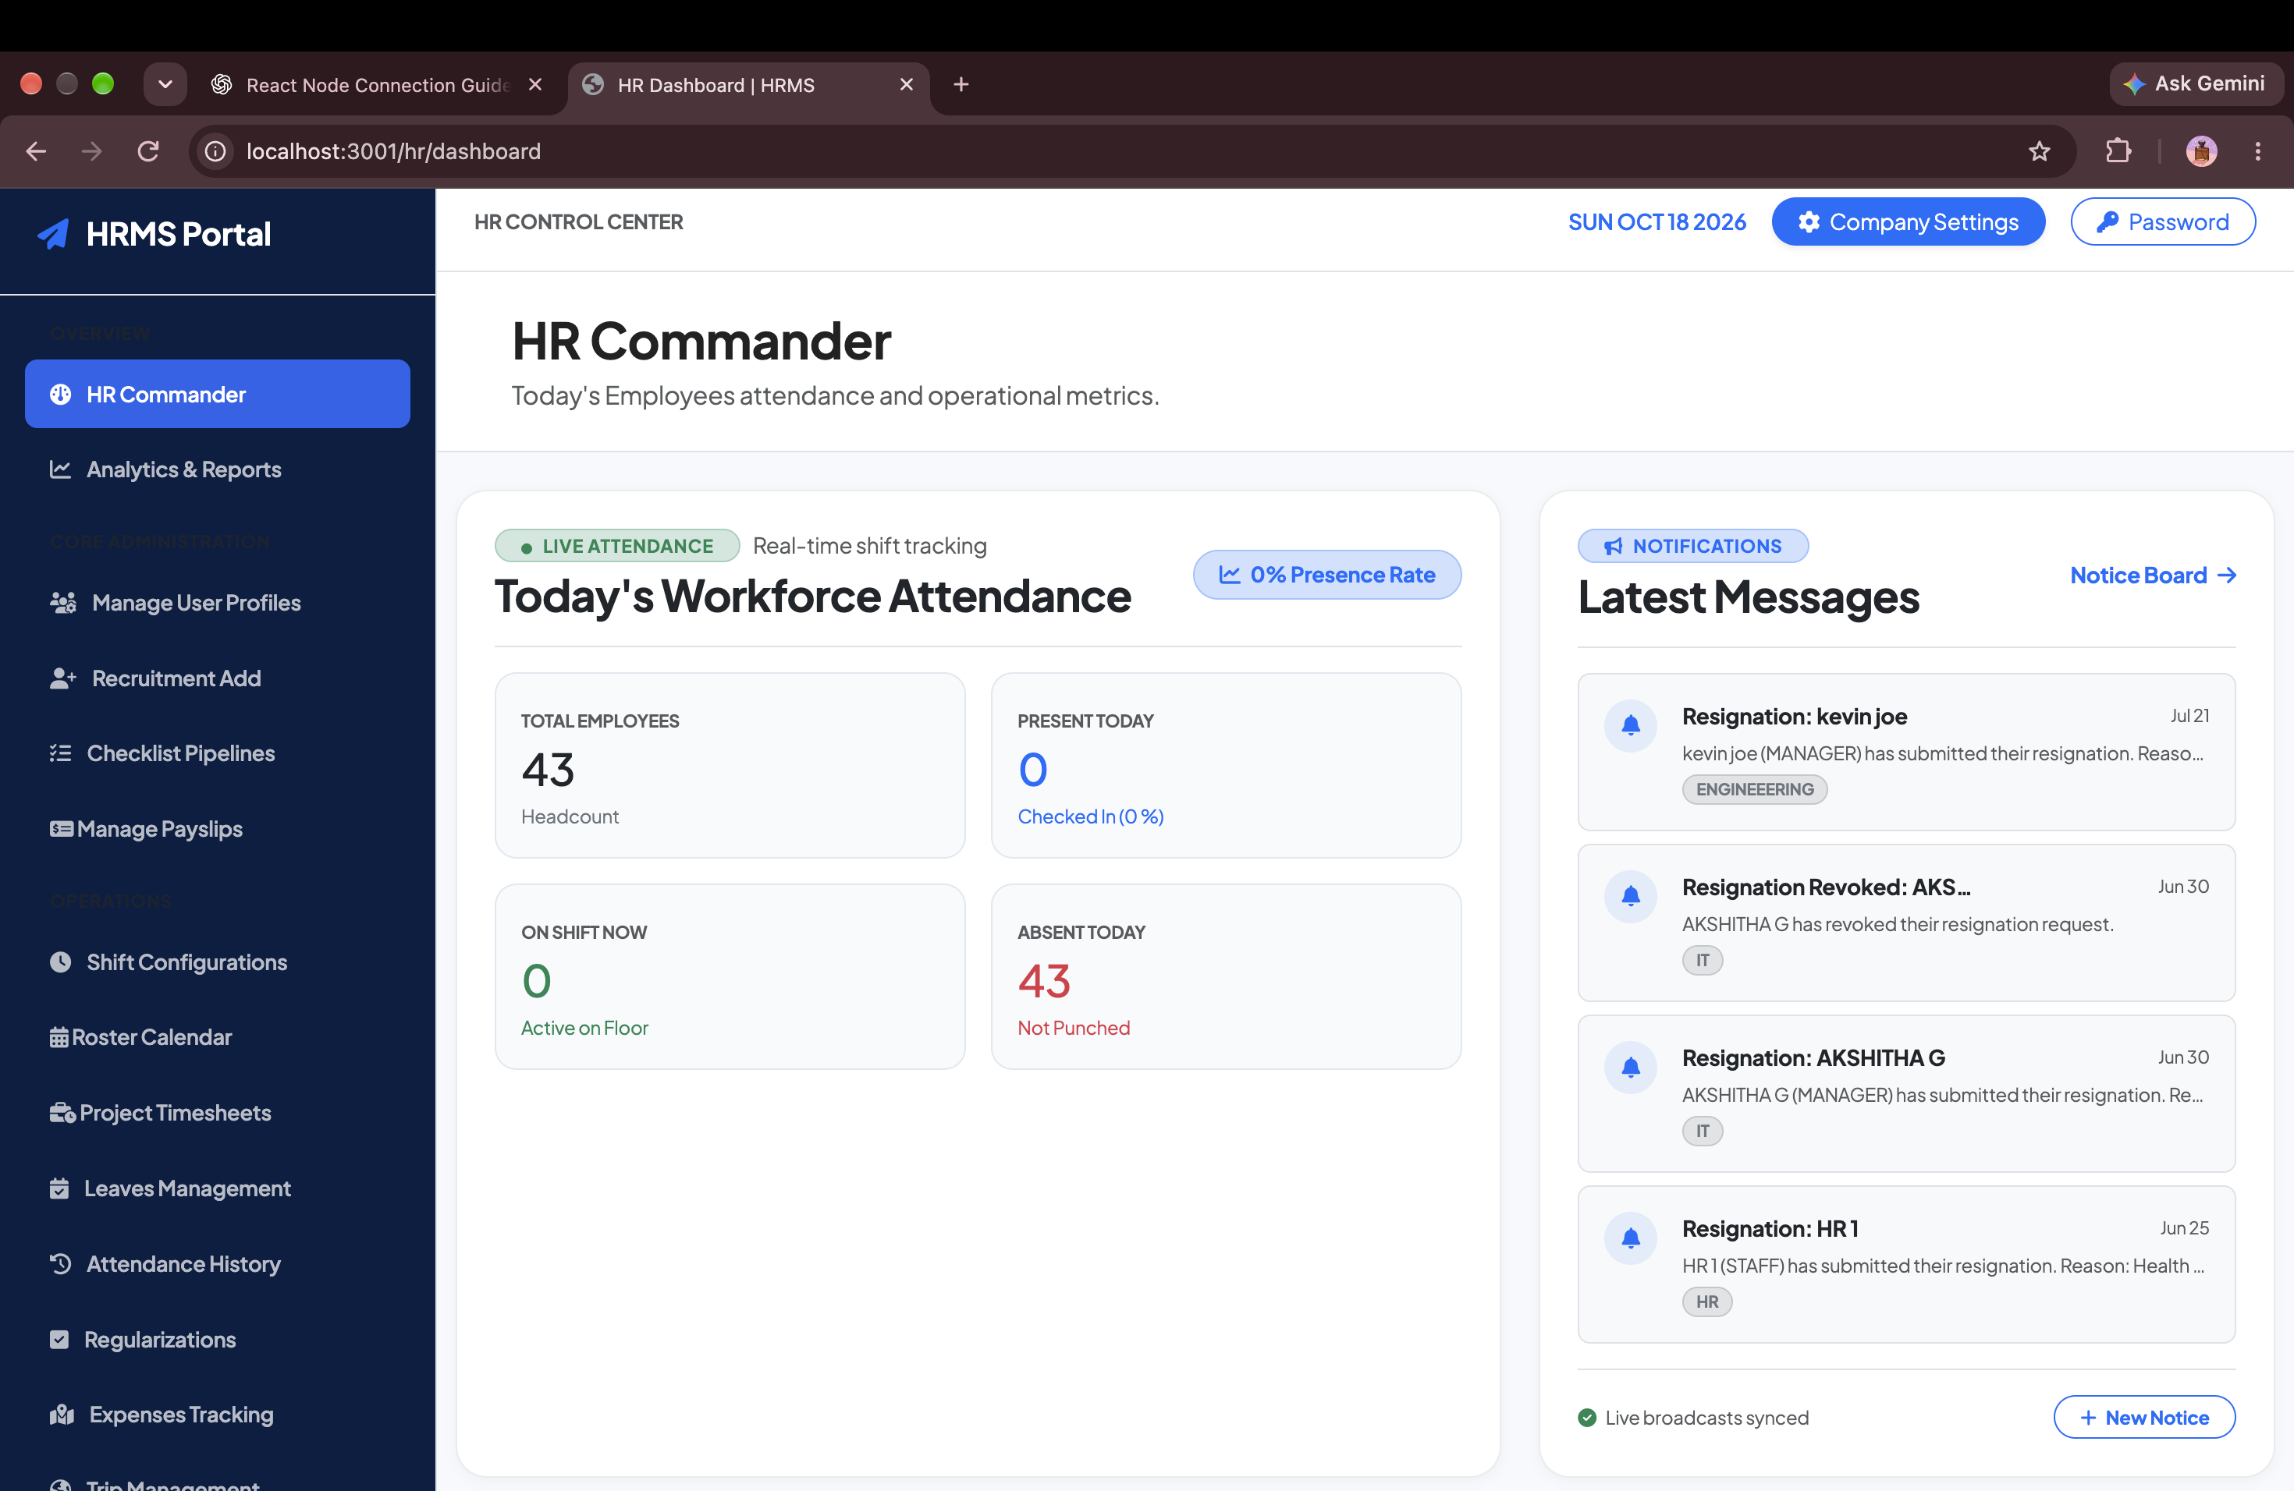
EXECUTIVE COMMAND
Executive HR Command Center & Live Workforce Radar
EXECUTIVE SUMMARY
Single-pane executive dashboard delivering immediate visibility into daily attendance, pending leaves, ongoing trips, and payroll cycles.
CORE BUSINESS ADVANTAGES
✔ Live Workforce Radar: Real-time counters for Present, Traveling, On-Leave, and Absent personnel.
✔ Urgent Action Triage: One-click approval queues for pending leave requests, travel requisitions, and appraisals.
✔ Direct Modular Navigation: Instant shortcut hub to all 12 operational modules across the enterprise suite.
ENTERPRISE IMPACT • VISIBILITY
360° Real-time Workforce Control
HRMS ENTERPRISE SUITE • Confidential & Proprietary • Enterprise Workforce Operating System
Slide 6 of 41

Slide 7
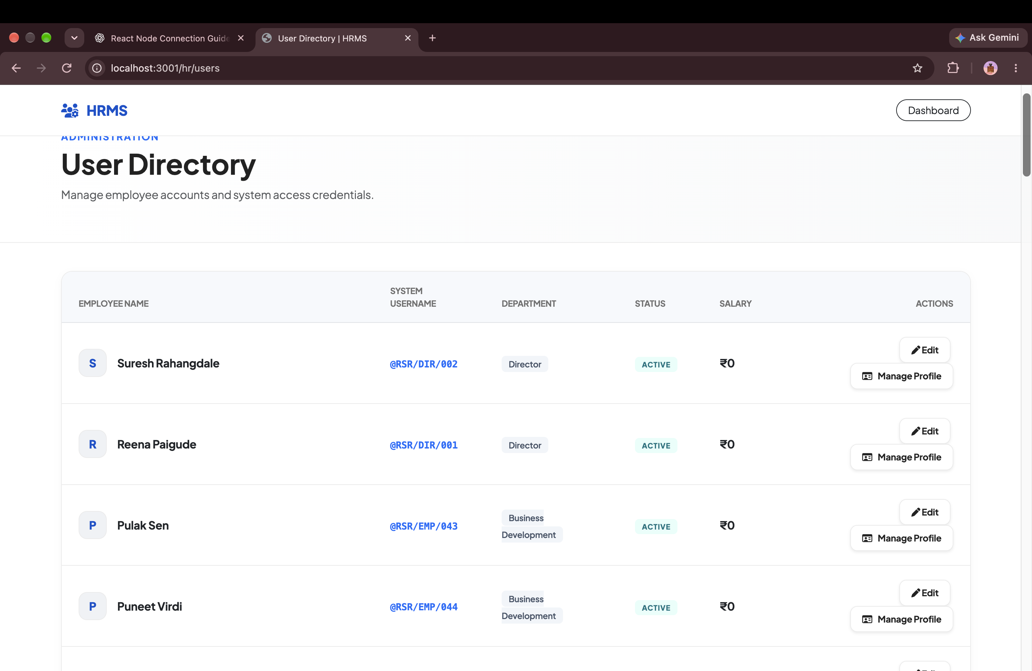
TALENT MANAGEMENT
Employee Master Directory & Role Management
EXECUTIVE SUMMARY
Centralized employee repository offering real-time status badges, department-based filtering, role reassignments, and CTC inspection.
CORE BUSINESS ADVANTAGES
✔ Sub-Second Search: Instant search across thousands of employee records with live keyword and role filters.
✔ Department Hierarchy: Visual organizational grouping across Engineering, HR, IT, Finance, and Operations.
✔ Complete Personnel Dossier: Single-click access to employee profiles, salary histories, emergency contacts, and assets.
ENTERPRISE IMPACT • SCALABILITY
Handles 10,000+ Employee Records
HRMS ENTERPRISE SUITE • Confidential & Proprietary • Enterprise Workforce Operating System
Slide 7 of 41

Slide 8
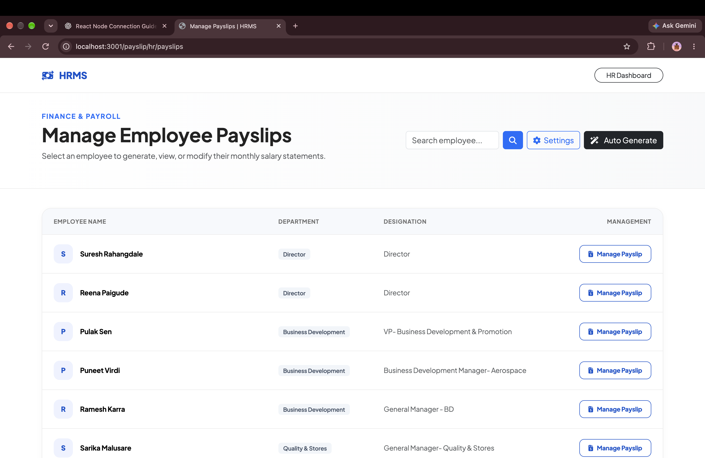
PAYROLL & COMPENSATION
Automated Multi-Tenant Payroll & Disbursal Engine
EXECUTIVE SUMMARY
End-to-end autonomous payroll engine calculating net pay by factoring biometric attendance, overtime, tax slabs, and statutory deductions.
CORE BUSINESS ADVANTAGES
✔ Zero Calculation Errors: Eliminates Excel spreadsheet mistakes with automated deduction and allowance formulas.
✔ Batch Payslip Generation: Generates cryptographic, tamper-proof salary slips for entire workforce in under 5 seconds.
✔ Financial Pre-Flight Audit: Comprehensive preview of total company salary liability before final executive disbursement.
ENTERPRISE IMPACT • ACCURACY
100% Error-Free Automated Run
HRMS ENTERPRISE SUITE • Confidential & Proprietary • Enterprise Workforce Operating System
Slide 8 of 41

Slide 9
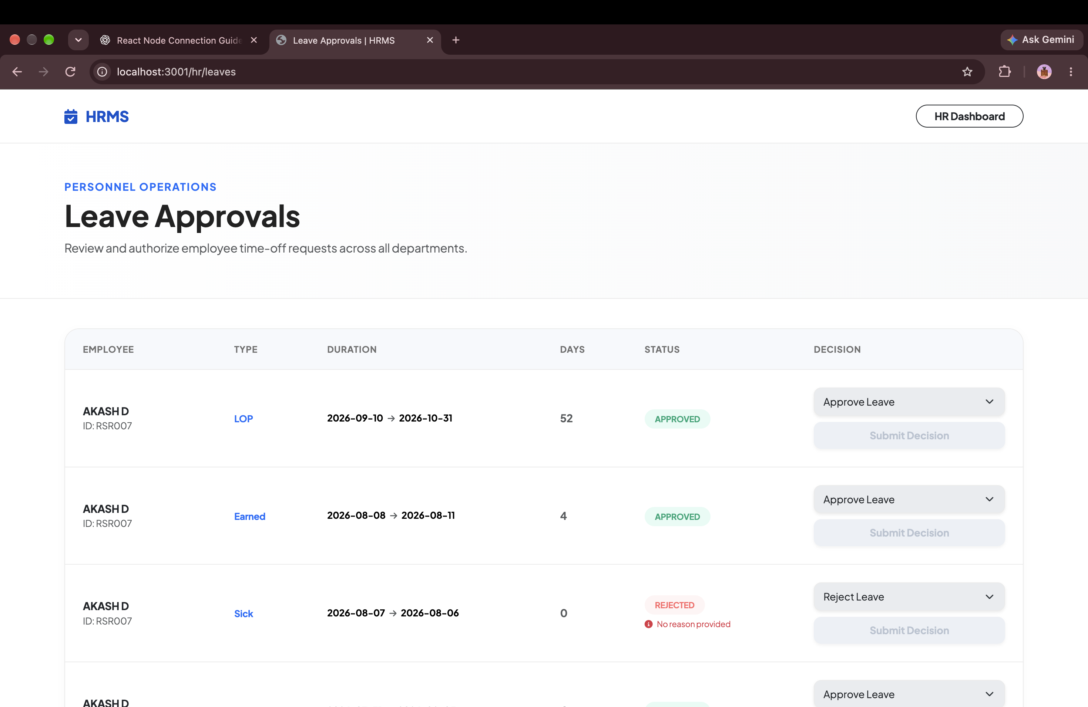
ATTENDANCE & TIME-OFF
Leave Management & Multi-Tier Approval Workflow
EXECUTIVE SUMMARY
Transparent leave requisition board with automated quota tracking (Casual, Sick, Earned, Unpaid) and instant manager actions.
CORE BUSINESS ADVANTAGES
✔ Zero Administrative Drag: Replaces messy email chains with structured one-click Approve / Reject actions.
✔ Quota Leakage Prevention: Live balance verification prevents employees from taking unearned paid leaves.
✔ Real-Time Synchronization: Approved leaves automatically deduct from balance and update biometric attendance rosters.
ENTERPRISE IMPACT • PRODUCTIVITY
85% Faster Leave Processing
HRMS ENTERPRISE SUITE • Confidential & Proprietary • Enterprise Workforce Operating System
Slide 9 of 41

Slide 10
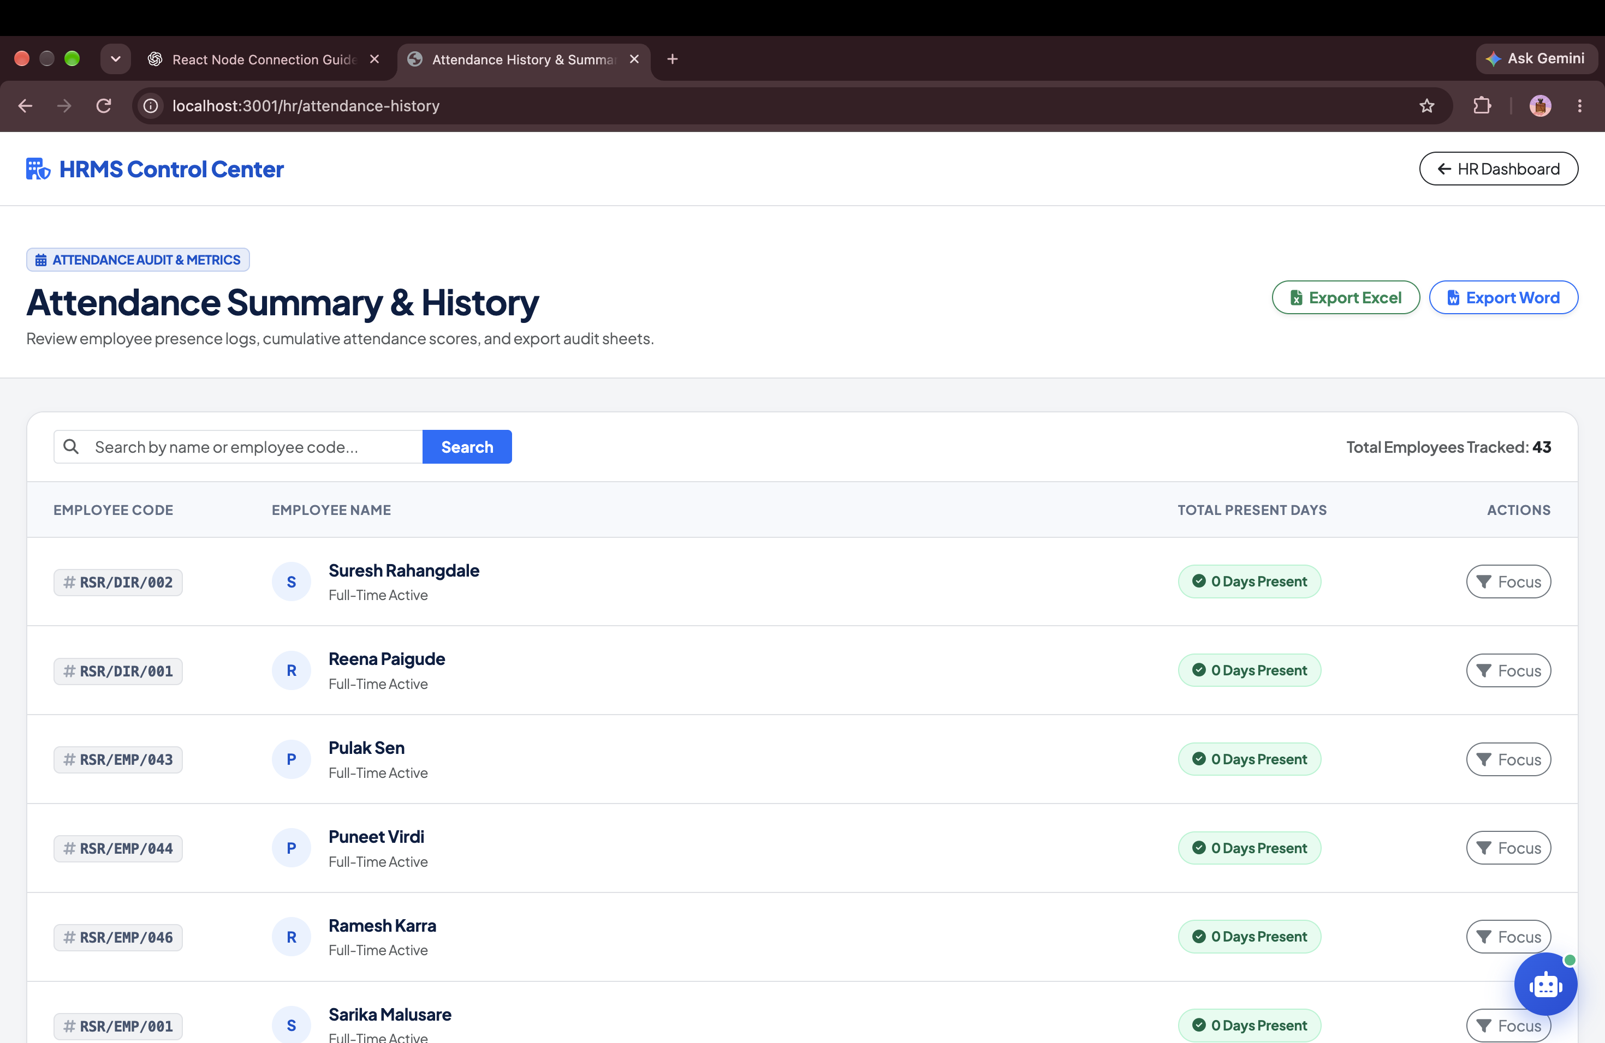
ATTENDANCE & COMPLIANCE
Biometric Attendance Audit & Daily Timecard Summaries
EXECUTIVE SUMMARY
Granular timecard auditing system logging exact clock-in, clock-out, total hours, shift compliance, and late arrival marks.
CORE BUSINESS ADVANTAGES
✔ Legal & Statutory Audit Trail: Maintains tamper-proof records for labor law inspections and client billing audits.
✔ Anomaly Detection: Automated highlighting of early departures, missing punches, and unexpected overtime.
✔ Export-Ready Reports: Single-click export to CSV and Excel for external auditors and executive reviews.
ENTERPRISE IMPACT • COMPLIANCE
Tamper-Proof Biometric Logging
HRMS ENTERPRISE SUITE • Confidential & Proprietary • Enterprise Workforce Operating System
Slide 10 of 41

Slide 11
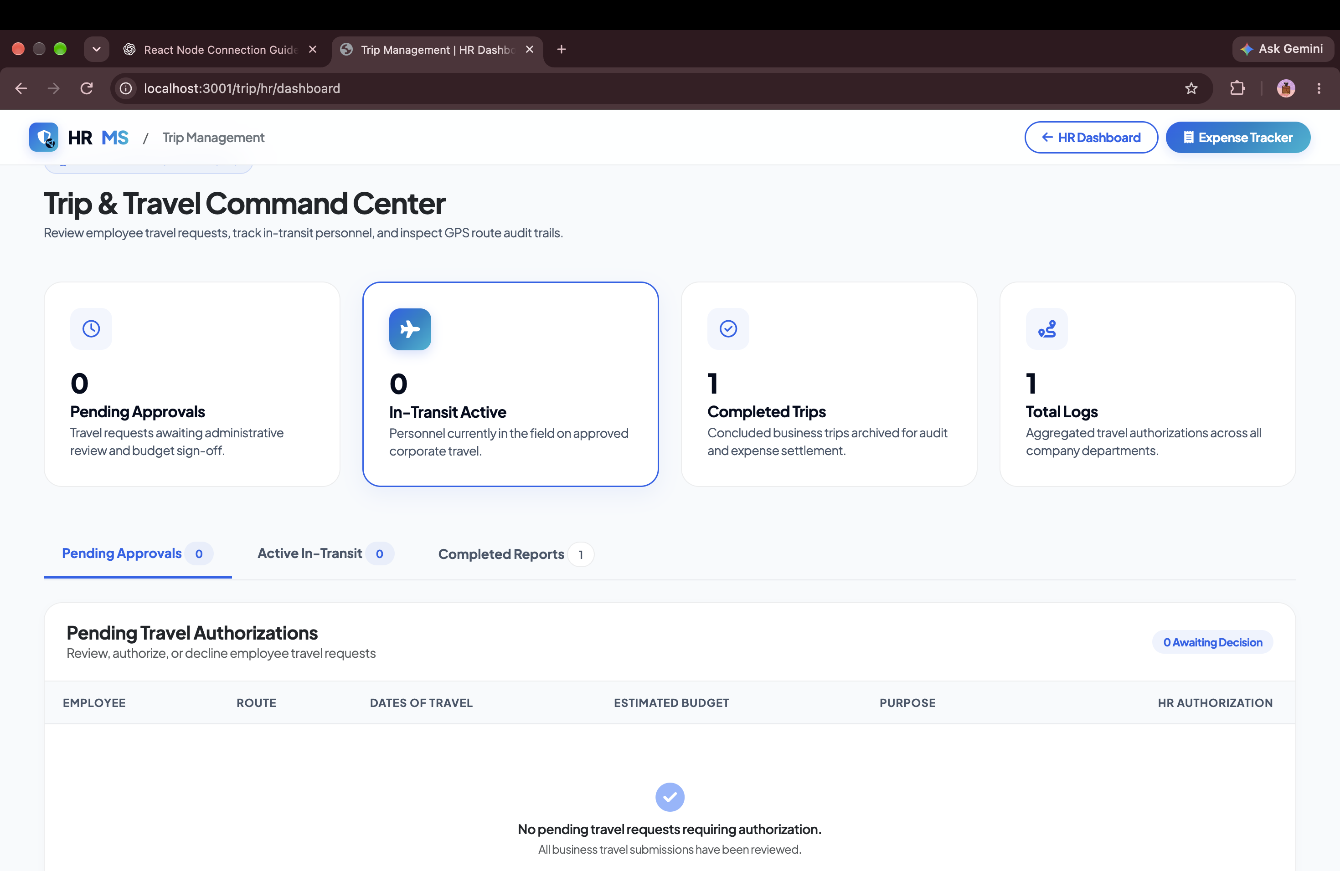
FIELD MOBILITY & LOGISTICS
Field Mobility & Business Trip Fleet Command
EXECUTIVE SUMMARY
Centralized command dashboard for field sales, traveling executives, and on-site service engineers across geographic territories.
CORE BUSINESS ADVANTAGES
✔ Territory Fleet Visibility: Real-time visibility over field personnel on active domestic and international trips.
✔ Lifecycle Tracking: Seamless tracking of trip stages from Approved Requisition to Active Transit and Final Audit.
✔ Expense Linking: Direct linkage between completed business trips and submitted expense claim vouchers.
ENTERPRISE IMPACT • OVERSIGHT
Complete Field Workforce Tracking
HRMS ENTERPRISE SUITE • Confidential & Proprietary • Enterprise Workforce Operating System
Slide 11 of 41

Slide 12
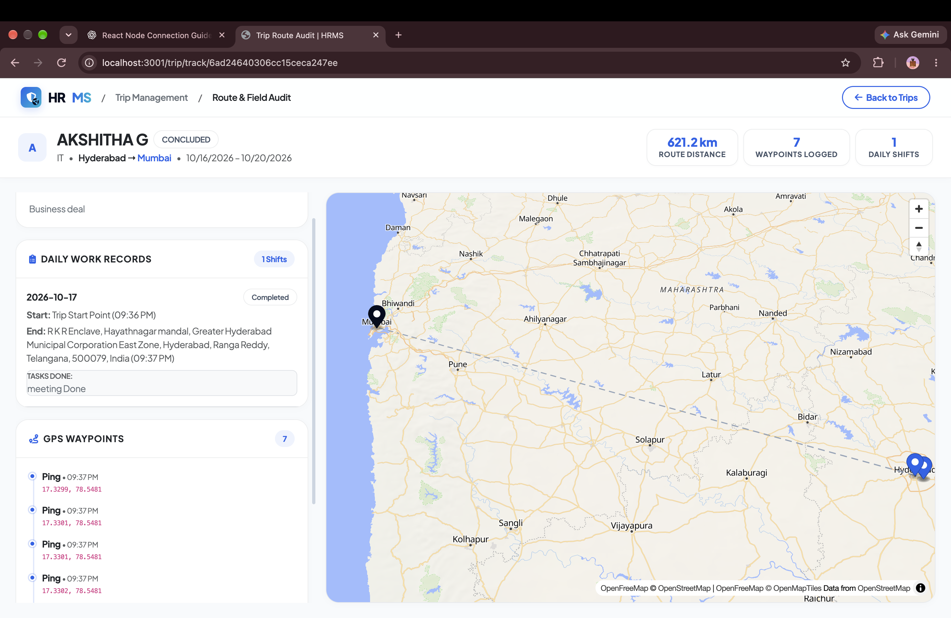
FIELD MOBILITY & LOGISTICS
OpenStreetMap GPS Route Audit & Breadcrumb Telemetry
EXECUTIVE SUMMARY
High-precision breadcrumb route tracing utilizing pure OpenStreetMap vector tiles with zero proprietary Google API billing lock-in.
CORE BUSINESS ADVANTAGES
✔ Verifiable Mileage Proof: Calculates exact travel distance in kilometers to validate fuel and travel reimbursement claims.
✔ Timestamped Checkpoint Pins: Visual chronological trail of employee location pings throughout the business trip.
✔ Zero Google Map Billing: Leverages OpenFreeMap Bright vector tiles, saving enterprises thousands in monthly API fees.
ENTERPRISE IMPACT • SAVINGS
Zero Proprietary Map API Fees
HRMS ENTERPRISE SUITE • Confidential & Proprietary • Enterprise Workforce Operating System
Slide 12 of 41

Slide 13
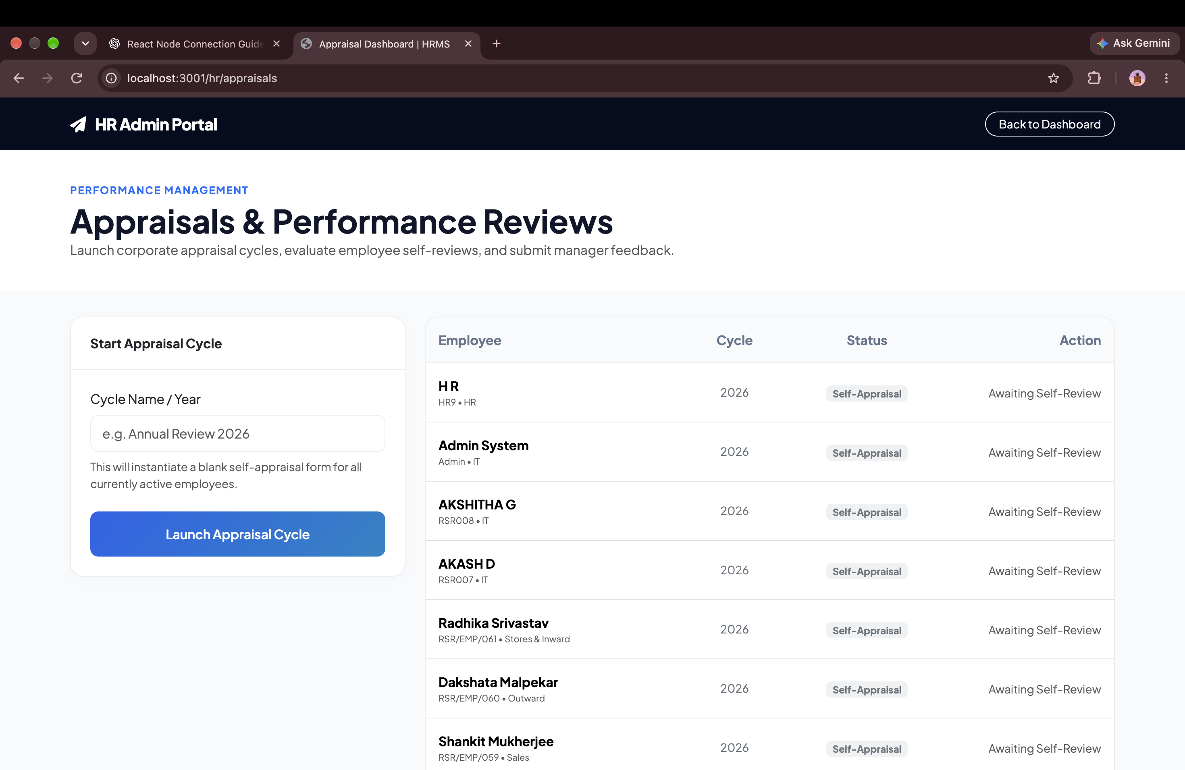
TALENT & MERIT
360° Appraisal Dashboard & Merit Rating Framework
EXECUTIVE SUMMARY
Performance appraisal system featuring multi-tiered scoring, manager evaluations, self-appraisals, and merit hike recommendations.
CORE BUSINESS ADVANTAGES
✔ Objective Meritocracy: Replaces subjective reviews with quantifiable metric scoring and KPI evaluations.
✔ Historical Growth Radar: Multi-quarter performance comparison tracking employee career velocity over time.
✔ Compensation Integration: Direct pipeline from top appraisal ratings to automated salary revision recommendations.
ENTERPRISE IMPACT • ENGAGEMENT
Transparent 360° Employee Reviews
HRMS ENTERPRISE SUITE • Confidential & Proprietary • Enterprise Workforce Operating System
Slide 13 of 41

Slide 14
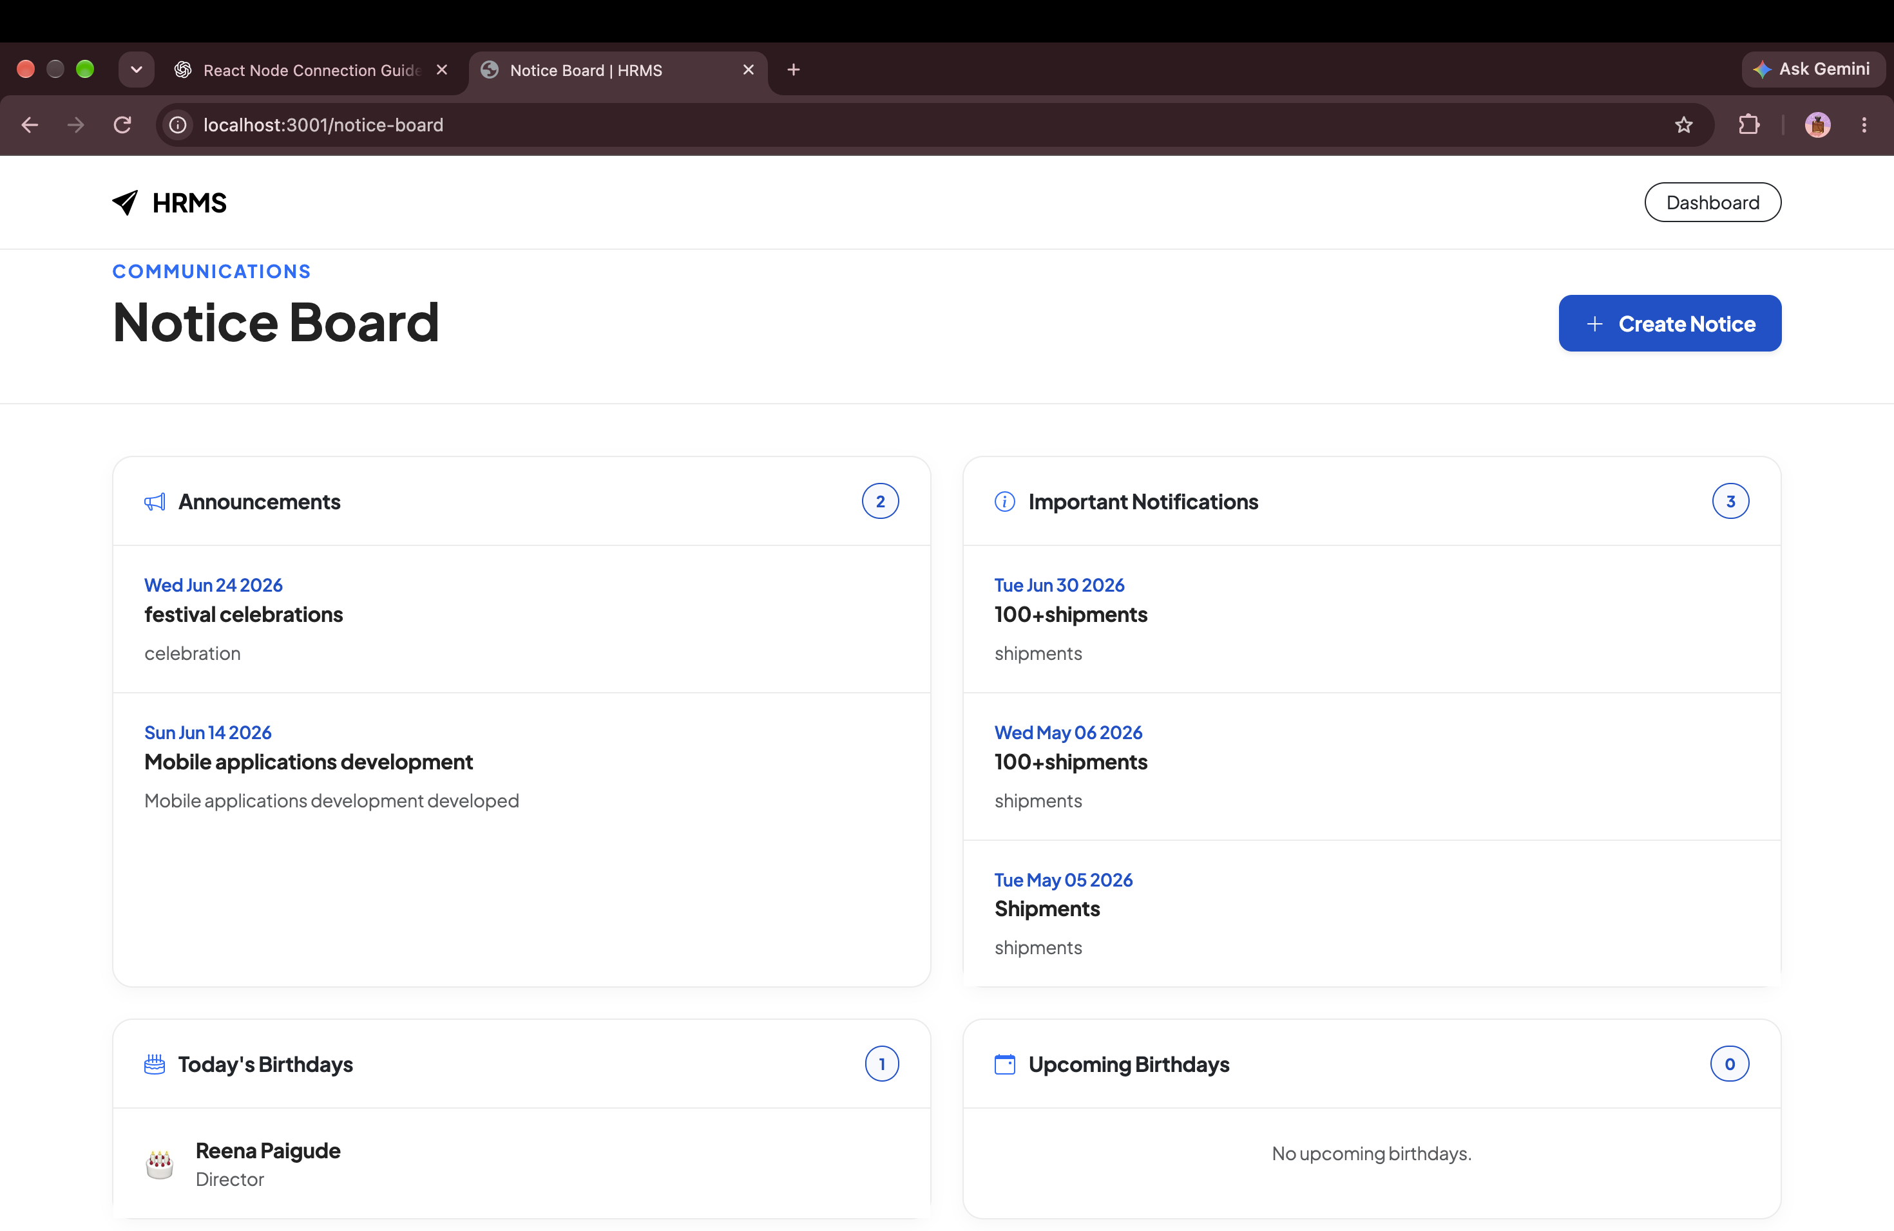
COMMUNICATIONS & CULTURE
Company Notice Board & Broadcast Hub
EXECUTIVE SUMMARY
Organization-wide broadcast center for executive announcements, policy updates, holiday notices, and emergency alerts.
CORE BUSINESS ADVANTAGES
✔ Guaranteed Message Delivery: Ensures vital corporate notices are never lost in cluttered email inboxes.
✔ Priority & Category Tags: Distinguishes between Urgent Safety Alerts, Policy Revisions, and Cultural Celebrations.
✔ Omnichannel Sync: Instant synchronization across employee web portals and mobile smartphone applications.
ENTERPRISE IMPACT • ALIGNMENT
100% Reach Across Distributed Teams
HRMS ENTERPRISE SUITE • Confidential & Proprietary • Enterprise Workforce Operating System
Slide 14 of 41

Slide 15
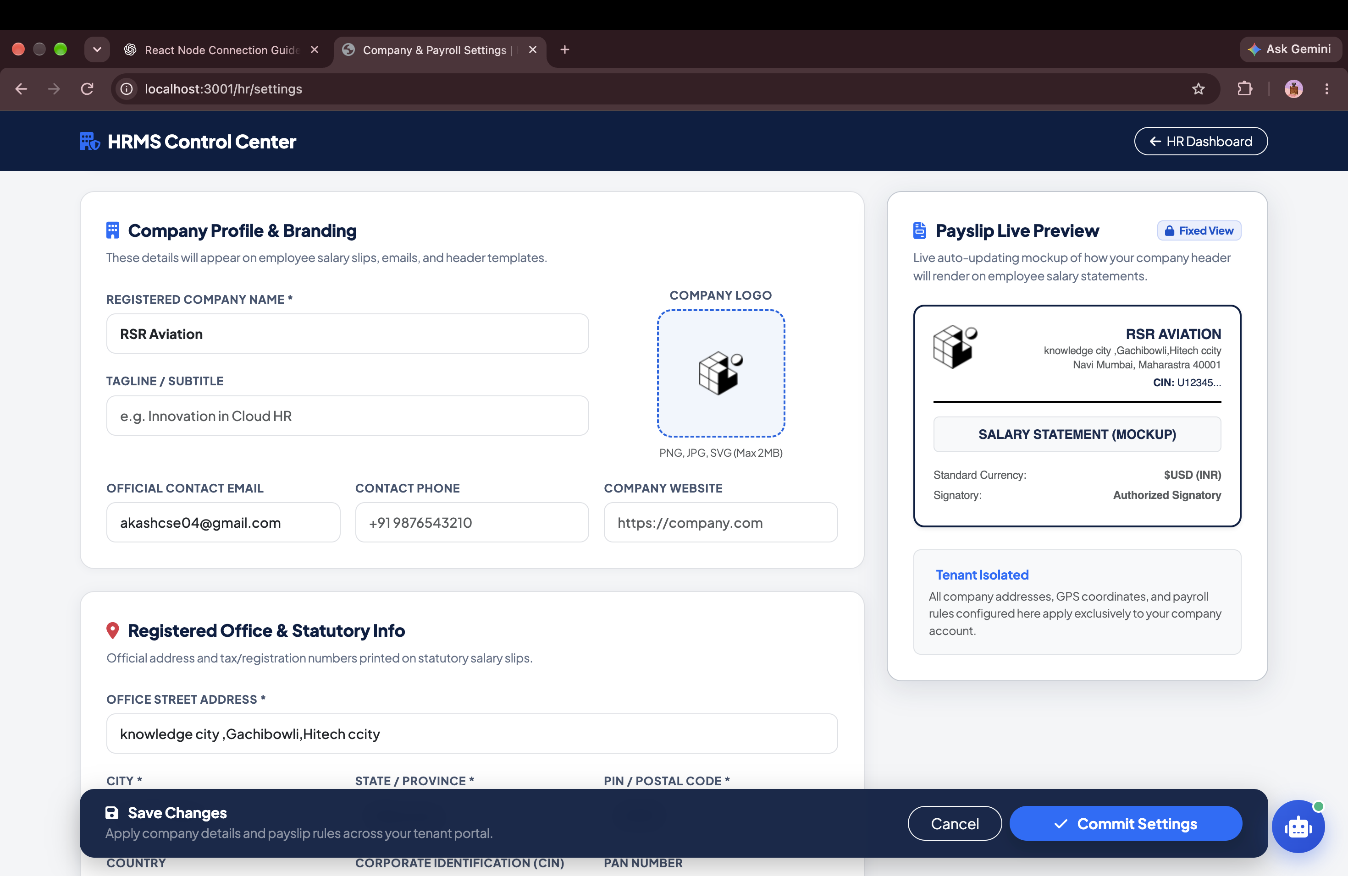
PAYROLL & COMPLIANCE
Statutory Tax Slabs, Allowances & Deductions Engine
EXECUTIVE SUMMARY
Granular payroll configuration suite allowing custom basic salary %, HRA, PF, Professional Tax, ESI, and custom allowances.
CORE BUSINESS ADVANTAGES
✔ Statutory Labor Compliance: Pre-configured templates for Provident Fund, ESI, Professional Tax, and Income Tax.
✔ Custom Allowance Architecture: Configure flexible allowances (Travel, Medical, Special, Food, Housing) in seconds.
✔ Zero-Code Tax Revisions: Update regional tax slabs and deduction thresholds without requiring developer intervention.
ENTERPRISE IMPACT • GOVERNANCE
Zero-Code Tax & PF Configuration
HRMS ENTERPRISE SUITE • Confidential & Proprietary • Enterprise Workforce Operating System
Slide 15 of 41

Slide 16
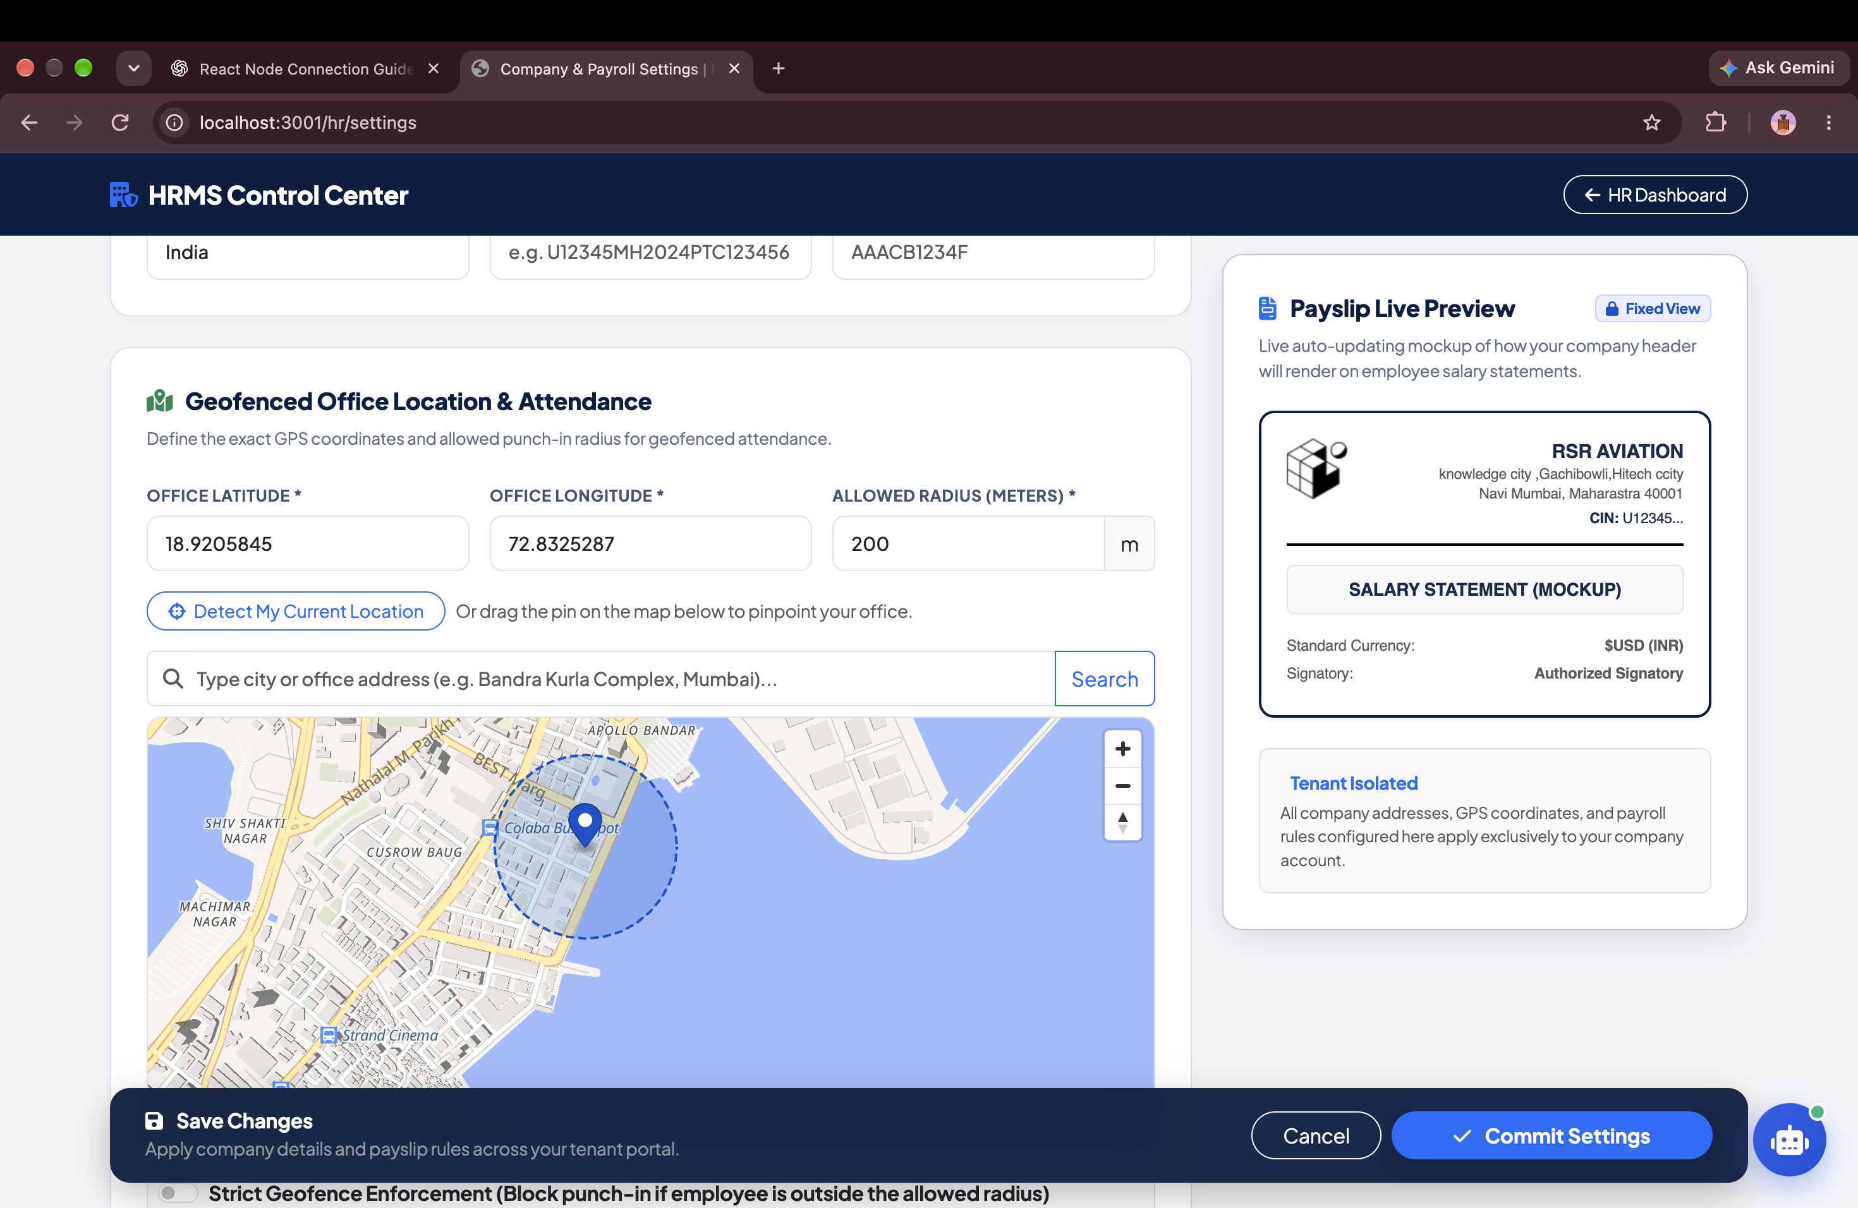
WORKFORCE MANAGEMENT
Work Shifts, Rotational Rosters & Overtime Multipliers
EXECUTIVE SUMMARY
Shift configuration suite supporting General, Morning, Night, and rotational shifts with grace periods and overtime multipliers.
CORE BUSINESS ADVANTAGES
✔ 24/7 Shift Flexibility: Built for round-the-clock manufacturing plants, IT support, and hospital operations.
✔ Grace Period Rules: Configurable buffer window before triggering half-day deductions or late arrival flags.
✔ Overtime Logic: Automated overtime multiplier calculation seamlessly fed into the payroll disbursal run.
ENTERPRISE IMPACT • FLEXIBILITY
Supports 24/7 Rotational Operations
HRMS ENTERPRISE SUITE • Confidential & Proprietary • Enterprise Workforce Operating System
Slide 16 of 41

Slide 17
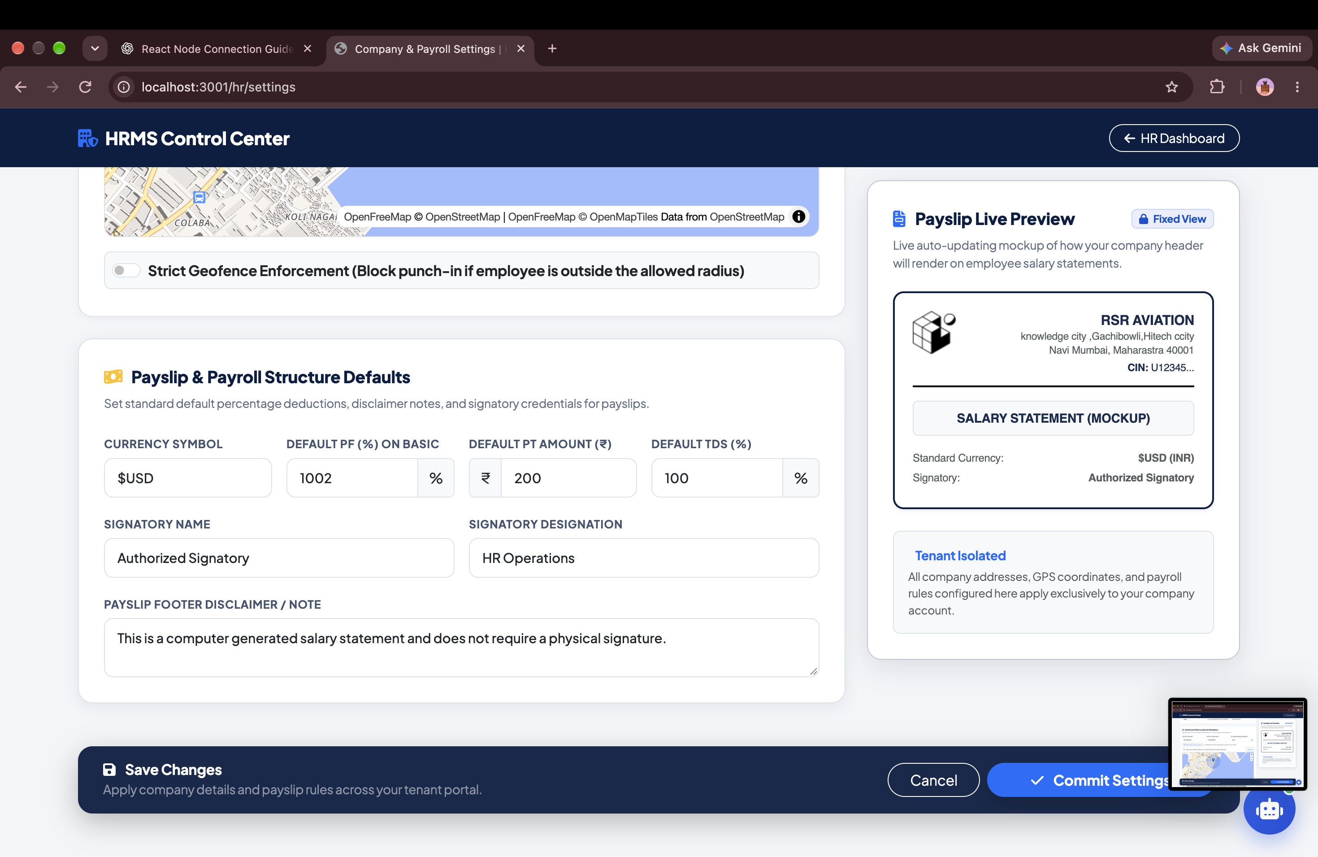
SECURITY & ATTENDANCE
Geofencing Radar & GPS Security Radius
EXECUTIVE SUMMARY
Pinpoint office location coordinates with configurable punch radius (50m, 100m, 250m) and remote work allowances.
CORE BUSINESS ADVANTAGES
✔ Anti-Spoofing Perimeter: Strict GPS boundary verification prevents remote clock-in fraud and proxy punches.
✔ Multi-Branch Management: Define unique geofence coordinates and radiuses for satellite offices and regional hubs.
✔ Smart Policy Overrides: Configurable exceptions for designated traveling sales reps and approved remote workers.
ENTERPRISE IMPACT • SECURITY
Zero Proxy Punches & Remote Fraud
HRMS ENTERPRISE SUITE • Confidential & Proprietary • Enterprise Workforce Operating System
Slide 17 of 41

Slide 18
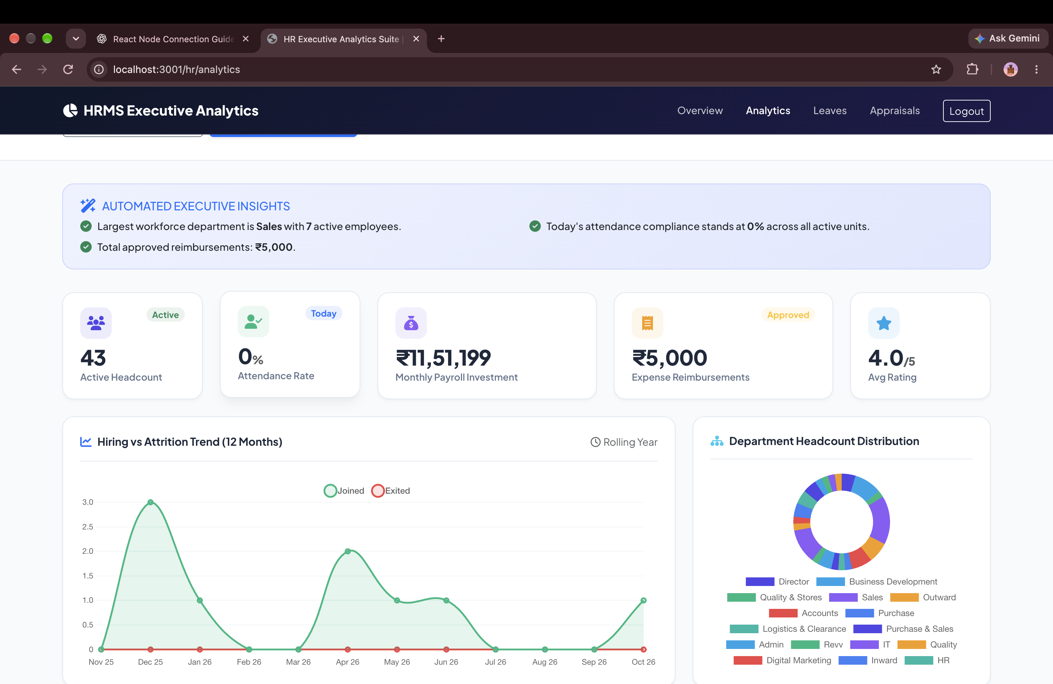
EXECUTIVE INTELLIGENCE
HR Executive Analytics & Predictive Attrition Radar
EXECUTIVE SUMMARY
C-suite strategic intelligence dashboard analyzing headcount growth, department salary distribution, and attrition velocity.
CORE BUSINESS ADVANTAGES
✔ Strategic Executive Insights: Equips CHROs and CFOs with real-time workforce cost and talent retention data.
✔ Attrition Early Warning: Detects departmental turnover spikes before critical talent exits impact business.
✔ Budgetary Forecasting: Visual payroll liability projections aiding future quarterly and annual budget allocations.
ENTERPRISE IMPACT • INTELLIGENCE
Data-Driven Talent & Cost Decisions
HRMS ENTERPRISE SUITE • Confidential & Proprietary • Enterprise Workforce Operating System
Slide 18 of 41

Slide 19
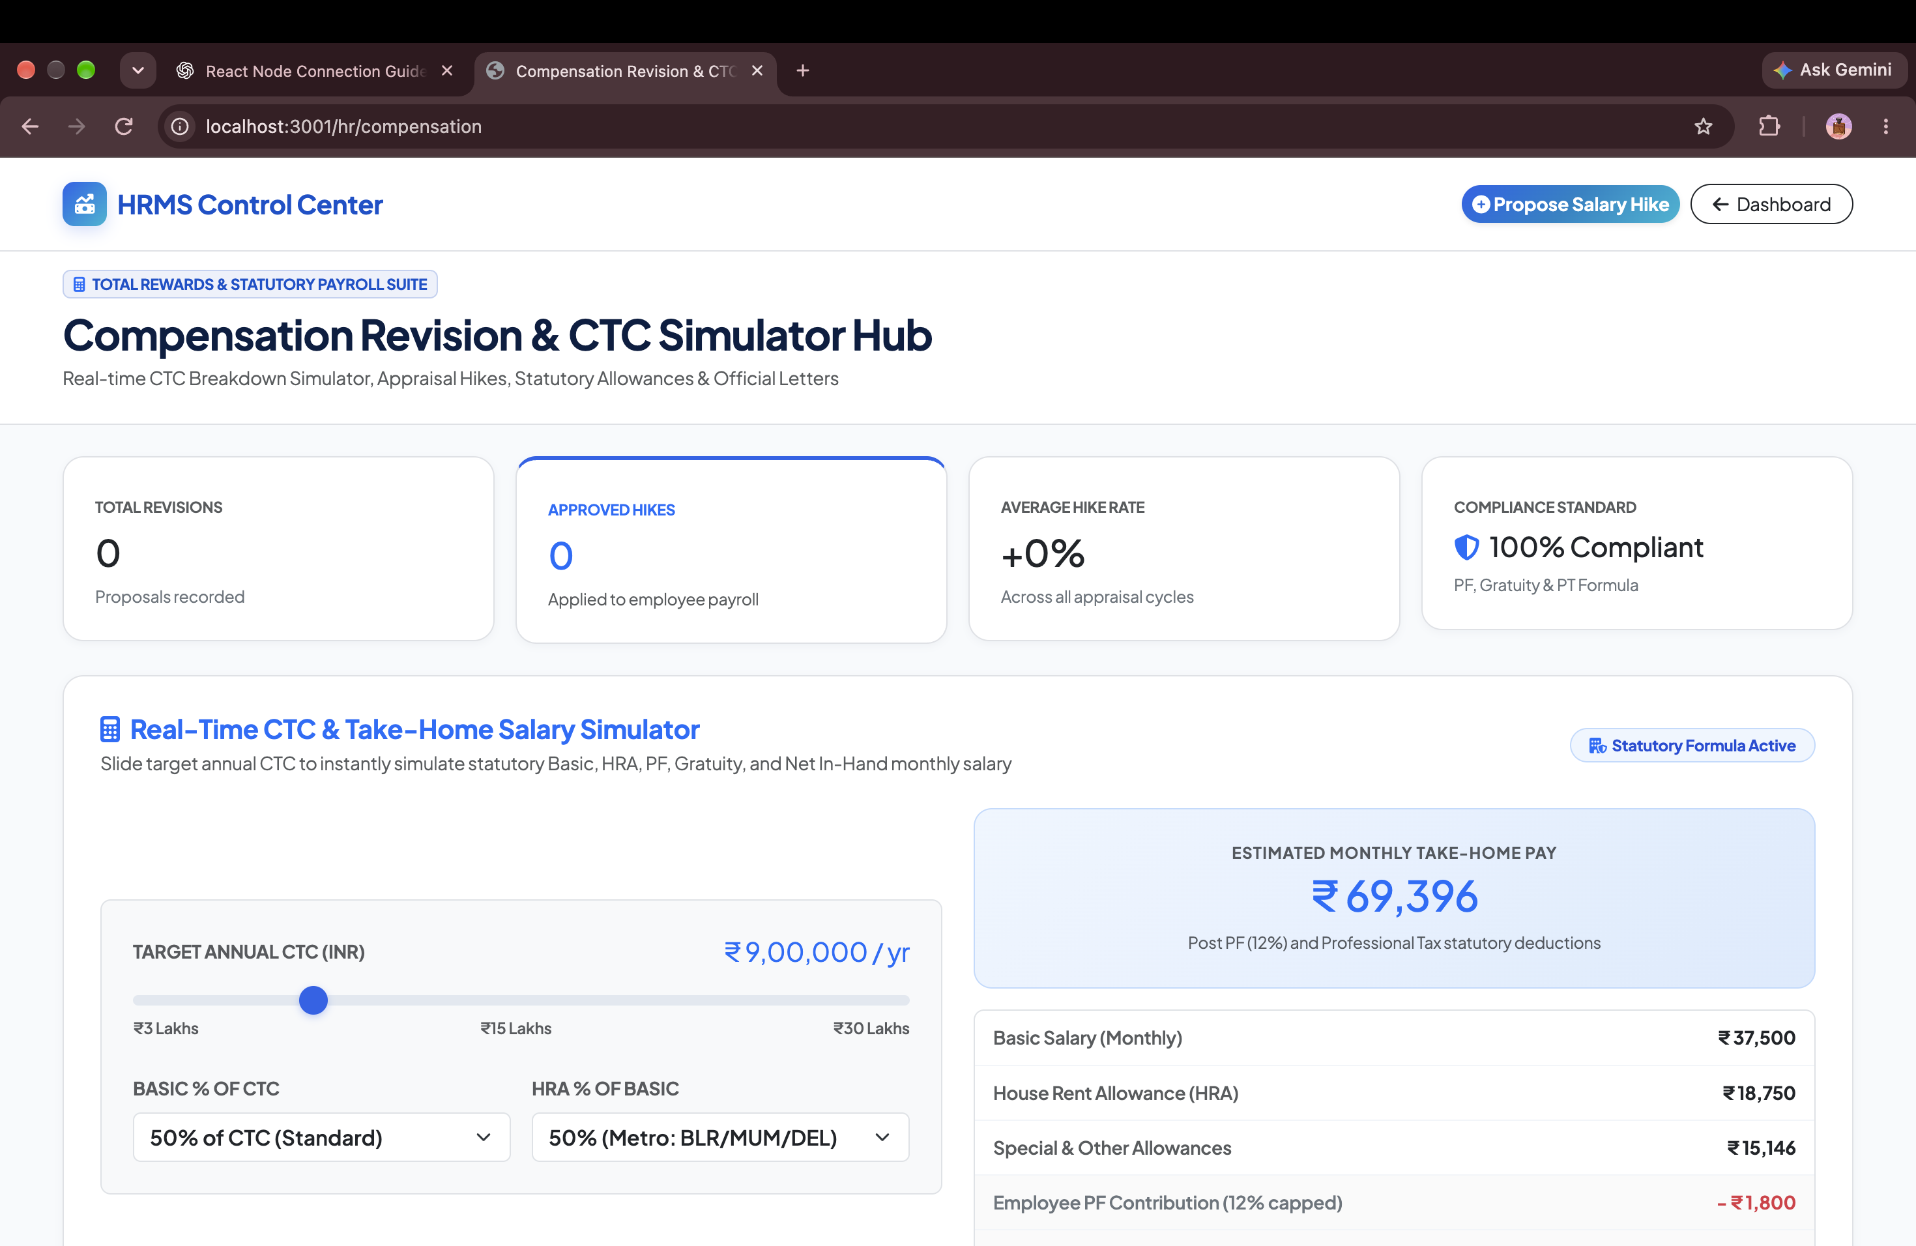
PAYROLL & FINANCE
Compensation Revision & CTC Hike Simulator
EXECUTIVE SUMMARY
Interactive salary hike modeling tool calculating revised basic pay, allowances, and company contributions in real time.
CORE BUSINESS ADVANTAGES
✔ Real-Time CTC Simulation: Model individual and department-wide raises and immediately preview total cost impact.
✔ Budgetary Safeguards: Enforces compensation limits and salary bands to prevent unauthorized payroll overruns.
✔ Audited Revision History: Complete digital paper trail detailing justification, approver, and effective date of hikes.
ENTERPRISE IMPACT • CONTROL
Real-Time Company CTC Modeling
HRMS ENTERPRISE SUITE • Confidential & Proprietary • Enterprise Workforce Operating System
Slide 19 of 41

Slide 20
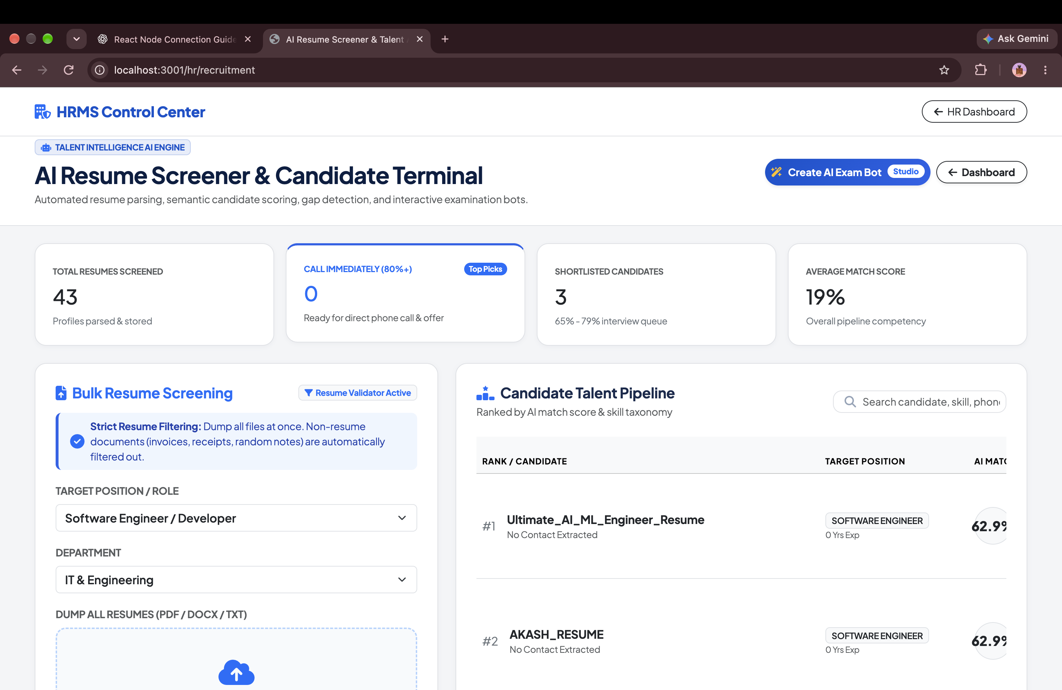
AI & RECRUITMENT
AI Resume Screener & Candidate Exam Bot Studio
EXECUTIVE SUMMARY
Next-generation AI recruitment engine featuring RAG semantic matching, automated candidate scoring, and custom interactive exam bots.
CORE BUSINESS ADVANTAGES
✔ RAG Resume Screening: Parses 100+ resumes in seconds against job descriptions using vector embeddings and ChromaDB.
✔ Domain Exam Bot Studio: 1-click interactive technical exam generation across Electronics, Embedded, Full-Stack & Finance.
✔ Dramatic Cost Reductions: Reduces recruiter screening time by over 78% and cuts agency recruitment fees to zero.
ENTERPRISE IMPACT • INNOVATION
78% Reduction in Screening Hours
HRMS ENTERPRISE SUITE • Confidential & Proprietary • Enterprise Workforce Operating System
Slide 20 of 41

Slide 21
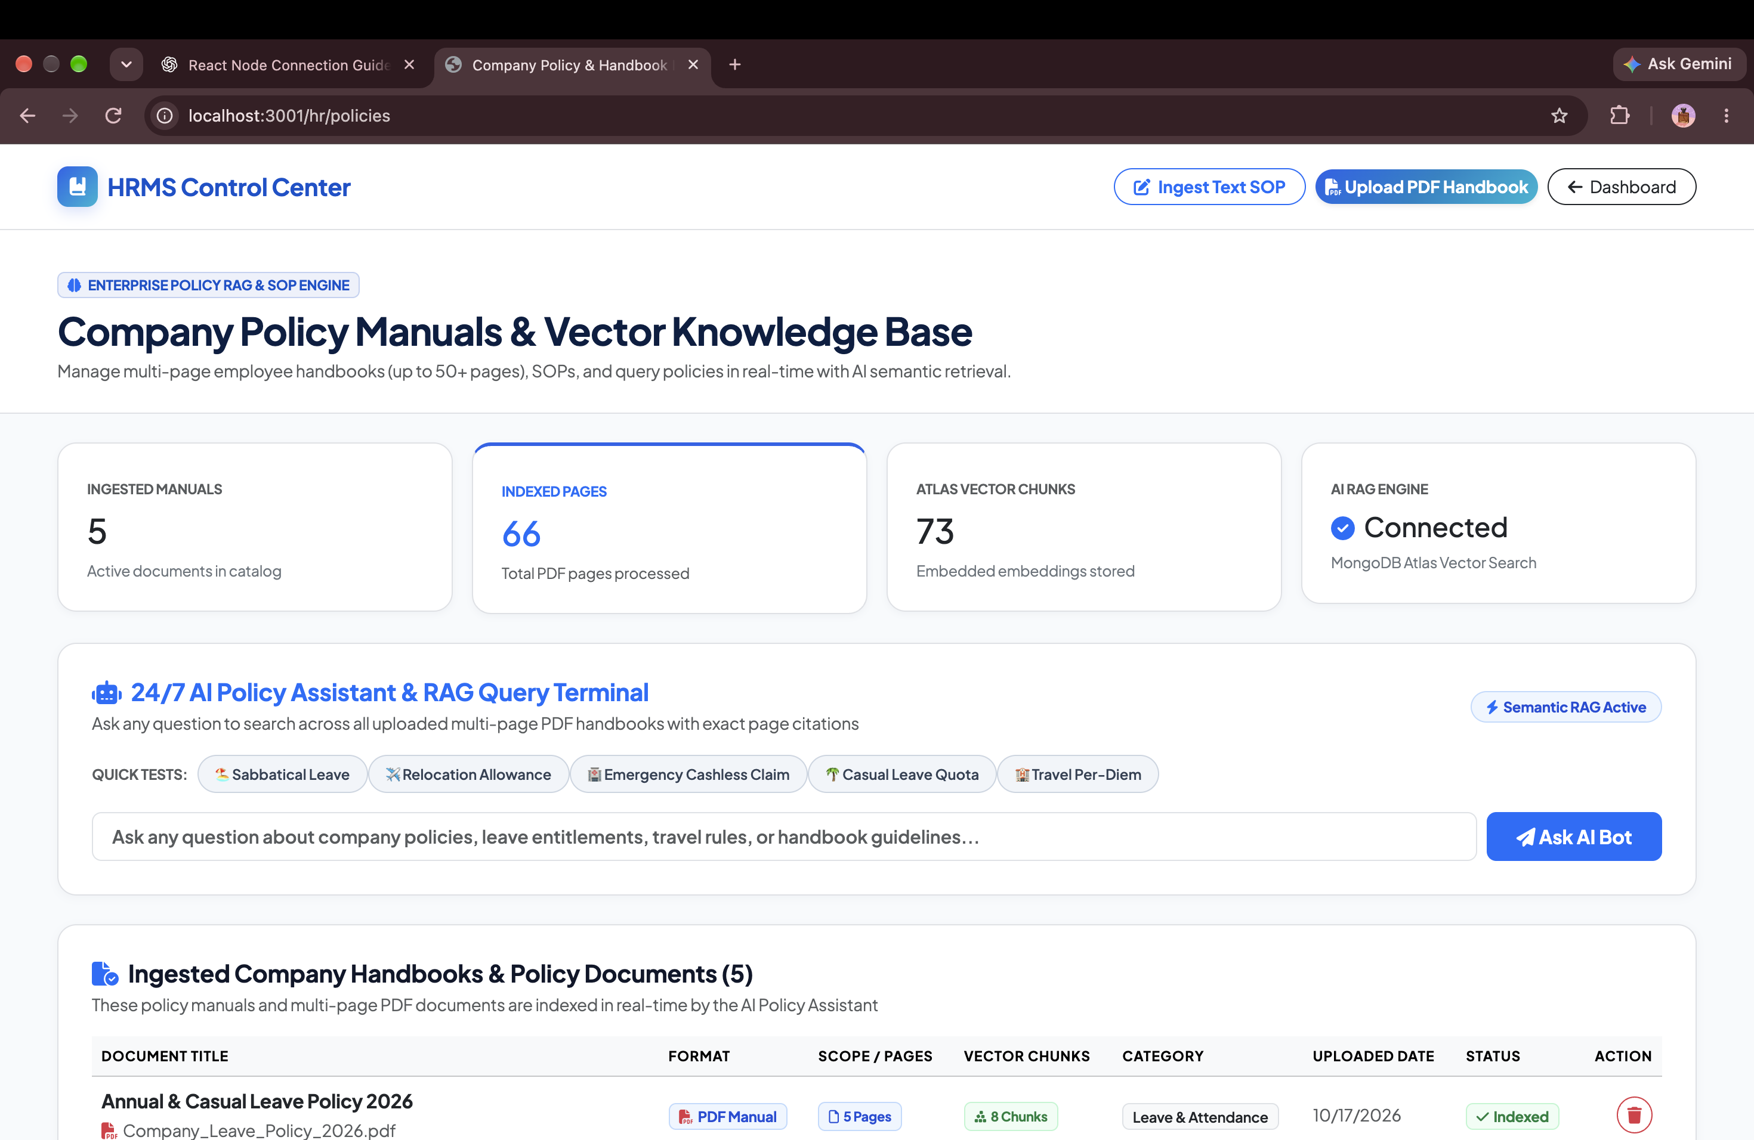
COMPLIANCE & LEGAL
Digital Company Policy & Compliance Handbook
EXECUTIVE SUMMARY
Centralized digital handbook for company codes of conduct, NDAs, IT security policies, POSH compliance, and employee benefits.
CORE BUSINESS ADVANTAGES
✔ Paperless Legal Compliance: Digital policy acknowledgement with verifiable employee timestamps.
✔ Rapid Employee Onboarding: Empowers new team members with instant answers on company rules and expectations.
✔ Single Source of Truth: Guarantees all distributed and remote personnel adhere to identical corporate guidelines.
ENTERPRISE IMPACT • COMPLIANCE
100% Paperless Regulatory Records
HRMS ENTERPRISE SUITE • Confidential & Proprietary • Enterprise Workforce Operating System
Slide 21 of 41

Slide 22
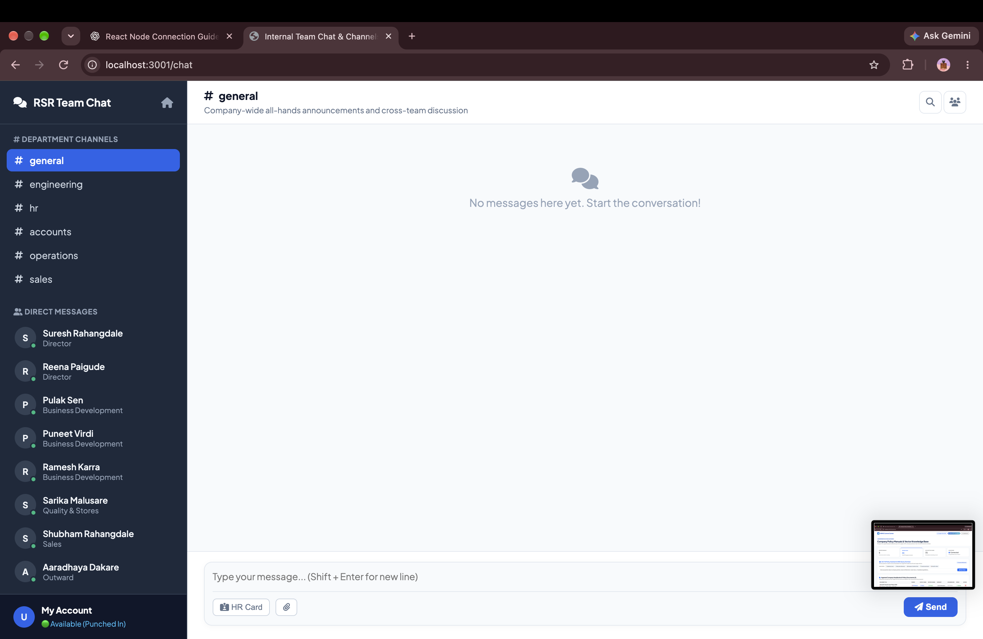
ENTERPRISE COLLABORATION
Internal Real-Time Team Chat & Collaboration Channels
EXECUTIVE SUMMARY
Built-in channel-based chat (#general, #announcements, #department) keeping internal conversations secure within the tenant platform.
CORE BUSINESS ADVANTAGES
✔ SaaS Cost Consolidation: Eliminates need for third-party Slack or Microsoft Teams subscriptions.
✔ Tenant Data Privacy: Internal discussions remain protected within enterprise MongoDB tenant collections.
✔ Immediate Context Switching: Collaborate on projects, leaves, and approvals without leaving the HRMS platform.
ENTERPRISE IMPACT • INTEGRATION
Built-in Zero-Cost Team Chat
HRMS ENTERPRISE SUITE • Confidential & Proprietary • Enterprise Workforce Operating System
Slide 22 of 41

Slide 23
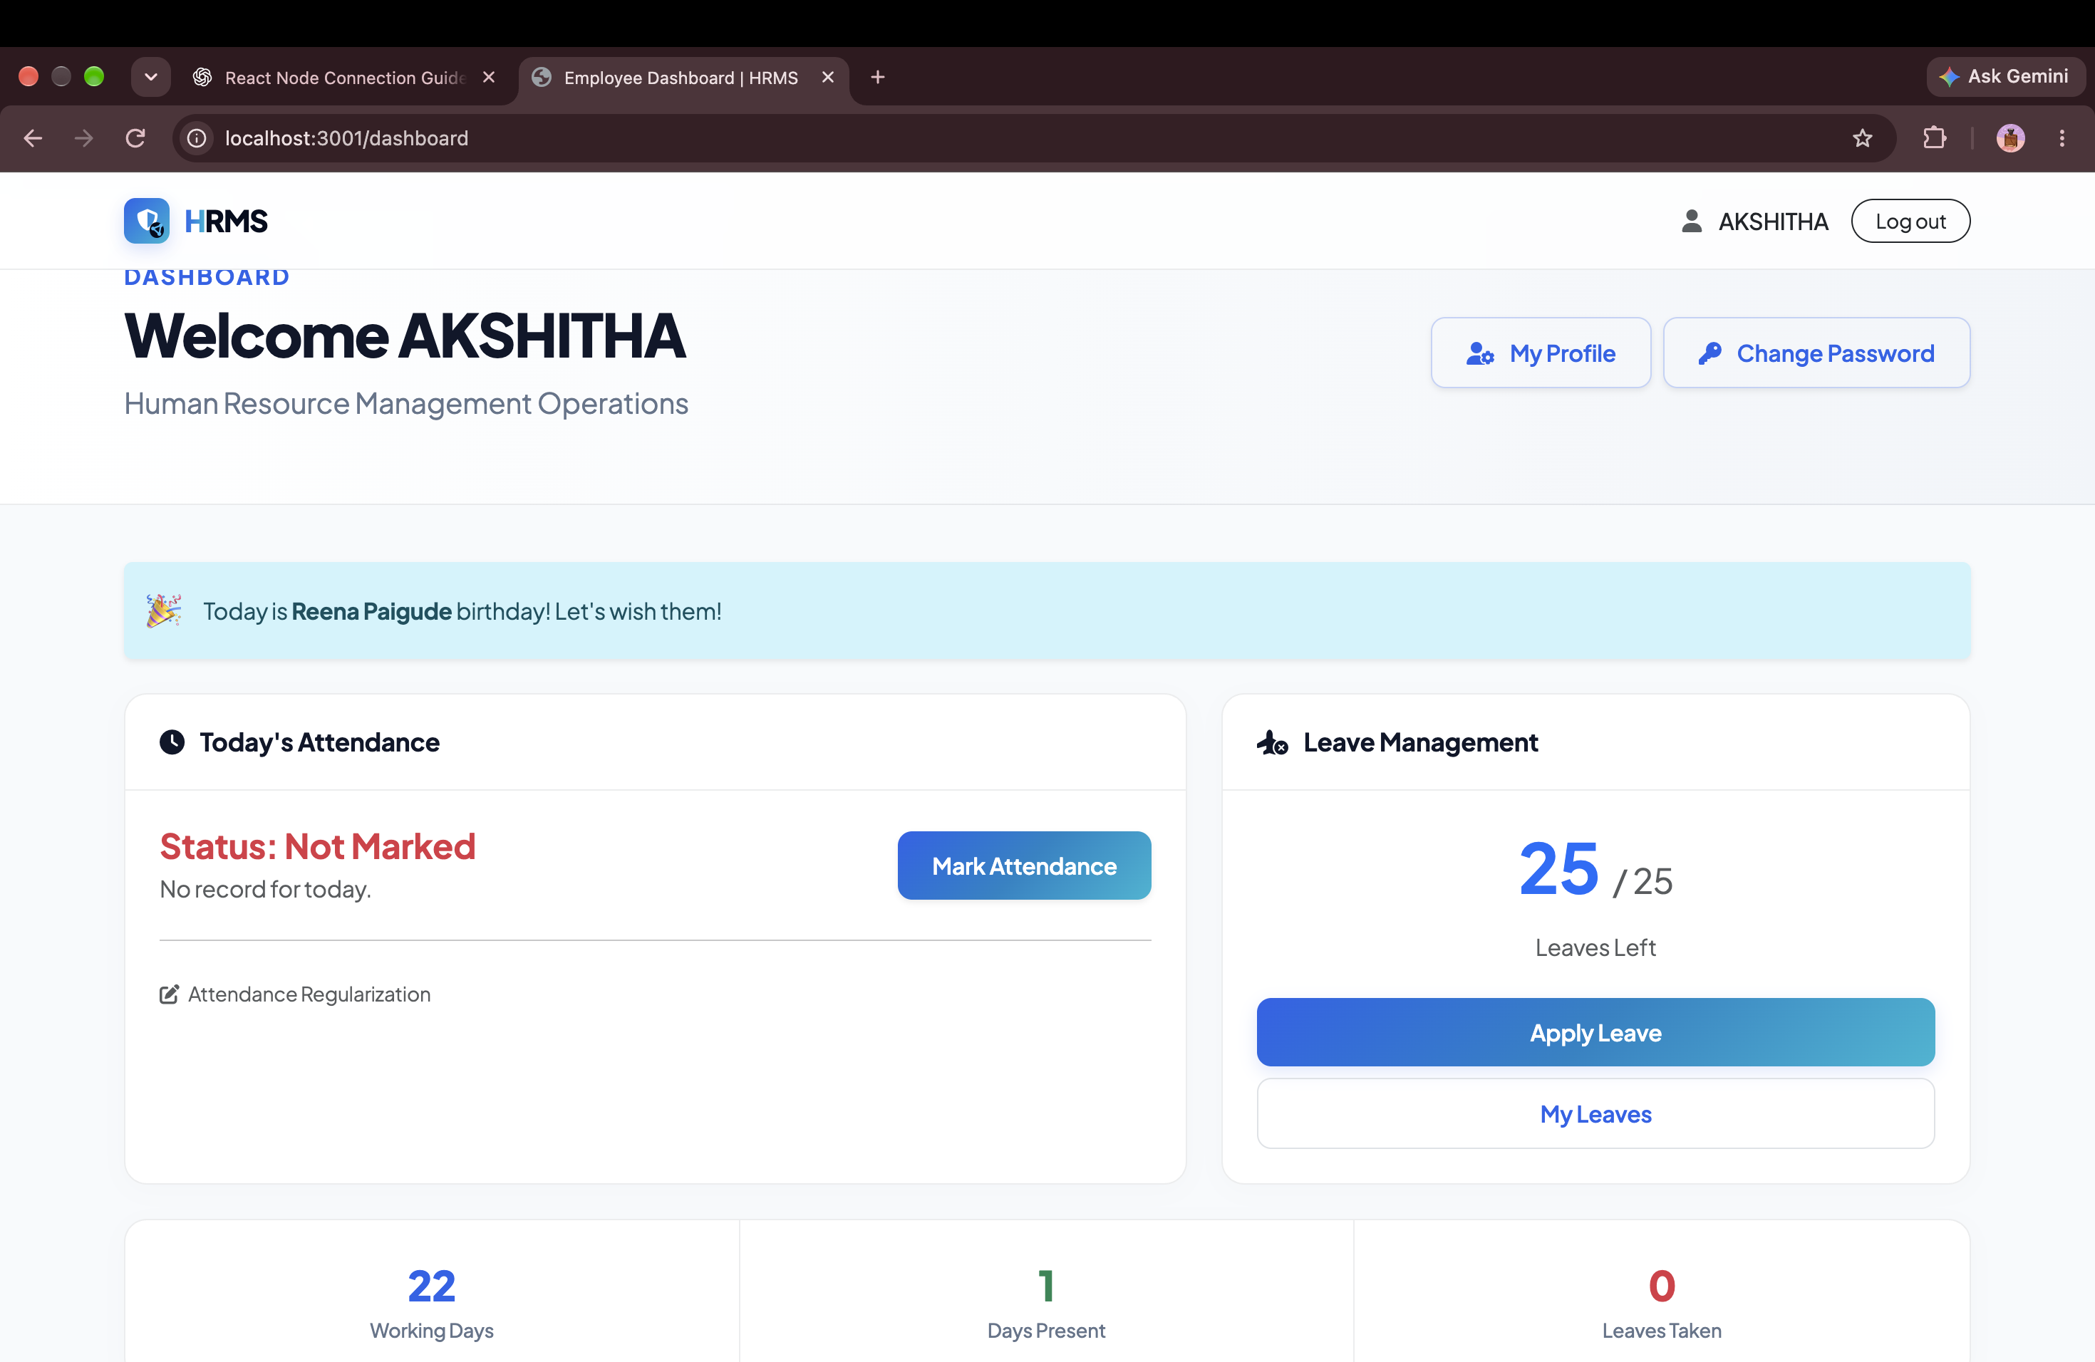
EMPLOYEE EXPERIENCE
Employee Self-Service Command Center
EXECUTIVE SUMMARY
Personalized employee dashboard with greeting banner, real-time clock-in status, pending requests, and fast-action shortcuts.
CORE BUSINESS ADVANTAGES
✔ Self-Service Empowerment: Employees apply for leaves, book trips, and download payslips without bothering HR.
✔ Live Shift & Punch Status: Displays exact current punch status, shift timings, and daily working hours counter.
✔ High-Adoption UX: Modern Corporate Blue interface designed for friction-free employee satisfaction and adoption.
ENTERPRISE IMPACT • EXPERIENCE
Frictionless Employee Self-Service
HRMS ENTERPRISE SUITE • Confidential & Proprietary • Enterprise Workforce Operating System
Slide 23 of 41

Slide 24
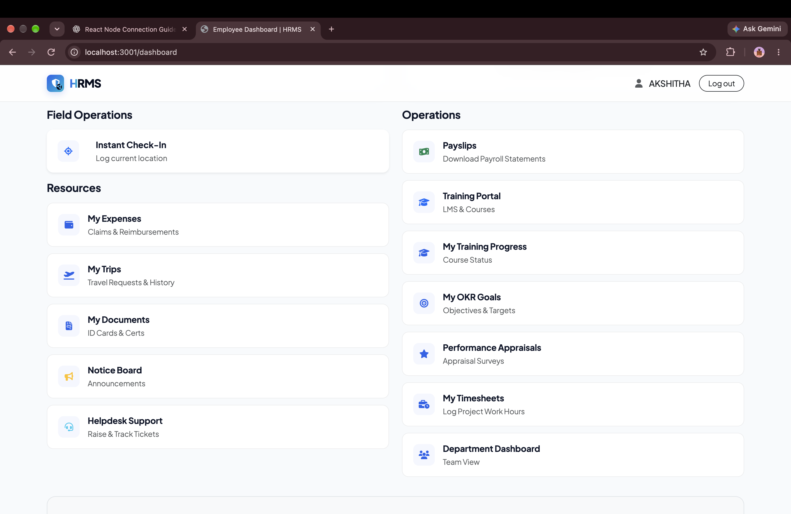
EMPLOYEE EXPERIENCE
Employee Action Center & KPI Metric Cards
EXECUTIVE SUMMARY
At-a-glance status cards detailing available leave balances, approved business trips, expense vouchers, and recent payslips.
CORE BUSINESS ADVANTAGES
✔ Transparent Balances: Completely eliminates employee inquiries regarding remaining casual or sick leave days.
✔ One-Click Document Downloads: Instant access to current and historical monthly salary slips.
✔ Real-Time Request Tracking: Live visibility into whether submitted leave or expense requests have been approved.
ENTERPRISE IMPACT • TRANSPARENCY
Zero Inquiries to HR Helpdesk
HRMS ENTERPRISE SUITE • Confidential & Proprietary • Enterprise Workforce Operating System
Slide 24 of 41

Slide 25
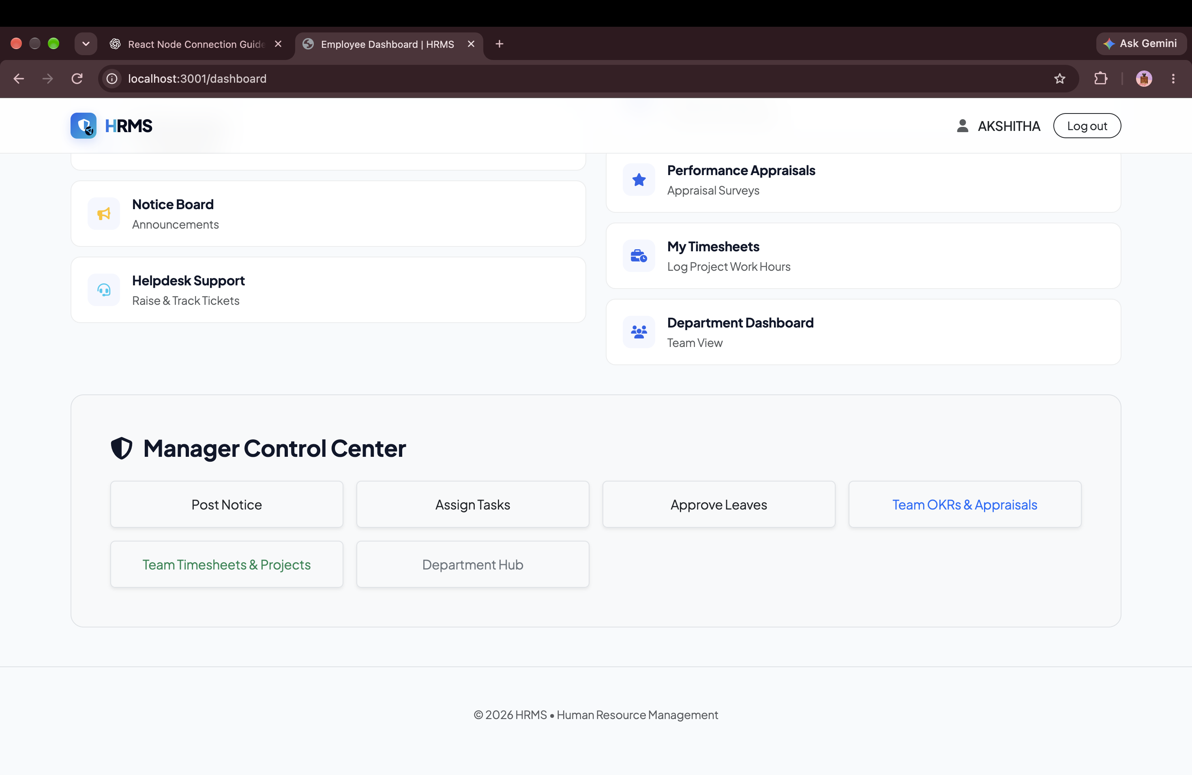
EMPLOYEE EXPERIENCE
Personal Productivity & Attendance History
EXECUTIVE SUMMARY
Personalized monthly attendance calendar displaying working days, public holidays, leaves taken, and punctuality records.
CORE BUSINESS ADVANTAGES
✔ Employee Accountability: Encourages personal attendance punctuality through transparent historical tracking.
✔ Dispute Avoidance: Identifies missing punches before monthly payroll cut-off dates to prevent salary deductions.
✔ Company Holiday Planning: Integrated holiday calendar aiding personal time-off and vacation planning.
ENTERPRISE IMPACT • ACCOUNTABILITY
Zero Payroll Dispute Timecards
HRMS ENTERPRISE SUITE • Confidential & Proprietary • Enterprise Workforce Operating System
Slide 25 of 41

Slide 26
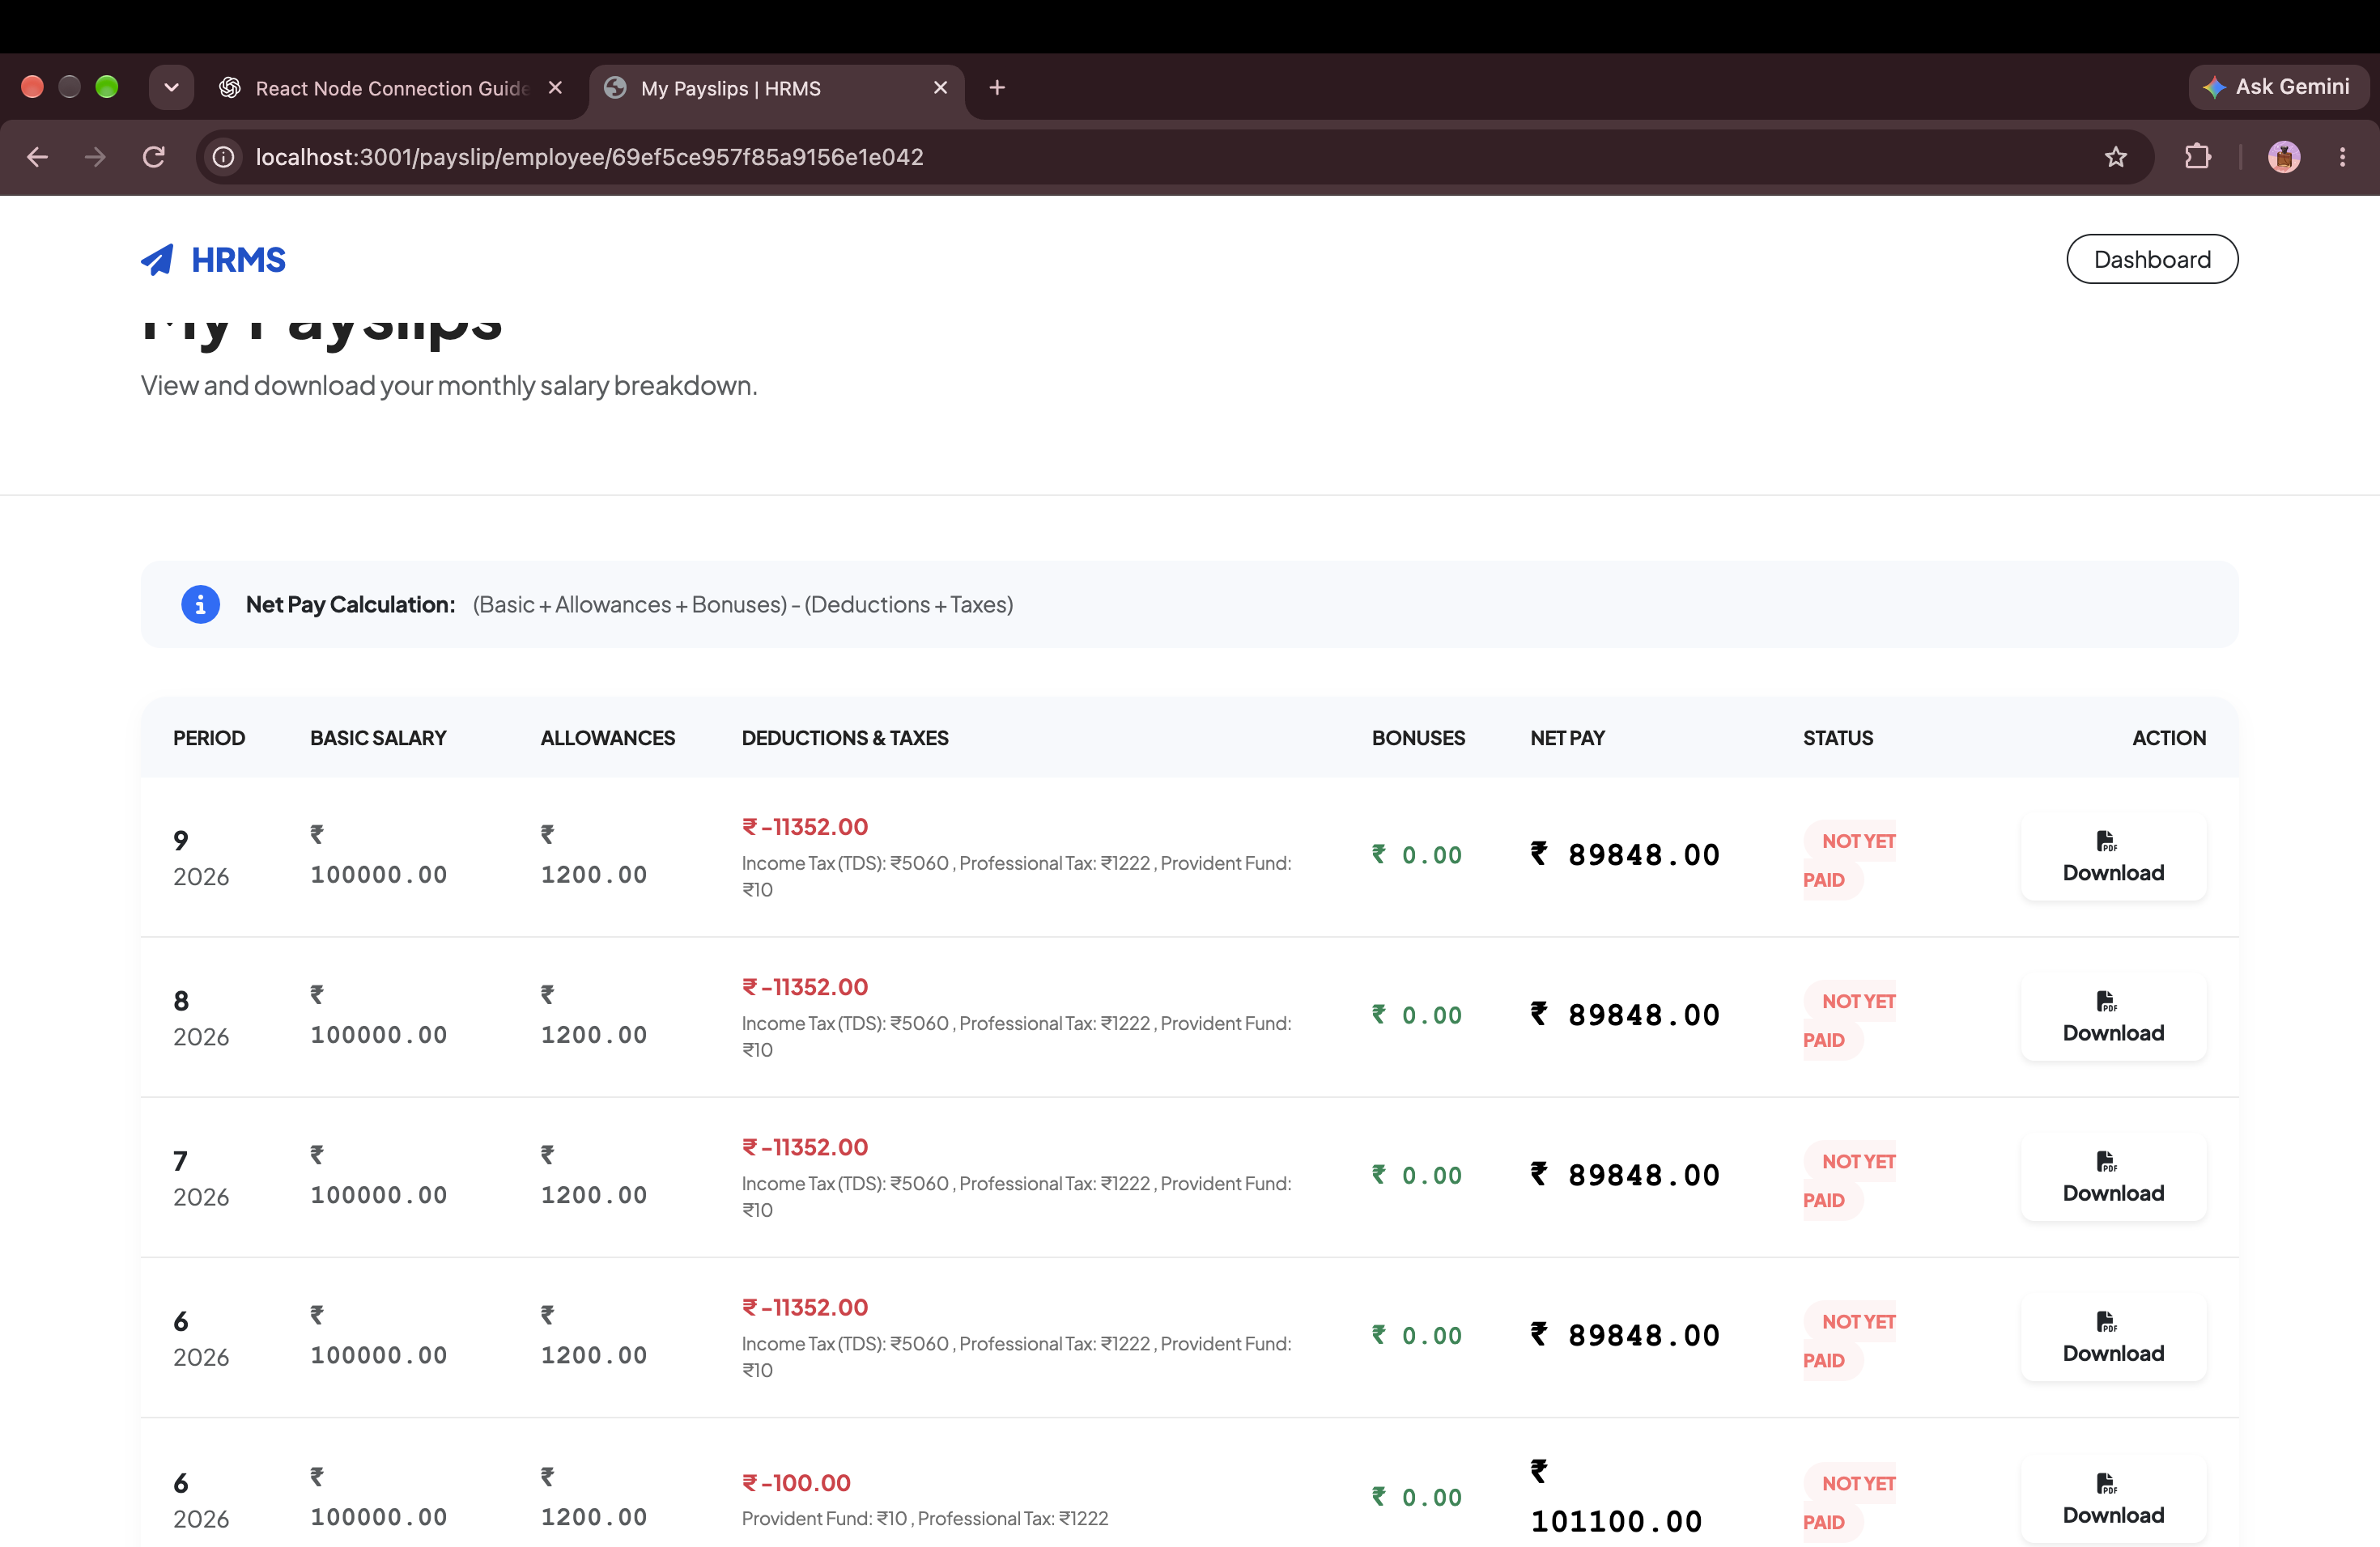
PAYROLL & TRANSPARENCY
Detailed Interactive Payslip & Statutory Deductions
EXECUTIVE SUMMARY
Exhaustive salary slip display breaking down basic salary, HRA, allowances, PF, ESI, professional tax, and net payable amount.
CORE BUSINESS ADVANTAGES
✔ Cryptographic Transparency: Shows every individual addition and deduction with exact statutory formulas.
✔ Official PDF Export: Instant print-ready PDF download featuring digital corporate seal for loans and visas.
✔ Historical Financial Archive: Employees maintain lifetime digital access to all past salary statements.
ENTERPRISE IMPACT • TRUST
Official PDF Payslip with Digital Seal
HRMS ENTERPRISE SUITE • Confidential & Proprietary • Enterprise Workforce Operating System
Slide 26 of 41

Slide 27
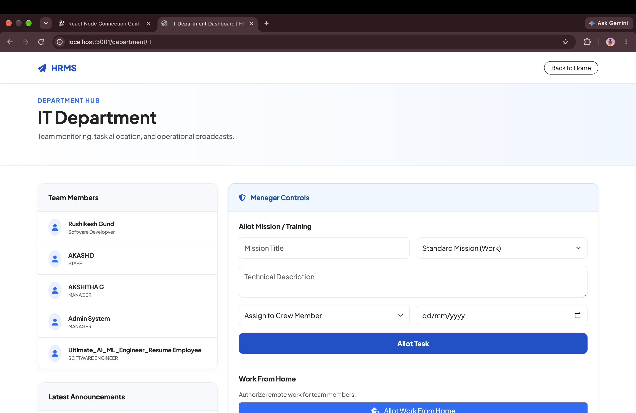
OPERATIONS & IT
IT Department Hardware Inventory & Asset Tracking
EXECUTIVE SUMMARY
Asset management suite tracking company laptops, monitors, software licenses, serial numbers, and custodian assignment histories.
CORE BUSINESS ADVANTAGES
✔ Asset Loss Prevention: Ensures all assigned IT hardware is tracked and returned during employee offboarding.
✔ Warranty & Maintenance: Tracks purchase dates, warranty expirations, and scheduled maintenance intervals.
✔ Custodian Accountability: Directly binds hardware serial numbers to employee digital profile records.
ENTERPRISE IMPACT • PROTECTION
100% Hardware Asset Accountability
HRMS ENTERPRISE SUITE • Confidential & Proprietary • Enterprise Workforce Operating System
Slide 27 of 41

Slide 28
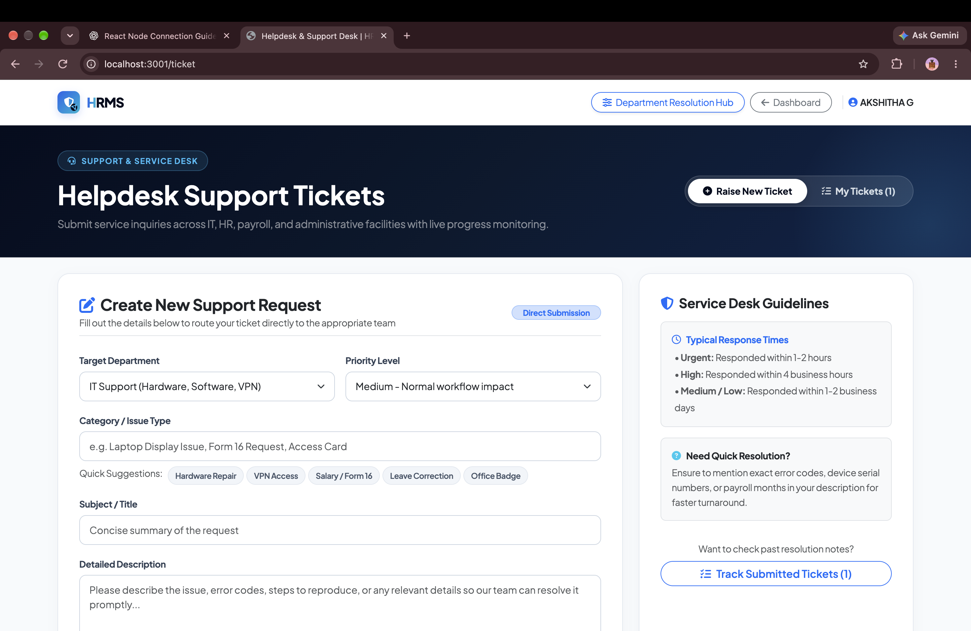
OPERATIONS & SUPPORT
Multi-Department Helpdesk & SLA Resolution Hub
EXECUTIVE SUMMARY
Internal ticketing system supporting priority triage, multi-department routing (IT, HR, Admin, Finance), and SLA monitoring.
CORE BUSINESS ADVANTAGES
✔ Guaranteed SLA Turnaround: Enforces resolution timeframes for critical workplace and IT support tickets.
✔ Departmental Routing: Directs employee tickets to the exact responsible team with automated notification alerts.
✔ Audit Trail & Status Updates: Replaces informal verbal complaints with verifiable digital ticket histories.
ENTERPRISE IMPACT • SLA CONTROL
Structured Multi-Department Tickets
HRMS ENTERPRISE SUITE • Confidential & Proprietary • Enterprise Workforce Operating System
Slide 28 of 41

Slide 29
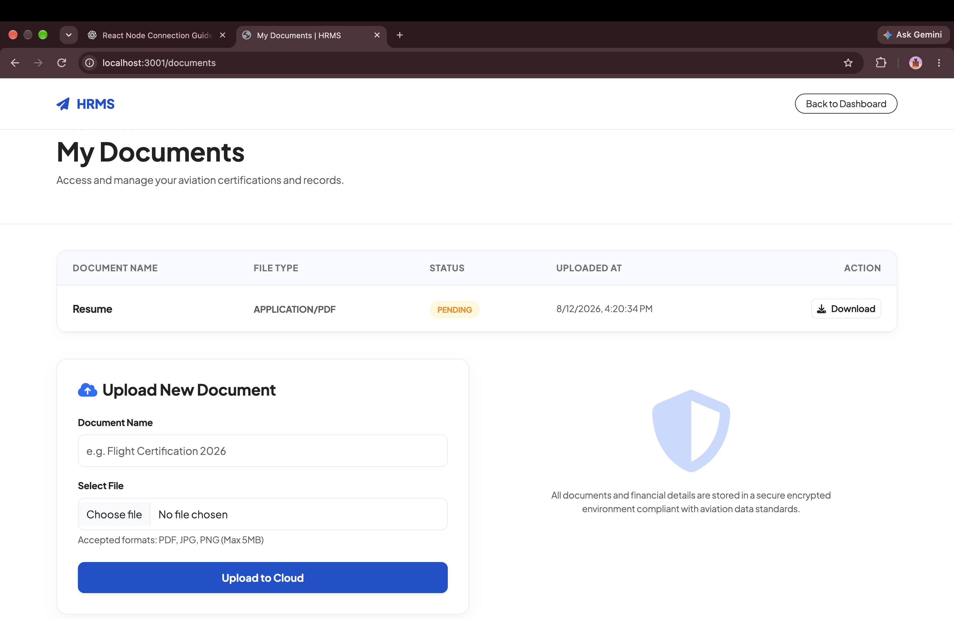
SECURITY & DOCUMENTATION
Enterprise Encrypted Document Vault
EXECUTIVE SUMMARY
Secure digital locker for storing offer letters, government IDs (Aadhaar/PAN), educational credentials, and appraisal certificates.
CORE BUSINESS ADVANTAGES
✔ Bank-Grade Encryption: Protects sensitive personal identity documents with encrypted cloud storage.
✔ Paperless HR Files: Completely replaces physical paper filing cabinets with instant digital search.
✔ Role-Restricted Access: Only authorized HR personnel and the document owner can inspect or download files.
ENTERPRISE IMPACT • SECURITY
Encrypted Cloud Document Locker
HRMS ENTERPRISE SUITE • Confidential & Proprietary • Enterprise Workforce Operating System
Slide 29 of 41

Slide 30
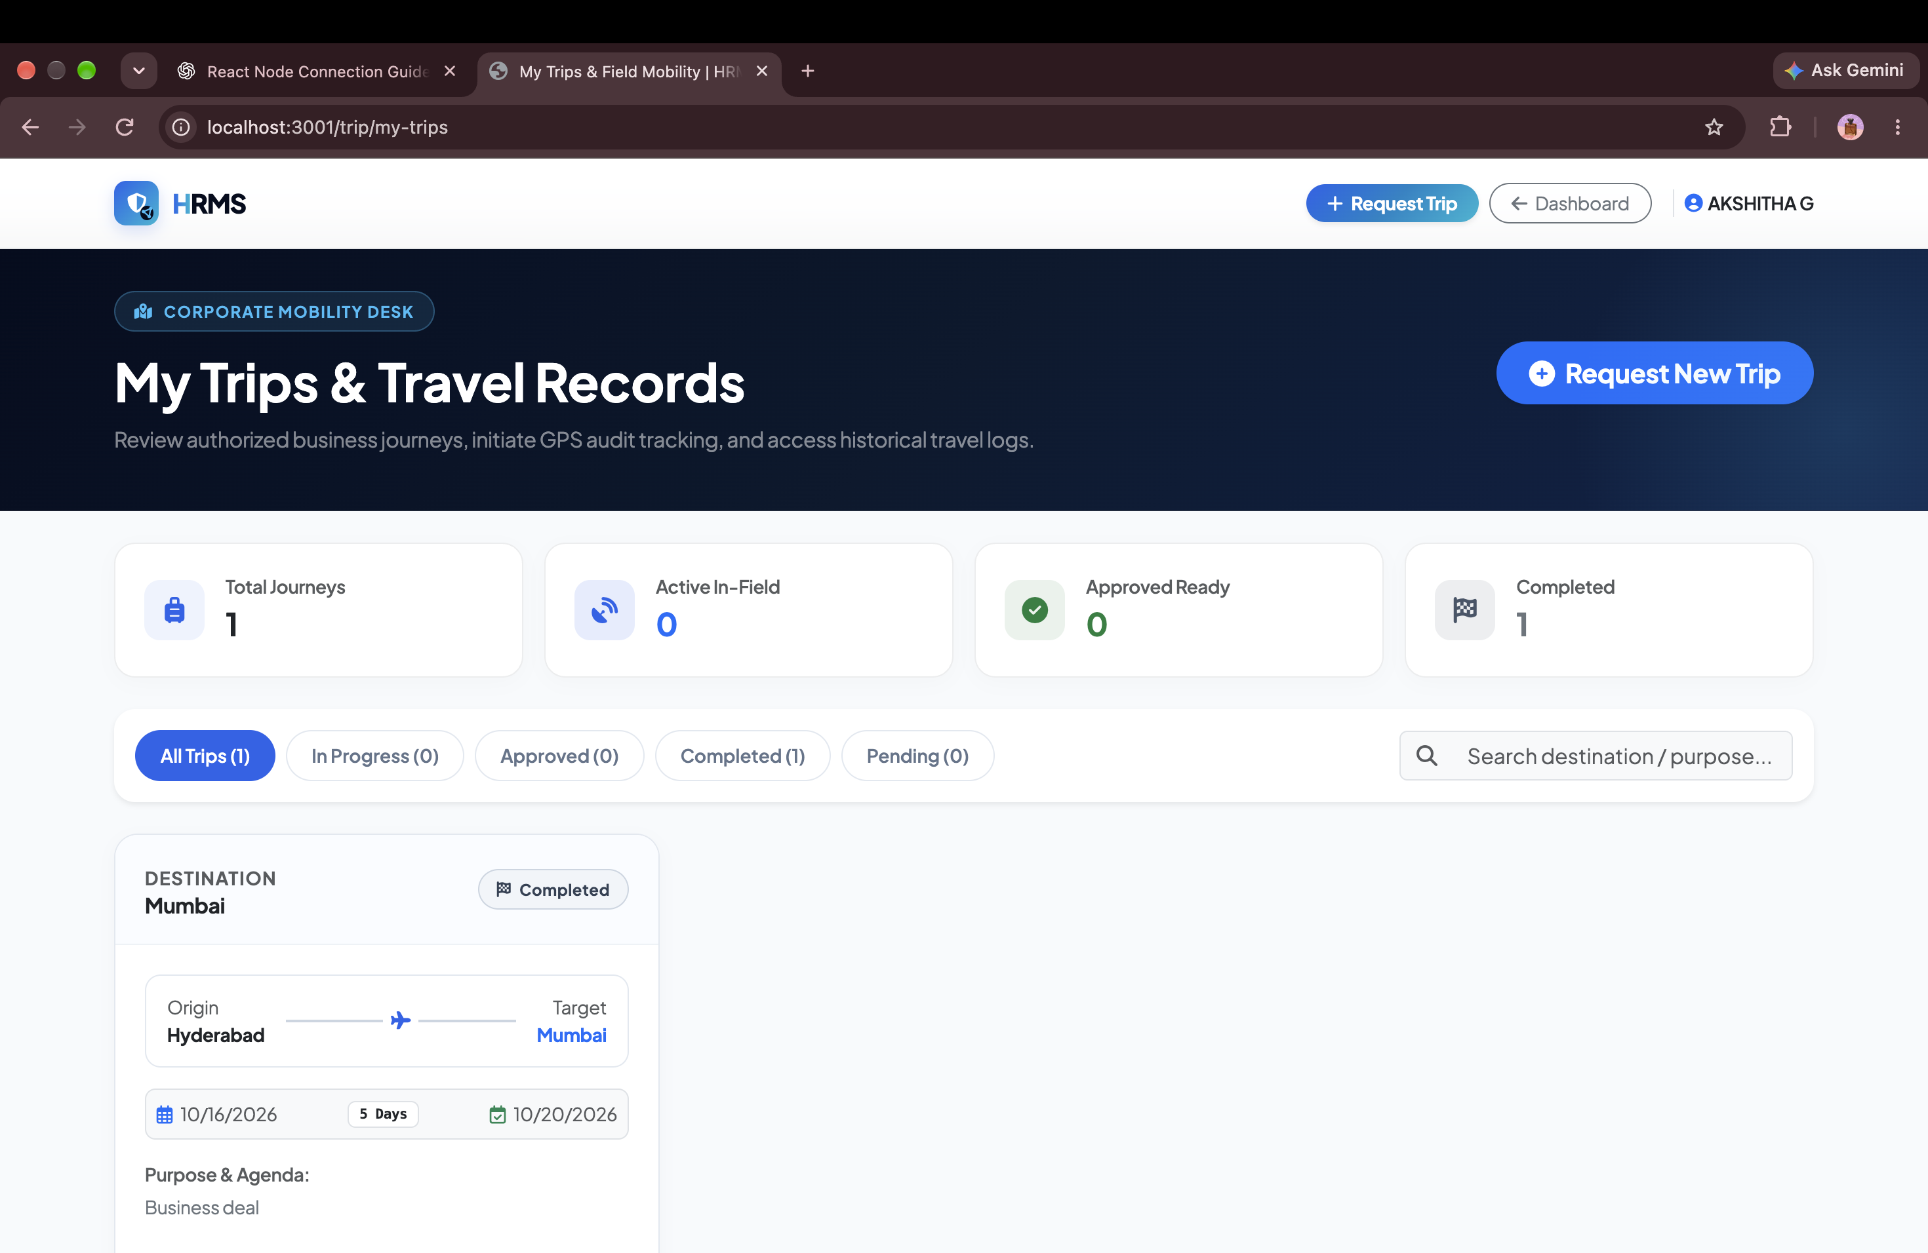
FIELD MOBILITY & LOGISTICS
Employee Field Mobility & Daily Trip Telemetry
EXECUTIVE SUMMARY
Field mobility tracker allowing employees on duty to initiate trips, record location checkpoints, and log activity pings.
CORE BUSINESS ADVANTAGES
✔ One-Touch Trip Activation: Simple start/stop interface designed for traveling executives and field engineers.
✔ GPS Checkpoint Pings: Logs location coordinates at client premises to verify customer visits.
✔ Seamless Expense Integration: Instant transition from completed trip to filing travel expense vouchers.
ENTERPRISE IMPACT • SIMPLICITY
1-Tap Field Trip Telemetry
HRMS ENTERPRISE SUITE • Confidential & Proprietary • Enterprise Workforce Operating System
Slide 30 of 41

Slide 31
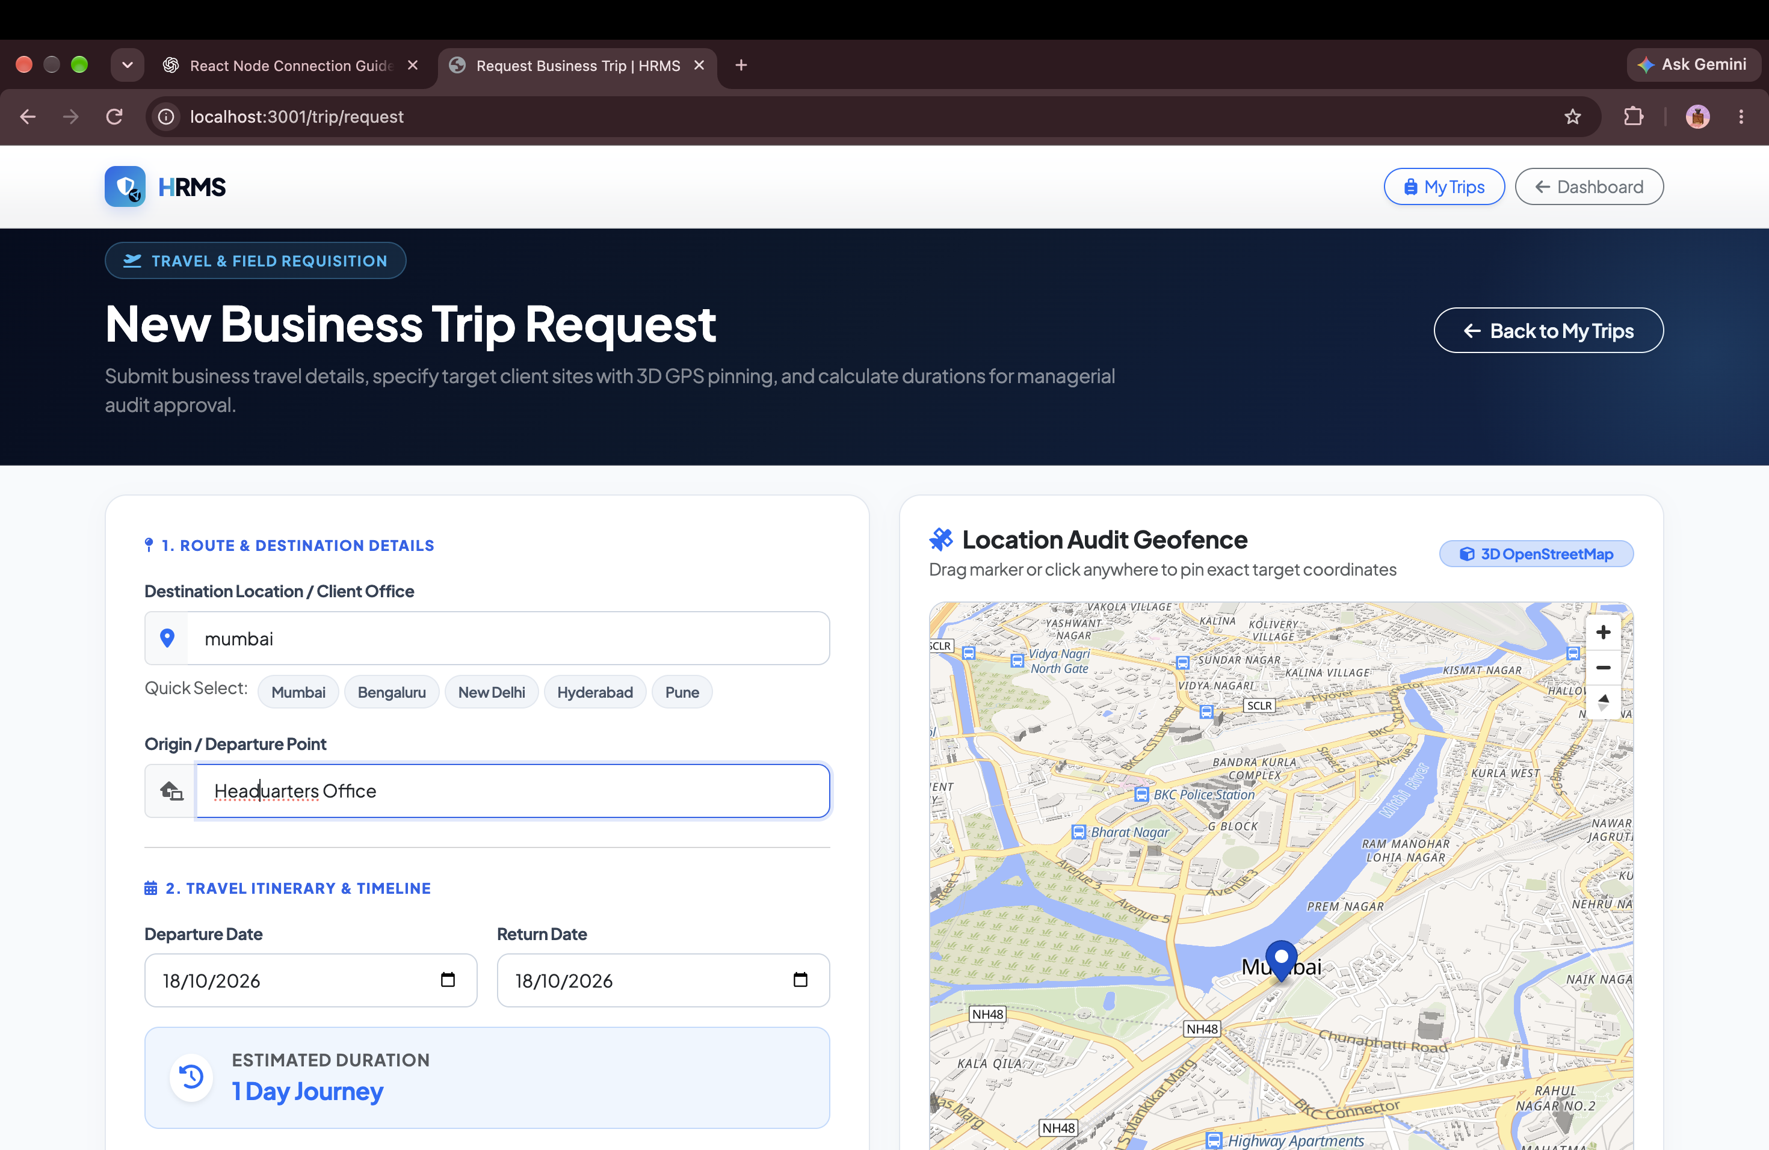
FIELD MOBILITY & LOGISTICS
Business Trip Requisition & Multi-City Wizard
EXECUTIVE SUMMARY
Comprehensive travel requisition wizard capturing origin, destination, business purpose, travel mode, and planned itinerary.
CORE BUSINESS ADVANTAGES
✔ Standardized Travel Approvals: Prevents unauthorized corporate travel with mandatory manager pre-approval.
✔ Policy-Compliant Itineraries: Ensures proposed travel dates and transport modes adhere to company travel policies.
✔ Multi-City Itinerary Support: Seamlessly supports complex travel routes across multiple client destinations.
ENTERPRISE IMPACT • WORKFLOW
Pre-Approved Travel Requisitions
HRMS ENTERPRISE SUITE • Confidential & Proprietary • Enterprise Workforce Operating System
Slide 31 of 41

Slide 32
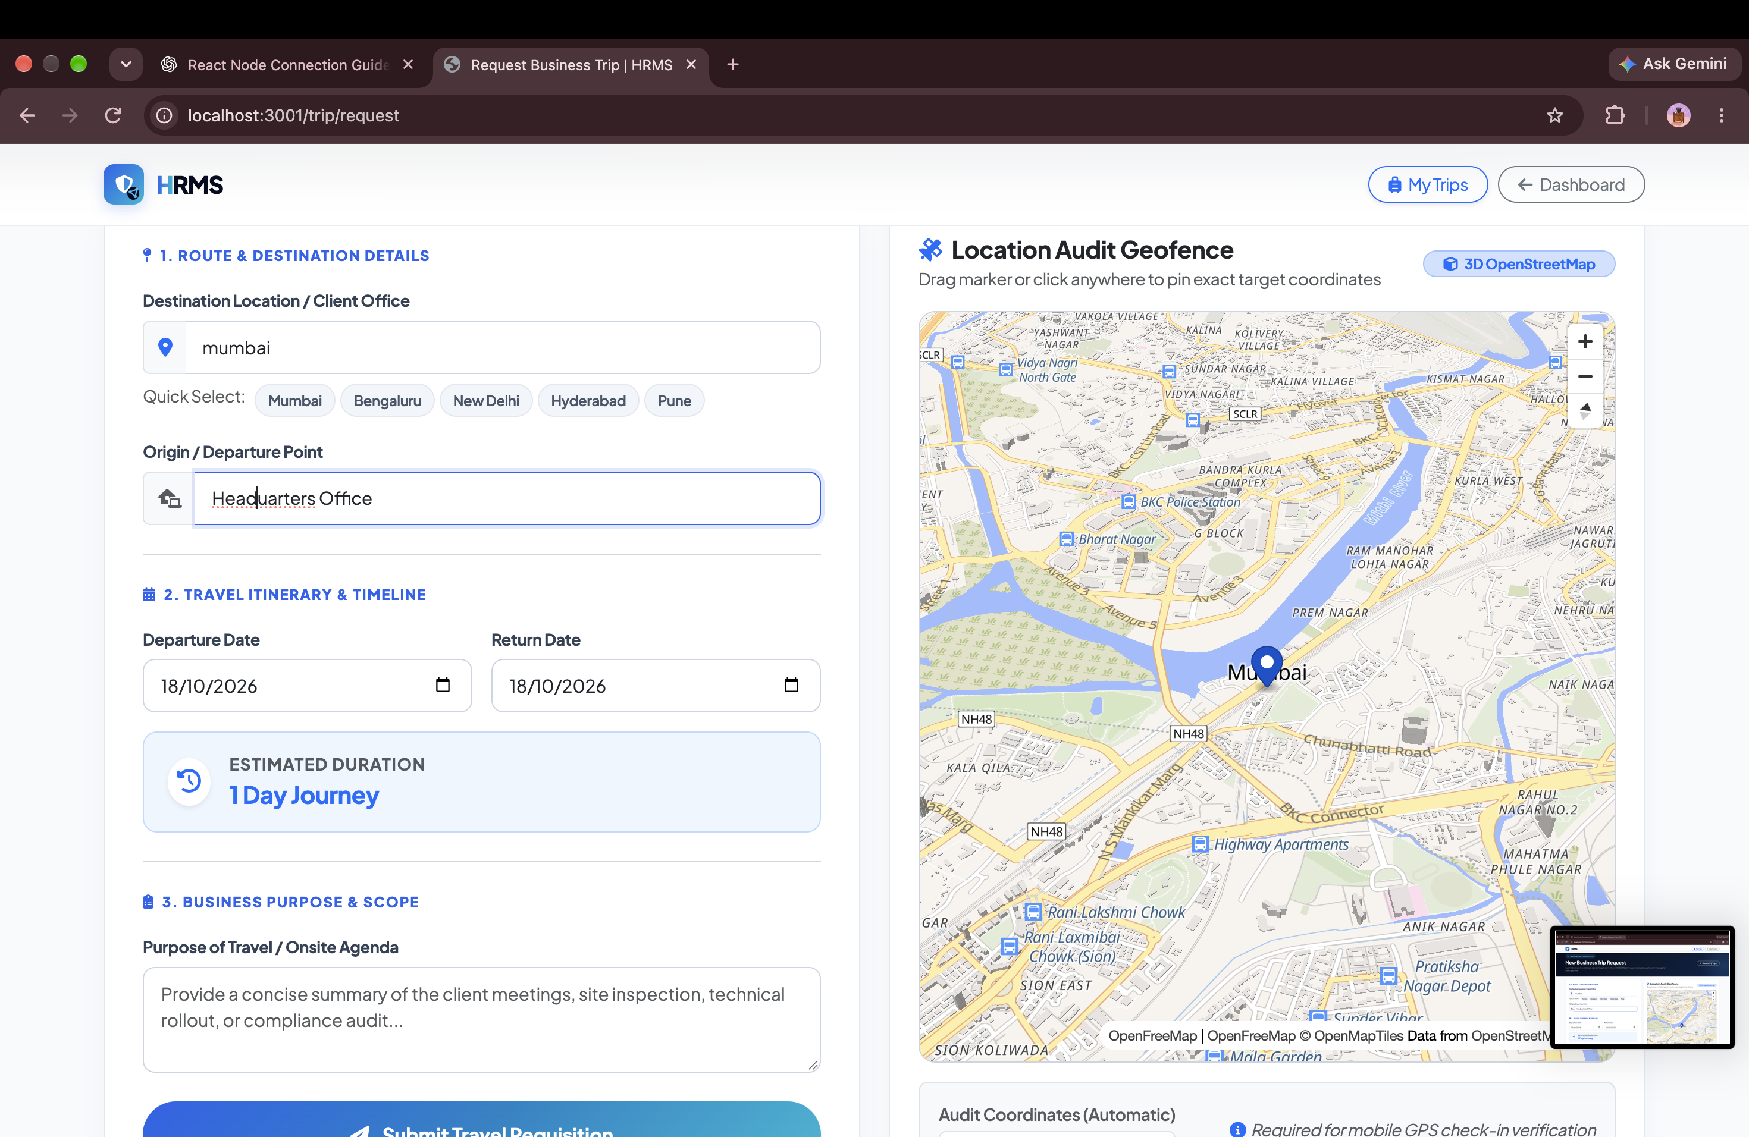
FIELD MOBILITY & FINANCE
Trip Budget Estimation & Daily Allowance Requisition
EXECUTIVE SUMMARY
Structured travel budget estimator covering lodging, transport, daily allowances, client hospitality, and cash advances.
CORE BUSINESS ADVANTAGES
✔ Expense Budget Caps: Establishes pre-approved spending ceilings to avoid unexpected expense claim surprises.
✔ Advance Cash Workflow: Streamlines travel advance requests with automated finance department approval.
✔ Financial Governance: Ensures travel budgets align with departmental quarterly travel allocations.
ENTERPRISE IMPACT • BUDGETING
Prevents Expense Overruns
HRMS ENTERPRISE SUITE • Confidential & Proprietary • Enterprise Workforce Operating System
Slide 32 of 41

Slide 33
FIELD MOBILITY & GOVERNANCE
Trip Review, Manager Routing & Approval Audit
EXECUTIVE SUMMARY
Final itinerary confirmation screen displaying complete travel summary, emergency contacts, and automated notification triggers.
CORE BUSINESS ADVANTAGES
✔ Duty of Care Compliance: Ensures company always knows employee location and emergency contacts during travel.
✔ Automated Manager Routing: Instantly notifies reporting managers for rapid one-click digital travel sign-off.
✔ Digital Travel Authorization: Produces official approved travel record required for ticketing and advance disbursal.
ENTERPRISE IMPACT • GOVERNANCE
Complete Corporate Duty-of-Care
HRMS ENTERPRISE SUITE • Confidential & Proprietary • Enterprise Workforce Operating System
Slide 33 of 41

Slide 34
TALENT & GOVERNANCE
360° Digital Employee Profile & Emergency Contacts
EXECUTIVE SUMMARY
Comprehensive employee digital dossier containing role details, blood group, emergency contacts, bank details, and hierarchy.
CORE BUSINESS ADVANTAGES
✔ Life-Safety Emergency Access: Instant access to employee blood group and emergency contacts in critical situations.
✔ Verified Banking Records: Maintains accurate bank account and IFSC details to prevent salary payment bounces.
✔ Self-Service Updates: Employees maintain their residential address and contact details, saving HR time.
ENTERPRISE IMPACT • SAFETY
Essential Emergency & Banking Records
HRMS ENTERPRISE SUITE • Confidential & Proprietary • Enterprise Workforce Operating System
Slide 34 of 41

Slide 35
ATTENDANCE & SECURITY
Live Geofenced Map Punch & Attendance Terminal
EXECUTIVE SUMMARY
Interactive OpenStreetMap clock-in interface displaying real-time employee position relative to designated office perimeter circles.
CORE BUSINESS ADVANTAGES
✔ Visual Geofence Verification: Renders clear visual feedback showing employee position inside designated office boundaries.
✔ Distance Validation Gate: Blocks punch attempts with clear warning messages if employee is outside allowable radius.
✔ Hardware-Free Biometrics: Turns any smartphone or laptop into an enterprise biometric attendance terminal.
ENTERPRISE IMPACT • INNOVATION
Visual Radius-Bounded Clock-In
HRMS ENTERPRISE SUITE • Confidential & Proprietary • Enterprise Workforce Operating System
Slide 35 of 41

Slide 36
ATTENDANCE & AUDITING
Daily Attendance Punch Telemetry & Timecard Verification
EXECUTIVE SUMMARY
Detailed punch log displaying timestamped check-in/out telemetry, IP address, and geofence verification status.
CORE BUSINESS ADVANTAGES
✔ Irrefutable Timecard Proof: Provides indisputable digital evidence of workplace presence for compliance audits.
✔ Shift Differential Tracking: Captures exact punch times required for accurate overtime and shift allowance calculations.
✔ Fast Dispute Resolution: Resolves employee timecard questions instantly with transparent timestamp data.
ENTERPRISE IMPACT • VERIFICATION
Irrefutable Digital Proof of Presence
HRMS ENTERPRISE SUITE • Confidential & Proprietary • Enterprise Workforce Operating System
Slide 36 of 41

Slide 37
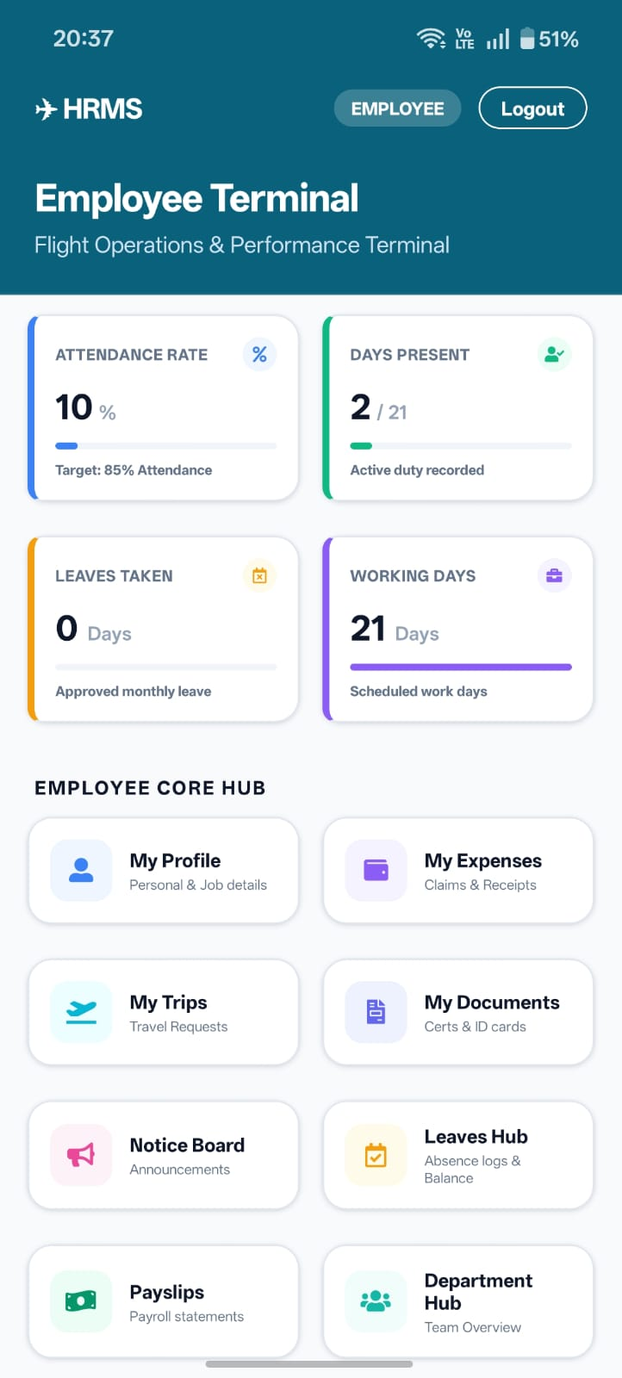
MOBILE APP EXCELLENCE
Mobile App: Executive Dashboard & Quick Punch
EXECUTIVE SUMMARY
Ergonomic native mobile interface featuring 1-tap attendance punch, leave quota widgets, and pending approval notifications.
CORE BUSINESS ADVANTAGES
✔ Native 60FPS Performance: Built on React Native Expo for fluid, responsive mobile performance on iOS and Android.
✔ Instant Mobile Punch: Clock-in from smartphone with instant geofence verification in under 2 seconds.
✔ Real-Time Mobile Alerts: Push notifications for leave approvals, company notices, and ticket updates.
ENTERPRISE IMPACT • MOBILE FIRST
Fluid Native iOS & Android App
HRMS ENTERPRISE SUITE • Confidential & Proprietary • Enterprise Workforce Operating System
Slide 37 of 41

Slide 38
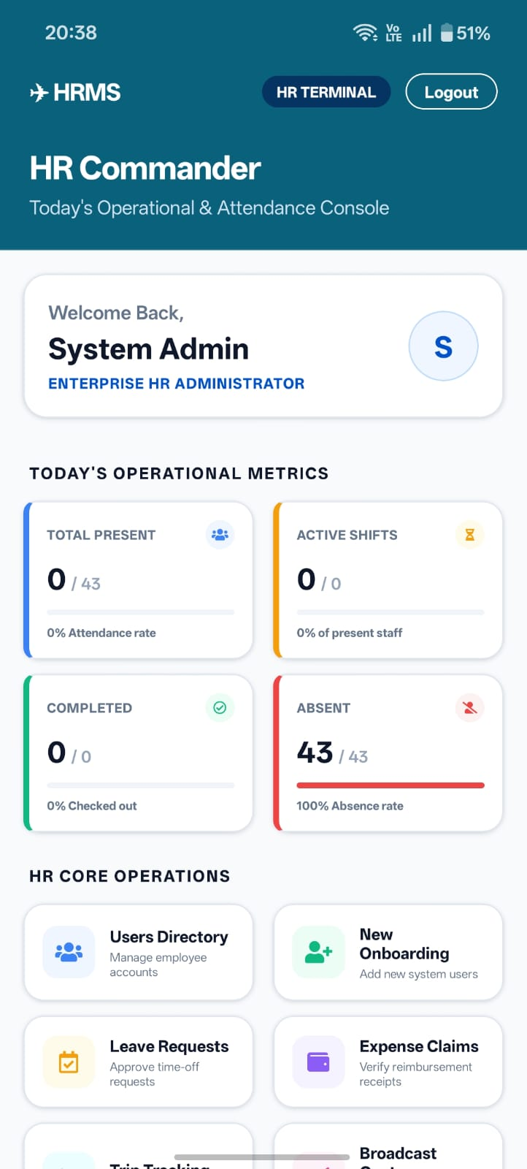
MOBILE APP EXCELLENCE
Mobile App: OpenStreetMap Geofenced Punch
EXECUTIVE SUMMARY
Native mobile map view displaying high-accuracy device GPS position relative to authorized company perimeter circles.
CORE BUSINESS ADVANTAGES
✔ Battery-Optimized GPS: High-accuracy geolocation without excessive smartphone battery drain.
✔ Visual Radius Circle: Real-time blue marker and green geofence circle indicate authorized punching zone.
✔ Zero Hardware Cost: Replaces expensive fingerprint scanners at factory gates and office entrances.
ENTERPRISE IMPACT • MOBILE MAPS
High-Precision Mobile Geofence
HRMS ENTERPRISE SUITE • Confidential & Proprietary • Enterprise Workforce Operating System
Slide 38 of 41

Slide 39
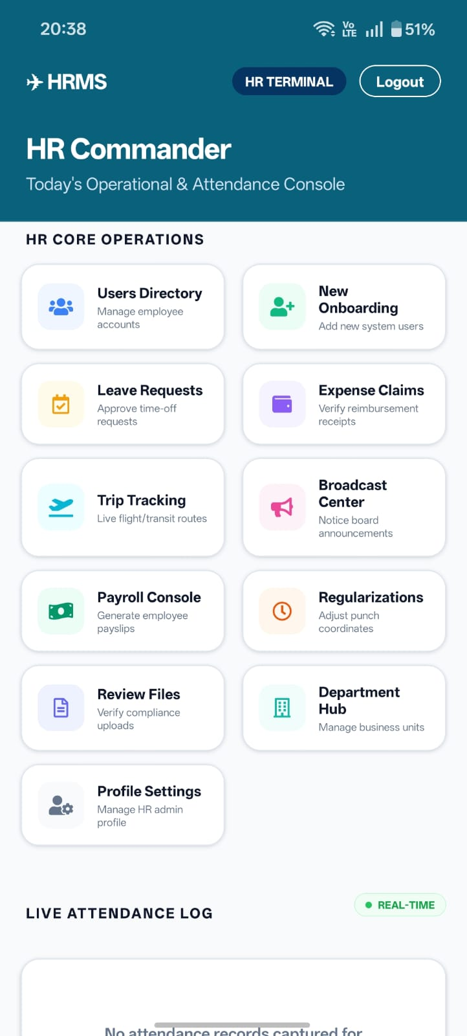
MOBILE APP EXCELLENCE
Mobile App: Field Trips & GPS Route Tracking
EXECUTIVE SUMMARY
Comprehensive mobile trip management screen with OpenStreetMap route tracing, status tabs, and direct expense claim submissions.
CORE BUSINESS ADVANTAGES
✔ Trip Status Tabs: Easily toggle between My Trips, Request Trip, and Trip Expenses on mobile.
✔ Live Mileage & Pings: Start trips and log location check-ins on-the-go from any smartphone.
✔ Direct Expense Claim: Submit hotel, fuel, food, and travel claims directly from the field.
ENTERPRISE IMPACT • FIELD READY
End-to-End Field Mobility on Mobile
HRMS ENTERPRISE SUITE • Confidential & Proprietary • Enterprise Workforce Operating System
Slide 39 of 41

Slide 40
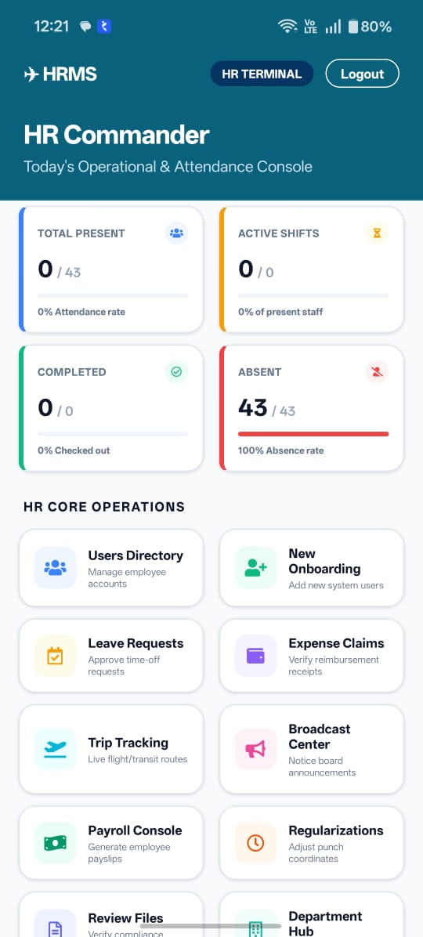
MOBILE APP EXCELLENCE
Mobile App: Digital Employee ID & Credentials
EXECUTIVE SUMMARY
Mobile digital identification badge displaying employee ID, department, manager, emergency contacts, and active status.
CORE BUSINESS ADVANTAGES
✔ Digital Employee ID: Serves as virtual company identity badge on smartphones for security gate entry.
✔ 1-Touch Emergency Calling: Direct speed-dial buttons for designated family and company emergency contacts.
✔ Mobile Document Access: Inspect company policies and employment credentials on mobile anytime.
ENTERPRISE IMPACT • IDENTITY
Digital Mobile Identity Badge
HRMS ENTERPRISE SUITE • Confidential & Proprietary • Enterprise Workforce Operating System
Slide 40 of 41

Slide 41
ENTERPRISE DEPLOYMENT READINESS
Ready for Production Rollout Across Global Organizations
Cloud & On-Premise Hosting
✔ AWS, GCP, Azure, or Self-Hosted Bare Metal compatibility
✔ Dockerized container architecture with horizontal auto-scaling
✔ MongoDB Atlas cluster with automated point-in-time backups
Security & Regulatory Posture
✔ SOC2, ISO 27001, and GDPR compliance architectural principles
✔ Multi-tenant cryptographic data separation and zero cross-leakage
✔ Role-Based Access Control (RBAC) with complete audit logging
Fast Turnkey Implementation
✔ Immediate CSV / Excel bulk employee data ingestion
✔ Pre-packaged statutory labor and tax configurations
✔ Instant mobile app rollout via Apple App Store & Google Play
HRMS ENTERPRISE SUITE • Confidential & Proprietary • Enterprise Workforce Operating System
Slide 41 of 41

