Slide 2
An Epsilon-NFA (ε-NFA), or epsilon non-deterministic finite automaton, is a type of nondeterministic finite automaton (NFA) that allows for transitions without consuming any input symbols.
These transitions are called epsilon (ε) transitions. They enable the automaton to change its state without reading any character from the input string.

Slide 3
An ε-NFA is defined by a 5-tuple (Q, Σ, δ, q₀, F):
Q: A finite set of states.
Σ: A finite set of input symbols (the alphabet).
δ: The transition function where δ: Q × (Σ ∪ {ε}) → P(Q). It maps a state and an input symbol (or ε) to a set of states.
q₀: The initial state.
F: A set of accepting (final) states.

Slide 4
ε-closure
The epsilon closure (ε-closure) of a state in an ε-NFA is the set of all states that can be reached from that state using only ε-transitions.
How to Compute the ε-closure:
To find the ε-closure of a state q, follow these steps:
Start with the state itself: The state q is always part of its own ε-closure.
Follow ε-transitions recursively: From state q, follow all possible ε-transitions to other states. If a state you reach via an ε-transition also has ε-transitions to other states, follow those as well.
Add all reachable states: Keep adding states you encounter via ε-transitions to the ε-closure until no new states can be reached.

Slide 5
ε-NFA to NFA Conversion
Step 1: Compute ε-closures for each state
Step 2: Update the transition function
Step 3: Update the set of final states

Slide 6
NFA
An NFA is defined by a 5-tuple (Q, Σ, δ, q₀, F):
Q: A finite set of states.
Σ: A finite set of input symbols (the alphabet).
δ: A transition function that maps a state and an input symbol to a set of possible next states, i.e., δ: Q × Σ → P(Q), where P(Q) is the power set of Q (the set of all subsets of Q).
q₀: The initial state, q₀ ∈ Q.
F: A set of final or accepting states, F ⊆ Q.

Slide 7
NFA to DFA conversion
Define the transition table of the DFA
Create the initial state of the DFA
Repeat for the new states
Mark the final states of the DFA

Slide 8
Minimization of the DFA
Remove the unreachable states
Reduce the dead states
Identify equivalent states
Partition the DFA States into Two Groups ( Final states and Non final states )
Refine the partitition

Slide 9
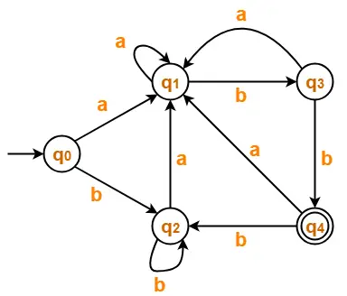

Slide 10
