Slide 1


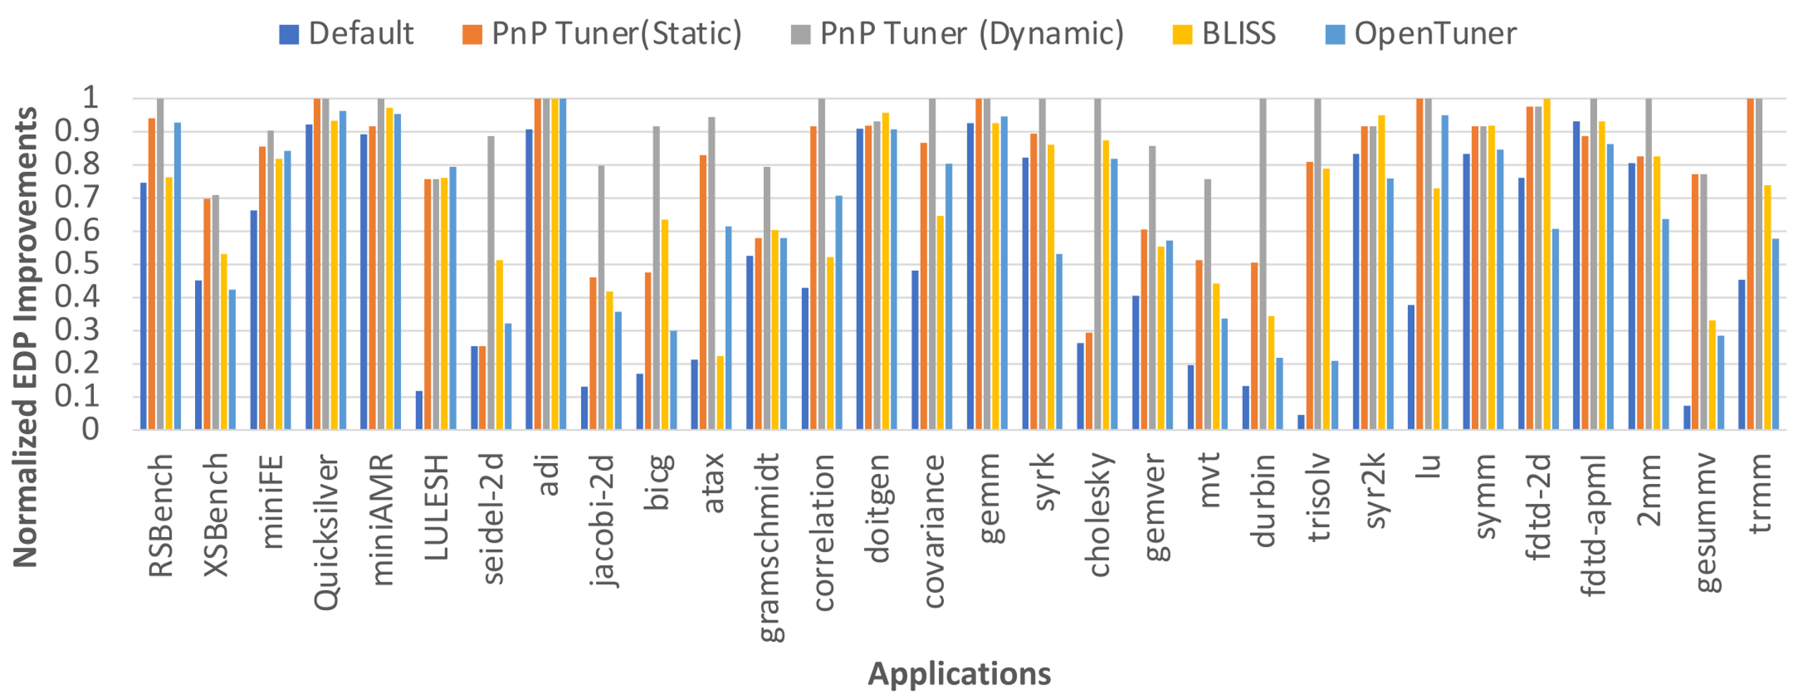
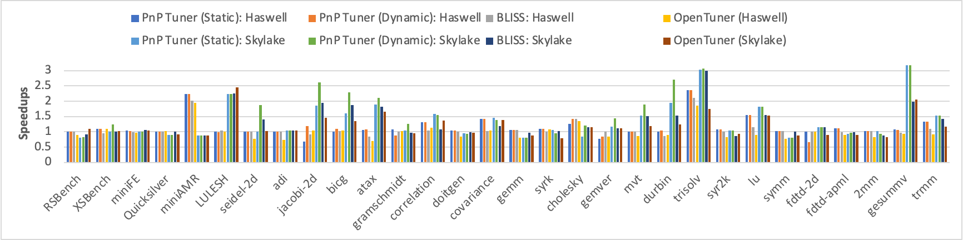
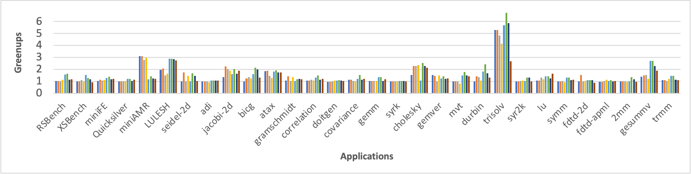
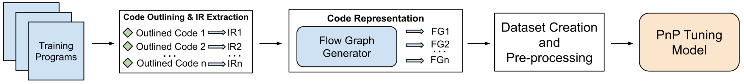
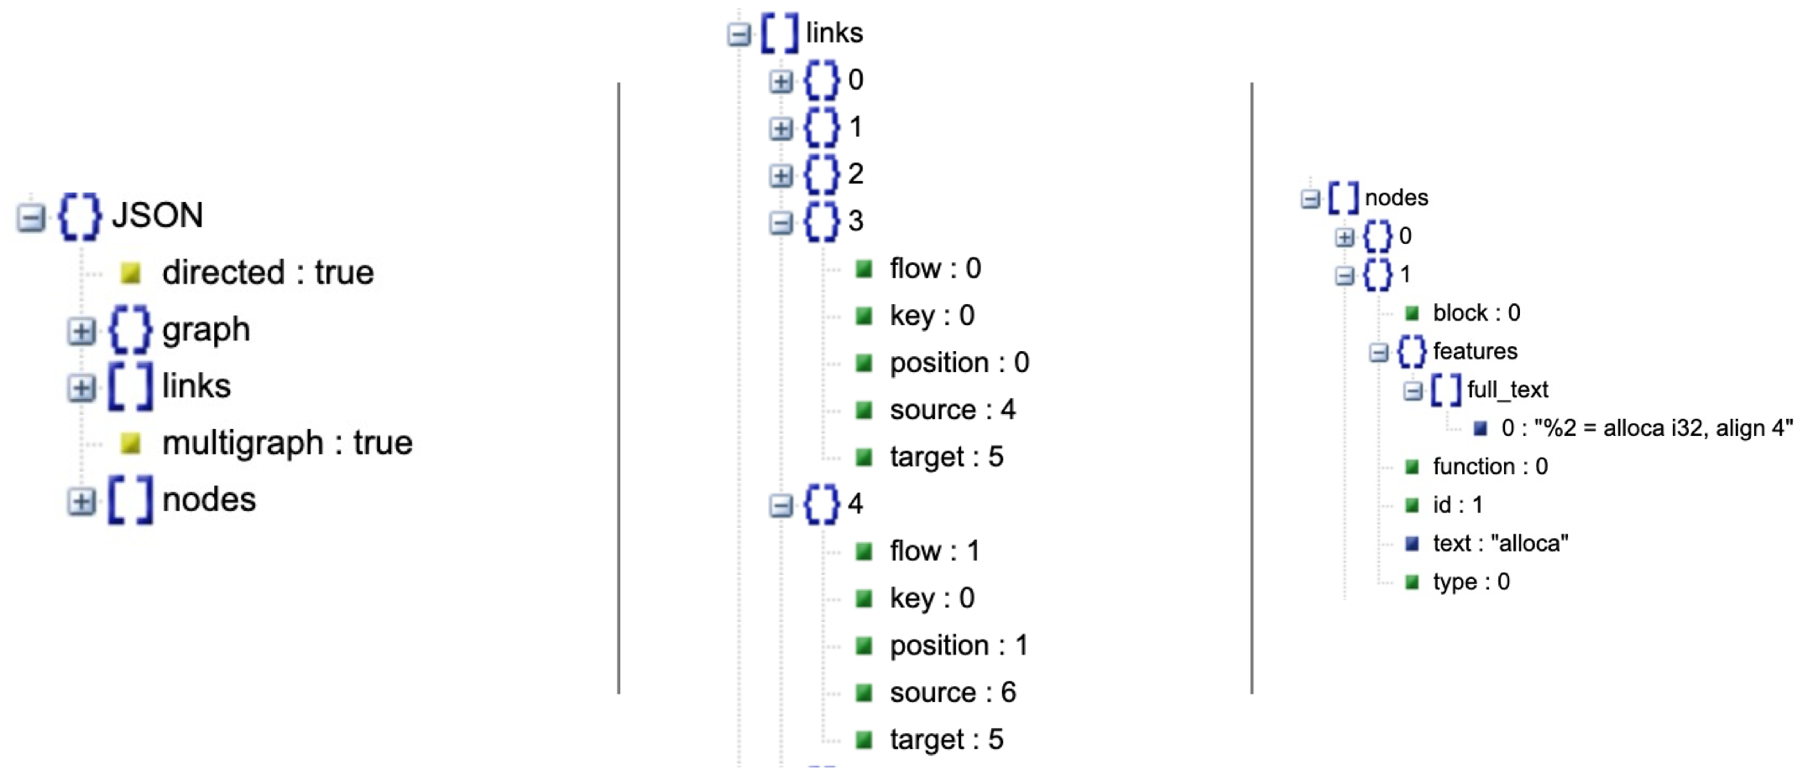

Autotuning Energy-Delay Product using Graph Neural Networks
Akash Dutta¹, Jee Choi², Ali Jannesari¹
¹Iowa State University, ²University of Oregon
Introduction
Model Parameters
Advances in multi and many-core processors have led to significant improvements in the performance
Addition of a large number of cores have also increased the overall power consumption
We can limit power consumption by software-based power constraints
To improve performance, power, and energy efficiency of scientific applications on modern multi-core processors, we propose a novel Graph Neural Network based auto-tuning approach that optimizes for both runtime performance and energy efficiency by minimizing the energy-delay product
In this work, we model parallel code regions as flow-aware code graphs to capture both semantic and structural code features.
Hyperparameter | Hyperparameter Values
Layers | RGCN(4), FCNN(3)
Activation Function | Leaky ReLU, ReLU
Optimizer | AdamW
Learning Rate | 0.001
Batch Size | 16
Loss function | Cross Entropy Loss
Results
Objectives
To model flow-aware graphs with GNNs (RGCNs) to capture semantic and structural features
To build a DL-based framework that optimizes for both time and energy simultaneously by minimizing the EDP.
To compare our framework against the state-of-the-art tuners.
Data Collection
Use RAPL to set power constraints
Use PAPI to collect performance counters
Collect runtime for each kernel in an application for each power constraint.
Collect performance counters for each power constraint and for each kernel
Process data to identify best configuration for each kernel
Approach
Our predictions lead to 2.31x improvement in EDP, 1.38x speedup, 1.6x greenup
Outperforms BLISS and OpenTuner in 83% and 97% cases.
Takeaways
Our approach needs only 2 executions during inference (less than existing dynamic tuners)
Simple models lead to fast training on CPUs.
Shows a promising approach for using both static and dynamic features
Limited to only a specific search space
In future, we aim to extend this work to GPUs.
Include pre-training techniques to work with variety of search spaces
Model above shown graphs through GNNs.
Merge GNN outputs with performance counters
Model these features with linear layers to predict the best config
References
Search Space
A. TehraniJamsaz, M. Popov, A. Dutta, E. Saillard and A. Jannesari, "Learning Intermediate Representations using Graph Neural Networks for NUMA and Prefetchers Optimization," 2022 IEEE International Parallel and Distributed Processing Symposium (IPDPS), Lyon, France, 2022, pp. 1206-1216, doi: 10.1109/IPDPS53621.2022.00120.
A. Dutta, J. Alcaraz, A. TehraniJamsaz, A. Sikora, E. Cesar and A. Jannesari, "Pattern-based Autotuning of OpenMP Loops using Graph Neural Networks," 2022 IEEE/ACM International Workshop on Artificial Intelligence and Machine Learning for Scientific Applications (AI4S), Dallas, TX, USA, 2022, pp. 26-31, doi: 10.1109/AI4S56813.2022.00010.
A. Dutta, J. Choi, and A. Jannesari, "Power Constrained Autotuning using Graph Neural Networks," 2023 IEEE International Parallel and Distributed Processing Symposium (IPDPS), St. Petersburg, FL, USA, 2023
A. Dutta, J. Alcaraz, A. TehraniJamsaz, E. Cesar, A. Sikora and A. Jannesari, "Performance Optimization using Multimodal Modeling and Heterogeneous GNN,” 2023 ACM International Symposium on High-Performance Parallel and Distributed Computing (HPDC), Orlando, FL, USA, 2023
Search Space | Parameter Values
Power Constraints | 75W, 100W, 120W, 150W (Skylake) 40W, 60W, 70W, 85W (Haswell)
Number of Threads | 1, 4, 8, 16, 32, 64 (Skylake) 1, 2, 4, 8, 16, 32 (Haswell)
Scheduling Policy | STATIC, DYNAMIC, GUIDED
Chunk Sizes | 1, 8, 32, 64, 128, 256, 512
This research was supported by NSF grant number 2211982.

