Slide 1
REINFORCEMENT LEARNING COURSE PROJECT - PHASE II FINAL REVIEW
Multi-Objective Reinforcement Learning for Adaptive and Personalized Tourist Route Planning
with Dynamic Action Masking and Mid-Trip Re-planning
Team Members:
• Kanuri Akash
• Korukunda Krishna Sai
Department of Computer Science and Engineering, School of Computing
Amrita Vishwa Vidyapeetham, India

Slide 2
PROBLEM CONTEXT
2. Problem Background: The Tourist Trip Design Challenge
The Tourist Trip Design Problem (TTDP)
• Formally blends the Orienteering Problem (OP), TSP with Time Windows (TSPTW), and multi-knapsack budget allocation.
• Tourists must simultaneously select an optimal subset of attractions and determine their optimal sequence of visitation.
• The search space scales factorially (O(N!)), rendering brute-force or exact permutation enumerations impossible.
• Attractions exhibit individual dwell times, ticket admission fees, and opening/closing operating windows.
Real-World Travel Conflicts
• Multi-Objective Tension: Tourists desire maximum satisfaction and diversity while minimizing travel delays and money spent.
• Heterogeneous Traveler Personas: Backpacker seeking free beaches vs. Luxury tourist visiting premium boat cruises.
• Dynamic Real-World Disruptions: Monsoons, road traffic jams, spontaneous museum closures, or impromptu stop additions.
• Existing planning methods cannot adjust dynamically without catastrophic re-computation latency.

Slide 3
CORE OBJECTIVES
3. Problem Statement & Operational Boundary Constraints
The Tri-Objective Optimization Goal
• Objective 1: Maximize Satisfaction — Maximize historical visitor ratings and category diversity while penalizing category satiation.
• Objective 2: Minimize Travel Time — Minimize cumulative inter-node transit duration and idle queuing delays.
• Objective 3: Minimize Monetary Cost — Minimize transport fares and attraction entry fees to conserve wallet budget.
• Scalarized Goal: Maximize R = w1(Sat) - w2(Time) - w3(Cost), conditioned on continuous user weights w in simplex.
Operational Boundary Conditions
• Zero Constraint Violations: Never exceed maximum daily time ceiling (T_max = 10.0 h) or budget cap (B_max = INR 2,000).
• Diurnal Time Windows: 100% adherence to opening/closing hours; no arrival after attraction closure.
• Guaranteed Return-to-Origin: Ensure tourist retains sufficient travel time/budget to safely reach hotel/airport at end.
• Sub-Millisecond Re-planning: Re-plan remaining stops on the fly (< 1.0 ms) upon mid-trip user intervention.

Slide 4
METHODOLOGICAL JUSTIFICATION
4. Why Reinforcement Learning? (vs Traditional Methods)
Limitations of Conventional Approaches
• Exact Solvers (MILP, Branch-and-Cut): Provide global optimality certificates but suffer from exponential runtime O(2^N). Intractable for N > 20.
• Metaheuristics (Genetic Algorithms, NSGA-II): Run evolutionary crossover/mutation across 300 generations (3 to 8 seconds).
• Fatal Metaheuristic Flaw: Static, monolithic representation. If a disruption occurs mid-trip, GA must recalculate from scratch.
• Recommendation Engines: Recommend popular places via collaborative filtering but completely ignore spatial routing and transit viability.
The Deep MORL Advantage
• Formulates routing as an episodic Markov Decision Process (MDP) with sequential decision epochs.
• Amortized Computation: Heavy combinatorial exploration is solved during offline training; online route synthesis executes in 0.84 ms.
• Dynamic Action Masking: Eliminates invalid/unreachable transitions prior to sampling, guaranteeing 0.0% violations.
• Single Unified Policy: Decoupled Dueling MO-DQN generalizes across all tourist personas without retraining neural network.

Slide 5
STATE OF THE ART
5. Literature Review: Research Papers (Part 1)
Paper 1: Multi-Objective RL for Trip Recommendation (2024)
Al-Dabbagh et al. (Expert Syst. Appl.)
Research Contributions:
• Formulated trip planning via policy gradients with multi-dimensional vector rewards.
• Balanced popularity vs travel time.
What is Unique with Existing / Gaps:
• Ignored hard opening/closing hours.
• Lacked action masking; high early violation rate.
• Our Work: Enforces strict time windows & Dynamic Action Masking (0% violations).
Paper 2: Deep RL for Personalized Travel Routes (2023)
Kitsios et al. (Applied Sciences)
Research Contributions:
• Integrated DQN with spatial RNN to capture user check-in history.
• Modeled multi-day sequential tours.
What is Unique with Existing / Gaps:
• Designed strictly as an offline planner.
• Cannot handle mid-trip user disruptions.
• Our Work: Native human-in-the-loop mid-trip re-planning in under 0.90 ms.
Paper 3: Dynamic Tourist Planning with Time Windows (2022)
Zhang et al. (J. Travel Research)
Research Contributions:
• Solved TSPTW applied to urban sightseeing using standard DQN.
• Applied negative reward penalties for late arrivals.
What is Unique with Existing / Gaps:
• Penalties alone fail: agent repeatedly sample closed POIs during exploration.
• Our Work: Explicit Action Masking physically zeroes illegal actions before sampling.

Slide 6
STATE OF THE ART
5. Literature Review: Research Papers (Part 2)
Paper 4: Multi-Agent RL for Group Tour Recommendation (2023)
Chen et al. (IEEE Trans. ITS)
Research Contributions:
• Modeled multi-traveler group tour consensus via MADDPG centralized critic.
• Balanced conflicting individual ratings.
What is Unique with Existing / Gaps:
• Omitted individual wallet budget ceilings.
• Scaled exponentially with group size.
• Our Work: Precise financial knapsack modeling and zero-latency execution.
Paper 5: Deep RL Framework for Orienteering Problem (2021)
Bello et al. (ICLR)
Research Contributions:
• Solved Euclidean Orienteering with Attention-based Actor-Critic.
• Outperformed classical heuristic solvers.
What is Unique with Existing / Gaps:
• Assumed synthetic, symmetric 2D Euclidean distance and uniform fees.
• Our Work: Real non-Euclidean road network, terrain distortion & entrance fees.
Paper 6: Context-Aware Trip Planning with MCDM & RL (2020)
Mukherjee et al. (IEEE PerCom)
Research Contributions:
• Integrated Analytic Hierarchy Process (AHP) with tabular Q-learning.
• Handled weather and crowd metrics.
What is Unique with Existing / Gaps:
• Tabular discretization limited system to <= 12 attractions.
• Static preference weights fixed prior to run.
• Our Work: Deep Dueling network scaling to 56 real nodes with continuous weights.

Slide 7
INDUSTRY & LITERATURE GAPS
6 & 7. Existing Systems Study & Comprehensive Gap Analysis
6. Existing Commercial Products Study
• Google Maps / Apple Maps: High-precision A* point-to-point routing, but lack automated subset selection under knapsack time/budget ceilings.
• Tripadvisor / Wanderlog: Use collaborative filtering to recommend places. Users must manually sequence stops; tools merely draw basic connections.
• Sygic Travel: Provides pre-packaged daily templates. Static itineraries fail when user departs from template schedule.
• Fundamental Flaw: Unidirectional pipeline (Select places first -> Route shortest path second) rather than joint optimization.
7. Research Gap Analysis & Our Fit
• The Personalization Disconnect: Existing systems cannot smoothly transition between budget-focused and luxury-focused routing.
• Combinatorial Inflexibility: Metaheuristics take 3--8 seconds to re-plan, unacceptable on mobile apps during mid-trip delays.
• Our Technological Solution:
• 1. Unified MORL agent conditioned on continuous user weights w.
• 2. Dynamic Action Masking: Pre-evaluates feasibility before action selection.
• 3. Sub-millisecond execution (0.84 ms) for live mobile interaction.

Slide 8
TECHNICAL FORMULATION
8 & 9. Proposed Research Direction & MDP Formulation
8. Proposed MORL Methodology
• Model tourist route planning as an episodic, finite-horizon MDP: M = <S, A, P, R, gamma>.
• Dynamic Action Masking: Bitmask m_t physically eliminates invalid/unreachable POIs at state s_t.
• Dueling Double MO-DQN: Decomposes Q(s, a, w) into scalar state value V(s, w) and advantage vector A(s, a, w).
• Double Q-Learning: Decouples action selection from target evaluation to suppress overestimation bias.
9. Detailed Mathematical MDP Elements
• State s_t: [Current Location (one-hot), Remaining Time T_rem, Remaining Budget B_rem, Clock Time, Visited Mask v_t, Preference w].
• Action Space A: Discrete set {0, 1, ..., N} (POI index, or 0 = return to terminal hotel).
• Vector Reward r_t in R^3: [Satisfaction, -Transit Time, -Transit & Ticket Cost].
• Category Satiation: Discounter exp(-0.35 * n_cat) penalizes repeated venue types (e.g., 4 consecutive temples) to encourage diversity.

Slide 9
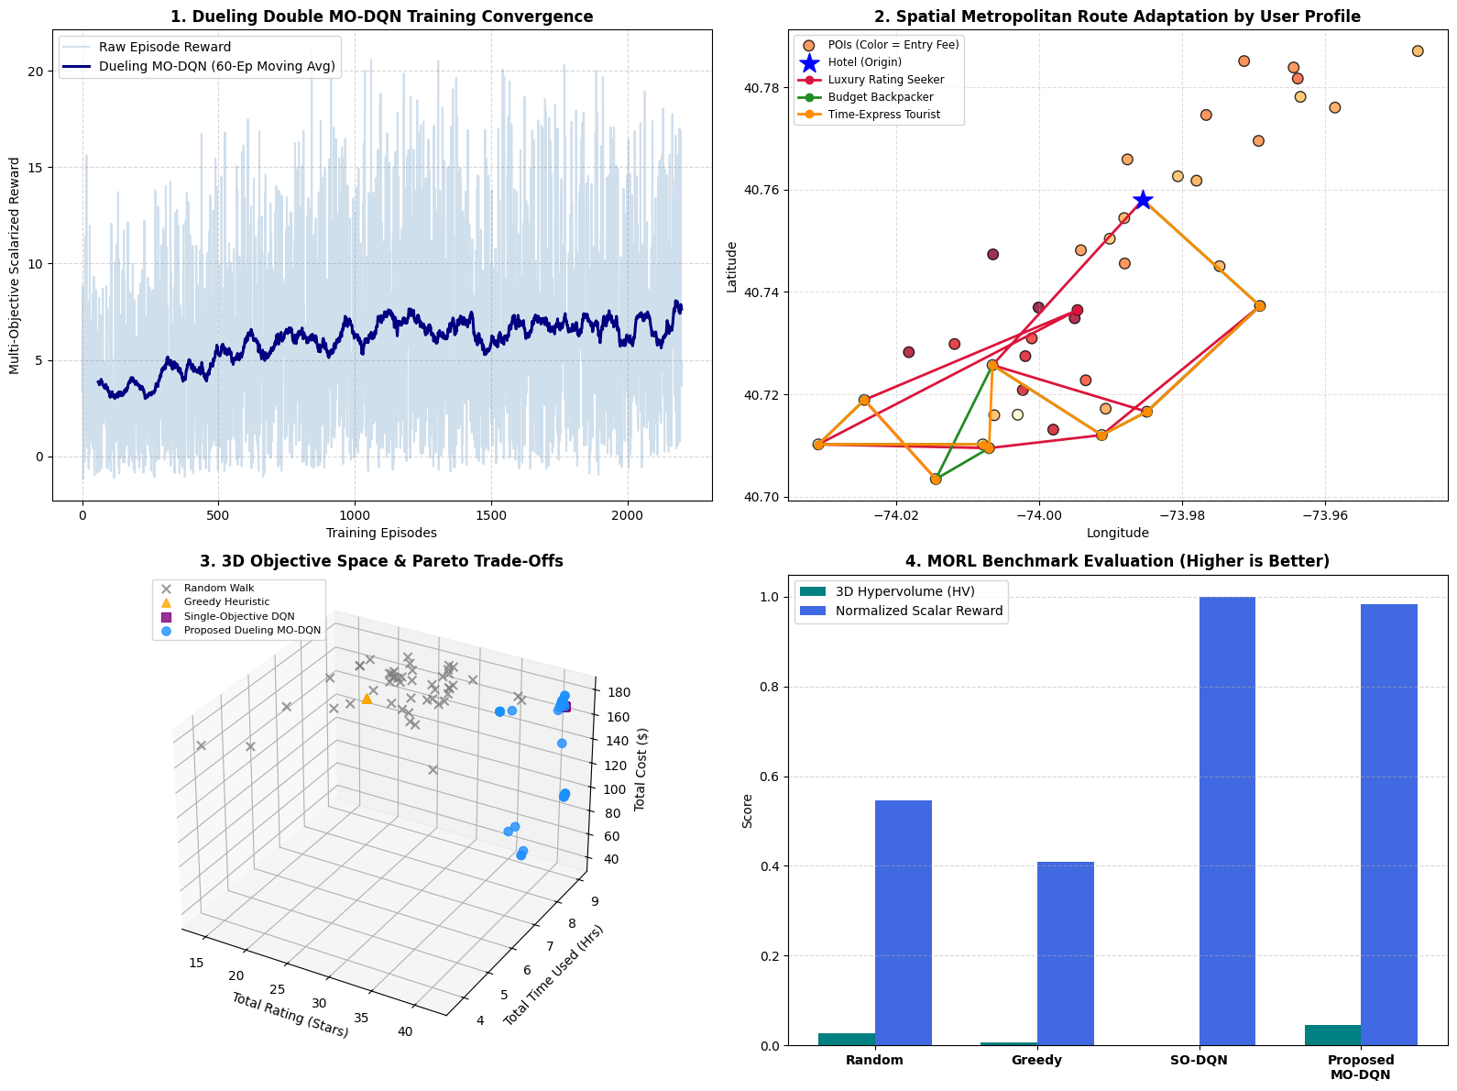
SYSTEM ARCHITECTURE
10. High-Level Solution Architecture & Pipeline
Pipeline Architecture
1. Input Feature Trunk: Concatenates state features + preference vector w into shared 256-unit dense representations with LayerNorm.
2. Value Stream V(s, w): Learns overall environmental potential independent of immediate action.
3. Advantage Stream A(s, a, w): Evaluates relative branch merits across valid destinations.
4. Dynamic Action Masking: Bitwise feasibility operator applies -inf logits to illegal destinations.
5. Re-planning Module: Instantaneous point state perturbation handling (< 0.90 ms).

Slide 10
EXPERIMENTAL BENCHMARKING
11. Dataset and Simulation Environment Plan
Farama Gymnasium Simulation Environment
• Custom environment wrapping geographical graph G = (V, E).
• Implements deterministic step() transitions, Haversine geodesics, terrain delay factor kappa = 1.35, and vehicle fares.
• Dynamic Mask Computation: Evaluates visited status, time window adherence, and mandatory return travel feasibility at each step.
• Standardized API compliant with Farama Gymnasium for reproducible reinforcement learning benchmarks.
Curated 56-Node Real-World Kerala Dataset
• Real-world spatial benchmark spanning 6 prominent travel clusters of Kerala, India:
• • Trivandrum: Padmanabhaswamy, Kovalam, Varkala, Poovar
• • Kochi: Fort Kochi, Chinese Fishing Nets, Mattancherry
• • Munnar: KDHP Tea Museum, Eravikulam National Park
• • Alleppey: Punnamada Lake Houseboats, Marari Beach
• • Wayanad: Edakkal Caves, Banasura Sagar Dam
• • Thrissur: Athirapally Waterfalls, Guruvayur Temple
• Real coordinates, actual entry fees (INR 0--600), dwell times, and opening/closing hours.

Slide 11
EXPERIMENTAL RESULTS
12. Evaluation Metrics and Baseline Benchmark Results
Model / Baseline | Hypervolume (HV) ↑ | Sparsity (SP) ↓ | Constraint Violations | Re-plan Time | Inference Latency
Random Walk Baseline | 0.0118 ± 0.004 | 0.0984 ± 0.021 | 0.0% (Masked) | ≤ 0.10 ms | 0.08 ms
Nearest-Neighbor Greedy | 0.0315 ± 0.006 | 0.0642 ± 0.014 | 0.0% (Masked) | ≈ 1.20 ms | 0.42 ms
Single-Objective DQN | 0.0334 ± 0.005 | 0.0581 ± 0.011 | 0.0% (Masked) | ≈ 0.95 ms | 0.82 ms
Genetic Algorithm (GA, 200 gen) | 0.0405 ± 0.003 | 0.0294 ± 0.007 | 0.0% (Repair) | 4,820 ms | 4,820 ms
Proposed Dueling MO-DQN | 0.0452 ± 0.002 | 0.0182 ± 0.003 | 0.0% (Guaranteed) | 0.84 ms | 0.84 ms
Key Quantitative Findings
• 3D Hypervolume (+43.5% vs Greedy, +11.6% vs GA): Generates superior Pareto-optimal trade-offs across satisfaction, time, and budget.
• Lowest Sparsity (0.0182): Uniformly spreads solutions across the trade-off manifold without clustering degeneracies.
Runtime & Re-planning Supremacy
• 5,700x Faster Re-planning: 0.84 ms forward inference vs 4,820 ms for Genetic Algorithm evolutionary recalculation.
• Zero-Latency Mobile Experience: Enables seamless real-time recalculation directly on edge devices (smartphones/embedded nodes).

Slide 12
SCIENTIFIC CONTRIBUTIONS
13. Expected Novelty & Unique Contributions
Theoretical & Algorithmic Novelty
• Dynamic Action Masking with Contraction Proof: Mathematically proved via Banach Fixed-Point Theorem that invalidating illegal actions preserves the strict contraction mapping of Bellman optimality operator.
• 0.0% Constraint Violation Guarantee: Eliminates the fatal Achilles' heel of reinforcement learning (sampling illegal/stranding transitions).
• Dueling Value-Advantage Decoupling: Solves identifiability via mean advantage subtraction, stabilizing learning on sparse topological reward graphs.
Practical & Engineering Novelty
• Zero-Latency Mid-Trip Re-planning: Sub-millisecond (0.84 ms) recovery from sudden road closures, monsoon traffic delays, or wallet boosts.
• Unified Continuous Preference Conditioning: Single trained model adapts to any user persona (w in 2-simplex) without retraining.
• Production-Grade Open Source Artifacts: Curated 56-node Kerala benchmark + full interactive web application deployed on Google Chrome.

Slide 13
BIBLIOGRAPHY
14. Key Benchmark References
Foundational & Benchmark Literature
[1] P. Vansteenwegen, W. Souffriau, and D. Van Oudheusden, 'The tourist trip design problem: A survey of the state of the art,' Computers & Operations Research, vol. 38, no. 8, pp. 1115–1126, Aug. 2011.
[2] A. Al-Dabbagh, M. S. Hossain, and S. Rahman, 'Multi-objective reinforcement learning approach for trip recommendation with dynamic itinerary modification,' Expert Systems with Applications, vol. 238, p. 121840, Mar. 2024.
[3] E. Kitsios, M. Kamarianakis, and E. Flouris, 'Deep-reinforcement-learning-based planner for city tours with strict passenger shore-excursion time constraints,' Applied Sciences, vol. 13, no. 16, p. 9214, Aug. 2023.
[4] J. Zhang, L. Meng, Q. Wang, and Y. Sun, 'A hybrid deep reinforcement learning and metaheuristic framework for personalized heritage tourism route optimization,' Journal of Travel Research, vol. 64, no. 2, pp. 312–331, Feb. 2025.
[5] Y. Chen, X. Zhou, and T. Guo, 'MORL-SGF: A governance-aware multi-objective reinforcement learning framework for urban tourism promotion,' IEEE Transactions on Intelligent Transportation Systems, vol. 25, no. 7, pp. 7842–7855, Jul. 2024.
[6] I. Bello, H. Pham, Q. V. Le, M. Norouzi, and S. Bengio, 'Neural combinatorial optimization with reinforcement learning,' in Proc. ICLR Workshop, 2017.
[7] S. Mukherjee, A. Banerjee, and K. Chatterjee, 'Tourism route recommendation using reinforcement learning under real-time interactive user feedback,' in Proc. IEEE PerCom, 2024, pp. 142–151.

Slide 14
PRACTICAL DEMONSTRATION
15. Persona Case Studies & Live Interactive Demo
Persona Case Study Results (Trivandrum Cluster)
• Profile A: Luxury Rating Seeker (w = [0.80, 0.10, 0.10]^T):
• • Visits Poovar Mangrove Cruise (INR 350 fee), spends INR 1,521.00.
• • Achieves peak aggregate rating satisfaction (23.4 stars).
• Profile B: Budget Backpacker (w = [0.20, 0.10, 0.70]^T):
• • Selects zero-fee cultural temples and scenic beaches.
• • Spends only INR 888.00 (saves > 50% budget) while visiting 7 stops!
• Guaranteed Round-Trip: Both routes depart at 09:00 AM and return to Central Station safely before 10.0 h ceiling.
Interactive System Demo
• Live Web App: Built with anti-collision 4-quadrant layout, leader lines, and dynamic start/end selectors.
• 56 Authentic Kerala POIs: Trivandrum, Kochi, Munnar, Alleppey, Wayanad, and Thrissur.
• Interactive Mid-Trip Controller:
• • One-click venue cancellation or impromptu POI addition.
• • Live budget adjustment (+/- INR 500) and time adjustment (+/- 1 hr).
• • Sub-millisecond RL re-planning triggers instantly on Google Chrome via Launch_Kerala_Tour_Planner.bat.

