Slide 1


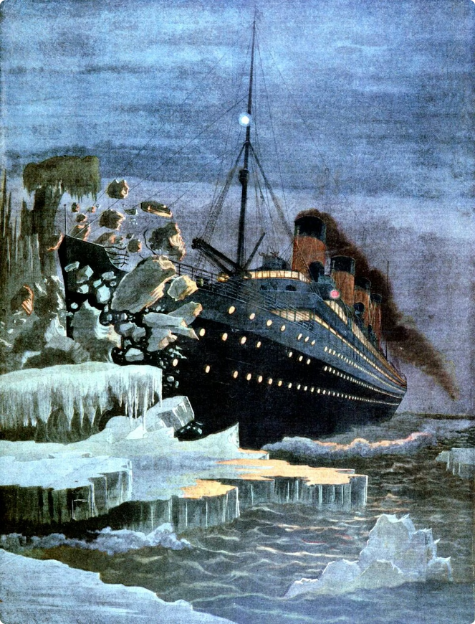
Titanic Survival Prediction: A Machine Learning Project
The Titanic disaster is one of the most infamous shipwrecks in history. On April 15, 1912, during her maiden voyage, the Titanic sank after colliding with an iceberg, leading to the deaths of over 1,500 passengers and crew. This tragedy has been the subject of numerous studies and analyses, including the application of machine learning techniques to predict the likelihood of survival based on various passenger attributes.
Presented by :- Akash Kumar

Slide 2
The Titanic Disaster: A Tragic Milestone in Maritime History
A Legendary Ship
A Fateful Maiden Voyage
Tragic Loss of Life
A Lasting Legacy
The RMS Titanic was one of the largest and most luxurious passenger ships of its time, measuring over 882 feet long and weighing 46,328 tons. It was hailed as an engineering marvel, capable of carrying over 2,200 passengers and crew.
On April 15, 1912, the Titanic struck an iceberg during her maiden voyage from Southampton to New York City. The collision caused irreparable damage, leading to the sinking of the ship in less than 3 hours, with a tremendous loss of life.
Out of the 2,224 passengers and crew on board, only 706 people survived the disaster. The majority of the passengers who perished were those traveling in the lower-class cabins, as the limited number of lifeboats were primarily reserved for the upper-class passengers.
The Titanic tragedy has become a defining moment in maritime history, sparking widespread changes in safety regulations and the development of improved ship design and navigation technologies to prevent such catastrophic incidents in the future.

Slide 3
Overview of Dataset
Titanic Survival Prediction Dataset (Kaggle)
The dataset we'll use is the Kaggle Titanic Survival Prediction dataset. It contains information about passengers, like age, gender, ticket class, and fare. We'll use this data to train a machine learning model.
Passenger Information
Survival Outcomes
Additional Features
The dataset includes the survival status of each passenger, labeled as 0 for deceased and 1 for survived.
The dataset also provides information on embarkation port, cabin number, and family relationships.
The dataset provides demographic details such as name, age, sex, and ticket class.

Slide 4

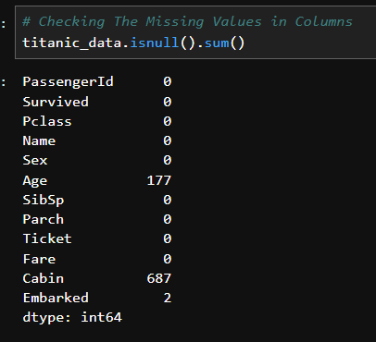
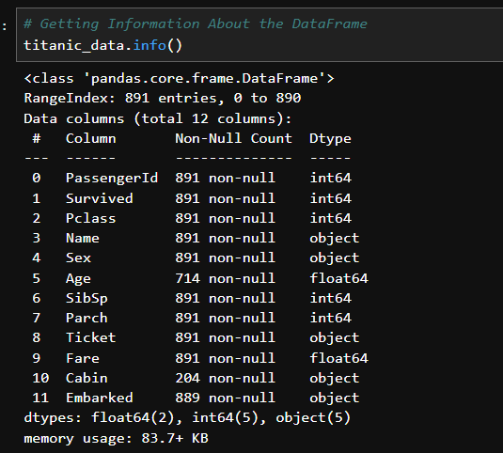
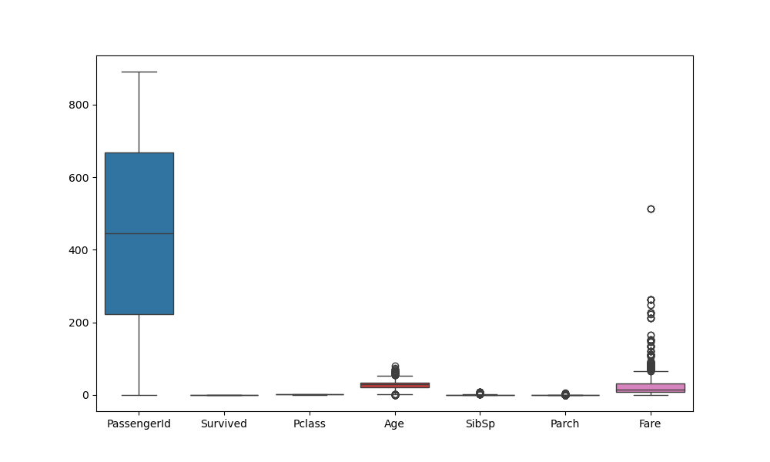
Exploratory Data Analysis: Understanding the Dataset
We will analyze the dataset through visualizations and statistical analysis. This will help us identify patterns, trends, and potential factors influencing survival.
1
Missing Data
We'll address missing data, such as missing ages or cabin information, through appropriate
imputation methods.
Information of Data Set
2
We’ll check the information of the dataset to view the type of data available in the dataset.
3
Checking the Outliers
Outliers are data points that deviate significantly from the rest of the data. Identifying and understanding outliers is important for several reasons:

Slide 5
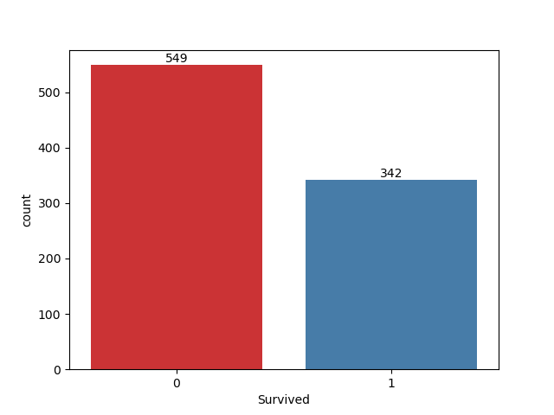
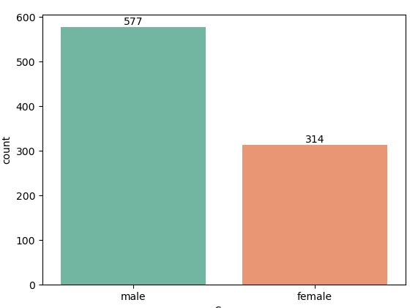
Exploratory Data Analysis: Understanding the Dataset
We will analyze the dataset through visualizations and statistical analysis. This will help us identify patterns, trends, and potential factors influencing survival.
1
Total passengers travels
We’ll Visualize the total Passengers Travel on the Boat , by their some categories to clearify the
Data set
Total Male or Female Passengers
2
In this Plot we can easily see the Total Male passenger By Their Categories , “Male” , “Female“

Slide 6
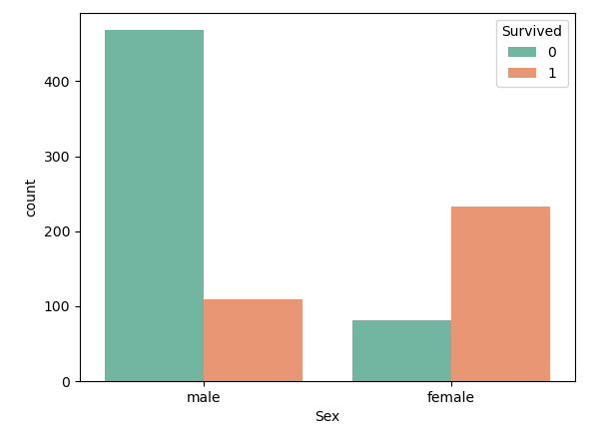
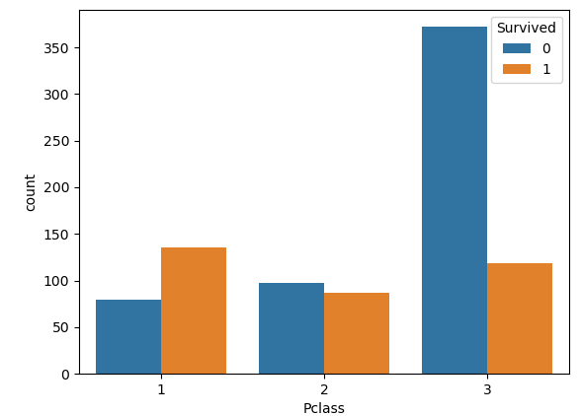
Exploratory Data Analysis: Understanding the Dataset
We will analyze the dataset through visualizations and statistical analysis. This will help us identify patterns, trends, and potential factors influencing survival.
1
Survival Rates Via Categories
We'll investigate survival rates across different genders .
2
Survival Rates Via Pclass
We'll analyze the distribution of features to understand the Surviced passenger in Pclass

Slide 7

Feature Engineering and Preprocessing
We'll create new features that may improve model performance. For example, we could combine features like age and passenger class into a single feature.
Feature Extraction
1
We will extract relevant information from existing features, potentially creating new features to capture useful patterns.
Data Transformation
2
We will transform features to a suitable format for machine learning algorithms, such as scaling numerical values or encoding categorical data.
Handling Missing Values
3
We'll address missing data using methods like imputation or deletion to ensure the model receives complete information.
Feature Selection
4
We'll identify the most relevant features by analyzing their contribution to model prediction accuracy and reducing dimensionality.

Slide 8
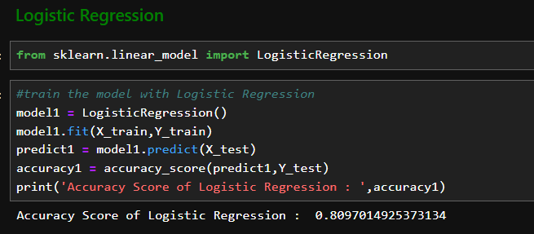
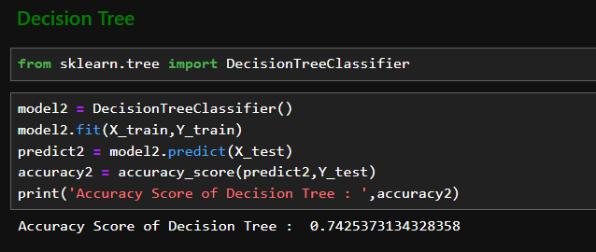
Selecting Appropriate Machine Learning Algorithms
We'll choose machine learning algorithms suitable for predicting survival. We'll consider factors like the nature of the data and the desired outcome.
Logistic Regression
A linear model that predicts the probability
of survival based on input features.
Decision Trees
A tree-based model that creates a hierarchy of decisions based on features to predict survival.

Slide 9
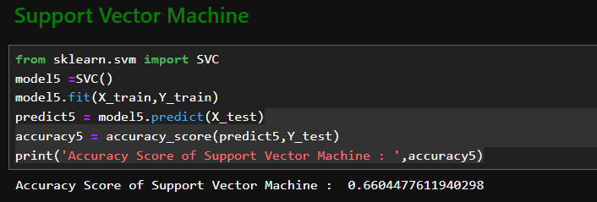
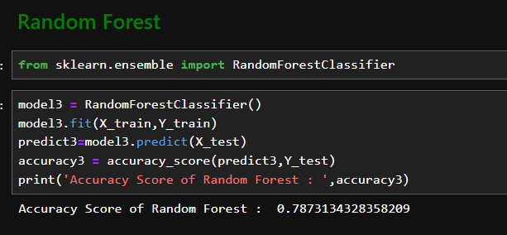
Selecting Appropriate Machine Learning Algorithms
We'll choose machine learning algorithms suitable for predicting survival. We'll consider factors like the nature of the data and the desired outcome.
Support Vector Machines (SVMs)
A model that finds an optimal hyperplane to separate survival and
non-survival classes.
Random Forests
An ensemble method that combines multiple decision
trees to improve prediction accuracy.

Slide 10

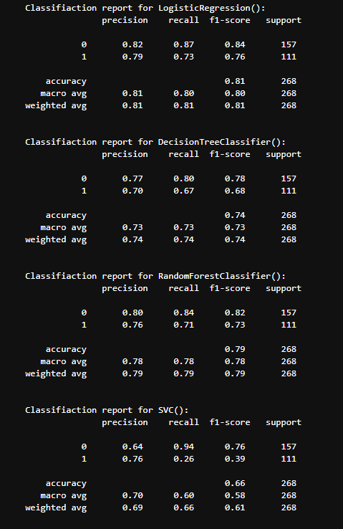
Model Training and Evaluation Metrics
We'll train our chosen algorithms using the prepared data and evaluate their performance using appropriate metrics.
Accuracy
Proportion of correctly predicted survival outcomes.
Precision
Proportion of correctly predicted survivors out of all predicted survivors.
Recall
Proportion of correctly predicted survivors out of all actual survivors.
F1 Score
Harmonic mean of precision and recall, providing a balanced measure of model performance.

Slide 11




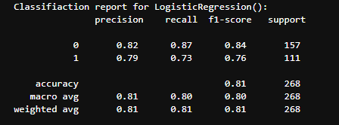

Interpreting Model Outputs and Insights
We'll analyze the model outputs and gain insights into the factors influencing survival. This will help us understand the relationships between features and survival outcomes.
Gender
We'll explore how gender affects survival rates.
Age
We'll analyze the impact of age on survival probabilities.
Passenger Class
We'll investigate the relationship between passenger class and survival rates.
Fare
We'll examine how fare impacts survival outcomes.

Slide 12
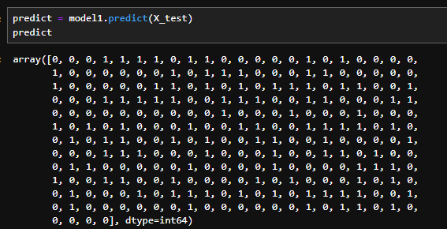
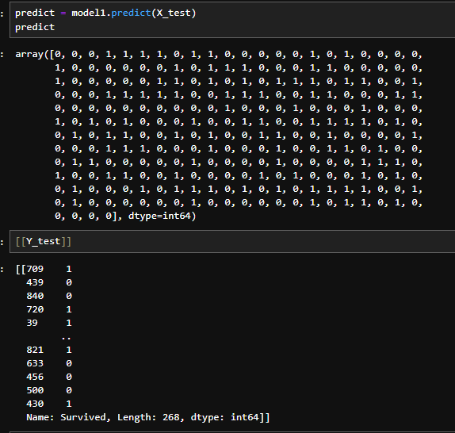

Deploying the Predictive Model
The Predicted Result from the Model
Y_test values

Slide 13

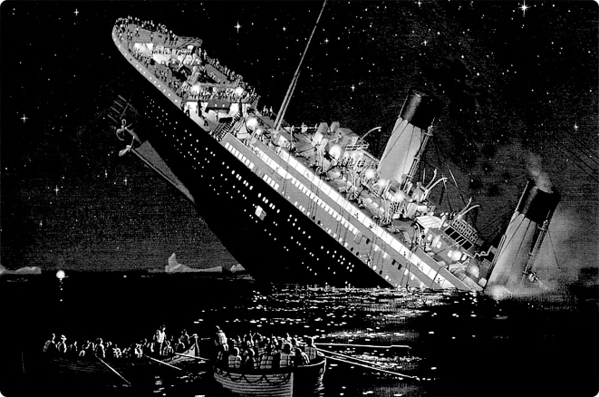
Conclusion and Future Considerations
We'll summarize our findings and discuss potential improvements to the model. We'll also consider future research directions and the potential applications of this project.
1
Model Accuracy
We'll discuss the model's performance and limitations.
2
Future Work
We'll explore potential extensions to the project, including incorporating more data or using advanced machine learning techniques.
3
Ethical Considerations
We'll reflect on the ethical implications of using machine learning to analyze historical events like the Titanic disaster.

