Slide 1

WATERMELON CHESS
AI LAB PROJECT
Akash Biswas
Md. Mosaddek Ali
Roll: 2107027
Roll: 2107013

Slide 2


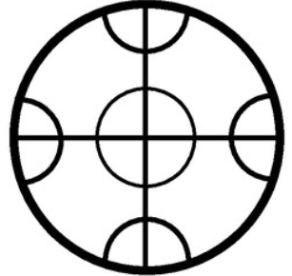
Introduction
Watermelon Chess is a two-player, turn-based strategic board game designed as a controlled adversarial environment for evaluating intelligent decision-making techniques. The game is played
on a fixed-structure board consisting of predefined nodes and connections, where each player controls a set of pieces centered around a critical unit called the watermelon.
Warermelon Chess Game
Chess Board

Slide 3




Game Equipment
Game Board
Game Tokens
Players
Circular board with 21 intersection points
12 tokens total
6 for each player
2 Players
Connected by lines for movement
Distinct colors or shapes
Player A (Red)
Player B (Green)
Similar to globe shape
Coins, buttons, beads can be used

Slide 4
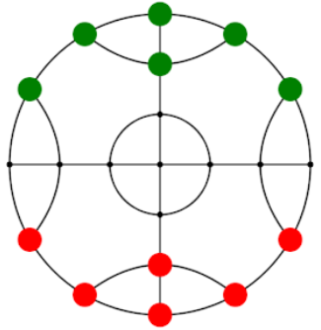
Watermellon Chess Board
21
21 Intersection points
12 tokens total (6 for each player)
2 player

Slide 5





Movement Rules
Alternate Turns
One Space at a Time
Players take alternate turns, moving one token each time
Move one token one space per turn
Along Lines Only
No Diagonal or Jumping
Tokens only move along connecting lines between intersection points
No diagonal or jumping moves unless the board lines allow them

Slide 6


Winning Condition
Objective
Be the last player with more than two tokens remaining
Game Ends When...
Why 2 Tokens?
•
One player has only 2 tokens left
At 2 tokens, a player cannot effectively surround any opponent tokens, so game is considered over
•
Opponent has 4 or more tokens

Slide 7

Game Board
All set
Ready for gameplay
Initial State

Slide 8
Game Board
Red's First Move

Slide 9
Game Board
Green's First Move

Slide 10
Game Board
Red’s Second Move

Slide 11
Game Board
Green’s Second Move

Slide 12
Game Board
Red’s Third Move

Slide 13
Game Board
Green’s Third Move

Slide 14
Game Board
Red’s Fourth Move

Slide 15
Game Board
Green’s Fourth Move

Slide 16

Game Board
Red’s Fifth Move
This green token is trapped because all its adjacent connected positions are occupied by three red tokens and one green token leaving no legal move available.

Slide 17
Game Board
So, The green token will be removed

Slide 18
Game Board
Green Wins
After optimal play by both agents, the game concludes with the Green player retaining five tokens while the Red player is reduced to two, thereby declaring the Green player as the winner.
A Termination State

Slide 19

THANK YOU!

