Slide 1
Samsung PRISM Metaverse
Team - ARians
Akash Mondal - Shrestha Singh - Geoffrey Anto Ignatius E

Slide 2
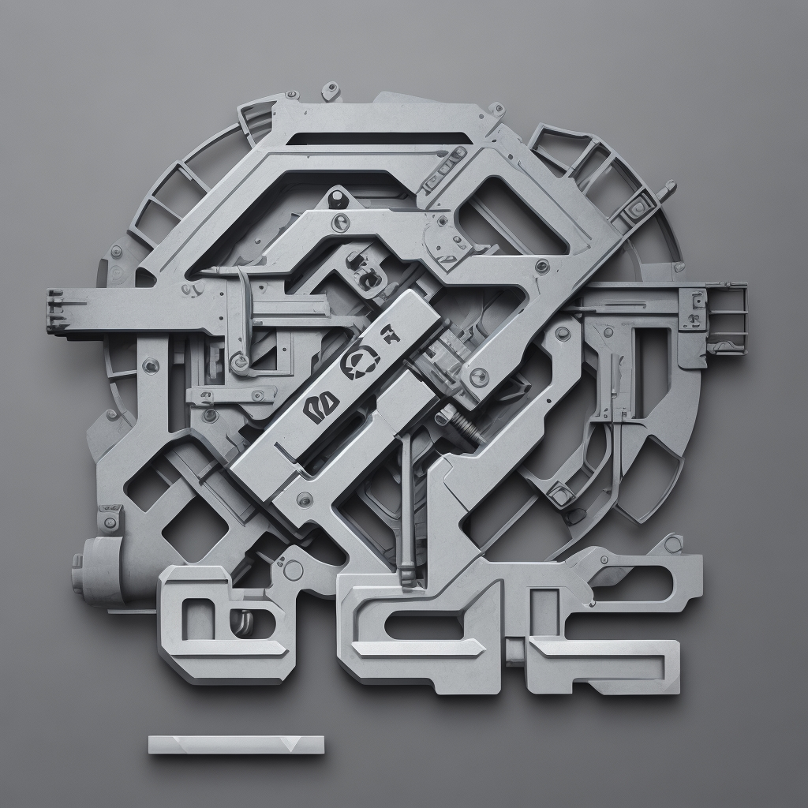
MARQR.AR
Revolutionizing Maintenance with Augmented Reality Precision

Slide 3
Executive Summary
Problem Statement: Inefficient industrial maintenance lacks real-time, guided solutions for optimal performance.
Expected Result:
MARQR.AR is an innovative Augmented Reality (AR) application designed to revolutionize the maintenance, repair, and overhaul (MRO) industry. Leveraging cutting-edge technology, MARQR.AR utilizes QR code scanning through Head-Mounted Displays (HMDs) or mobile devices to instantly identify industrial machines (assuming the QR code will be sticked on the equipment). The app then provides a tailored list of potential repairs for the selected equipment. The core feature of MARQR.AR lies in its immersive 3D model animations that guide users through the repair process step by step. Users can place realistic 3D twin models of the industrial machines in their physical environment, where interactive AR overlays showcase detailed instructions, precautionary measures, and textual explanations for each repair task. The emphasis on safety is paramount, with comprehensive information on precautionary measures accompanying every repair. MARQR.AR aims to be a comprehensive tool, offering a user-friendly interface, offline accessibility, and a training mode for practice. The potential integration with other MRO systems and collaborative features ensures a seamless experience for maintenance teams. This app not only modernizes maintenance procedures but also enhances efficiency, safety, and the overall user experience. As we embark on the development journey, MARQR.AR promises to be a game-changer in the MRO sector, empowering technicians with an advanced and user-centric approach to equipment maintenance.

Slide 4
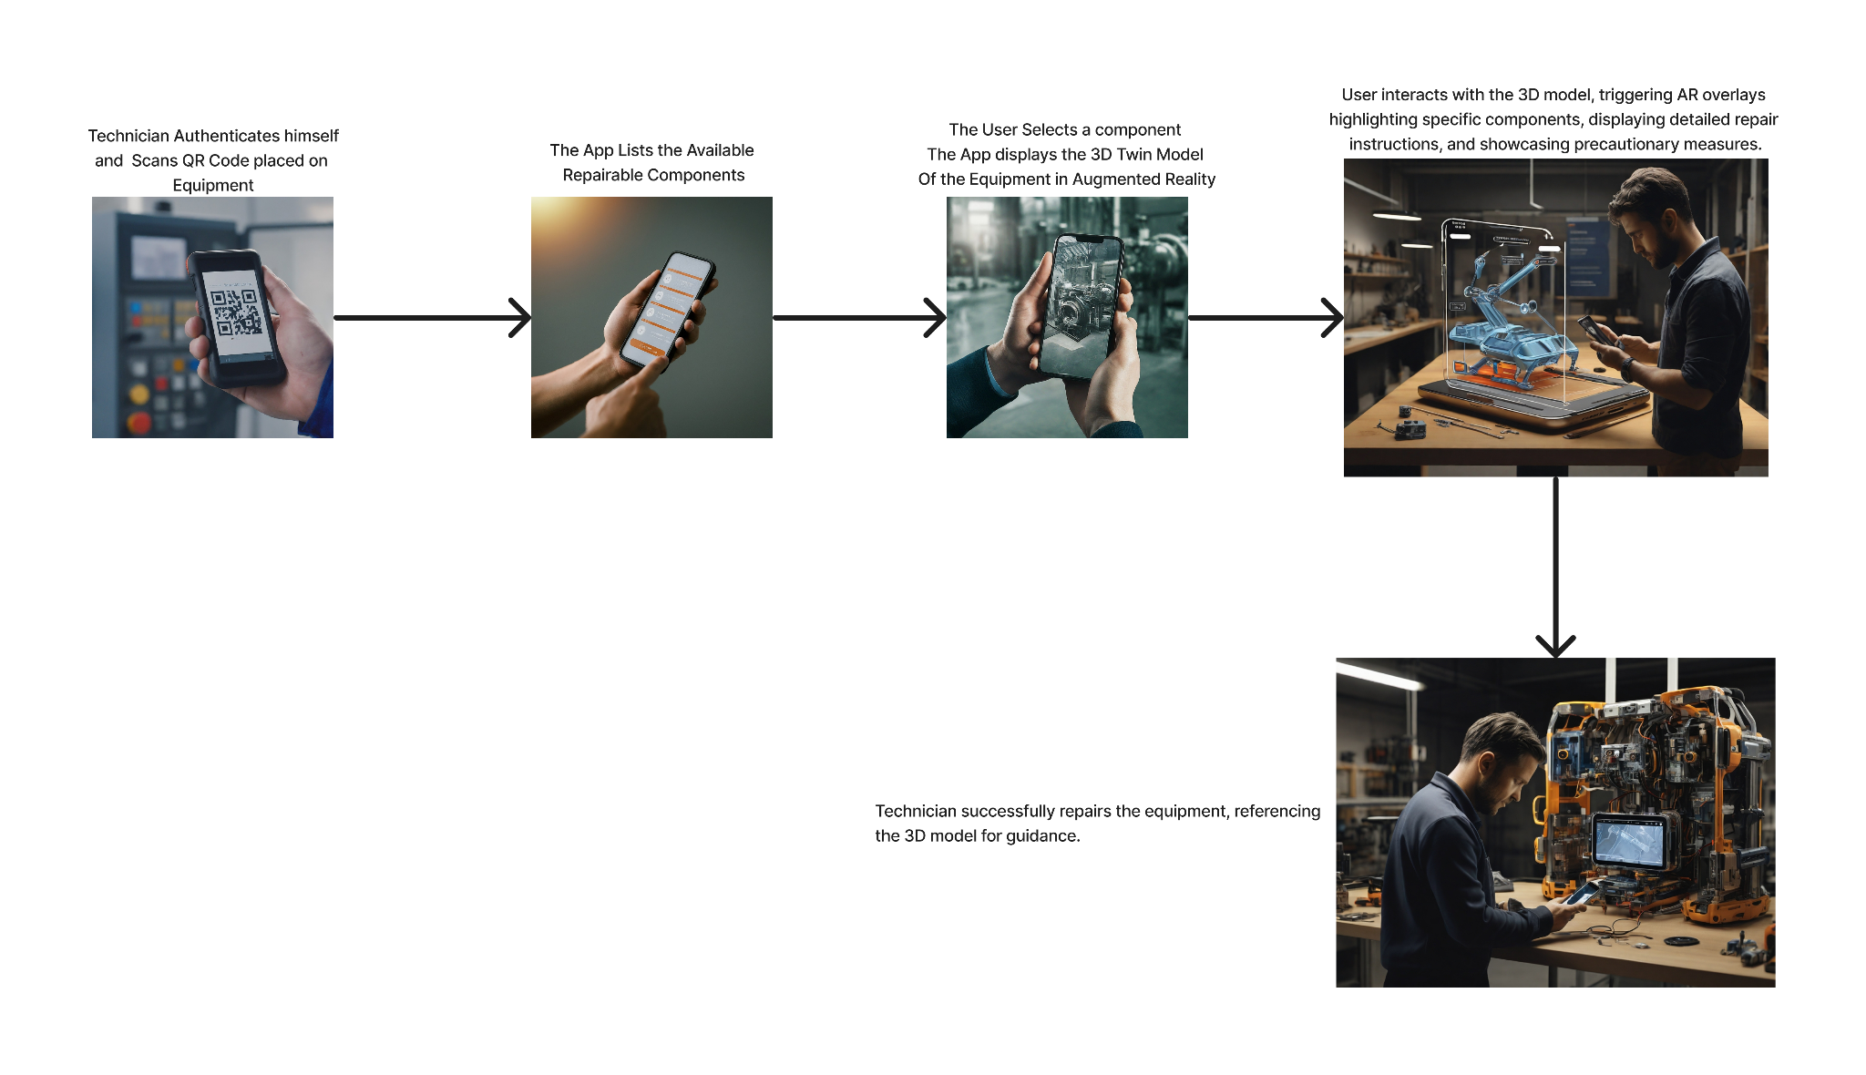

Slide 5
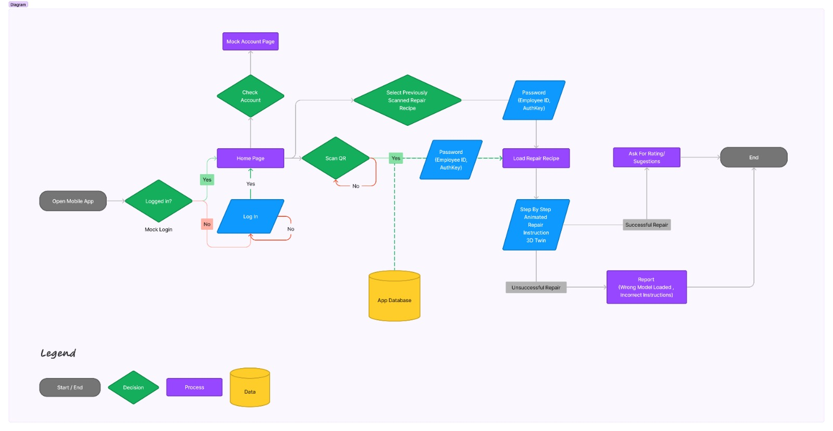
Impact
Innovation:
Pioneers AR technology for industrial MRO
Introduces an interactive and immersive repair guidance system
Modernizes outdated paper-based maintenance with digital 3D visualization
Business Value:
Boosts technician productivity and efficiency
Reduces equipment downtime leading to cost savings
Lowers risk of errors during complex repairs
Standardizes and digitizes repair knowledge sharing
Target Audience:
Maintenance and repair technicians
Plant managers overseeing MRO operations
Original Equipment Manufacturers (OEMs)
Businesses managing large industrial machinery fleets
Companies aiming to streamline MRO procedures
Organizations focused on better knowledge management
The Market of Augmented Reality for MRO In 2024, industrial maintenance is expected to receive the largest investment among all commercial use cases for AR – 4.1 billion dollars.
(Source - https://www.scnsoft.com/augmented-reality/maintenance-and-repair )

Slide 6
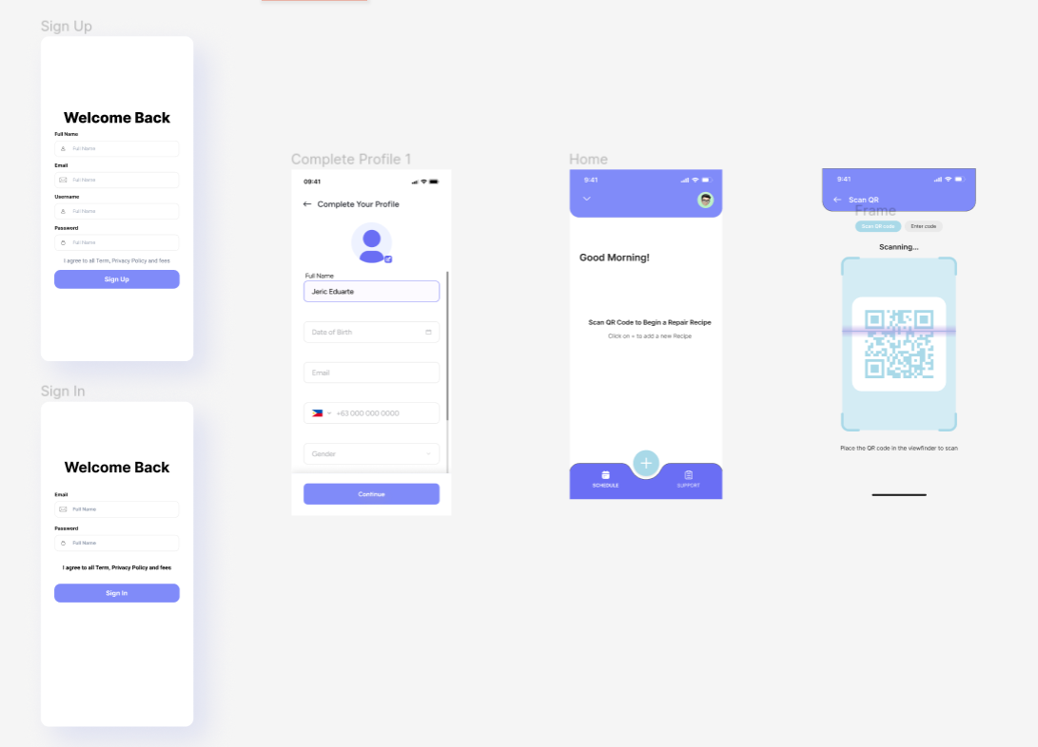
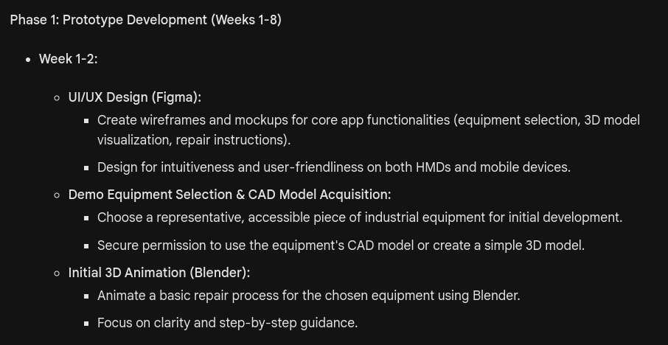
Development Plan/Timeline
Overall Timeline 3 Months

Slide 7
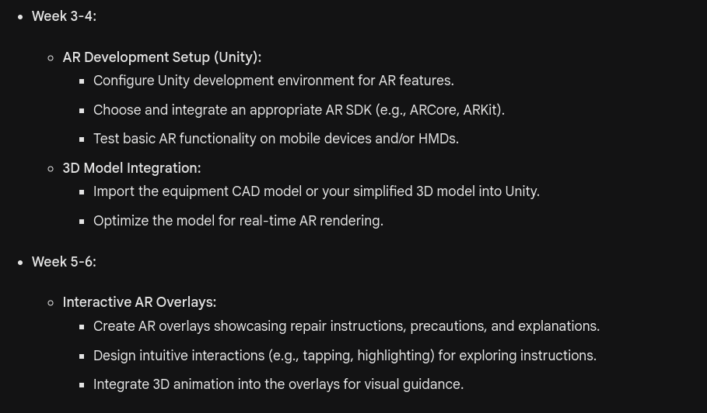

Slide 8
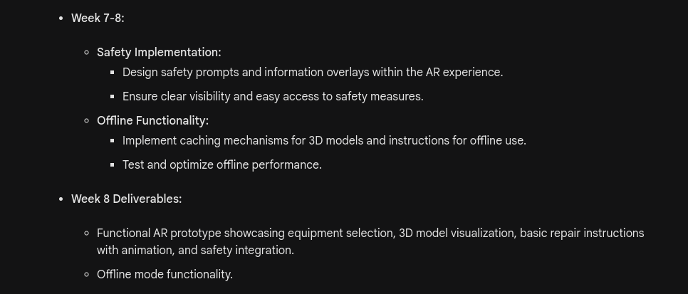

Slide 9
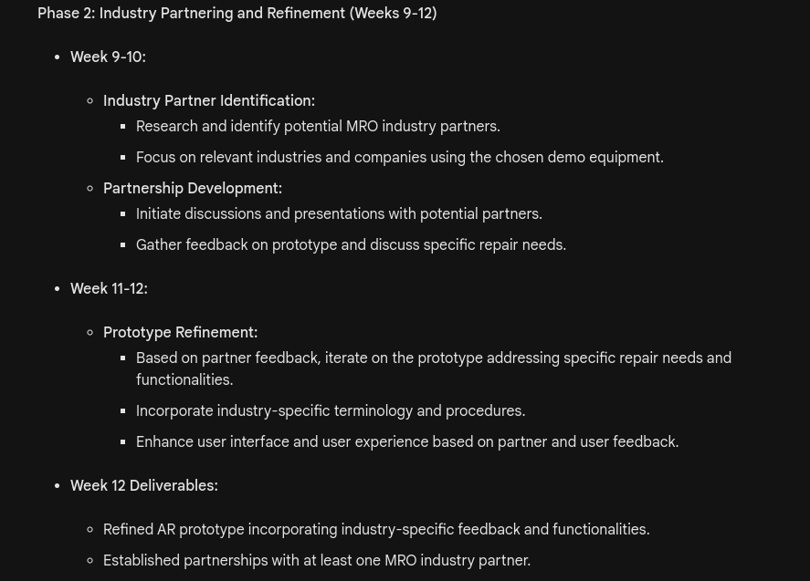

Slide 10
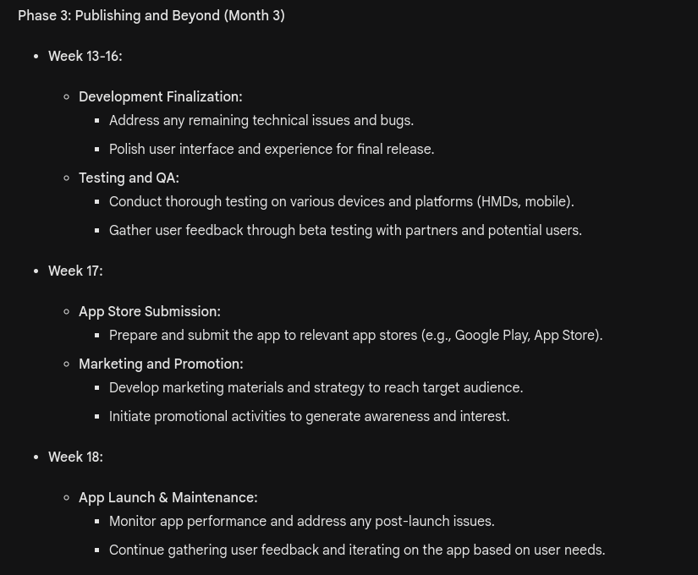

Slide 11
Unique Selling Point
1. Industry Agnosticism: MARQR.AR is not bound by any specific industry. Whether it's manufacturing, aviation, energy, or healthcare, the app can cater to a broad spectrum of industries. This adaptability makes it a one-stop solution for maintenance teams in various sectors.
2. User-Friendly Integration Process: The integration process is straightforward and doesn't require extensive technical expertise. Any industry can become part of the MARQR.AR ecosystem by providing 3D twin models and animations of their machinery. This inclusivity ensures that even smaller businesses with limited resources can benefit from the app.
3. Partnership Opportunities: MARQR.AR offers a collaborative partnership model. Through partnerships with manufacturers or industry experts, the development team can efficiently integrate machinery information into the app. Manufacturers can then affix QR codes on their machines, creating a direct link between the physical equipment and the wealth of information stored in the app.
4. Customized Repair Guidance: By providing twin models and animations specific to each machine, MARQR.AR ensures that repair guidance is highly customized. This tailoring enables the app to address the unique characteristics and complexities of different industrial equipment, making it an indispensable resource for technicians regardless of their industry background.
5. Real-Time AR Assistance: The real-time AR assistance feature sets MARQR.AR apart. Technicians can scan the QR code on the machine and instantly access detailed information, accompanied by an animated twin model overlay in AR. This immediate guidance enhances efficiency, reduces downtime, and minimizes the chances of errors during repairs.
6. Empowering Repair Professionals: MARQR.AR empowers repair professionals by placing comprehensive repair guidance at their fingertips. The app transforms any repair technician into an expert, allowing them to perform intricate repairs with confidence. This democratization of expertise is a game-changer for professionals at all skill levels.
7. Worldwide Applicability: The universal nature of QR codes and the accessibility of AR technology mean that MARQR.AR has global applicability. Repair professionals worldwide can benefit from the standardized QR code system, ensuring a consistent and user-friendly experience regardless of geographical location, the User Interface can also support different languages and so can the repair instructions

Slide 12
Our Inspirations
Maintenance of Central Inverters with Augmented Reality App https://www.youtube.com/watch?v=DLReNT98YBQ&t=141s
Augmented Reality Maintenance Training
https://www.youtube.com/watch?v=G5qnu15WOuU

Slide 13
Thank You
Contact Details:
Akash Mondal
7095417327 akash.mondal2021@vitstudent.ac.in

