Slide 1
EXPOSYS DATA LABS
SOFTWARE DEVELOPMENT INTERNSHIP

Slide 2
Details
Name : Akash Ramanand Rajak
Email ID : aakashrajak02@gmail.com
College : Indian Institute of Information Technology, Kalyani.
Department : B Tech/ CSE

Slide 3
TASK
Try to build or change an existing algorithm to secure message send by the user based on efficiency.
Confirm the identity of the user by entity authentication using verification and validation.
Need to use Python and ML to do this task.

Slide 4
Python Libraries Used
Python (3.9) – used python language
Tkinter (8.6.11) – for GUI based things
Pil (1.1.7) – for adding images in the GUI
Random (1.0.1) – for generating randomness in data
Math (0.0.1) – for mathematics kind of operation

Slide 5
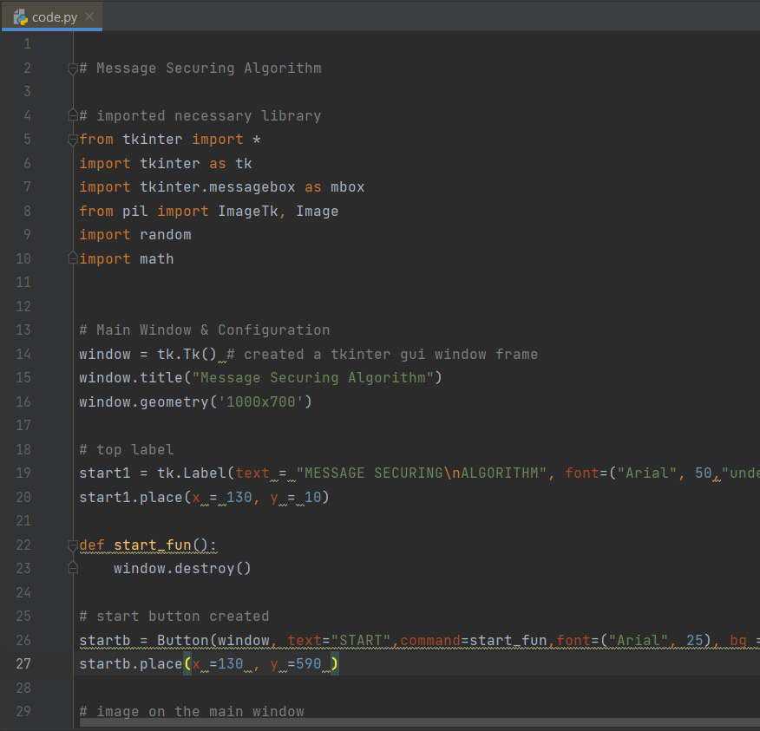
CODE
Code written in python language.
This is how python code looks like.

Slide 6
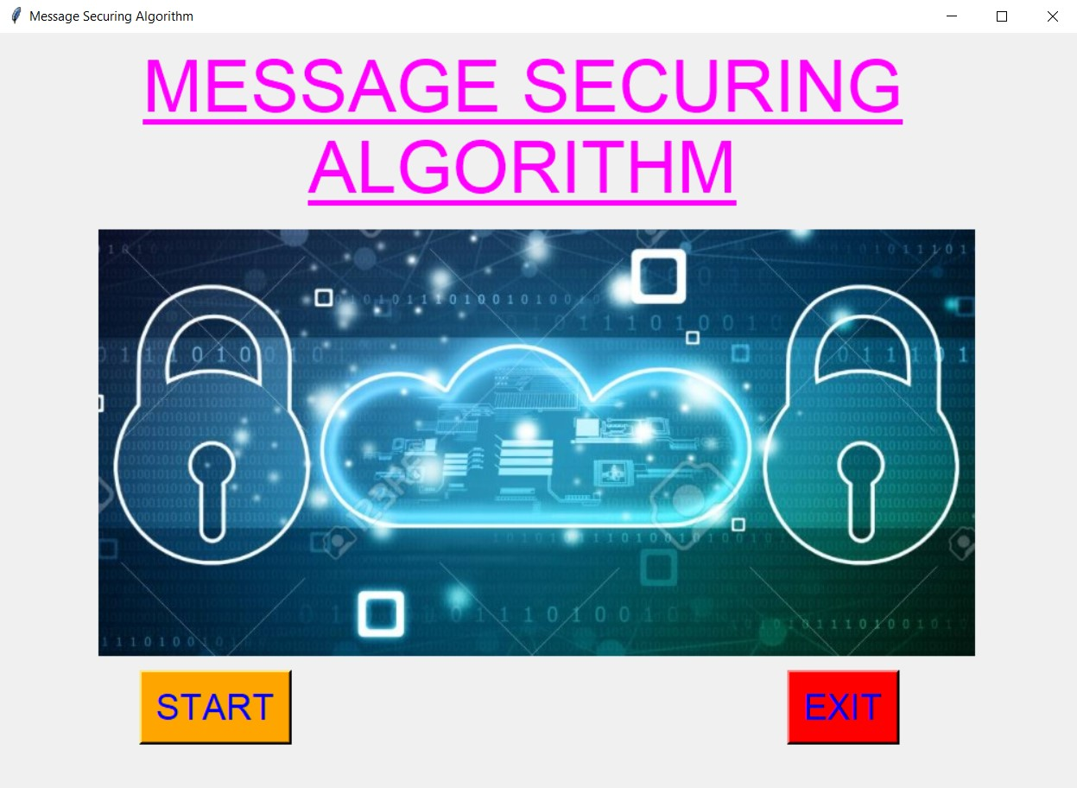
GUI APPLICATION
This is the main GUI window that opens when code in run on any Python IDE. And on clicking on the start button user will be able to see the GUI window of working application.

Slide 7
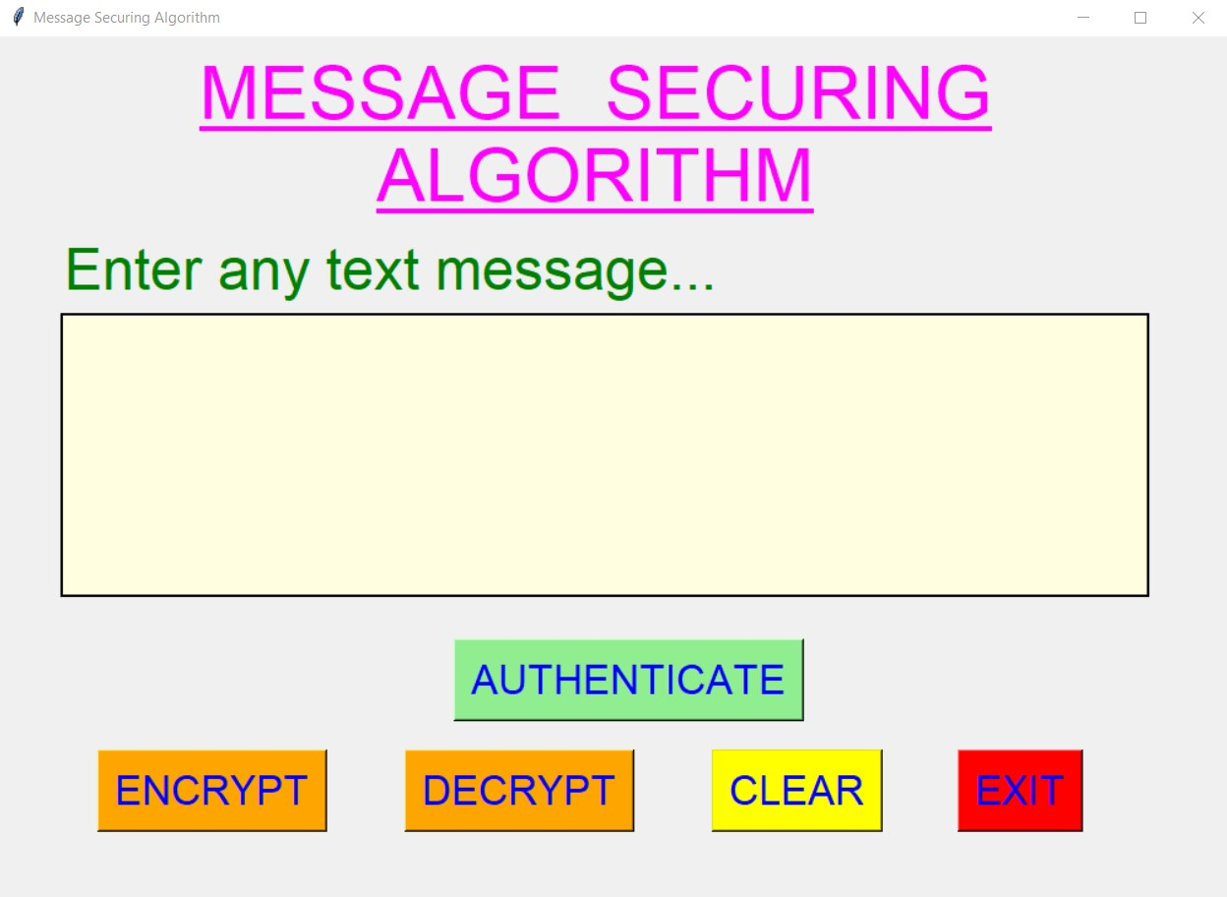
Application Window
In this application window, user will be allowed to enter any text message and when user clicks on the AUTHENTIC button, user will be able to see the authentication of user.

Slide 8
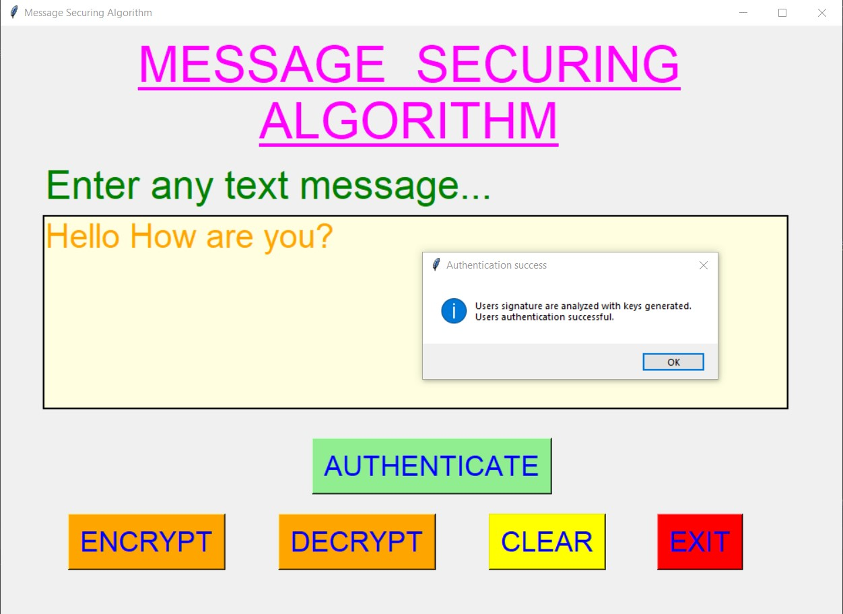
User Authentication
After user has entered the text message, when user clicks on the AUTHENTICATE button, the authentication process will start which user hash values like SHA-512, SHA-384, SHA-256, to verify signature and entity.

Slide 9
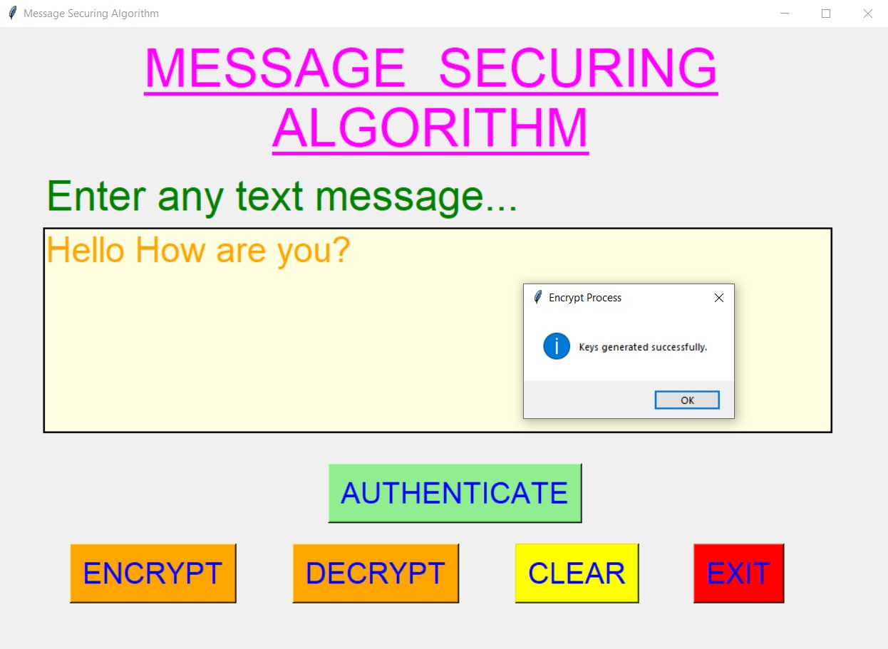
Keys generation
After entering any text message inside the text area provided, when user clicks on the ENCRYPT button, the encryption process of the entered text message will start.This steps involves, converting string to decimal , generating primes, and keys generation.

Slide 10
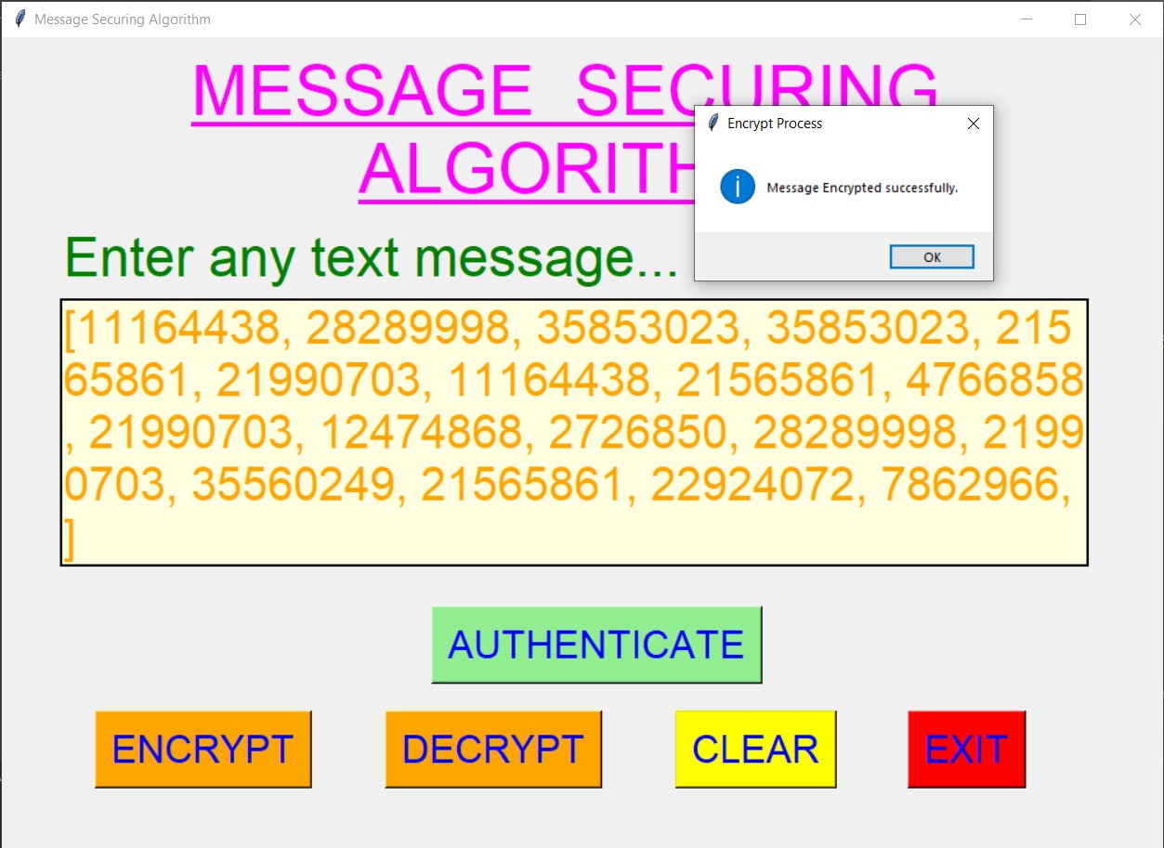
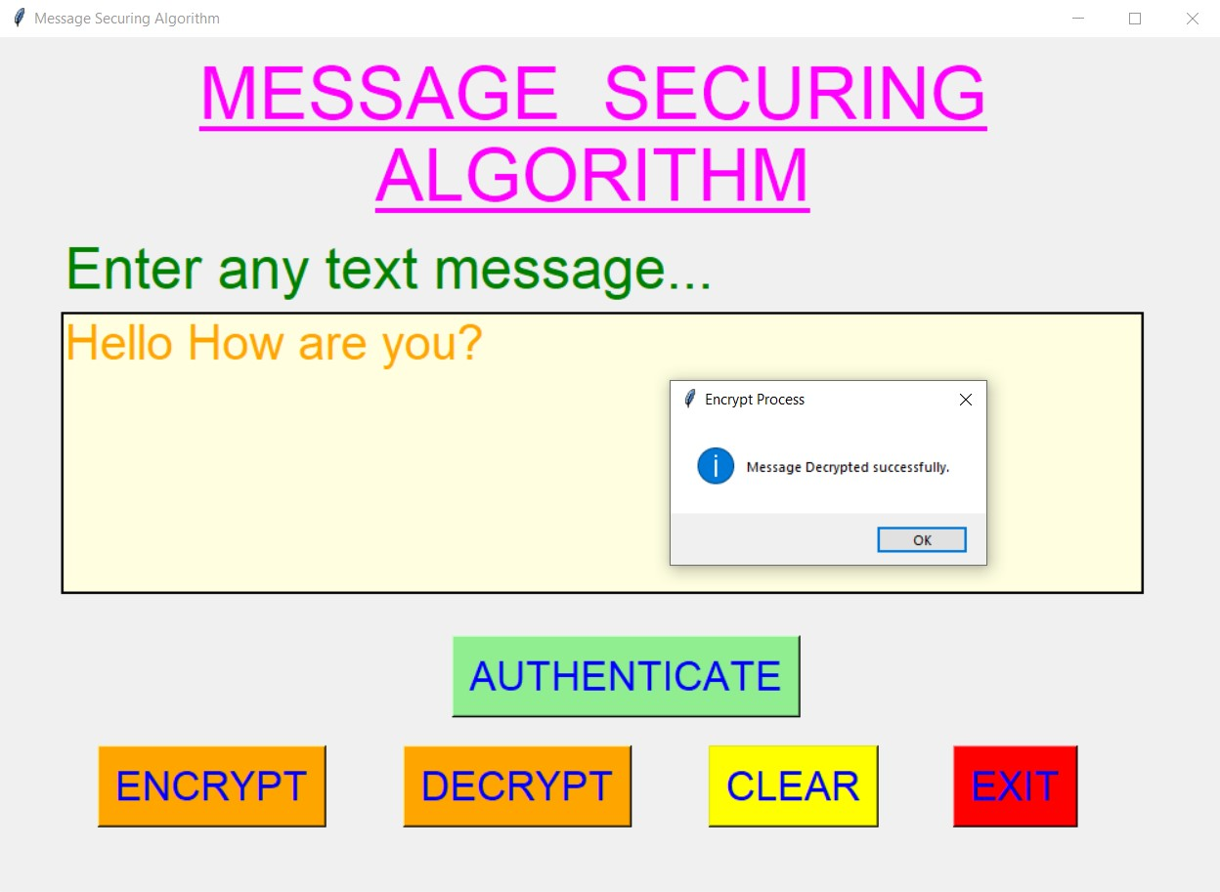

Slide 11
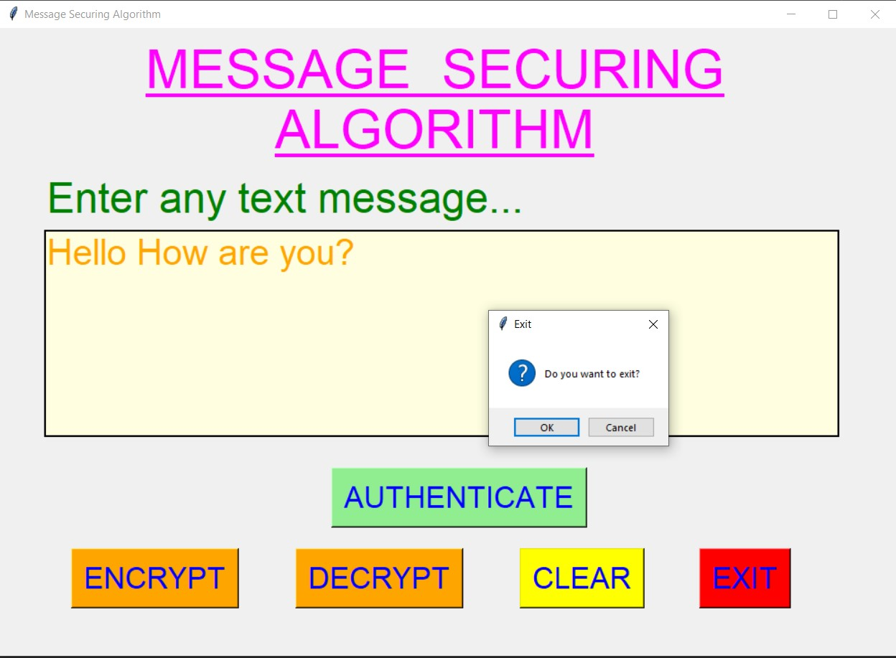
The END

