Slide 1
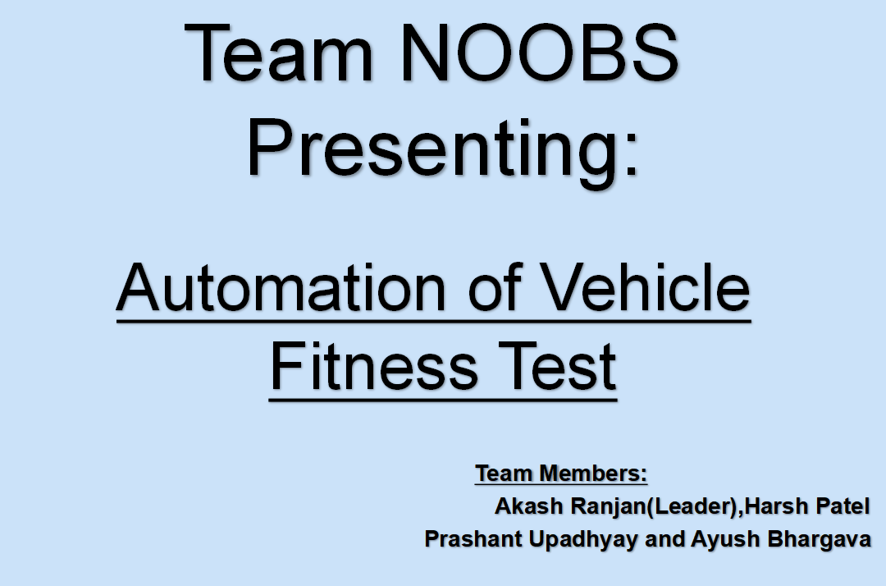
GOV-TechThon 2020:
Virtual Hackathon

Slide 2
Problem Statement:
Automation of vehicle fitness inspection process with respect to rule number 62 of central motor vehicle rules.
To understand why atomation needed few points are mentioned below:
During the process of Inspection lots of dataset are needed to store hence facing storage and easy to access problem.
The process of approving any vehicle are on the basis of data available hence a better automated model needed to analyse data and give output.
All the process consume lots of time hence we need to make this process more smooth to save time.

Slide 3
How we solve the problem ?
To solve the problem mentioned in previous slide we are going to build an app based upon Flutter ( they run on both Android and IOS ) technolgy.
Our App will majorly work in 3 field which are :
Security: Application contain high secure technique such as secure login,trusted database excess software etc.
To Fill up all requirement : Use compressing techniques on data, set them in easy to excess formate, Analyse the data and give the output based upon AI models etc.
Easy interface and Cost effective : App will have smooth interface so that it is easy to use and time effictive. Also we try to make Cost effective app.

Slide 4
Security:
We will do below given things for security :
Write a Secure Code
Encrypt All Data
Extra Cautious With Libraries
Use Authorized APIs Only
Use High-Level Authentication
Deploy Tamper-Detection Technologies
Use the Principle of Least Privilege
Deploy Proper Session Handling
Use the Best Cryptography Tools and Techniques
Test Repeatedly etc

Slide 5
To Fill Up all the requirement :
Basic Requirement Such as Secure login, storing information of data(Registration number,color,engine number etc ) are Stored using the app inside the database linked with app with compress techniques.
Collected data is used by Machine Learning algorithim to give output about the fitness of vehicles.
Data related images are also be taken and we are building an AI system to check the defects on the vehicles such as scrach,head lamps, broken windshield etc.
We will also make the Online Certification sytem approved by RTO .

Slide 6
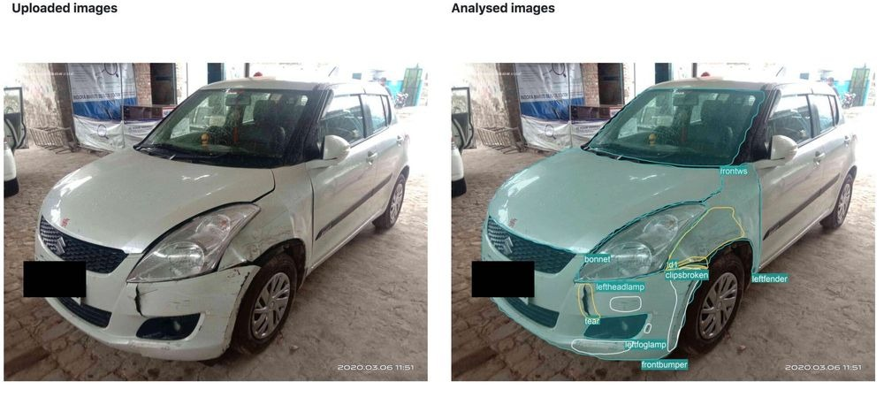
Its really very hard to explain how we did all AI system in our application but still few examples is given below:
Image Recognising the damage of vehicle:
We will the Images of Vehicle.
Using image we recognize the type of vehicle ie car,bike etc
Now we try to the actual model of vehicle to estimate its dimensions.
Then we compare its dimension with the latest click pictures.
Now our AI model is going to tell the percentage of damage and its location.
Now we store this data in our database.

Slide 7
To Give output using the traced data by Machine Learning Algorithms:
First We Collect All the Data.
Then we load the data in our model.
Now we explore the data ( Data stats,Data cleaning,Data Preprocessing etc)
Now we differentiate the data in Categorical or Numerical.
Then treat both set of data in their best format.
We use Regression,ANN etc algorithim whichever algorithim give best result.
Now We integrate all set of data and create the best model to give the best results.

Slide 8
Easy Interface and Cost effective:
We will provide the easy interface in our app such that anyone can use it.
We try to make or system as fast it can to give a best time effective app.
We also make our app in affordable range to reduce the finnacial pressure on RTO.

